Slide 1





Process-Based Estimates of Seasonal Catchment Hydrology: Dimensionless Models
$$dS/dt=P−E−Q$$
Zeqiang Wang
Supervisors: Ross Woods,
Nicholas Howden
Email: lf19903@bristol.ac.uk
May 2022

Slide 2
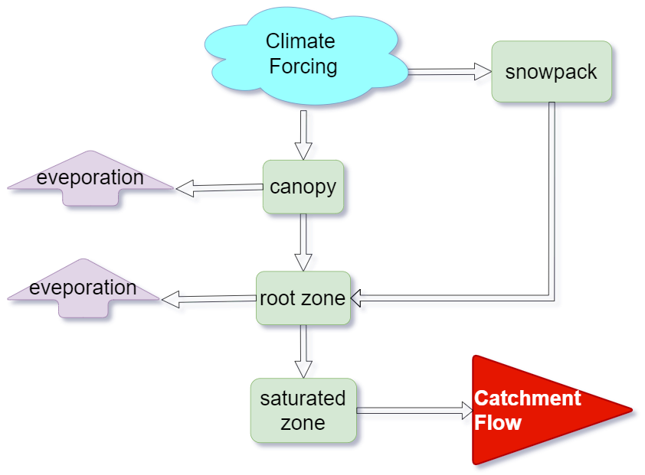
Make simple estimates of seasonal water balance in ungauged catchments
Motivation: Current methods applied to these ungauged locations are unreliable for applications
Research Question: In which situations is it possible to reliably estimate seasonal variation in river flow without flow measurements?
Woods(2009)
Woods(2003)

Slide 3
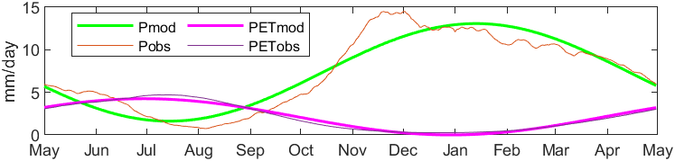
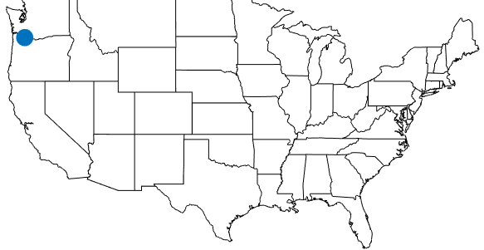
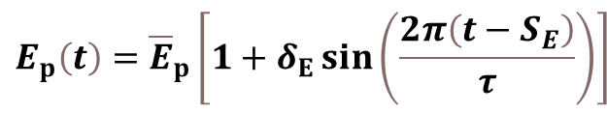
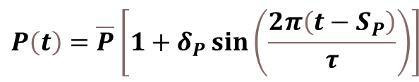
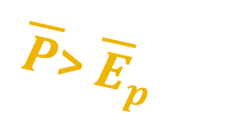
As a starting point, I’m testing the method of Woods (2003) and Gnann et al.(2020) in CAMELS_US catchments so far.
Both methods use sine curves for climate;
Woods has submodels for canopy, root zone, saturated zone;
Gnann et al. have a linear reservoir.
$$\begin{aligned}&P\left(t\right)=\overline{P}\left[1+δ_{P}\sin\left(\frac{2π\left(t−S_{P}\right)}{τ}\right)\right]\#\end{aligned}$$
$$\begin{aligned}&E_{p}\left(t\right)={\overline{E}}_{p}\left[1+δ_{E}\sin\left(\frac{2π\left(t−S_{E}\right)}{τ}\right)\right]\#\end{aligned}$$
30-days moving central average with equal weight
Sinusoidal functions
Gauge 659 (wet) in CAMELS_US
climate
$\overline{P}$> ${\overline{E}}_{p}$

Slide 4
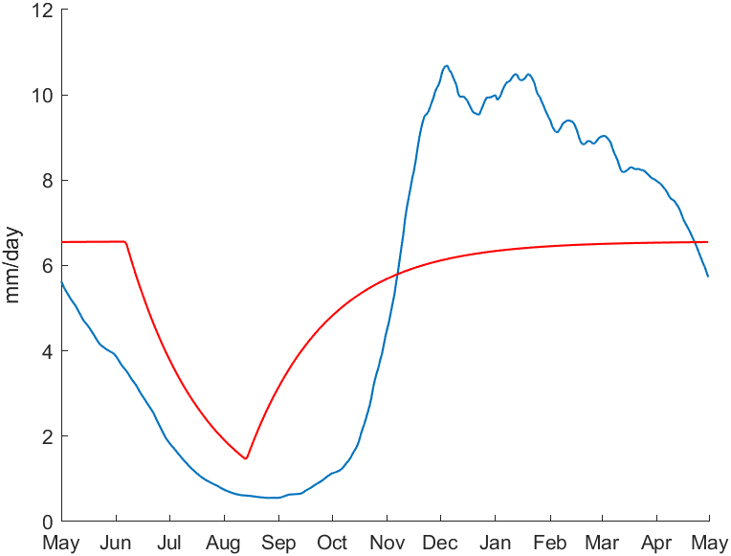

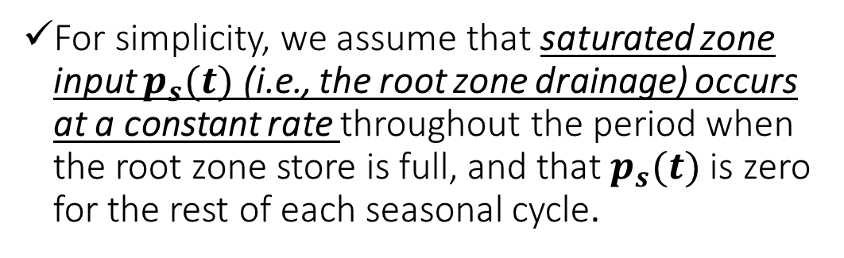
1. Approach of Woods (2003): The root zone drainage should have temporal pattern
Observed streamflow
For simplicity, we assume that saturated zone input $p_{s}(t)$ (i.e., the root zone drainage) occurs at a constant rate throughout the period when the root zone store is full, and that $p_{s}(t)$ is zero for the rest of each seasonal cycle.
$$p_{s}\left(t\right)$$
$constant$
Woods (2003, Advances in Water Resources)
Modelled flow from Sat Zone

Slide 5
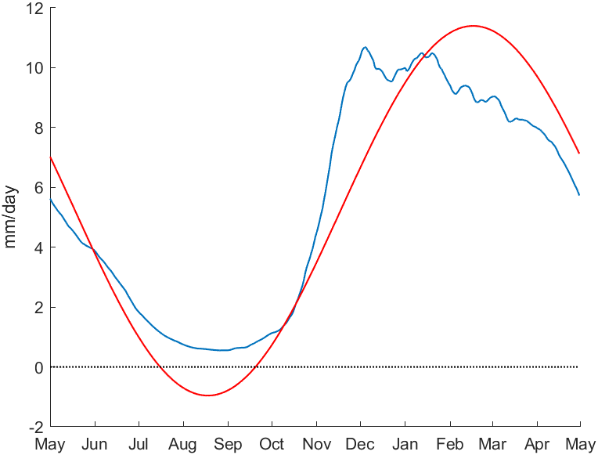
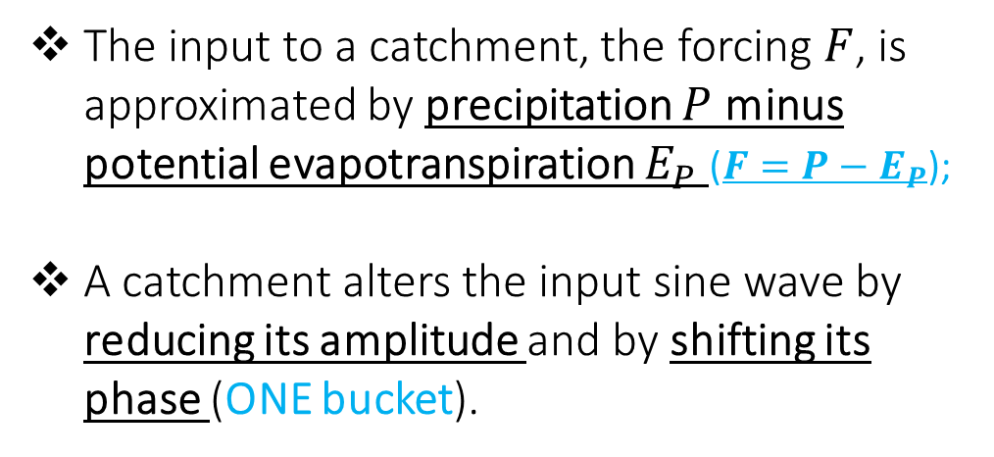
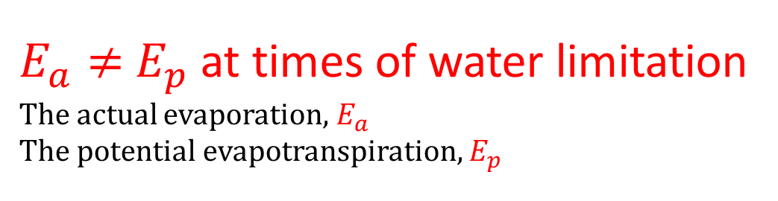
2. Approach of Gnann et al.(2020):
$E_{a}≠{ E}_{p}$ at times of water limitation
The actual evaporation, $E_{a}$
The potential evapotranspiration, $E_{p}$
The input to a catchment, the forcing $F$, is approximated by precipitation $P$ minus potential evapotranspiration $E_{P}$ (${F=P−E}_{P}$);
A catchment alters the input sine wave by reducing its amplitude and by shifting its phase (ONE bucket).
Observed streamflow
Modelled streamflow
Q<0 reveals the unrealistic result
Gnann et al. (2020, Hydrol. Earth Syst. Sci.)

Slide 6
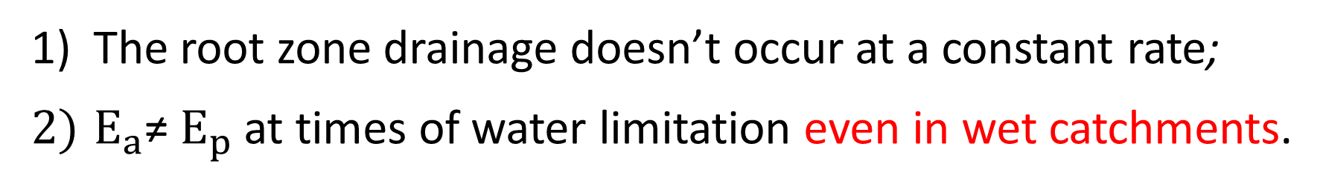
CONCLUSION:
The root zone drainage doesn’t occur at a constant rate;
$E_{a}$≠ $E_{p}$at times of water limitation even in wet catchments.
PLAN TO DO:
Combine Woods (2003) and Gnann et al. (2020)
OR Formulate a new model including both methods
Email: lf19903@bristol.ac.uk

Slide 7
Supplement

Slide 8
More research questions:
Do the model parameters make a big difference?
Which parameters are important?
Is it important to quantify soil water storage capacity accurately?
Berghuijs and Woods (2016, International Journal of Climatology) show that a sinusoidal function with an annual period can adequately describe the vast majority of monthly precipitation and temperature climates around the world, however, Knoben et al.,(2017, International Journal of Climatology) find that the bimodal rainfall pattern is commonly associated with locations within the tropics but is reported outside the tropics as well, which might cause some failures for our model.
Woods (2003) neglect the Vadose (unsaturated) zone between root zone and saturated zone
Following Woods (2003), so far, we assume the catchment runoff is only derived from the subsurface flow.

Slide 9
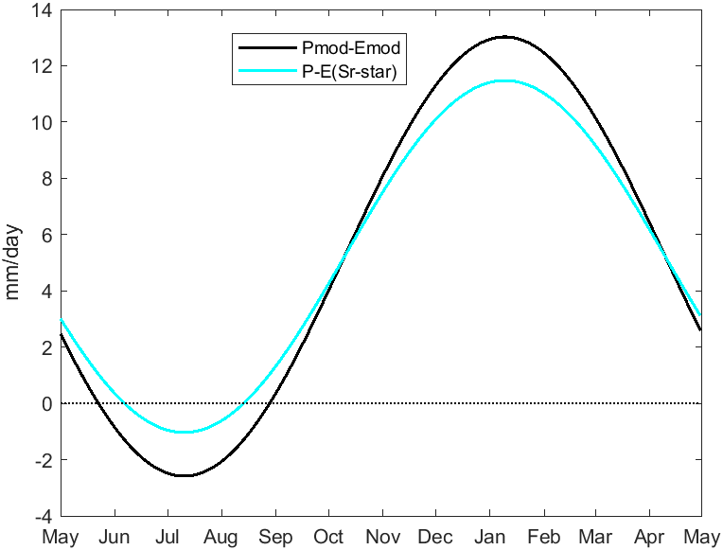
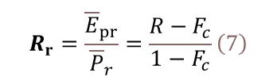
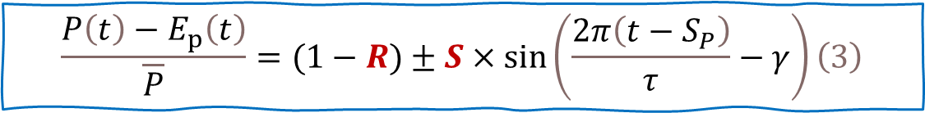
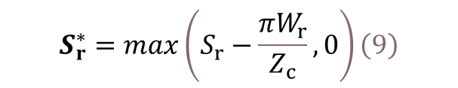
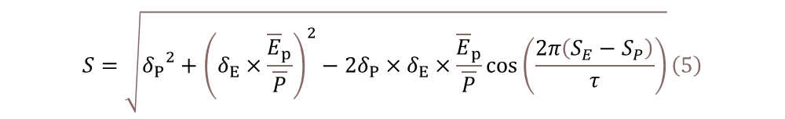


To summarize the modelled climate of (1) and (2) in dimensionless form (using the method from Appendix A in (Woods, 2009, Advances in Water Resources) to express the difference of two sine functions as a third cosine function ) :
$$\begin{aligned}&\frac{P\left(t\right)−E_{p}\left(t\right)}{\overline{P}}=(1−R)±S×\sin\left(\frac{2π\left(t−S_{P}\right)}{τ}−γ\right)\#\left(3\right)\end{aligned}$$
1.Following Woods(2003) we define the climate dryness index, R, and the climate seasonality index, S:
$$\begin{aligned}&R=\frac{{\overline{E}}_{p}}{\overline{P}}\#\left(4\right)\end{aligned}$$
$$\begin{aligned}&S=\sqrt{{δ_{P}}^{2}+{\left(δ_{E}×\frac{{\overline{E}}_{p}}{\overline{P}}\right)}^{2}−2δ_{P}×δ_{E}×\frac{{\overline{E}}_{p}}{\overline{P}}\cos\left(\frac{2π\left(S_{E}−S_{P}\right)}{τ}\right)}\#\left(5\right)\end{aligned}$$
Root zone
$${\text{2}\text{.}F}_{c}\text{, }\text{as} \text{the} \text{dimensionless} \text{average} \text{canopy} \text{evaporation}$$
3.For the root zone:
$$\begin{aligned}&R_{r}=\frac{{\overline{E}}_{pr}}{{\overline{P}}_{r}}=\frac{R−F_{c}}{1−F_{c}}\#\left(7\right)\end{aligned}$$
$$\begin{aligned}&{and S}_{r}=\frac{S}{1−F_{c}}\#\left(8\right)\end{aligned}$$
climate
4. The effects of seasonality are buffered by root zone storage.
$$\begin{aligned}&S_{r}^{∗}=max\left(S_{r}−\frac{πW_{r}}{Z_{c}},0\right)\#\left(9\right)\end{aligned}$$
Woods (2003, Advances in Water Resources)

Slide 10
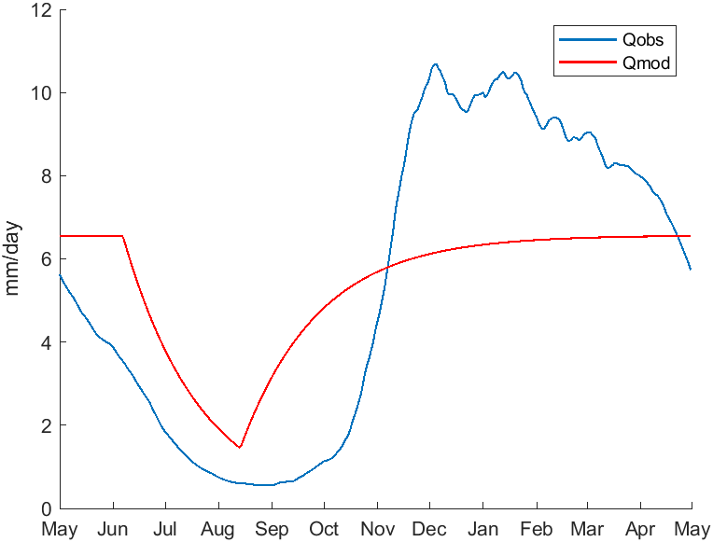
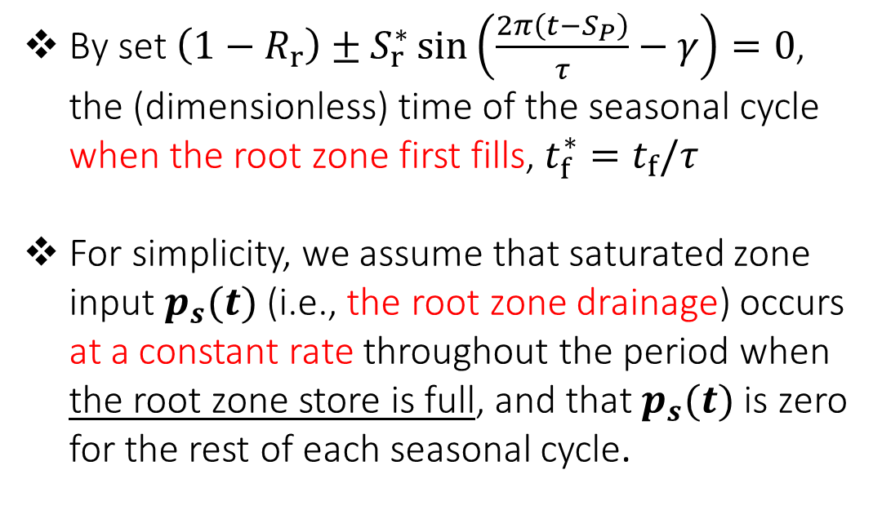

1. Bad result caused by the assumptions in Woods (2003)
Root zone
$$t_{f}$$
By set$\left(1−R_{r}\right)±S_{r}^{∗}\sin\left(\frac{2π\left(t−S_{P}\right)}{τ}−γ\right)=0$, the (dimensionless) time of the seasonal cycle when the root zone first fills, $t_{f}^{∗}=t_{f}/τ$
For simplicity, we assume that saturated zone input $p_{s}(t)$ (i.e., the root zone drainage) occurs at a constant rate throughout the period when the root zone store is full, and that $p_{s}(t)$ is zero for the rest of each seasonal cycle.
climate
Baseflow from Sat zone
Woods (2003, Advances in Water Resources)

Slide 11

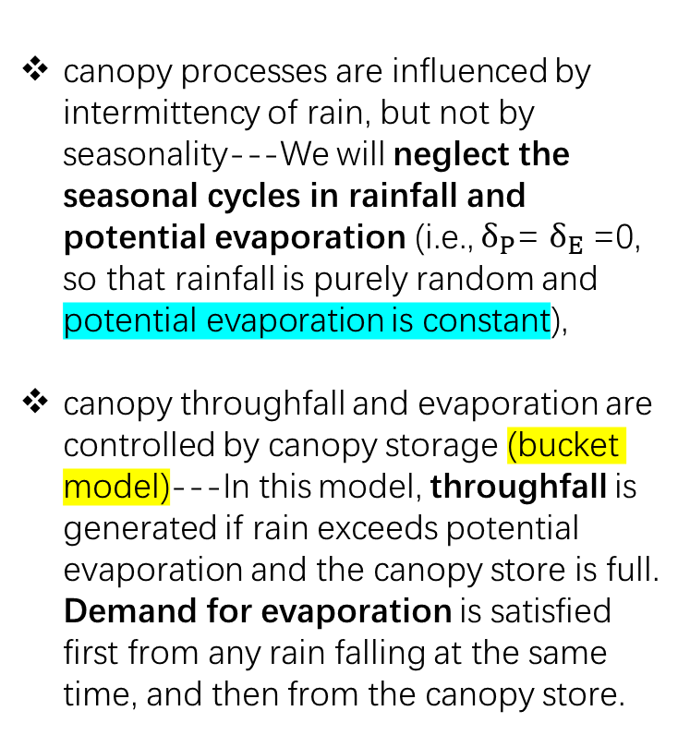
Assumptions:
rain and potential evaporation have seasonal variability which can be modeled by a sine wave,
climate and vegetation properties are stationary in time.---The canopy model could be adapted to include some other attributes of vegetation, such as very simple treatments of spatial or temporal variability,
canopy processes are influenced by intermittency of rain, but not by seasonality---We will neglect the seasonal cycles in rainfall and potential evaporation (i.e., $δ_{P}$= $δ_{E}$=0, so that rainfall is purely random and potential evaporation is constant),
canopy throughfall and evaporation are controlled by canopy storage (bucket model)---In this model, throughfall is generated if rain exceeds potential evaporation and the canopy store is full. Demand for evaporation is satisfied first from any rain falling at the same time, and then from the canopy store.
Rainfall,
Potential Evaporation
Canopy Evap
Canopy
Woods (2003, Advances in Water Resources)
Throughfall

Slide 12
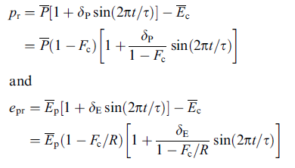
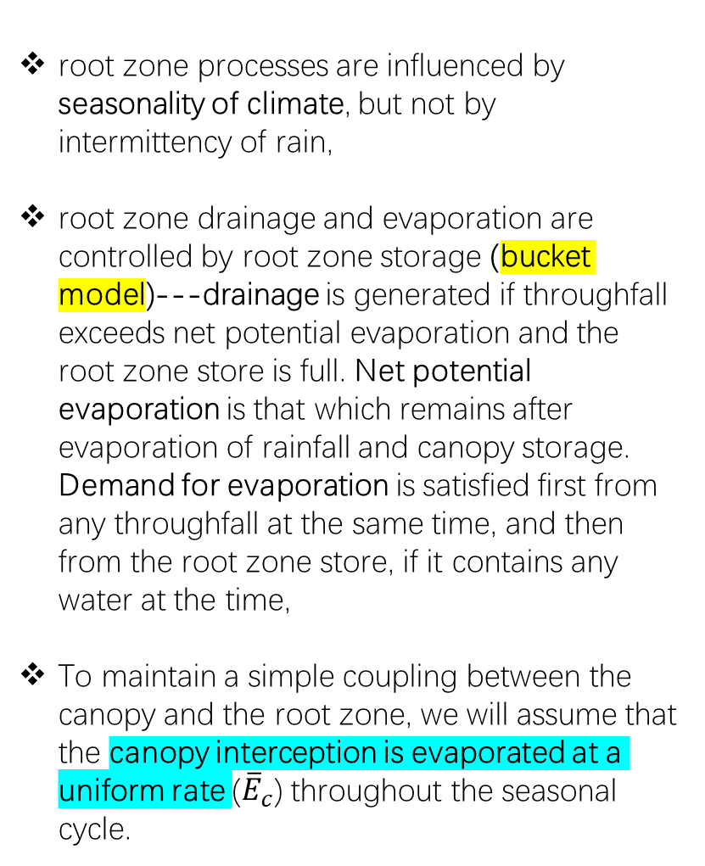
Assumptions:
The process submodels are sequentially coupled, so that the throughfall from the canopy is the moisture input to the root zone, and the drainage from the root zone is the moisture input to the saturated zone,
root zone processes are influenced by seasonality of climate, but not by intermittency of rain,
root zone drainage and evaporation are controlled by root zone storage (bucket model)---drainage is generated if throughfall exceeds net potential evaporation and the root zone store is full. Net potential evaporation is that which remains after evaporation of rainfall and canopy storage. Demand for evaporation is satisfied first from any throughfall at the same time, and then from the root zone store, if it contains any water at the time,
To maintain a simple coupling between the canopy and the root zone, we will assume that the canopy interception is evaporated at a uniform rate (${\overline{E}}_{c}$) throughout the seasonal cycle.
Throughfall
Net potential evaporation
Root zone
Rootzone Evap
Drainage
Woods (2003, Advances in Water Resources)

Slide 13
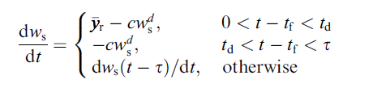
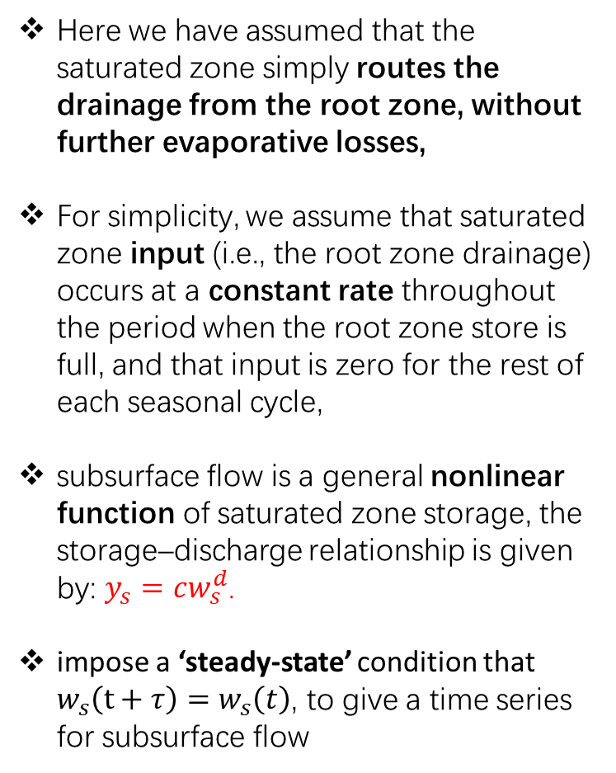
Assumptions:
Here we have assumed that the saturated zone simply routes the drainage from the root zone, without further evaporative losses,
For simplicity, we assume that saturated zone input (i.e., the root zone drainage) occurs at a constant rate throughout the period when the root zone store is full, and that input is zero for the rest of each seasonal cycle,
subsurface flow is a general nonlinear function of saturated zone storage, the storage–discharge relationship is given by: $y_{s}=cw_{s}^{d}$.
impose a ‘steady-state’ condition that $w_{s}\left(t+τ\right)=$ $w_{s}\left(t\right)$, to give a time series for subsurface flow
Drainage
Saturated
zone
Subsurface
flow
Woods (2003, Advances in Water Resources)

Slide 14
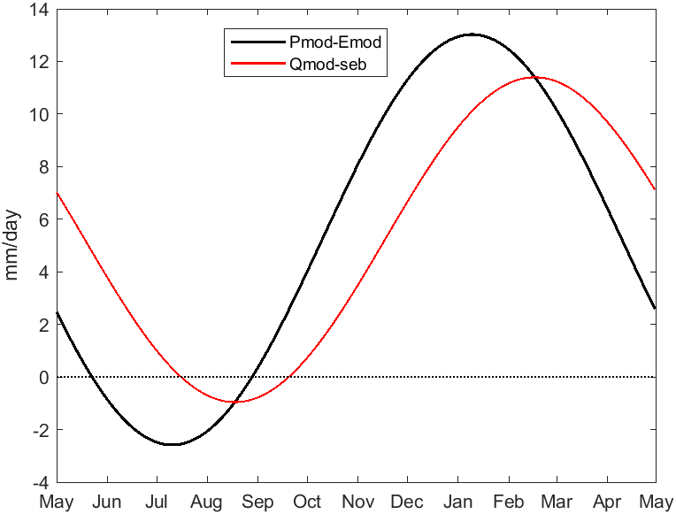

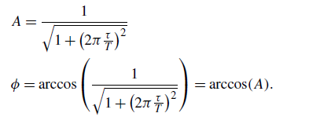
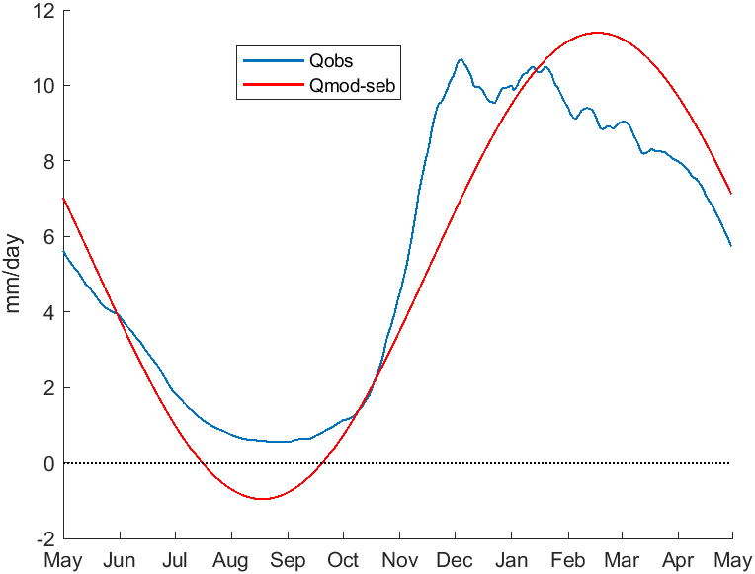
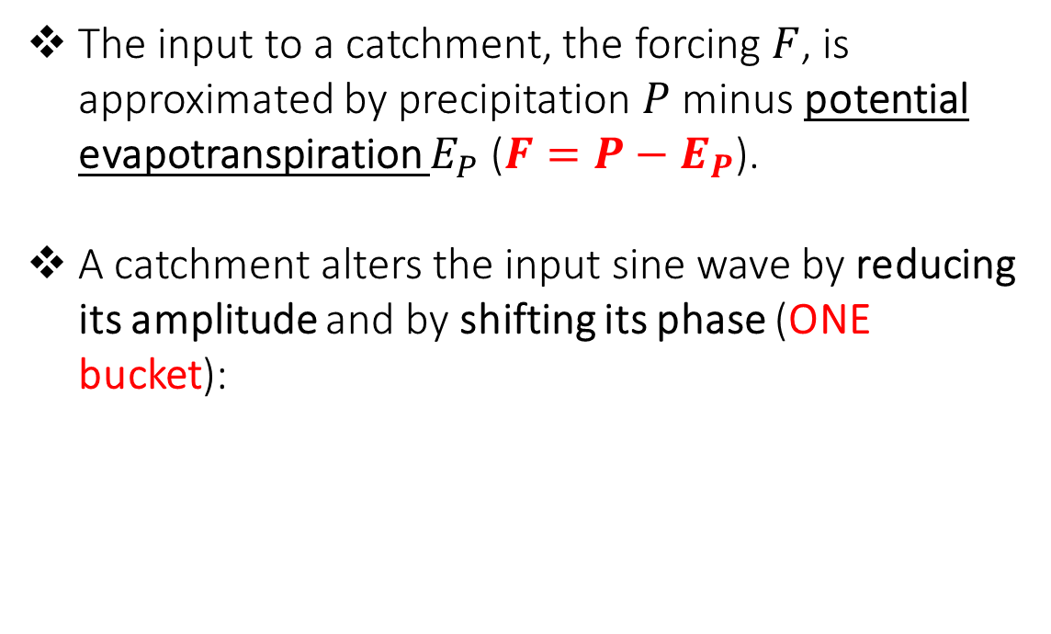
The input to a catchment, the forcing $F$, is approximated by precipitation $P$ minus potential evapotranspiration $E_{P}$ (${F=P−E}_{P}$).
A catchment alters the input sine wave by reducing its amplitude and by shifting its phase (ONE bucket):
Gnann et al. (2020, Hydrol. Earth Syst. Sci.)
climate
runoff
This might be particularly problematic in water-limited catchments, where actual evapotranspiration is much smaller than potential evapotranspiration, and in catchments where precipitation and potential evapotranspiration are out of phase.

