Slide 1

Title Slide
Assessing Social Vulnerability and Understanding the Flood Risk Factors in Massachusetts
Cielo A. Sharkus, Jennifer Givens, Sheila M. Saia, James Knighton, Christian D. Guzman
Notes:
Hello everyone thank you for joining me for my presentation titled “Spatial and Temporal variation of Hydrological Risk in Rural and Urban Environmental Justice communities” I am pleased to join the Geoethics in the face of global anthropogenic changes: how do we intersect different knowledge domains? Session

Slide 2
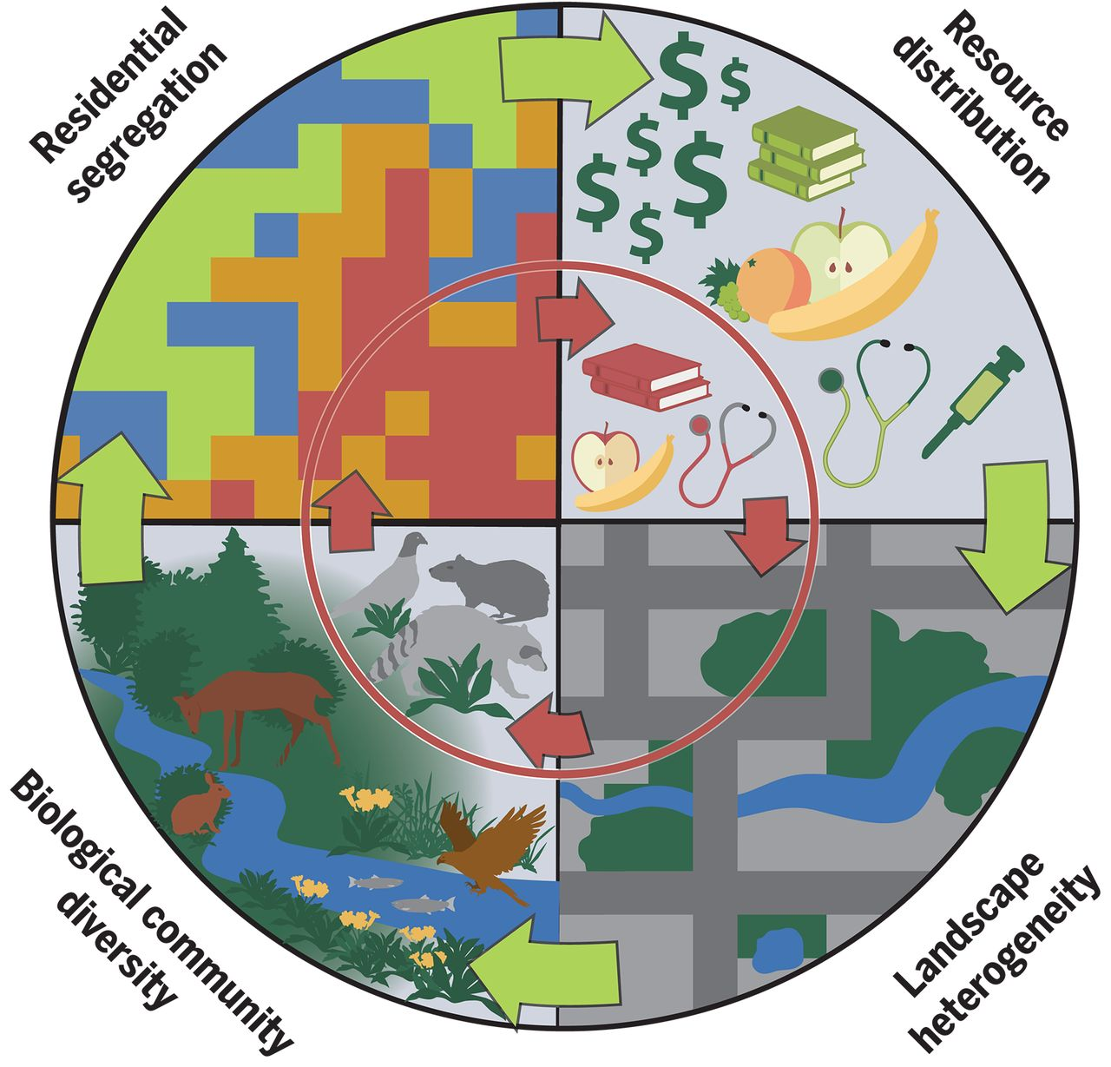
Environmental Justice
Introduction
Methods
Results
Differential exposure yields varying environmental risks by socioeconomic status (Bullard, 1993; Martuzzi, 2010)
The politics of marginalization increase vulnerabilities (Baah, 2019)
Notes:
The motivation of this research is centered around Environmental Justice, or EJ, which describes the fair treatment and meaningful involvement of all people, regardless of race, color, national origin, or income with respect to the development, implementation and enforcement of environmental laws, regulations and policies.
By “fair-treatment”, no group of people should bear a disproportionate share of the negative environmental consequences resulting from industrial, governmental and commercial operations or policies. However, this is certainly not always the case, especially when it comes to disasters and flooding.
For decades, researchers demonstrated that differential exposure yields varying environmental risks that disproportionately impact historically marginalized communities. Robert Bullard, who is considered to be the founder of environmental justice, described this as an interplay between environmental and social factors that lead to communities of color shouldering the burden of environmental injustice.

Slide 3
Institutional Injustice
Introduction
Methods
Results
“After a disaster, minorities and the poor suffer a much slower recovery because of the lethargic response of agencies whose participation is critical to their recovery. They often receive less information, are rejected more often for necessary loans, receive less government relief, and endure discrimination and rejection in their search for housing. ”
- Robert Bullard and Beverley Wright (2009)
“
Notes:
This interplay between socioeconomic status and vulnerability to environmental hazards manifests into multidimensional hazards for systemically marginalized communities. In urban areas, efforts to manage and mitigate risks are connected to affluence, whereas those of lower socioeconomic status find them selves displaced or placed in undue harm. Many of these patterns od disparity raise multifaceted questions of how will climate change, extreme weather, and flooding affect those who are in these precarious situations. Robert Bullard again describes how social factors contribute to and affect disaster recovery.

Slide 4
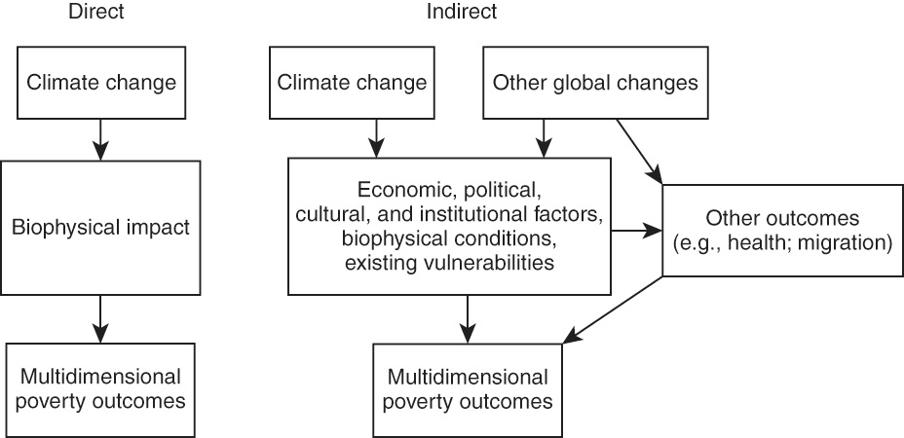
Inequalities in Climate Change
Introduction
Methods
Results
Notes:
In this regard we analyze “climate-based risk” as a multifaceted entity that encompasses a broad range interdisciplinary work ranging from food, water, and energy systems to discrepancies in the built environment. Both kinds of hazards, the direct impacts and the indirect impacts, exacerbate existing social, political, and economic inequalities causing a vicious cycle where the initial inequality causes the disadvantaged communities to suffer disproportionately from the adverse effects of climate change, resulting in greater subsequent inequality.
We therefore aim to understand the underlying economic, political, and institutional factors and their impacts on the way communities experience climate disasters.

Slide 5
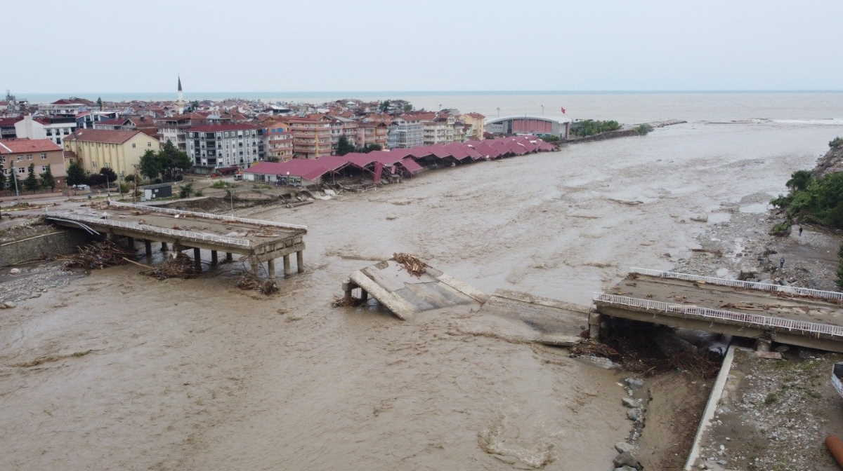
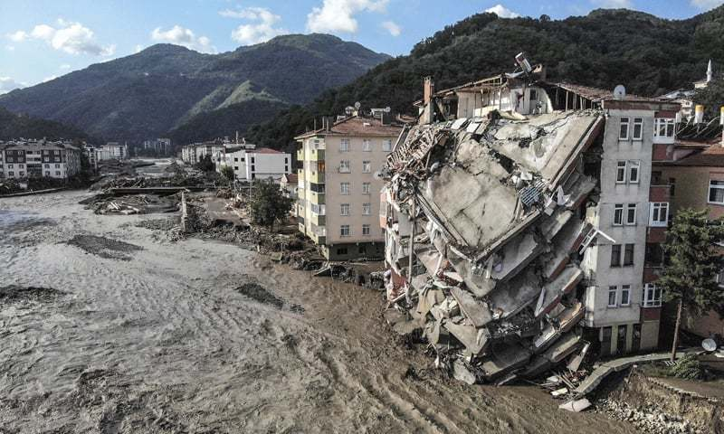
How Do We Quantify Inequality in Flooding?
What are the commonalities ?
How can we understand and try to find a solution for hazard?
Introduction
Methods
Results
How can we understand and try to find a solution for hazard?
What are the commonalities ?
Notes:
This study aims to combat shortcomings of common generalized vulnerability indices by examining root causes of social vulnerability, interactions between flooding, and geographic scales of operation in Massachusetts. In this study we attempt to answer questions such as “Do characteristic hotspots of flooding differ substantially based on urban and rural settings?”, “What is the relationship between flood exposure, vulnerability, and development?” We attempt to address these questions to provide evidence to support more equitable strategies in flood hazard reduction and disaster recovery.

Slide 6
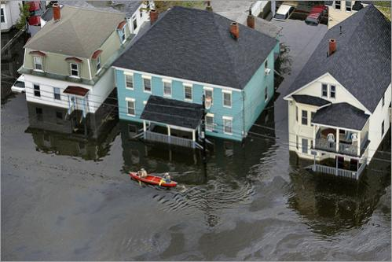
Who Bears the Burden?
What are the commonalities ?
How can we understand and try to find a solution for hazard?
Introduction
Methods
Results
41 million Americans live in flood risk zones
Social vulnerability - socio economic status, race and ethnicity, age/gender, family/household structure , and disability
CDC – 15 factor Social Vulnerability Index
Massachusetts’ 3-factor Environmental Justice Scale
What are the most influential demographics in flood zones?
Notes:
The way we answer these questions is by analyzing who bears the burden.
Researchers on social vulnerability to flood hazards developed methods like the CDC’s 15-factor Social Vulnerability Index (Flanagan et al., 2011) to answer this question. This index is uses American community survey data and demographic factors to assign a ranking of vulnerability to a census tract.
Similarly, Massachusetts’ developed a 3-factor Environmental Justice scale (EEA, 2017), to demonstrate the greater preponderance of these factors within flood zones, and to predict which factors predict greater social vulnerability to compounding negative effects within a flood zone. We examine three categories that make up an environmental justice community: race, minority composition, and English-speaking ability which are ranked in census block groups. However, changes in population density and socioeconomic status may affect the distribution of risk in flood-prone communities. So the question becomes, what are the most influential demographics in flood zones? How do changing population dynamics impact flood-risk occurrence for environmental justice groups? These are important question to better assess the flood vulnerability risk of different groups and demographic factors, target policies and programs more effectively, increase the likelihood of recovery during all stages of a disaster, decrease human suffering, and reduce economic loss.

Slide 7
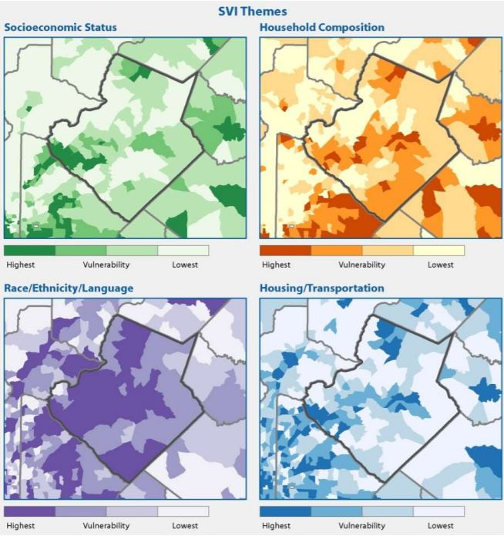
What are the commonalities ?
How can we understand and try to find a solution for hazard?
Introduction
Methods
Results
Indices of Risk
SVI:
Socioeconomic status
Household composition & disability
Minority status & language
Housing & transportation
Based on census bureau data
EJI:
Annual median household income
English Language proficiency
Minority composition
Finer spatial and temporal scales
Notes:
In this study, we first combined the two indices SVI, developed by the CDC, and EJI, developed by Massachusetts, to assess hot spots of vulnerability that intersect with 100- and 500-year flood risks. We ranked the highest growing cities in Massachusetts using population density and household income growth from 2010-2019 using publicly available data from the American Community Survey (ACS) and the Donahue Institute
The underlying social vulnerability model used is sourced from the CDC SVI publicly available dataset that draws on data from the American community survey. We delineated census tracks data from 2018, split into four socioeconomic themes. The four “percentile ranking” (RPL) themes assessed factors summarized in Table 1. For more detailed spatial analysis into trends specific to census block groups, we accessed additional socioeconomic data from MassGIS on environmental justice populations. The overlapping vulnerability model “Environmental Justice Index” used census block group data from 2020 using three criteria: Minority population, median household income, and household English language isolation. FEMA Q3 digital flood insurance risk maps (FEMA FIRMs), which represented known flood hazards for 100- & 500-year fluvial flooding, were projected together under varying colorimetric ranges.
the annual median household income is not more than 65 per cent of the statewide annual median household income;
minorities comprise 40 per cent or more of the population;
25 per cent or more of households lack English language proficiency; or
minorities comprise 25 per cent or more of the population and the annual median household income of the municipality in which the neighborhood is located does not exceed 150 per cent of the statewide annual median household income.

Slide 8
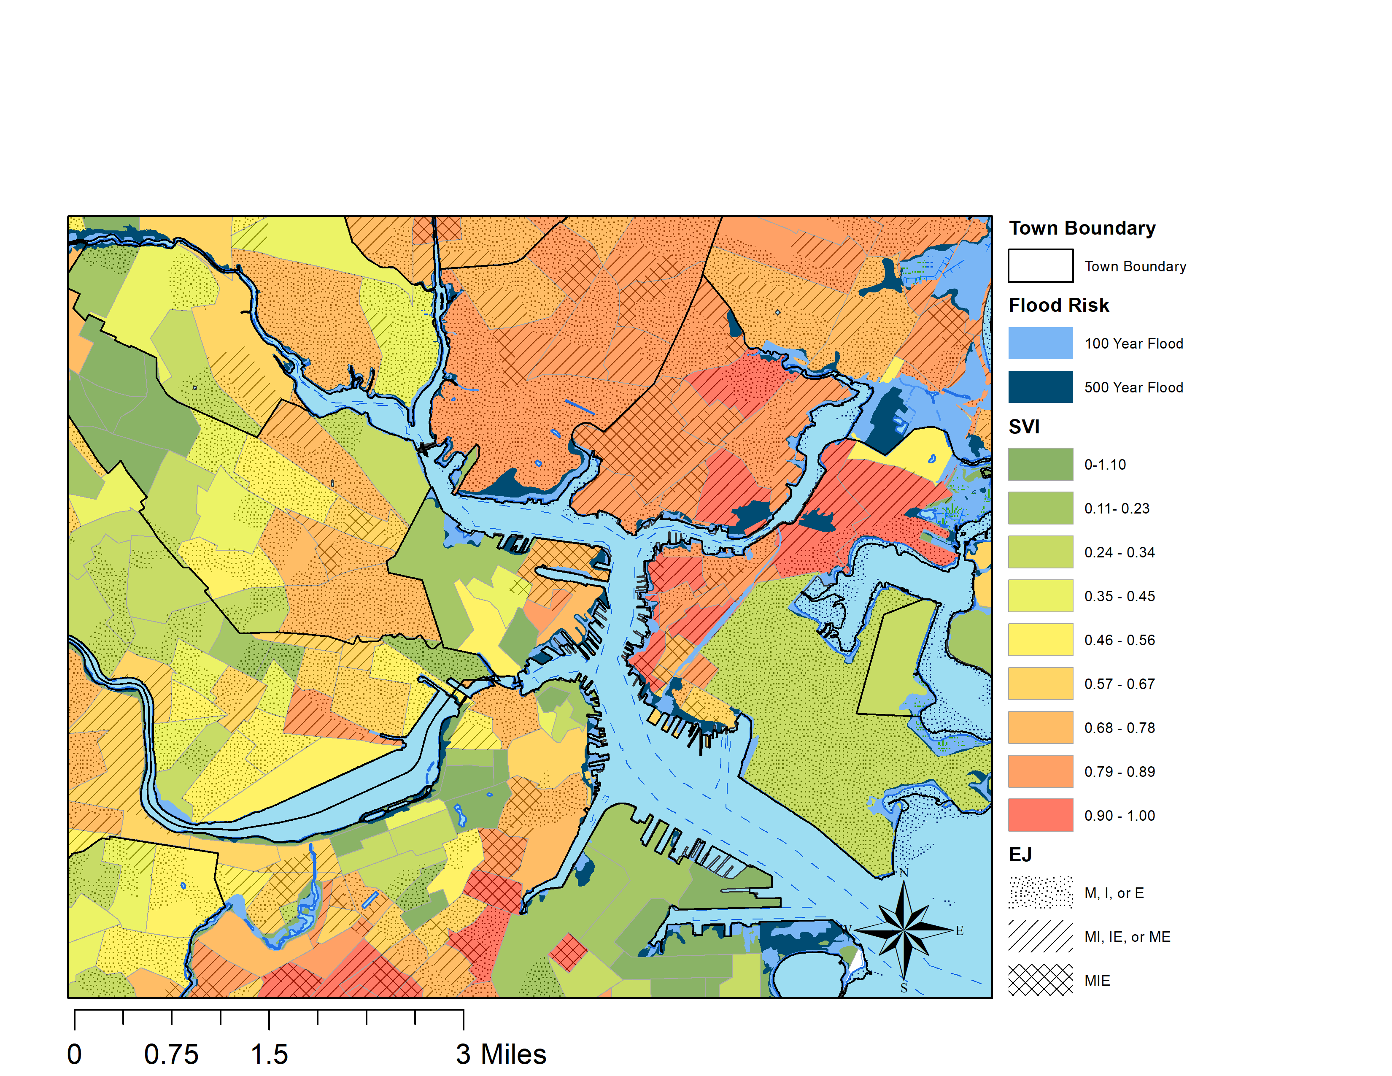
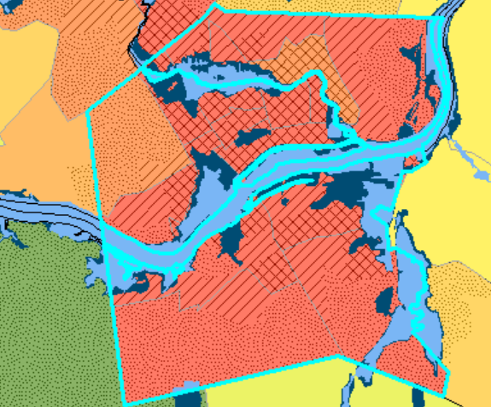
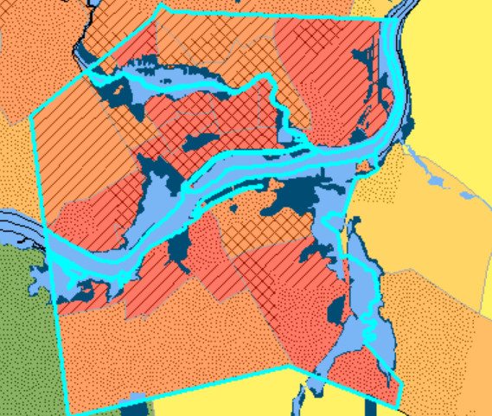
Introduction
Methods
Results
Spatial Variations of Risk
Lawrence, MA, 2010 vs Lawrence, MA in 2020
Notes:
In this study we examine spatial and temporal associations of flood-risk for 20 urban and rural environmental justice communities in Massachusetts. We examine the spatial variations of hydrological risk in a systemically and historically marginalized “Environmental justice community” by overlapping SVI with the EJI indices and developing a model work flow in ArcGIS Model Builder. The dotted, hatched, and cross hatched lines represent the Massachusetts Environmental Justice Index. The three categories, Minority, Income, and Education are represented in the census block groups. If a single census block group has just 1 of these categories, it ranks lower. If it has 3 or more, it is ranked the highest. The blue lines show the boundaries of FEMA based flood zones and as you can see in the middle of the map, they are surrounded by the other race, Hispanic, or Latino populations. What is more specific on the EJI index, opposed to Social vulnerability index, is that EJI has a finer resolution. Since it maps at the census block group level over tracts, we are able to visualize vulnerability more distinctly than SVI. This therefore visualizes how areas north of the Merrimack are more acutely vulnerable to flooding, signifying a need for better environmental policies surrounding flooding in these areas.
The results demonstrate that increased vulnerability to flooding is driven by factors that relate to marginalization (via minority status (M), income (I), or language proficiency (E)) as defined by EJI or the increased intensity of red/orange shading for SVI. This is prevalent for case study sites across Massachusetts. In these cases, combined EJI factors reduce percentage of flood risk present within total area of block groups.

Slide 9
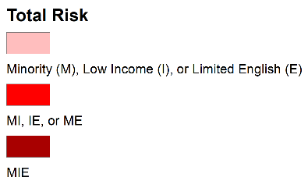
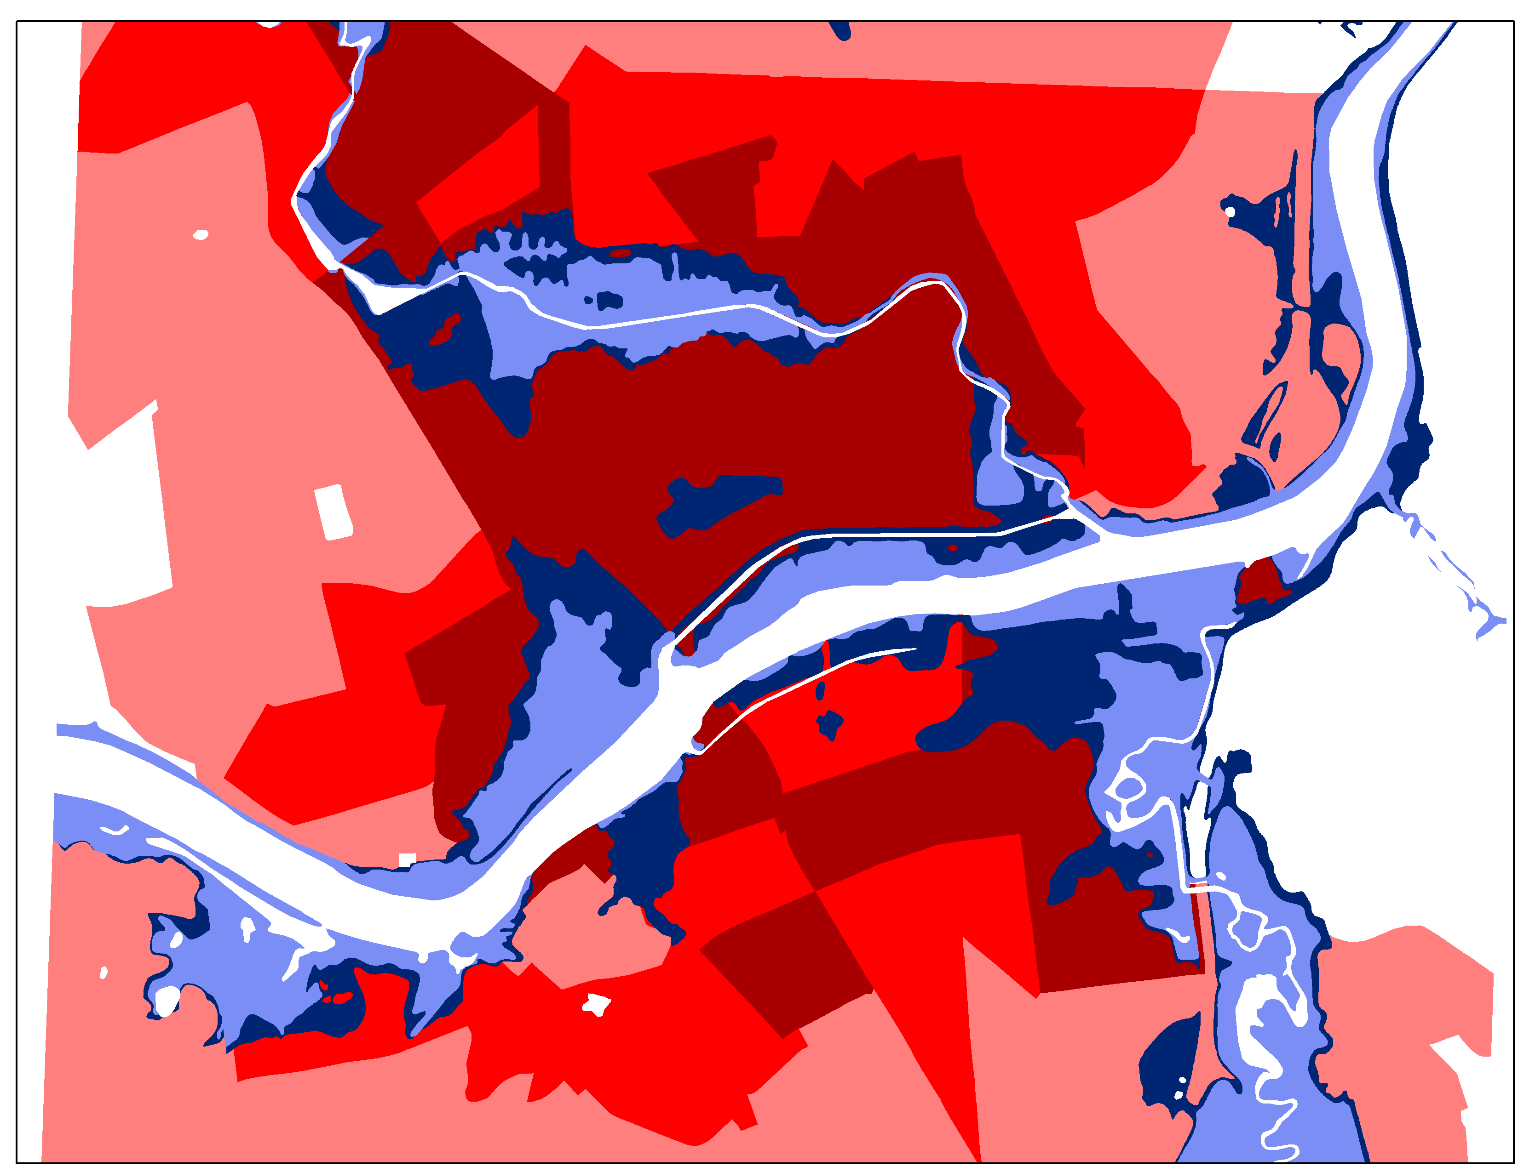
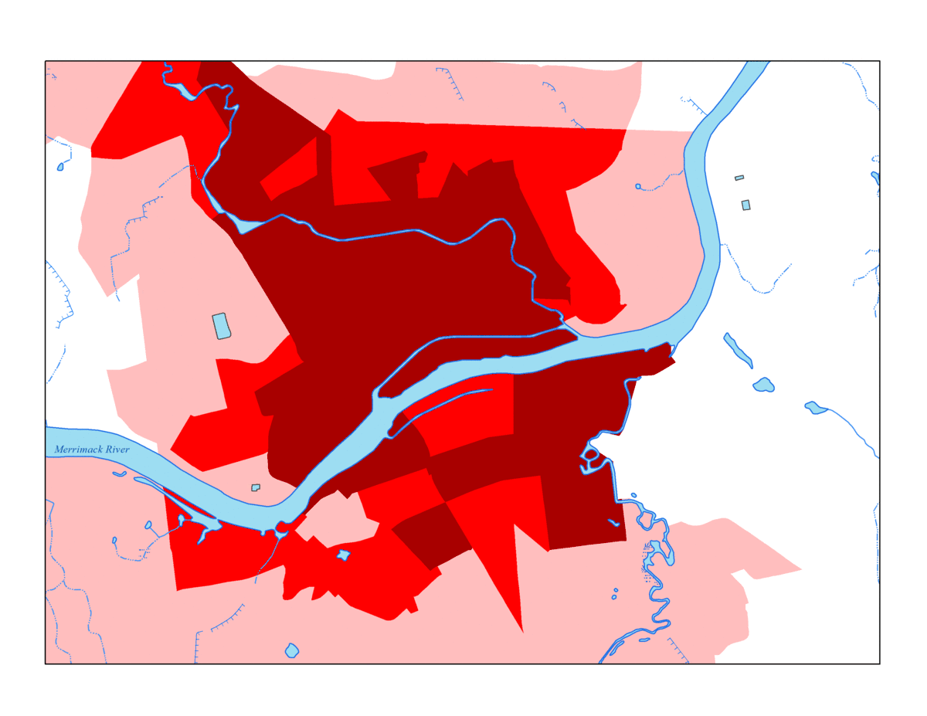
Spatial Variations of Risk
Notes:
Here is Lawrence MA again with just the environmental justice index. I created this gif to show just how much flood waters overlap with neighborhoods that have 3 factors that contribute to socioeconomic vulnerability. In areas with high minority, low income, and low English proficiency, the flood waters overlap by 34%. This is much higher than the neighboring town of andover, which does not have any environmental justice communities overlapping with flood risk. Even compared to Boston, a city of similar racial and ethnic composition, other socioeconomic factors drive up the flood risk in Lawrence over 5 times that of Boston.

Slide 10
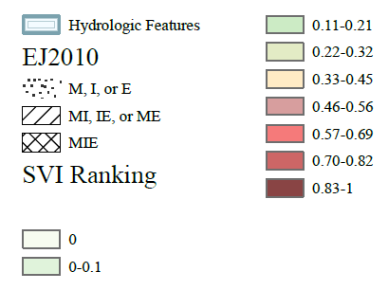
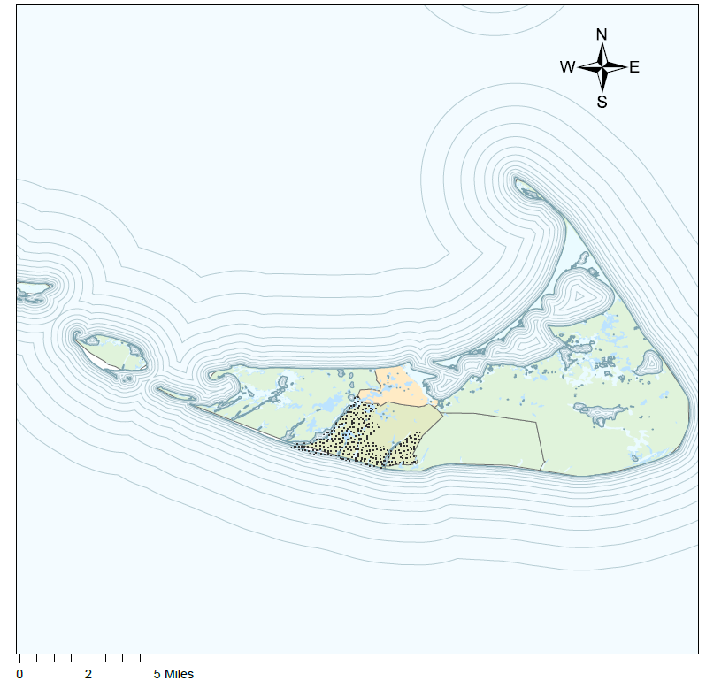
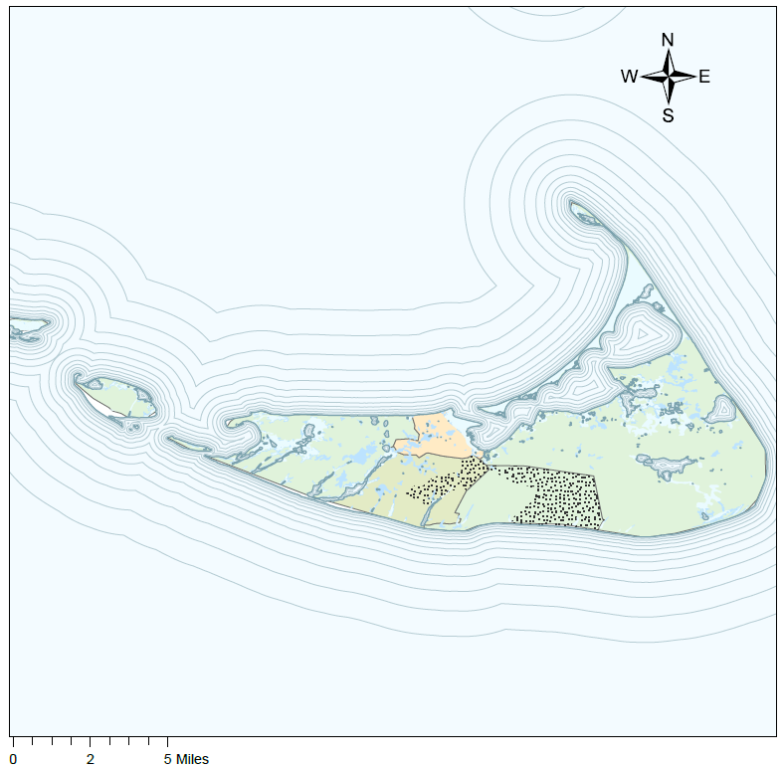
Introduction
Methods
Results
Temporal Variations of Risk
Notes:
We also mapped these results from 2010 to 2020 using community survey data to see how flood risks change with respect to time. As you can see, in 2020, the social vulnerability index shows a decrease in the intensity of vulnerability, whereas the EJI index shows that vulnerability is staying the same or worsening in areas with these changes. These differences in vulnerability demonstrate the need for more specific maps that are based upon community vulnerabilities. For Nantucket Massachusetts alone, we saw a 350% increase in the proximity of environmental justice groups to flood-hazards. This pattern was similar across both rural and urban environmental justice groups, with urban environmental justice communities having a statistically significant increase in the proximity of flood hazards based on increases in population density from 2010 to 2020. These results suggest that as community dyanmics in environmental justice communities shifts, increasing population density in urban areas are driving increased vulnerability to flood-hazards. In rural areas, historically marginalized communities are increasingly entering and living in flood-zones as well.

Slide 11
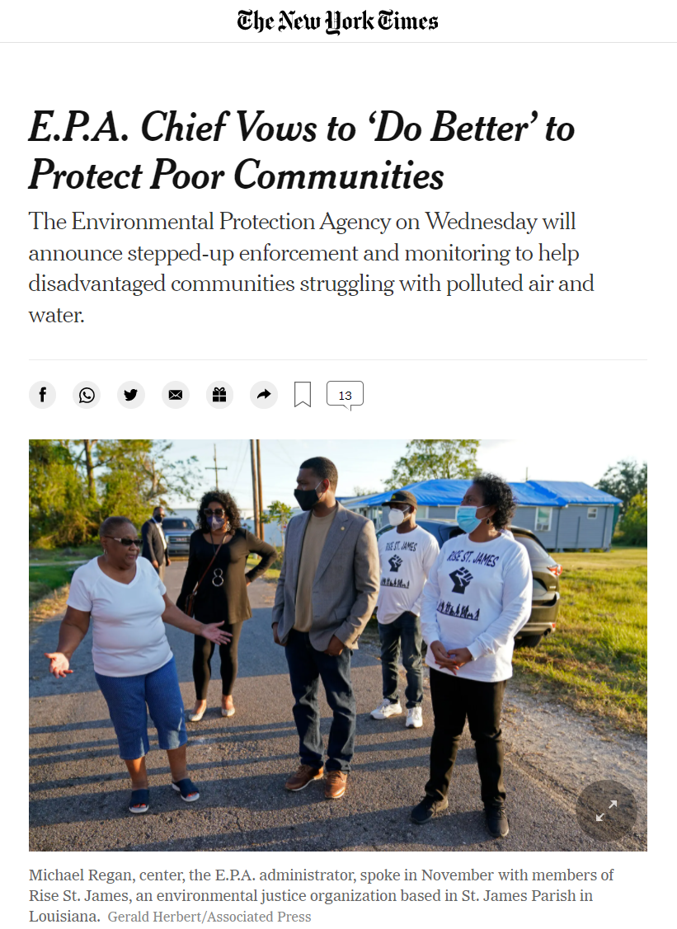
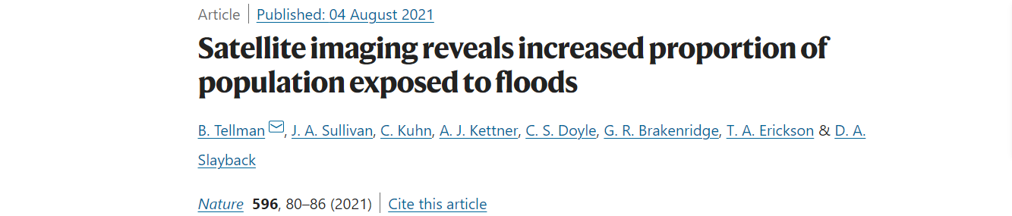
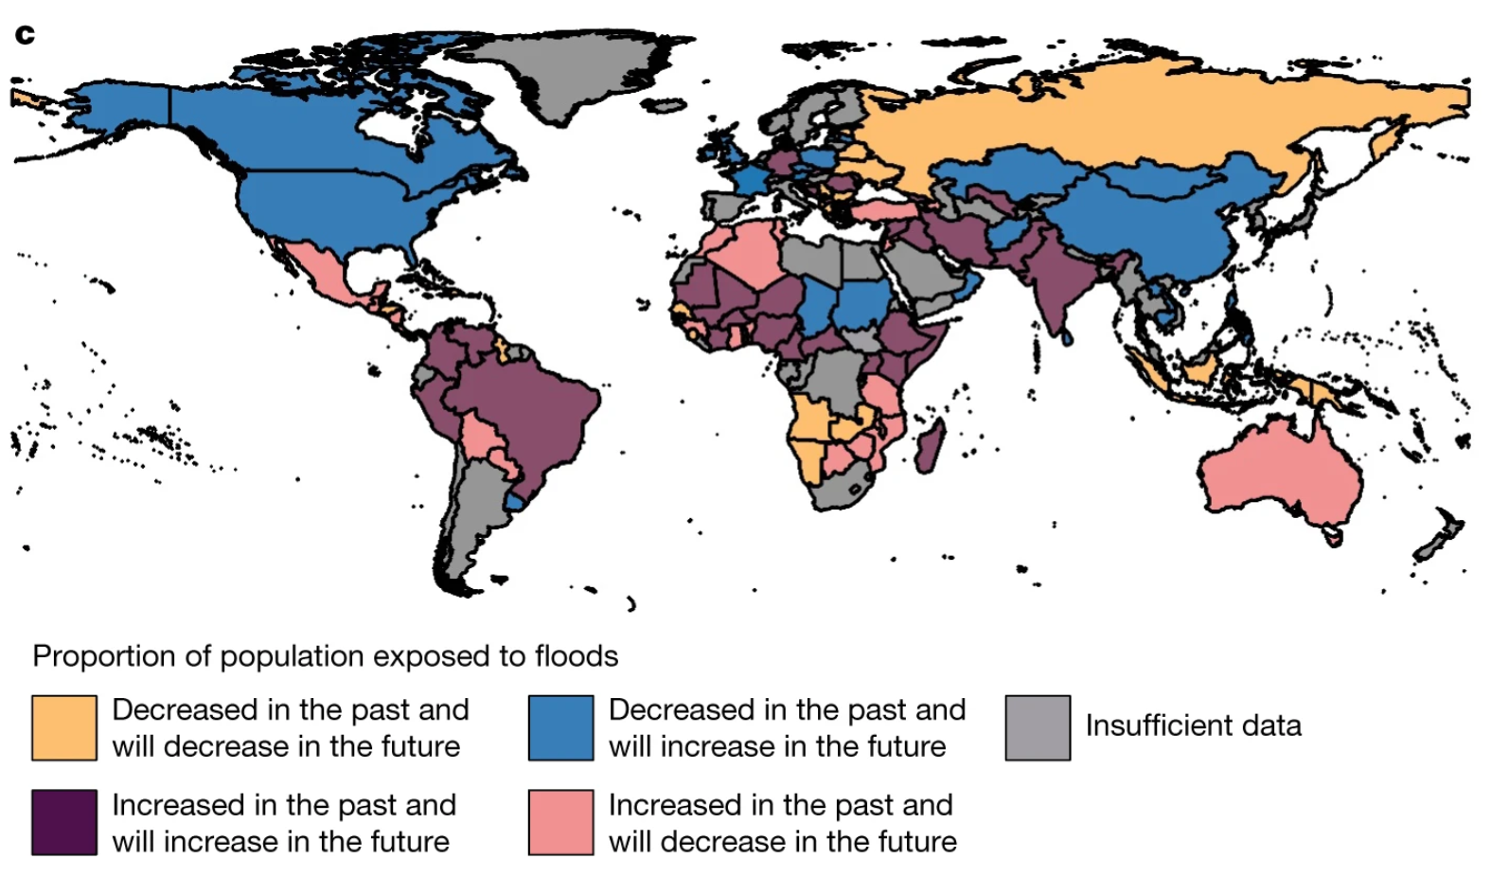
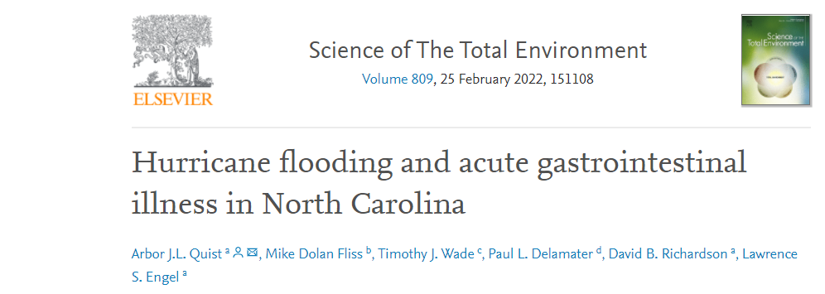
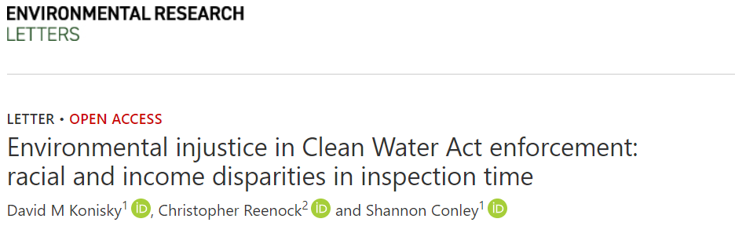
Connection to larger trends and needs
Notes:
Overall, this research pushes the need to connect flood vulnerability and socioeconomic status to larger trends in climate change. As the spatial and temporal variation of flood-risk increasingly and disproportionately threatens systemically and historically marginalized groups we will need more research that highlights and exemplifies how threats of climate-based hazards interact with community groups. The threat of hurricanes, heavy rainfall, and flooding pose much more of a threat than just inundation to homes and businesses. For example, flooding is able to spread legacy contamination such as PFAS and PFOAS, bacteria, and other things that make us sick, which can be hazardous for population dense communities who rely on river systems for food, water, and energy.

Slide 12
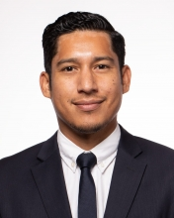
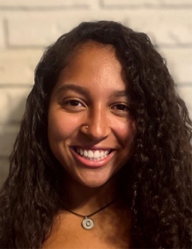

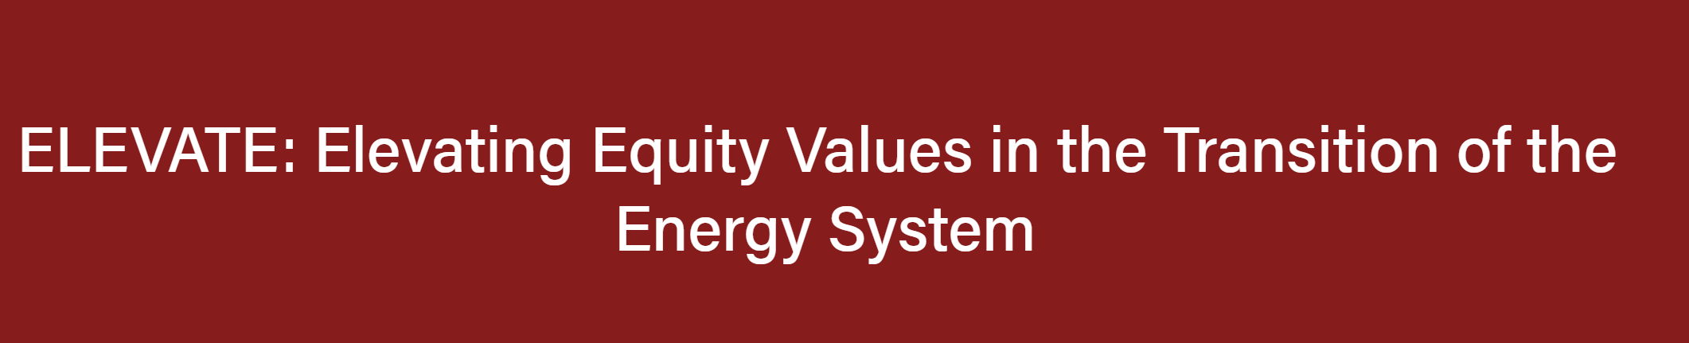
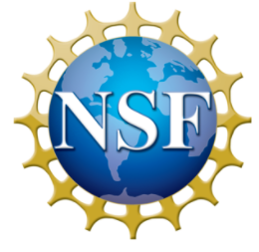

Acknowledgements
Cielo A. Sharkus – Department of Civil and Environmental Engineering, UMass Amherst
Support by the Energy Transition Institute, NSF Research Traineeship, and the NE CASC
Christian D. Guzman – Department of Civil and Environmental Engineering, UMass Amherst
Jennifer Givens - Department of Sociology, Social Work, and Anthropology, Utah State University
Sheila M. Saia - Department of Forestry and Environmental Resources, North Carolina State University
James Knighton - Department of Natural Resources and the Environment, University of Connecticut
Notes:
In my last slide I would like to acknowledge the participation of my all my collaborators. In addition, I would also like to acknowledge the support of the Spaulding Smith Fellowship, Energy Transition Institute, and NE CASC for funding this study.

Slide 13
Closing Slide
THANK YOU!

Slide 14
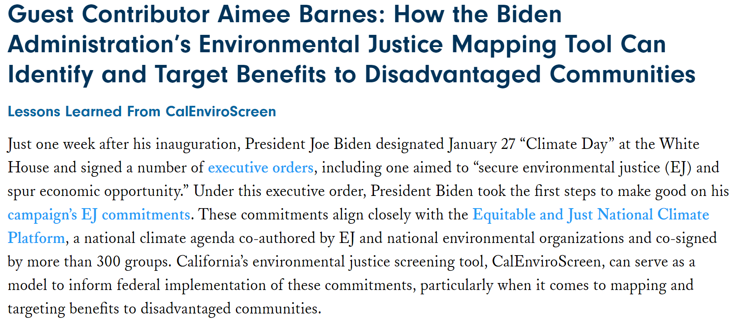
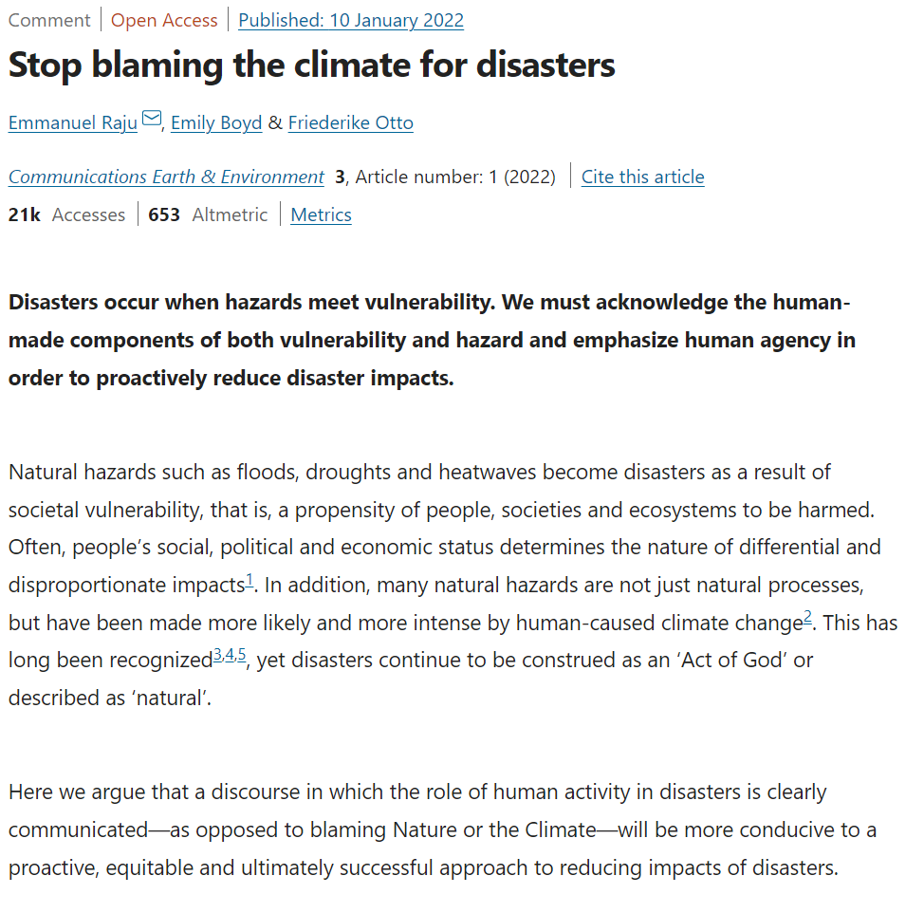
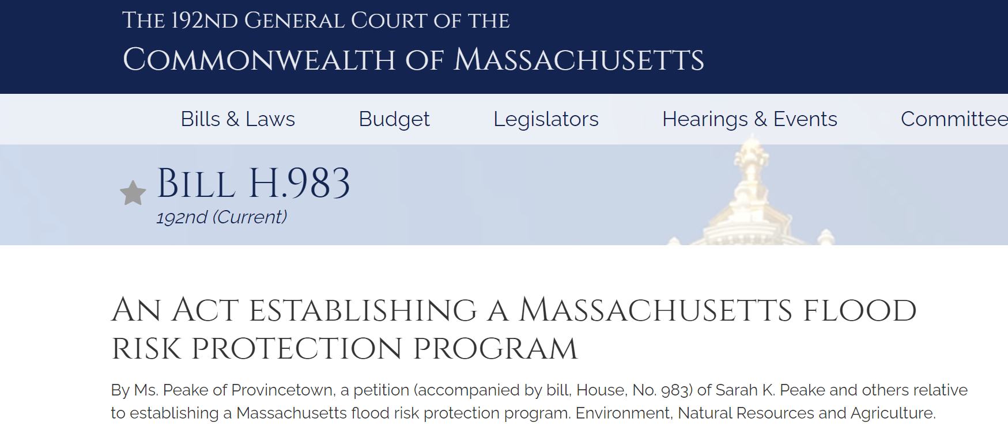
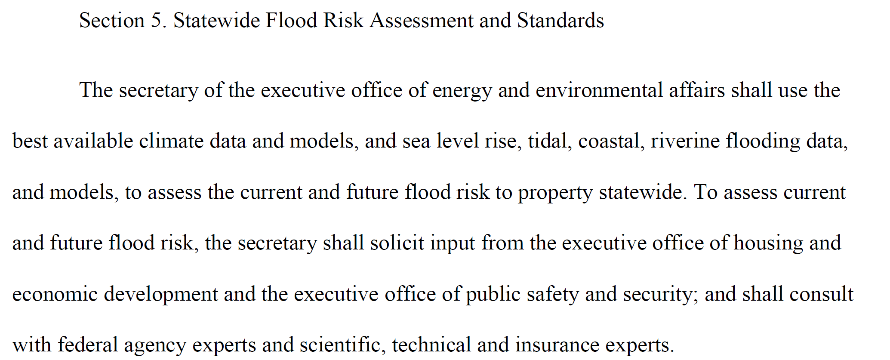
Application for findings
Notes:
These findings stress the importance of parsing out the role that socioeconomic status, racial composition, and other demographic factors have in disaster risk. It is critical that we work to establish flood risk protection programs that cater to those who are most vulnerable, and develop them in a participatory manner that includes voices historically excluded. In the future, we plan to improve this research using a hydrodynamic and sediment model to evluate hydrological risks to the water energy food nexus.

