Slide 1




Session HS3.1 - EGU22-6277 Estuarine morphodynamics forecast using a numerical model emulator based on deep learning methods. A first approach.
Willian Weber de Melo¹, José Luís Pinho¹, Isabel Iglesias², Ana Gomes¹, José Vieira¹, Ana Bio², Luisa Bastos^{2,4}, Fernando Veloso-Gomes^{2,3}, and Paulo Avilez-Valente^{2,3}
Abstract available at:
¹University of Minho, School of Engineering, Civil Engineering, Portugal (id9257@alunos.uminho.pt)
²Interdisciplinary Centre of Marine and Environmental Research (CIIMAR/CIMAR), University of Porto
³Faculty of Engineering, University of Porto
⁴Department of Geosciences Environment and Spatial Planning, Faculty of Sciences of the University of Porto

Slide 2
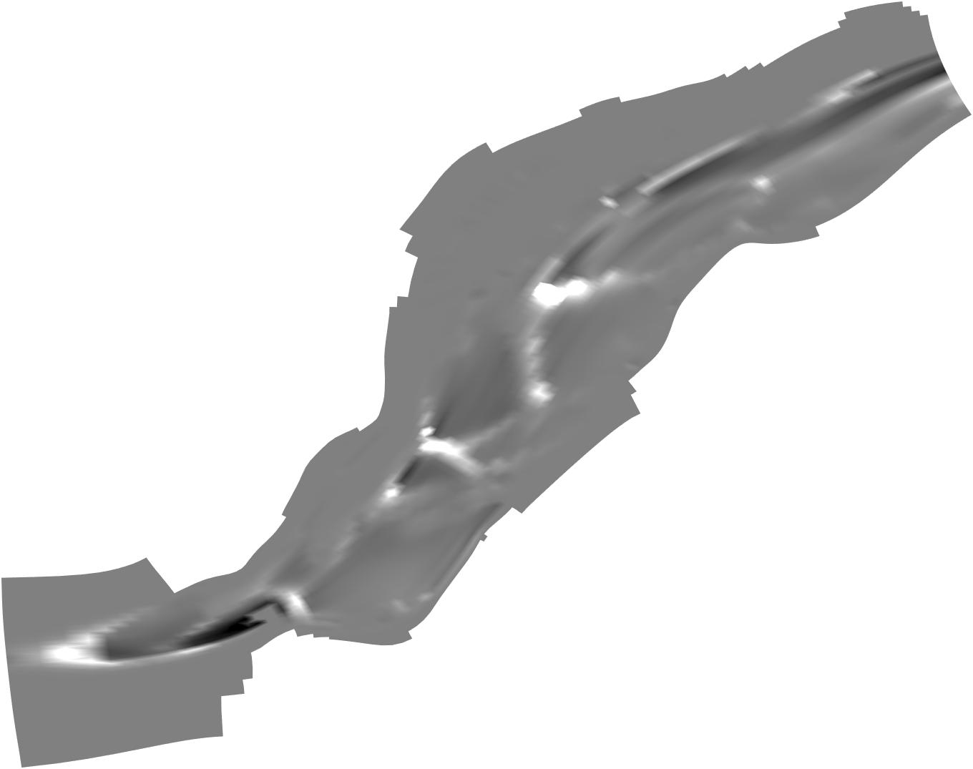
Estuarine morphodynamics forecast using a numerical model emulator based on deep learning methods. A first approach.
Study focus: Improve morphodynamics forecasts of high spatial and temporal resolutions numerical models.
How: using results of calibrated numerical models as input for deep learning models.
Numerical model
Delft3D – FLOW
Delft3D – MOR
Delft3D – FLOW
How to model morphodynamics?
Data (AI) Models
CNN

Slide 3


Estuarine morphodynamics forecast using a numerical model emulator based on deep learning methods. A first approach.
Numerical Model implementation (Delft3D)
Results generation
Organization of the datasets
Definition of the domain (grid and bathymetry);
Calibration;
Loading the numerical model outputs;
Automatically exporting the results as jpeg file.
Loading images datasets;
Split the data in training and testing datasets;
Training and testing
Definition of the training optimizer;
Definition of training and testing metrics.
Selection of the network architecture;
Boundary conditions.
Sources: The Python Logo | Python Software Foundation
GitHub - tensorflow/tensorflow: An Open Source Machine Learning Framework for Everyone

Slide 4
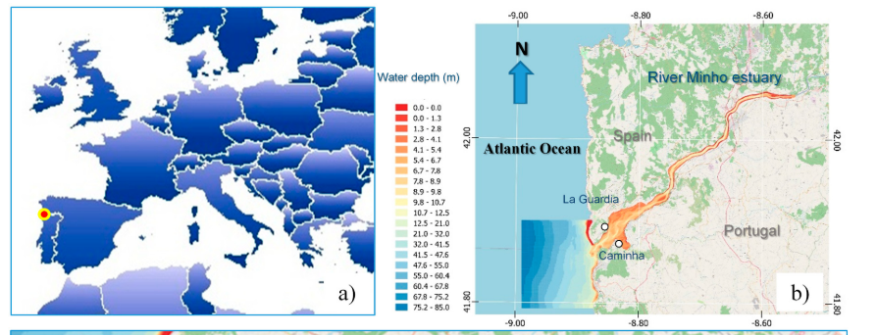
Study area
Figure 1: Map of the study area. a) Location of the Minho river estuary in Europe; b) Domain of the numerical model

Slide 5
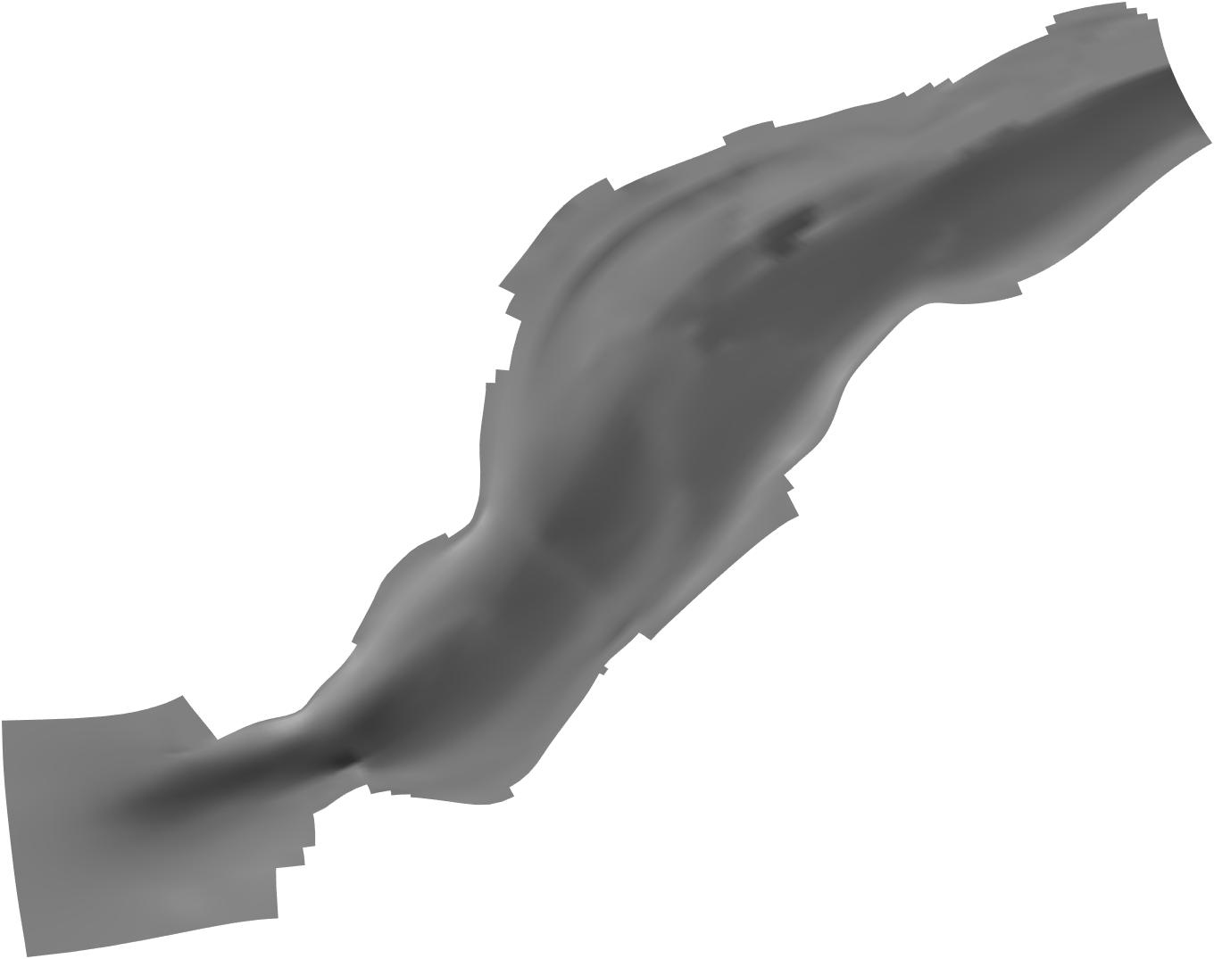
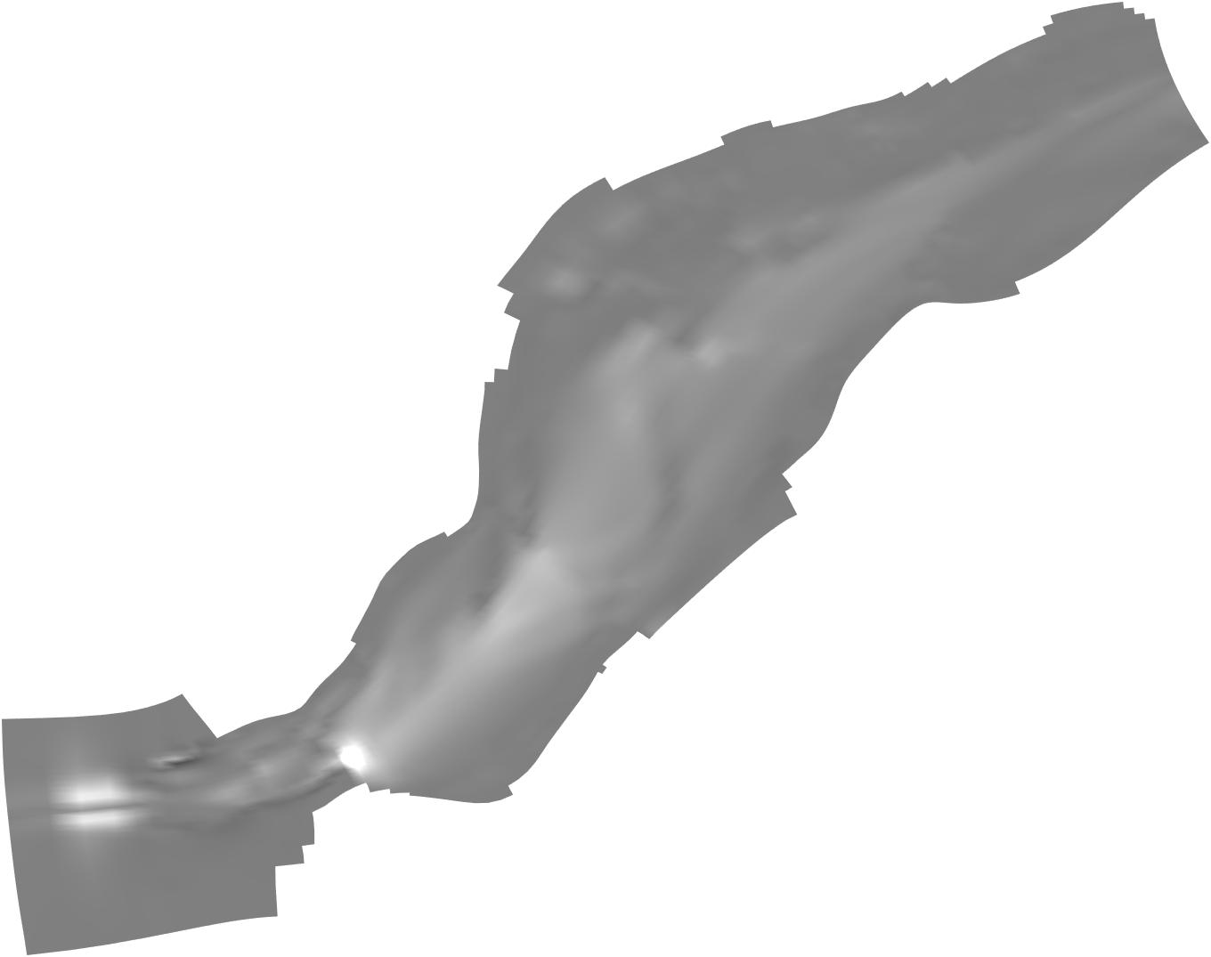
Convolutional Neural Network architecture
Squared depth averaged velocity
Rescaling
Conv
Conv
Conv
Legend
Conv
Convolution layer
Conv
2x2 stride convolution
Concat
Concat
Concat
Concat
Concatenate
Rescaling
Conv
Conv
Conv
Upsampling
Upsampling
Bottom shear stress
Conv
Relu
Conv
ReLU layer
Conv
Conv
Upsampling
Upsampling
Rescaling
Rescaling
Conv
Relu
Erosion / sedimentation
Rescaling

Slide 6
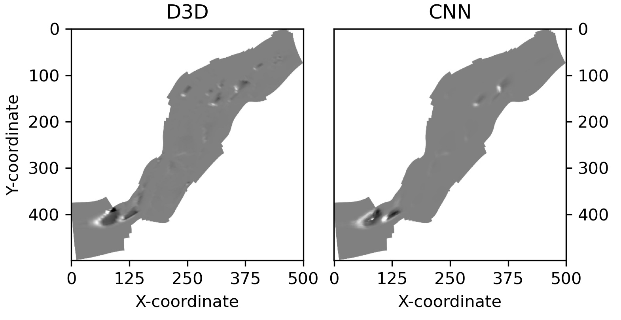

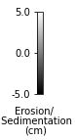
Results
Mean Structural Similarity Index (SSIM) = 84%
MAPE = 0.77%
The AI model simulated 6 days in 7 seconds, while the numerical model needed 12 minutes
Figure 2: Comparison between the numerical model and the CNN

Slide 7
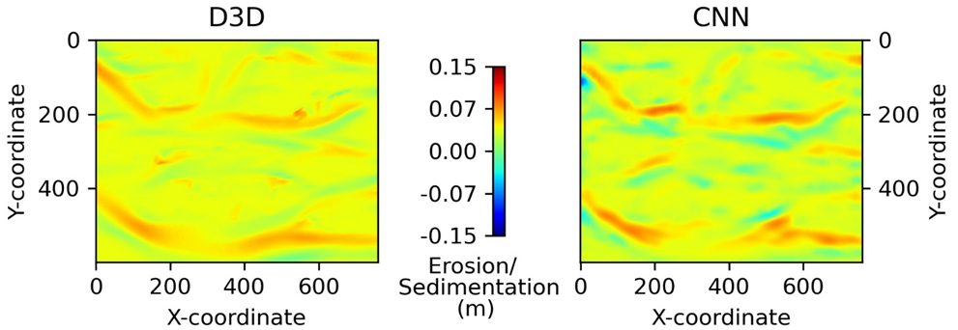
Results
Figure 3: Application of the CNN in a different domain (work submitted in May 2022.)

Slide 8
Conclusions
The emulator could reproduce the morphodynamics evolution of the estuary
The AI model was much faster than the numerical morphodynamic D3D component (D3D = 12 min, CNN = 7 sec).
The emulator presented a reasonable performance, however some configurations could be still improved;
CNN hyperparameters for an estuarine morphodynamic problem were successfully defined;

Slide 9
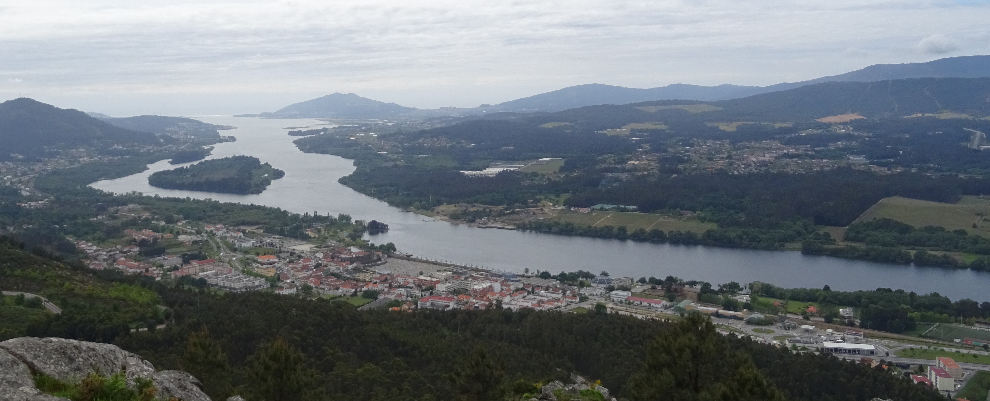



Acknowledgements
Questions, comments or sugestions?
Thank you all for your attention!
E-mail: id9257@alunos.uminho.pt
This contribution has been funded by the project Esco-Ensambles (PTDC/ECI-EGC/30877/2017), and Willian Weber de Melo received the doctoral Grant (SFRH/BD/151383/2021) financed by the Portuguese Foundation for Science and Technology (FCT), and with funds from the Ministry of Science, Technology and Higher Education, under MIT Portugal Program.

