Slide 1
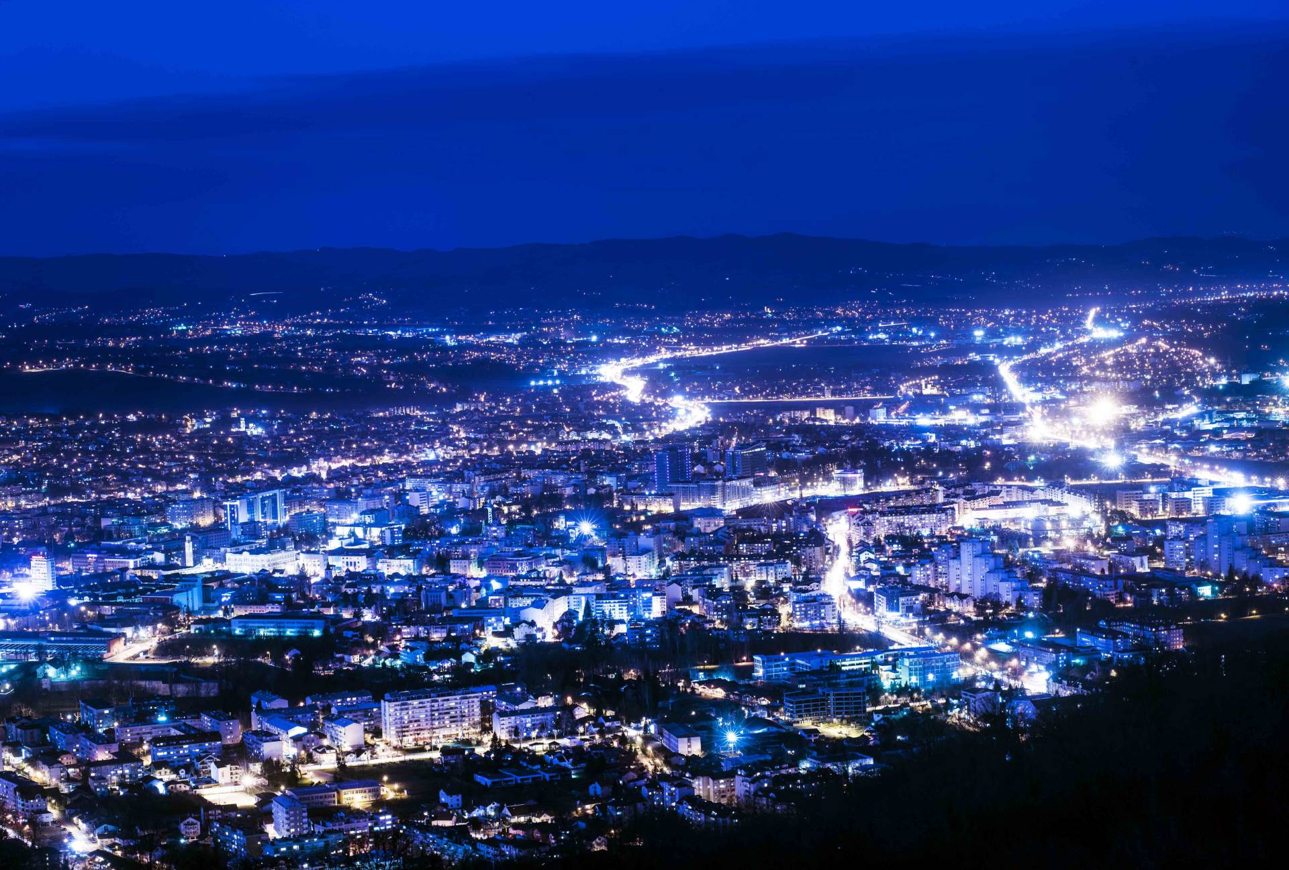



The potential of geothermal district heating in the city of Banja Luka, Bosnia and Herzegovina
The potential of geothermal district heating in the city of Banja Luka, Bosnia and Herzegovina
Petar Gvero, Einar Jón Ásbjörnsson, David Finger, Milovan Kotur, Xavier Musonye, Danijela Kardas, and Milan Pupcevic

Slide 2

District heating system in Banja Luka
Biomass and heavy oil based district heating system
Heated area - 1.350.000 m²
Number of clients (households and business) – 20.000
Only 35% users are covered by DHS, rest is based on the individual systems (boilers and stoves).

Slide 3
Fuel consumption for DHS in 2020/21 (t)
 | Heavy oil | Biomass (Eko-toplana)
October | 48,30 | 5.634,00
November | 136,00 | 10.662,00
December | 316,00 | 12.433,00
January | 432.00 | 13.195,00
February | 207,00 | 10.565,00
March | 58.00 | 10.790,00
April | 37,00 | 6.688,00
TOTAL | 1.234,30 | 69.967,00

Slide 4
Heat production in 2020/21
 | MWh |  |  | %
 | Heavy oil | Biomass | Total | Heavy oil | Biomass
October | 453 | 14.723 | 15.176 | 2,98 | 97,02
November | 1.279 | 29.692 | 30.971 | 4,13 | 95,87
December | 2.920 | 34.650 | 37.570 | 7,77 | 92,23
January | 4.072 | 36.209 | 40.281 | 10,11 | 89,89
February | 1.957 | 27.984 | 29.941 | 6,54 | 93,46
March | 546 | 29.215 | 29.761 | 1,83 | 98,17
April | 349 | 19.844 | 20.193 | 1,73 | 98,27
TOTAL | 11.576 | 192.317 | 203.893 | 5,68 | 94,32

Slide 5
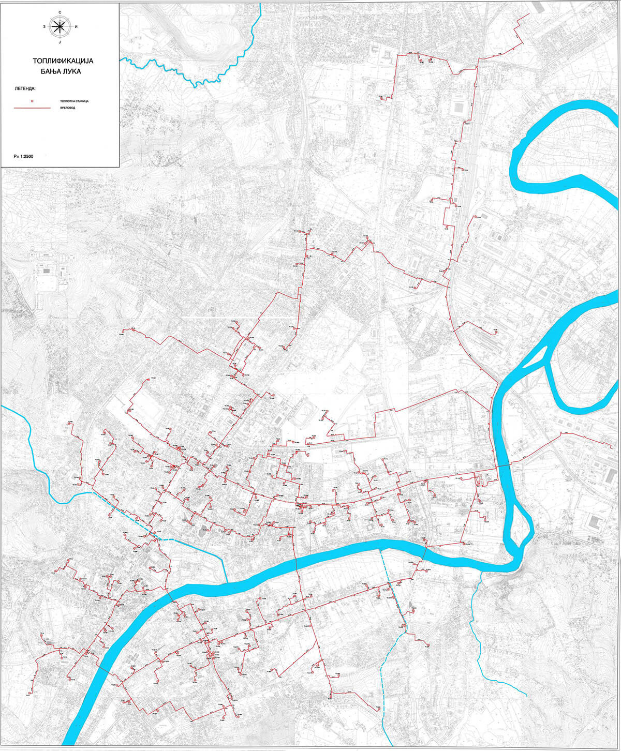
District heating network

Slide 6
District heating network
170 km of the network in total
  50 km primary network
  120 km secondary network
Primary network is ring based
Temperature regime: 110/90°C
It was previously 130/73°C

Slide 7
The existing air quality problems in Banja Luka (suburban)
Suburban areas are not connected to DHS
Large concentration of households with single chimneys – solid fuel based
According to Typology for the houses built in 1961-1970, average net surface of the heated space is 55,65 m² and specific energy need for intermitted heating is 464,90 kWh/m²/year

Slide 8
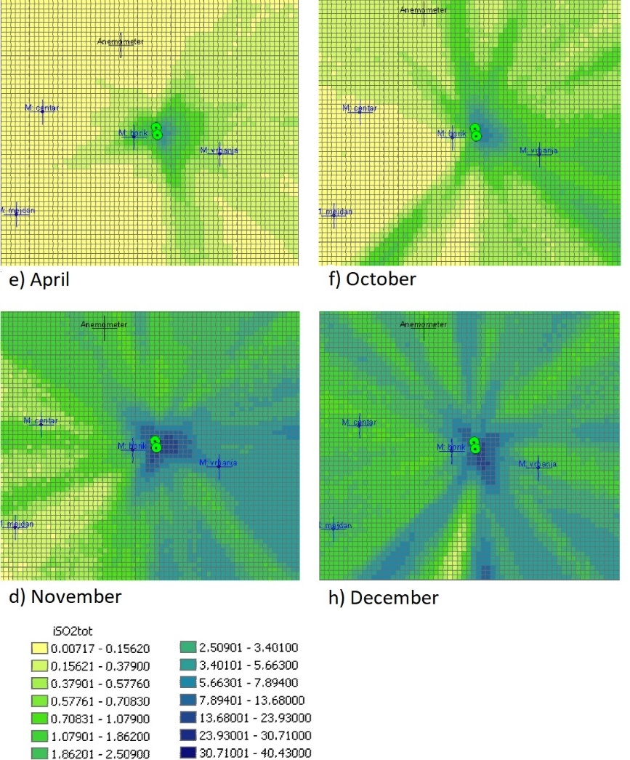
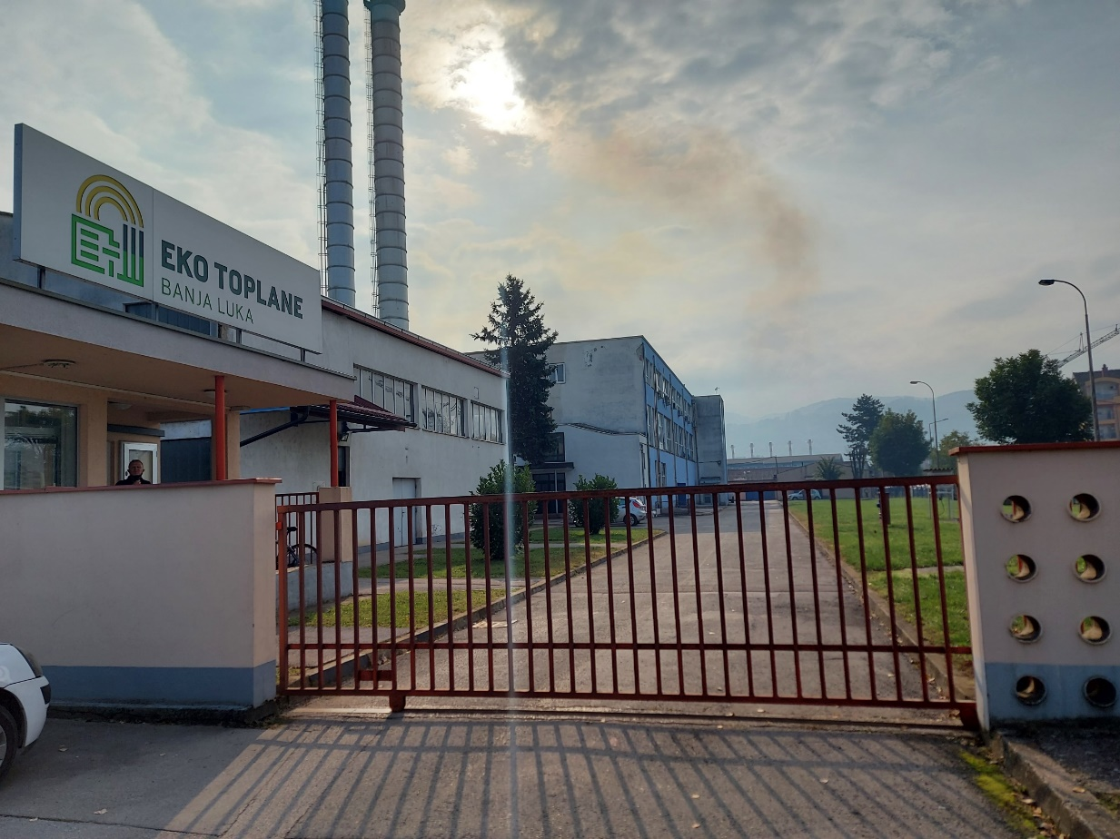
Dispersion model of SOx pollution before installation of biomass boilers

Slide 9
The existing air quality problems in Banja Luka (urban) – after installation of biomass boilers
Period of measurment | PM _{2.5*} |  |  | PM _{10*} |  |  | PM ₁₀ – treshold value 24 h
 | BAS EN 12341:2015 Standard gravimetric method |  |  | BAS EN 12341:2015 Standard gravimetric method
 | Paprikovac | Borik | Centar | Paprikovac | Borik | Centar
24.12.2021. | 30.21 | 34.63 | 32.50 | 42.95 | 48.02 | 45.42 | 50 μg/m³
25.12.2021. | 10.55 | 11.32 | 12.88 | 15.04 | 15.87 | 17.86
26.12.2021. | 12.94 | 14.13 | 17.43 | 18.40 | 19.83 | 24.08
27.12.2021. | 15.15 | 16.42 | 18.70 | 21.52 | 22.98 | 25.84
28.12.2021. | 24.95 | 28.46 | 26.54 | 35.31 | 39.34 | 37.21
29.12.2021. | 60.21 | 71.43 | 66.89 | 85.74 | 97.93 | 93.44
30.12.2021. | 84.38 | 89.83 | 110.03 | 119.83 | 125.55 | 152.49
31.12.2021. | 82.71 | 90.28 | 107.35 | 117.90 | 126.18 | 148.70

Slide 10
Geothermal potential of Bosnia and Herzegovina

Slide 11
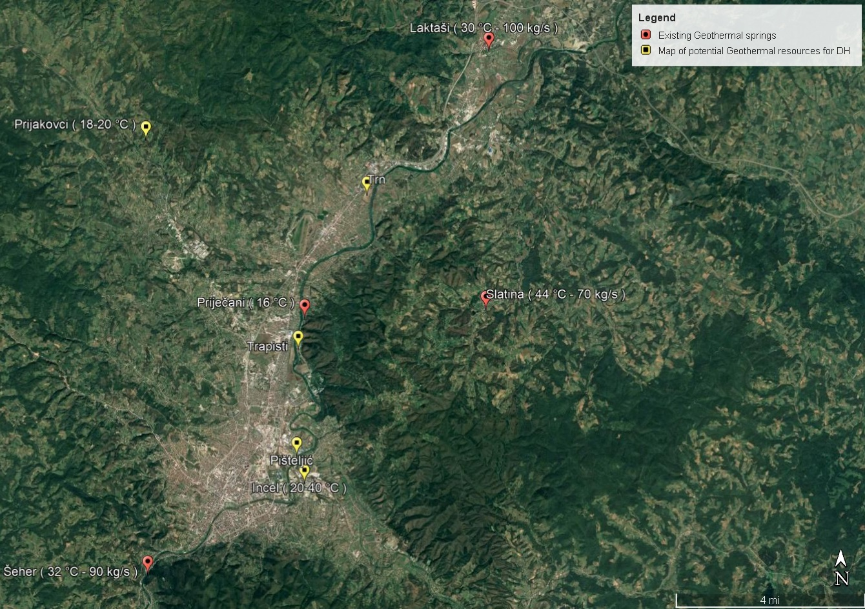
Banja Luka geothermal estimated potential
Surface waters – 63.42 MW (20-60 °C)
Deep drills – 98,28 MW – with expectation approx. 100-110 °C
In general direct use can achieve 315 MW of heat for the heating system (for double system 630 MWt)

Slide 12

Heavy Oil
Biomass
Geothermal Borehole

Slide 13
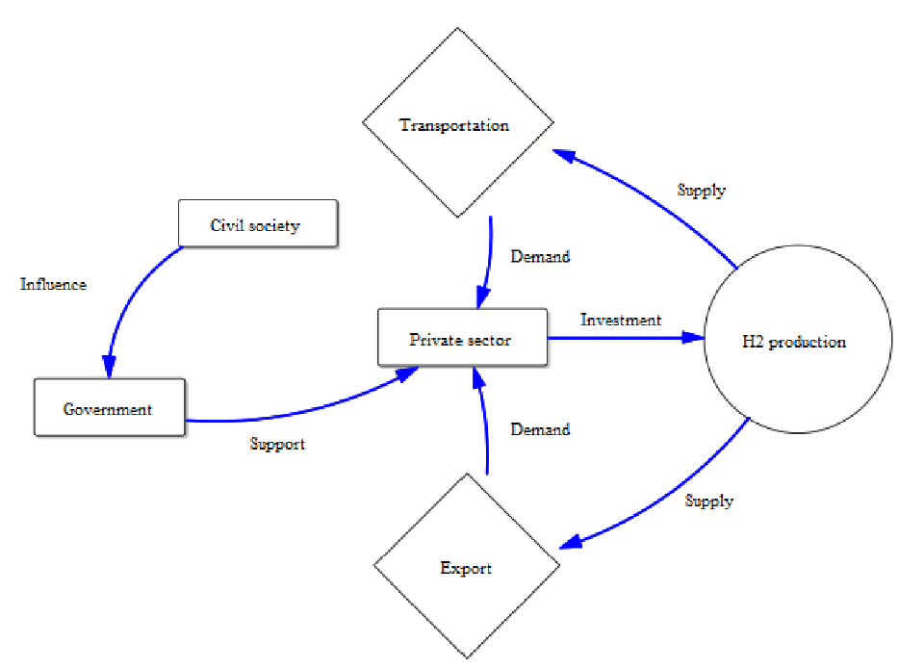
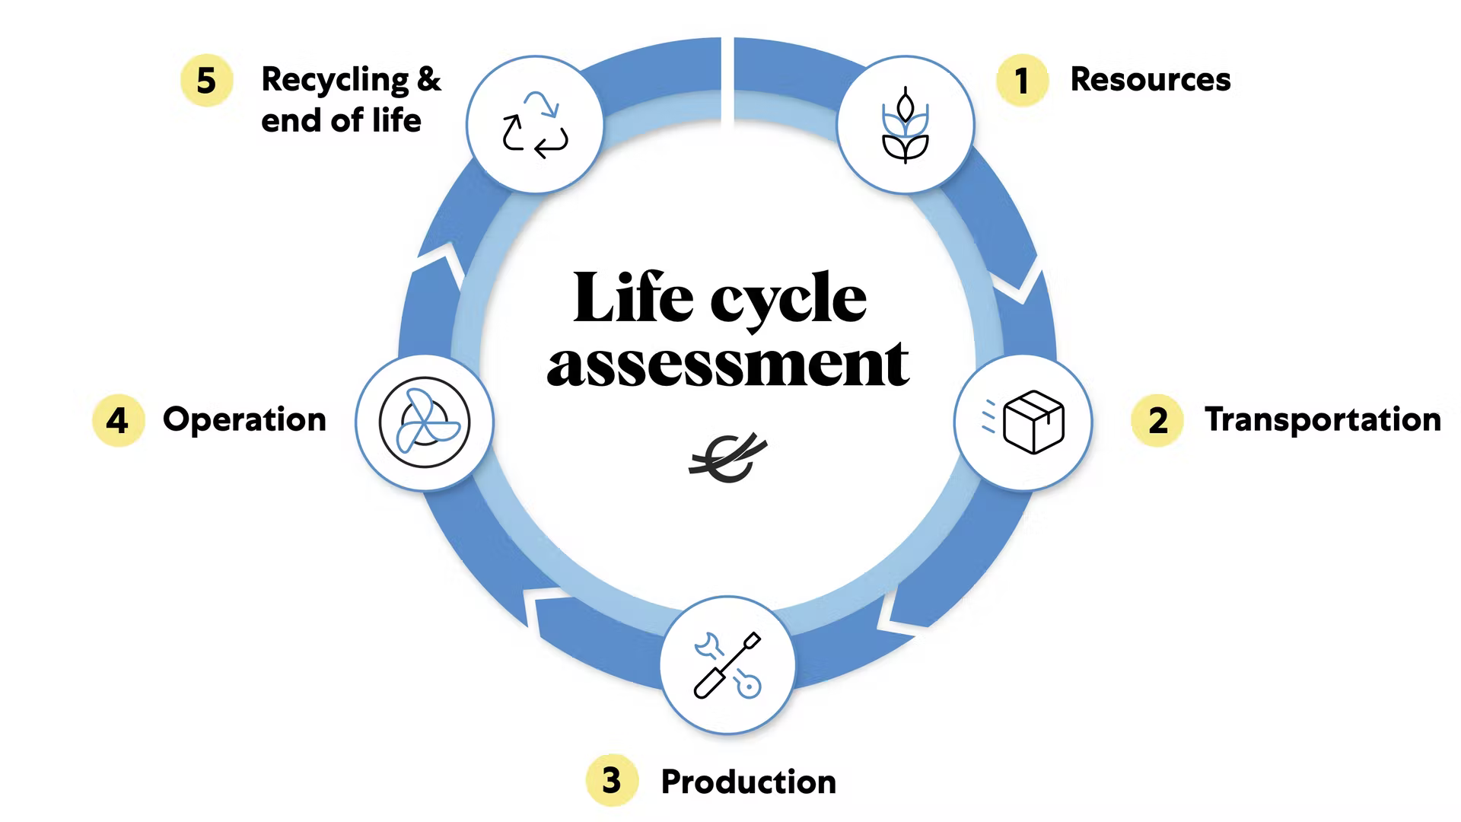
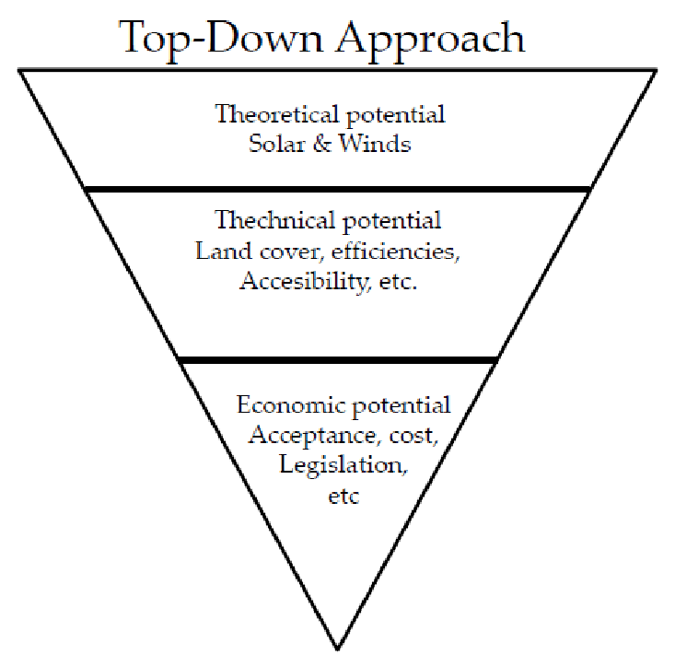
Methods to be applied
Causal Loop diagrams
  Semis structured interviews
Environmental Impacts Assessment
  Life Cycle Analysis
Feasibility studies
  Energy potential estimations

Slide 14
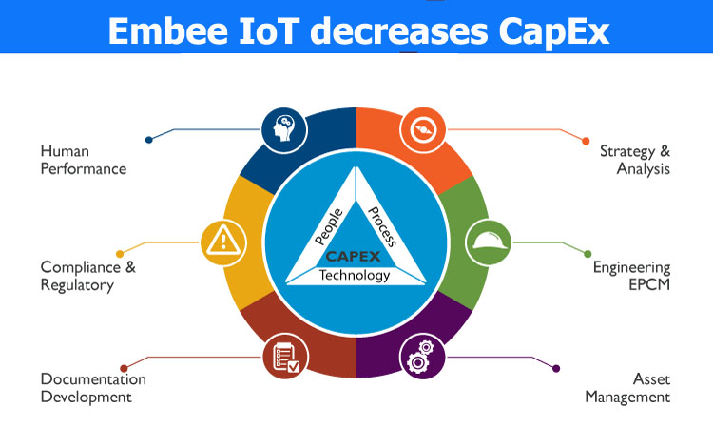
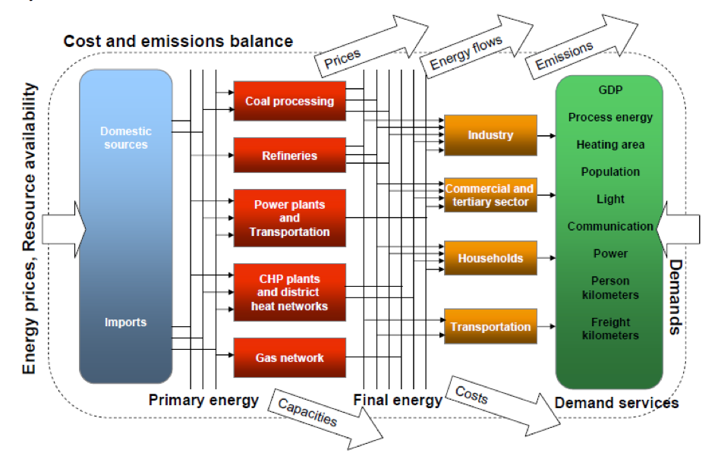
Methods to be applied
Socio Technical Analysis
  CAPEX
Energy modelling
  TIMES

Slide 15
Conclusions
Introduction of geothermal energy in DHS will:
  Spread the DHS network on the urban and suburban areas which are not covered at the moment
  Improve air quality
  Increase energy security and flexibility of the supply
  Increase energy independence
  Reduce energy costs
  Reduce GHG

Slide 16
Thank you for your attention
petar.gvero@mf.unibl.org

