Slide 1

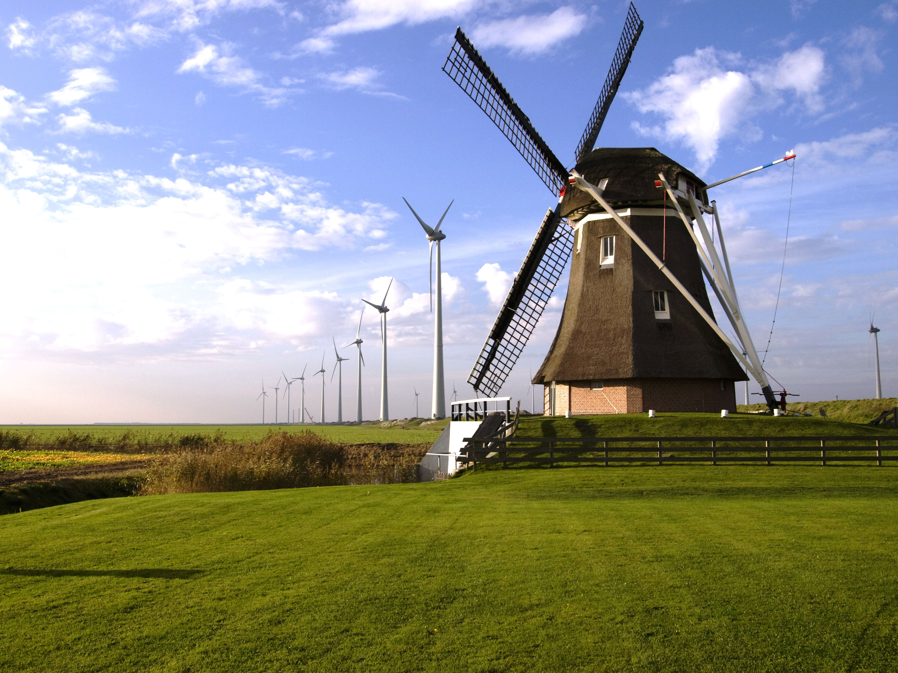

Probabilistic forecasting and scenario generation of pumped discharge in polder systems
Ties van der Heijden^{1,2}
Nick van de Giesen¹
Peter Palensky²
Edo Abraham¹
1: Department of Water Resources Management, Delft University of Technology
2: Department of Electrical Sustainable Energy, Delft University of Technology

Slide 2
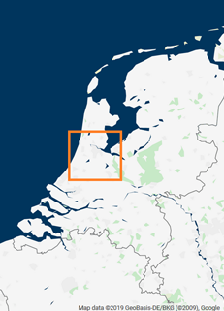
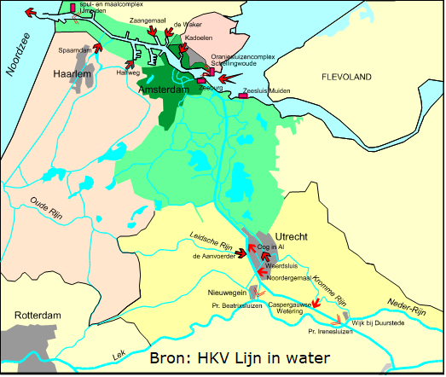
The NZK-ARK

Slide 3
Control of IJmuiden
Gates and a pumping station
500 m³s⁻¹, 260 m³s⁻¹ @ 6 MW
Water system constraints
Flood safety
Shipping
Complex objectives
Minimize flooding when inevitable
Use renewable energy as much as possible
≈ Minimize energy cost

Slide 4
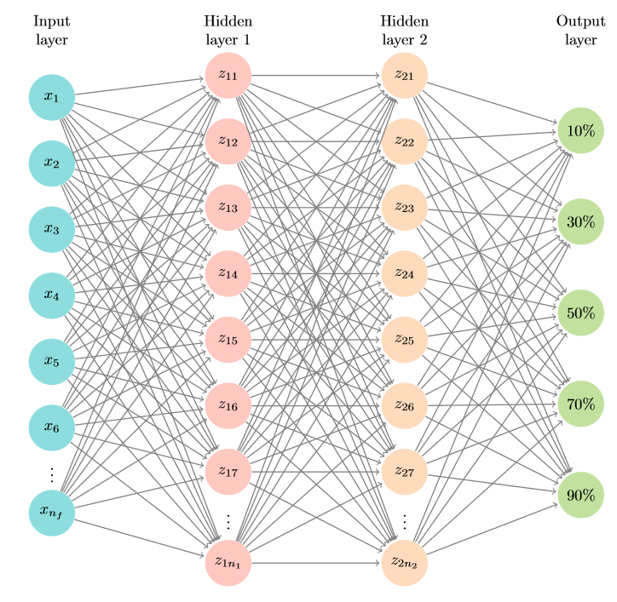
Probabilistic forecasting
Classic control: predict then optimize
Point forecast…wrong 100% of times
Suboptimal decision-making
Quantile regression: show me the value which is expected to be higher than the observation x% of the times
Pump discharge
Electricity prices
Electricity grid load
Solar irradiance
Probabilistic forecast -> scenario (tree) generation -> stochastic MPC
Source: van der Heijden, T., Palensky, P., & Abraham, E. (2021). Probabilistic DAM price forecasting using a combined Quantile Regression Deep Neural Network with less-crossing quantiles. In IECON 2021 – 47th Annual Conference of the IEEE Industrial Electronics Society: Proceedings

Slide 5
Features and hyperparameters
‘Classic’ neural network hyperparameters
N layers, nodes per layer, batch norm, l₂ regularization, batch size
‘Water balance’ features
Precipitation, evaporation, discharge
Only observed historic data
Features as hyperparameters
N lags, feature transformations, moving window size
Optimize with Tree of Parzen Estimators
Use a hold-out validation set for optimization

Slide 6
Non-parametric Bayesian Network
Directed Acyclic Graph
Sklar’s theorem
Bivariate PDF = 2 marginal PDF’s + a copula
Copula is parametrized by the rank correlation of the observed variables
User-defined dependency structure between variables
Samples that respect the forecast distribution AND observed correlation in data

Slide 7
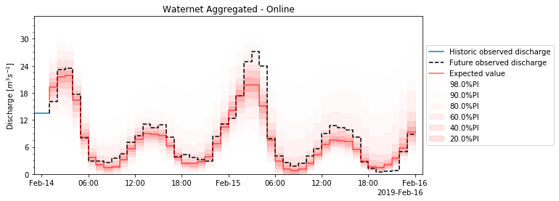
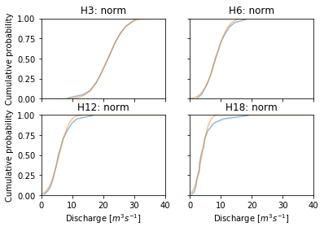
Results – CQR DNN

Slide 8
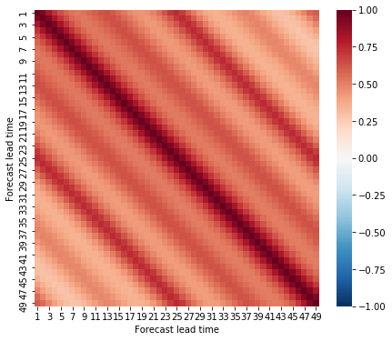
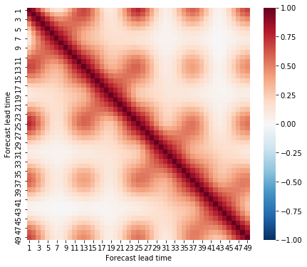
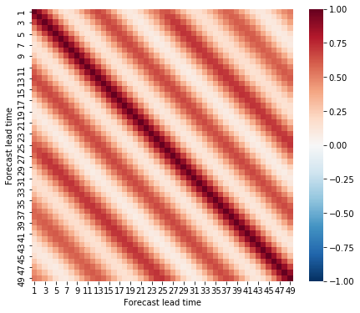
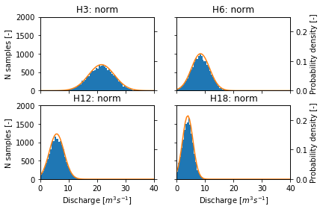
Results – Scenarios
Observed correlations
Scenario correlations
Structure 1
Scenario correlations
Structure 2

Slide 9
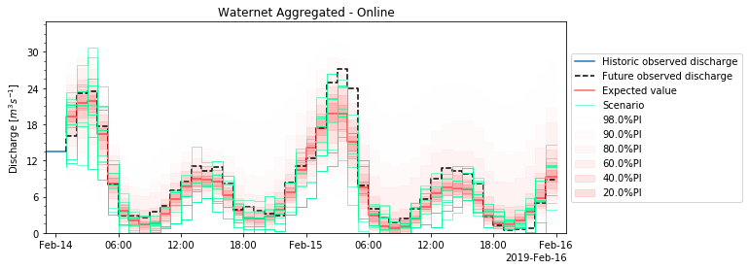
Results – Scenarios

Slide 10
Conclusion
Operationally low cost
Occasional feature- and hyperparameter optimization
Rank-correlation calculated beforehand
Flexible BN architecture
Marginal PDFs are easily changed
Structure can be changed to fit observed dependencies

Slide 11
Thanks!
Relevant material
van der Heijden, T., Lugt, D., van Nooijen, R., Palensky, P., Abraham, E. (2021). Multi-market Demand Response from pump-controlled open canal systems: an economic MPC approach to pump scheduling. Under review at IWA Journal of Hydroinformatics.
van der Heijden, T., Palensky, P., Abraham, E. (2021). Probabilistic DAM price forecasting using a combined Quantile Regression Deep Neural Network with less-crossing quantiles. In IECON 2021 – 47th Annual Conference of the IEEE Industrial Electronics Society: Proceedings
van der Heijden, T., Palensky, P., van de Giesen, N., Abraham, E. (2022). Day Ahead Market price scenario generation using a Combined Quantile Regression Deep Neural Network and a Non-parametric Bayesian Network. Accepted for Powercon 2022, Malaysia.
van der Heijden, T., Lago, J., Palensky, P., Abraham, E. (2021). Electricity Price Forecasting in European Day Ahead Markets: a Greedy Consideration of Market Integration. IEEE Access. Available: https://doi.org/10.1109/ACCESS.2021.3108629

