Slide 1










Role and contribution of eustasy as a triggering force of the onset of Oceanic Anoxic Events:
A case study of the early Aptian OAE1a in the Tethyan margin of Tunisia
Panagiotis Athanasios Giannenas, Cécile Robin, François Guillocheau, Emmanuelle Vennin, and Benjamin Gréselle
Is there a relation between OAE1a and early Aptian global maximum floodings?
What is the response of S2S systems to these global perturbations?
EGU, Vienna, 27th May 2022
The project has received funding from the European Union's Horizon 2020 research and innovation programme under the Marie Sklodowska-Curie Grant Agreement No 860383 (https://www.s2s-future.eu/).
Abstract: EGU22-6309

Slide 2
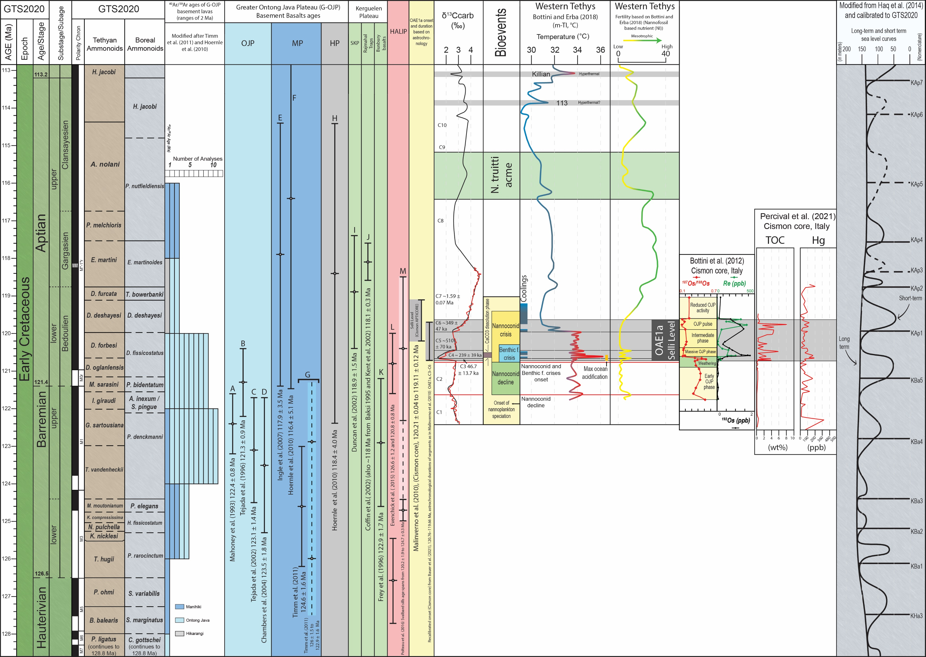
Early Aptian Oceanic Anoxic Event 1a
Volcanism
Long phase of activity
Periodic peak phases
Emissions of volcanic CO₂
OAE1a= (strongest?) peak
Global crises
Global warming, hyperthermal
Black shales
  Dysoxia/anoxia
  OMZ expansion
  Sluggish circulations
Biotic crises
Global isotopic/element anomalies
Eustasy
Global major rapid sea level rise (>60m, Ray et al., 2019)
Ontong Java volcanics volume + glacio-eustasy (e.g. Davies et al., 2020)
(Chronology after Malinverno et al. 2010. Onset recalibrated based on Bauer et al. 2021)
Synthesis of nannofossil-based nutrient (NI) and temperature (m-TI) variations reconstructed in the western Tethys

Slide 3
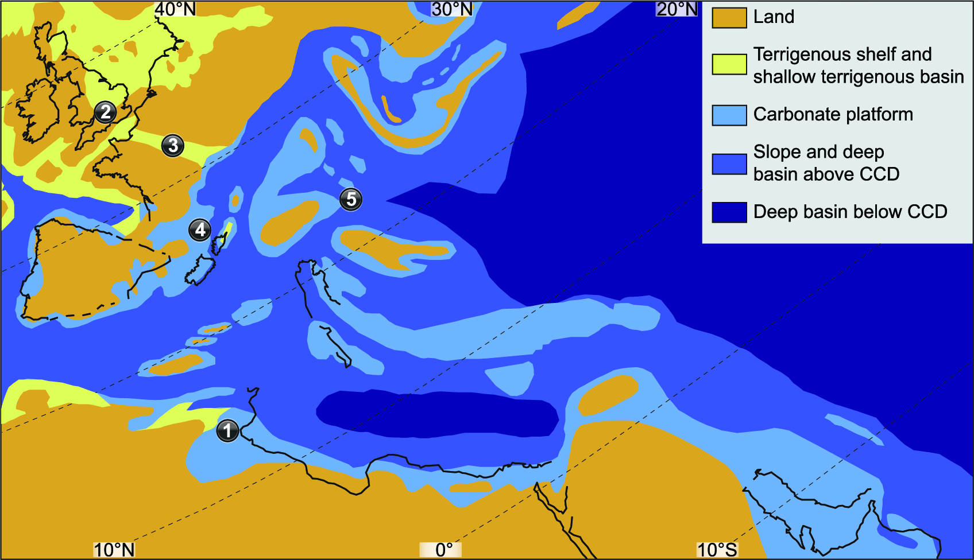
Early Aptian Oceanic Anoxic Event 1a
Magmatism
Long phase of activity
Periodic peak phases
Emissions of volcanic CO₂
OAE1a= (strongest?) peak
Global crises
Global warming, hyperthermal
Black shales
  Dysoxia/anoxia
  OMZ expansion
  Sluggish circulations
Biotic crises
Global isotopic/element anomalies
Eustasy
Global major rapid sea level rise (>60m, Ray et al., 2019)
Ontong Java volcanics volume + glacio-eustasy (e.g. Davies et al., 2020)
(Chronology after Malinverno et al. 2010. Onset recalibrated based on Bauer et al. 2021)
Synthesis of nannofossil-based nutrient (NI) and temperature (m-TI) variations reconstructed in the western Tethys
Early Aptian palaeogeographic map modified after Godet et al. 2014 with paleogeography after modifications of Steuber et al. 2005 based on original map of: Masse, J. P. et al. in Atlas Tethys Palaeoenvironmental Maps (eds Dercourt, J., Ricou, L. E. & Vrielynck, B.) (BEICIP FRANLAB, Rueil-Malmaison, 1993).

Slide 4
Early Aptian Oceanic Anoxic Event 1a
Magmatism
Long phase of activity
Periodic peak phases
Emissions of volcanic CO₂
OAE1a= (strongest?) peak
Global crises
Global warming, hyperthermal
Black shales
  Dysoxia/anoxia
  OMZ expansion
  Sluggish circulations
Biotic crises
Global isotopic/element anomalies
Eustasy
Global major rapid sea level rise (>60m, Ray et al., 2019)
Ontong Java volcanics volume + glacio-eustasy (e.g. Davies et al., 2020)
(Chronology after Malinverno et al. 2010. Onset recalibrated based on Bauer et al. 2021)
Synthesis of nannofossil-based nutrient (NI) and temperature (m-TI) variations reconstructed in the western Tethys

Slide 5
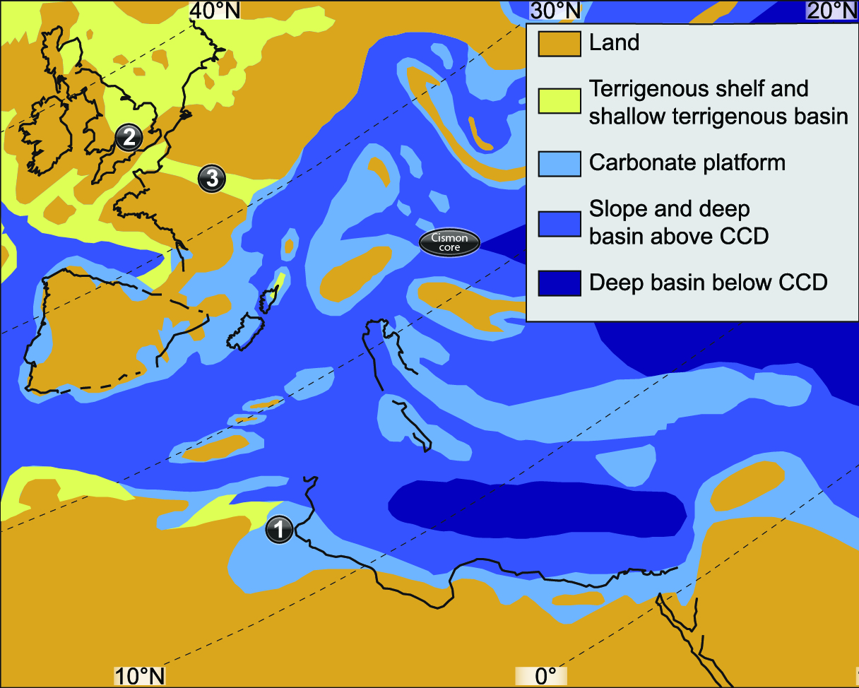
Case study
Early Aptian palaeogeographic map
What is the response of S2S systems by these global perturbations?
Tunisia
  Stable epicontinental area
  Aim: tracking migration of clastic system to understand OAE1a effects
Map modified after Godet et al. 2014 with paleogeography after modifications of Steuber et al. 2005 based on original map of: Masse, J. P. et al. in Atlas Tethys Palaeoenvironmental Maps (eds Dercourt, J., Ricou, L. E. & Vrielynck, B.) (BEICIP FRANLAB, Rueil-Malmaison, 1993).

Slide 6
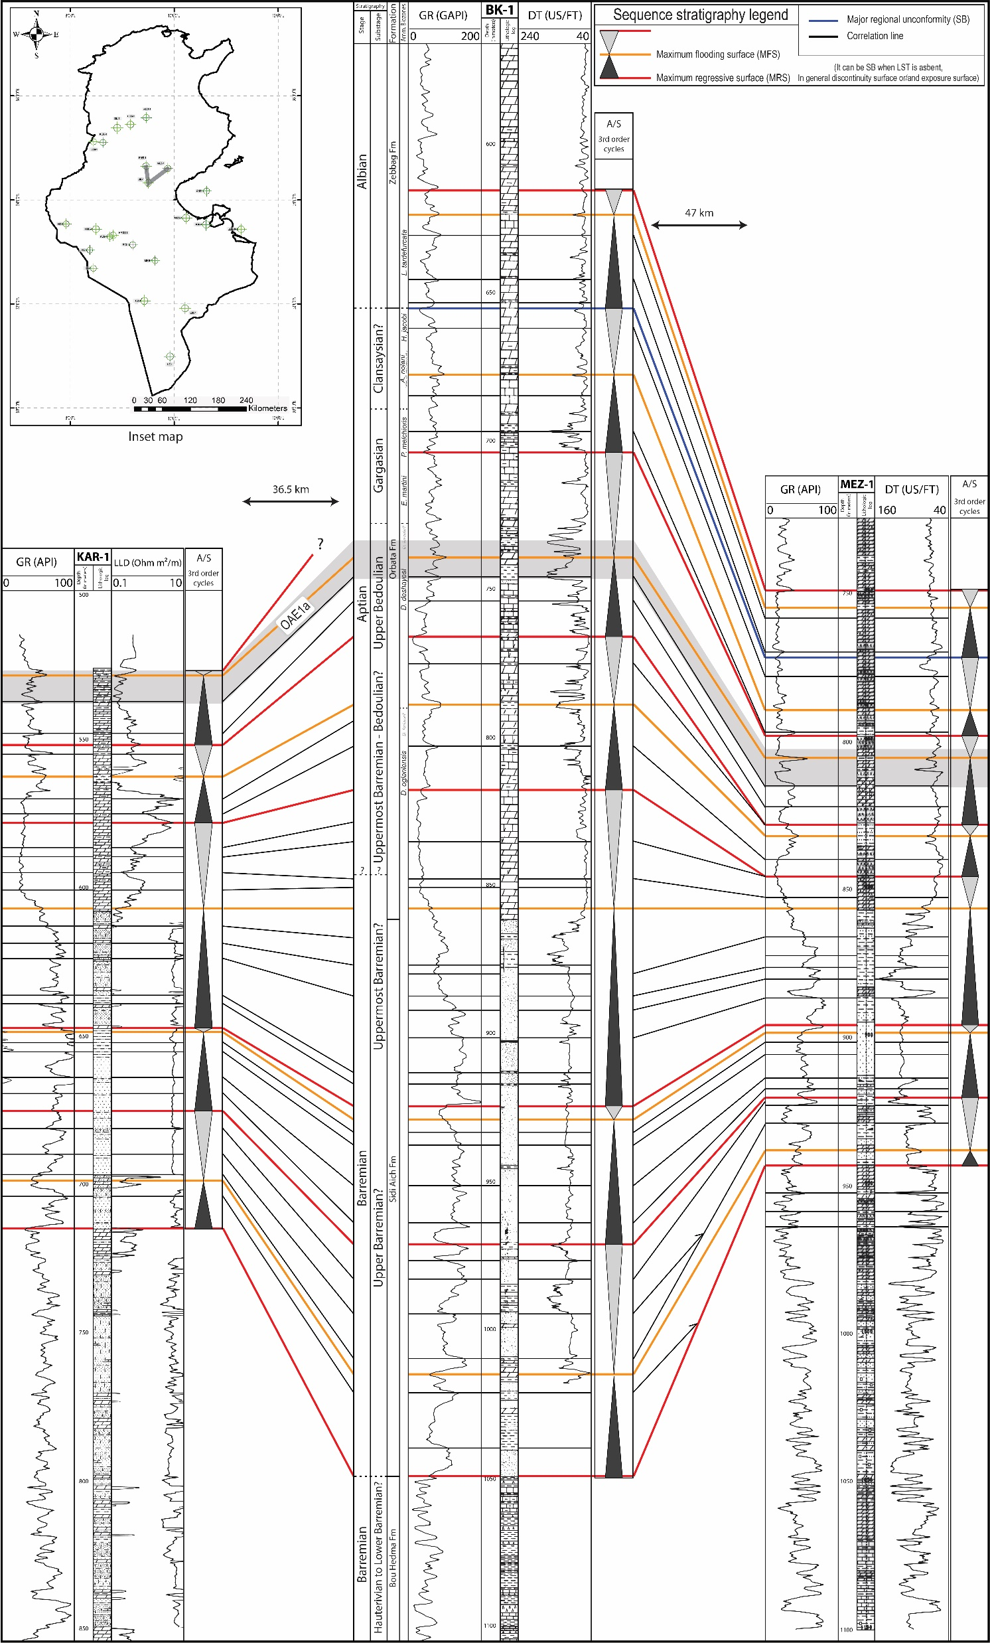
Results – Tunisia
40km
Object and methods
Sections
~12 outcrops
~1000 subsurface wells
Sedimentology – Stratigraphy
Wireline signal
Lithology
Dep. environments
Relative sea level change
Correlation framework:
Biostratigraphy
Sequence stratigraphy
Chemostratigraphy
Orbitolinoids
(in Hfaiedh et al. 2013)
Reference well
Outcrop in Godet et al. (2014) after Hfaiedh et al. (2013)
Nearby
outcrop
Reference well
Central Tunisia correlation panel

Slide 7
Results – Tunisia
40km
Timing of clastic sedimentation
Stratigraphic reinterpretation
  Clastics (SE Tunisia) are Barremian
  Aptian=carbonates
Shift from clastics to carbonates
  A response to pre-OAE1a crisis?
  First warming?
  Aridification due to OJP paroxysm?
Orbitolinoids
(in Hfaiedh et al. 2013)
Reference well
Aptian carbonates
Outcrop in Godet et al. (2014) after Hfaiedh et al. (2013)
Nearby
outcrop
Upper Barremian clastics
Reference well
Central Tunisia correlation panel

Slide 8
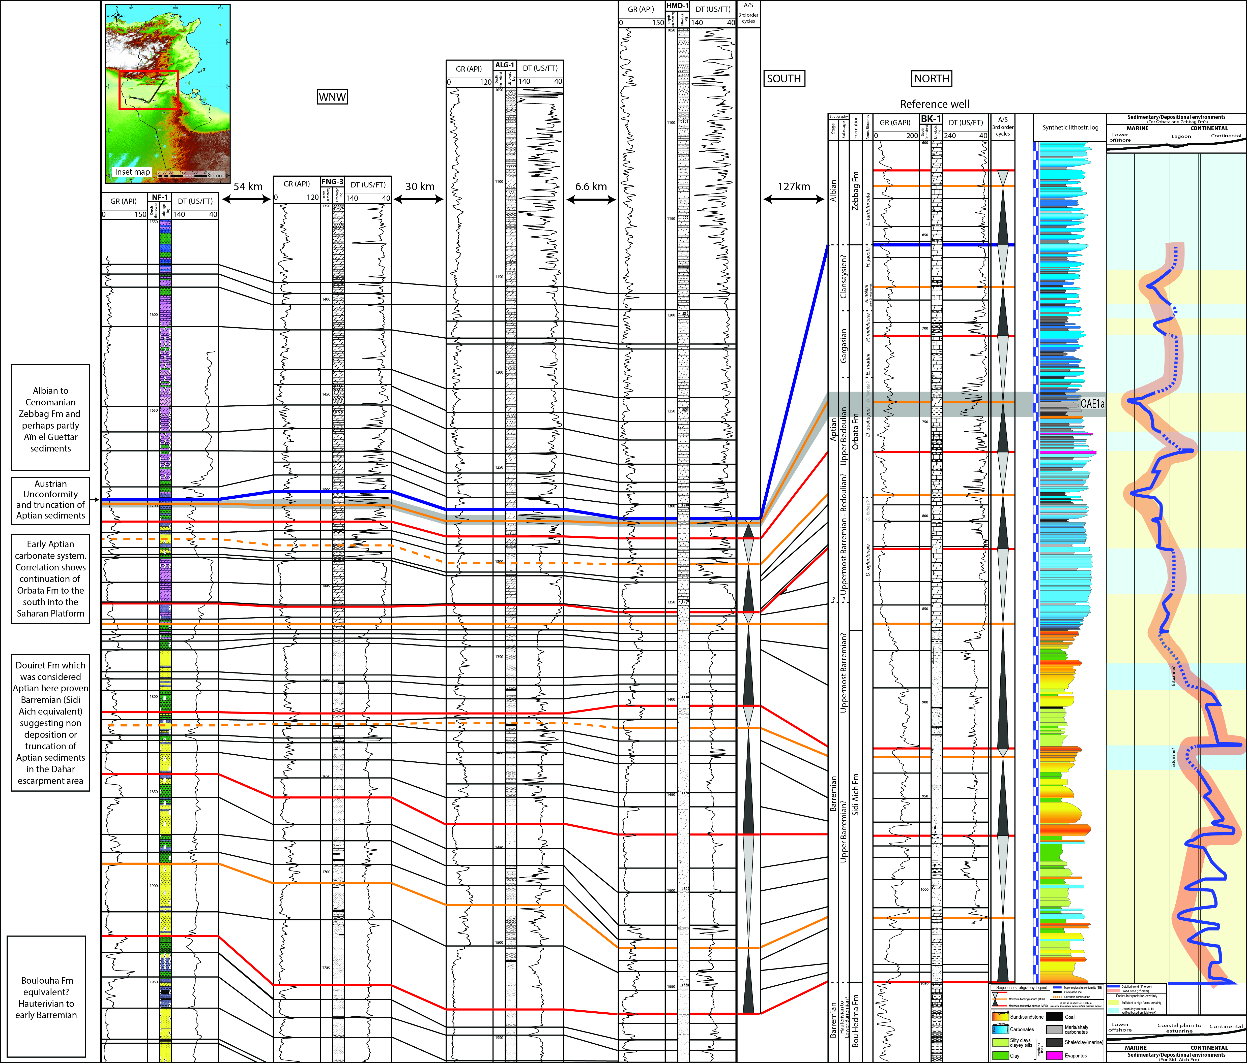
Results – Tunisia
From central Tunisia to Saharan Platform
correlation panel
Reference well
Timing of clastic sedimentation
Stratigraphic reinterpretation
  Clastics (SE Tunisia) are Barremian
  Aptian=carbonates
Shift from clastics to carbonates
  A response to pre-OAE1a crisis?
  First warming?
  Aridification due to OJP paroxysm?
Aptian carbonates
Upper Barremian clastics

Slide 9
Results – Tunisia
40km
Orbitolinoids
(in Hfaiedh et al. 2013)
Identification of OAE1a
  Lithology
  Wireline signal
  δ¹³C
Regional scale MFS
Synchronous occurrence
Reference well
Outcrop in Godet et al. (2014) after Hfaiedh et al. (2013)
Nearby
outcrop
Reference well
Central Tunisia correlation panel

Slide 10
Discussion and future work
Discussion
Clastics responded but in different time than expected
OAE1a corresponds to local MFS
Multiple similar records across the globe
>> global eustatic signal of high amplitude sea level rise
  Future work
With a robust sea level framework established:
Move to northern and cooler Tethyan domains
Clastic dominated (no carbonates)
UK Wessex – Weald basins, Paris basin
Sea-level signal Vs perturbations of source area (S2S)
Early Aptian palaeogeographic map
TERRIGENOUS
Continental-Delta
Weald facies
Map modified after Godet et al. 2014 with paleogeography after modifications of Steuber et al. 2005 based on original map of: Masse, J. P. et al. in Atlas Tethys Palaeoenvironmental Maps (eds Dercourt, J., Ricou, L. E. & Vrielynck, B.) (BEICIP FRANLAB, Rueil-Malmaison, 1993).
CARBONATE
Platforms

Slide 11

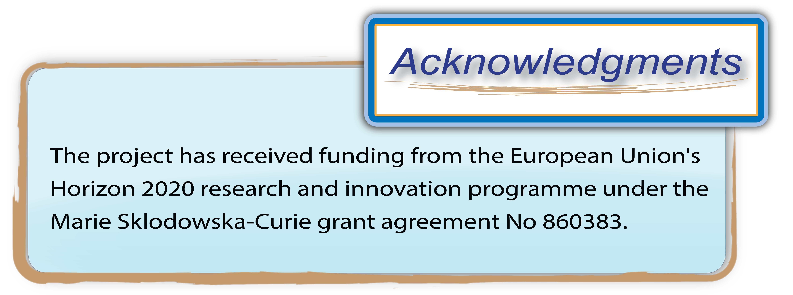
Thank you for your attention!

