Slide 1

SWAT+ application to a small catchment for NSWRM assessment
Amro Negm*, Paolo Gaini, Enrico Antonio Chiaradia, and Claudio Gandolfi
Department of Agricultural and Environmental Sciences - Production, Landscape, Agroenergy, University of Milan
*E-mail: amro.negm@unimi.it

Slide 2
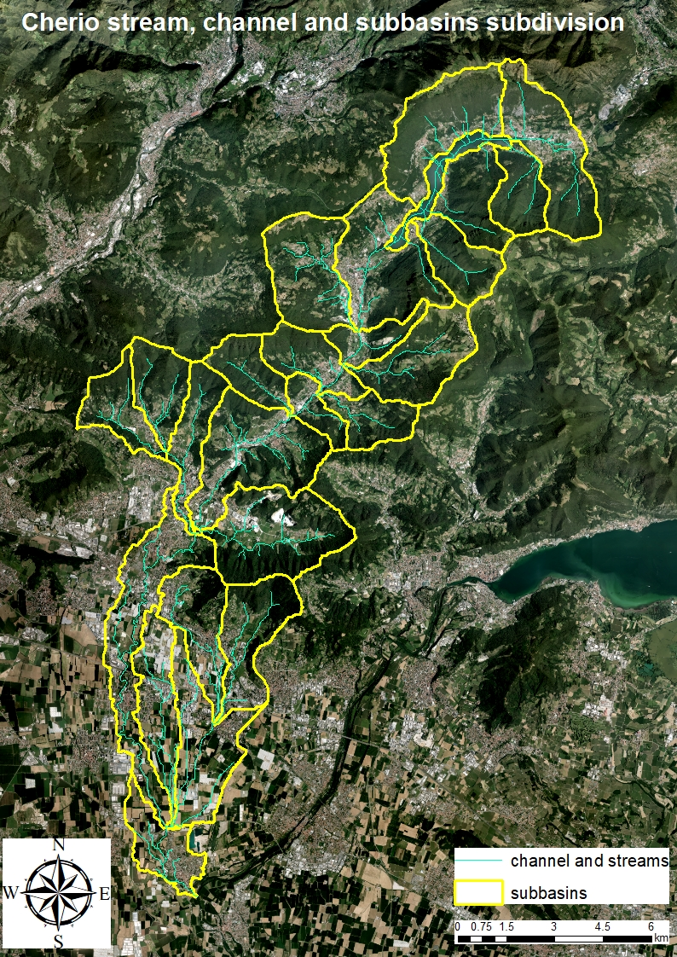
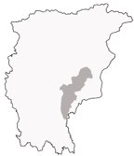
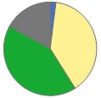
The project objective
Province of Bergamo
Using SWAT+ model to have a better understanding of the Natural/Small Water Retention Measures (NSWRMs) towards strategies to retain and re-use water and nutrients in small agricultural catchments across different soil-climatic regions in Europe.
Catchment of the Cherio river:
Superficial area:​
153 km²​
Lake of Endine:
2.18 Km²
Altitude:​
142 – 1380 m s.l.m. ​
Average annual precipitation:​
840 mm​
Water bodies
2%
Urban
17%
Agriculture
39%
Forest
42%

Slide 3
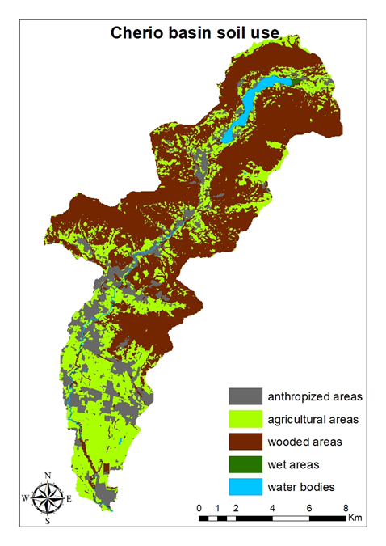
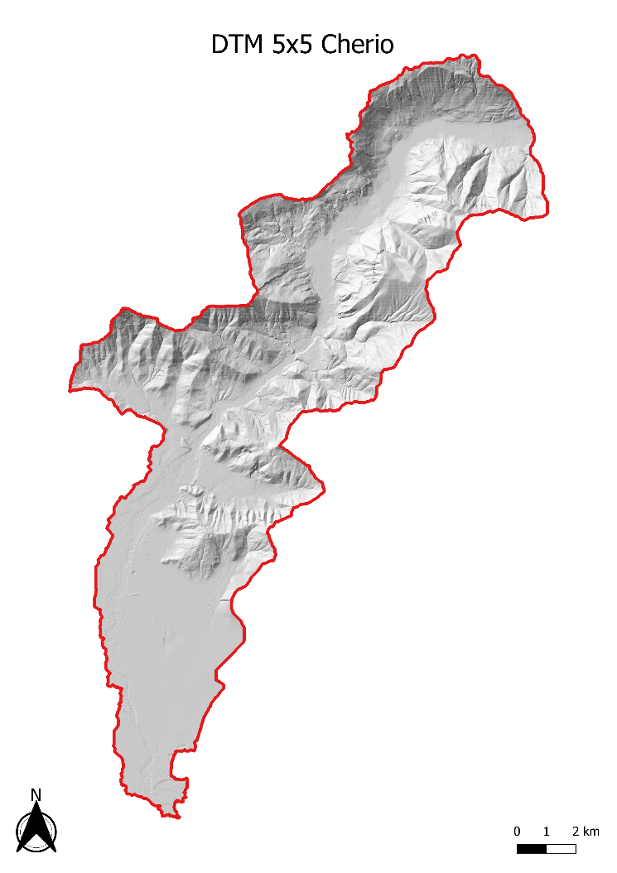
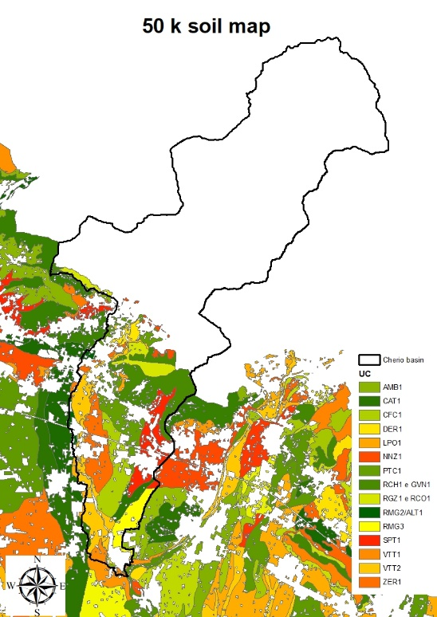
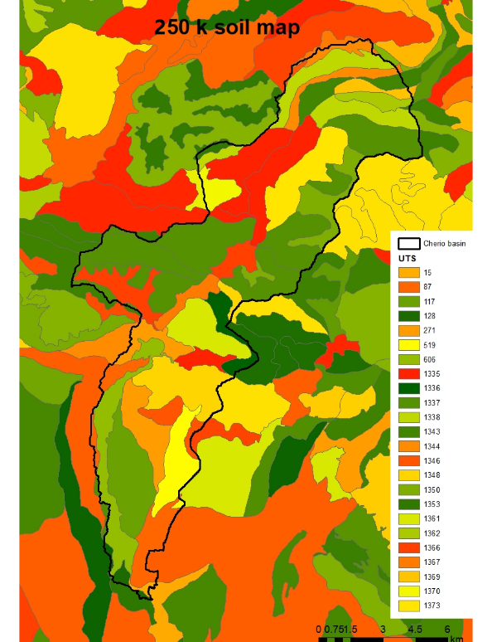
Input for the SWAT+ model: Spatial data
LOSAN data bank
DUSAF 2018

Slide 4
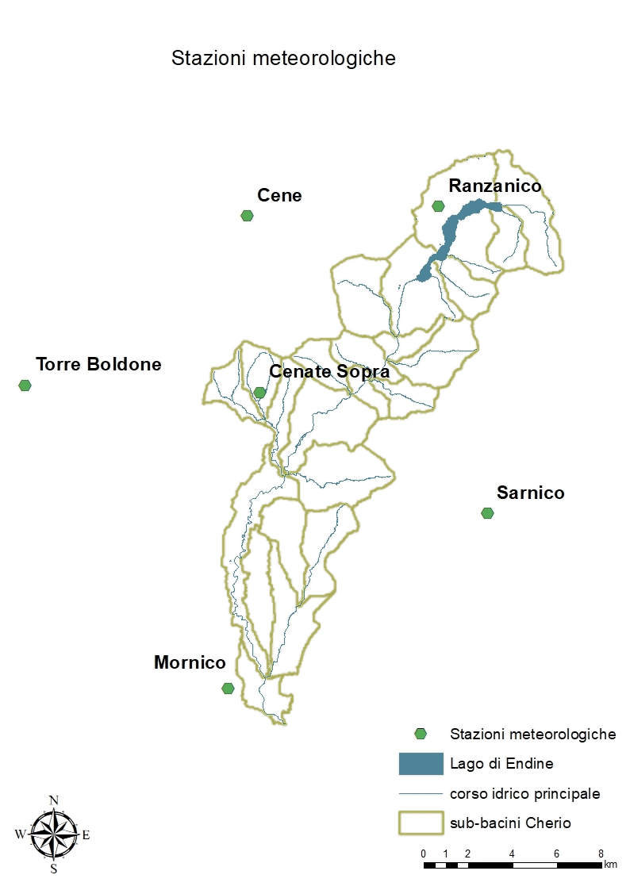
Meteorological Stations
Input for the SWAT+ model: Meteorological variables
SWAT+ requires several meteorological inputs including:
Precipitation (mm),
Relative humidity (fraction),
Minimum and maximum temperature (°C),
Solar radiation (MJ/m2),
Wind speed (m/s).
The data were collected and analyzed for the period from 2002 to 2020. As the observed climate data have many gaps, the missing data were filled from the ERA5 dataset.
However, we have long data series (2002-2020), only the meteorological data recorded between 2013-2020 was used as it is more robust as will be described later.

Slide 5
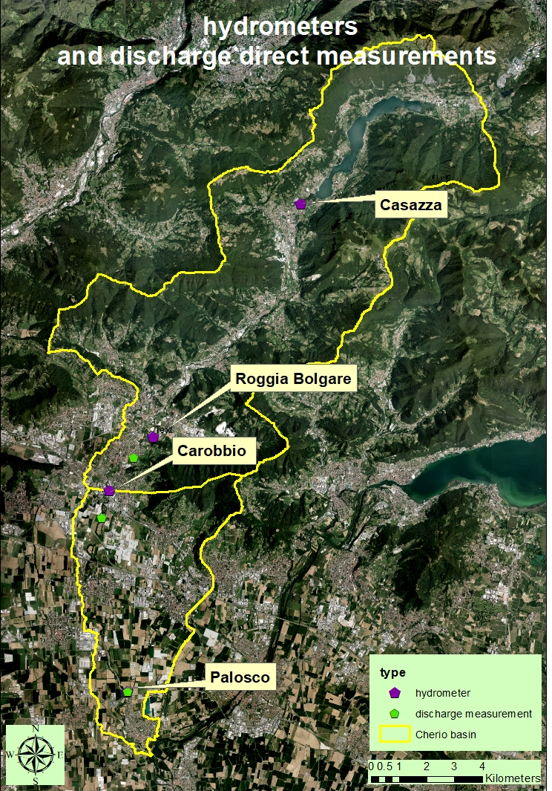
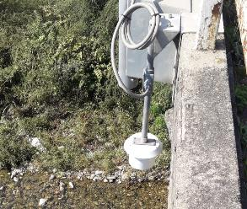
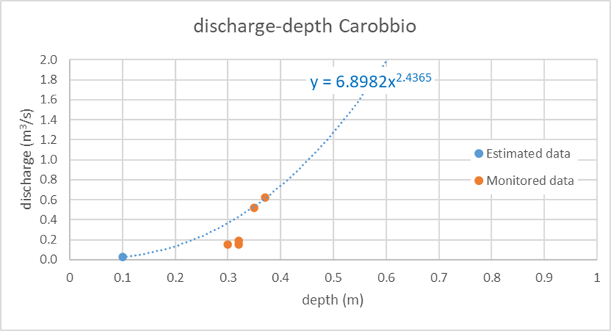
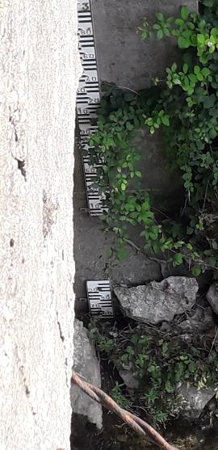
Hydrometric observations

Slide 6
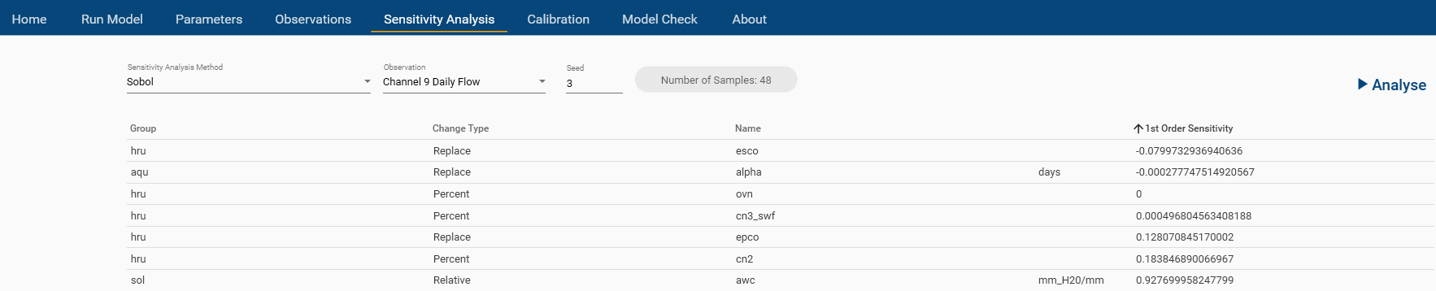
Preliminary results: Simulation and Calibration
The hydrological outputs of the model include several estimates such as evaporation, transpiration, surface runoff, groundwater recharge, and flow.
The measured discharge gets calibrated according to observations.
Examples of some parameters that tested for sensitivity: curve number (CN2), plant uptake compensation factor (EPCO), and available water capacity of the soil layer (AWC).
Sensitivity analysis of hydrological parameters affecting simulated flow (performed using SWAT+ toolbox)

Slide 7
Preliminary results: Simulation and Calibration
The last result obtained for calibrating the flow data for Carobbio was of NSE = 0.2. Still NSE will be improved in the future simulation

Slide 8
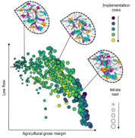
Mapping measures and indicators of NSWRM using SWAT+
Several measures can be applied to the basin using the SWAT model, here are only few examples described
Retention/detention ponds: Mapping of retention and detention ponds with a focus on different functionalities, e.g. retention of excess water during flood events. Crop rotation:
A crop rotation can be implemented in the southern part of the watershed where agriculture is dominant. Rotation can be done between corn (summer) and Alfalfa (winter). The rotation can be performed through the management table or decision table by defining the plant and harvesting data or by heat units. The data required for this part is the name of the crop, year of plantation/harvesting, and coordinates (long, lat).
Terraces:
Terraces can be present in our landscape but in most cases, they were removed or modified by woodland. However, some terraces get recovered near the urban areas (still need to be located where exactly it is located).

Slide 9
The calibration of the model needs to be improved by having a better investigation for:
If the local meteorological data, particularly precipitation, would improve the simulation results or not.
Detailed analysis for single rainfall events could be used to calibrate simulated flow with observation.
Adding more measurements of discharge data along the Cherio river
The measures and indicators of NSWRM measure mapping will be implemented after identifying its location
Conclusions and
Future work

Slide 10
Amro Negm, Ph.D.
Postdoctoral Fellow, University of Milan
Remotely based in Calgary, Canada
Phone: +1 (403)874-0030
E-mails: amro_negm@hotmail.com
amro.negm@unimi.it

