Slide 1



Assessing the physical controls of simulated drain flow dynamics
Hafsa Mahmood¹
Raphael Schneider²
Rasmus Frederiksen³
Anders Christiansen¹
Simon Stisen²
1. Hydro Geophysics Group, Department of Geoscience, Aarhus University
2. Department of Hydrology, Geological survey of Denmark and Greenland
3. Department of Ecoscience, Aarhus University

Slide 2
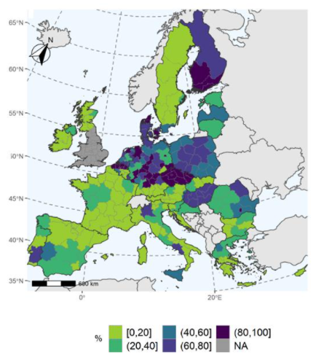
Background
Nitrate pollution in surface water
Nitrate pollution – links to agricultural surplus in Denmark
Surface waters in eutrophic status (EU, 2021)

Slide 3
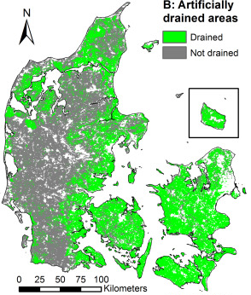
Background
50% of Denmark’s agricultural area has subsurface drains
(Møller et al, 2018)
Contact: hm@geo.au.dk

Slide 4
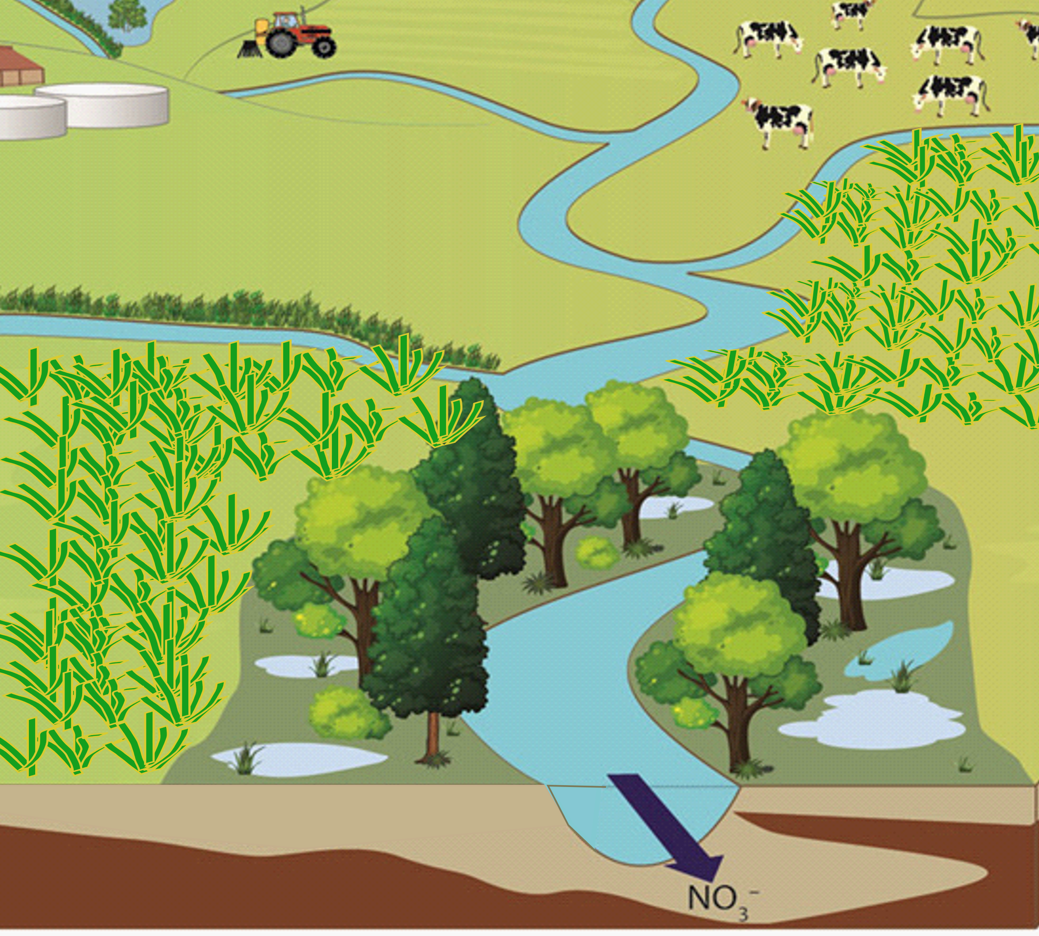
Why subsurface drains are important?
Agricultural surplus into surface water
Subsurface drains increase contribution to nitrate pollution
Need to study subsurface drain flow dynamics
Unsaturated zone
Saturated zone
Agricultural surplus leaching into groundwater
Subsurface drains – direct flow to surface water
Nitrate reduction
Petersen et al., 2021

Slide 5
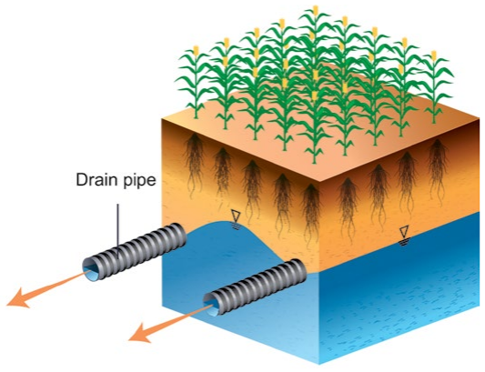
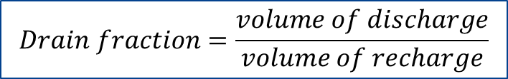
Drain fraction
Recharge
Subsurface drain
2m
Drain flow
$$Drain fraction=\frac{volume of discharge}{volume of recharge}$$

Slide 6
Objective
What drives drain flow generation?
Establish a groundwater flow model that can simulate drain flow dynamics for several drain catchments in Denmark
Investigate the physical control on generated drain fraction

Slide 7
Objective
What drives drain flow generation?
Establish a groundwater flow model that can simulate drain flow dynamics for several drain catchments in Denmark
Investigate the physical control on generated drain fraction

Slide 8
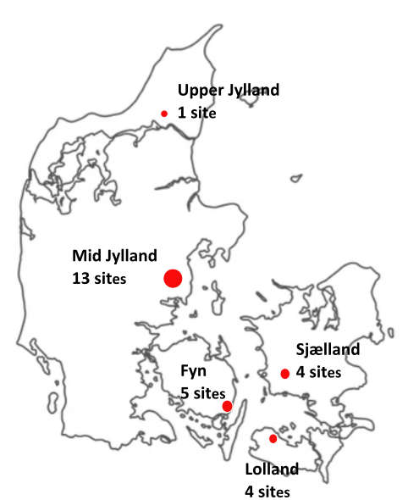
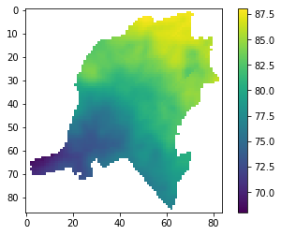
Data collection and selection of drain sites
Total 26 field scale (<1km²) drain catchment
Collected observed drain flows data
Drain site
Elevation

Slide 9
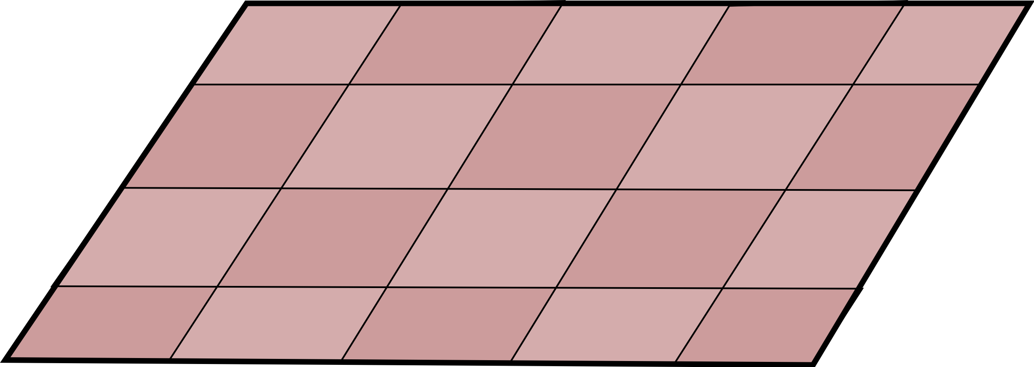
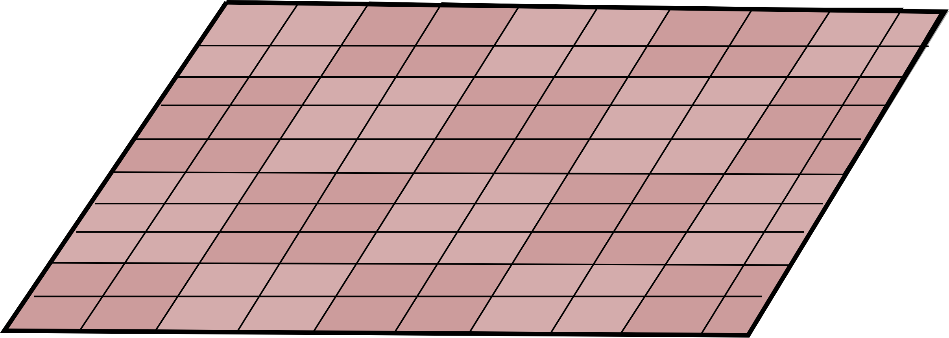
Groundwater flow model (MIKE-SHE)
Pre-existing DK hydrological model (100*100m)
Modified DK hydrological model (10*10m)
Drain conductance
Hydraulic conductivity (0-2m)
Geological layers depth
Drain depth

Slide 10
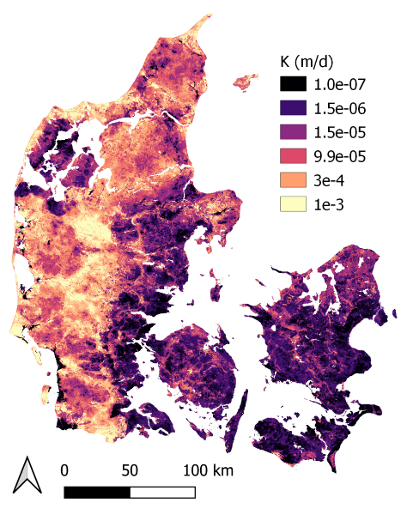
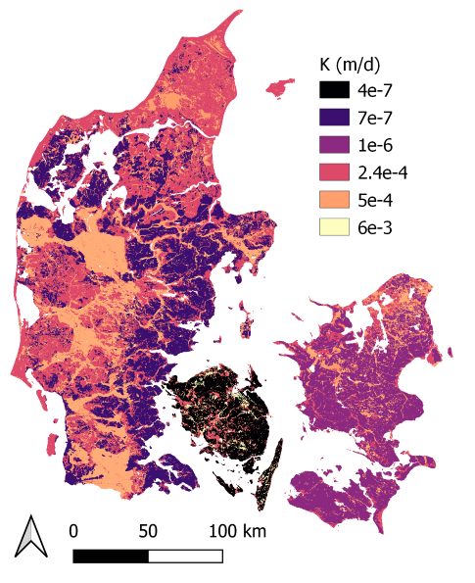
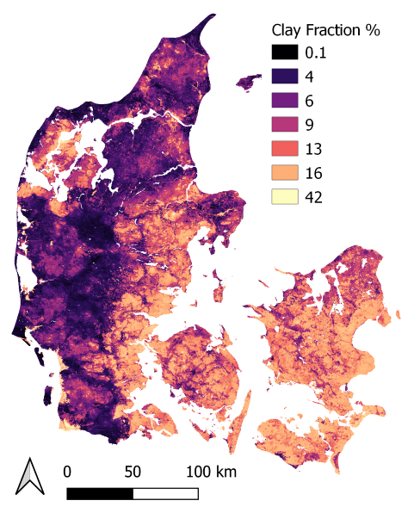
Generation of hydraulic conductivity map
100 m resolution National model K
30 m resolution Clay fraction
Linear Correlation
Log(K) = 0.217*Clay fraction (%) - 2.48
30 m resolution K

Slide 11
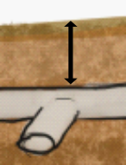
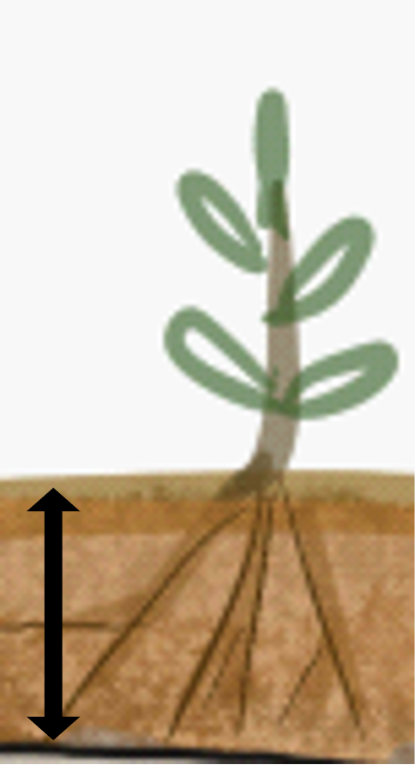
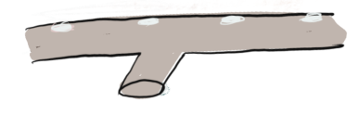
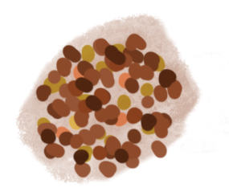
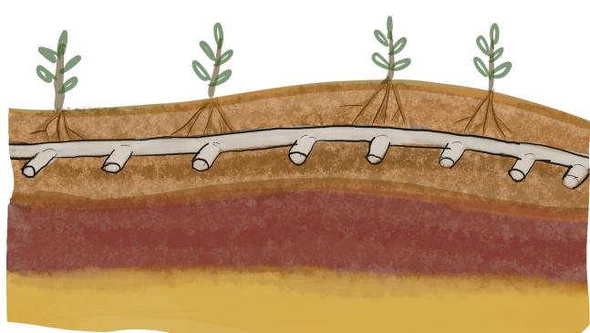
Calibration parameters
Drain depth - m
Root depth - mm
Slope & Intercept
of clay fraction and K linear equation
Drain conductance - /s
1st Clay layer Kx - m/s
1st Sand layer Kx - m/s
Joint calibration – spatial distribution of parameters

Slide 12
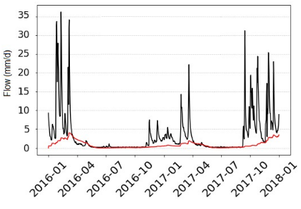
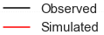
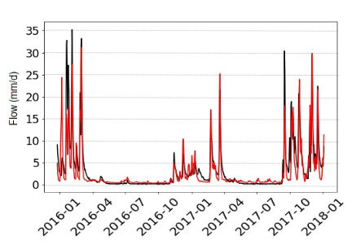
Calibration performance
Drain flow hydrographs
Drain Catchment area
Pre- calibration
Elevation
Post- calibration

Slide 13
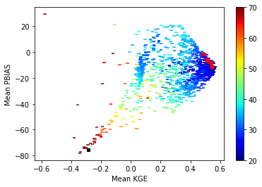
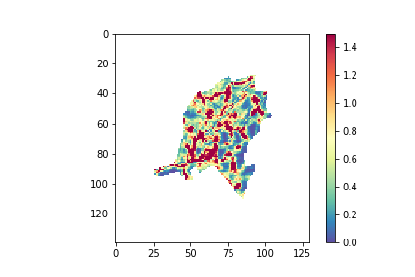
Calibration performance
Mean performance of all 26 drain catchment
Model produced drain fraction
Mean |PBIAS|
Contact: hm@geo.au.dk

Slide 14
Objective
What drives drain flow generation?
Establish a groundwater flow model that can simulate drain flow dynamics for several drain catchments in Denmark
Investigate the physical control on generated drain fraction

Slide 15
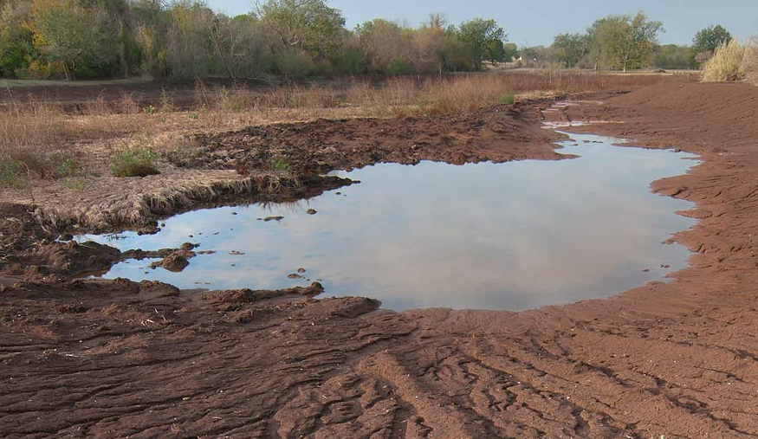
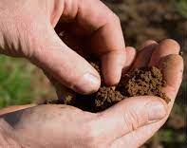
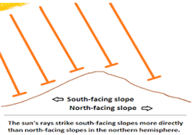
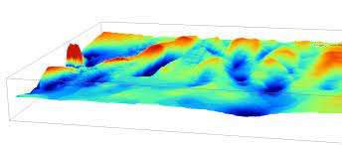
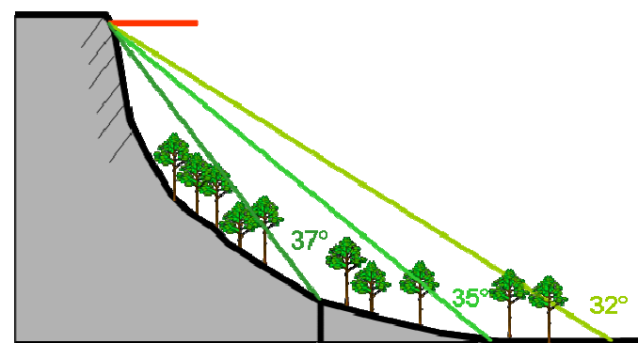
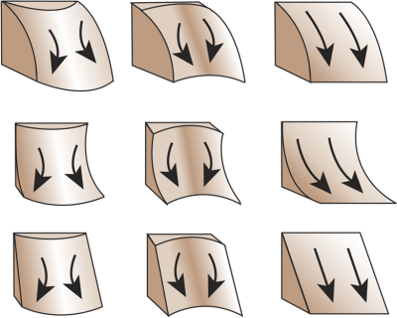
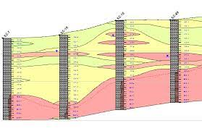
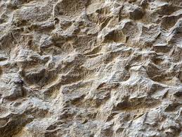
Identified physical variables
Topographical wetness index
Clay fraction
Aspect
Relative Topography
Slope
Curvature
Clay/Sand thickness
Roughness

Slide 16
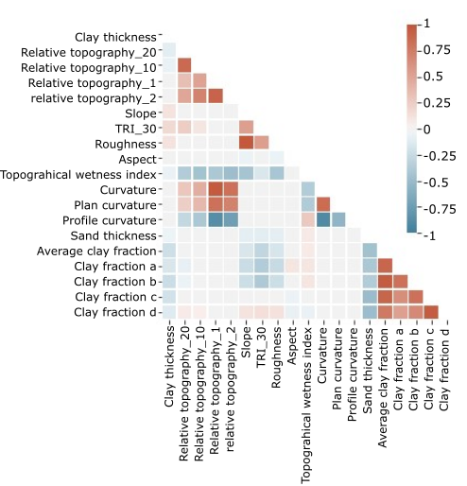
Covariance of identified physical variables
Removal of redundant variables

Slide 17
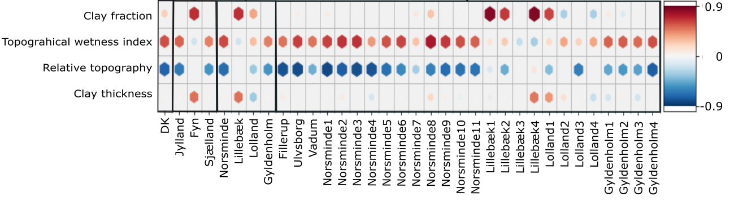
Scale based correlations
10⁴ km²
≤10¹ km²
National scale
Catchment scale
Regional scale
Field scale
Topographical wetness index
Relative Topography

Slide 18
Conclusion
A reliable calibrated model that can predict drain flow dynamics accurately
Topographical wetness index and relative topography has control over drain flow dynamics

Slide 19
Thank you

