Slide 1


Changes in aerosol atmospheric composition and radiative forcing in OsloCTM3 over the past two decades – the effect of the updated CEDS emission inventory
Ragnhild Bieltvedt Skeie, Marianne T. Lund and Gunnar Myhre
CICERO
EGU General Assembly 2022, Vienna & Online, 24th of May 2022

Slide 2
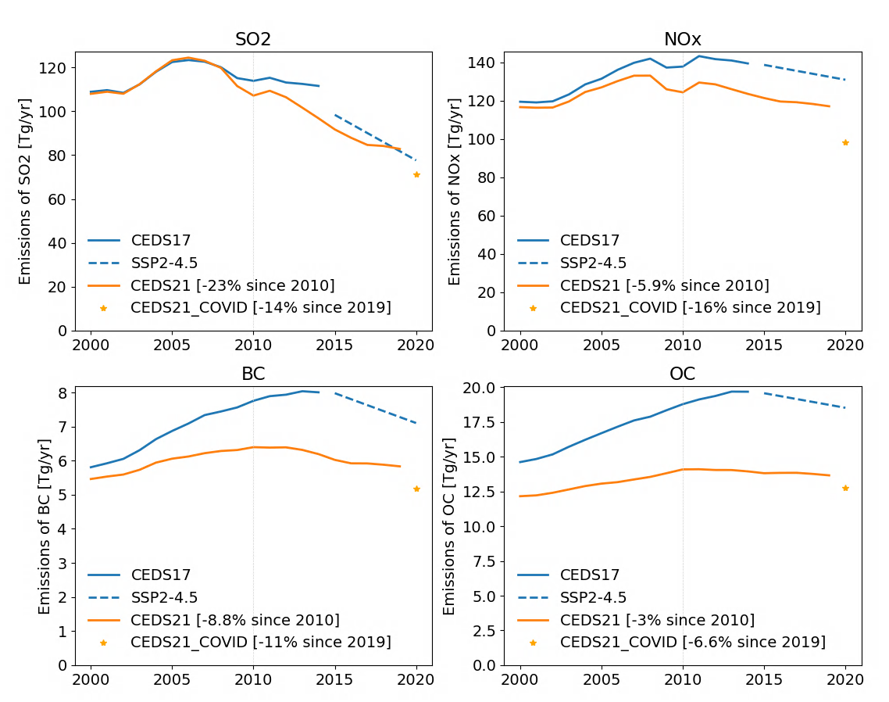
Emissions past decades
Gridded emissions:
CEDS17: used in CMIP6 (Hoesly et al. 2018)
CEDS21: v_2021_02_05
See: JGCRI/CEDS: Community Emissions Data System (CEDS) (github.com)
CEDS21_COVID: Scaled the CEDS21 year 2019 emissions by the relative reduction in the COVID_MIP emissions (version 5.1) (Lamboll et al., GMD, 2021) (by sector/month/gridbox)
See: https://zenodo.org/record/3897382#.YVa6_TFBxPY

Slide 3
Oslo CTM3 model
MODEL: Oslo CTM3
3-D Chemistry-Transport Model.
Driven by 3-hourly meteorological forecast data by the Open IFS at the ECMWF.
Resolution: 2.25x2.25 degrees with 60 vertical layers ranging from the surface up to 0.1 hPa.
Tropospheric and stratospheric chemistry scheme (Søvde et al. GMD 2012)
Modules for sulphate, nitrate, black carbon, primary organic carbon, secondary organic aerosols, mineral dust and sea salt (Lund et al. GMD 2018).
Simulations:
Fixed meteorology (year 2010) for selected years: 2000, 2007,2010, 2014, 2017, 2019, 2020.
2000-2017 meteorology.
CEDS17: CEDS17 emissions 2010-2014, extended by SSP2-4.5 to 2020.
CEDS21: CEDS21 emissions + CEDS21_COVID for 2020.
Radiative Forcing (RF) calculated by a radiative kernel.
Full RF calculations in progress (Lund et al. in prep.)

Slide 4
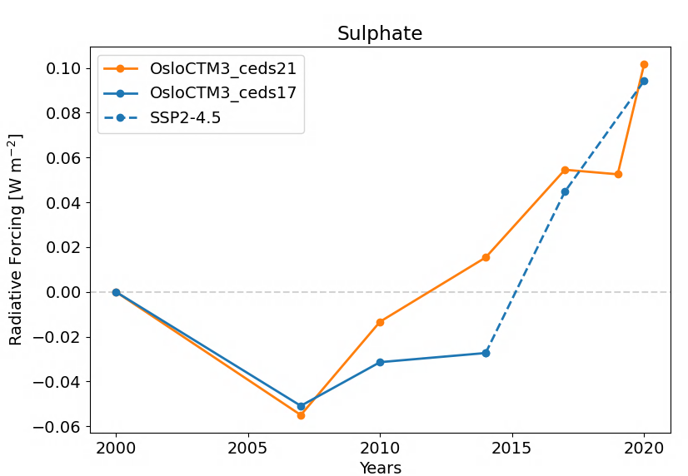
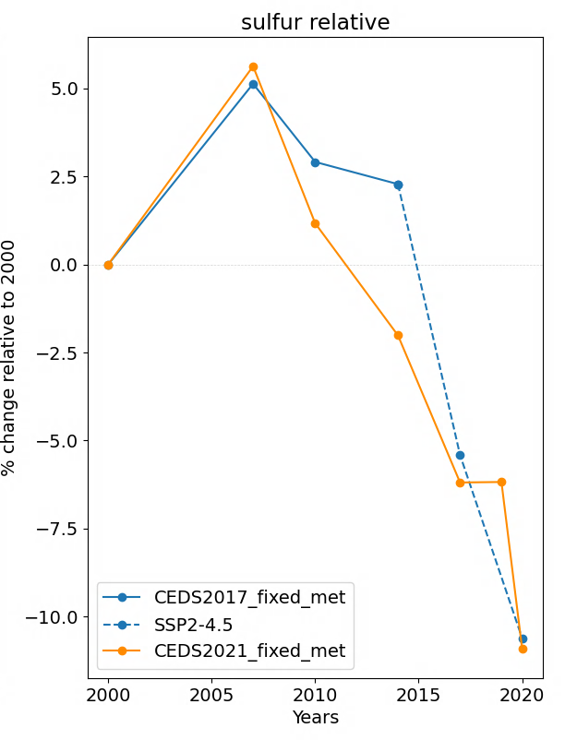
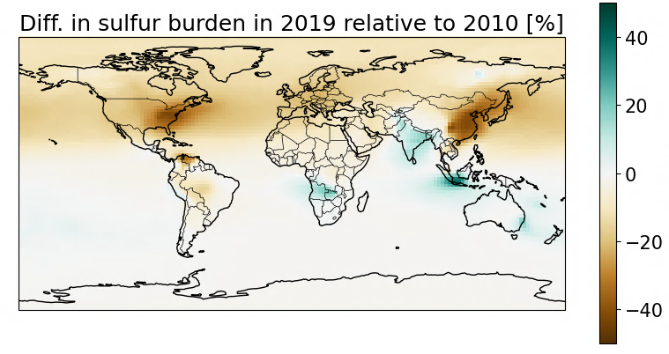
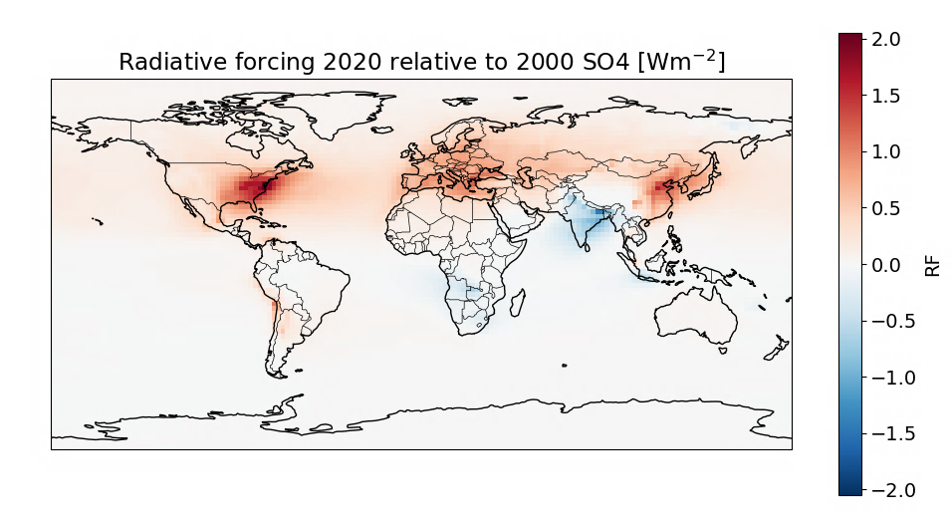
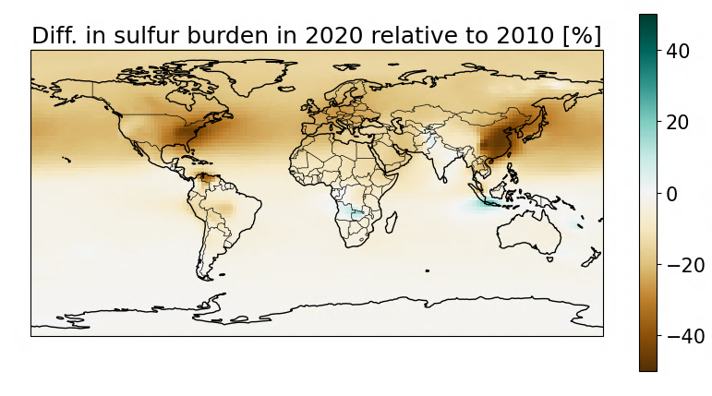
Sulphate
Radiative forcing:
Aerosol-radiation interaction
Burden:
CEDS21, 2019 relative to 2010:
+0.10 Wm⁻²
+0.05 Wm⁻²
0.04 Wm⁻²
CEDS21, 2020 COVID relative to 2010:

Slide 5
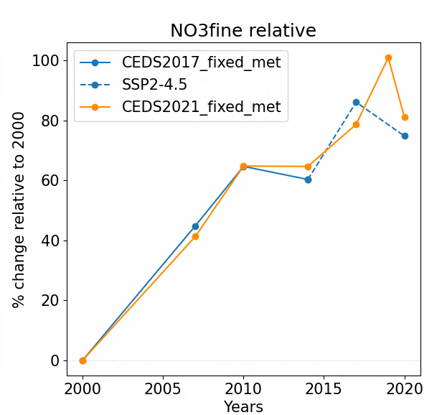
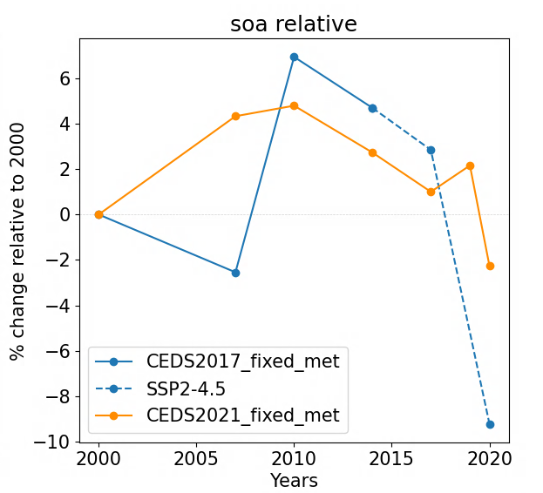
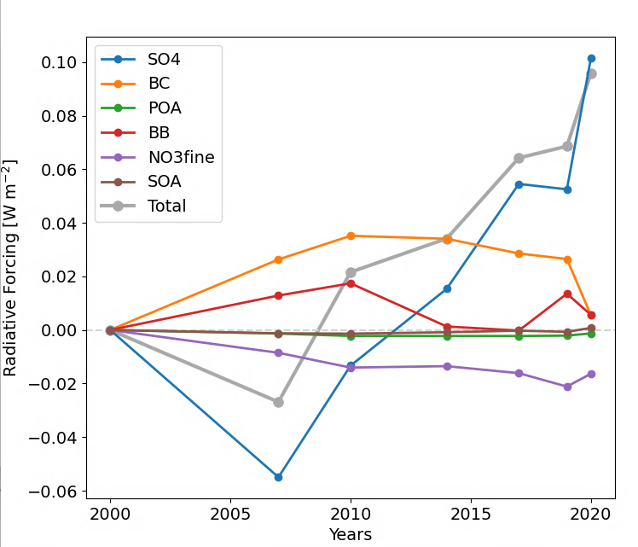
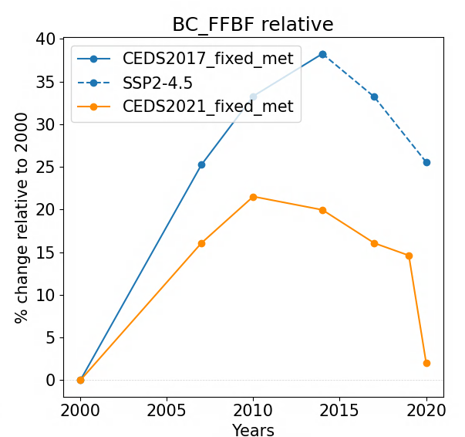
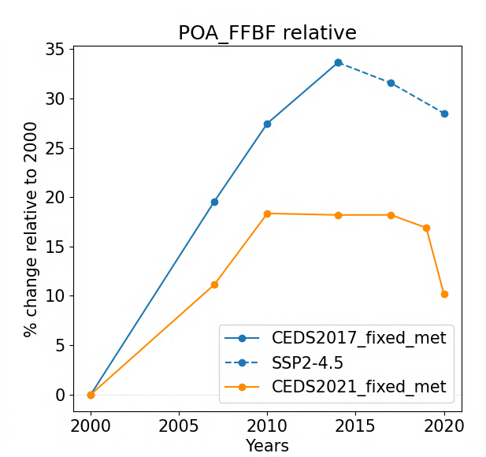
Other components
Radiative forcing:
Aerosol-radiation interaction
Burden:
% change relative to 2000
Total aerosol RFari of +0.069 Wm⁻² in 2019 relative to 2000.

Slide 6
Thank you
Additional display material online
Ragnhild Bieltvedt Skeie
r.b.skeie@cicero.oslo.no
@RBSkeie
www.cicero.oslo.no

Slide 7
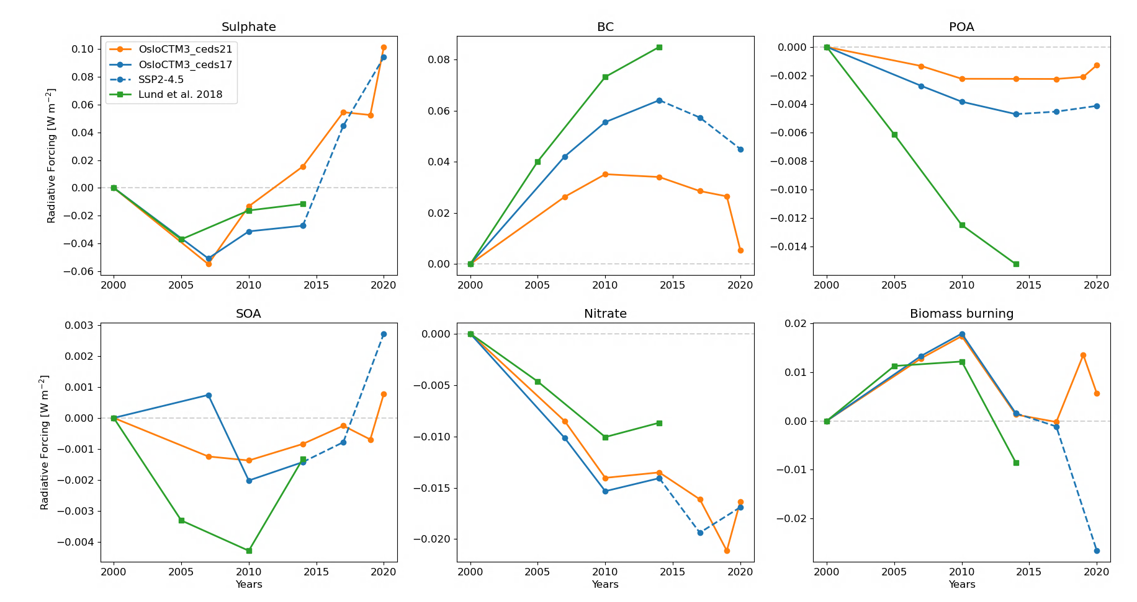
RF for each aerosol component.
Difference Lund et al. 2018 and the results here with ceds17 are due to the use of the kernel, that are based on an older version of the radiative transfer code.

Slide 8
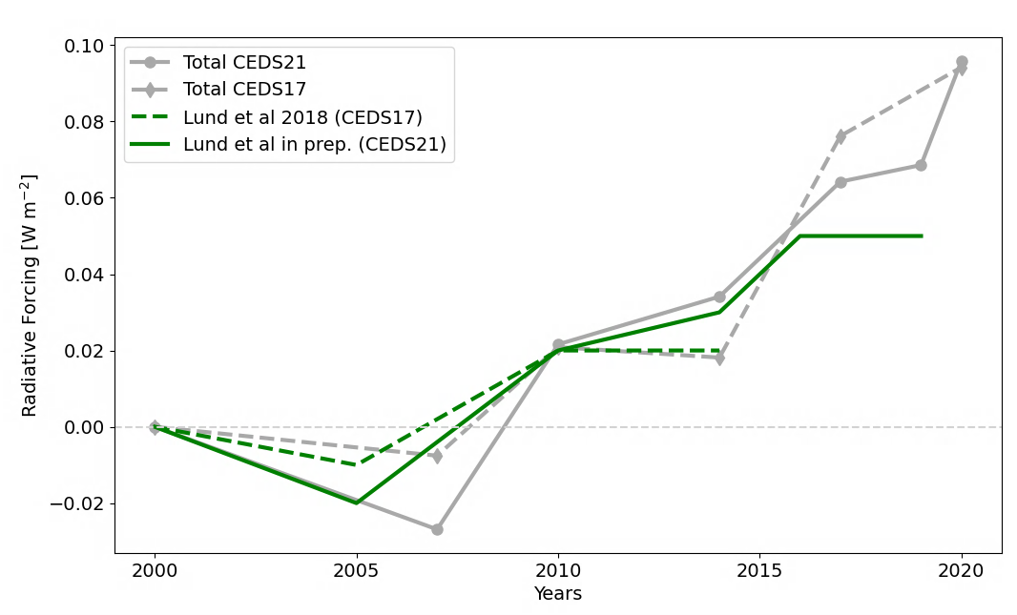
Total RFari
In grey, the sum of the kernel results.
In green detailed radiative transfer calculations for total aerosol changes.

Slide 9
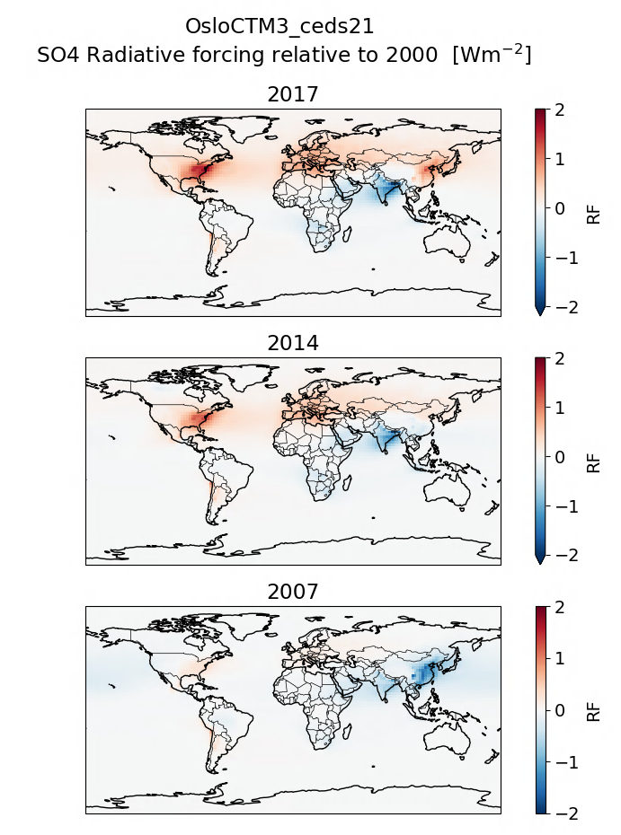
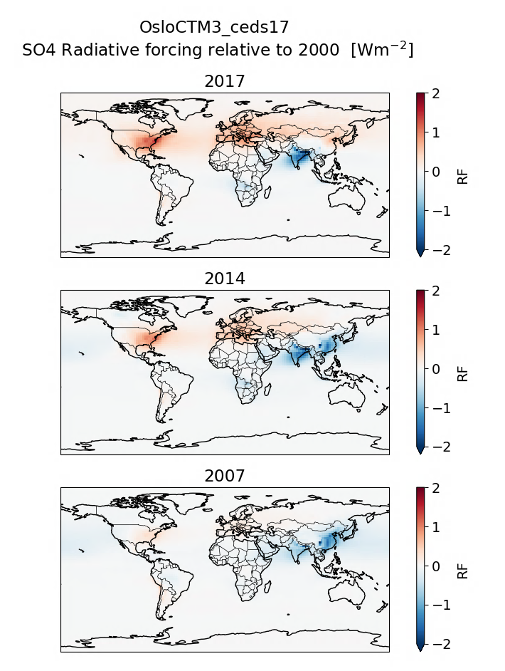
SO4
CEDS21 CEDS17

Slide 10
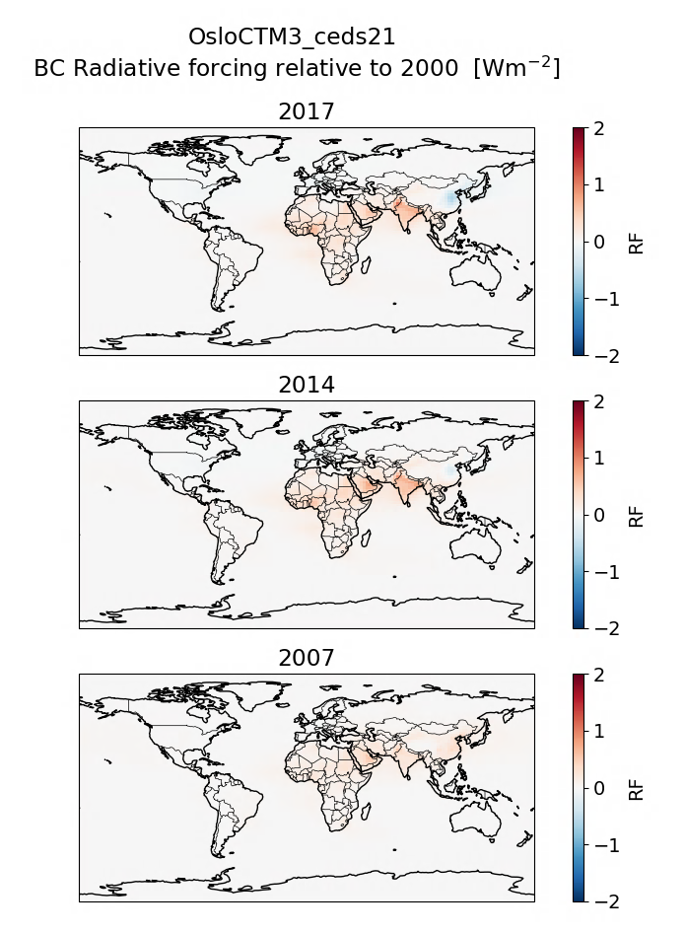
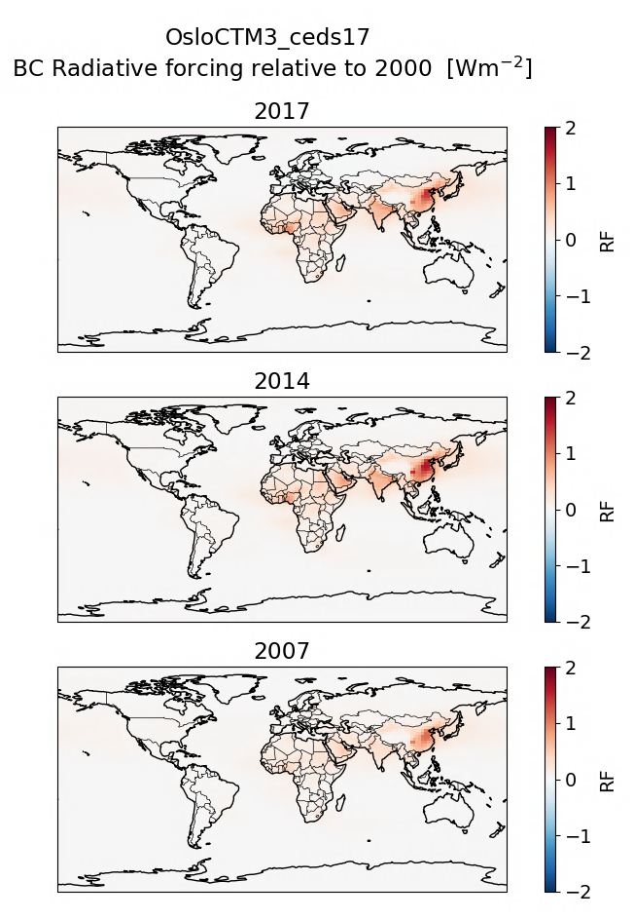
BC
CEDS21 CEDS17

Slide 11
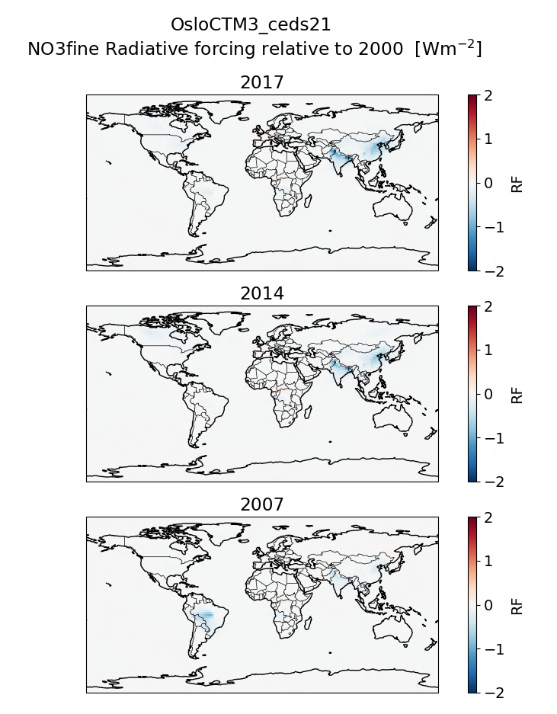
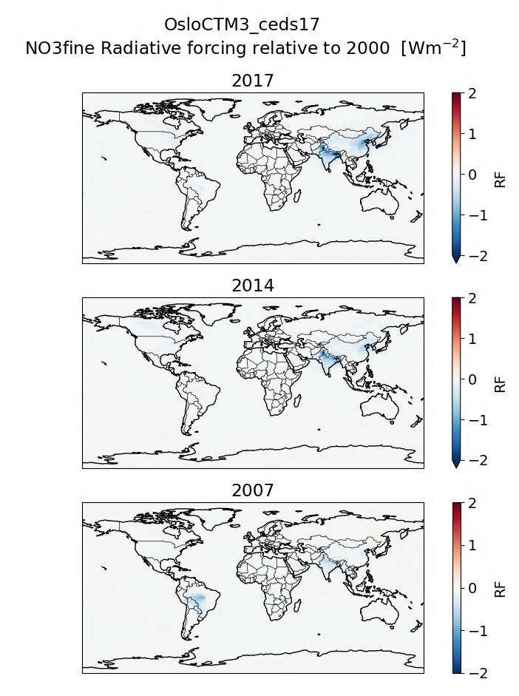
NO3
CEDS21 CEDS17

Slide 12
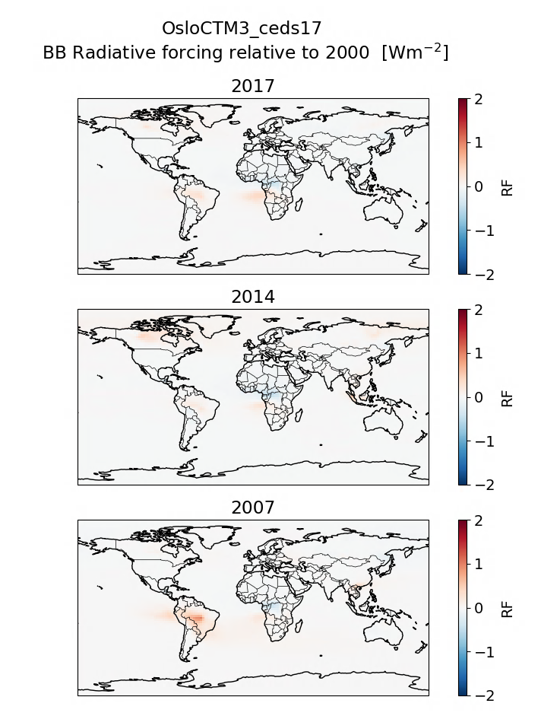
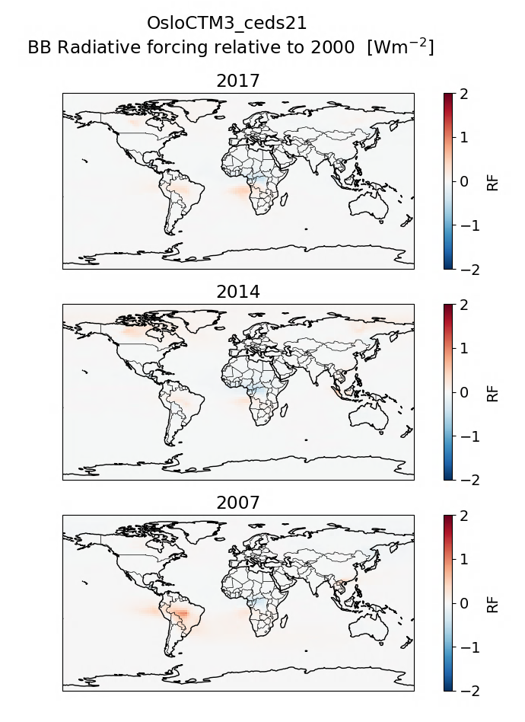
BB
CEDS21 CEDS17
NB: Emissions equal in the two set of simulations.

Slide 13
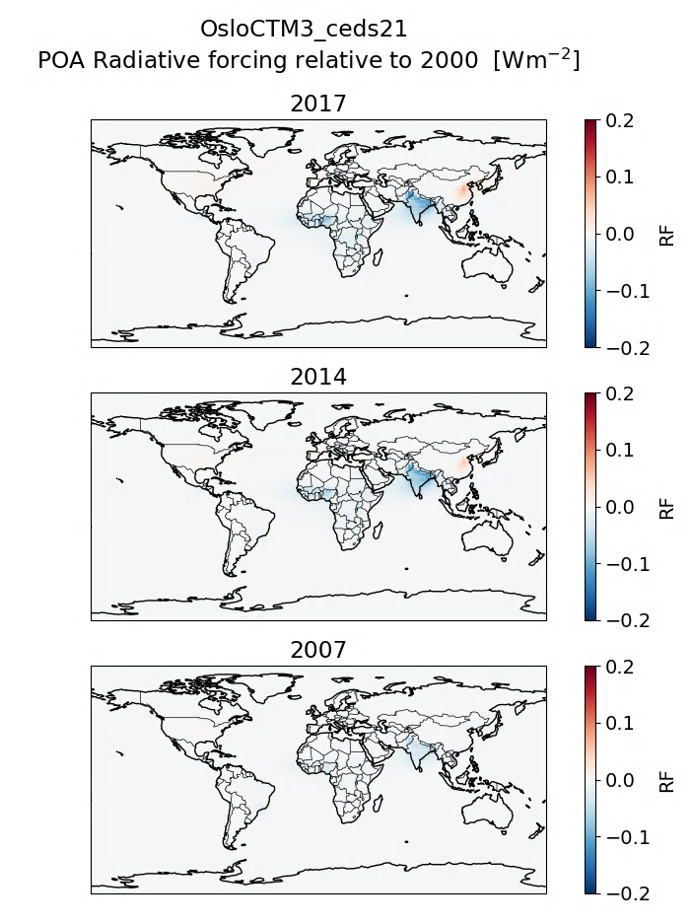
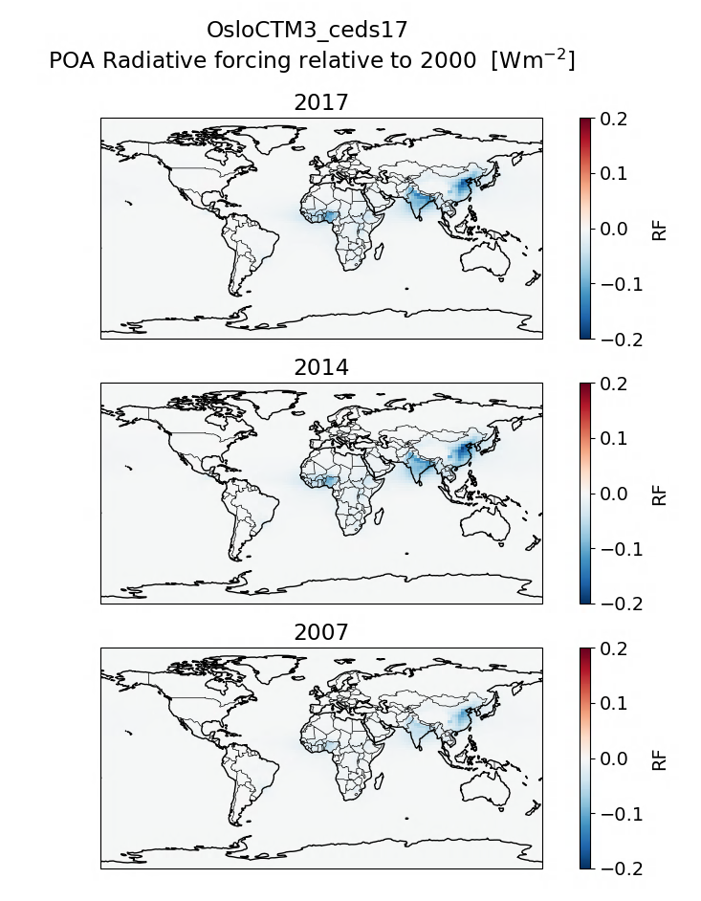
POA
CEDS21 CEDS17
NB: Colorscale changed compared to the previous components.

Slide 14
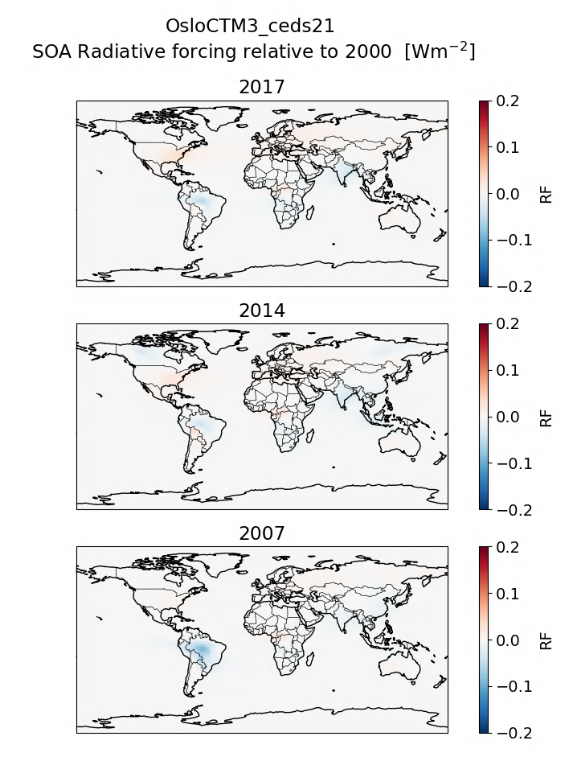
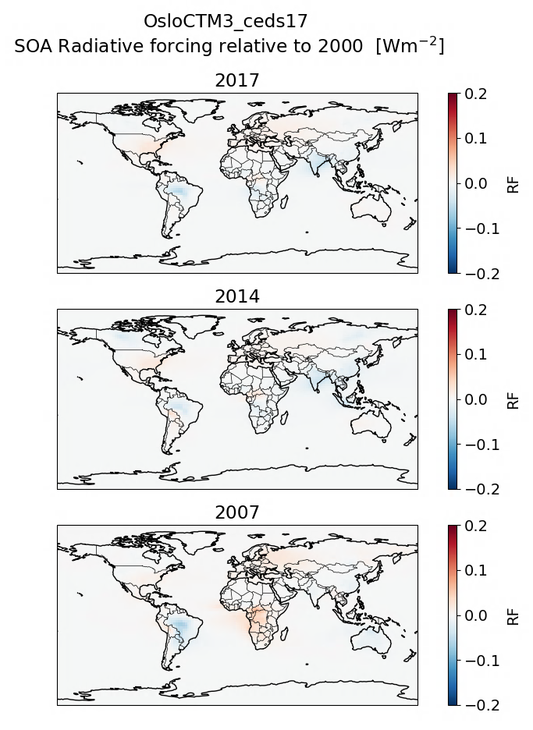
SOA
CEDS21 CEDS17

