Slide 1
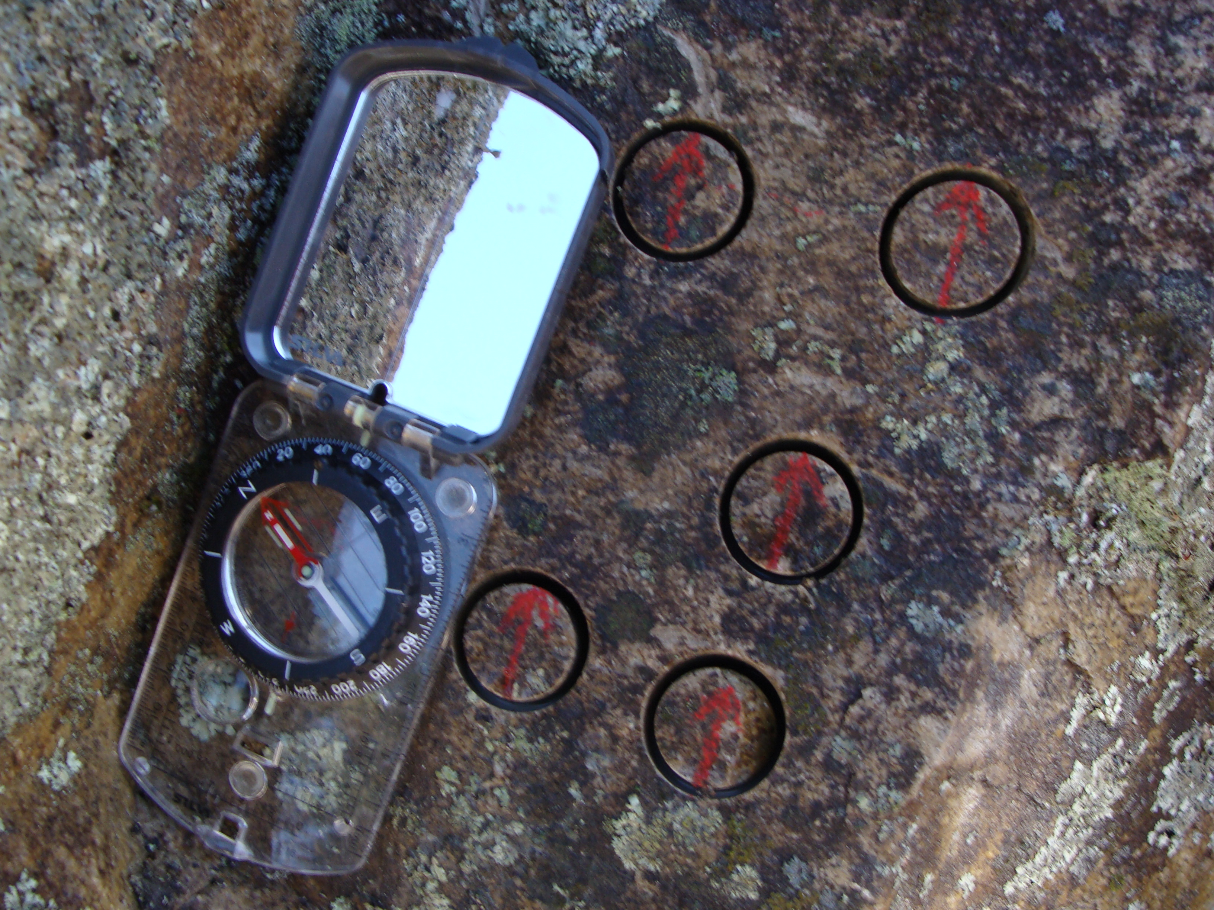




Unveiling the magnetic mineralogy and magma flow dynamics within subvolcanic dykes from northern Portugal, Central Iberian Zone
European Geosciences Union General Assembly 2022
Vienna, 26th May 2022
A. Oliveira^{1,2*}, H. Sant’Ovaia^{1,2}, H.C.B. Martins^{1,2}
¹ Faculdade de Ciências da Universidade do Porto, DGAOT, Rua do Campo Alegre, s/n, 4169-007 Porto
² Instituto de Ciências da Terra, Polo do Porto, Rua do Campo Alegre, s/n, 4169-007 Porto, Portugal
* up201107754@edu.fc.up.pt

Slide 2
1. Introduction
- The Permo-Carboniferous hypabyssal magmatism is a well-recorded igneous event throughout southwestern and northwestern Europe, associated with the post-collisional setting that followed the Variscan orogeny;
- In northern Portugal, this episode is represented by dykes and masses of granitic porphyry, lamprophyre, and dolerite;
- Main goals of the present study:
(1) To determine the magnetic and structural fabrics of selected dykes by analyzing low-field AMS (anisotropy of magnetic susceptibility) data;
(2) To ascertain the respective magnetic mineralogy and associated characteristics through rock magnetism tests;
(3) To integrate the results obtained from the aforementioned studies with petrological and geochemical data for petrogenetic purposes.

Slide 3
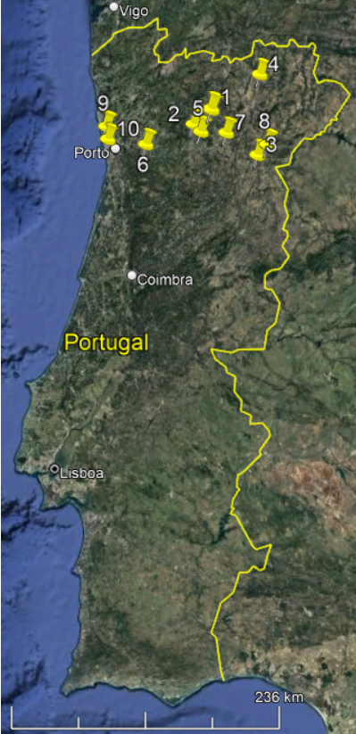

2. Geographic and Geological Setting
- Study areas: Vila Pouca de Aguiar (VPA), Lamas de Olo (LO), Vila Nova de Foz Côa (VNFC), Rebordelo, Vila Real (VR), Penafiel, Alijó, Torre de Moncorvo (TM), Labruge and Castelo do Queijo (CQ);
- Central Iberian Zone (CIZ) or near the limit between the CIZ and Galicia and Trás-os-Montes Zone (GTMZ).
Figure 1 – Geographic location of the study areas in northern Portugal (Google Maps image). Legend: 1 – Vila Pouca de Aguiar; 2 – Lamas de Olo; 3 – Vila Nova de Foz Côa; 4 – Rebordelo; 5 – Vila Real; 6 – Penafiel; 7 – Alijó; 8 – Torre de Moncorvo; 9 – Labruge; 10 – Castelo do Queijo.

Slide 4
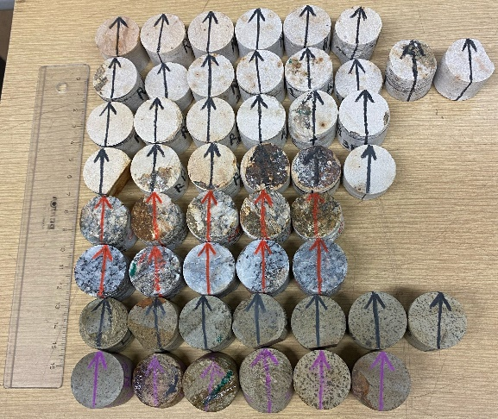
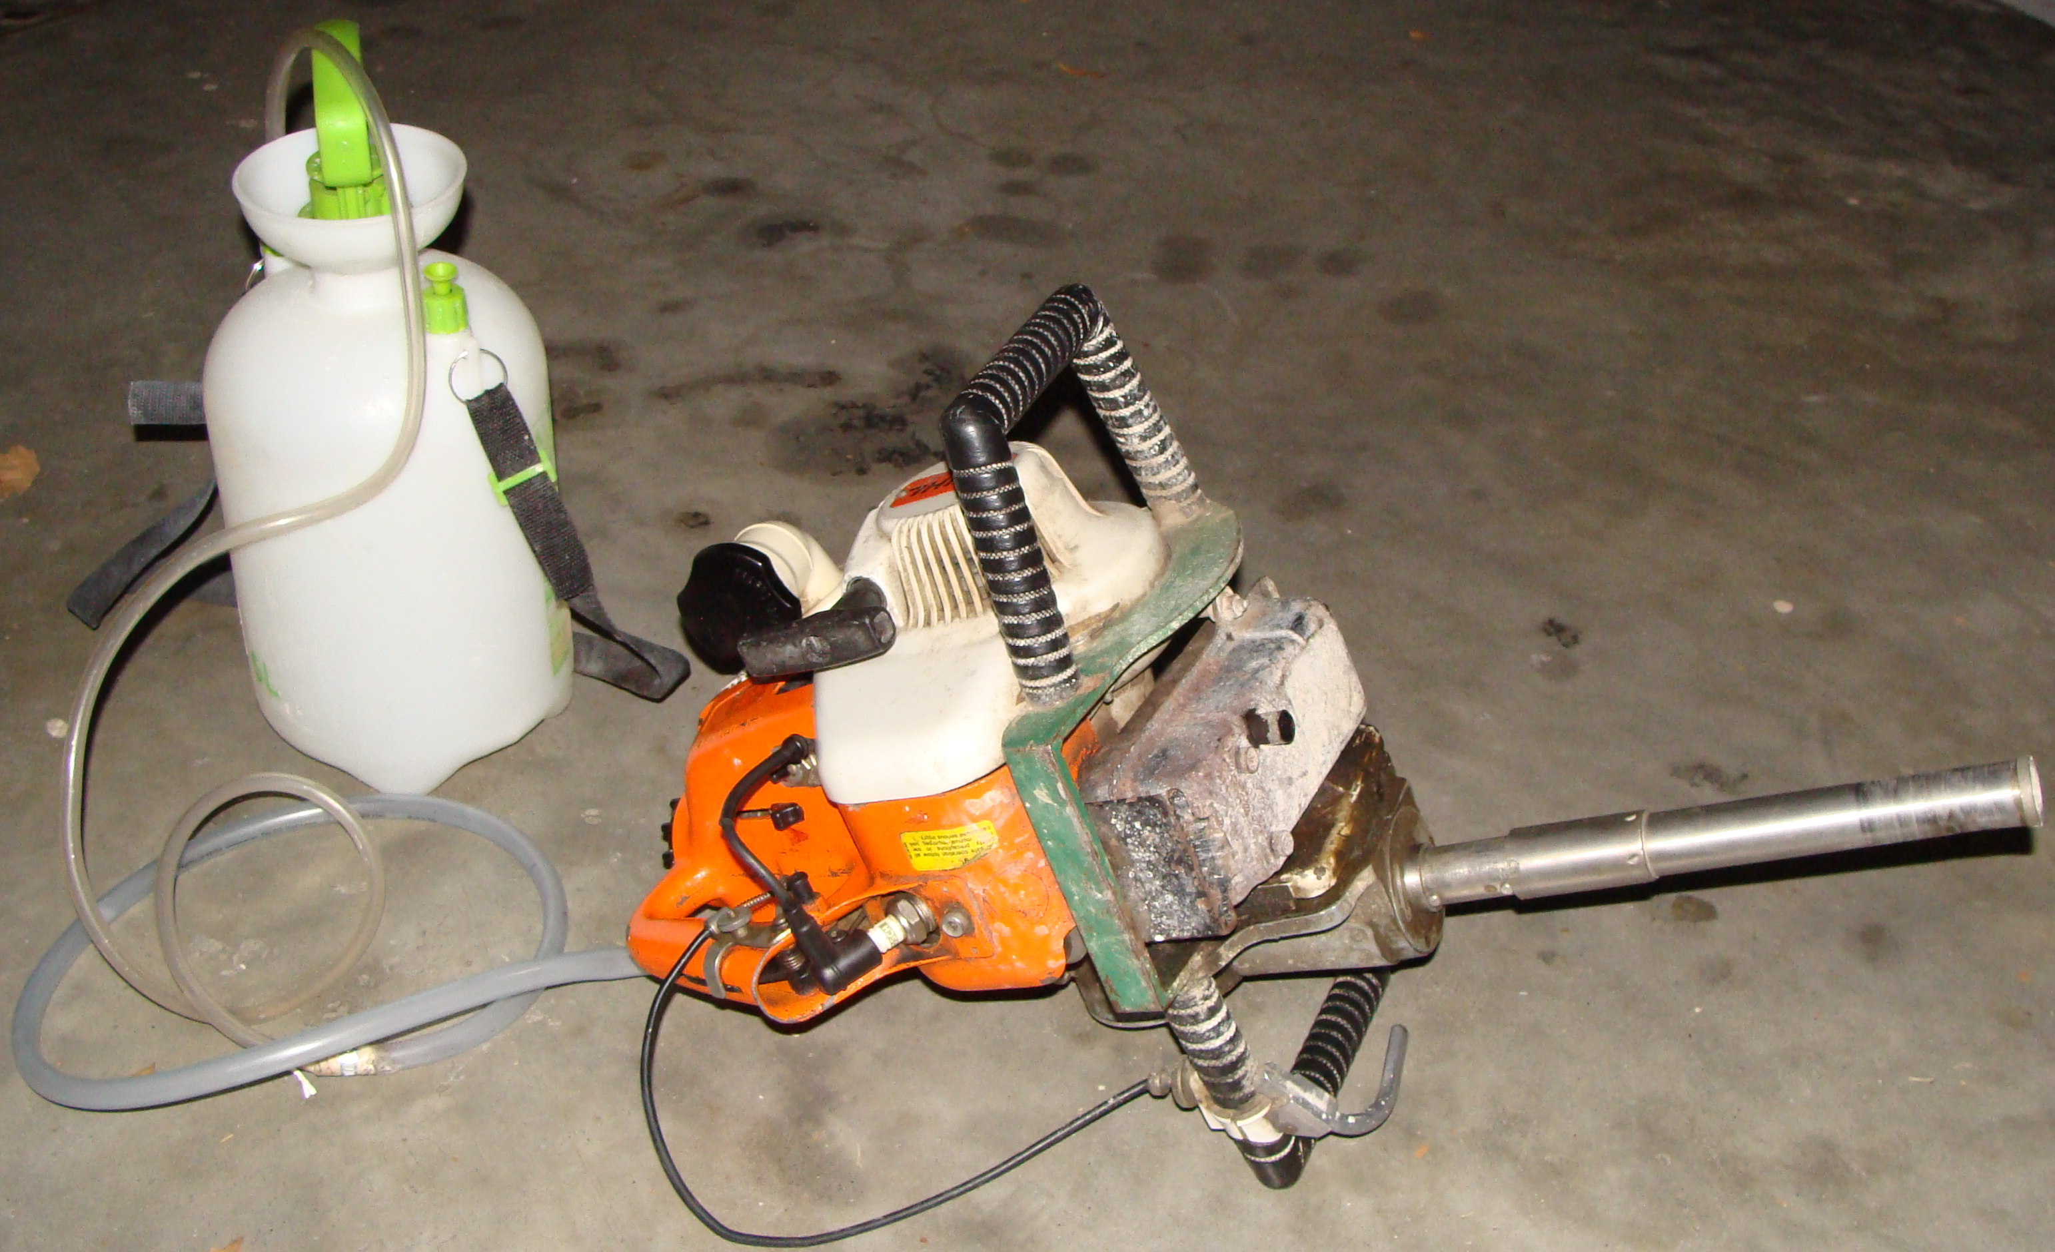
3. Methods
Magnetic susceptibility (K_{m}) and AMS;
IRM (Isothermal remanent magnetization) curve acquisition and data treatment: Kruiver et al. (2001), MAX UnMix software (Maxbauer et al., 2016);
Kfd (frequency-dependence of the magnetic susceptibility);
Modified Lowrie-Fuller and Cisowski tests;
Thermomagnetic analyses.
Figure 2 – STIHL portable, petrol-powered, diamond-pointed, mechanical drill and external hand pump.
Figure 3 – Examples of oriented standard-sized samples for the AMS analysis.
Figure 4 – KLY-4S kappabridge magnetic susceptibility meter of the AMS Porto laboratory (ICT – Porto Polo) (photos from Gonçalves, 2017).

Slide 5
4. Magnetic Susceptibility and Anisotropy of Magnetic Susceptibility (AMS)
Felsic rocks
Intermediate rocks
Mafic rocks
K_{m} = 0.90-148.20 µSI
K_{m} = 65.36-676.58 µSI
K_{m} = 238.17-67,739.58 µSI
Scalar AMS parameters (VPA, LO, VNFC, Rebordelo, CQ):
K_{m}: 0.90 to 148.20 µSI (average values = 36.37; 2.04; 55.73; 16.45; 40.43 µSI);
P(%): 0.70 to 14.10% (average values = 3.50; 4.28; 2.09; 4.00; 6.66%);
- T: -0.776 to +0.851 (average values = +0.119; +0.139; +0.206; +0.090; -0.012).
Scalar AMS parameters (LO, Labruge):
K_{m}: 238.70 to 1178 µSI (average values = 789.47; 281.35 µSI);
P(%): 0.50 to 3.30% (average values = 1.65; 1.41%);
- T: -0.476 to +0.500 (average values = +0.122; -0.102).

Slide 6
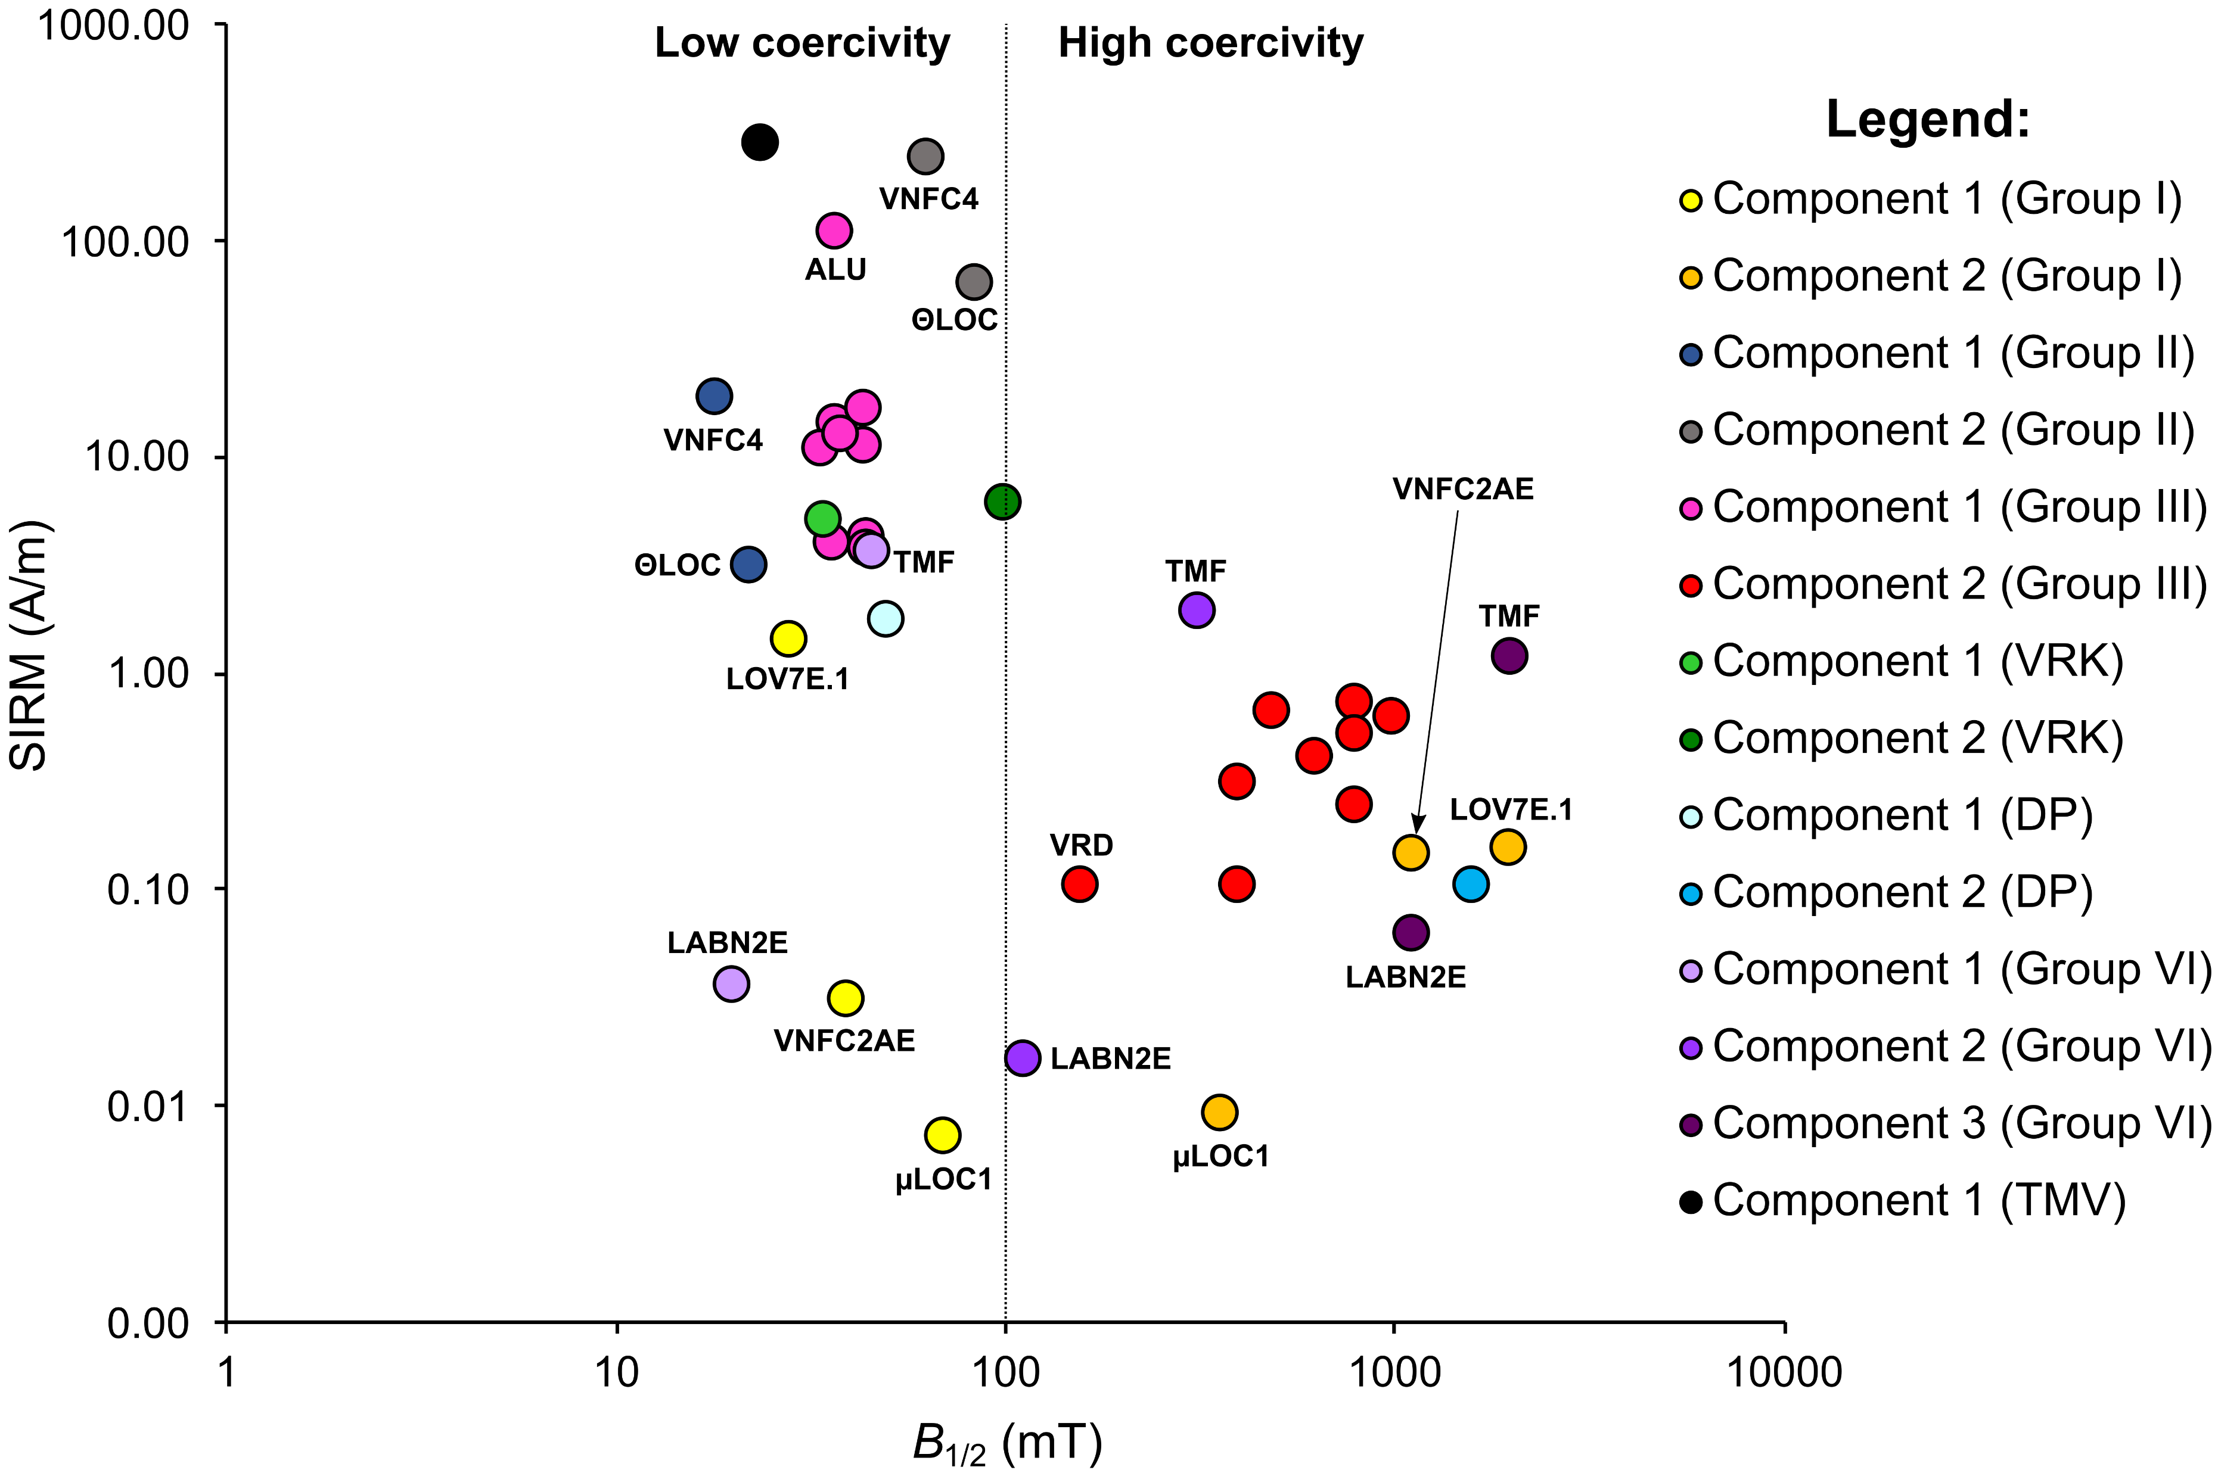
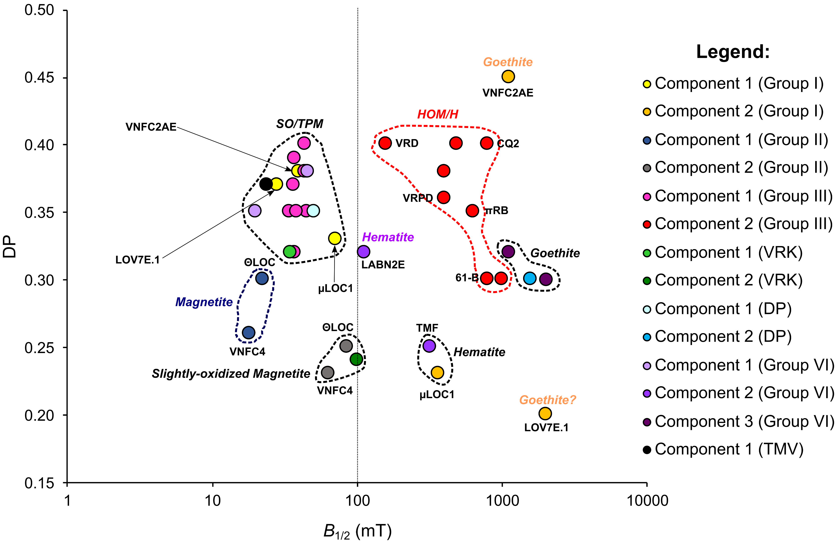
5. IRM (Isothermal Remanent Magnetization)
Figure 6 – Plot of B_{1/2} versus DP illustrating heterogeneities between the magnetic components identified in the studied samples. Legend: SO/TPM – slightly oxidized/Ti-poor magnetite; HOM/H – highly oxidized magnetite/hematite.
Figure 5 – Plot of B_{1/2} versus SIRM highlighting the mostly bimodal distribution of the magnetic mineralogy of the studied dykes. The field limit between the low and high coercive phases (i.e., magnetite versus hematite + goethite) is arbitrarily stated at around 100 mT.

Slide 7
6. Frequency-dependence of the Magnetic Susceptibility (Kfd)
Table I – Frequency-dependence of susceptibility of the studied samples. Legend: PA – Póvoa de Agrações; K_{LF} – magnetic susceptibility at low frequency; K_{HF} – magnetic susceptibility at high frequency; M1, M2, M3 – first, second, and third measurements, respectively.
Location | Lithology | Sample | K_{LF} (0.46 kHz) (unit: 10⁻⁸ m³/kg) |  |  |  | K_{HF} (4.6 kHz) (unit: 10⁻⁸ m³/kg) |  |  |  | Kfd (%)
 |  |  | M1 | M2 | M3 | Mean | M1 | M2 | M3 | Mean
VPA | Loivos porphyry | LOV7E.1 | 4.60 | 4.56 | 4.75 | 4.64 | 4.26 | 4.67 | 4.75 | 4.56 | 1.61
VPA | PA porphyry | 61-B | 14.98 | 15.31 | 15.20 | 15.16 | 15.05 | 15.09 | 14.87 | 15.00 | 1.05
LO | Microgranite | µLOC1 | 0.32 | 0.27 | 0.22 | 0.27 | 0.22 | 0.24 | 0.20 | 0.22 | 18.18
LO | Lamprophyre | ΘLOC | 46.11 | 46.41 | 46.35 | 46.29 | 46.43 | 46.25 | 46.59 | 46.42 | -0.28
VNFC | Porphyry | VNFC2AE | 5.76 | 5.71 | 5.78 | 5.75 | 5.71 | 5.69 | 5.74 | 5.71 | 0.67
VNFC | Microgabbro | VNFC4 | 350.18 | 357.73 | 357.80 | 355.24 | 355.43 | 355.97 | 355.25 | 355.55 | -0.09
Rebordelo | Mafic dyke | ΘBol | 50.98 | 52.18 | 51.99 | 51.72 | 51.77 | 51.77 | 51.55 | 51.70 | 0.04
Rebordelo | Porphyry | πRB | 53.79 | 54.71 | 54.71 | 54.40 | 54.46 | 54.46 | 53.86 | 54.26 | 0.26
Vila Real | Dacitic porphyry | VRPD | 18.22 | 18.50 | 18.54 | 18.42 | 18.47 | 18.58 | 18.50 | 18.52 | -0.52
Vila Real | Dolerite | VRD | 19.14 | 19.14 | 18.24 | 18.84 | 16.45 | 17.64 | 18.24 | 17.44 | 7.41
Vila Real | Microtonalite | VRH | 46.84 | 46.84 | 46.20 | 46.62 | 47.15 | 47.78 | 46.20 | 47.05 | -0.90
Vila Real | Granite porphyry | VRK | 40.74 | 41.34 | 38.93 | 40.33 | 40.74 | 40.74 | 41.04 | 40.84 | -1.25
Penafiel | Dolerite | DP | 27.21 | 28.02 | 27.21 | 27.48 | 26.67 | 26.67 | 27.21 | 26.85 | 2.29
Alijó | Metamorphic | ALR | 31.10 | 30.81 | 29.94 | 30.62 | 30.52 | 30.23 | 29.65 | 30.14 | 1.58
Alijó | Serpentinite | ALU | 1041.52 | 1044.37 | 1039.82 | 1041.90 | 1034.98 | 1031.00 | 1038.40 | 1034.79 | 0.68
TM | Dolerite | TMF | 24.66 | 24.08 | 24.37 | 24.37 | 23.80 | 24.66 | 24.66 | 24.37 | 0.00
TM | Serpentinite | TMV | 2302.34 | 2303.84 | 2313.44 | 2306.54 | 2295.74 | 2299.04 | 2293.94 | 2296.24 | 0.45
Labruge | Lamprophyre | LABN2E | 13.29 | 13.49 | 12.67 | 13.15 | 12.47 | 12.47 | 12.67 | 12.54 | 4.66
CQ | Granite porphyry | CQ2 | 32.07 | 32.37 | 31.47 | 31.97 | 31.47 | 32.07 | 32.37 | 31.97 | 0.00

Slide 8
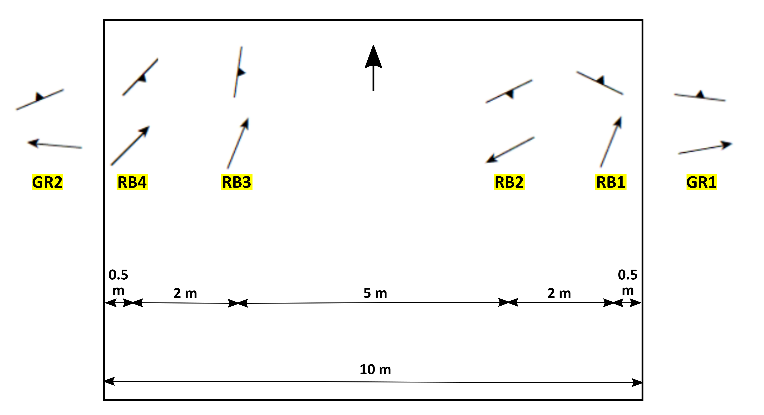
Vector AMS parameters (CQ porphyries):
- N44 to 49°E trending dykes;
- Average magnetic lineation: 66°/N34°E and 78°/N208°E;
- Average magnetic foliation: N288°E-67°NE and N86°E-80°SE;
- Intermediate magnetic fabric between types I and II.
N215°E
73°
59°
53°
34°
69°
61°
63°
33°
1°
37°
3°
59°
Figure 7 – Schematic representation of the magnetic lineations and foliations of the Loivos porphyry (VPA region).
Figure 8 – Schematic representation of the magnetic lineations and foliations of the Rebordelo rhyolitic porphyry.

Slide 9






7. Acknowledgements
This work was supported by the Portuguese Foundation for Science and Technology (FCT), through the project ref. UIDB/UIDP/04683/2020 and ICT (Institute of Earth Sciences). The main author is also financially supported by FCT through an individual PhD grant (reference SFRH/BD/138818/2018).
The present study would not have been possible without the help provided by Dr. Cláudia Cruz, Dr. Ana Marta Gonçalves, José Carlos Oliveira, and Duarte Silva, throughout the various field and sampling sessions.
We also acknowledge Professor Eric Font (FCTUC and Institute Dom Luiz) whose contributions and support were crucial for all rock magnetism tests.

