Slide 1



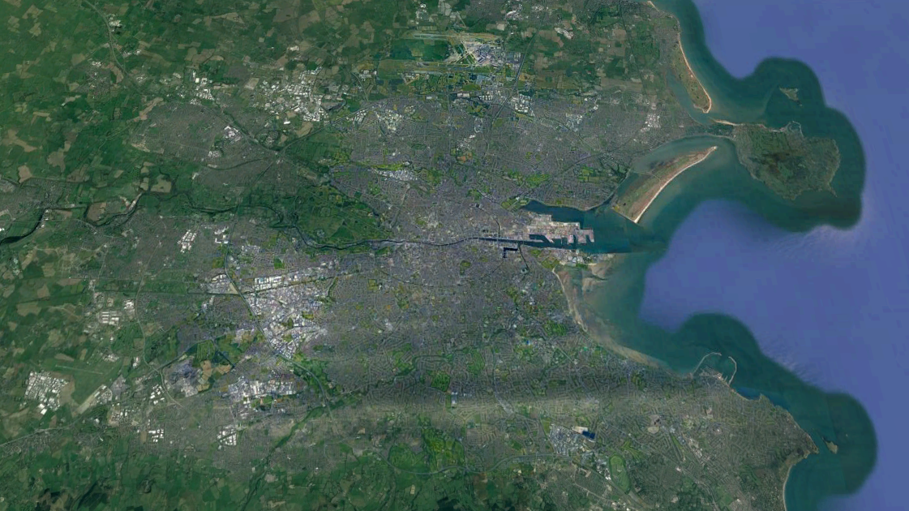
Evaluating urban risks in Europe using publicly available continental-scale data
Zeting Li, Gerald Mills, Matthias Demuzere, and Benjamin Bechtel
School of Geography, UCD.
School of Geography, RUB
Terrain-AI is sponsored by Science Foundation Ireland and Microsoft (Ireland)
Notes:
Hello, everyone. My topic is Global climate change risks and cities. The contributors are me and my supervisor Professor Gerald Mills. Cities are major drivers of climate change and are at great risk from the effects of climate change. Projected hazards associated with global climate change include sea-level rise, more frequent hot days/nights, more intense heatwaves, and more intense rainfall events. These hazards will be enhanced in cities because of local effects such as the urban Heat Island and enhanced surface runoff. Managing risk in each city must take note of the spatial nature of the hazard and the exposure and vulnerability of the population and the supporting infrastructure. For example, when we manage climate risks of Dublin city, we firstly noticed that Dublin is at low elevation and close to sea-level along coasts, and the built urban form and concentrated populations are located alongside Liffey River. Therefore, we can say Dublin is probably at the risks of river flooding and sea-level rising flooding. Also, there is a considerable body of knowledge on Dublin’s unique nature of built landscapes, local topography, and emission patterns, which could be used to evaluate other climate risks in Dublin city.

Slide 2
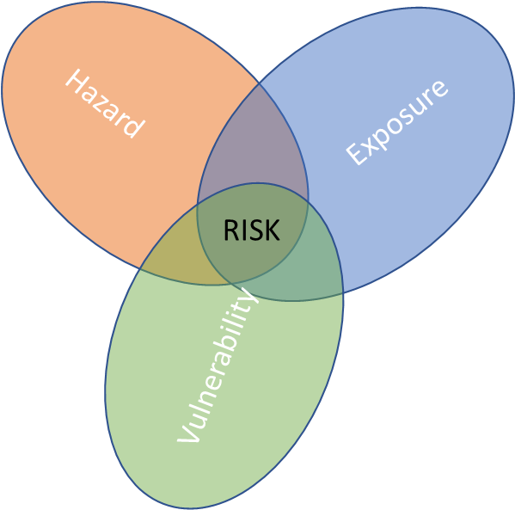
Context
Cities are exposed (population and physical infrastructure) to several hazards (natural and anthropogenic) that will be enhanced in the near future:
Most cities are located at low-elevation and close to coasts. This exposes them to the impacts of coastal flooding and strong storms.
Urbanised landscapes are also paved so that rainfall pools is either quickly displaced to rivers (fluvial flooding) or pools on the ground (pluvial flooding).
The radical changes to the surface in cities also creates an urban heat island, which can increase heat stress.
Vulnerability describes the degree of exposure to these hazards, which can be addressed by examining urban resilience to climate shocks. A key part of building resilience is knowledge sharing between cities.
Assessing and comparing risks across cities requires a consistent method.
Global databases on a range of hazards are now available at a resolution that allows intra-city and inter-city comparisons. The recently published Local Climate Zone (LCZ) database at 100m resolution is ideally suited to provide a framework for this work.

Slide 3
Geospatial Datasets
Dataset | Resolution | Extent | Source | Description
LCZ_EU | 100m | Europe | European LCZ map (figshare.com) | A European Local Climate Zone map
DEM | 30m | Globe | Earthdata Search (nasa.gov) | STRM Globe DEM data from NASA
River Flood Risk | 100m | Europe | Joint Research Centre Data Catalogue - River flood hazard maps for Europe - version 1 - European Commission (europa.eu) | The maps depict flood prone areas for river flood events for six different flood frequencies (from 1-in-10-years to 1-in-500-years)
WorldPOP | 1km and 100m | Globe | WorldPop | Population density data for Globe
GHSL | Vector data | Globe | Global Human Settlement - GHSL Homepage - European Commission (europa.eu) | Spatially detailed information of population and settlements
GHG emission | 0.1 degree (10km) | Globe | EDGAR - The Emissions Database for Global Atmospheric Research (europa.eu) | emissions of the three main greenhouse gases (CO2, CH4, N2O) and fluorinated gases per sector and country.
European Coastline | Vector data | Europe | Europe coastline shapefile — European Environment Agency (europa.eu)
Air Quality | Tabulated per city | Globe | SDG Indicator 11.6.2 Concentrations of fine particulate matter (PM2.5) (who.int) | Annual mean concentrations of air pollution for the city or town as a whole
Topography | From 1km to 100km | Globe | Global 1,5,10,100-km Topography - EarthEnv | There are 10 geomorphological landform classes. Each variable is provided at different aggregations from 1, 5, 10, 50 to 100 km spatial grains.
UHI |  |  | https://cds.climate.copernicus.eu/cdsapp#!/home | The C3S Climate Data Store (CDS) provides various datasets of different climate parameters, which could be used to evaluate Urban heat island effects.

Slide 4
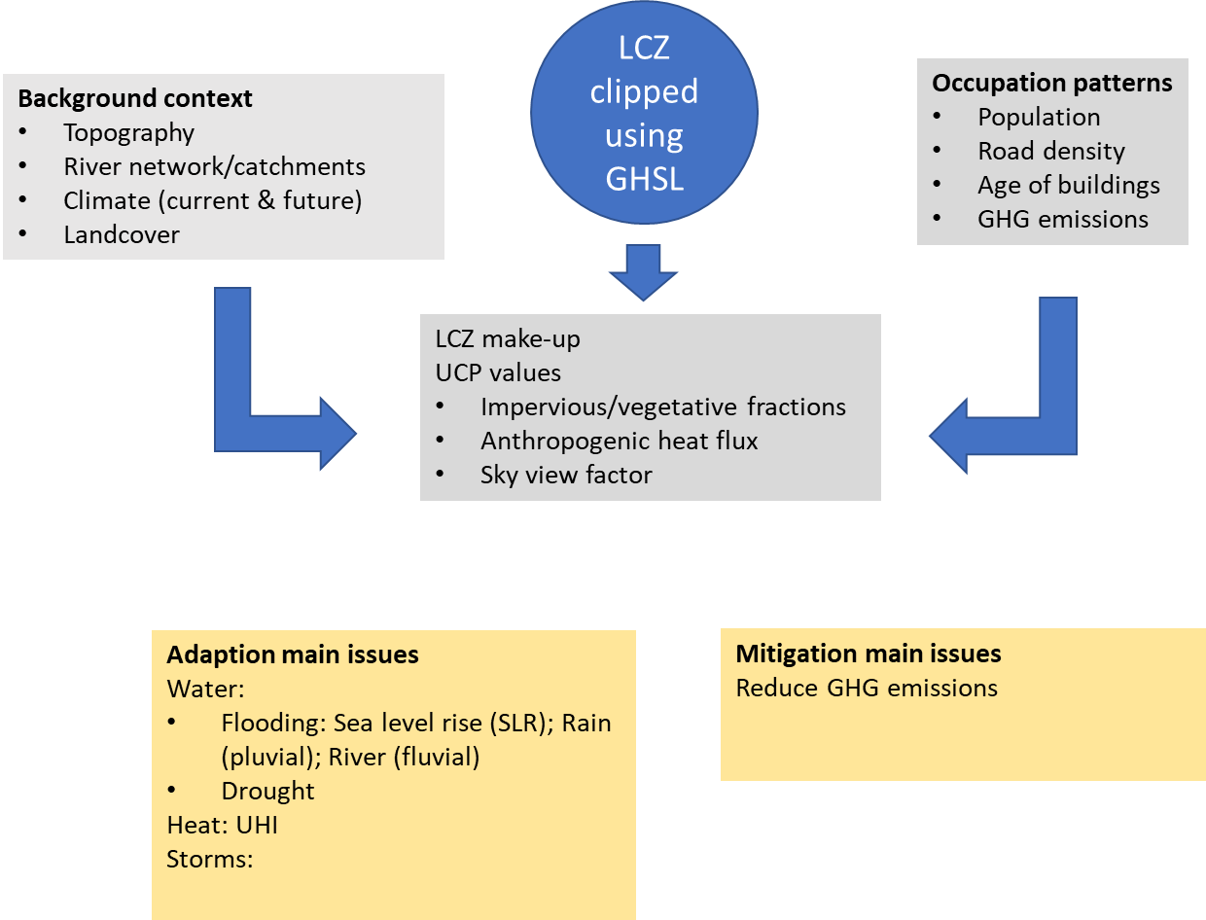
Methodology
Data Management
  Downloaded using Python
  Data initialization (spatial reference, resolution, and extent)
Data analysis
  Time series reconstruction (GHG emission profiles)
  Correlation analysis (between LCZ and other geospatial datasets)

Slide 5
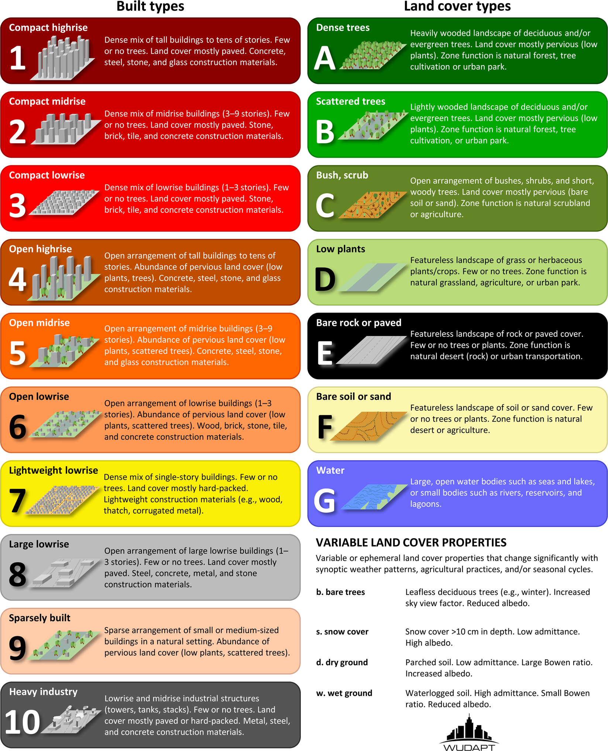
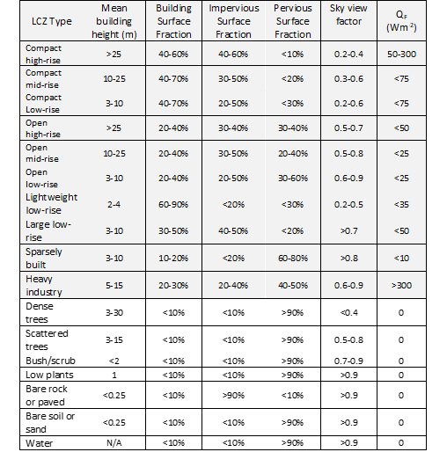
A description of types of urban landscapes.
Local Climate Zone (LCZ) typology

Slide 6
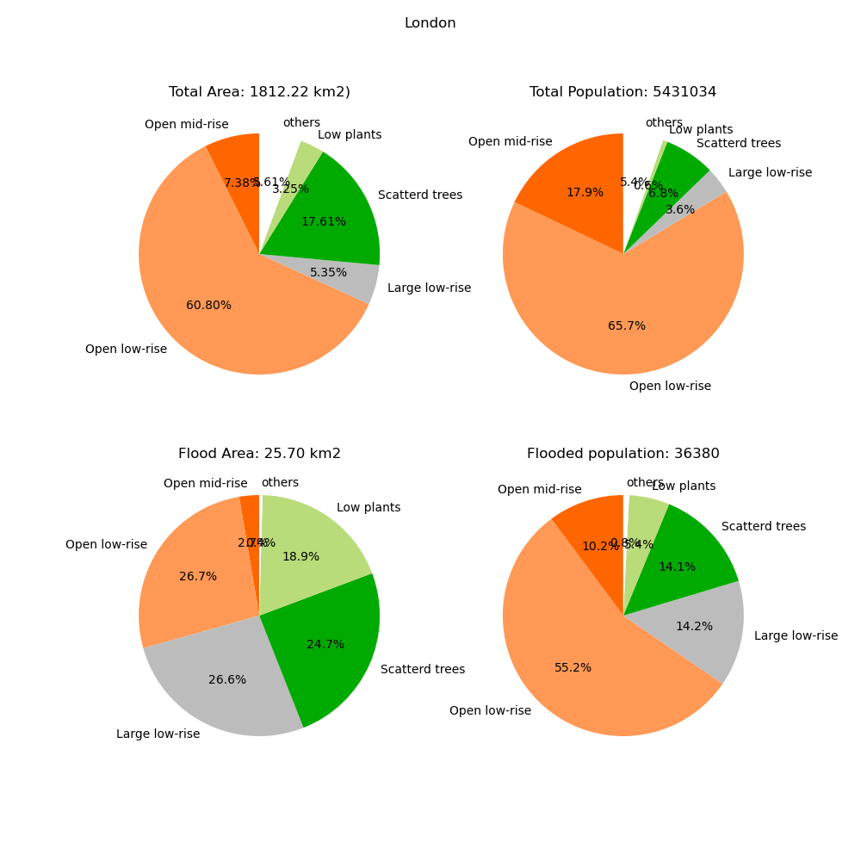
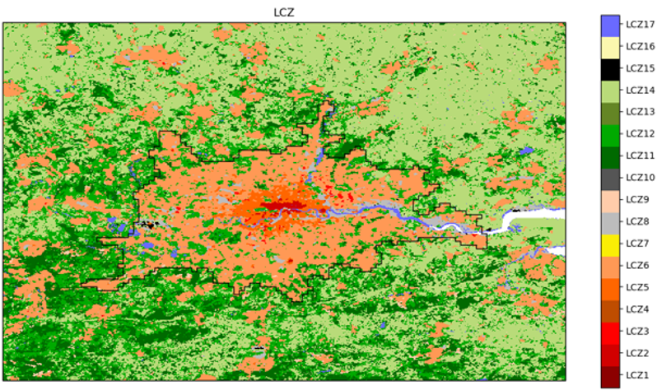
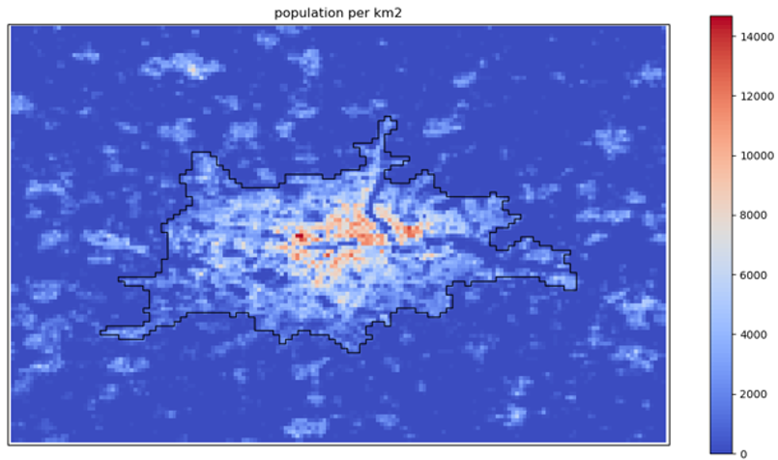
London as Example

Slide 7
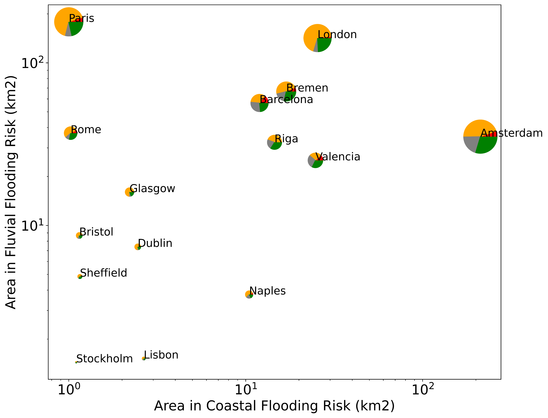
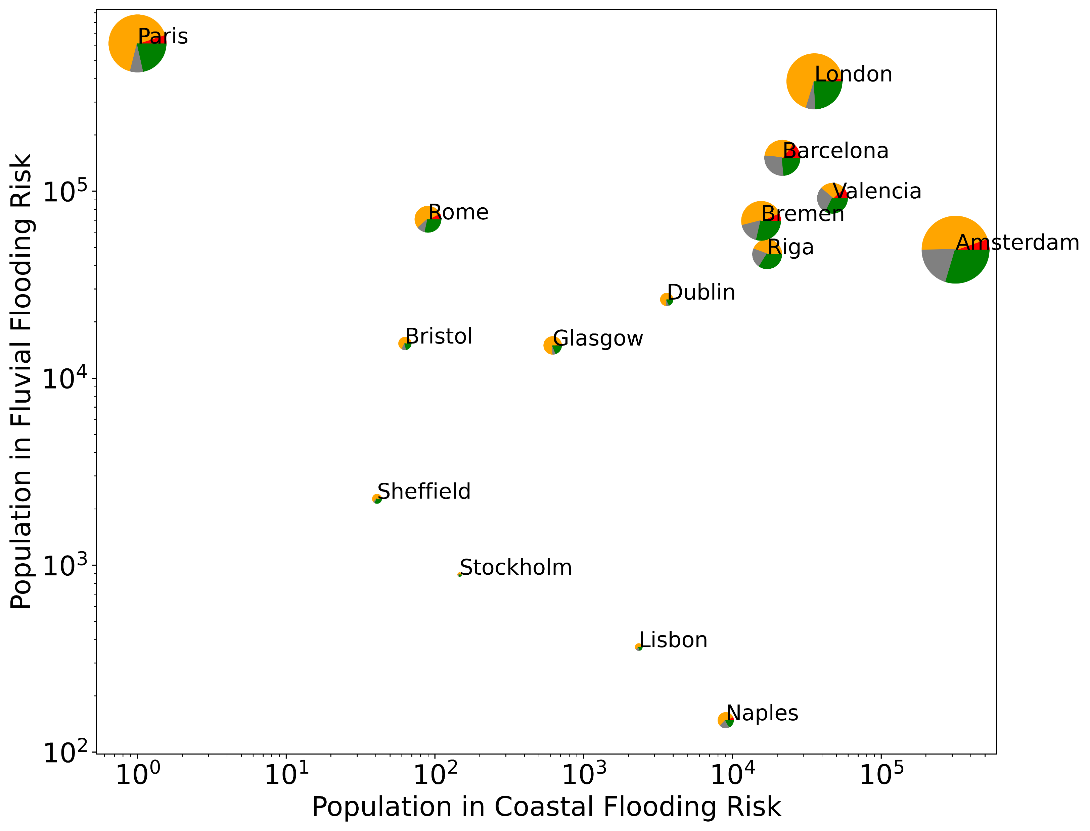
Exposure of European cities to flooding risks
The cities selected is the major cities of Europe (largest by population) that are affected by both coastal flooding and fluvial flooding risks. The size of each pie chart is the area in flooding risks of the city.

Slide 8
Discussion and Conclusion
The exposure of urban form and urban population to climate risks highly depends on the made up of cities which are efficiently described by the Local Climate Zones (LCZs)
Further Steps
  Add other datasets: Air quality (WHO), Urban heat island (Copernicus), Current and projected climate (Climate Data Store)
  Combine data (e.g., wind and coastal flooding) to improve hazard assessment.
  Expand work to global scale using recent global LCZ data.

Slide 9
References
Anjos, M., Targino, A. C., Krecl, P., Oukawa, G. Y., & Braga, R. F. (2020). Analysis of the urban heat island under different synoptic patterns using local climate zones. Building and Environment, 185, 107268.
Brousse, O., Martilli, A., Foley, M., Mills, G., & Bechtel, B. (2016). WUDAPT, an efficient land use producing data tool for mesoscale models? Integration of urban LCZ in WRF over Madrid. Urban Climate, 17, 116-134.
Demuzere, M., Bechtel, B., Middel, A., & Mills, G. (2019). Mapping Europe into local climate zones. PloS one, 14(4), e0214474.
Dimitrov, S., Popov, A., & Iliev, M. (2021). An Application of the LCZ Approach in Surface Urban Heat Island Mapping in Sofia, Bulgaria. Atmosphere, 12(11), 1370.
Wang, C., Middel, A., Myint, S. W., Kaplan, S., Brazel, A. J., & Lukasczyk, J. (2018). Assessing local climate zones in arid cities: The case of Phoenix, Arizona and Las Vegas, Nevada. ISPRS Journal of Photogrammetry and Remote Sensing, 141, 59-71.
Zhao, Z., Shen, L., Li, L., Wang, H., & He, B.-J. (2020). Local climate zone classification scheme can also indicate local-scale urban ventilation performance: An evidence-based study. Atmosphere, 11(8), 776.
Zhou, Y., Zhang, G., Jiang, L., Chen, X., Xie, T., Wei, Y., . . . Lun, F. (2021). Mapping local climate zones and their associated heat risk issues in Beijing: Based on open data. Sustainable Cities and Society, 74, 103174.

