Slide 1
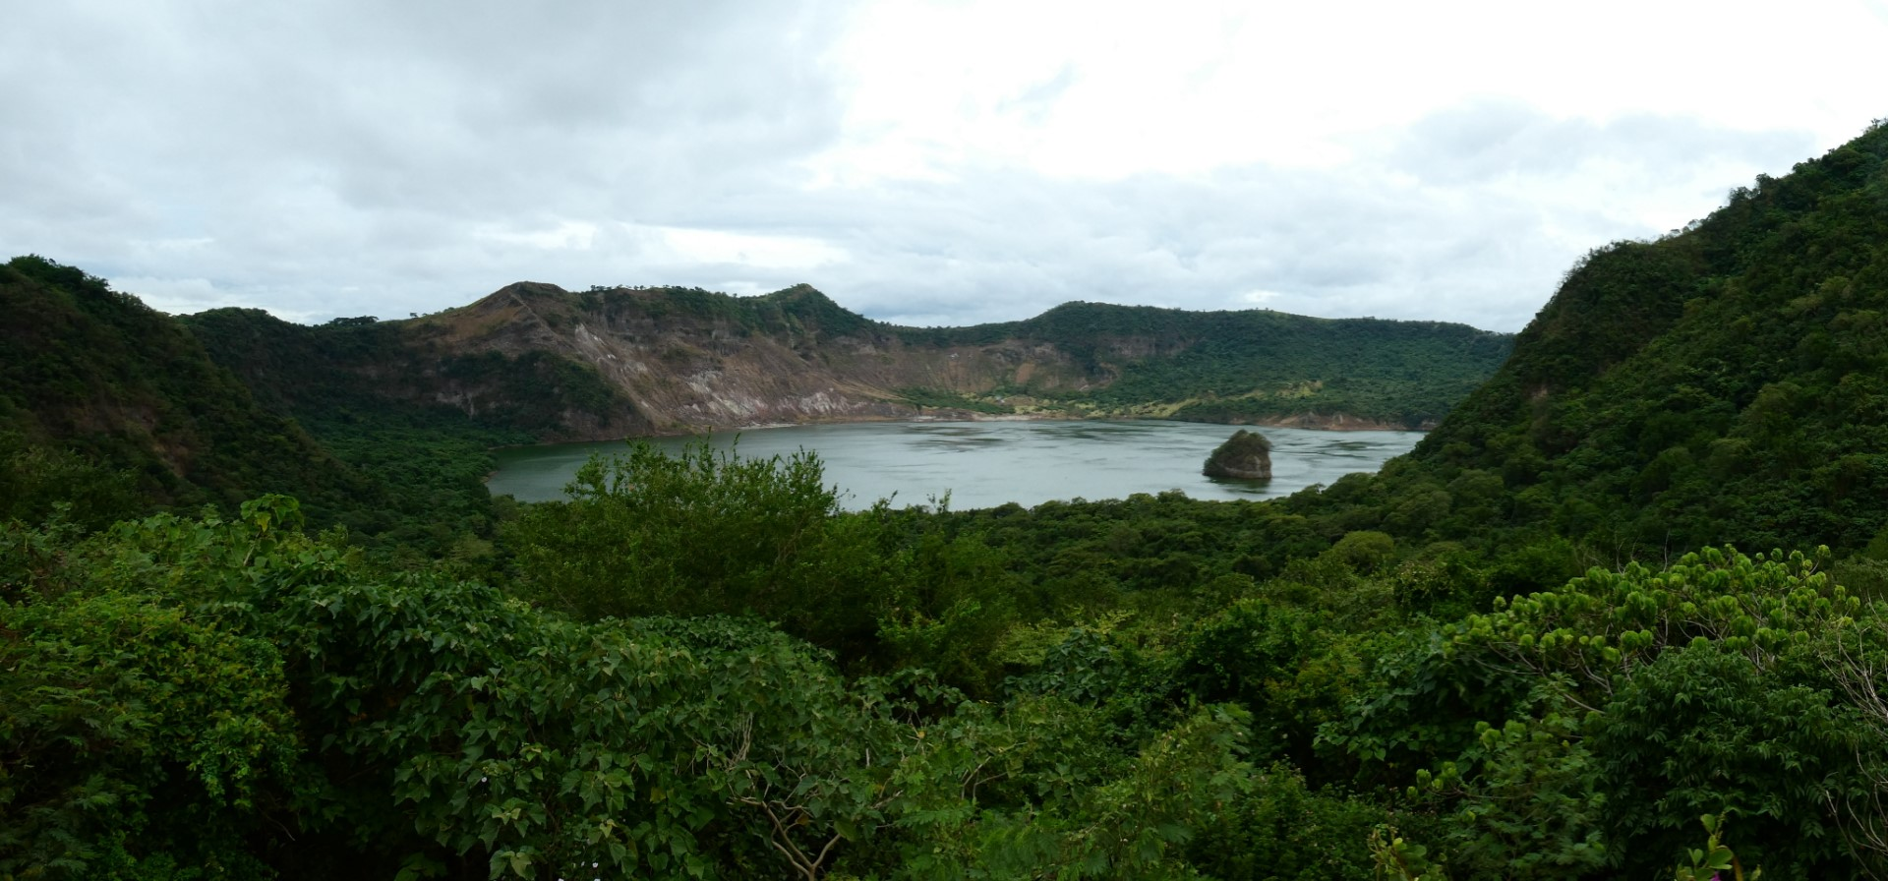

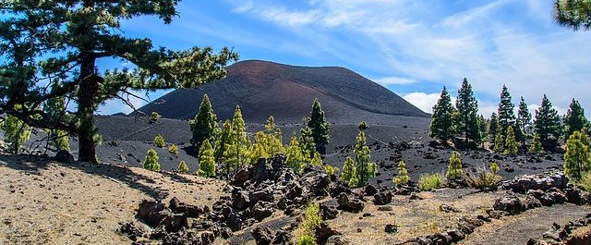


Geochemical monitoring of the Tenerife North-East and North West Rift Zones by means of diffuse degassing surveys
Lía Pitti Pimienta^{1,2,} Fátima Rodríguez^{1,} María Asensio-Ramos¹, Gladys Melián^{1,2}, Daniel Di Nardo¹, Alba Martín-Lorenzo^{1,2,} Mar Alonso^{1,2}, Rubén García-Hernández¹, Víctor Ortega¹, David Martínez Van Dorth^{1,2}, María Cordero¹, Tai Albertos^{1,2}, Pedro A. Hernández^{1,2}, and Nemesio M. Pérez^{1,2}
Instituto Volcanológico de Canarias (INVOLCAN), 38320 La Laguna, Tenerife, Canary Islands, Spain
(2) Instituto Tecnológico y de Energías Renovables (ITER), 38600 Granadilla de Abona, Tenerife, Canary Islands, Spain
https://www.caminantesdeaguere.com/ruta-por-el-volcan-chinyero/

Slide 2
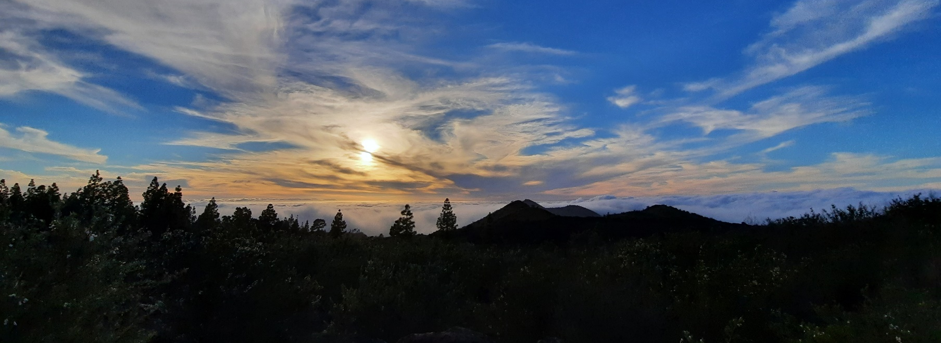
INTRODUCTION
METHODOLOGY
OBJECTIVES
CONCLUSIONS
RESULTS
Investigate the temporal and spatial variation of diffuse CO₂ emission at the North-East (NERZ) and North-West (NWRZ) rift zones of Tenerife island
To strengthen the volcanic surveillance program of Tenerife island through surface geochemical surveys.

Slide 3
INTRODUCTION
METHODOLOGY
OBJECTIVES
CONCLUSIONS
CONCLUSIONS
RESULTS
Why diffuse CO₂ emission studies in North-East and North-West rift zones?
Many studies on volcanic gas emissions report that large amounts of CO₂ are release during periods of quiescence and not only as visible emanations.
CO₂ is, after water, the main component of the volcanic gases and has low solubility in silicate melts.
Diffuse CO₂ degassing studies can be used to identify active structural features and potential sites of future eruptions.
The diffuse CO₂ emission rates may increase extraordinarily before a volcanic eruption.
Notes:
Tenerife (2,034 km2 ), the largest island of the Canarian archipelago, is characterized by three volcanic rifts NW-SE, NE-SW and N-S oriented, with a central volcanic structure in the middle, Las Cañadas Caldera, hosting Teide-Pico Viejo volcanic complex. The North-West Rift-Zone (NWRZ) is one of the youngest and most active volcanic systems of the island, where three historical eruptions (Boca Cangrejo in 16th Century, Arenas Negras in 1706 and Chinyero in 1909) have occurred, whereas the North-East Rift-Zone (NERZ) is more complex than the others due to the existence of Pedro Gil stratovolcano that broke the main NE-SW structure 0.8 Ma ago. The most recent eruptive activity along the NERZ took place during 1704 and 1705 across 13 km of fissural eruption in Siete Fuentes (Arafo-Fasnia). To monitor potential volcanic activity through a multidisciplinary approach, diffuse degassing studies have been carried out since 2000 at the NWRZ (72 km2 ) and since 2001 at the NERZ (210 km2 ) in a yearly basis. Long-term variations in the diffuse CO2 output in the NWRZ have shown a temporal correlation with the onsets of seismic activity at Tenerife, supporting unrest of the volcanic system, as is also suggested by anomalous seismic activity recorded in the studied area during April, 2004 and October, 2016 (Hernández et al., 2017)

Slide 4
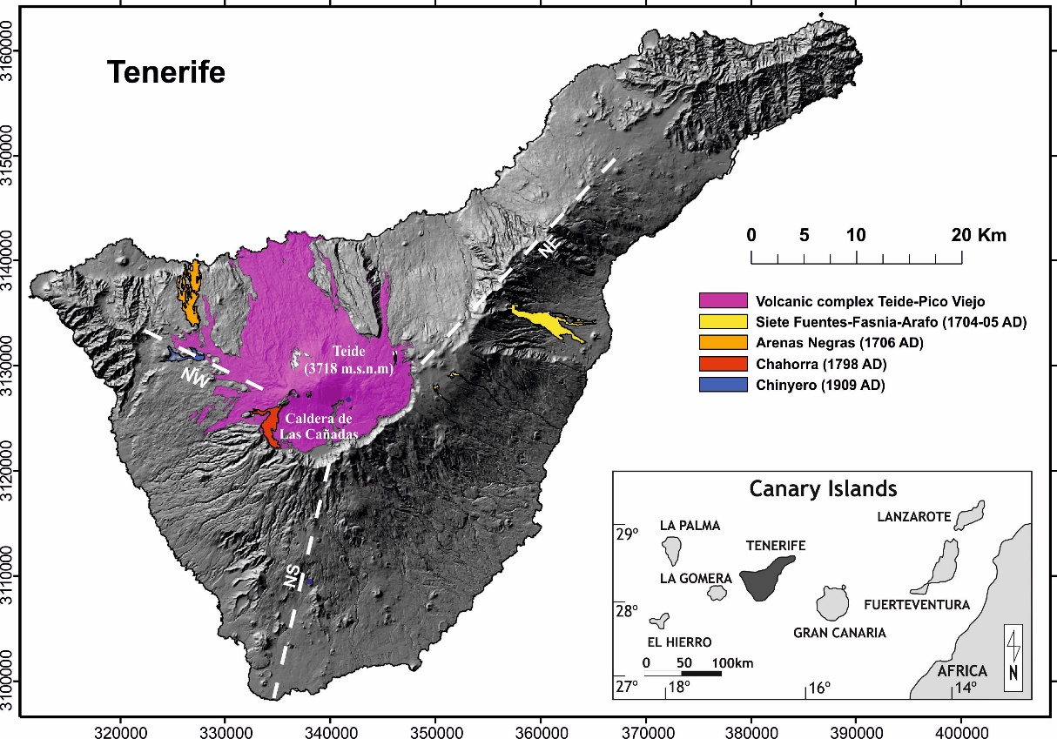
INTRODUCTION
METHODOLOGY
OBJECTIVES
CONCLUSIONS
CONCLUSIONS
RESULTS
Geological setting
Notes:
Tenerife (2,034 km2 ), the largest island of the Canarian archipelago, is characterized by three volcanic rifts NW-SE, NE-SW and N-S oriented, with a central volcanic structure in the middle, Las Cañadas Caldera, hosting Teide-Pico Viejo volcanic complex. The North-West Rift-Zone (NWRZ) is one of the youngest and most active volcanic systems of the island, where three historical eruptions (Boca Cangrejo in 16th Century, Arenas Negras in 1706 and Chinyero in 1909) have occurred, whereas the North-East Rift-Zone (NERZ) is more complex than the others due to the existence of Pedro Gil stratovolcano that broke the main NE-SW structure 0.8 Ma ago. The most recent eruptive activity along the NERZ took place during 1704 and 1705 across 13 km of fissural eruption in Siete Fuentes (Arafo-Fasnia). To monitor potential volcanic activity through a multidisciplinary approach, diffuse degassing studies have been carried out since 2000 at the NWRZ (72 km2 ) and since 2001 at the NERZ (210 km2 ) in a yearly basis. Long-term variations in the diffuse CO2 output in the NWRZ have shown a temporal correlation with the onsets of seismic activity at Tenerife, supporting unrest of the volcanic system, as is also suggested by anomalous seismic activity recorded in the studied area during April, 2004 and October, 2016 (Hernández et al., 2017)

Slide 5
INTRODUCTION
METHODOLOGY
OBJECTIVES
CONCLUSIONS
RESULTS
Sampling sites
639 sampling points; 210 km²
375 sampling points; 72 km²
Diffuse CO₂ efflux
Temperature at 15 and 40 cm depth
Soil gas sampling
Notes:
In order to monitor potential volcanic activity through multidisciplinary approach, diffuse degassing studies have been carried out since 2000 and 2001 in a yearly basis covering an area of 72 square kilometers and 345 sampling points and 210 square kilometers and 639 sampling points respectively.

Slide 6
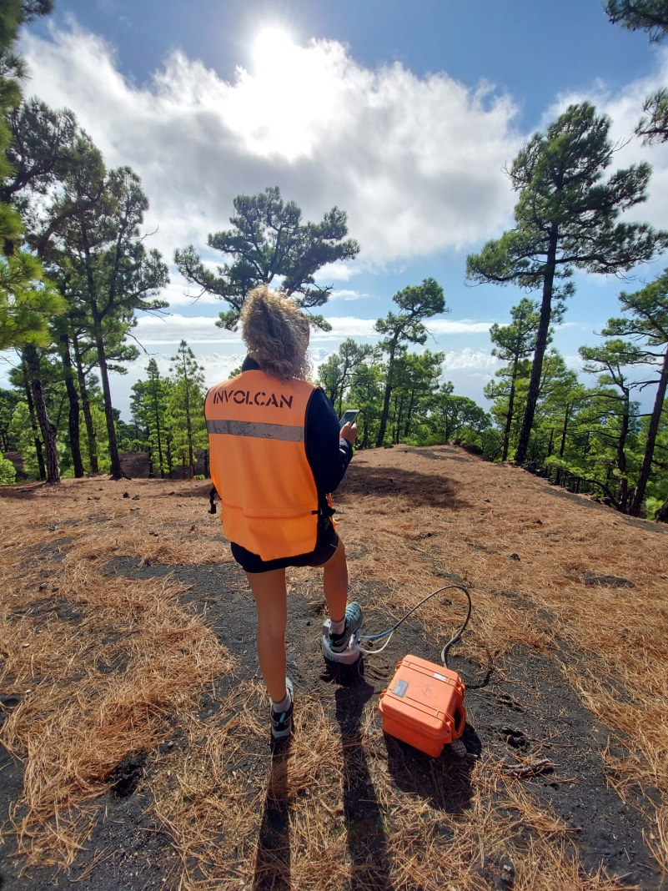
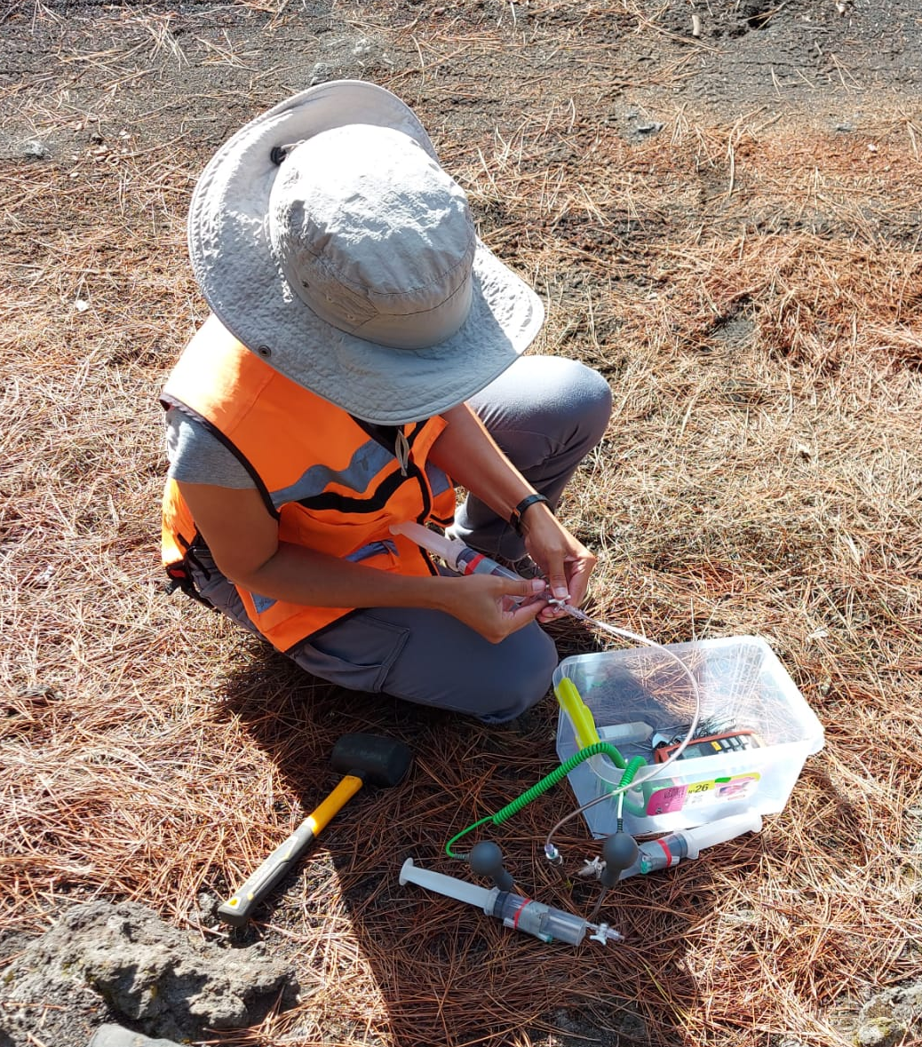
INTRODUCTION
METHODOLOGY
OBJECTIVES
CONCLUSIONS
RESULTS
Measurements
CO₂ efflux measurement
Temperature and ground gases measurement
Notes:
In each point we measured the CO2 flux, we took 3 ground gases samples, each of them for a different analise, QMS for the helium, mGC for the gas components, and IRMS for the isotopes. Besides that, we measured the ground temperature at 15 and 40 cm depth, and the ambient temperature.

Slide 7
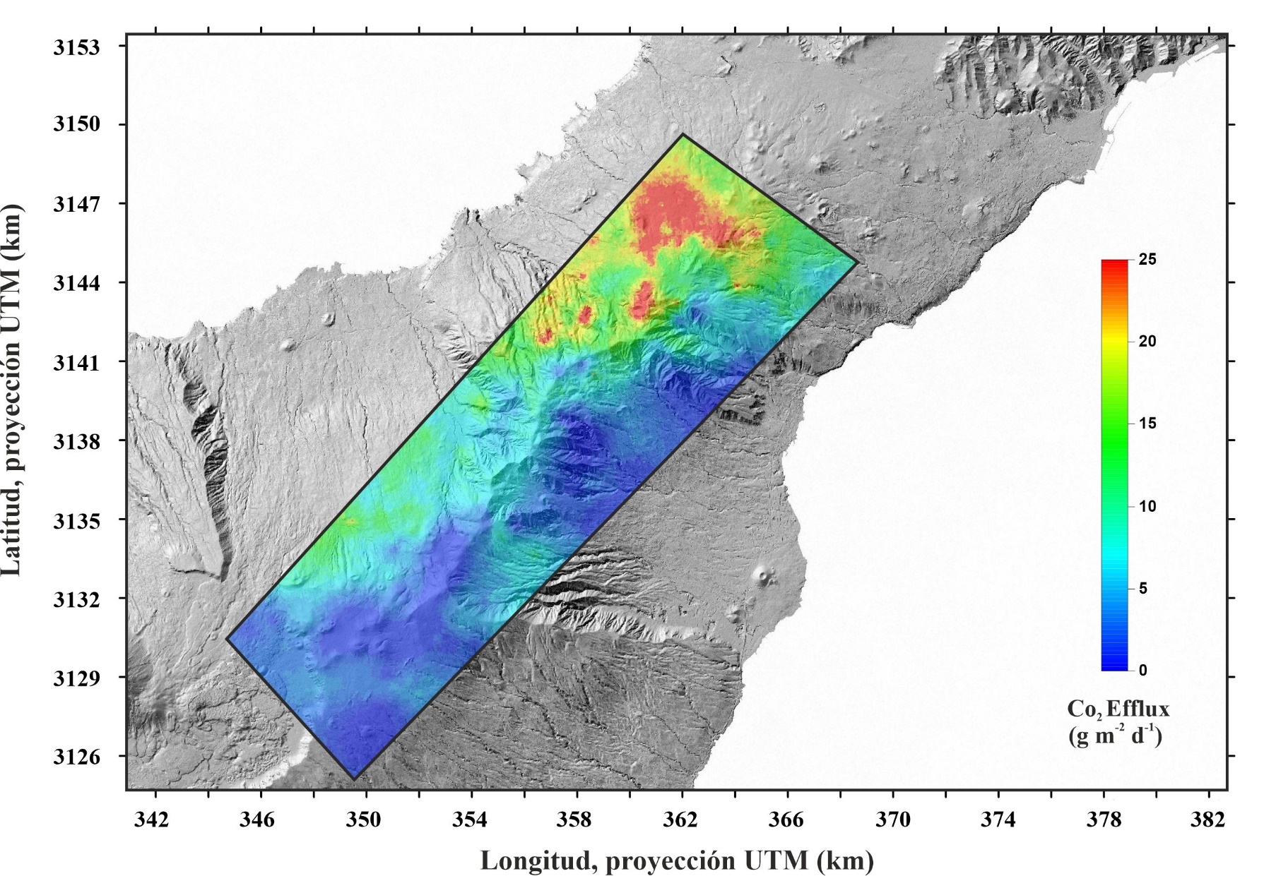
INTRODUCTION
METHODOLOGY
OBJECTIVES
CONCLUSIONS
RESULTS
sGs spatial distribution maps of CO₂ efflux
Notes:
Soil CO2 efflux contour maps were constructed to identify spatial-temporal anomalies and to quantify the total CO2 emission using the sequential Gaussian simulation (sGs) interpolation method. For NERZ, soil CO2 efflux values ranged between non-detectable values and 79 g·m2 ·d-1, with an average value of 7 g·m-2·d-1.
Diffuse emission rate of 1,509 ± 58 t·d-1 for NERZ were obtained.
The normalized CO2 emission value by area was estimated in 7.2 t·d-1·km-1 for NERZ.

Slide 8
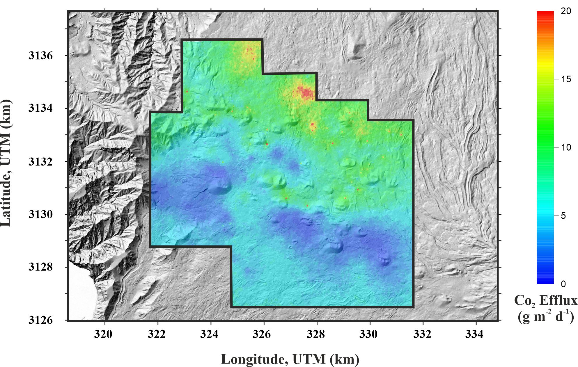
INTRODUCTION
METHODOLOGY
OBJECTIVES
CONCLUSIONS
RESULTS
sGs spatial distribution maps of CO₂ efflux
Notes:
In-situ measurements of CO2 efflux from the surface environment were performed according to the accumulation chamber method using a portable non-dispersive infrared (NDIR) sensor. Soil CO2 efflux values for the 2021 survey ranged between non-detectable values and 104 g·m-2·d-1, with an average value of 8 g·m-2·d-1 for NWRZ.
Diffuse emission rate of 506 ± 22 t·d-1 for NWRZ.
The normalized CO2 emission value by area was estimated in 7.03 t·d-1·km-1 for NWRZ
The probability plot technique applied to the data allowed to distinguish different geochemical populations. Background population represented 74,0% and 49,2% of the total data for NERZ and NWRZ, respectively, with a mean value (1.7 - 2.0 g·m-2·d-1) similar to the background values calculated for other volcanic systems in the Canary Islands with similar soils, vegetation and climate.
Peak population represented 0.7 and 0.9% for NERZ and NWRZ, respectively and with a mean value of 45 and 57 g·m-2·d-1

Slide 9
NERZ diffuse CO₂ emission (2001-2021)
INTRODUCTION
METHODOLOGY
OBJECTIVES
CONCLUSIONS
RESULTS

Slide 10
NWRZ diffuse CO₂ emission (2001-2021)
INTRODUCTION
METHODOLOGY
OBJECTIVES
CONCLUSIONS
RESULTS

Slide 11
INTRODUCTION
METHODOLOGY
OBJECTIVES
CONCLUSIONS
RESULTS
Spatial distribution maps of the diffuse CO₂ emission shows the highest values as multiple isolated anomalies and did not show a clear relation with the main volcano-structural features of the study areas.
Results reveal significant variations on the diffuse CO₂ emission rates at NWRZ and NERZ and do not seem to be masked by external variations, showing a temporal correlation with the seismic activity.
The observed increase of the seismicity recorded from end of 2016 in and around Tenerife Islands is preceded by an increase on the diffuse CO₂ emission rate from 2014 at the NERZ, with maximum values registered in 218, 2019 and 2020 surveys.
The increase on seismicity registered in and around Tenerife Island between 2004 and 2005, 2010–2011 and 2016 were preceded by geochemical anomalies produced by an increasing release to the surface of soil CO₂ at the NWR zone.
The recorded data demonstrate the importance of measuring these parameters to identify and evaluate changes in volcanic activity and allowed us to define background levels for NWRZ and NERZ zones of Tenerife and to establish thresholds useful for future monitoring.

Slide 12




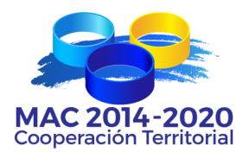

Acknowledgements
Projects VOLRISKMAC (MAC/3.5b/124) and VOLRISKMAC II (MAC2/3.5b/328), financed by the Program INTERREG V A Spain-Portugal MAC 2014-2020 of the European Commission
Project TFvolcano financed by the Cabildo Insular de Tenerife
Notes:
REVISAR AGRADECIMIENTOS

Slide 13
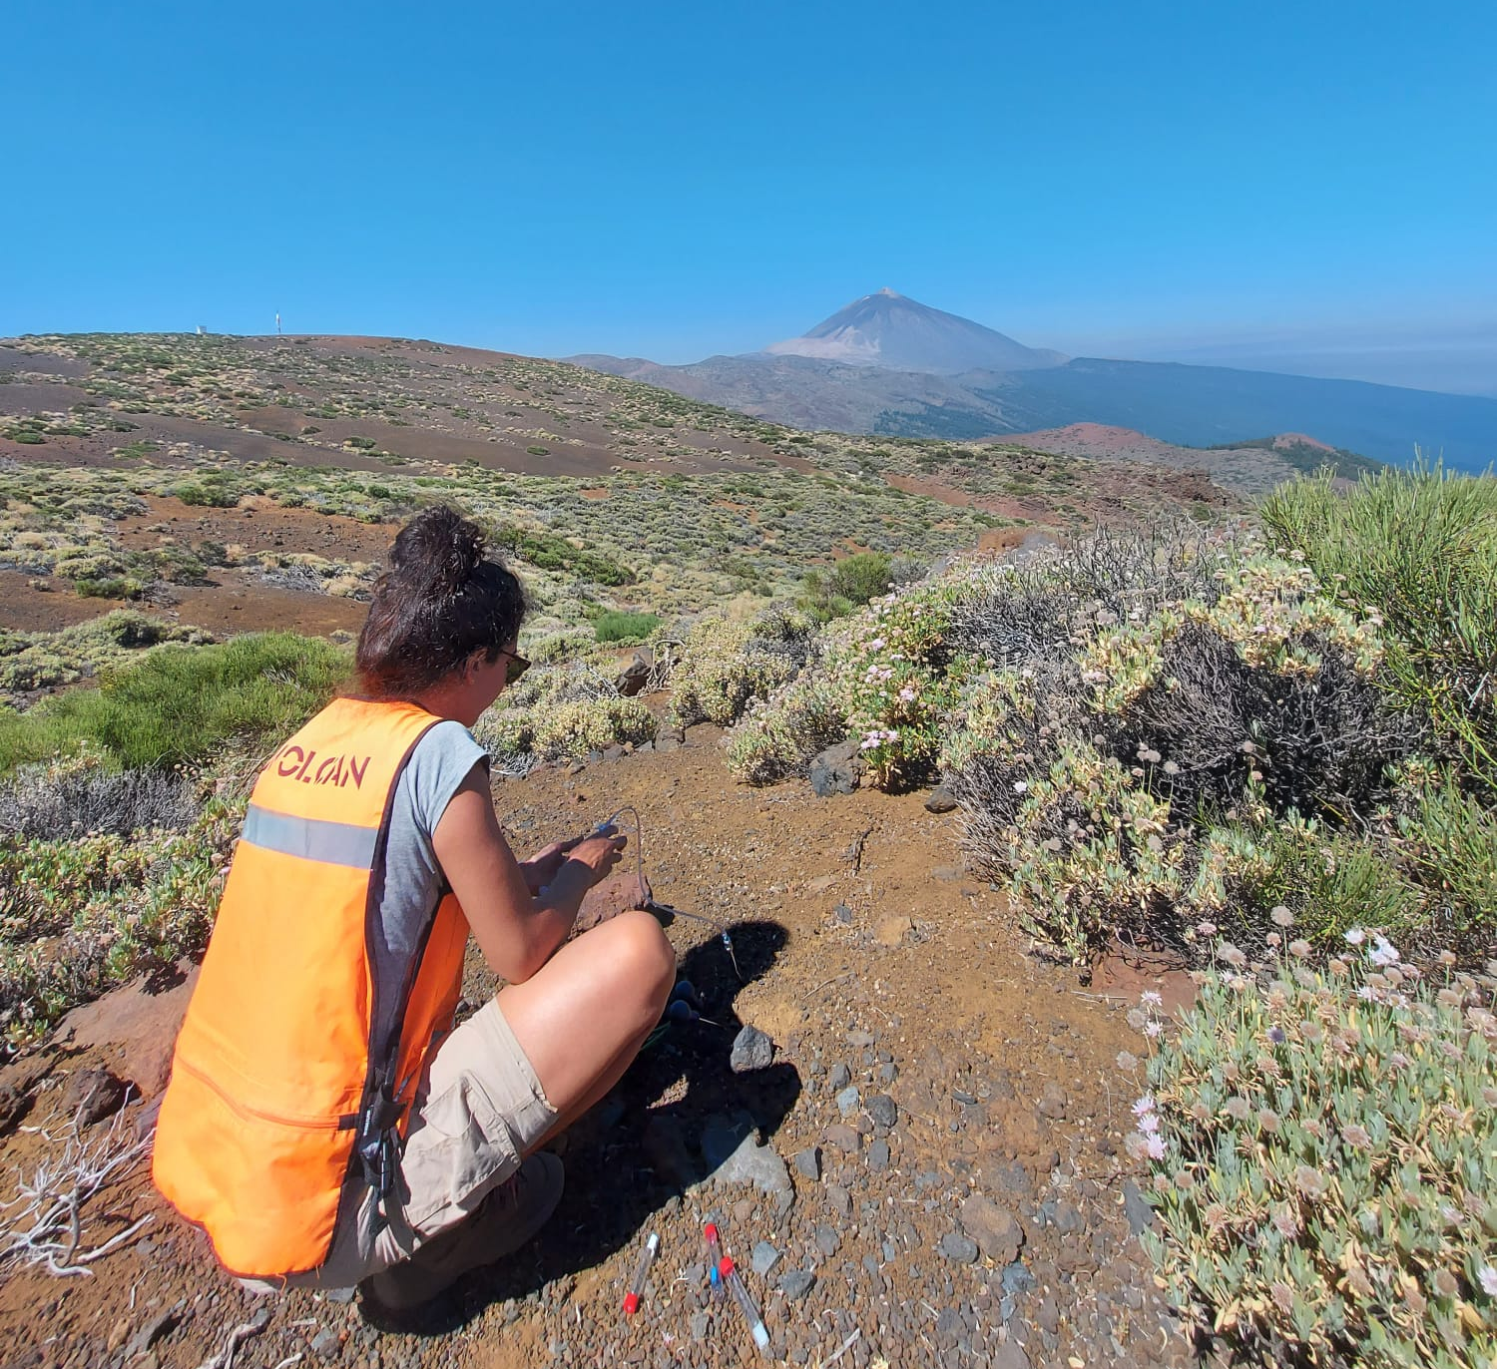
THANK YOU VERY MUCH
FOR YOUR ATTENTION

