Slide 1
Kinetic signatures of magnetic reconnection
in the global hybrid-Vlasov and local particle-in-cell simulations.
I. Zaitsev¹⁾ , A. Divin²⁾, Y. Pfau-Kempf¹⁾, U. Ganse¹⁾, G. Cozzani¹⁾, M. Battarbee¹⁾, M. Alho¹⁾, J. Suni¹⁾, L. Turc¹⁾, M. Grandin¹⁾, K. Horaites¹⁾, M. Dubart¹⁾, M. Bussov¹⁾, K. Papadakis¹⁾, H. George¹⁾, V. Tarvus¹⁾, T. Mangleyev¹⁾, H. Zhou¹⁾, M. Palmroth¹⁾.
University of Helsinki, Helsinki, Finland
Saint-Petersburg State University, Saint-Petersburg, Russia

Slide 2
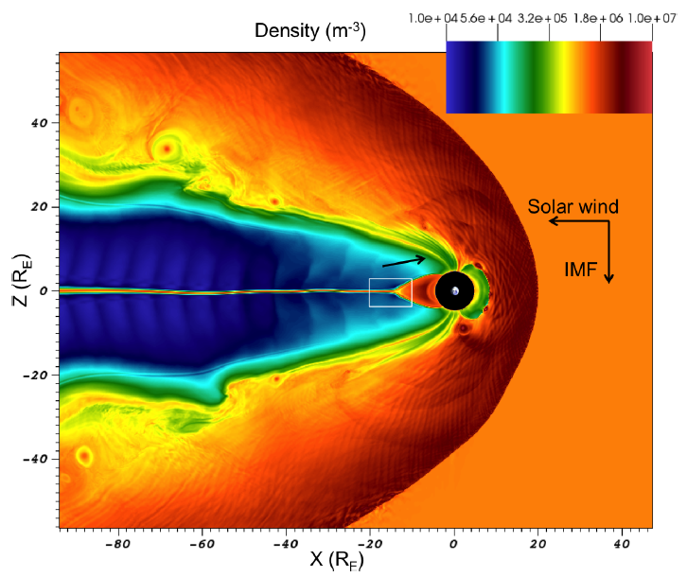


Models
Vlasiator: global hybrid-Vlasov model [Palmroth 2018]:
Solves Vlasov equation:
2D Run: Velocity grid resolution 30 km/s
Constant spatial mesh with dx=300 km
Box size: X [-150,50] Re, Y [-50,50] Re
3D Run: Velocity grid resolution 40 km/s
Adaptive mesh with 3 refinement levels: dx1=0.16 Re, dx1=0.64 Re, dx1=1.28 Re,
Box size: X [-111,50], Y [-58,58], Z [-58,58].
IMF conditions: (0,0,-5) nT, ni=10^6 m^-3, Vsw = (-750,0,0) km/s
iPIC3D: implicit moments fully-kinetic code [Markidis 2010]:
Calculates trajectories of macro particles:
2D run: Spatial resolution: dx=0.0417di = 0.0047 Re; Box size: [Lx x Lz] =[96 x 16] Re
Mass ratio: me/mi = 1/256
Parameters for renormalization to SI: n0=0.1 * 10^6 m^-3 ; B0=25 nT

Slide 3
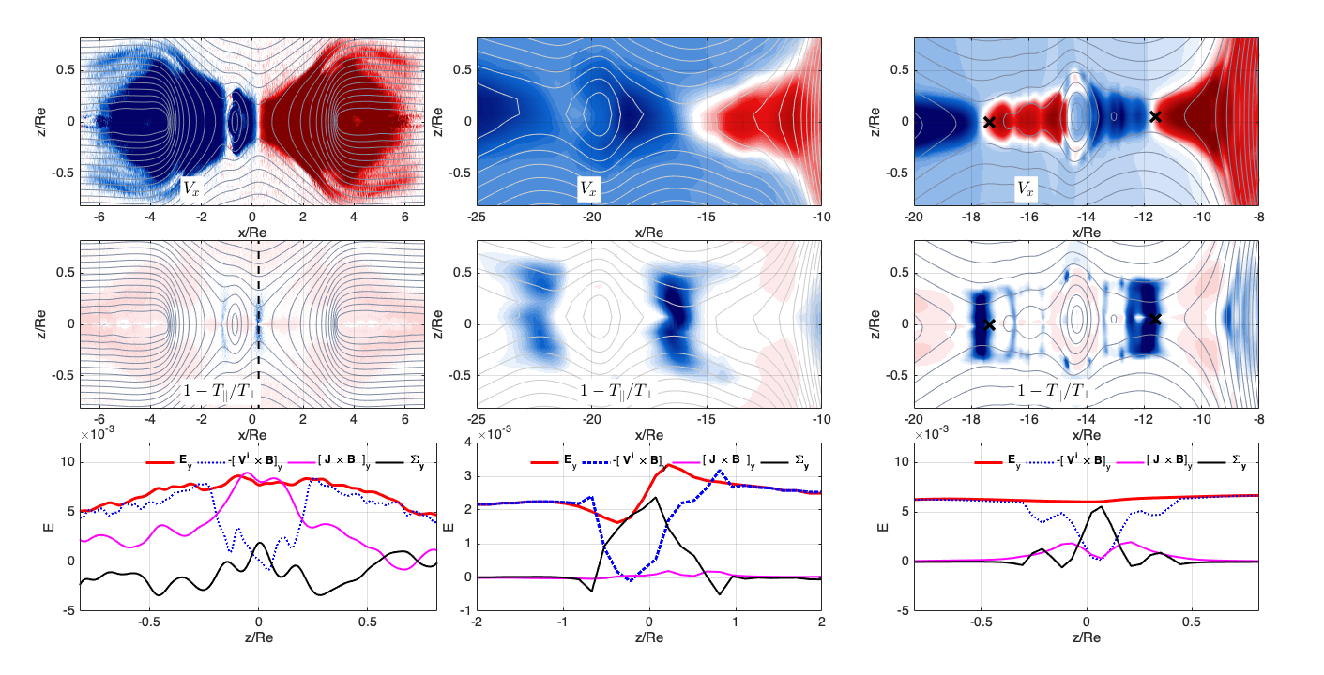
Reconnection signatures:
2D PIC
3D Vlasiator
2D Vlasiator
X point: flow divergent; IDR: perpendicular anisotropy, frozen-in conditions violation.
X points in 2D global simulation found with flux function method [Hoilijoki 2017].
For the 3D simulation we can not define the X-point (X-line) unambiguously.

Slide 4
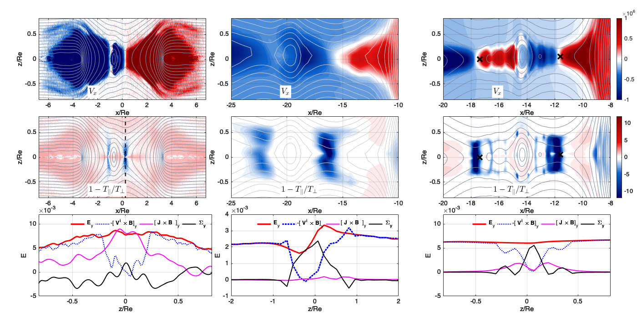
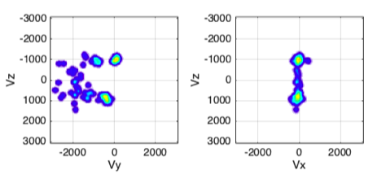
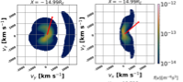
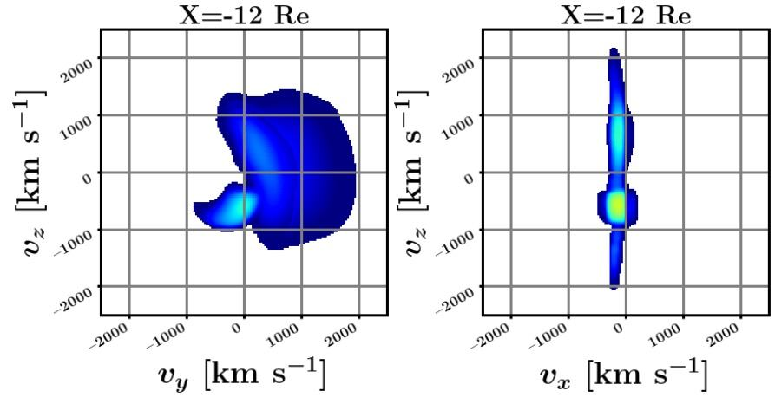
Reconnection signatures in the velocity space:
2D PIC
3D Vlasiator
2D Vlasiator
Crescent-shape distribution (in high energy range) indicates demagnetised population.
Counterstreaming along the normal to current layer displays to acceleration by Hall fields.

Slide 5
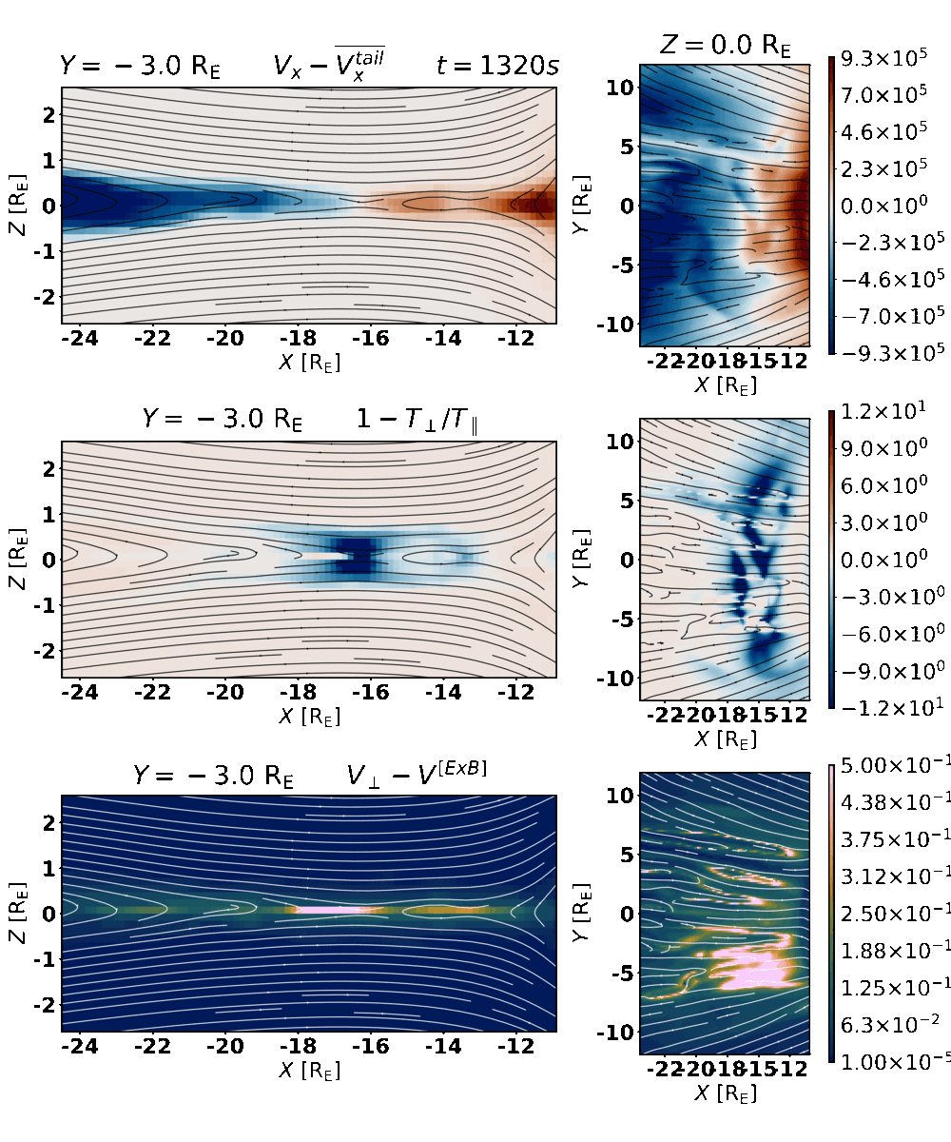

Evolution of X-line in 3D magnetotail current layer
Flow reversal indicate
the “X-line” dynamic across the tail
(average tailwind velocity is extracred)
Anisotropy (Tperp>Tpar) within IDR:
Demagnetization
Acceleration by Hall Ez fields
Proxy for ion demagnetization:
Perpendicular slippage

Slide 6
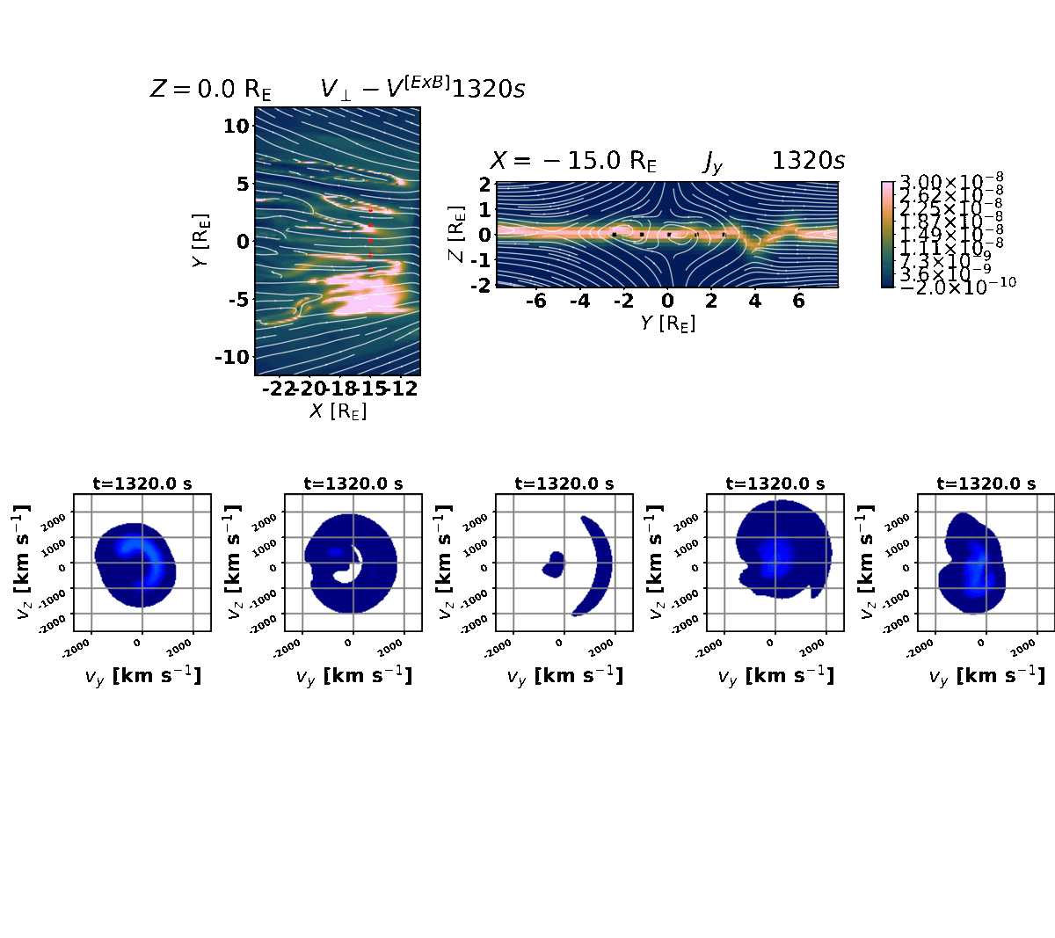
Large-scale oscillations of current layer
Current layer kinking
The region of ion
demagnetization
perturbes and
vanishes
Dawn
Dusk
1.Perturbation arrived from flank
2. Oscillations growed from ion kink instability
Accelerated (~2000 km/s) non-gyrotropic beam is thermalized.

Slide 7
Conclusions:
The numerical diffusion in global hybrid-Vlasov lead to force imbalance in the Ohm’s law.
Within the IDR global hybrid simulation reproduce ion kinetic features of 2D PIC (Hall physics, anisotropic features, crescent-type distributions).
Reconnection produce the demagnetised beam in Y-direction
Cross-tail ion motion provide the excitation of ion-scale instability leading to current layer oscillations.

