Slide 1



Formation model of silica sinter deposits: an example from Western Turkey
Hatice Ünal Ercan¹, Ömer Işık Ece², Paul A. Schroeder³, and Fatma Gülmez²

Slide 2
Purpose of the study
The purpose of this study was to characterize silica microfacies and lithological properties of the silica sinter deposits in the Etili Fossil Silica Sinter Region (EFSSR).
We hypothesize that ancient alkali chloride and acid-sulfate springs were manifesting within the fossil geothermal area, which resulted in silicification and alteration processes.
We support this hypothesize with X-ray diffraction (XRD), field emission – scanning electron microscopy (FE-SEM), elemental analysis, and stable isotopic analysis on the host rock, altered samples, and siliceous and silicified samples.

Slide 3
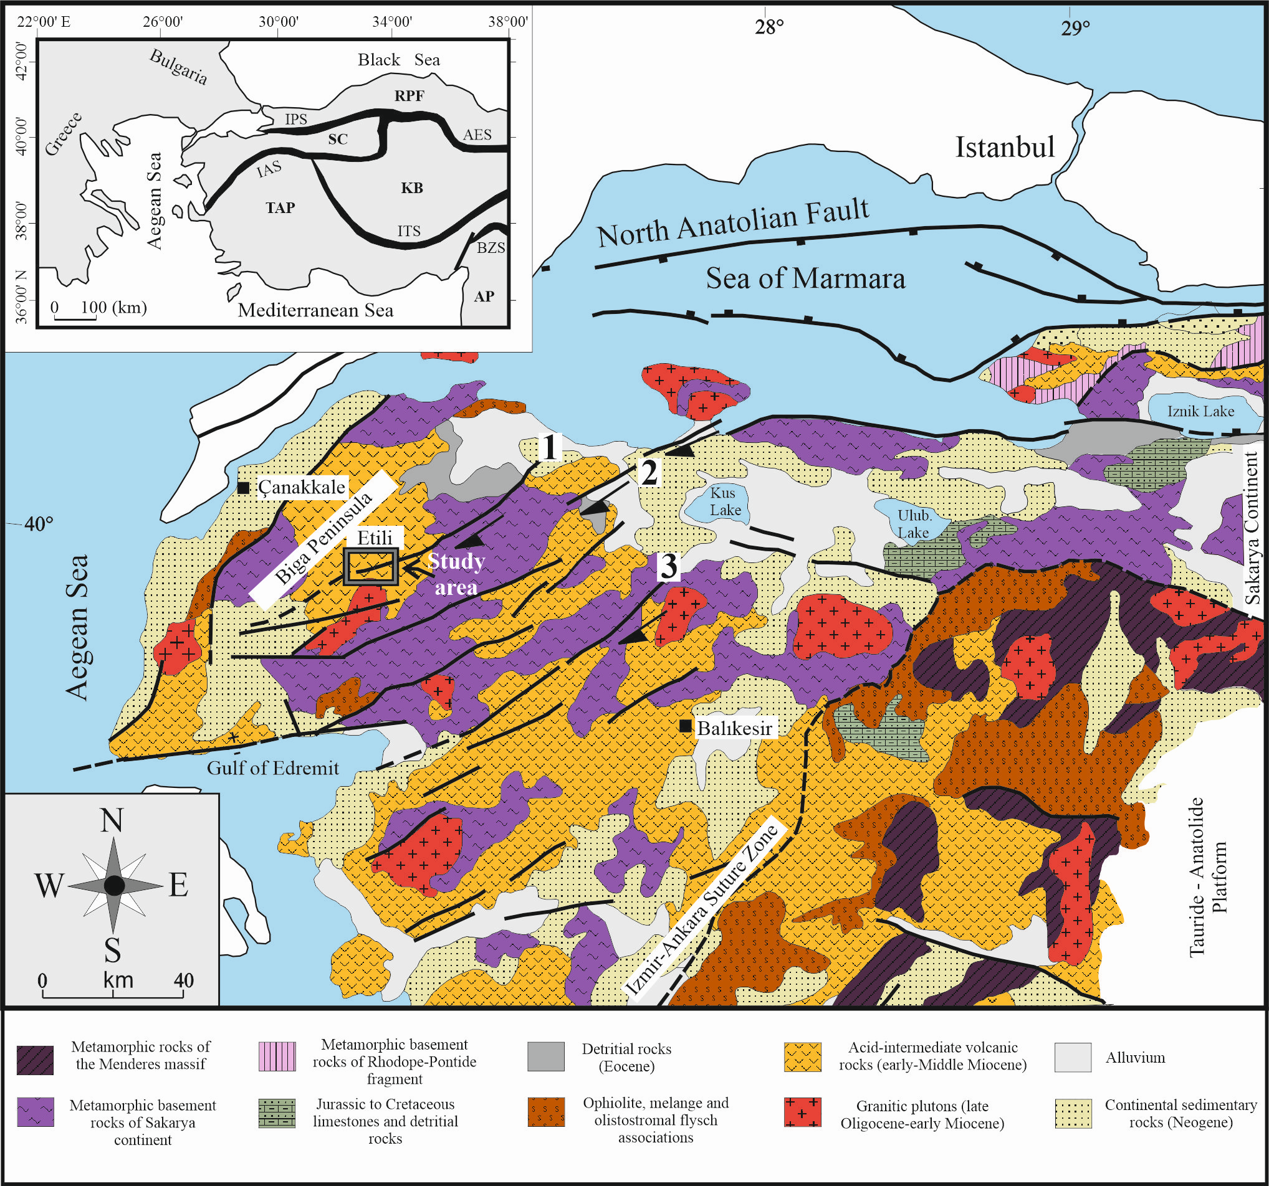
Geological background:
The Etili Fossil Silica Sinter Region is of Oligo-Miocene age well-preserved fossil geothermal system in NW Anatolia (Çanakkale).
It comprises of extensive epidermal deposits with the largest fossil siliceous hot spring deposits of Turkey.
NE trending faults with minor NW-trending fracture systems are the structural components of EFSSR.
Siliceous deposits are commonly associated with the calc-alkaline tuffs, ashes and pyroclastic rocks the products of the extensinal magmatism.

Slide 4
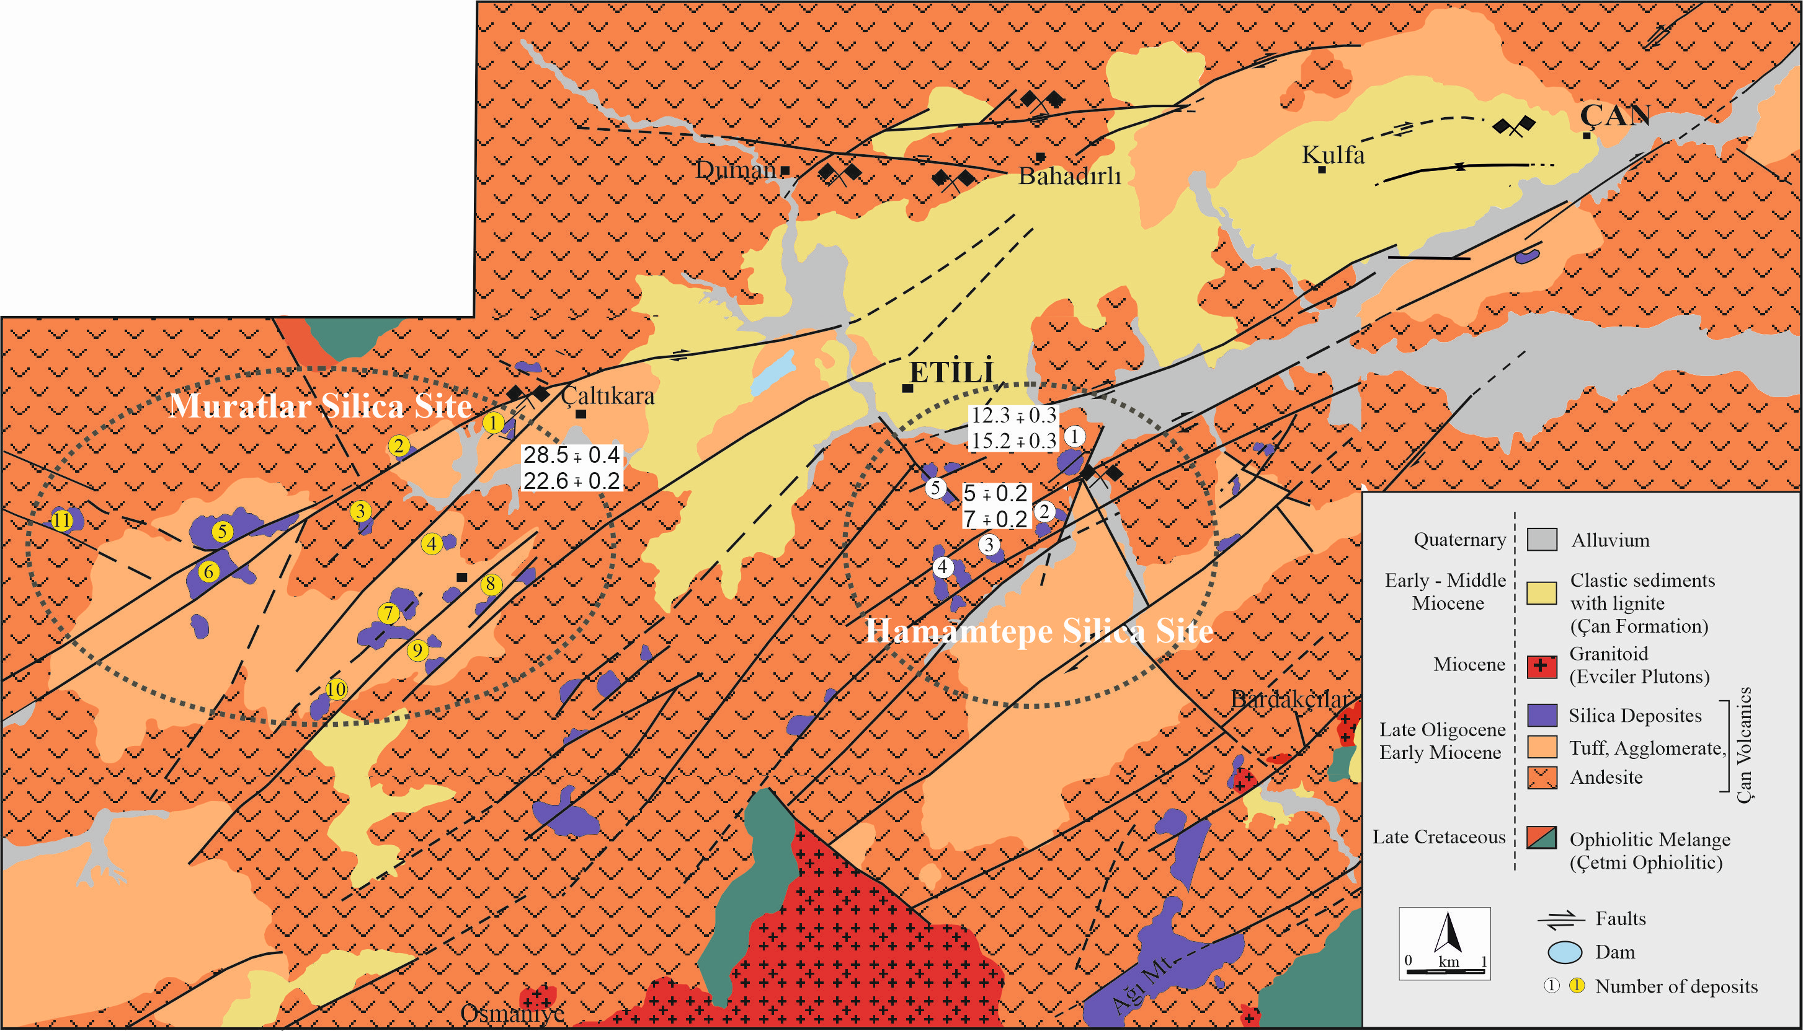
Geological background:
NE trending faults with minor NW-trending fracture systems are the structural components of EFSSR.

Slide 5
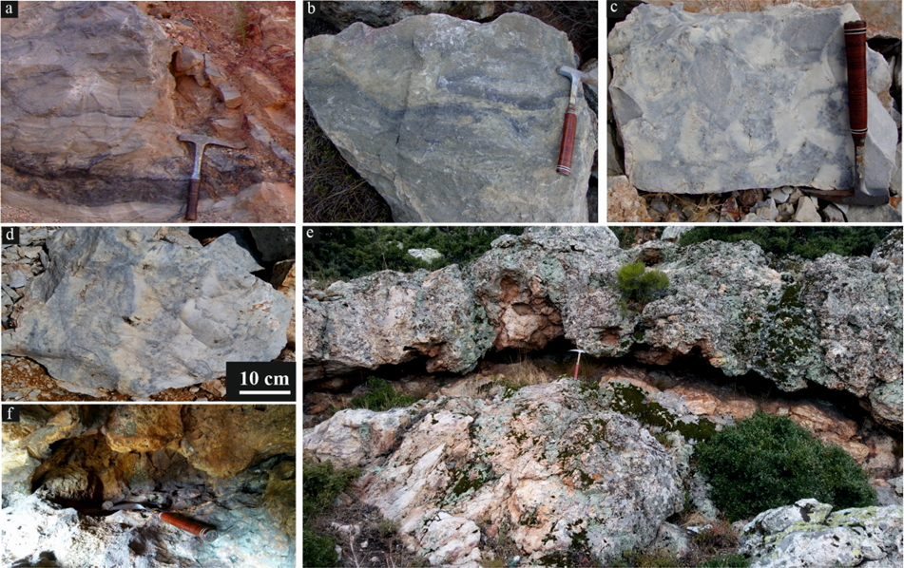
Lithofacies:
Proximal apron lithofacies were the only facies preserved in the region.
Other lithofacies were not preserved due to erosion and tectonism.
The lithofacies observed in the Etili epithermal systems include; silica infiltrates, spring conduits, nodular and finely laminated geyserite, sinter clast breccia, silicified volcanic rocks, and epithermal veins.

Slide 6
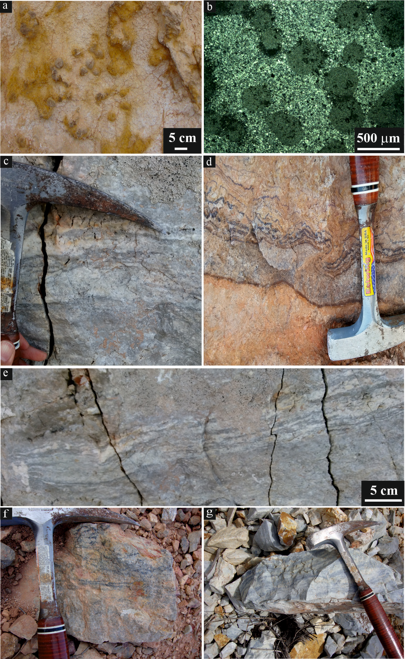
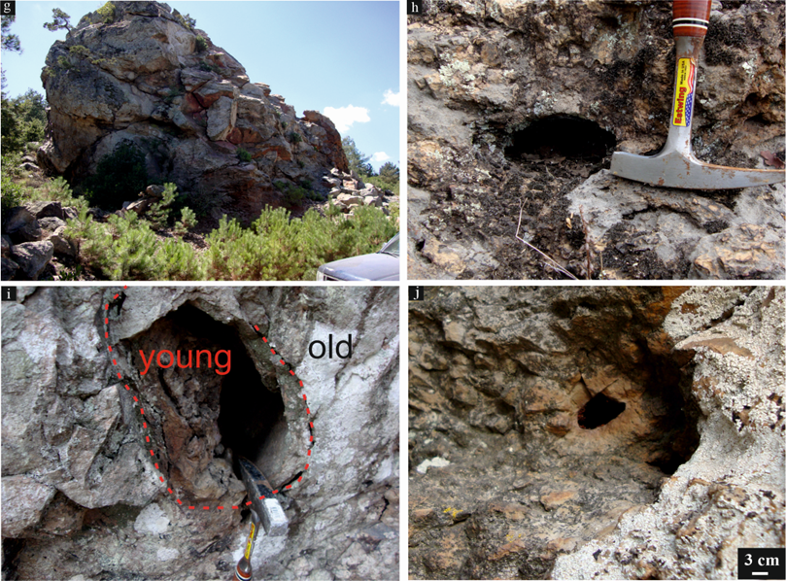
Lithofacies:
The lithofacies observed in the Etili epithermal systems include; silica infiltrates, spring conduits, nodular and finely laminated geyserite, sinter clast breccia, silicified volcanic rocks, and epithermal veins.

Slide 7
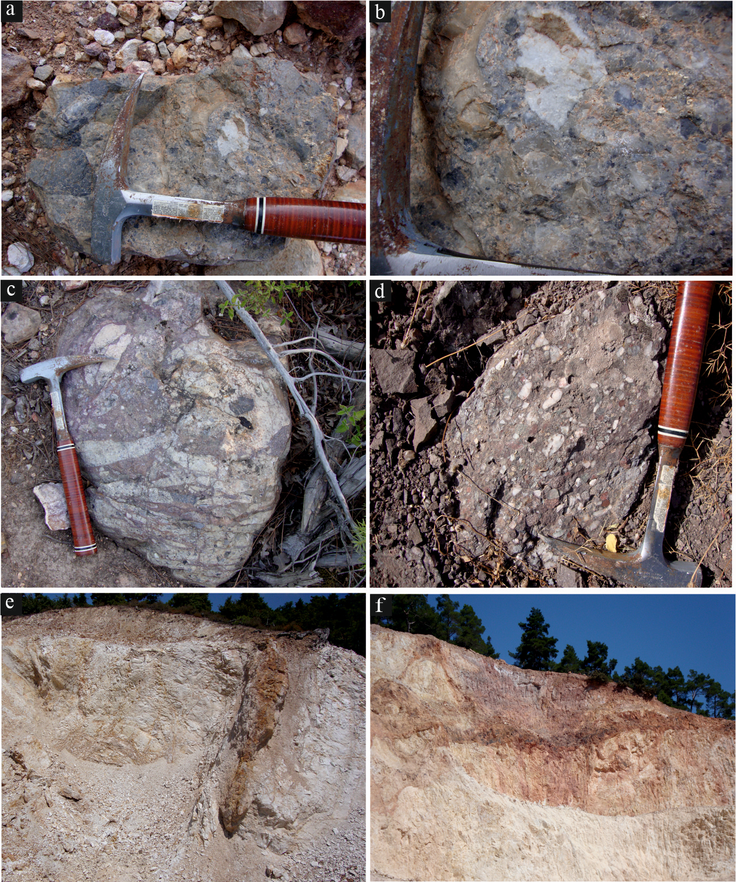
Lithofacies:
Proximal apron lithofacies were the only facies preserved in the region.
Other lithofacies were not preserved due to erosion and tectonism.
The lithofacies observed in the Etili epithermal systems include; silica infiltrates, spring conduits, nodular and finely laminated geyserite, sinter clast breccia, silicified volcanic rocks, and epithermal veins.

Slide 8
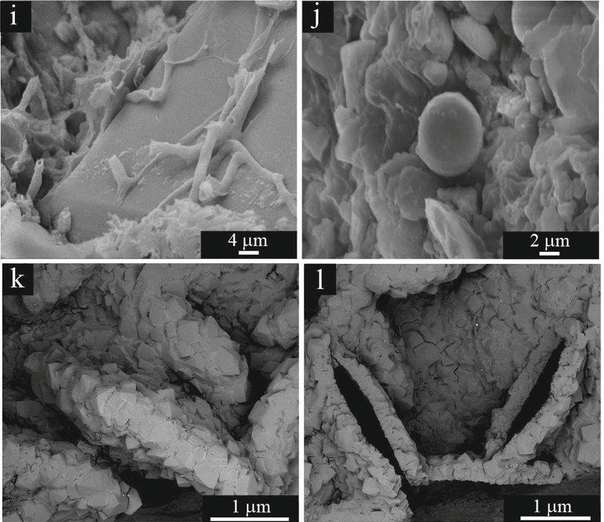
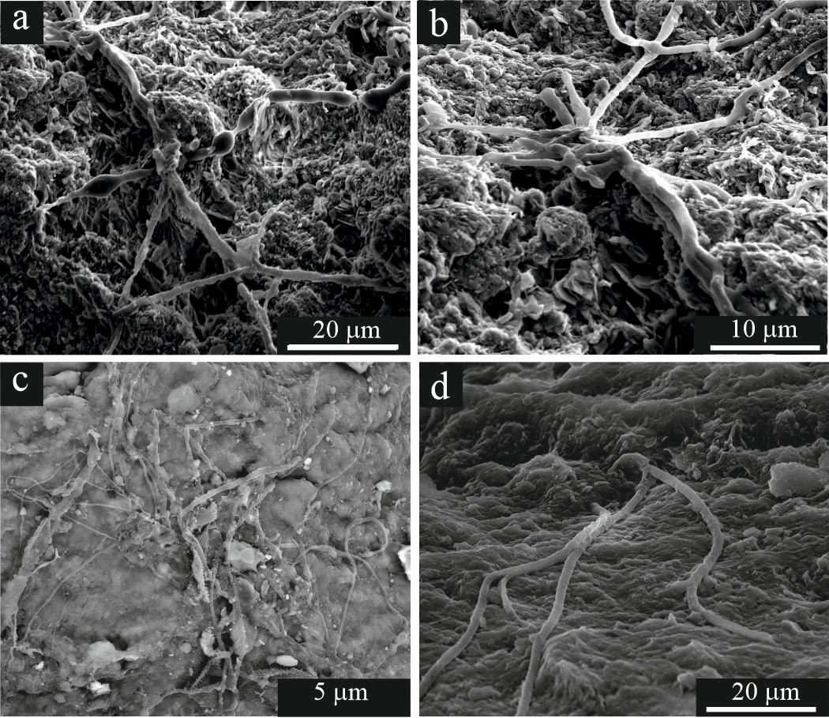
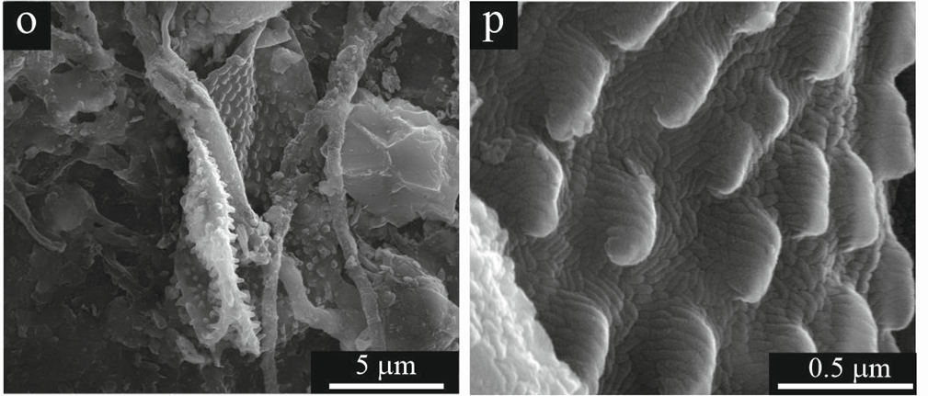
Microfossils:

Slide 9
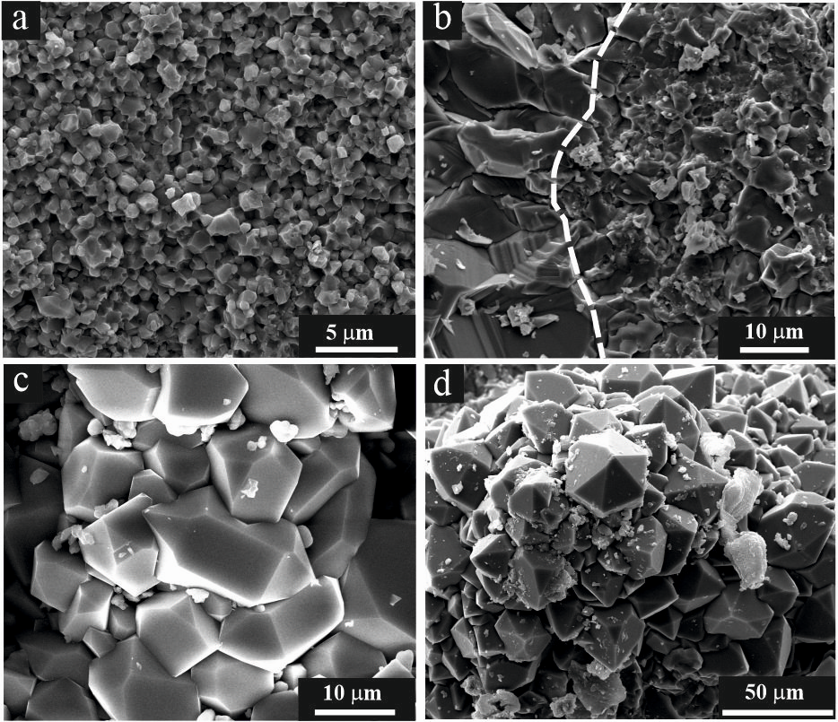
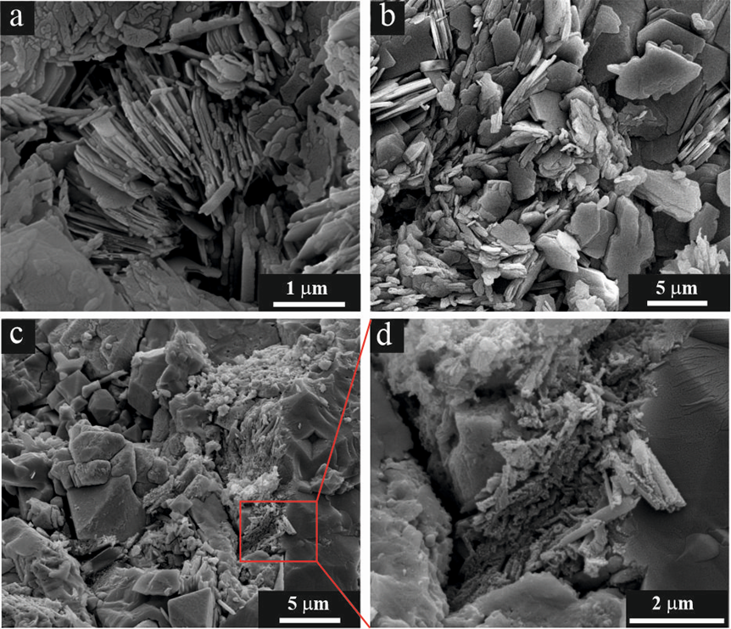
Mineralogy and petrography:
The mineralogical assemblage of the Etili epithermal system consists of kaolinite, halloysite, alunite +/- jarosite, and quartz. The most common silica polymorph detected in the sinters is alpha-quartz. No other silica polymorphs were observed in the region.

Slide 10
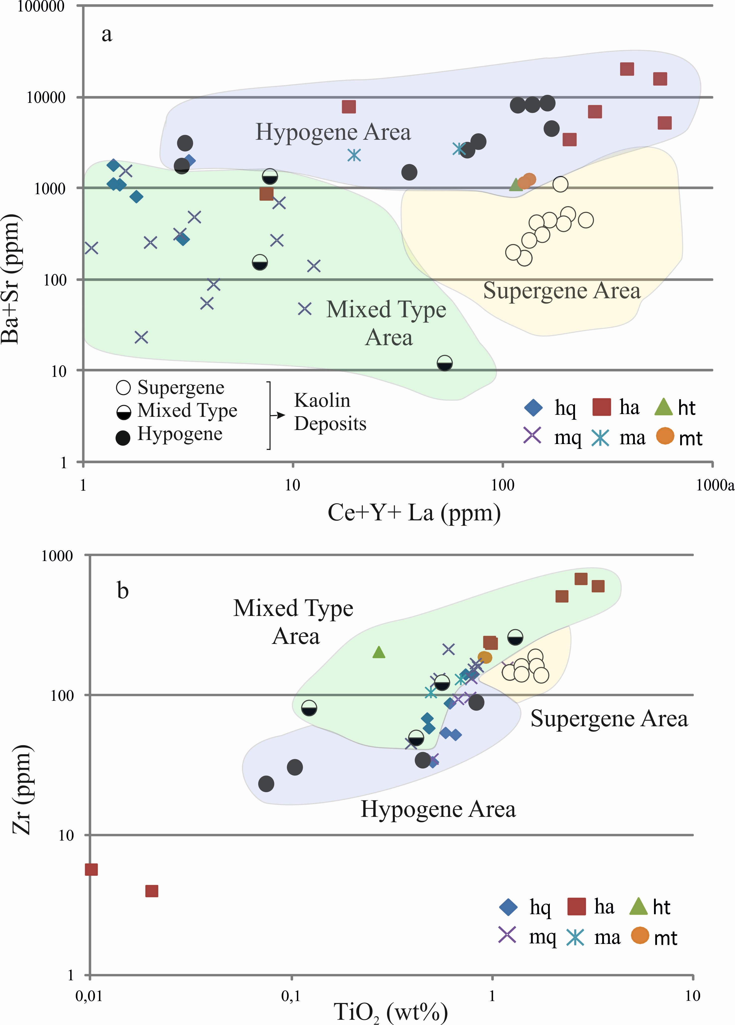
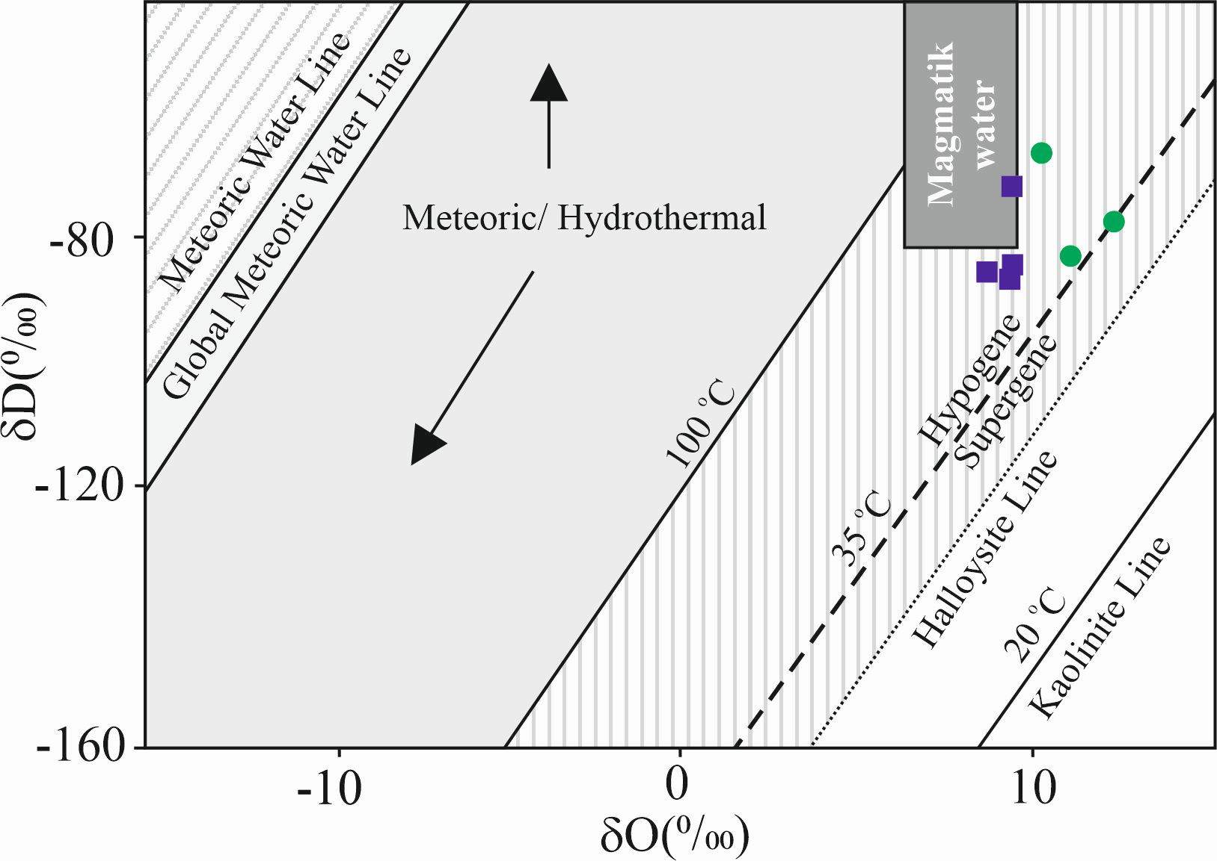
Geochemistry:

Slide 11
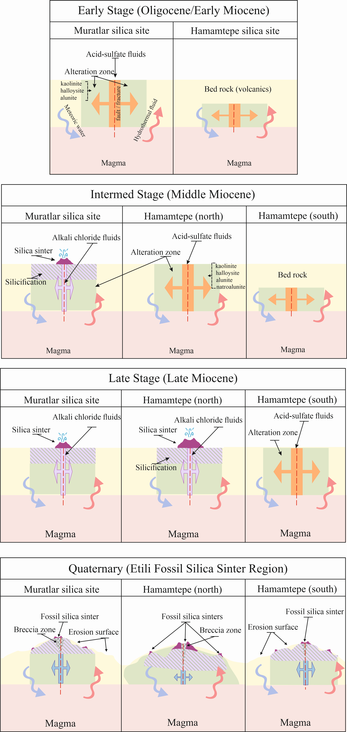
Formation model of silica sinter deposits

Slide 12
Thank you for your participation

