Slide 1






University of Pisa
Circular Economy Rebound: A case-based management guideline
Pierluigi Zerbino, PhD
pierluigi.zerbino@unipi.it
Assistant Professor of Circular Economy and Digital Innovation

Slide 2

A Circular Economy can entail both benefits and drawbacks (Murray et al., 2017; Niero et al., 2021)
A major negative impact is the Circular Economy Rebound effect

Slide 3

Circular Economy Rebound (CER)
Phenomenon according to which a Circular Economy practice, which reduces per-unit production impacts, causes increased levels of production and consumption that offset the environmental benefits (Zink and Geyer, 2017)
Primary products
Secondary products

Slide 4



Circular Economy Rebound (CER)
Circular Economy environmental unsustainability
Environmental performance overstatement
Greenwashing

Slide 5



Research objective
How to manage CER is a largely unaddressed issue that deserves urgent attention (Bakker et al., 2021; Figge and Thorpe, 2019; Goyal et al., 2021; Horvath et al., 2019; Makov and Vivanco, 2018; Salvador et al., 2021)
“How may a firm undertake to manage the Circular Economy Rebound?”
Case study in an Italian firm: CER assessment and guidelines development through Management theory

Slide 6




Remanufacturing marble waste slats

Slide 7
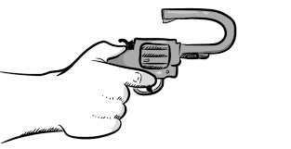



Circular Economy Rebound (Makov and Vivanco, 2018)
113.2%
Backfire
Emissions
Production volumes
100%
13.2%
+
Complete offset of the environmental savings
Additional environmental impact
Should be the Circular Economy initiative of the firm be interrupted?

Slide 8

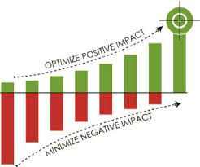
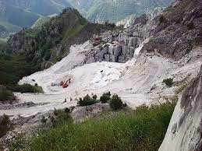
How may a firm undertake to manage the Circular Economy Rebound effect?
The CER assessment should be related to Value creation and account for environmental impacts other that emissions
Better eco-efficiency
Preservation of mountains
Do not be afraid of CER

Slide 9





How may a firm undertake to manage the Circular Economy Rebound effect?
CER has different components (Siderius and Poldner, 2021) that should be managed individually through appropriate strategies (mitigation, avoidance, transfer, accept and so on)
Product design
Circular transition
Consumers behaviour
Economics
Reject one-size-fits-all approach to CER

Slide 10

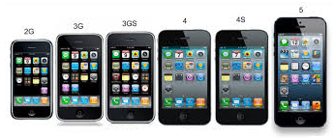

How may a firm undertake to manage the Circular Economy Rebound effect?
The characteristics of the resource to recover and of its demand may amplify or narrow the range of variation of the CER components
Aesthetic obsolescence vs Technological obsolescence
Commodity vs Luxury
With the same circular strategy, you can experience a different CER

Slide 11


How may a firm undertake to manage the Circular Economy Rebound effect?
Product displacement should be encouraged only after creating the conditions to make it convenient
Improve secondary product unit profit, e.g. through Upcycling
React to the Circular Economy Rebound

Slide 12
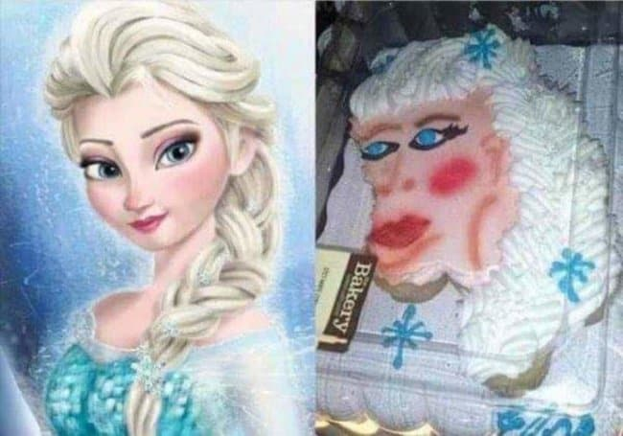
Circular Economy
Expectations
(Possible) Reality

Slide 13
University of Pisa
Thank you
Pierluigi Zerbino, PhD
pierluigi.zerbino@unipi.it
Assistant Professor of Circular Economy and Digital Innovation

