Slide 1
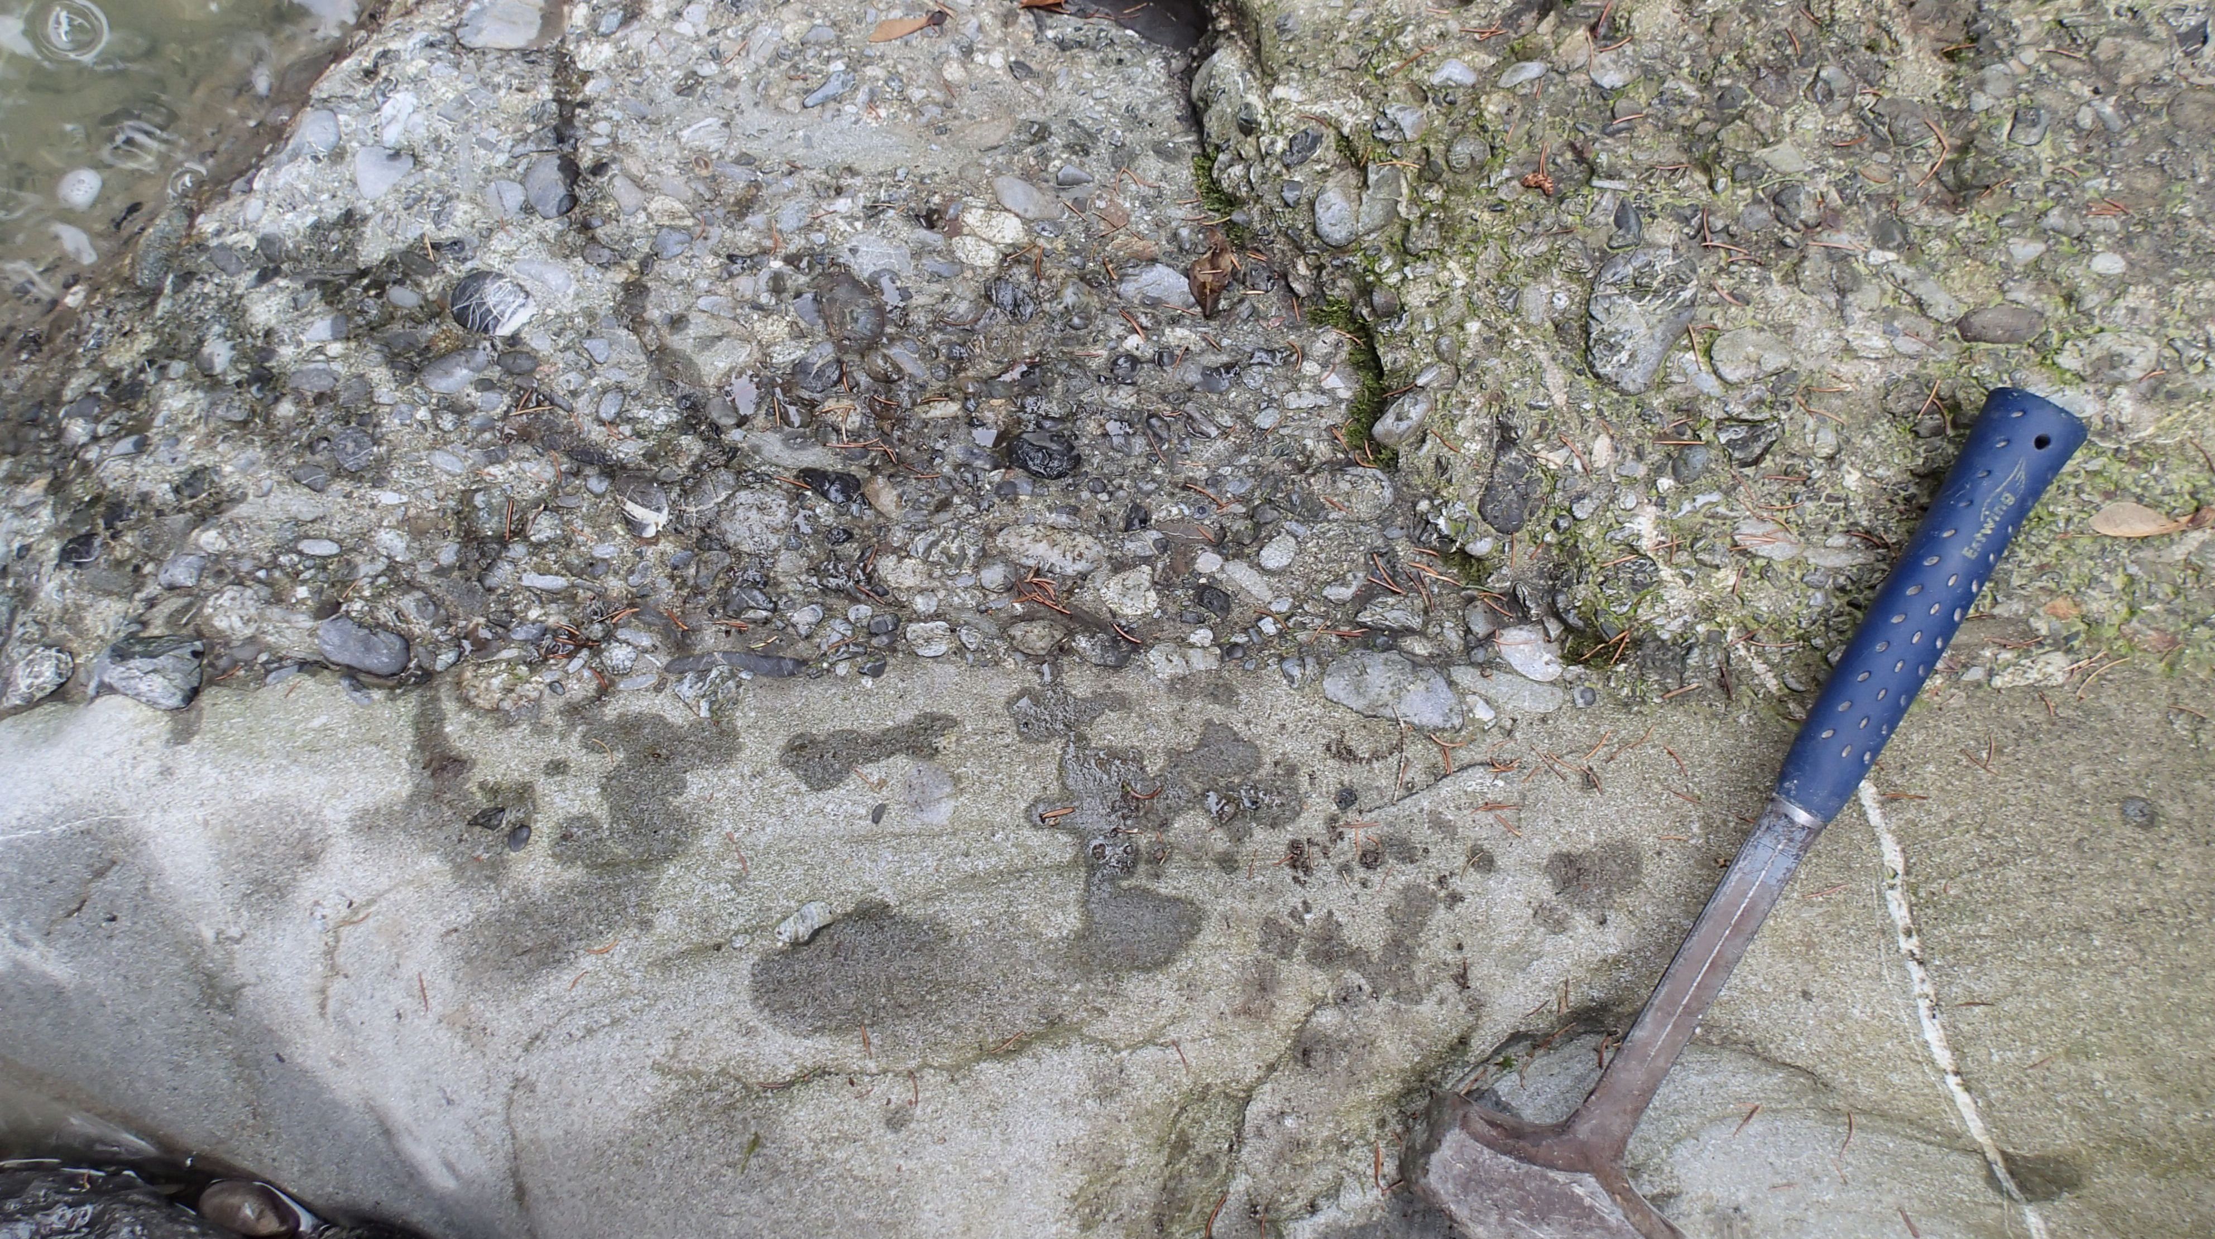



Detrital garnet Lu-Hf and U-Pb geochronometry coupled with
compositional analysis: Possibilities and limitations for sediment provenance
Chris Mark (1,2), Laura Stutenbecker (3), Sergio Andó (4), Marta Barbarano (4), Gary O’Sullivan (2), Stijn Glorie (5), Alexander Simpson (5), and J. Stephen Daly (2)
Department of Geosciences, National Museum of Natural History, Stockholm, Sweden
School of Earth Sciences, University College Dublin, Belfield, Dublin, Ireland
Institute of Applied Geosciences, Technische Universität Darmstadt, Darmstadt, Germany
Department of Earth and Environmental Sciences, Università di Milano-Bicocca, Milan, Italy
Department of Earth Sciences, The University of Adelaide, Adelaide, Australia

Slide 2
Detrital (zircon) U-Pb dating: A popular tool
2011:
LA-ICPMS approach validated for common-Pb hosting phases (4)
2020:
Peak detrital zircon?
Detrital phase U-Pb (n = total publications)
1993:
LA-ICPMS
approach validated
for zircon (U-)Pb
(plus other concordant phases) (3)
1984:
SHRIMP
approach validated
for zircon U-Pb (2)
1962:
First detrital zircon U-Pb study, by TIMS (1)
Results for search string “Detrital provenance [mineral] U-Pb” using Web of Science.
Dates show first publication of method; first use in provenance analysis 3-5 years later.
After Flowerdew et al., 2019; (1) Ledent et al., 1962, J. Geol.; (2) Compston et al., 1984, JGR; (3) Feng et al, 1993, GCA; (4) Chew et al., 2011, Chem Geol.

Slide 3
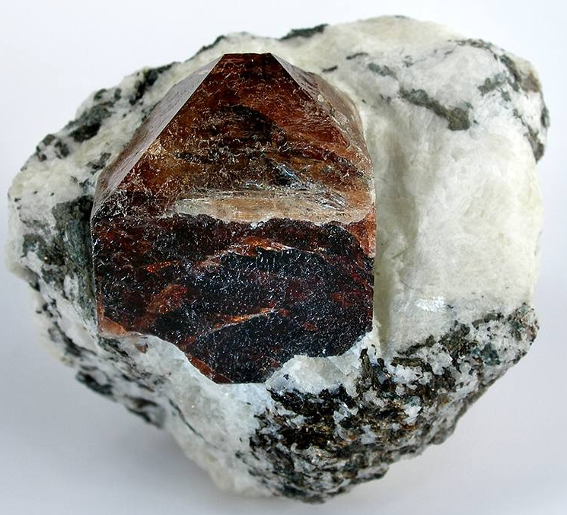
Benefits and drawbacks of zircon
Zircon is:
Mechanically and chemically stable
-> present in most detrital rocks
Analytically cooperative
-> accepts U and Hf, rejects Pb
Easy to separate and identify
Cheap and quick to analyse
Zircon is also:
Mechanically and chemically stable
-> frequently recycled!
Analytically cooperative
-> accepts U and Hf, rejects Pb –
and rejects most other trace
elements too!
Easy to separate and identify
-> a convenient choice?
Cheap to analyse by LA-ICPMS
-> but so are other U-hosting
phases.
R. Lavinsky, WikiMedia

Slide 4
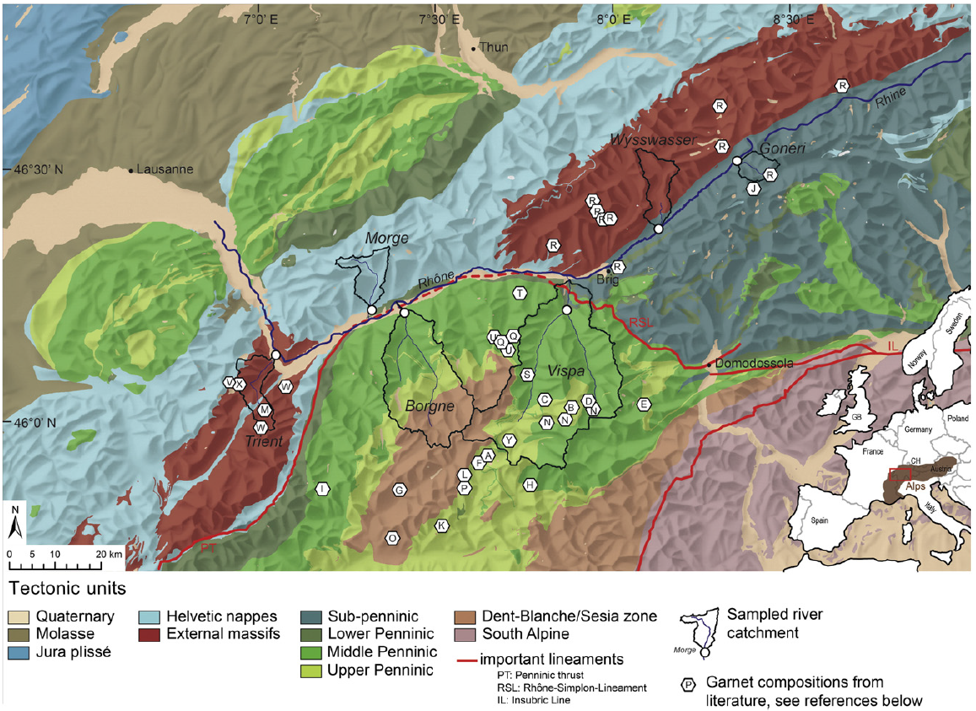
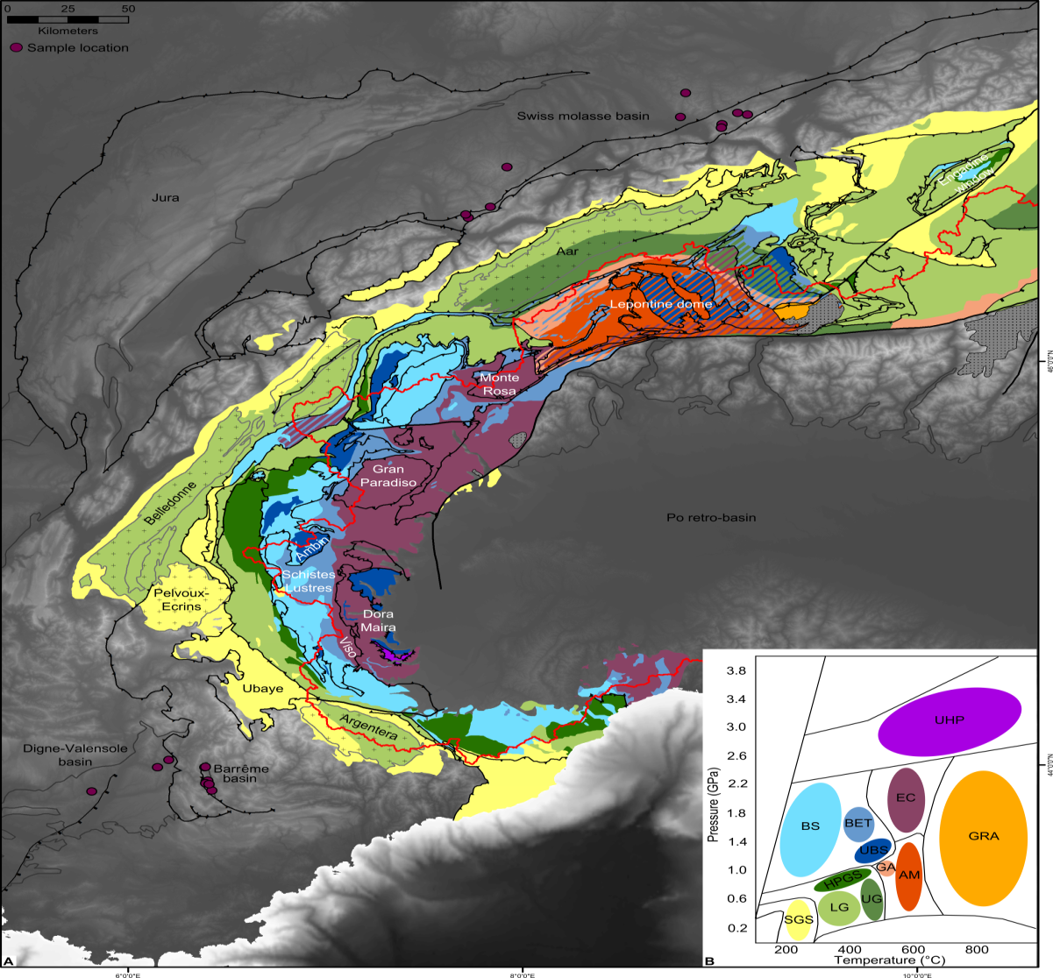
Detrital garnet from the Alpine pro-foreland
Garnet: A rock-forming and accessory mineral in a wide range of metamorphic (rarely also igneous) rocks. Resistance to weathering and diagenesis comparable to apatite & titanite
-> widely present in detrital record.
Detrital garnet seldom persists in metamorphic rocks beyond sub- to lower-greenschist facies grade
-> less prone to recycling than zircon or titanite.
Miocene detrital samples
“Monolithologic” catchments
Stutenbecker et al. (2017, Sed. Geol.)

Slide 5
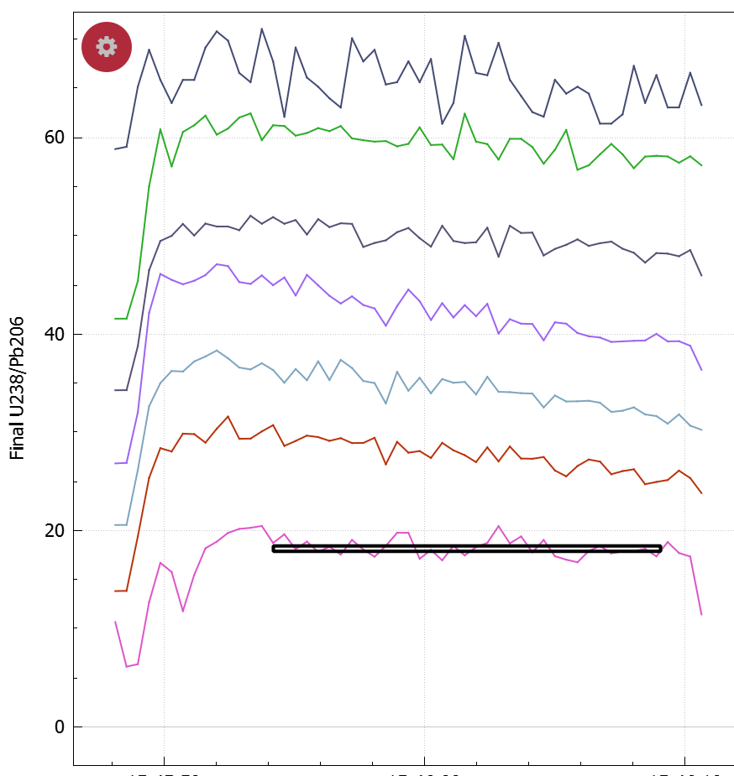
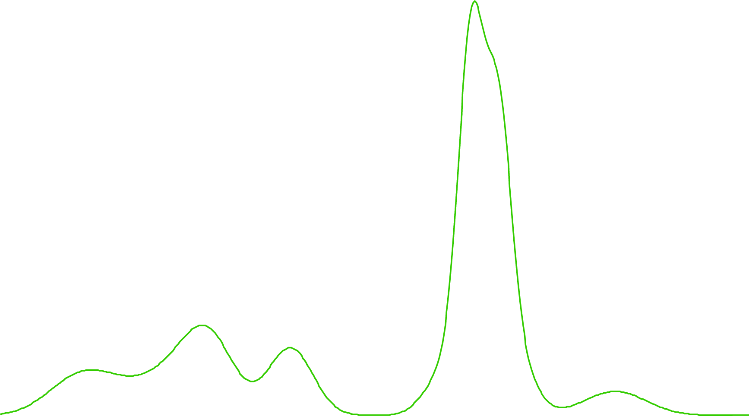
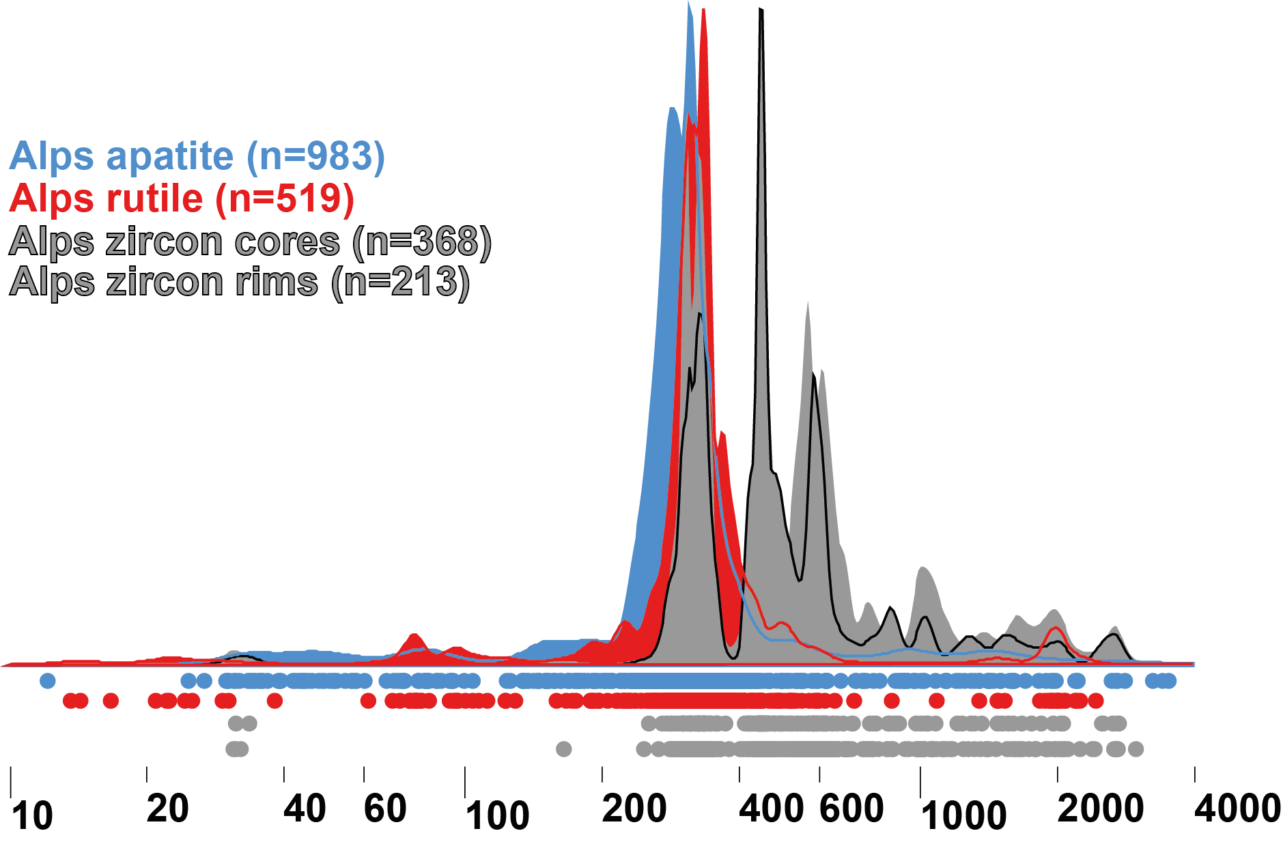
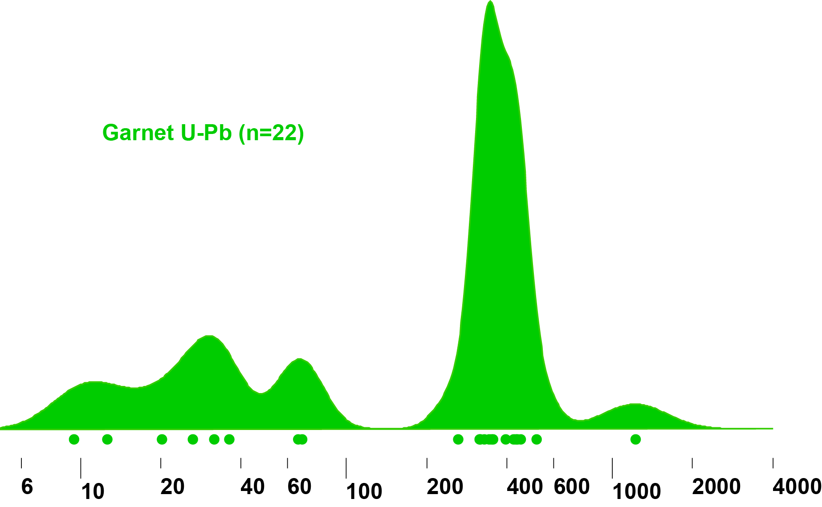
Detrital garnet U-Pb analyses from the Alpine pro-foreland
In Alpine pro-foreland, 35% of garnet U-Pb ages record the Alpine orogen…<1% of zircon U-Pb ages do so.
Use of LA-Q-ICPMS permits inclusion screening (P, Ti, Y, Zr, LREE masses monitored with U-Pb masses)
Downhole signals:
Analysis by LA-Q-ICPMS @ University College Dublin and @ Trinity College Dublin
Garnet U-Pb reference materials from Salnikova et al. (2019, Lithos)
31P
Alps garnet (n = 27)
49Ti
89Y
91Zr
139La
140Ce
238U/206Pb
rut
ap
zrc rims
zrc cores
Age (Ma)
Mark et al., 2016, 2018; Zimmerman et al., 2018

Slide 6
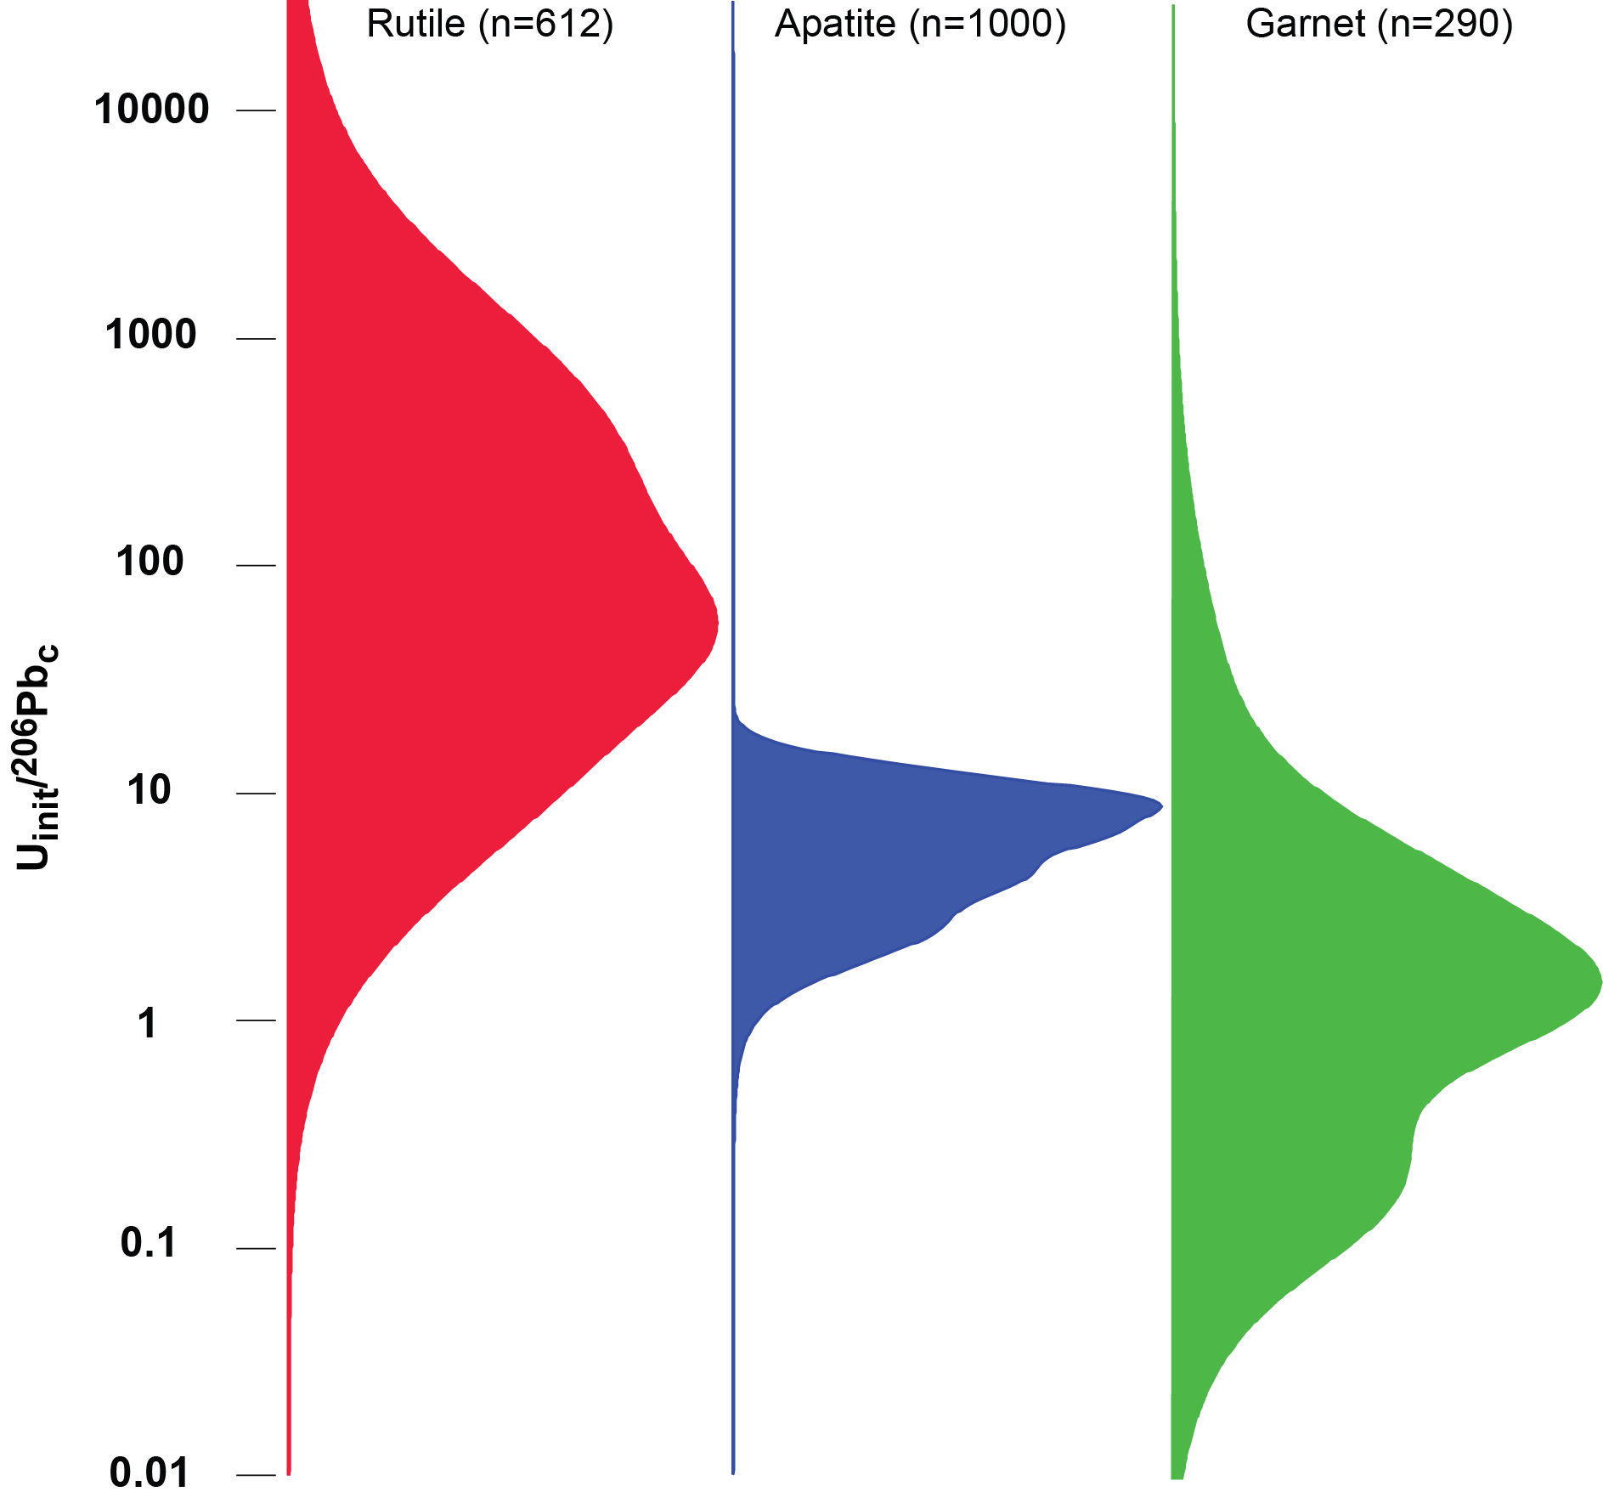
Detrital garnet U-Pb analyses from the Alpine pro-foreland
In Alpine pro-foreland, 35% of garnet U-Pb ages record the Alpine orogen…<1% of zircon U-Pb ages do so.
However, garnet initial U/common Pb ratios nearly two orders of magnitude lower than rutile and an order of magnitude less than apatite: only 9% of garnets yield an acceptable U-Pb age after filtering to remove analyses with high uncertainties (for comparison: rutile = 64%; apatite = 50%).
-> many garnet grains undateable by U-Pb.
Analysis by LA-Q-ICPMS @ University College Dublin and @ Trinity College Dublin
Garnet U-Pb reference materials from Salnikova et al. (2019, Lithos)
Alps garnet (n = 27)
81
8
1
rut
ap
zrc rims
zrc cores
Median U_{init} /²⁰⁶Pb_{c}
Age (Ma)
Mark et al., 2016, 2018; Zimmerman et al., 2018

Slide 7
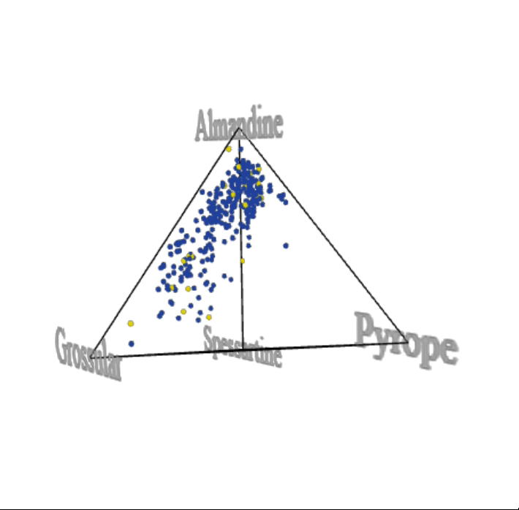
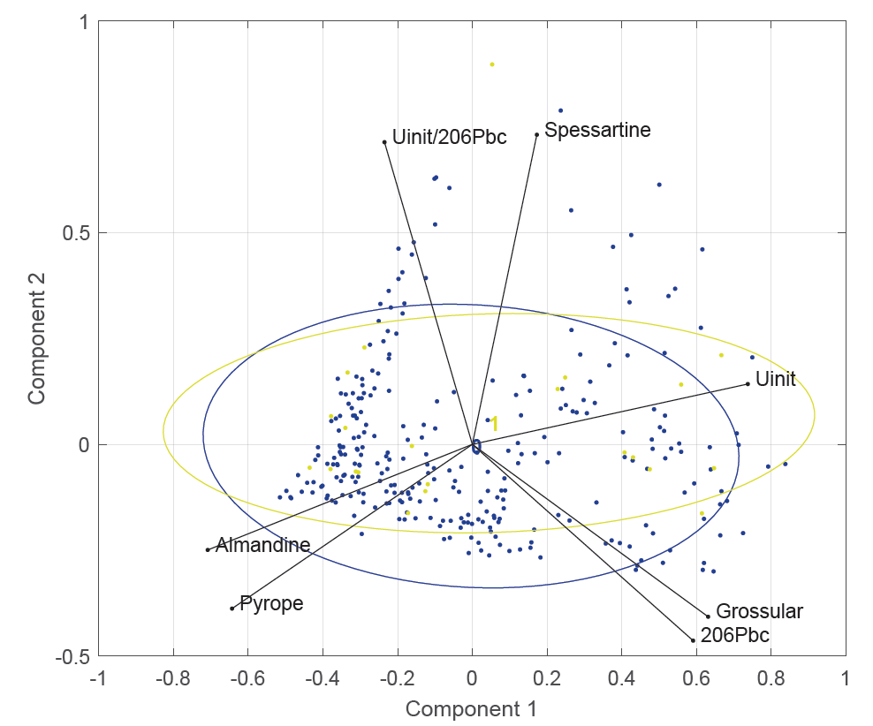
Detrital garnet U-Pb analyses from the Alpine pro-foreland
No correlation between garnet composition and U-Pb “date-ability” (all samples);
Undateable
Date obtained

Slide 8
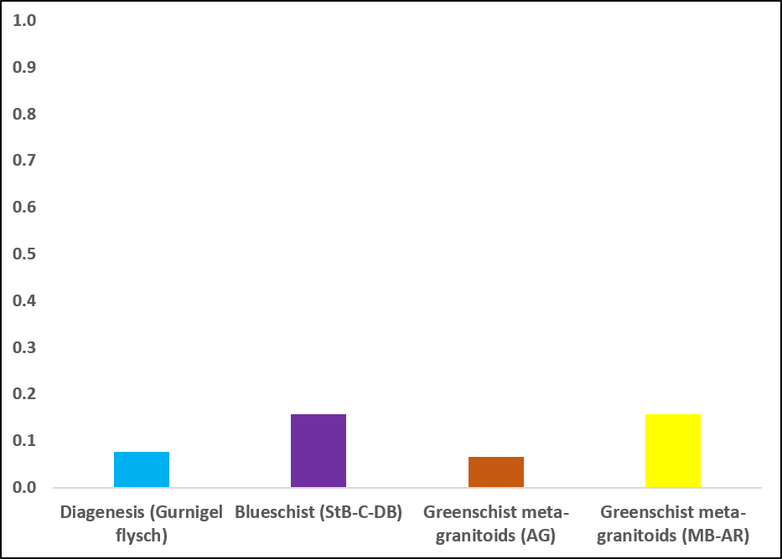
Detrital garnet U-Pb analyses from the Alpine pro-foreland
No correlation between garnet composition and U-Pb “date-ability” (all samples);
No correlation between source lithology and U-Pb “date-ability” (monolithological catchments)
Fraction of garnets yielding acceptable U-Pb ages:

Slide 9
Detrital garnet Lu-Hf analyses by LA-QQQ-ICPMS
In-situ Lu-Hf analysis by quadrupole MS equipped with a mass-filtered reaction cell (Woods, 2017; Simpson et al., 2021);
Single-analysis age calculations using a fixed common-Hf ratio (0.282 ± 0.004)
Mass filtered reaction cell
(Hf(NH)(NH₂)(NH₃)₃)
(m/z 258)
175Lu
176Hf
175Lu
Reaction gas: NH₃

Slide 10
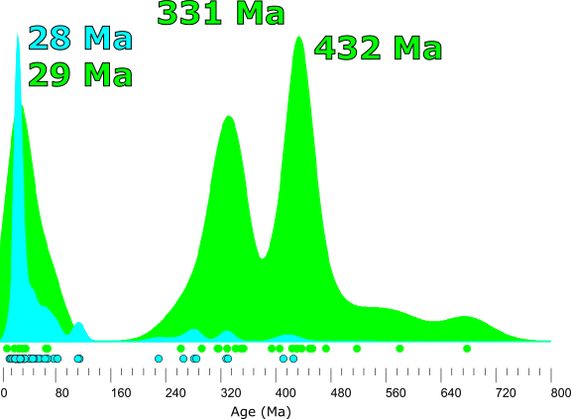
Detrital garnet Lu-Hf analyses from the Alpine pro-foreland
In Alpine pro-foreland, 87% of garnet Lu-Hf ages record the Alpine orogen…<1% of zircon U-Pb ages do so.
31 % of detrital garnets yield an acceptable Lu-Hf age after filtering to remove ages with high uncertainty.
Central Alpine age peaks by deconvolution:
Garnet U-Pb: 40.2 ± 3.8 Ma (25%)
Garnet Lu-Hf: 28.4 ± 1.4 Ma (68%)
Alps garnet U-Pb (n = 27/303)
Alps garnet Lu-Hf (n = 59/192)
Analysis by LA-Q-ICPMS @ University College Dublin
and LA-QQQ-ICPMS @ University of Adelaide

Slide 11
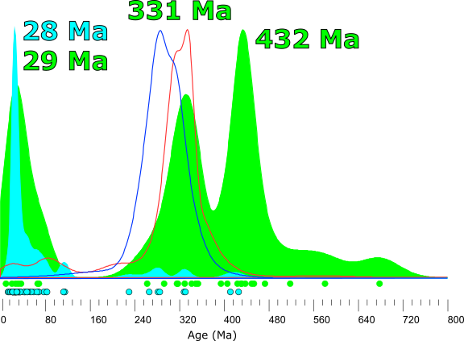
Detrital garnet Lu-Hf analyses from the Alpine pro-foreland
In Alpine pro-foreland, 87% of garnet Lu-Hf ages record the Alpine orogen…<1% of zircon U-Pb ages do so.
31 % of detrital garnets yield an acceptable Lu-Hf age after filtering to remove ages with high uncertainty.
Central Alpine age peaks by deconvolution:
Garnet U-Pb: 40.2 ± 3.8 Ma (25%)
Garnet Lu-Hf: 28.4 ± 1.4 Ma (68%)
Rutile U-Pb: 23.9 ± 1.1 Ma (3%)
Apatite U-Pb: 79.0 ± 4.8 Ma (1%)
Alps garnet U-Pb (n = 27/303)
Alps garnet Lu-Hf (n = 59/192)
Analysis by LA-Q-ICPMS @ University College Dublin
and LA-QQQ-ICPMS @ University of Adelaide

Slide 12
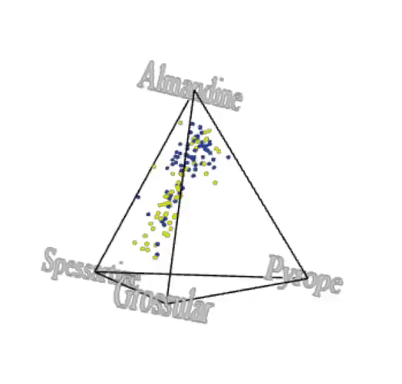
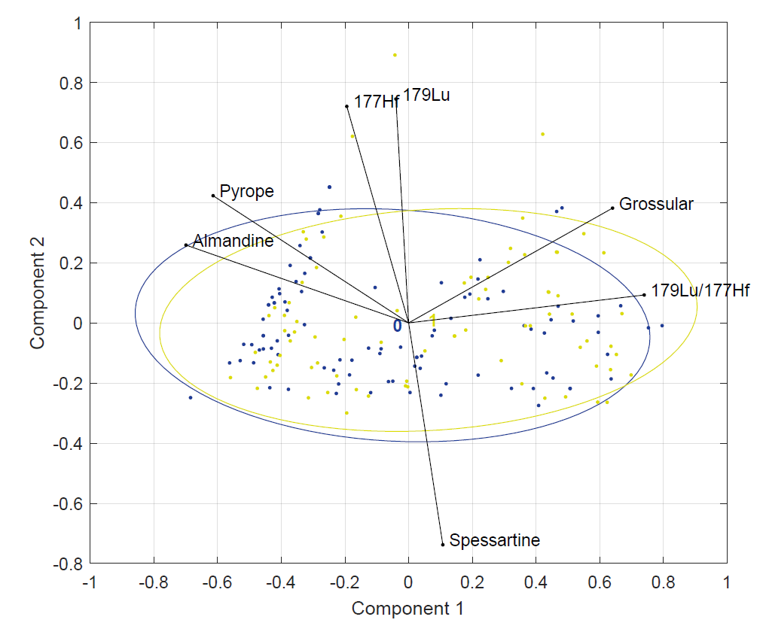
Detrital garnet Lu-Hf analyses from the Alpine pro-foreland
No correlation between garnet composition and Lu-Hf “date-ability” (all samples);
Undateable
Date obtained

Slide 13
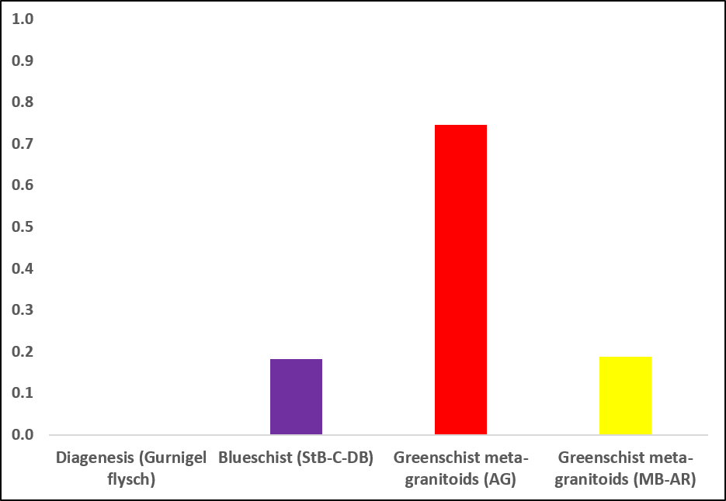
Conclusions
No correlation between garnet composition and Lu-Hf “date-ability” (all samples);
No correlation between source lithology and Lu-Hf “date-ability” (monolithological catchments)
…but garnets from the Gotthard massif (Goneri catchment modern river sediment) much more amenable to Lu-Hf dating.

Slide 14
Conclusions
Detrital garnet Lu-Hf dating has promise: effective way to identify most recent (garnet-forming) metamorphic event in magma-poor orogens;
Lower success rate than alternate metamorphic proxy rutile U-Pb (c. 31% vs 64%), but potential to recover P(T) information;
Source area biases evident, but not yet understood;
Challenge of identifying garnet in the heavy mineral fraction (scope for automated mineralogy, e.g., QEMSCAN).

