Slide 1

Designing the next generation of seismic arrays using fibre optic DAS
Session NH10.15 International Monitoring System and On-site Verification for the CTBT, disaster risk reduction and Earth Sciences
DOI: https://doi.org/10.5194/egusphere-egu22-6408
ID: EGU22-6408
Ben Dando¹, Kamran Iranpour¹, Andreas Wuestefeld¹, Sven Peter Näsholm^{1,2}, Alan Baird¹, and Volker Oye^{1,3}
¹ NORSAR, Kjeller, Norway
² Univ. of Oslo, Department of Informatics, Norway
³ Univ. of Oslo, Department of Geosciences, Norway

Slide 2
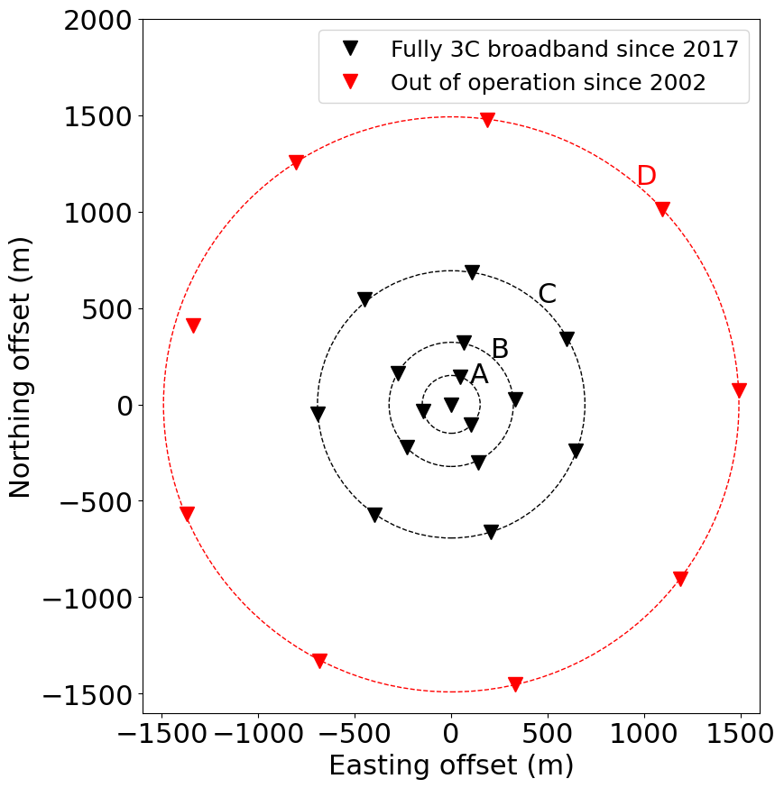
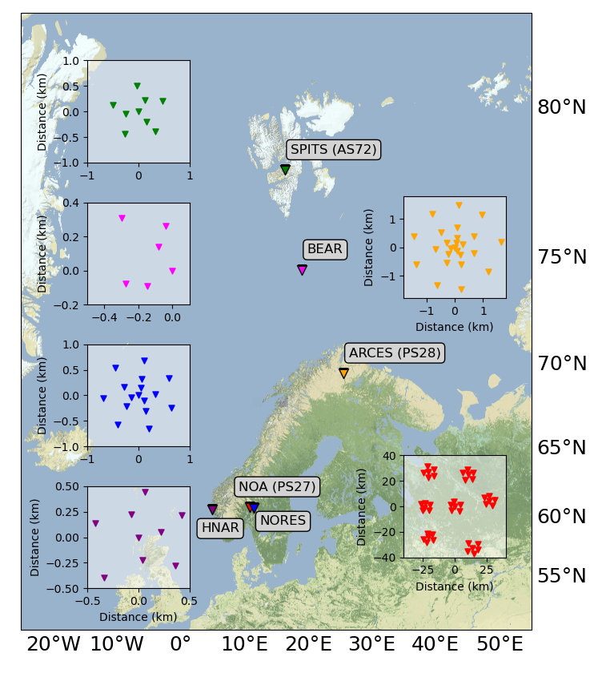
NORES seismic array
NORES
Seismic arrays are an integral part of the IMS
Effective at enhancing SNR (via beamforming) and discerning back azimuth and slowness of an arrival (via fk-analysis)
NORSAR operates six seismic arrays (NOA, ARCES, SPITS, NORES, BEAR, HNAR)
NORES (Norwegian Experimental Seismic System) is a seismic array in south-east Norway
Co-located within a subarray of the larger NOA array (IMS station PS27)
Established in 1984
Currently 16 broad-band (3C) seismometers
3 rings (A-C) with a total aperture of ~1.4 km
4th D-ring (3 km diameter with 9 sites) has been out of use since 2002
A DAS-array will be deployed in summer 2022 at the NORES site to evaluate it’s potential
Designing a DAS-array requires additional considerations…
Notes:
To start with a bit of context, it’s worth noting that seismic arrays are a key component of the IMS. In NORWAY we run six seismic arrays – one of which is a primary station in the IMS (NOA), and one which is an auxillary station – SPITS on Svalbard.
In this talk I’ll be focussing on NORES, which was established in 1984, and currently has 16 broadband 3C sensors.
And it’s at this site that we plan to deploy fibre optic cable for a DAS-array as a technology demonstrator so we can compare how such as array performs compared to the 3C seismic array.
However, the design of the DAS array will require some changes due to the nature of DAS signals.

Slide 3
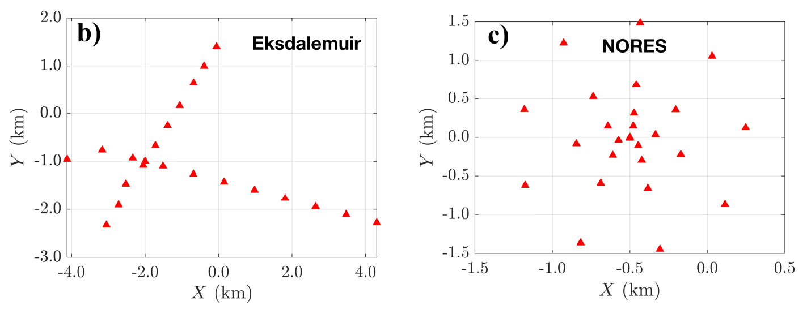
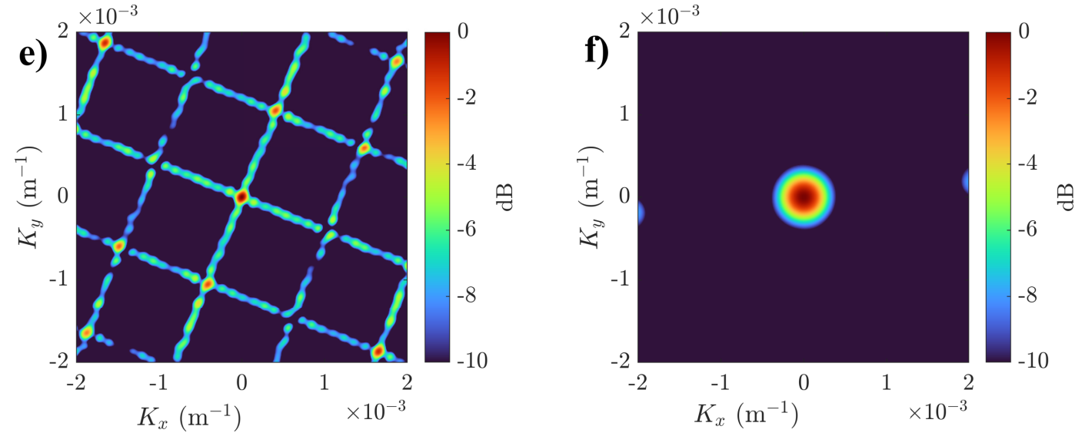
Classical array-response modelling
Aim: high resolution of wavefront parameters i.e. slowness and back azimuth
Important observations:
width of the main lobe
presence and location of side lobes
Controlling factors:
Array aperture
Inter-station distance
Number of sites
Array geometry
Näsholm et al., 2022 (JGR)
Notes:
Traditionally when we design a seismic array we often look at the array-response to tell us about the sensitivity and resolution of the array.
Ideally we want to be able to resolve the slowness and back azimuth of an incoming wavefront with high resolution and little ambiguity.
So we want to have a narrow main lobe (to resolve sources close to each other) with minimal side-lobes that could introduce ambiguity in an fk-analysis and reduce the SNR.
The array response is simply a discrete spatial Fourier transform of the sensor layout.
A wider aperture will yield a narrower main lobe, while the inter-sensor spacing can control the side-lobe structure.
Geometry of ESK is reflected in the FK response as repeating pattern. This is designed for sensitivity in specific directions
ESK has a much narrower main lobe but the array shows different resolution differences for diff azimuths.
NORES symmetry shows equal sensitivity in all direction

Slide 4
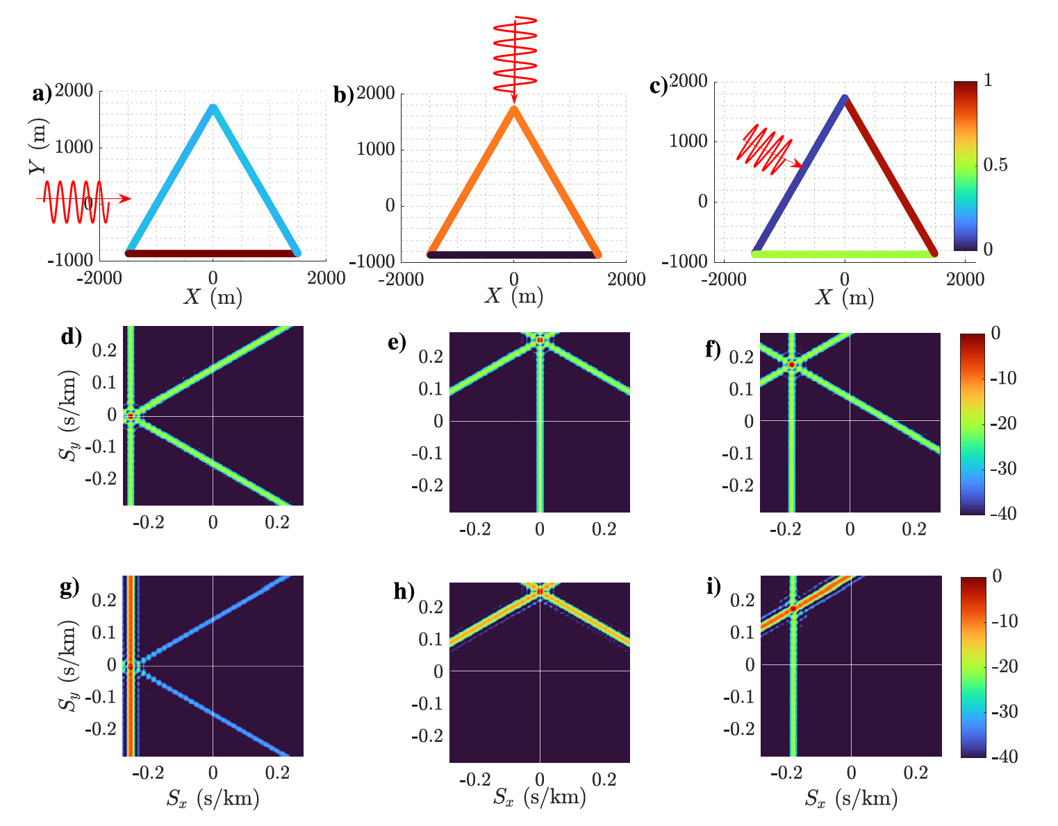
Considerations for DAS-array processing/design
Source direction from:
west
north
north-west
Two main factors to consider for DAS-based arrays:
Broadside sensitivity
Gauge length averaging (negligible below λ/2 - see bonus slides)
The cable is insensitive to P-wave's arriving broadside to the cable
Figure demonstrates the effect for a simple triangular cable for 3 different source directions
Bottom row demonstrates the need to evaluate a steered response
DAS arrays require an evaluation of the steered response – a general array response function is not possible
Cable sensitivity
Steered response (cable sensitivity NOT accounted for)
Steered response (cable sensitivity accounted for)
Näsholm et al., 2022 (JGR)
Notes:
If we want to use DAS observations in array-processing there are two main factors to consider....
Both of these factors mean that we cannot generate a general array response function.
First is the well-known broadside sensitivity, where the cable is insensitive to P-waves arriving broadside
In the top-row of this figure we're showing a triangular cable setup with waves arriving from 3 different directions.
and we can see the difference in sensitivity.
In the middle row I'm showing the 3 different steered responses for the 3 sources when we ignore cable directivity.
You can see the response stays the same and is just shifted around in slowness space. This is why for seismic arrays
where cable directivity is not an issue, we can generate a representative array response function.
However, in the bottom row where we do take cable directivity into account we can see that the response changes
For different source directions. This is why we have to evaluate the steered response for different directions of interest
To tell us about the performance of the DAS-array.

Slide 5
Evaluating DAS-array steered responses
How can we evaluate the steered response of a (DAS) array?
Beamwidth: measure of array resolution
i.e. how well can we resolve two nearby sources
Width of the main lobe determined by half-max value (3 dB amplitude or 6 dB in power spectrum)
Controlled by effective array aperture
This can be measured over a grid of steered responses (i.e. slownesses) to give a 2D representation of beamwidth
‘SNR’ (mainlobe-to-sidelobe ratio): measure of array's detection capability
Ratio of main lobe power to side lobe power (i.e. everything outside of the main lobe)
Controlled by the number of sensors and inter-sensor spacing
Directivity effects (cable sensitivity & gauge length averaging) for DAS also influence this as previously shown
This can be measured over a grid of steered responses (i.e. slownesses) to give a 2D representation of SNR
Notes:
So bearing in mind that we cannot judge an DAS array by a simple and general array response function,
But instead need to evaluate different steered responses for different sources. How can we evaluate the performance of a design?
Well we can evaluate the beamwidth and SNR for each steered response. And we can even do this over a grid of slowness values
To build up a 2D representation.

Slide 6
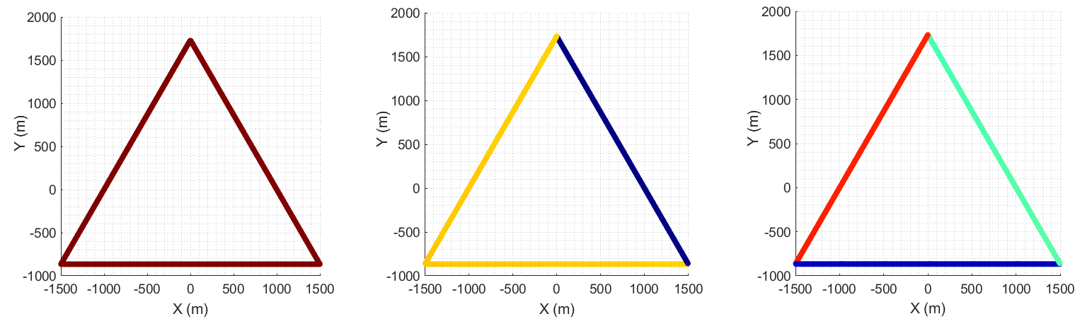
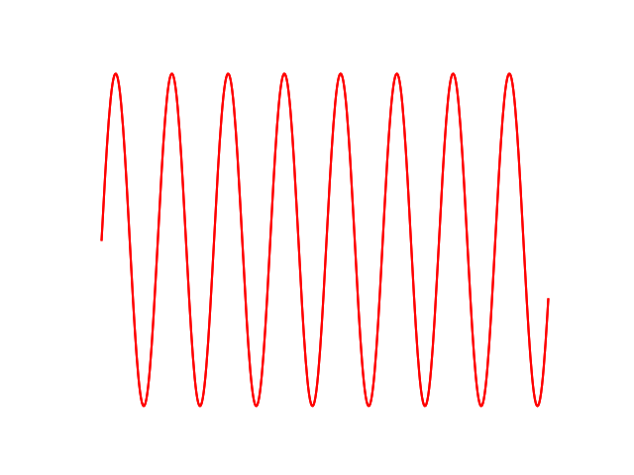
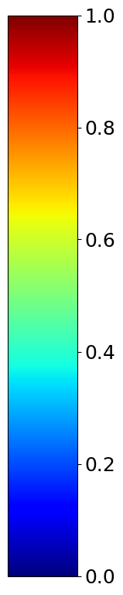
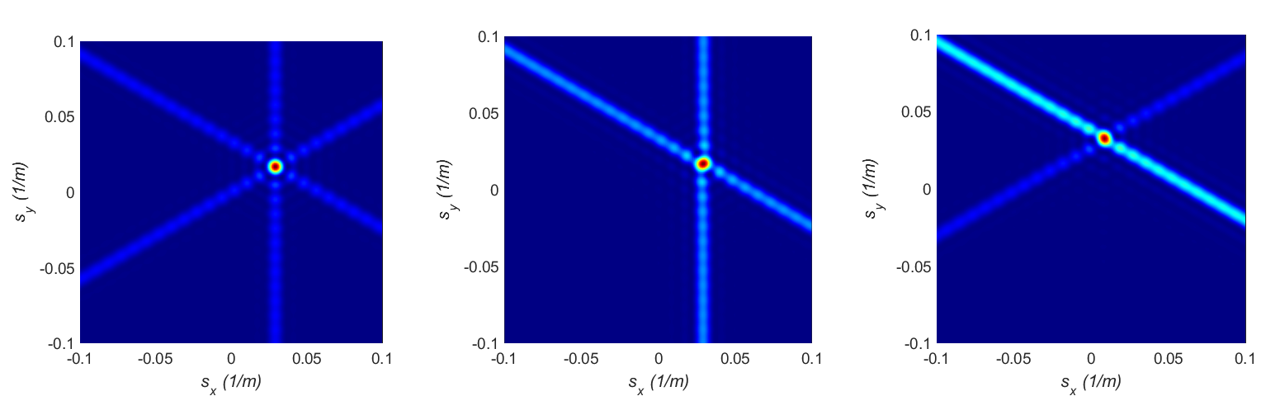
Defining beam-width and ‘SNR’ for steered responses
No directivity
Wavefront from 30°
Wavefront from 15°
Cable sensitivity
Steered response
Notes:
So in order to estimate the beam width and SNR of a cable we have to compute the steered response shown here for two different source directions and on the left
The case where cable directivity is not taken into account.

Slide 7
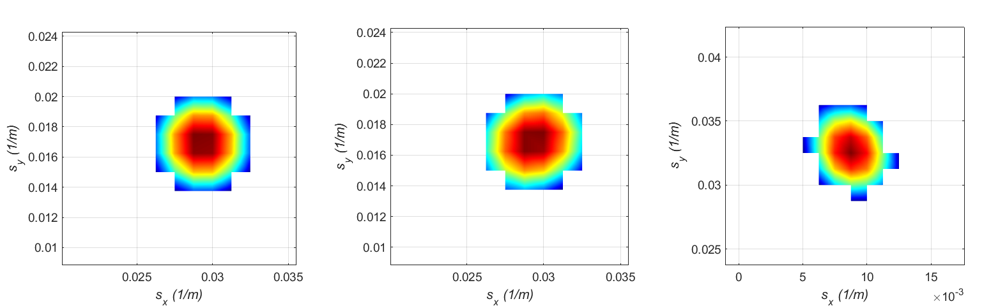
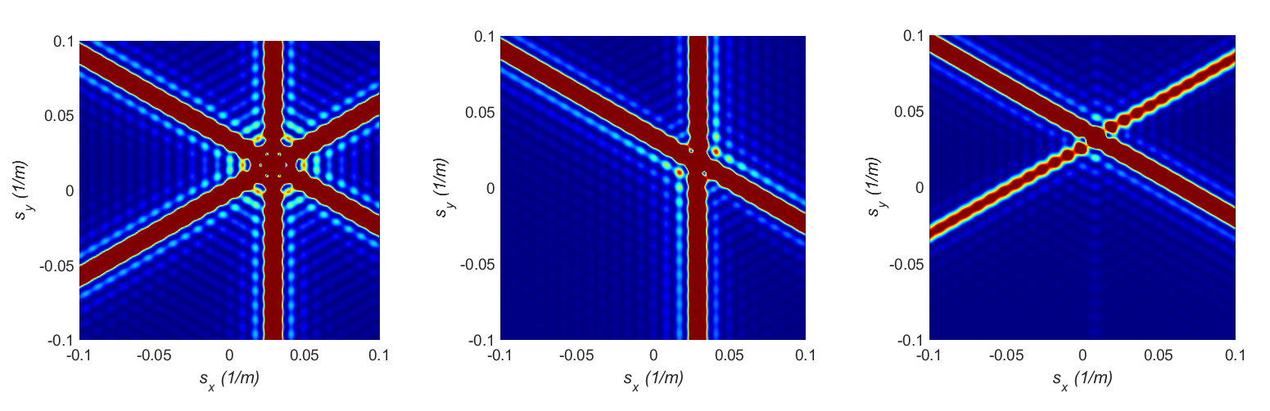
Defining beam-width and ‘SNR’ for steered responses
No directivity
Wavefront from 60°
Wavefront from 15°
Measuring beamwidth
Defining side-lobes for ‘SNR’ estimates
SNR drops by 2 dB
SNR drops by 3 dB
Notes:
From that steered response we can measure the beamwidth by simply measuring the width at half the maximum value.
For the SNR we can remove the main lobe and sum up all the energy in the surrounding area which we define as the sidelobes.
This can be repeated for many source directions or a grid of slownesses to give us a consolidated map of beamwidth (array resolution)
And SNR
I will show these results for various potential designs in a couple of slides

Slide 8
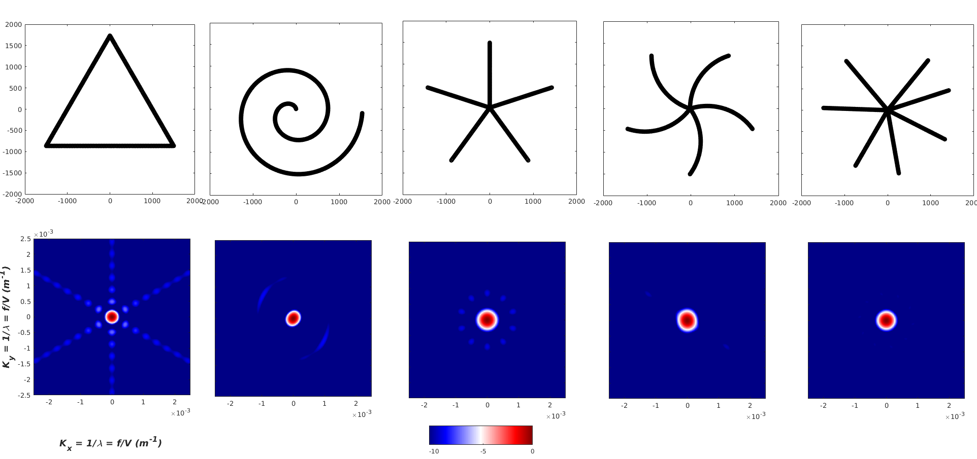
NORES DAS-array considerations
What do we want to monitor?
Local, regional or teleseismic events?
Is there a direction of interest?
We want:
An experimental array to learn as much as possible
Aim to have a ‘good’ response for as many directions and distances as possible
What is the best geometry (fibre is flexible)
Straight arms
Curved arms
Spiral
Other
Possible DAS-array designs
Classical array response (directivity not accounted for)
Notes:
Before I show you the results of such an evaluation for different designs, we need to think about what we are aiming for in the design.
What sort of events do we want to monitor, is there a direction and distance range of interest.
Well in this case, this is an experimental array where we want to try and learn as much as possible and evaluate its performance for a range of scenarios.
This means we need to have a good response for as many steered responses as possible.
It’s also worth noting that a fibre array offers many exciting possibilities for design given the sheer number of sensors and ease of deployment.
On the right I show 5 different designs and the corresponding ‘classical array response’. In this case quite similar to each other.

Slide 9
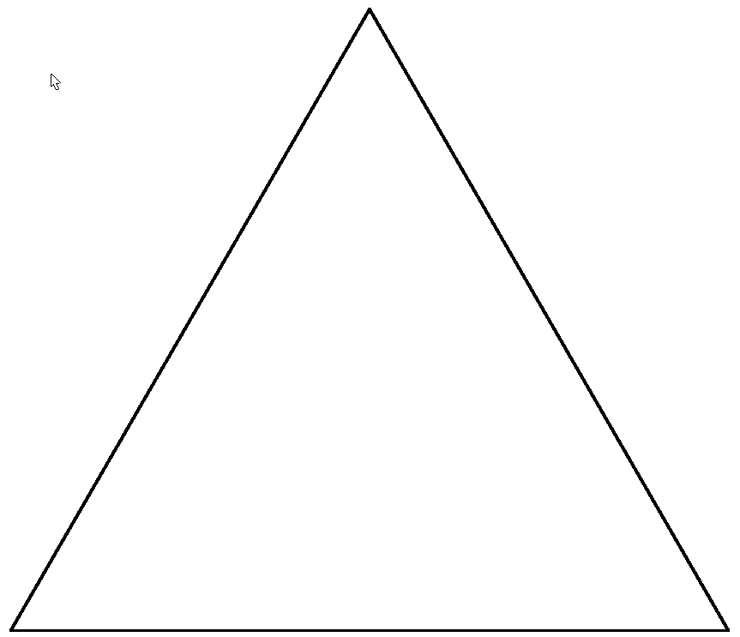
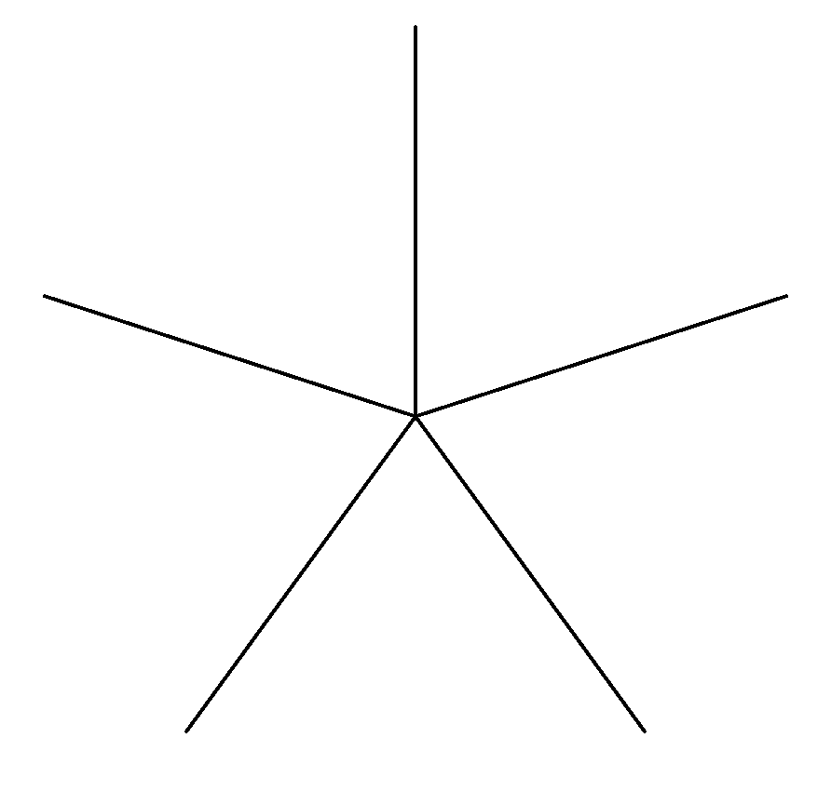
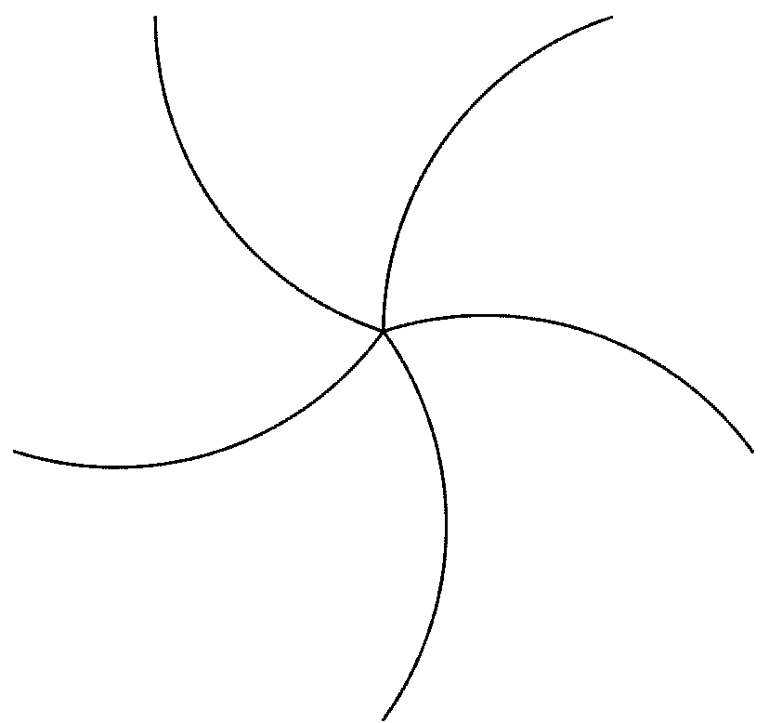
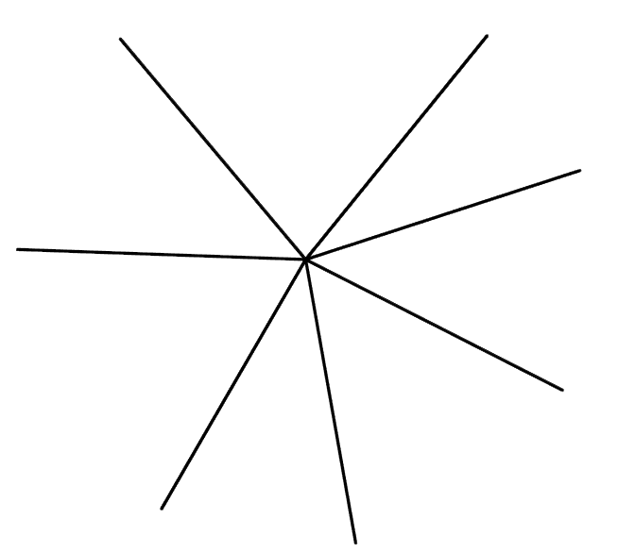
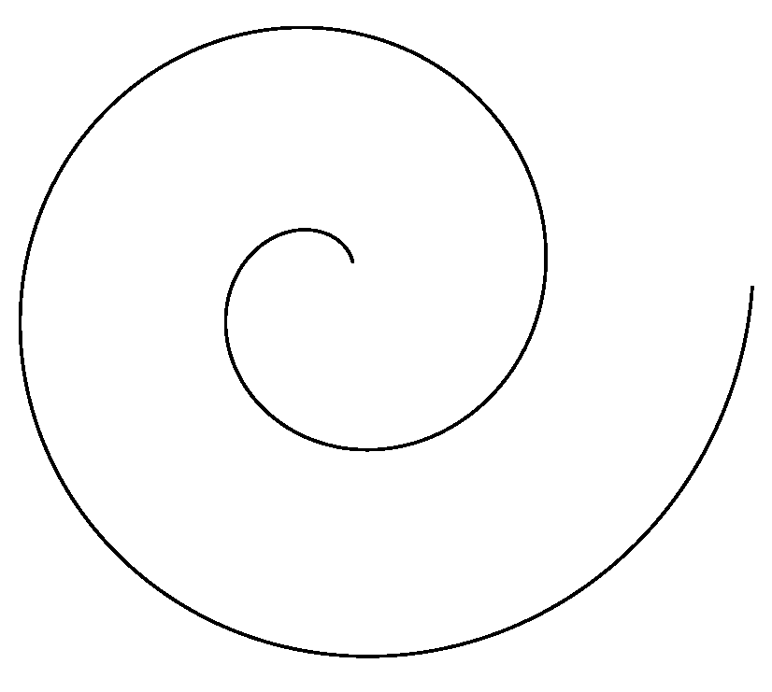
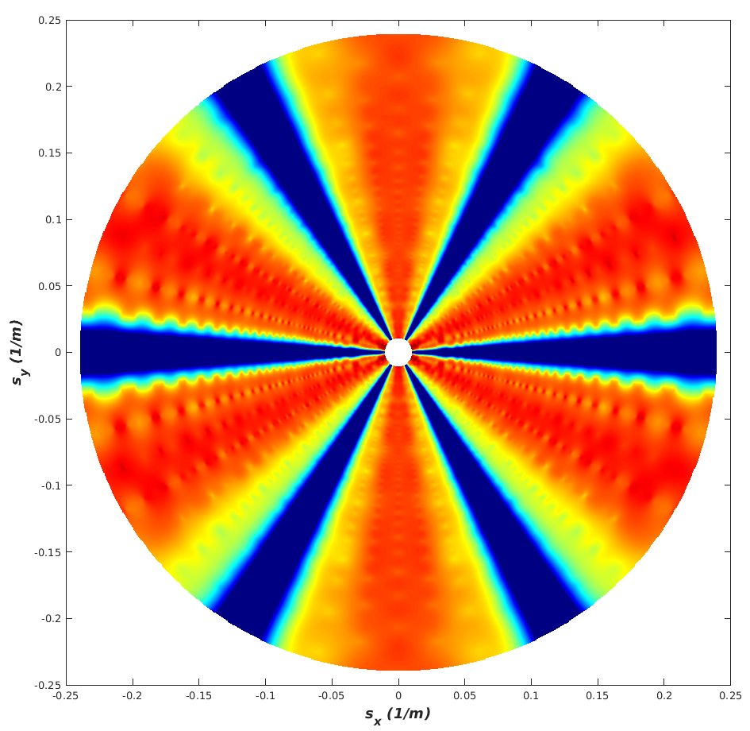
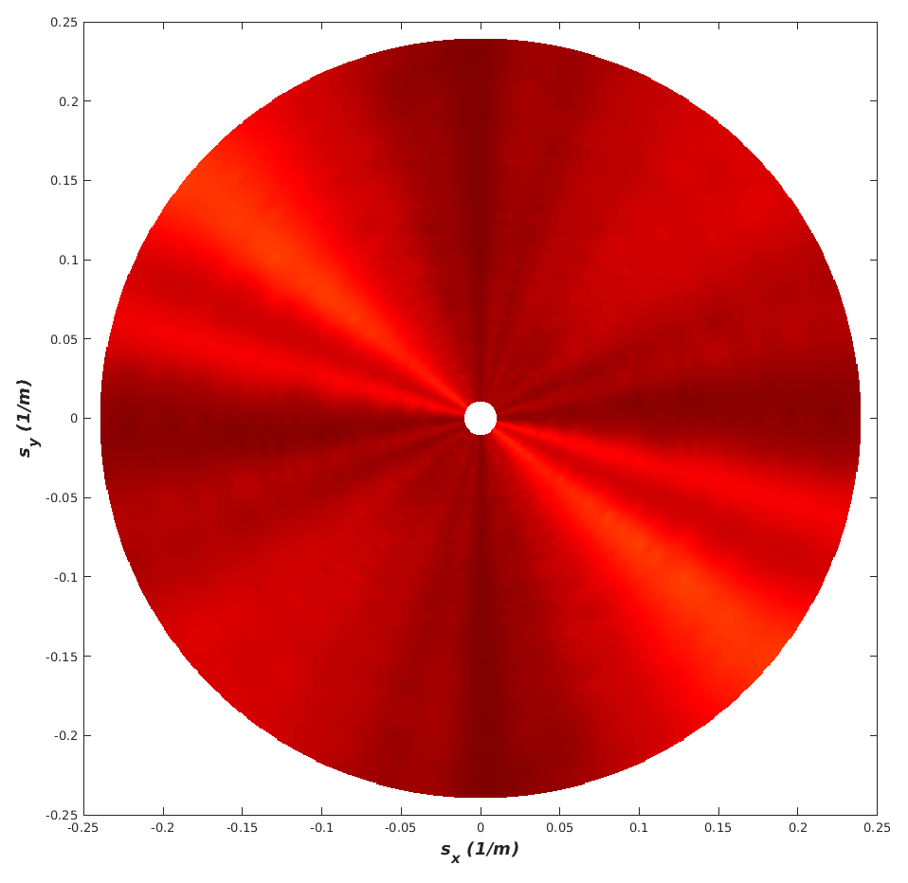
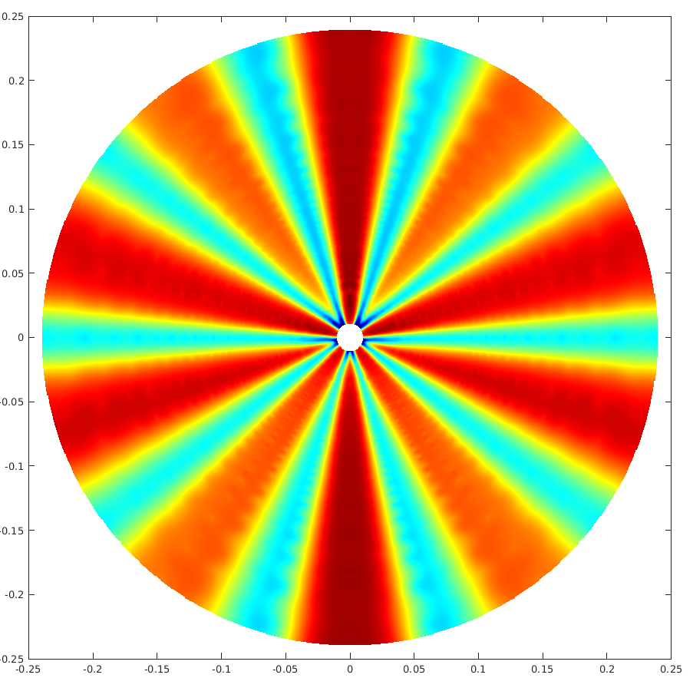
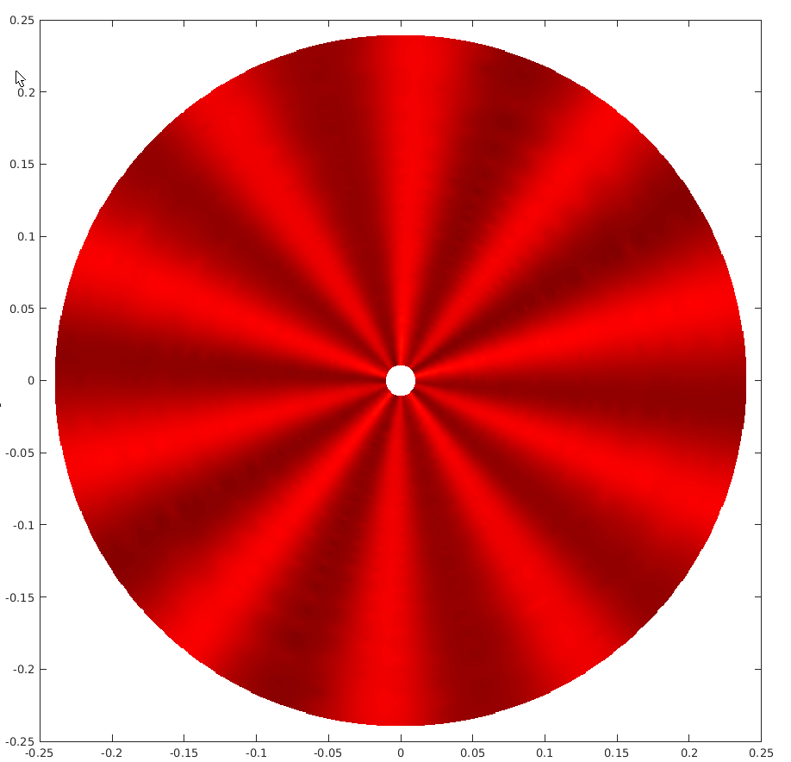
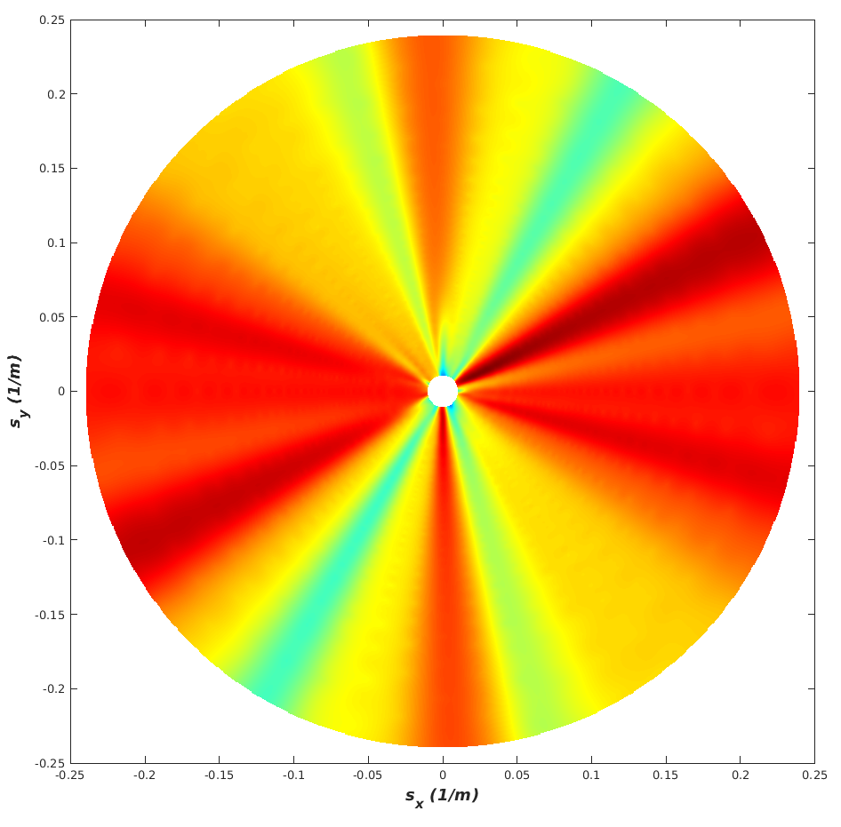

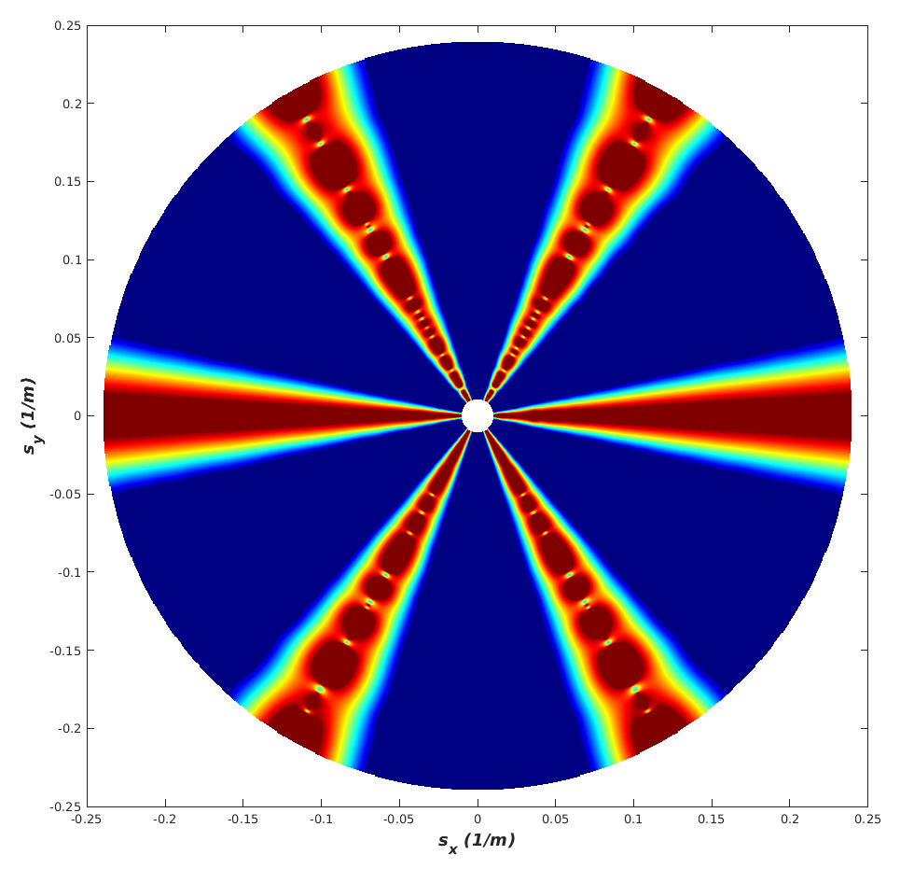
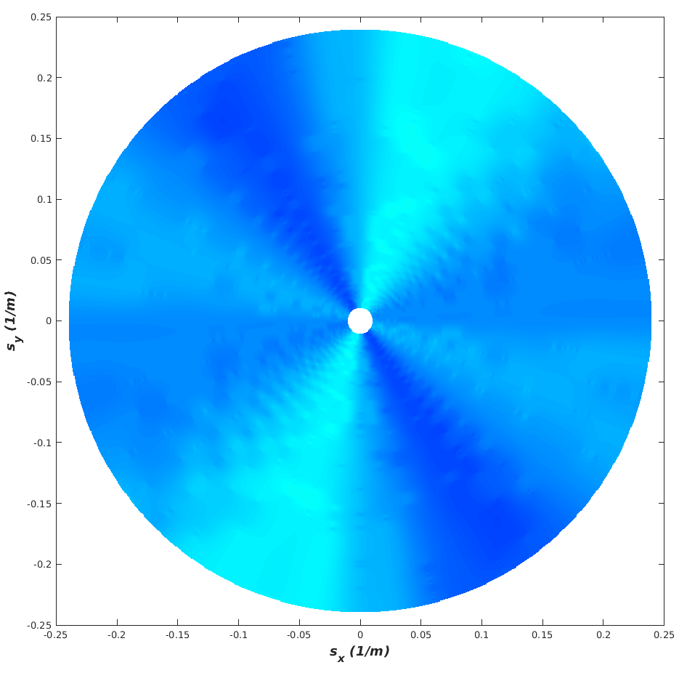
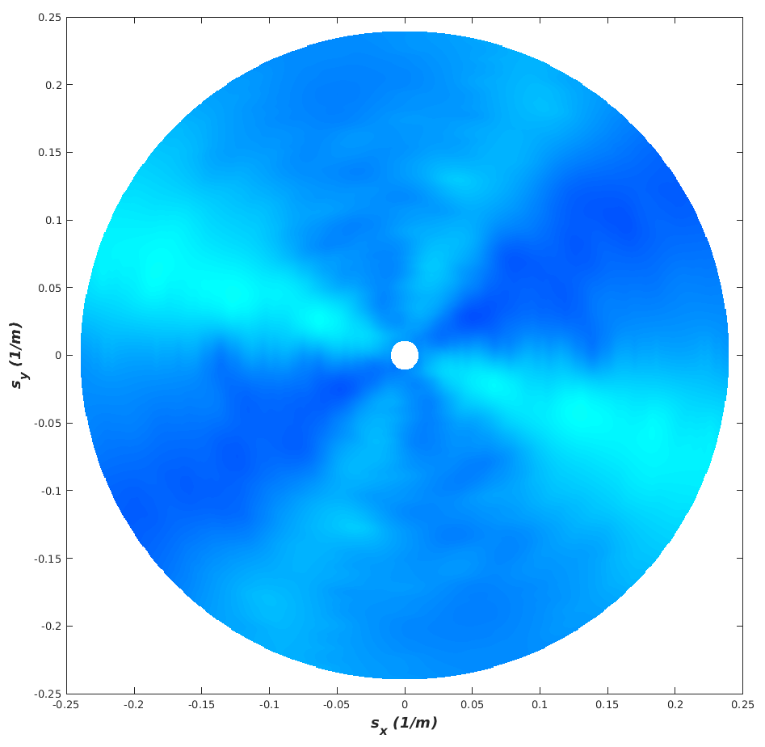
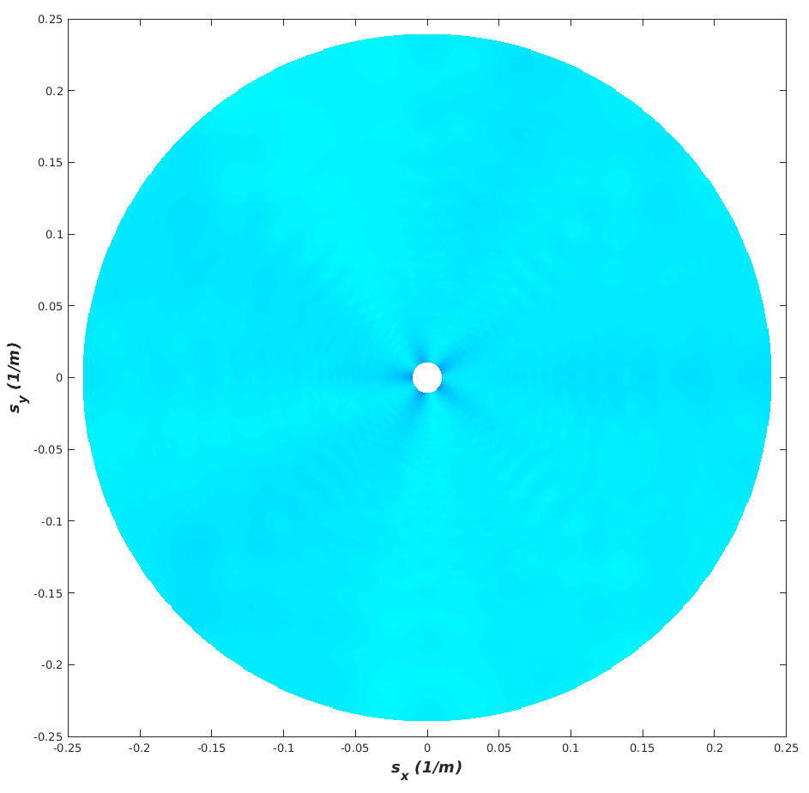
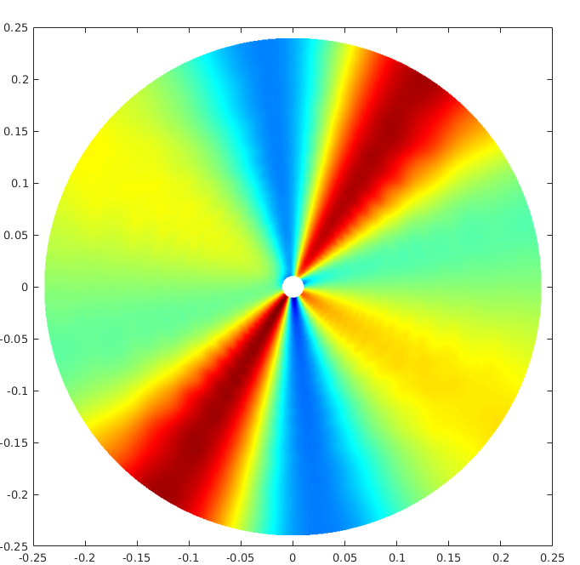
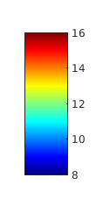
Evaluating design options
Array design
3 km
3 km
‘SNR’
S_{y} (1/m)
dB
S_{x} (1/m)
S_{x} (1/m)
S_{x} (1/m)
S_{x} (1/m)
S_{x} (1/m)
Beam-width (resolution)
Degrees
S_{y} (1/m)
S_{x} (1/m)
S_{x} (1/m)
S_{x} (1/m)
S_{x} (1/m)
S_{x} (1/m)
Notes:
So here I show the evaluations of the five different DAS layouts. The results show
For SNR, red is good (i.e. high SNR).
For beam-width, blue is good (i.e. low beam width).
Remember these represent the response for a grid of slowness values
If we want to have a design that is good for the complete range of directions and distances, then we want to have an homogeneous (and good) result for the SNR and beamwidth.
Although the spiral appears to perform very well, this would not be possible to deploy at the NORES site. But the curved arm array provides a good alternative.
This is what we will be deploying this summer.

Slide 10
Summary
A new fibre installation at the NORES seismic array site will be used to demonstrate DAS technology in the context of array processing
We plan to compare the DAS array with the 3C seismic array
DAS arrays allow novel geometries not feasible with traditional seismic arrays
Designing a DAS array requires additional factors to consider due to:
Cable sensitivity
Gauge length averaging
Gauge length typically has little effect for wavelengths observed on regional arrays
A ‘general array response function’ used for traditional seismic arrays is not possible for a DAS array – the response varies as a function of source direction
Evaluating steered responses e.g. using beam-width and SNR can aid in designing an optimal DAS array
Over-engineering the DAS array at NORES will allow us to test different configurations and different applications

Slide 11
Extra material

Slide 12
Further information
Näsholm, S. P., Iranpour, K., Wuestefeld, A., Dando, B.D.E., Baird, A. F., & Oye, V. (2022). Array signal processing on distributed acoustic sensing data: Directivity effects in slowness space. Journal of Geophysical Research: Solid Earth, 127(2), e2021JB023587 https://doi.org/10.1029/2021JB023587
Additional presentation at EGU (Näsholm et al.): Array signal processing on distributed acoustic sensing data: directivity effects in slowness space. Session SM2.1, Tuesday 24th May, 14:07, https://doi.org/10.5194/egusphere-egu22-6984

Slide 13
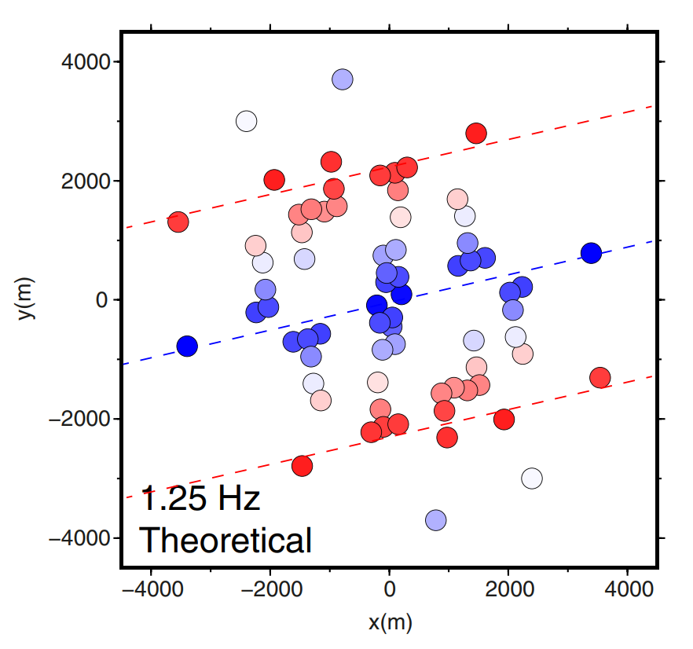
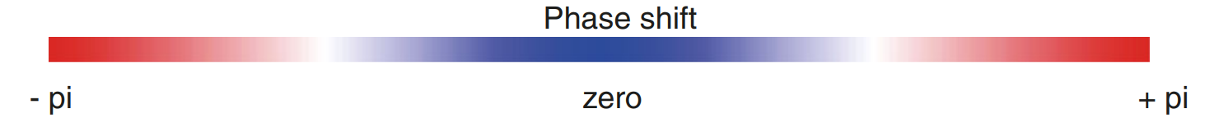
Classical array-response modelling
Co-array = inter-sensor distances within an array
Use:
Optimise the spatial sampling of the observations
Find what sensor pairs are important
A well distributed co-array demonstrates the ability to discern direction of arrival from the phase shifts (see figure)
Empirical observations can highlight coherent station pairs
Example co-array with theoretical phase-shifts
Wavefront propagation direction
Kværna et al., 2021 (J. Seismol.)
Notes:
Another factor to consider for seismic arrays in the co-array. This is a representation of all the inter-sensor distances.
Analysing the co-array can make sure that we have a good spatial sampling and also illustrate which sensor pairs
are important and which are potentially redundant.
Interstation distance: we want coherency of the wave field, and thus station distances covering the wave lengths of interest
You can also see from the co-array how when we map the theoretical phase-shifts onto each station pair it shows how
we can discern the direction of arrival. We can similarly do the same for real observations and see how both the phase-shifts
and coherency deviate from the theoretical.

Slide 14
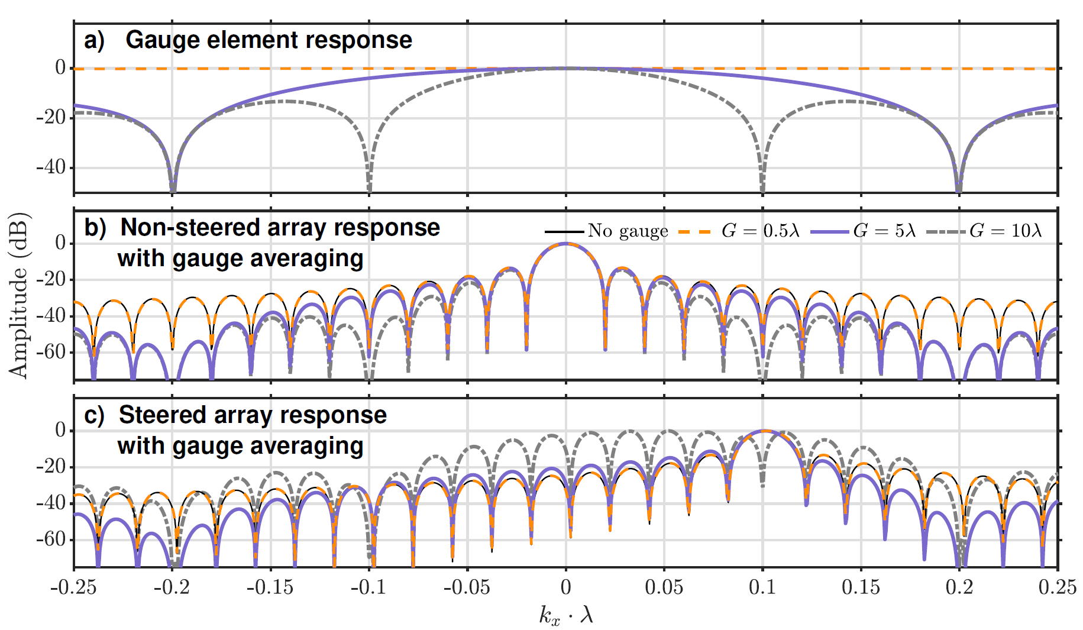
Considerations for DAS-array processing
Gauge length effect on a linear cable (cable sensitivity NOT included)
Two main factors to consider for DAS-based arrays:
Broadside sensitivity
Gauge length averaging
For gauge lengths above λ/2 there is a directivity effect on each sensor element
Main lobe and first sidelobe largely unaffected for parallel wavefronts
The total steered response is heavily influenced by the element response for non-parallel wavefronts
Wavefront parallel to cable
Wavefront impinging at 0.1/λ
Näsholm et al., 2022 (JGR)
Notes:
The second factor to consider is gauge length averaging.
Since our DAS measurement is averaging over a discrete distance, this also introduces in a directivity effect depending on the wavelength and gauge length
In the top row of this figure we show this effect on a linear cable. For gauge lengths below at or below half a wavelength there is a neglible effect.
But increasing gauge lengths we no longer get this flat response.
In the middle row, we see the overall response for a wavefront parallel to the cable. Here we see even at long gauge lengths the main-lobe and the first couple of side-lobes are unaffected.
However, on the third row we start to see how the element response influences the overall steered response for a wavefront impinging at some angle to the cable.

Slide 15
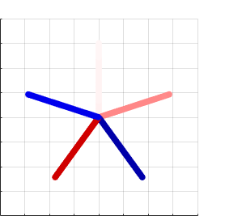
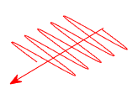
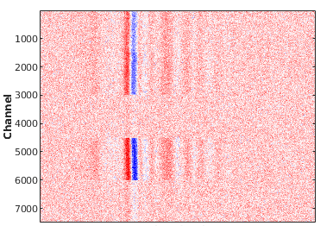
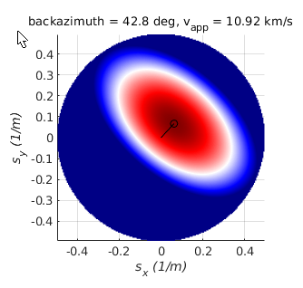
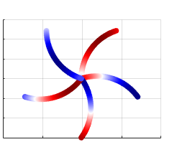
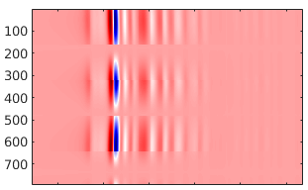
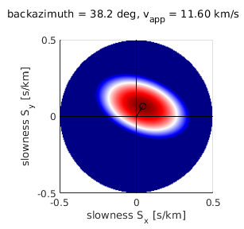
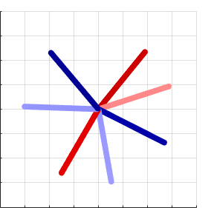
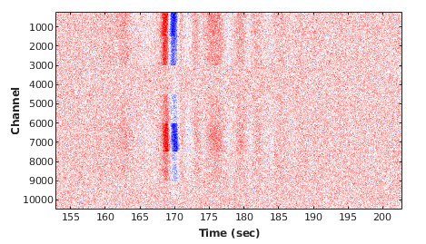
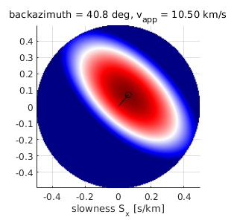
Synthetic example - single event
Array design & sensitivity
Synthetic data
fk-analysis
3 km
Channel
3 km
Channel
3 km
Channel
3 km
Time
Notes:
Back-azimuth of 41.5 degrees. 3 km aperture for all these designs

