Slide 1


Interrogating Tomographic Uncertainties to obtain Subsurface Information
Xuebin Zhao, Andrew Curtis and Xin Zhang
25/05/2022

Slide 2



Interrogation Theory
Answer real-world questions by interrogating data
Answers are often low-D:
What is the volume of a particular subsurface reservoir?
Is there a geothermal plume beneath this area?
What is the depth of the Moho around this region?
$${X km}^{3}$$
$$Yes/No$$
$$X km$$
Low dimensional answers often lie within high dimensional data
Notes:
Interrogation theory is used to answer some low dimensional scientific questions by interrogating to the observed data.

Slide 3
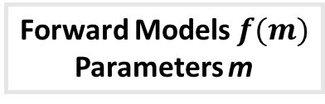

Inverse Theory and Interrogation Theory
Is there a geothermal plume beneath this area?
Forward Models $f(m)$
Parameters m
Forward
Problem
Inverse
Problem
Parameters m
Forward Problem
Inverse Problem
Algorithms C
QUESTIONS Q
ANSWERS A
Decision
Problem
Recorded
Data d
Data d
Data Space D
Design
Problem
Experimental Design $E_{d}$
Data Space D
Experiment
or Elicitation
Inverse Theory
Interrogation Theory
Arnold & Curtis, 2018 – GJI
Zhao et al., 2022 – JGR: Solid Earth
Notes:
This slide compares the inverse and interrogation theory.
On the left, we solve inverse problems by updating the information about model parameters m using the observed data, and we mainly care about the model parameters m.
The right panel shows the schema for interrogation theory. We focus on the scientific questions Q rather than the model parameters. By combining the forward problem, design problem and inverse problem, we could solve the decision problem and find the optimal answers to our questions.
In some cases we need to apply interrogation theory iteratively to answer the questions, and under this circumstance we also need the accumulated knowledge about the information we obtained from previous iteration of the interrogation theory.

Slide 4
Interrogating the East Irish Sea Basins

Slide 5
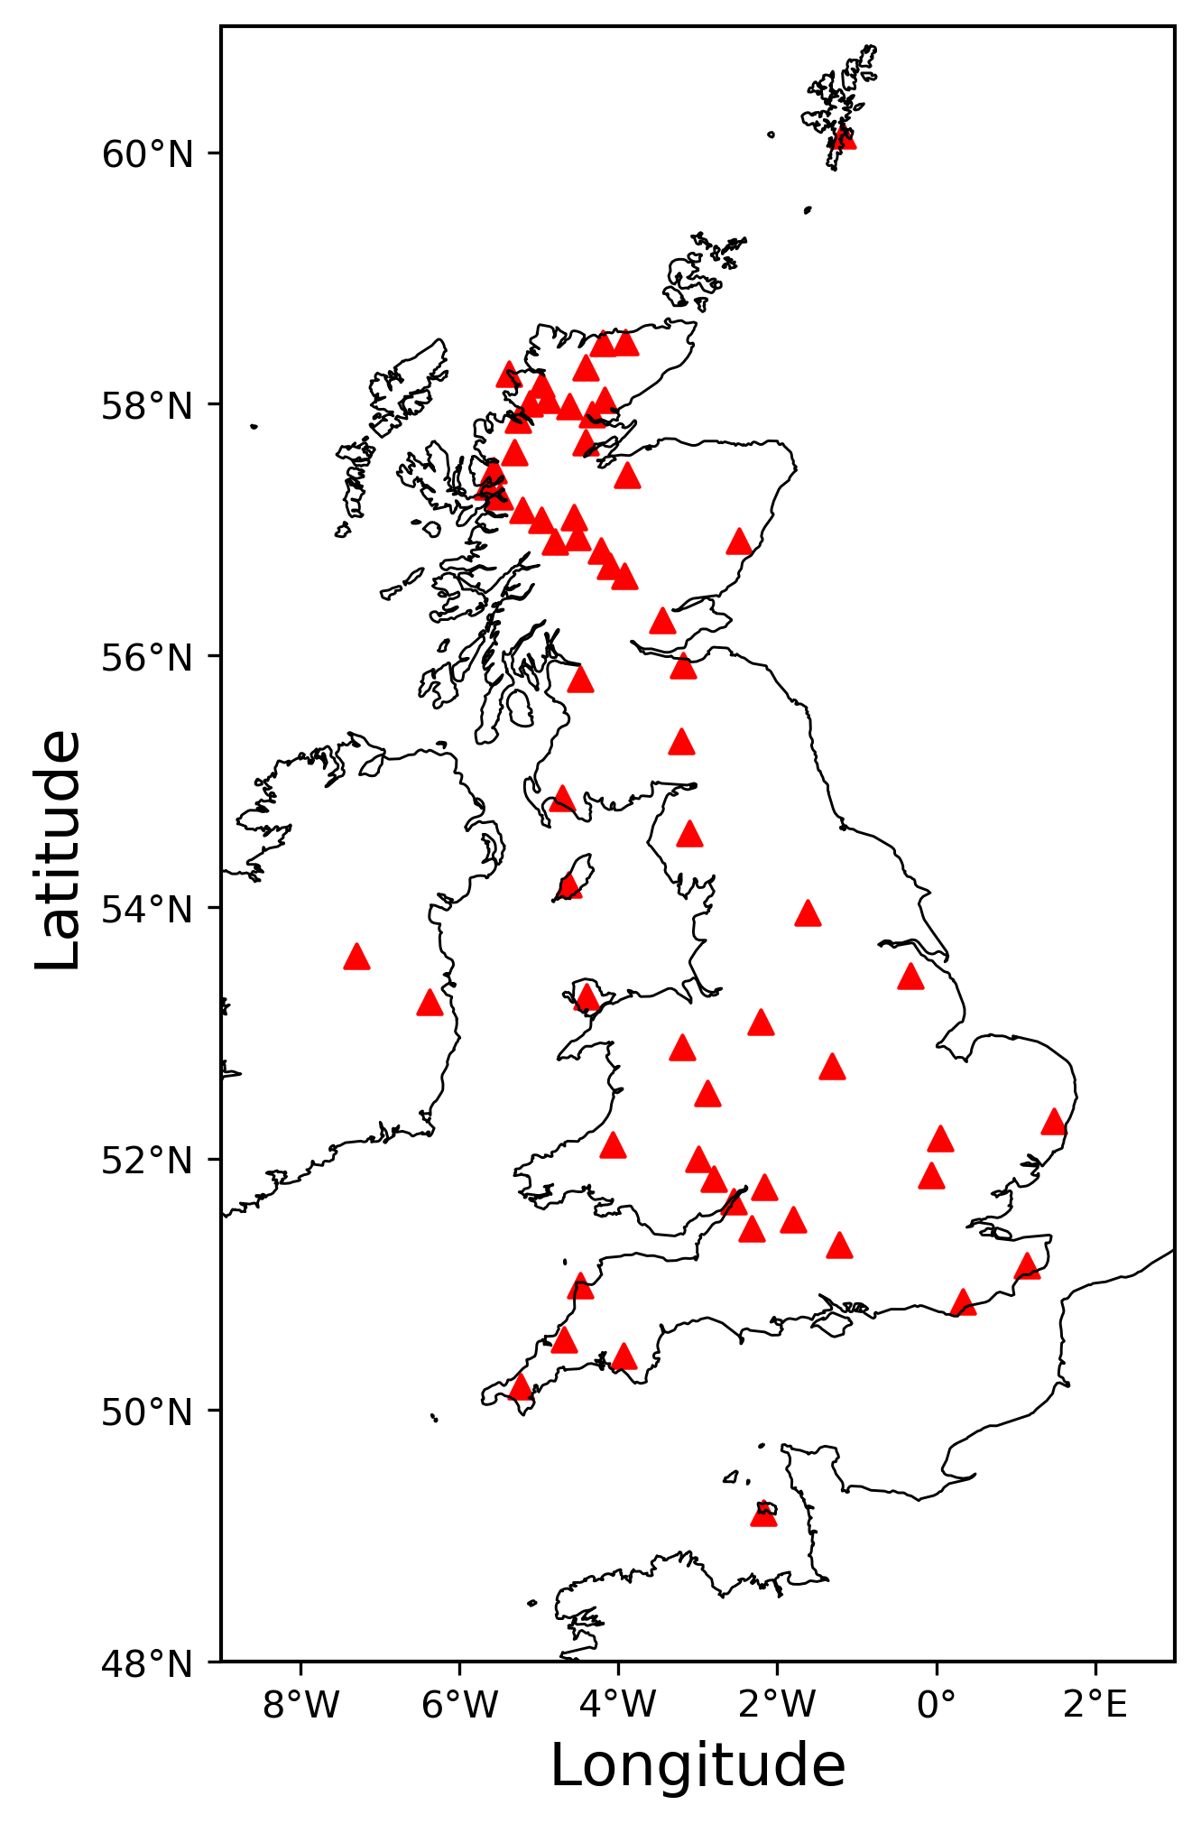
S Wave Velocity Inversion
Notes:
In the second example, we apply interrogation theory to find the area of the East Irish Sea Basins based on the 3D depth inversion around the Irish Sea.
We use 61 receivers marked as the red triangles to record the ambient noise data, and further estimate the inter-receiver Love wave travel times at different periods of 4s, 6s, 8s, 9s, 10s, 11s, 12s and 15s, which is used as the observed data in this interrogation problem.

Slide 6
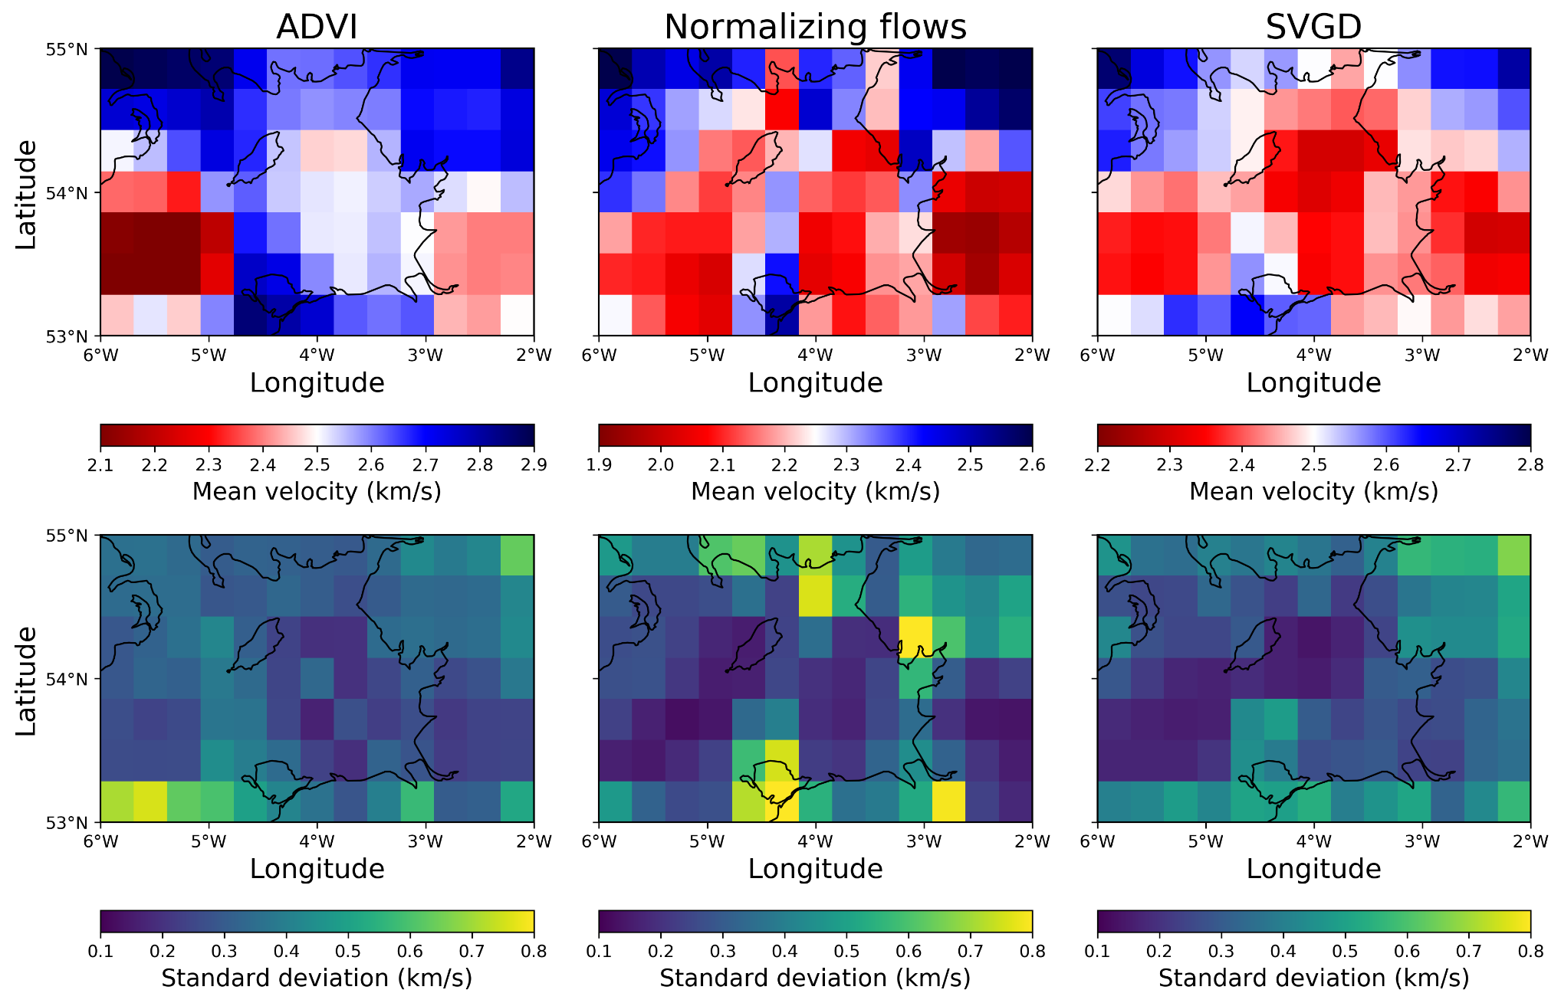
S wave velocity at Z = 200 m
What is the area of these three Sedimentary Basins?
Stranraer Basin
Horizontal Slices at Z = 200 m
Solway Firth Basin
East Irish Sea Basin
Notes:
This slide shows the results of shear wave velocity at depth of 200m.
From the shallow subsurface geology (BGS report CR/15/057) we know that the bedrock geology around this depth is made up of several sedimentary basins. In the figure, we have marked three of them – namely Stranraer Basin, Solway Firth Basin and East Irish Sea Basin – which performs a continuous (low) velocity zone around the east Irish Sea.
At this same depth, due to different formation age of different basins, it is possible that the shear wave velocity might be different at different horizontal locations. So we want to evaluate the total area of the three basins at this depth using the obtained velocity inversion result.

Slide 7
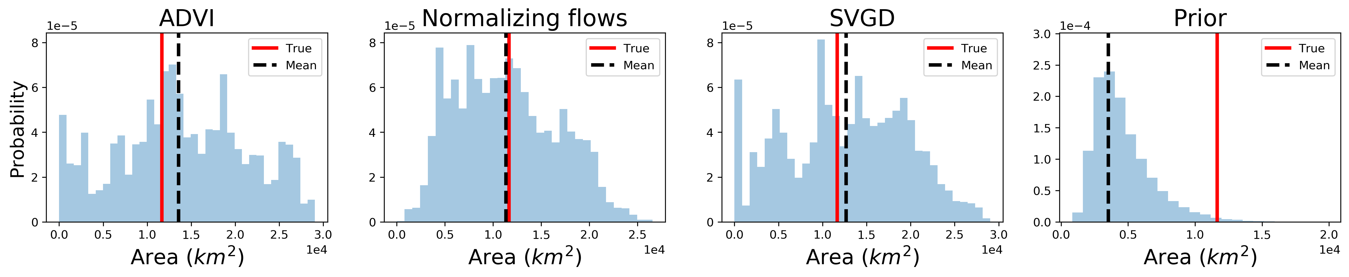

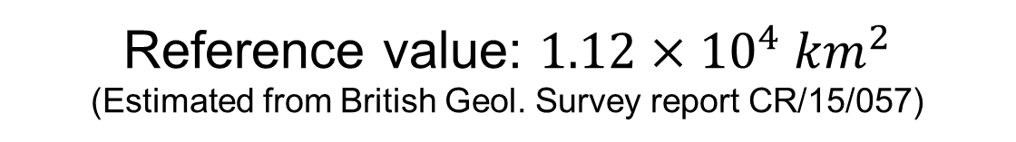
S wave velocity at Z = 200 m
Question: what is the area of the three Sedimentary Basins?
Optimal Answer: $a_{}^{∗}=1.21×{10}^{4} {km}^{2}$
Reference value: $1.12×{10}^{4} {km}^{2}$
(Estimated from British Geol. Survey report CR/15/057)
Notes:
The long-period surface wave data are relatively insensitive to the near surface, hence the distributions are broad, but they are significantly more informative than our prior probability distribution, as shown [click] on the right; this gives an extremely poor answer [click] to the area of sediment."

Slide 8


Thank you
Contact: Xuebin.zhao@ed.ac.uk
Arnold, R., & Curtis, A. (2018). Interrogation theory. Geophysical Journal International, 214(3), 1830-1846.
Zhao, X., Curtis, A., & Zhang, X. (2022). Interrogating Subsurface Structures using Probabilistic Tomography: an example assessing the volume of Irish Sea basins. Journal of Geophysical Research: Solid Earth.

