Slide 1



SUSCEPTIBILITY ANALYSIS FOR SEISMICALLY-INDUCED LANDSLIDES: APPLICATION TO THE 2001 EARTHQUAKES IN EL SALVADOR (C.A.)
Mercurio C.1, Martinello C.1, Azzara G.1, Argueta-Platero A.A.2, Manno G.3,
Cappadonia C.1, Conoscenti C.1, Rotigliano E.1.
1 Department of Earth and Marine Sciences (DiSTeM), University of Palermo, Palermo, Italy
2 Faculty of Agronomic Sciences, University of El Salvador, San Salvador, El Salvador
3 Department of Engineering (DI), University of Palermo, Palermo, Italy
NH4.4
Earthquake-induced hazards: ground motion amplification and ground failures
Convener: Giovanni Forte | Co-conveners: Hans-Balder Havenith, Paolo Frattini, Céline Bourdeau

Slide 2
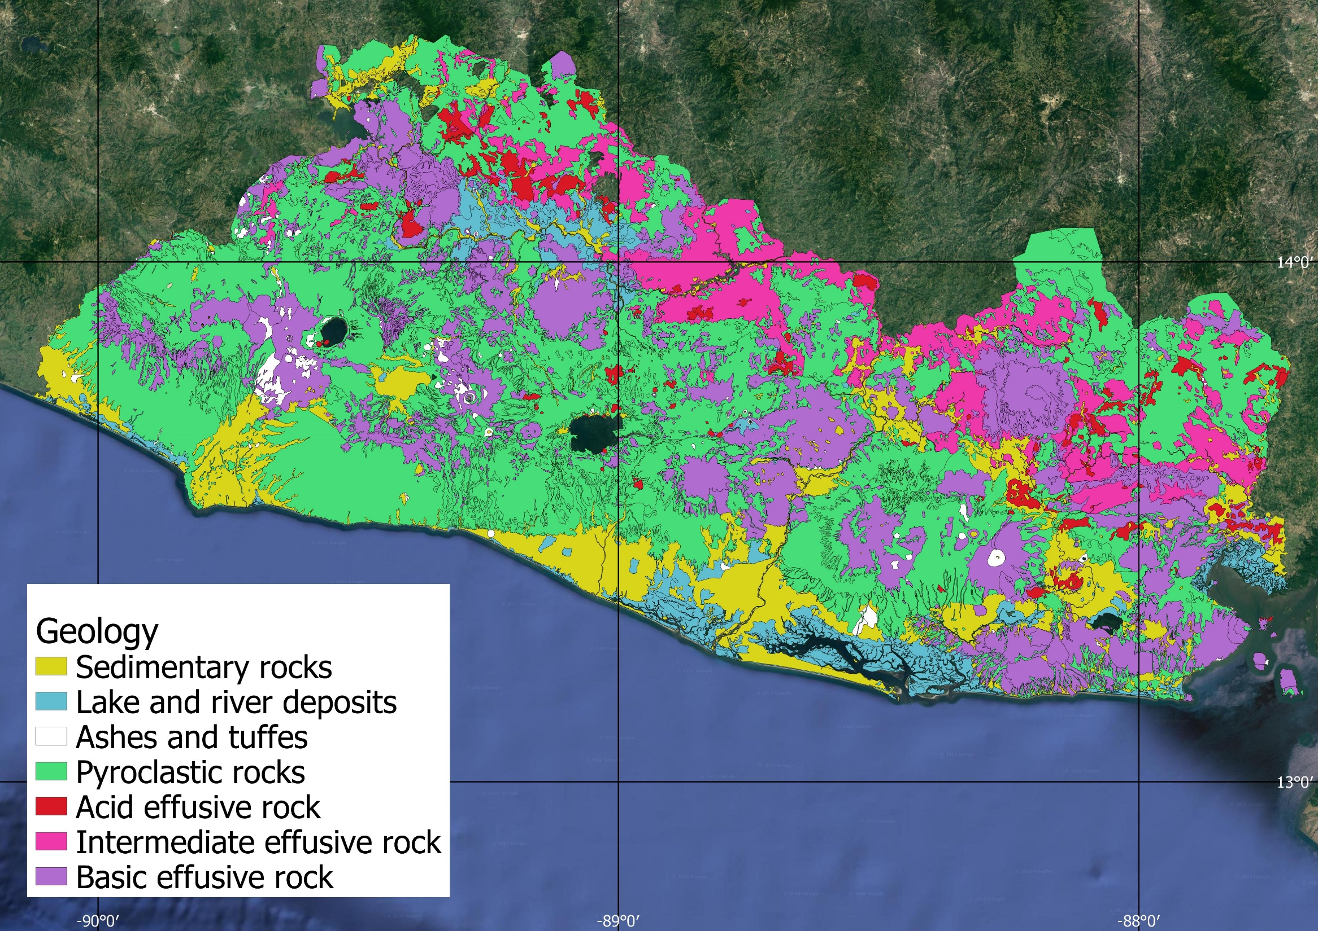

EL SALVADOR (C.A.)
Volcanic rocks represent 95% of the surface lithology.
The lithological features of these outcropping rocks are responsible for the very high seismically-induced landslide susceptibility of the country.
SUSCEPTIBILITY ANALYSIS FOR SEISMICALLY-INDUCED LANDSLIDES: APPLICATION TO THE 2001 EARTHQUAKES IN EL SALVADOR (C.A.)

Slide 3
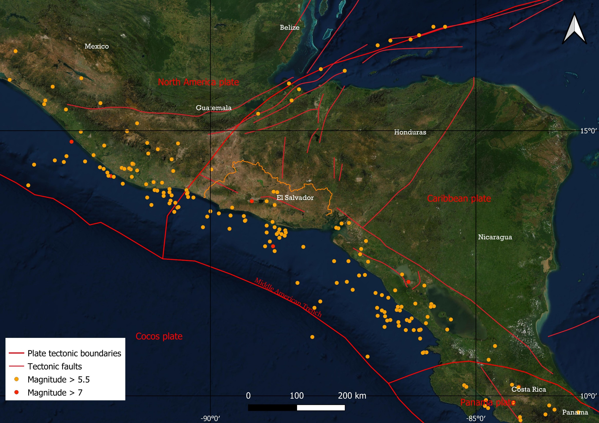
The largest earthquakes are generated in the Benioff - Wadati zone of the subducted Cocos plate, which converges with the Caribbean plate in the Middle American Trench (7 cm/year).
Subduction earthquakes in Central America tend to be followed by either large thrust events or shallow intra-plate events.
SUSCEPTIBILITY ANALYSIS FOR SEISMICALLY-INDUCED LANDSLIDES: APPLICATION TO THE 2001 EARTHQUAKES IN EL SALVADOR (C.A.)

Slide 4
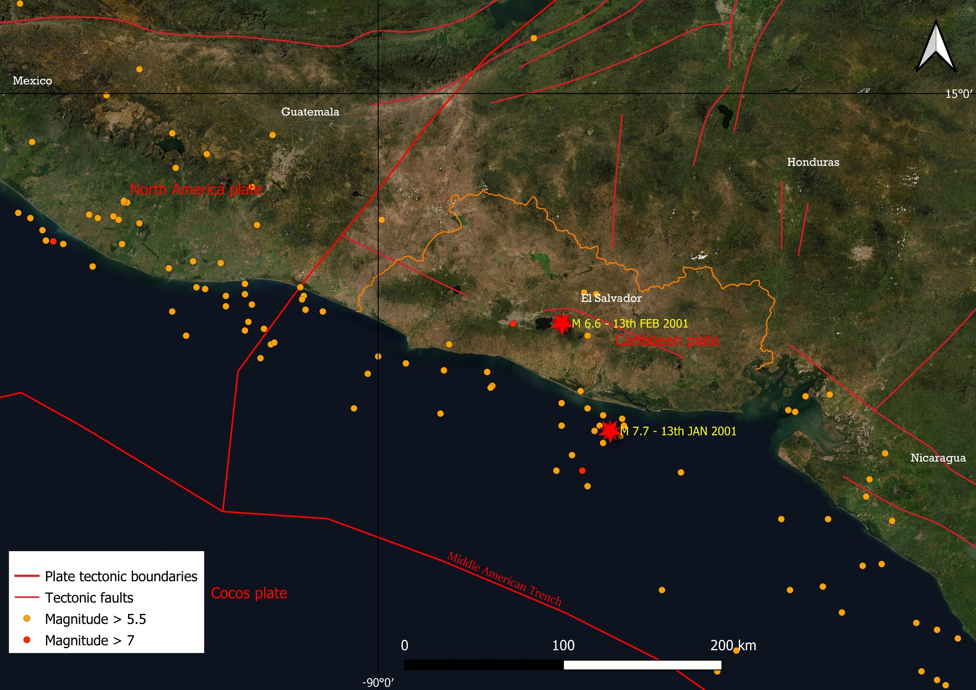
COMPLEX GEOLOGICAL CONTEXT
+
LITHOLOGY (non-cohesive or semi-cohesive rocks)
+
PROXIMITY OF POPULATION CENTERS
=
VERY HIGH RISK
13th January 2001
M 7.7 - Depth 60 km, offshore at 20 km from the coastline. 844 fatalities.
13th February 2001
M 6.6 - Depth 10 km, onshore, between Ilopango and San Vicente. 315 fatalities.
SUSCEPTIBILITY ANALYSIS FOR SEISMICALLY-INDUCED LANDSLIDES: APPLICATION TO THE 2001 EARTHQUAKES IN EL SALVADOR (C.A.)

Slide 5
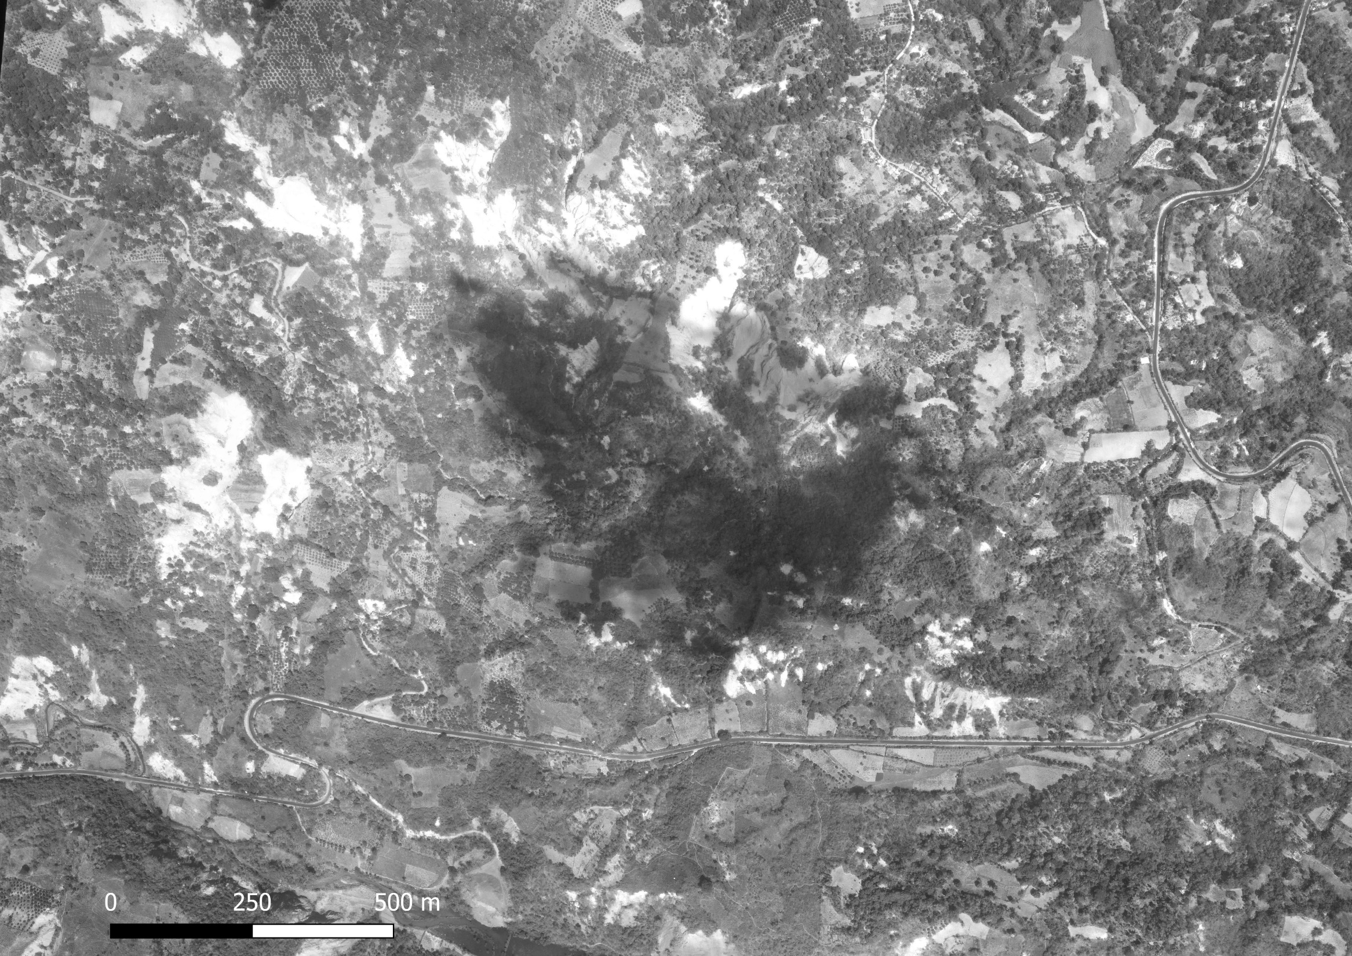
SUSCEPTIBILITY ANALYSIS FOR SEISMICALLY-INDUCED LANDSLIDES: APPLICATION TO THE 2001 EARTHQUAKES IN EL SALVADOR (C.A.)

Slide 6
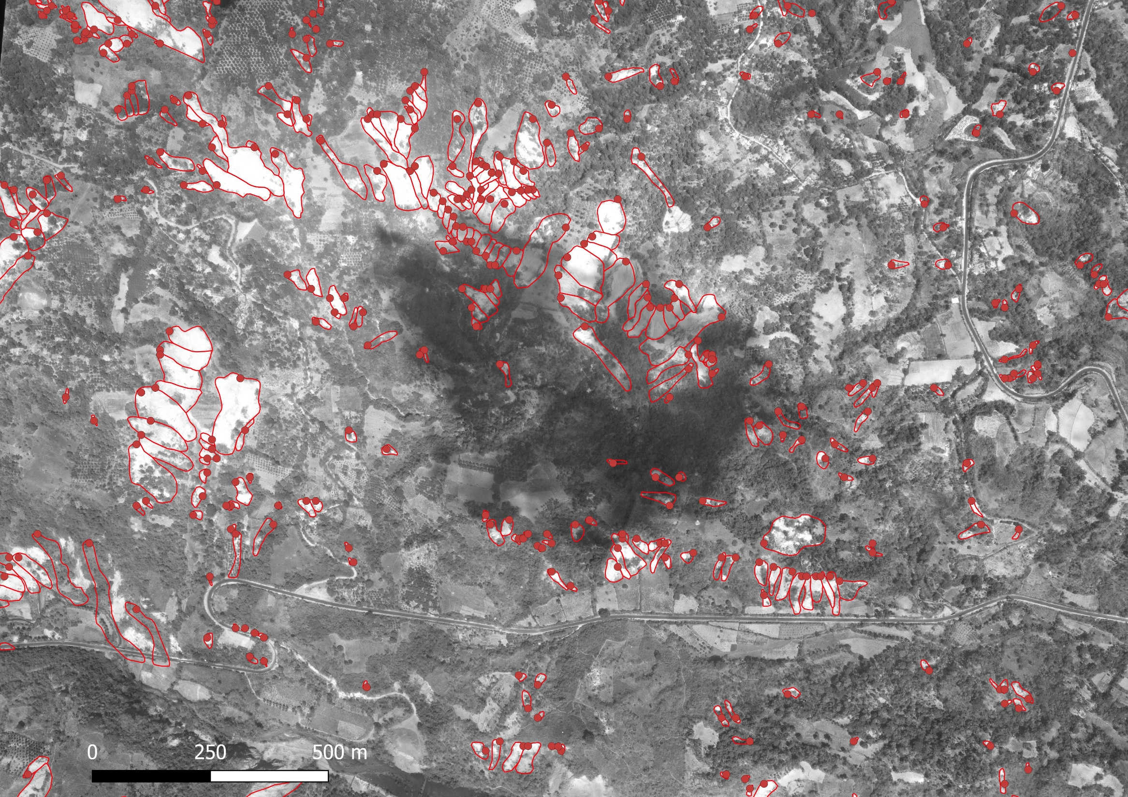
SUSCEPTIBILITY ANALYSIS FOR SEISMICALLY-INDUCED LANDSLIDES: APPLICATION TO THE 2001 EARTHQUAKES IN EL SALVADOR (C.A.)

Slide 7
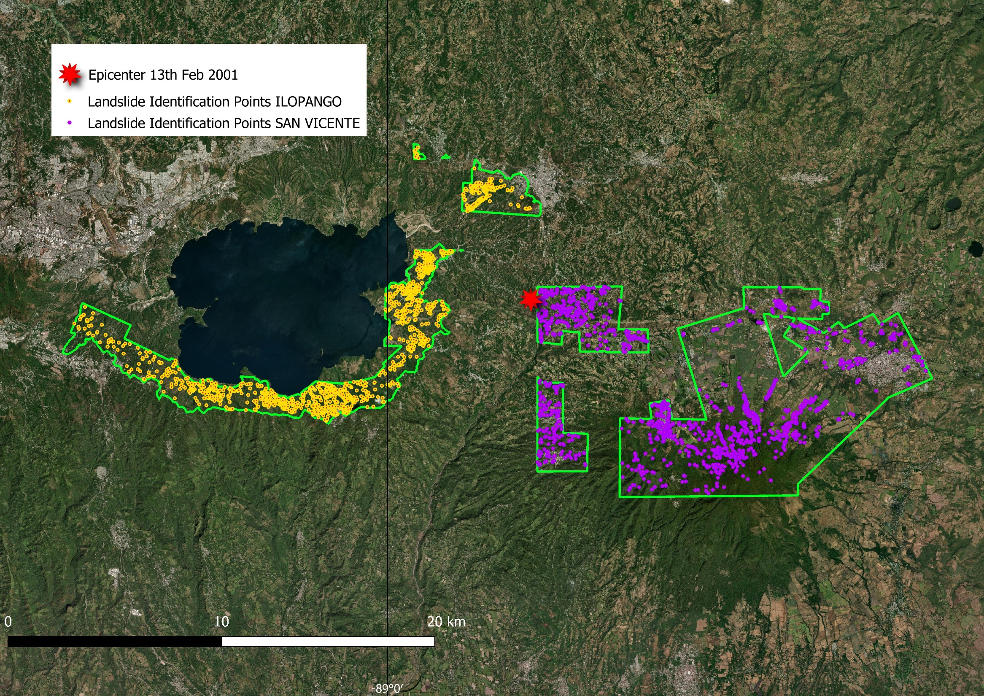
ILOPANGO
1612 landslides in an area of around 40km²
SAN VICENTE
1590 landslides in an area of around 108 km²
ILOPANGO
SAN VICENTE
SUSCEPTIBILITY ANALYSIS FOR SEISMICALLY-INDUCED LANDSLIDES: APPLICATION TO THE 2001 EARTHQUAKES IN EL SALVADOR (C.A.)

Slide 8
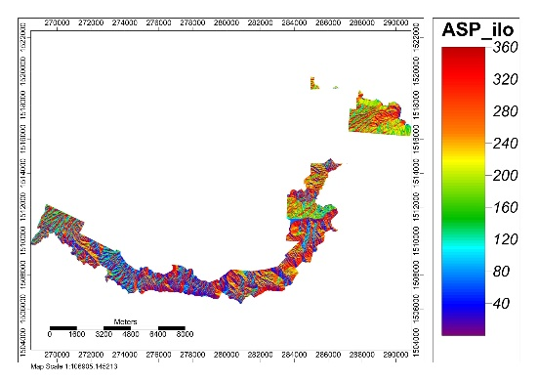
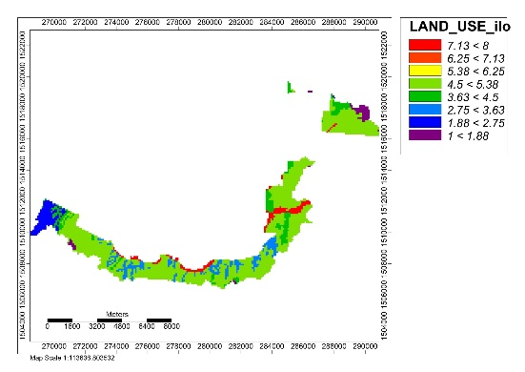
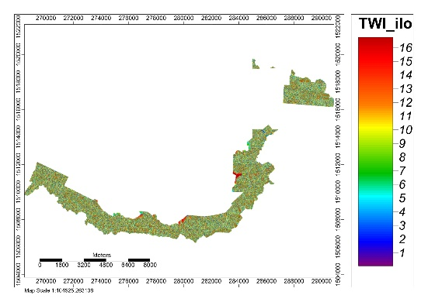
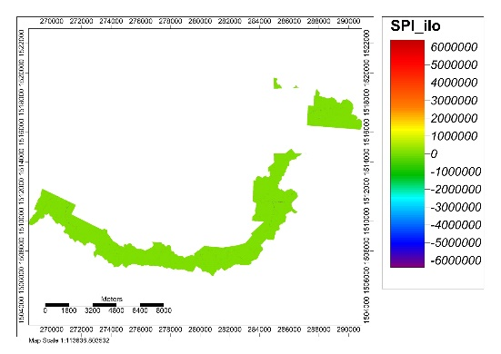
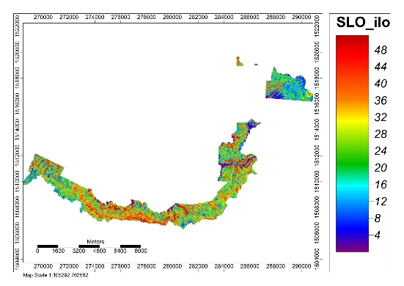
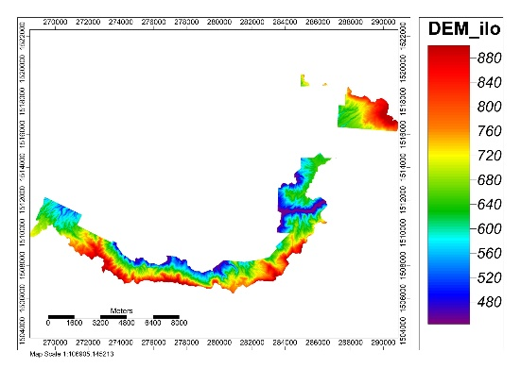
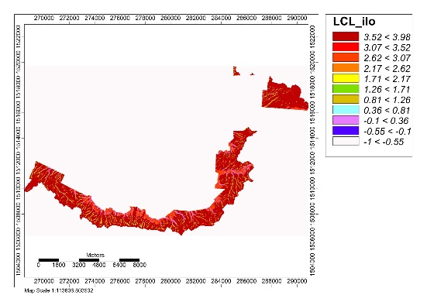
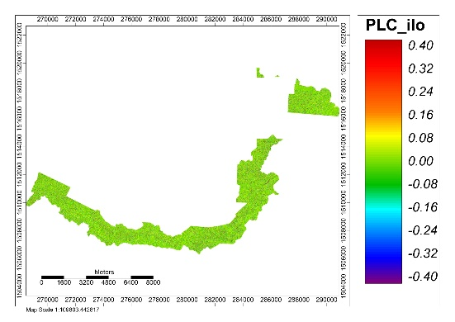
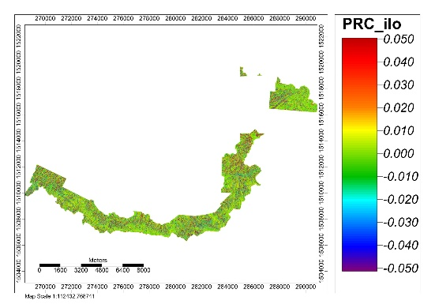
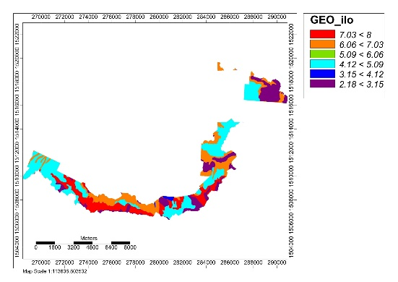



1
2
3
4
5
6
7
8
Aspect
Land use
Topographic Wetness Index
Stream Positioning Index
1
2
3
4
5
6
7
8
9
10
11
Slope
Elevation
Landform Classification
Plan Curvature
1
2
3
4
5
6
Profile Curvature
Lithology
SUSCEPTIBILITY ANALYSIS FOR SEISMICALLY-INDUCED LANDSLIDES: APPLICATION TO THE 2001 EARTHQUAKES IN EL SALVADOR (C.A.)
ILOPANGO

Slide 9
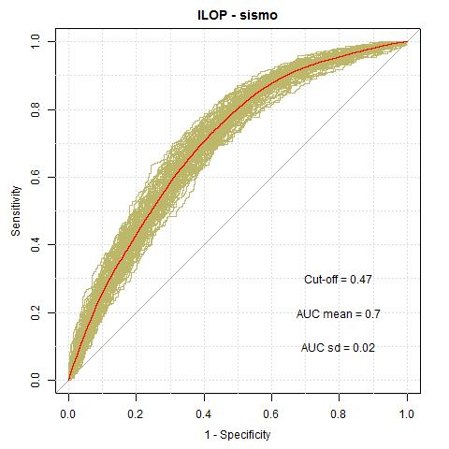
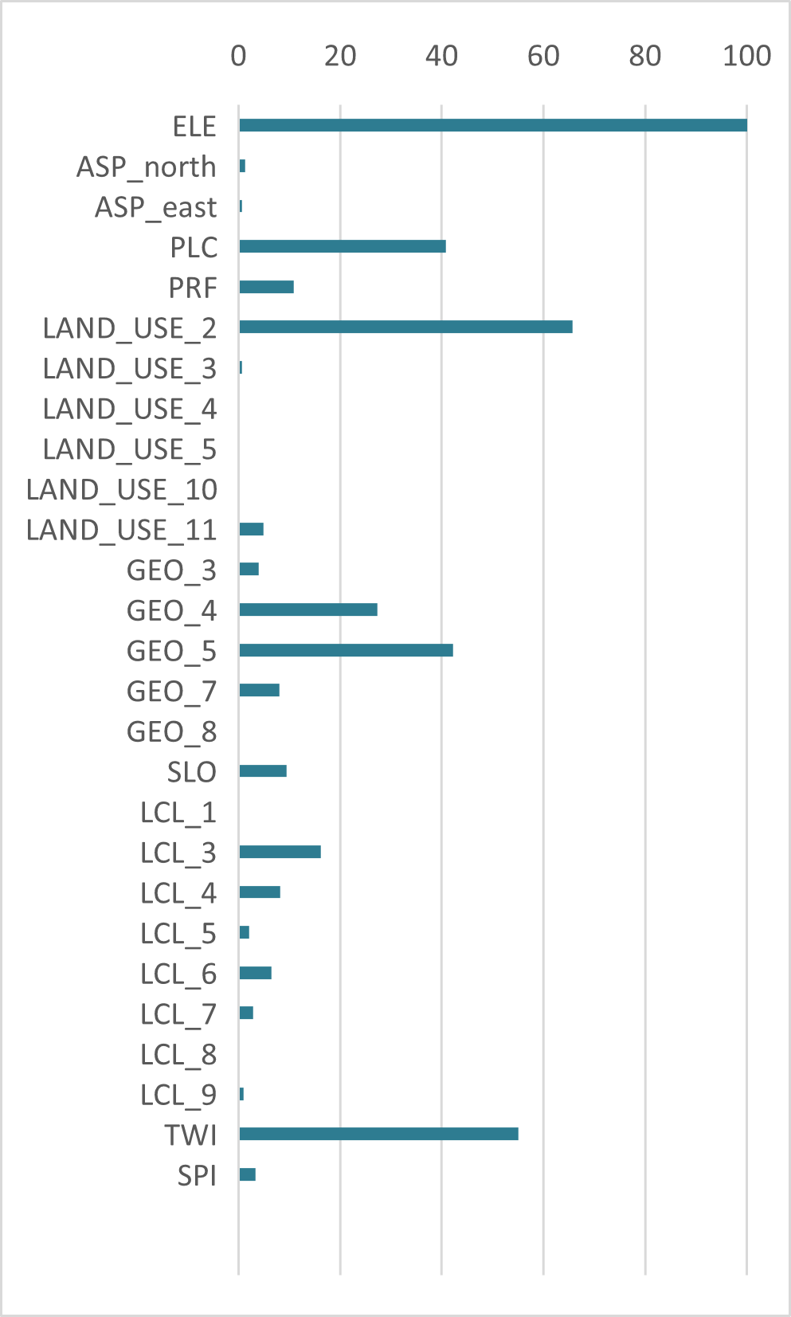
1
2
3
4
5
6
7
8
Aspect
Land use
Topographic Wetness Index
Stream Positioning Index
1
2
3
4
5
6
7
8
9
10
11
Slope
Elevation
Landform Classification
Plan Curvature
1
2
3
4
5
6
PLOT ROC
VARIABLES IMPORTANCE
Profile Curvature
Lithology
SUSCEPTIBILITY ANALYSIS FOR SEISMICALLY-INDUCED LANDSLIDES: APPLICATION TO THE 2001 EARTHQUAKES IN EL SALVADOR (C.A.)
ILOPANGO

Slide 10
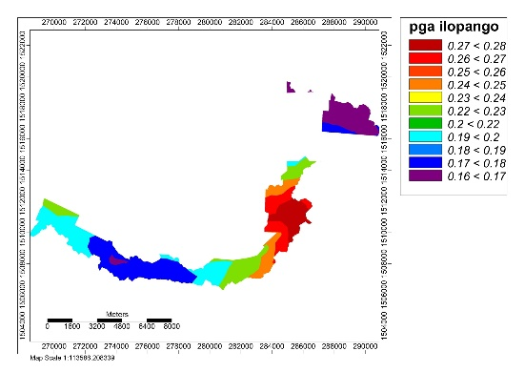
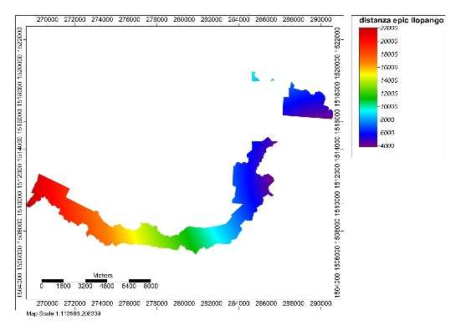
1
2
3
4
5
6
7
8
Aspect
Land use
Topographic Wetness Index
Stream Positioning Index
1
2
3
4
5
6
7
8
9
10
11
Slope
Elevation
Landform Classification
Plan Curvature
1
2
3
4
5
6
Profile Curvature
Lithology
Peak Ground Accelerations
Epicentral Distances
SUSCEPTIBILITY ANALYSIS FOR SEISMICALLY-INDUCED LANDSLIDES: APPLICATION TO THE 2001 EARTHQUAKES IN EL SALVADOR (C.A.)
ILOPANGO

Slide 11
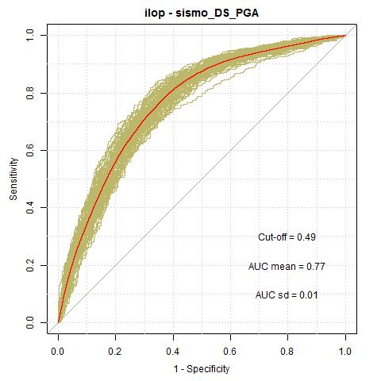
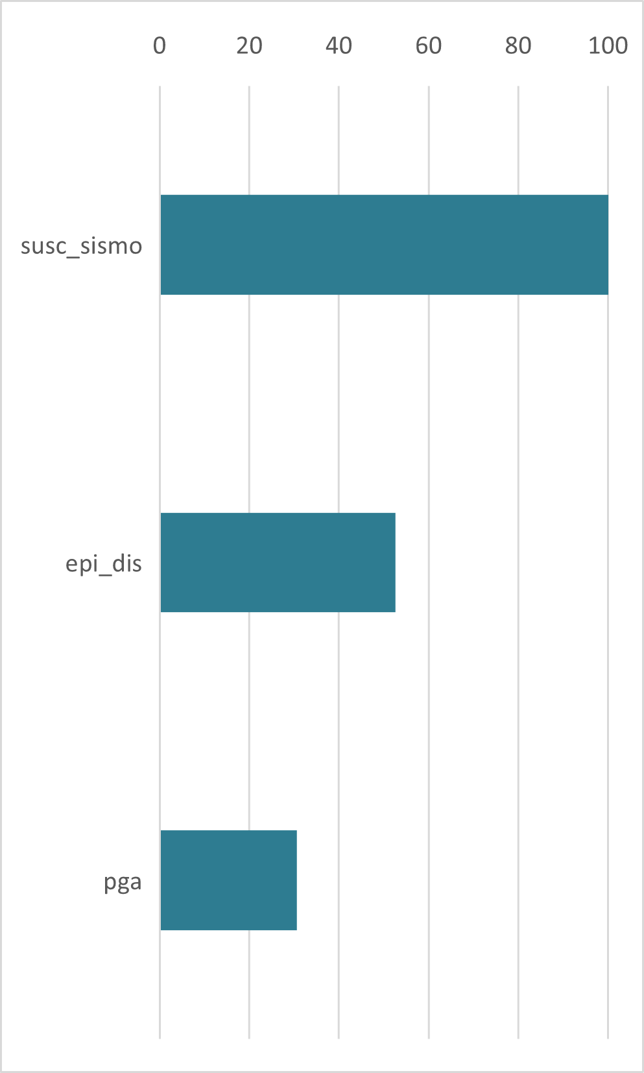
1
2
3
4
5
6
7
8
Aspect
Land use
Topographic Wetness Index
Stream Positioning Index
1
2
3
4
5
6
7
8
9
10
11
Slope
Elevation
Landform Classification
Plan Curvature
1
2
3
4
5
6
PLOT ROC
VARIABLES IMPORTANCE
Profile Curvature
Lithology
Peak Ground Accelerations
Epicentral Distances
AUC FROM 0.7 TO 0.77
SUSCEPTIBILITY ANALYSIS FOR SEISMICALLY-INDUCED LANDSLIDES: APPLICATION TO THE 2001 EARTHQUAKES IN EL SALVADOR (C.A.)
ILOPANGO

Slide 12
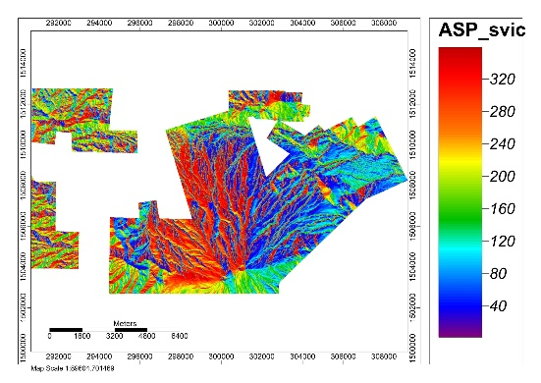
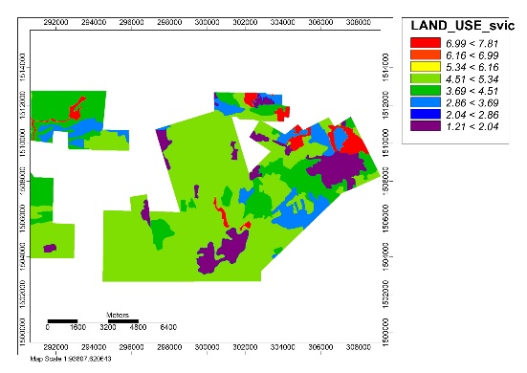
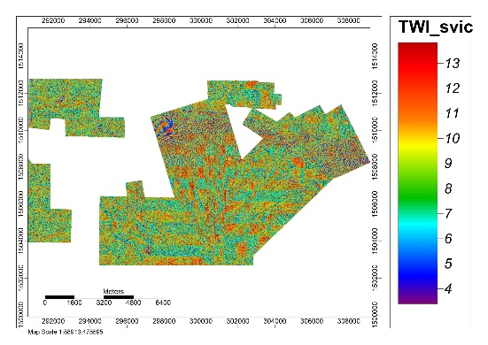
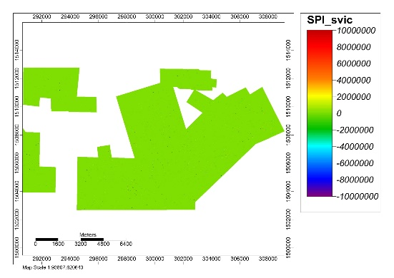
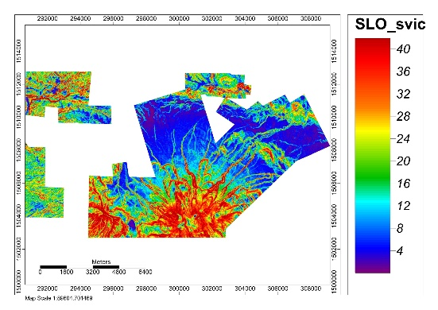
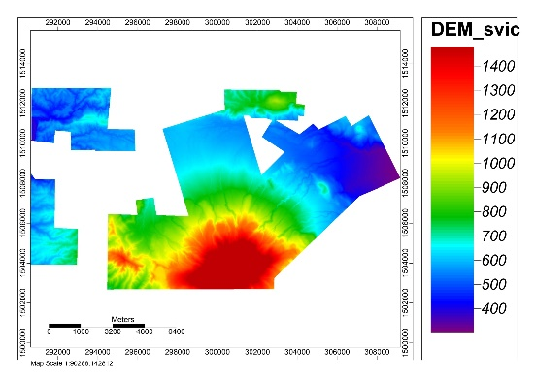
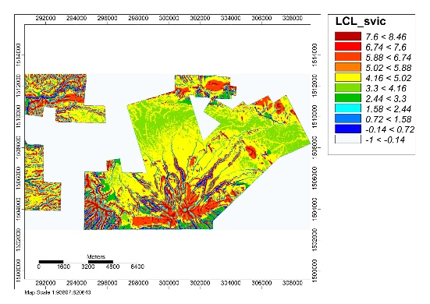
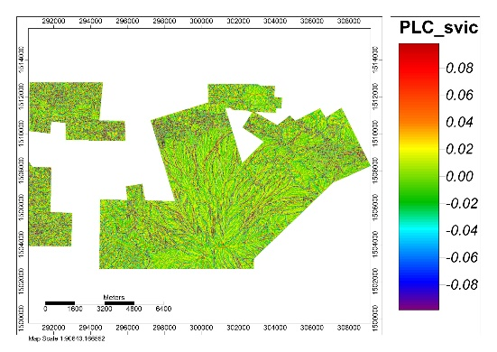
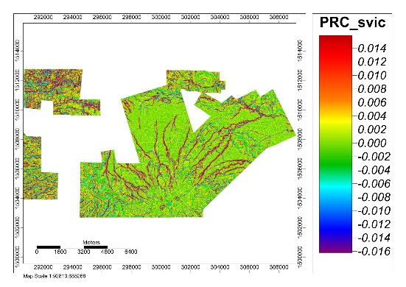
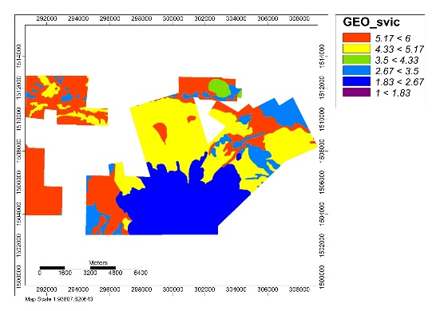
1
2
3
4
5
6
7
8
Aspect
Land use
Topographic Wetness Index
Stream Positioning Index
1
2
3
4
5
6
7
8
9
10
11
Slope
Elevation
Landform Classification
Plan Curvature
1
2
3
4
5
6
Profile Curvature
Lithology
SUSCEPTIBILITY ANALYSIS FOR SEISMICALLY-INDUCED LANDSLIDES: APPLICATION TO THE 2001 EARTHQUAKES IN EL SALVADOR (C.A.)
SAN VICENTE

Slide 13
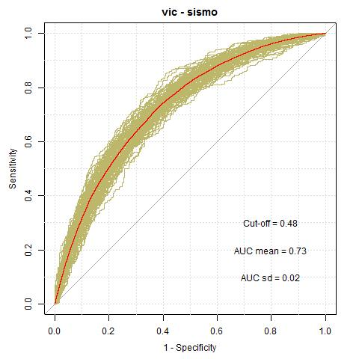
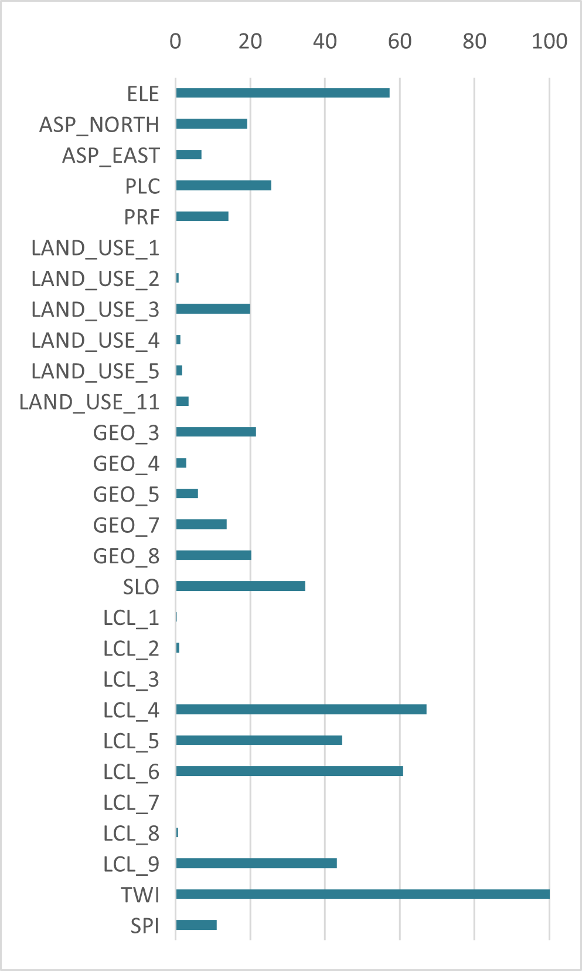
1
2
3
4
5
6
7
8
Aspect
Land use
Topographic Wetness Index
Stream Positioning Index
1
2
3
4
5
6
7
8
9
10
11
Slope
Elevation
Landform Classification
Plan Curvature
1
2
3
4
5
6
PLOT ROC
VARIABLES IMPORTANCE
Profile Curvature
Lithology
SUSCEPTIBILITY ANALYSIS FOR SEISMICALLY-INDUCED LANDSLIDES: APPLICATION TO THE 2001 EARTHQUAKES IN EL SALVADOR (C.A.)
SAN VICENTE

Slide 14
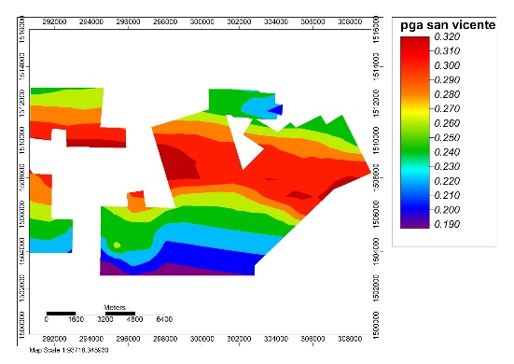
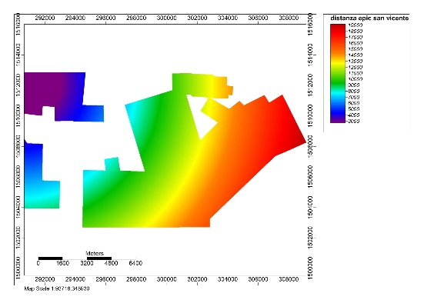
1
2
3
4
5
6
7
8
Aspect
Land use
Topographic Wetness Index
Stream Positioning Index
1
2
3
4
5
6
7
8
9
10
11
Slope
Elevation
Landform Classification
Plan Curvature
1
2
3
4
5
6
Profile Curvature
Lithology
Peak Ground Accelerations
Epicentral Distances
SUSCEPTIBILITY ANALYSIS FOR SEISMICALLY-INDUCED LANDSLIDES: APPLICATION TO THE 2001 EARTHQUAKES IN EL SALVADOR (C.A.)
SAN VICENTE

Slide 15
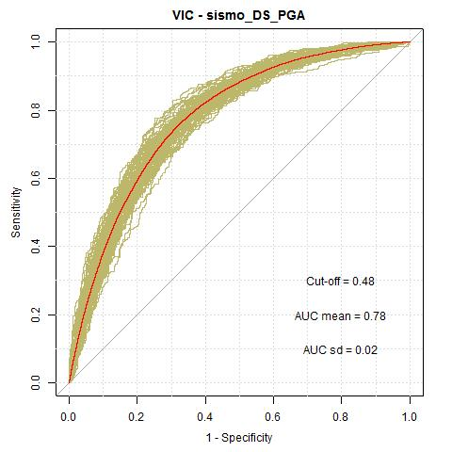
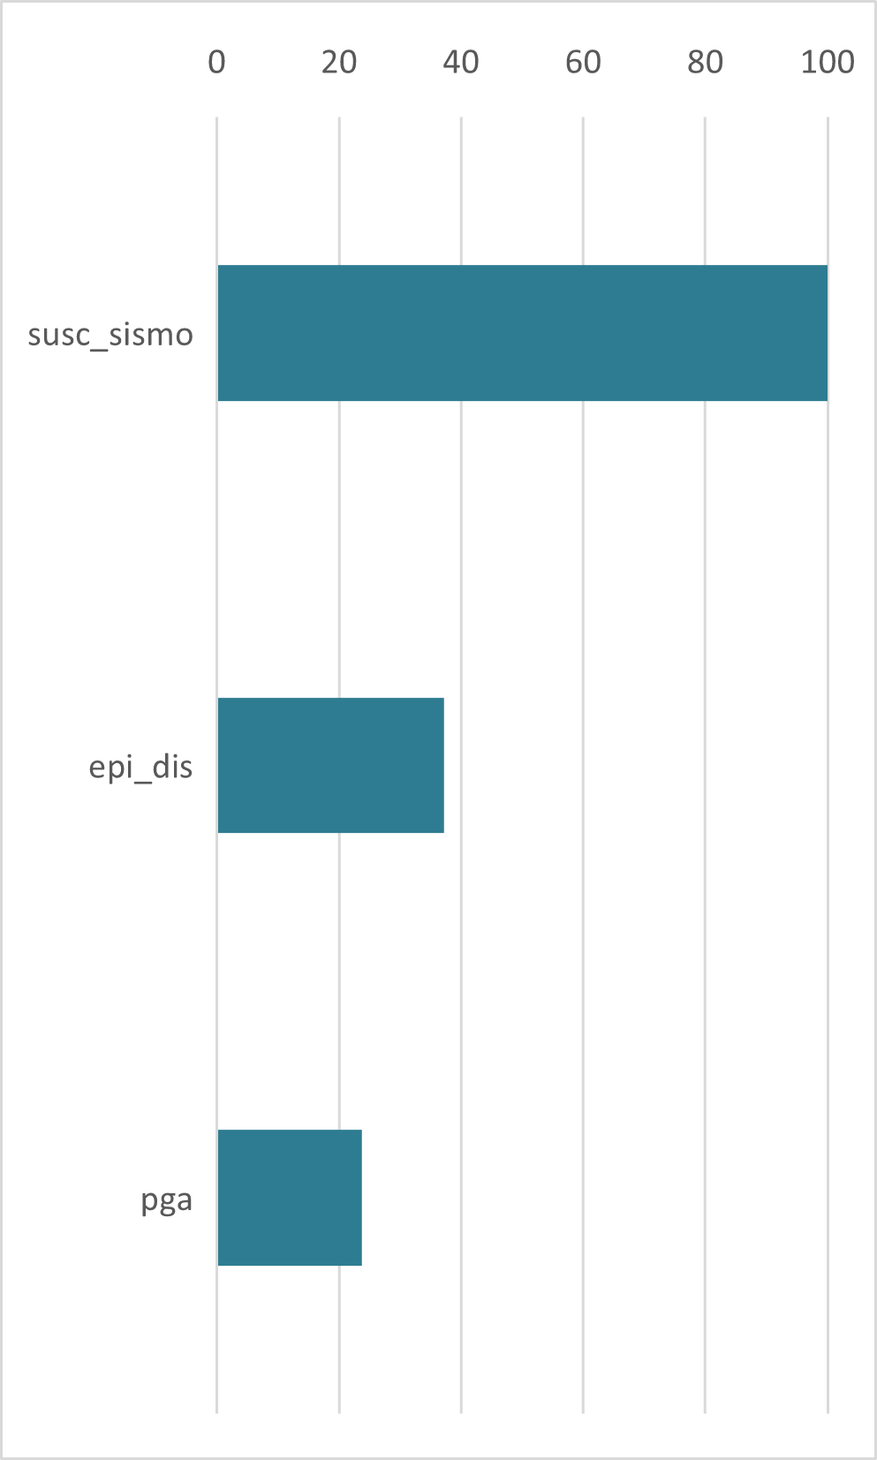
1
2
3
4
5
6
7
8
Aspect
Land use
Topographic Wetness Index
Stream Positioning Index
1
2
3
4
5
6
7
8
9
10
11
Slope
Elevation
Landform Classification
Plan Curvature
1
2
3
4
5
6
PLOT ROC
VARIABLES IMPORTANCE
Profile Curvature
Lithology
Peak Ground Accelerations
Epicentral Distances
AUC FROM 0.73 to 0.78
SUSCEPTIBILITY ANALYSIS FOR SEISMICALLY-INDUCED LANDSLIDES: APPLICATION TO THE 2001 EARTHQUAKES IN EL SALVADOR (C.A.)
SAN VICENTE

Slide 16
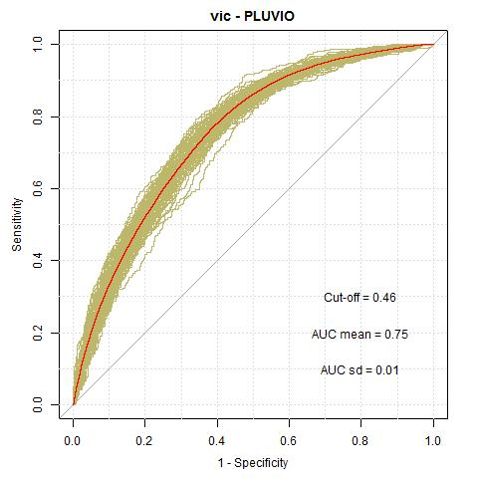
Ilopango rainfall-induced susceptibility model (2009 IDA/12E storm events) with classical independent variables
Ilopango rainfall-induced susceptibility model (2009 IDA/12E storm events) with classical independent variables and shaking-dependent variables
Landform Classification, Plan Curvature, Lithology, Profile Curvature, Slope, Aspect, Land use, Elevation, Topographic Wetness Index, Stream Positioning Index
Landform Classification, Plan Curvature, Lithology, Profile Curvature, Slope, Aspect, Land use, Elevation, Topographic Wetness Index, Stream Positioning Index
+
PGAs and Epicentral Distances
SUSCEPTIBILITY ANALYSIS FOR SEISMICALLY-INDUCED LANDSLIDES: APPLICATION TO THE 2001 EARTHQUAKES IN EL SALVADOR (C.A.)
AUC FROM 0.7 to 0.75

Slide 17
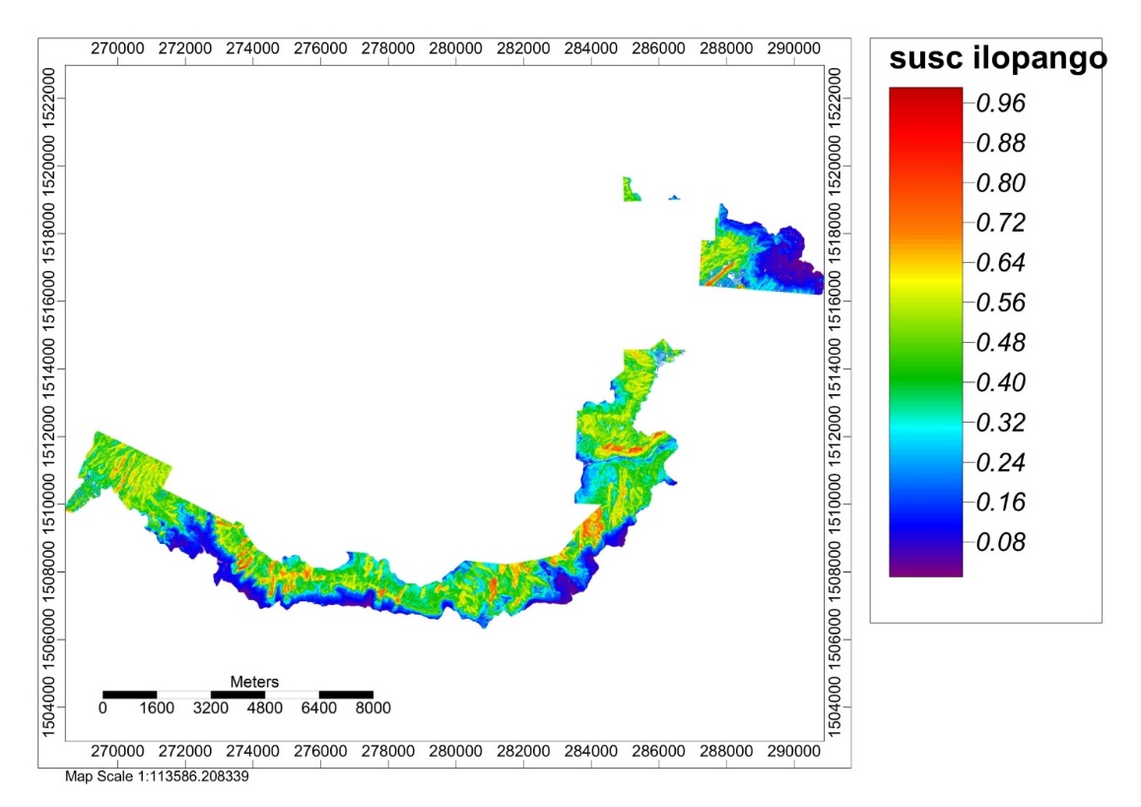
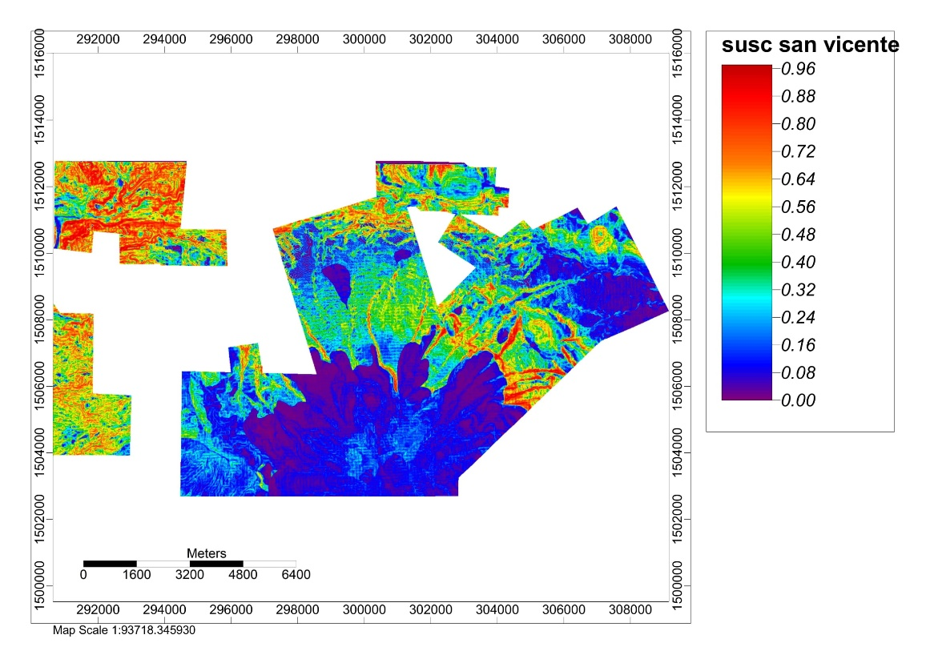
CONCLUSIONS:
ILOPANGO and SAN VICENTE models (seismically-induced landslides event):
A marked increase in models’ performances using shaking-dependent variables along with other "classic" variables. AUC from 0.7 to 0.77 for the Ilopango model and from 0.73 to 0.78 for the San Vicente model.
ILOPANGO model (rainfall-induced landslides event):
A marked increase in models’ performances using shaking-dependent variables along with other "classic" variables also in rainfall-induced landslides events. AUC from 0.7 to 0.75.
The results obtained from the research suggest the possibility of coupling the susceptibility scores obtained from static modeling to the expected mechanical shaking for the seismically-induced susceptibility assessment (i.e. Peak Ground Acceleration and epicentral distances).
SUSCEPTIBILITY ANALYSIS FOR SEISMICALLY-INDUCED LANDSLIDES: APPLICATION TO THE 2001 EARTHQUAKES IN EL SALVADOR (C.A.)

Slide 18
Thanks for your attention!
SUSCEPTIBILITY ANALYSIS FOR SEISMICALLY-INDUCED LANDSLIDES:
APPLICATION TO THE 2001 EARTHQUAKES IN EL SALVADOR (C.A.)
Mercurio C.1, Martinello C.1, Azzara G.1, Argueta-Platero A.A.2, Manno G.3,
Cappadonia C.1, Conoscenti C.1, Rotigliano E.1.
1 Department of Earth and Marine Sciences (DiSTeM), University of Palermo, Palermo, Italy
2 Faculty of Agronomic Sciences, University of El Salvador, San Salvador, El Salvador
3 Department of Engineering (DI), University of Palermo, Palermo, Italy

