Slide 1
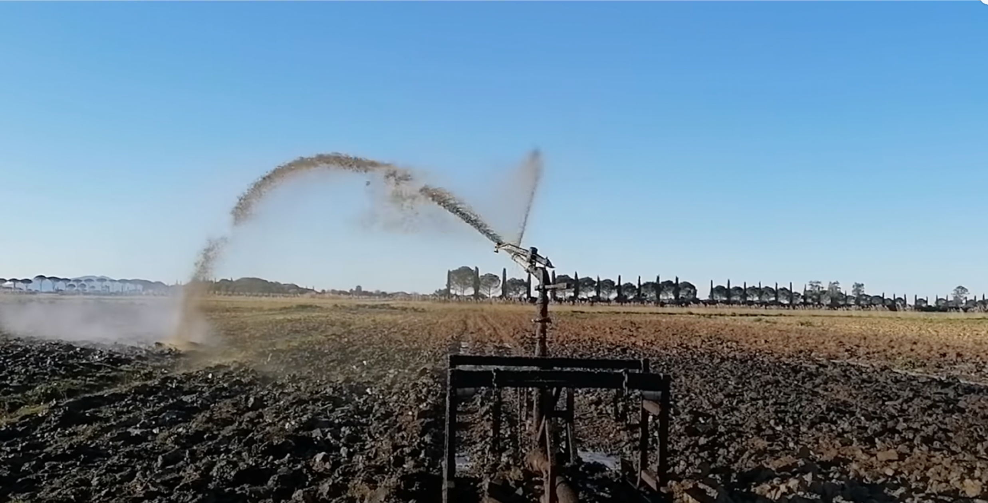
Nitrosat: Mapping reactive nitrogen at the landscape scale
EGU22-6473, March 25
BG3.20 – Gas exchange and related soil processes in agricultural ecosystems, virtual pre-recorded presentation Wednesday, 25 May 2022, 11:20 CEST
Pieternel Levelt (NCAR (USA), KNMI, TU Delft (Netherlands) ) and Pierre Coheur (ULB, Belgium) and the Nitrosat Science Team

Slide 2
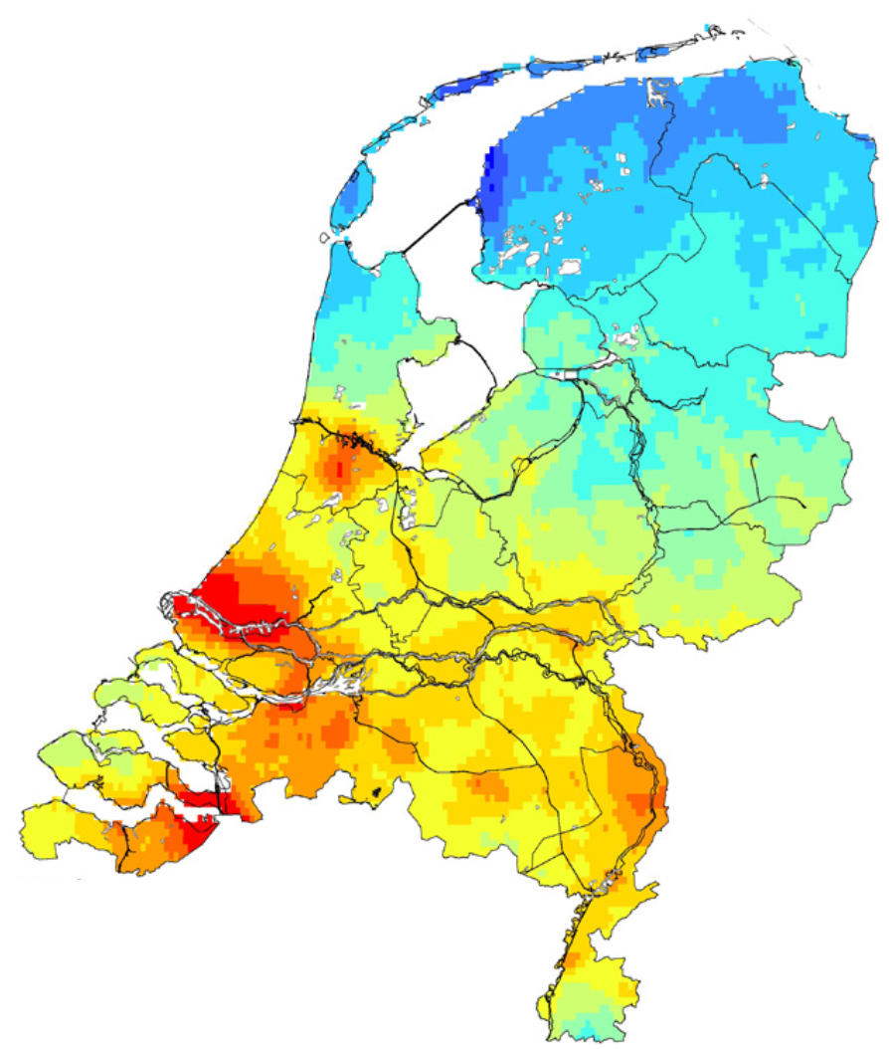
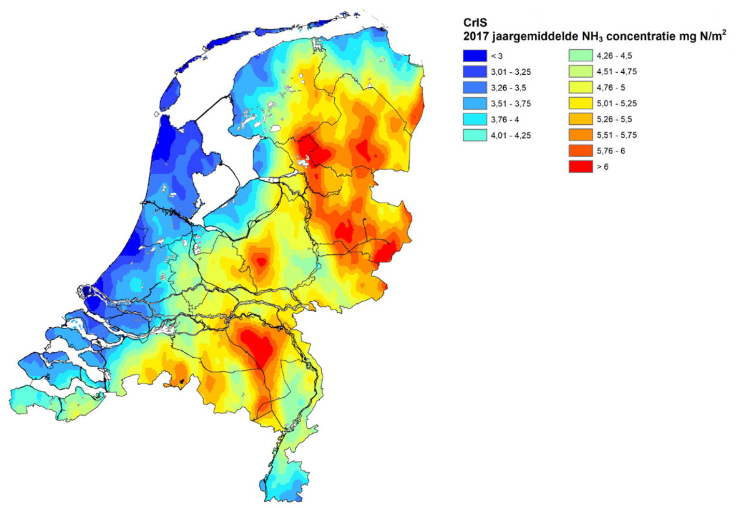
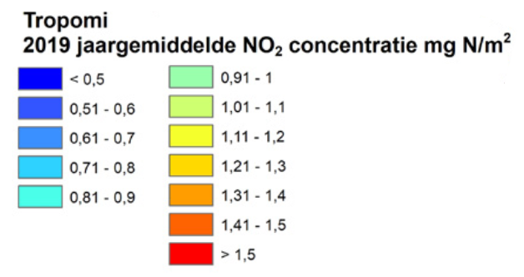
Nitrogen Cycle : measuring Ammonia and NOx on farm scale resolution from space (500x500 m²)
With NITROSAT: an Earth Explorer ESA mission pre-feasibility study
Lead-Investigator: Pierre Coheur (ULB); co-Lead Investigator Pieternel Levelt (KNMI, TUD, NCAR)
Lieven Clarisse (ULB), Martin Van Damme (ULB), Henk Eskes (KNMI), Pepijn Veefkind (KNMI and TUD), Cathy Clerbaux (LATMOS, France), Michel Van Roozendael (BIRA-IASB, Belgium), Frank Dentener (JRC, Italy) , Jan Willem Erisman (Leiden University, The Netherlands), Martijn Schaap (TNO, The Netherlands; TU Berlin, Germany), Mark Sutton (CEH, United-Kingdom)
TROPOMI
NO₂
Mission Objectives
CrIS
Ammonia
Quantify the emissions of NH₃ and NO_{x} on the landscape scales, and to attribute the relative contributions of natural, industrial, agricultural, fire, transport and household sources.
Quantify the contribution of reactive nitrogen to air pollution.
Constrain the atmospheric dispersion and surface deposition of reactive nitrogen and its impacts on ecosystems and the carbon cycle.
Reduce uncertainties in the contribution of reactive nitrogen to climate forcing via a better understanding of gas phase chemistry, secondary aerosol formation and interactions between biogeochemical cycles.

Slide 3
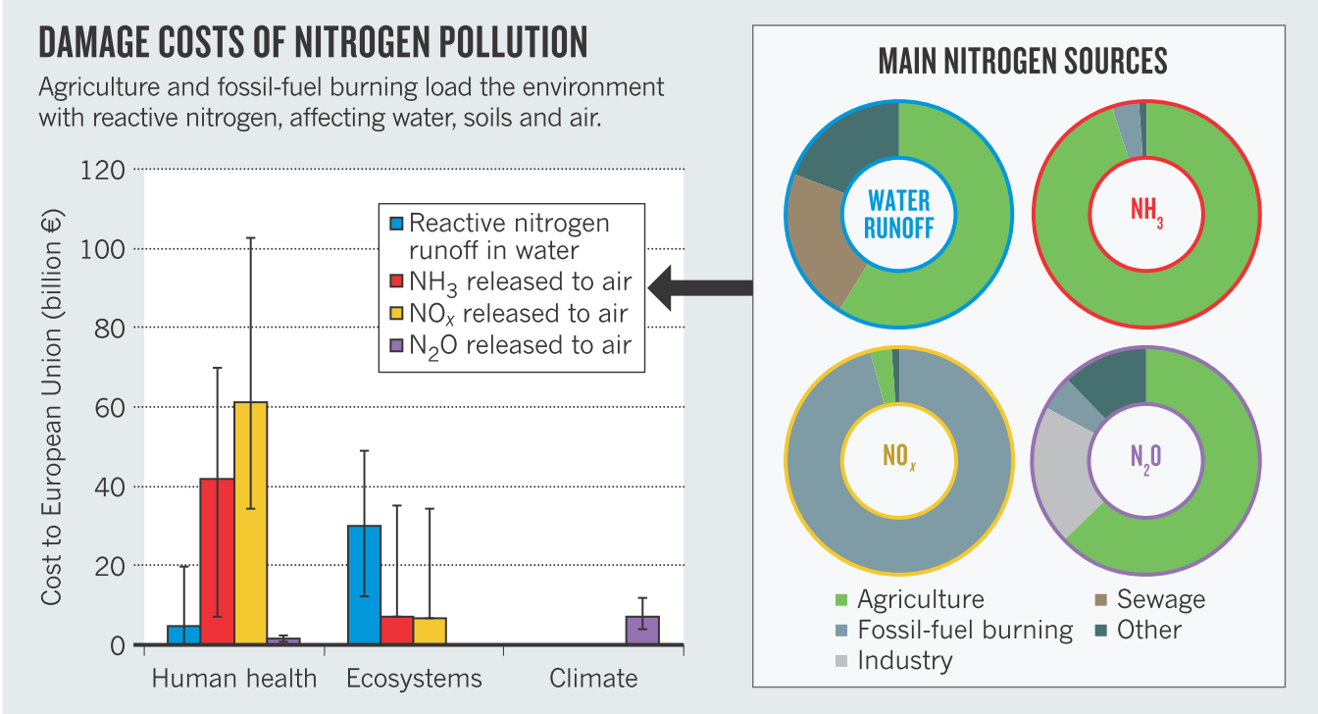
Scientific motivation and goals
Anthropogenic perturbation of the reactive nitrogen cycle
Emissions of reactive nitrogen have increased five to ten-fold since preindustrial times due to agriculture and energy production
62% of the area of European ecosystems was exposed to levels of nitrogen beyond that which they can safely tolerate
90 % of the emissions occur in the form of NO_{x} and NH₃
Excess reactive nitrogen has detrimental impacts on human and ecosystems health, as well as on the global environment (climate, biodiversity, stratospheric ozone) on all scales
The current nitrogen biogeochemical flow is placing humanity in a zone of high-risk.
EU damage cost: 70-320 billion € / year
Sutton et al., Nature 2011

Slide 4
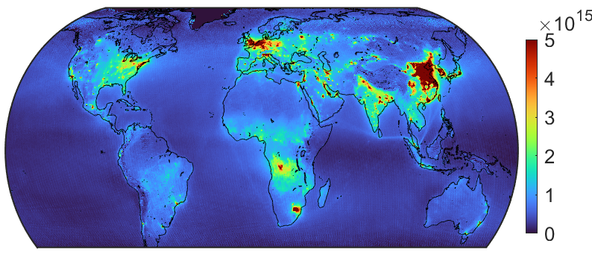
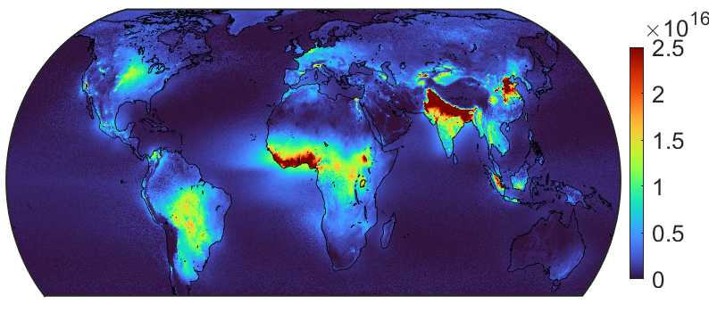
Scientific motivation and goals
Landscape scale: a remaining gap for measuring reactive nitrogen
Much is known on reactive nitrogen at the global and regional scale: spatial resolution of the satellite pixels is around 5 x 5 to 10 x 10 km2
10-year averages
Tropospheric NO₂ from OMI
Tropospheric NH₃ from IASI
Fingerprint of anthropogenic pollution (regional, country to global scale)
Energy production; transport…
Agriculture

Slide 5
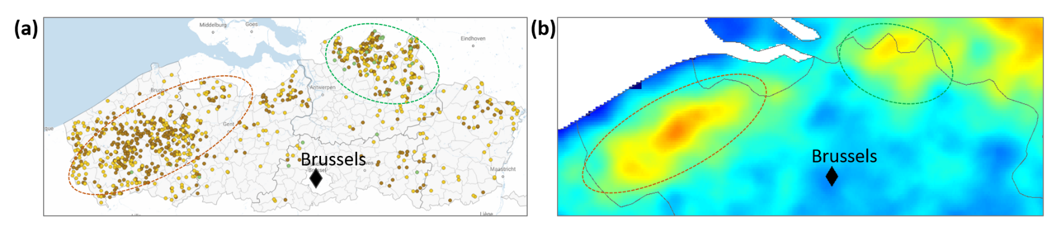
Scientific motivation and goals
Landscape scale: a remaining gap for measuring reactive nitrogen
Ammonia distribution from IASI – 10 year average
Much is known on reactive nitrogen at the global and regional scale but:
Point source detection only possible using long term averages and specialised imaging techniques (wind-rotated supersampling)
Clusters cannot be disentangled
Extracting reliable emission / deposition fluxes and assessing the related impacts at local scale
Feedlots in Flanders
Nitrosat will provide measurements at the landscape (sub-km) scale

Slide 6
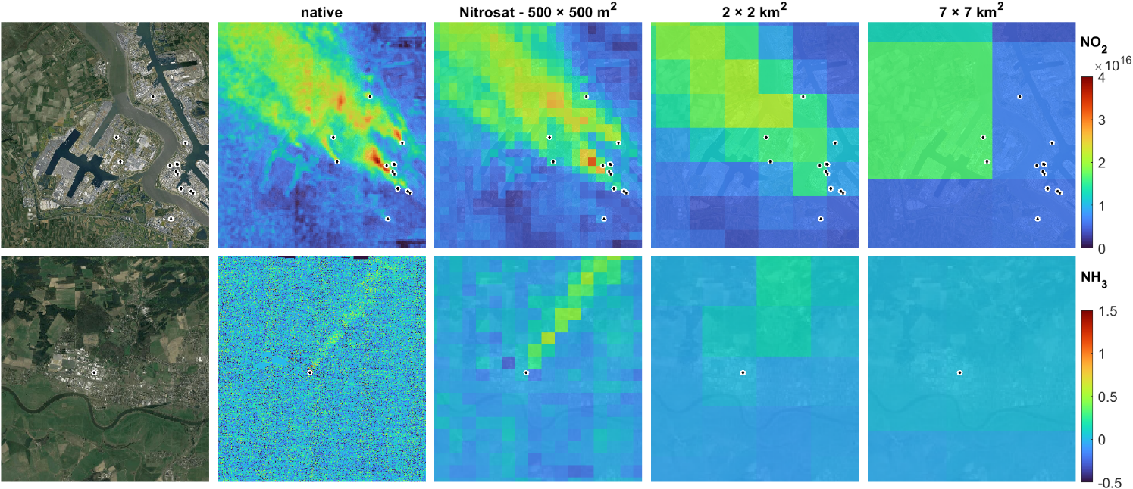
Science and mission objectives
Industrial point sources
Port of Antwerp
NO₂
Piesteritz (agro)chemical
complex
NH₃
Measurements at the landscape scale

Slide 7
Science and mission objectives
Sentinel 5
MTG – IRS
CO2M
Industrial point sources
Port of Antwerp
NO₂
Piesteritz (agro)chemical
complex
NH₃
Measurements at the landscape scale

Slide 8
Science and mission objectives
Sentinel 5
MTG – IRS
Nitrosat
CO2M
Industrial point sources
Port of Antwerp
NO₂
Piesteritz (agro)chemical
complex
NH₃
Measurements at the landscape scale

Slide 9
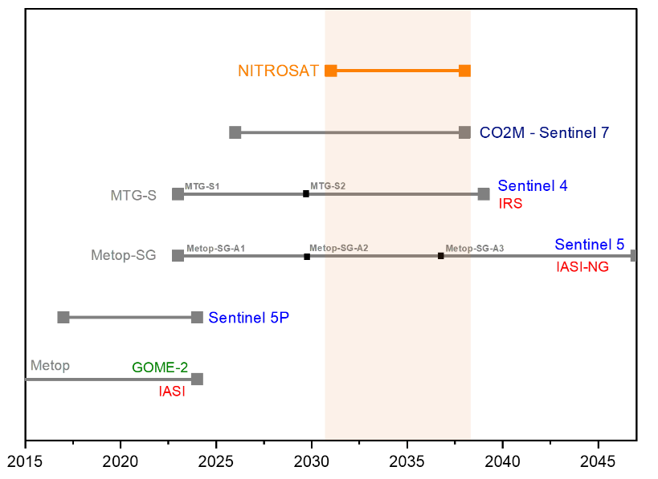
Mission concept
Synchronized imaging of NH₃ and NO₂ at a spatial resolution of 500 x 500m² and a
Bi-monthly revisit time for detecting seasonal impacts
NH₃
Infrared imaging Fourier Transform Spectrometer
NO₂
Visible Imaging Pushbroom Spectrometer
900-1000 cm⁻¹ spectral range
0.625 cm⁻¹ spectral sampling
NeDT < 0.38 K
<405-500 nm spectral range
0.5 nm spectral resolution
SNR 600-800 (cloud free)
Uniqueness and complementarity
Launch in 2031
7-years lifetime (goal)
to identify first signs of adaptations in economy and agriculture
Synergies
With Sentinel 4-5: High-resolution mapping of Nitrogen on top of the operational backbone
With CO2M: Mapping nitrogen and carbon cycle disruptions together

Slide 10
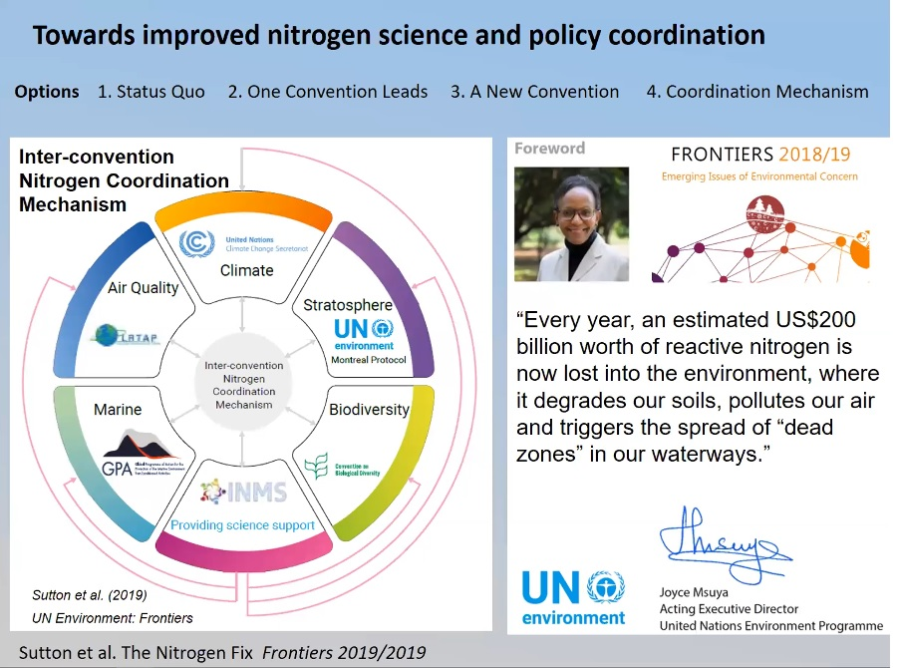
Summary and Conclusions
Nitrosat would be the first atmospheric sounding mission capable of addressing the global nitrogen challenge on farm scale resolution
Measurement of both oxidized and reduced nitrogen
Coupling NO₂ and NH₃ links source sectors: agriculture, industry and transport. All sectors must be involved!
Unprecedented spatial resolution and mapping
Capability to distinguish major sources globally
  ⇨ towards establishing an international (compliance) monitoring system as input to emerging UN action including INMS & INCOM
Capability to link atmospheric measurements to exposure for assessing impacts on human and ecosystems health
Synchronized with the future CO2M mapping mission, Nitrosat will be a key element for assessing the intertwined carbon and nitrogen budgets on the landscape scale

