Slide 1

Improving microbial quality assessment for irrigation water in ponds using the Environmental Fluid Dynamic Code
Seongyun Kim, Matthew Stocker, Manan Sharma, Yakov Pachepsky
May 25th, 2022
USDA-ARS, Beltsville Agricultural Research Center, Beltsville, MD, USA

Slide 2
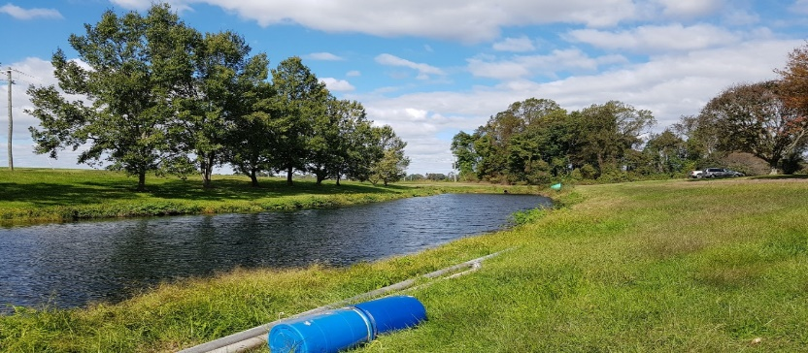
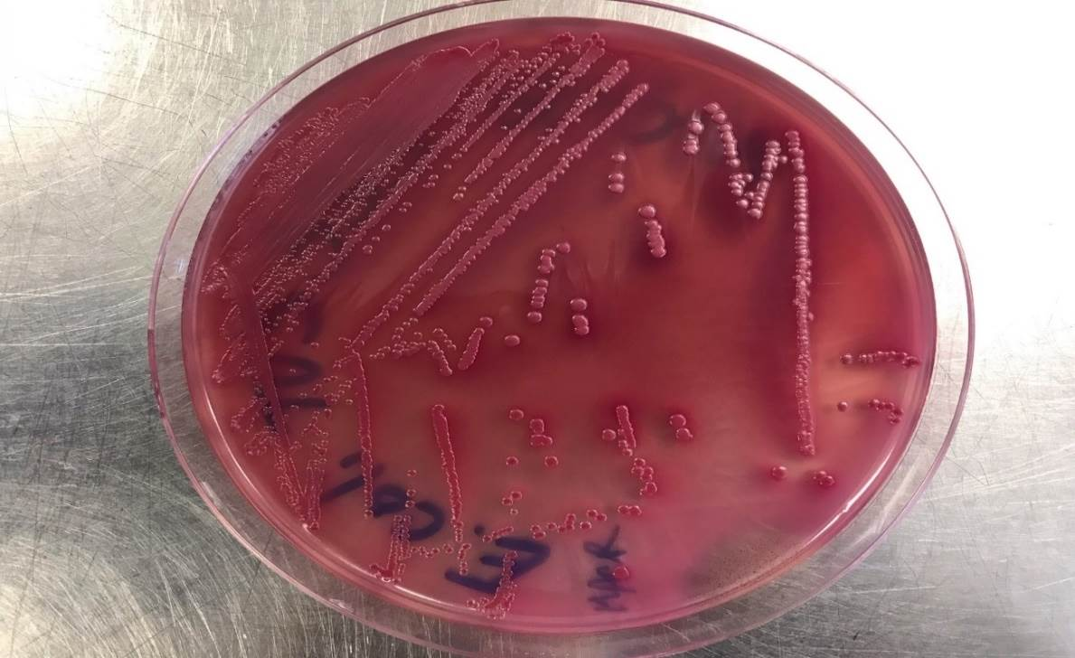
Introduction
Microbial quality of irrigation water is a public concern.
E. coli are commonly used as fecal indicator microorganisms to evaluate the microbial water quality of irrigation water source.
Sampling for monitoring E. coli concentration in irrigation water is often collected near the bank at shallow depth.
E. coli TVS 353

Slide 3
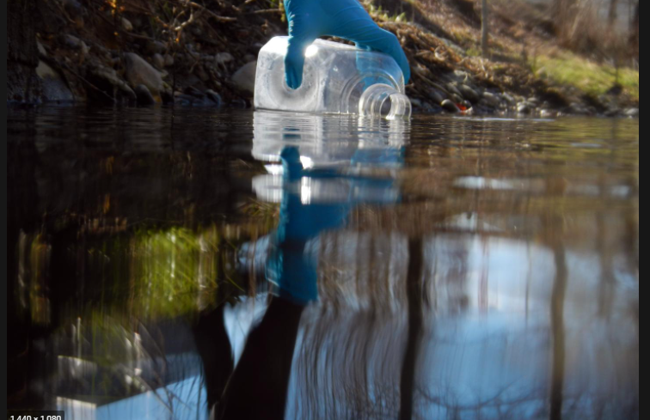
Introduction
Most survey studies for the microbial quality of irrigation waters have been conducted by taking a single sample from a single depth.
Predicting 3D spatial heterogeneity of E. coli concentrations in irrigation ponds is useful for monitoring microbial water quality.

Slide 4
Objective
To understand the 3D distribution of fecal coliform concentrations in an irrigation pond in Maryland.
To trace the dynamic of fecal coliform concentrations based on different initial and boundary conditions, and environmental factors during irrigation events.

Slide 5
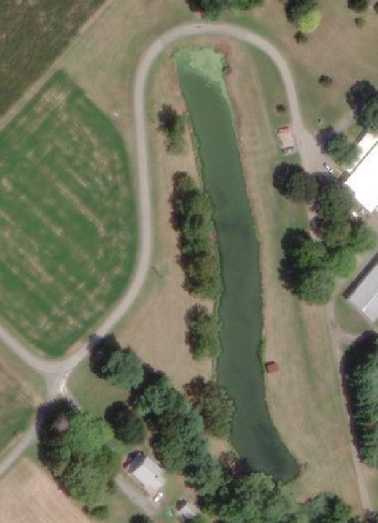
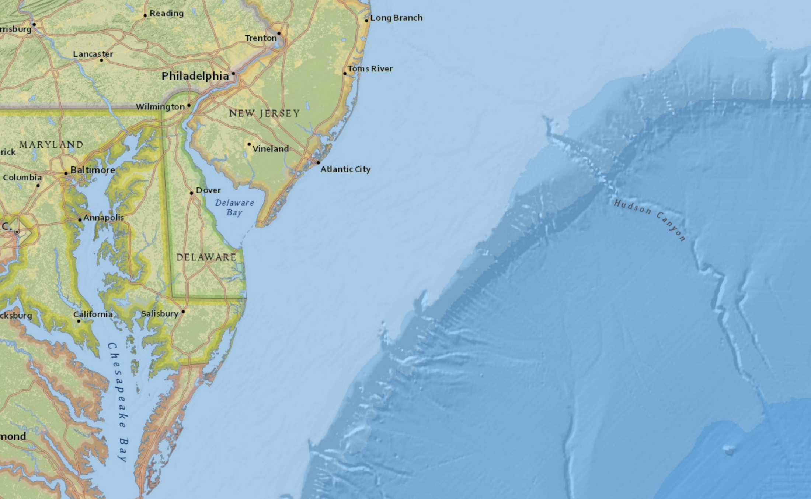
Materials and methods
Site description
The pond is located at the University of Maryland Wye Research and Education Center.
The pond is approximately 22 m by 200 m with an average of 1.5 meter deep.
Wye pond located in Eastern Shore, Maryland

Slide 6
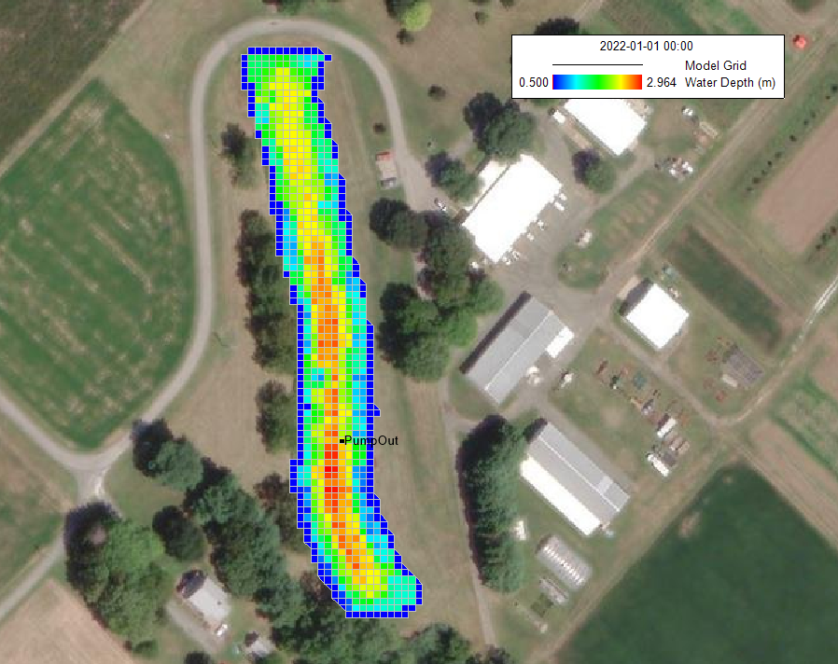
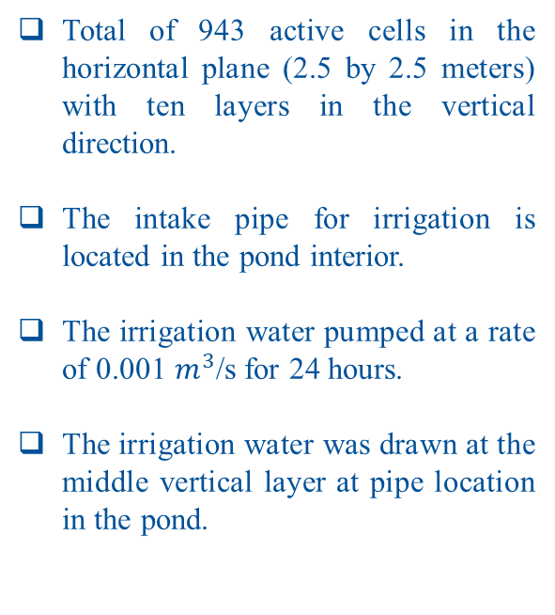
Materials and methods
EFDC model setup
Total of 943 active cells in the horizontal plane (2.5 by 2.5 meters) with ten layers in the vertical direction.
The intake pipe for irrigation is located in the pond interior.
The irrigation water pumped at a rate of 0.001 $m^{3}$/s for 24 hours.
The irrigation water was drawn at the middle vertical layer at pipe location in the pond.

Slide 7
Materials and methods
Scenario description
Four scenarios were performed based on different setting of initial and boundary conditions of fecal coliform and environmental impact.
For Scenario A, the initial concentration of fecal coliform was set as zero at interior and one at the shoreline at the pond.
For Scenario A-1, based on the same setting for the initial boundary condition of scenario A, three different wind scenarios were applied: West to East, North to South, East to West.
For Scenario B, different initial fecal coliform was distributed at ten vertical layers. The top layer was set to 0 and increased by 0.1 until 0.9 at the bottom layer.
For Scenario B-1, based on the same setting for the initial boundary condition of scenario B, a sediment module was applied to check sediment effect at the vertical layers.

Slide 8
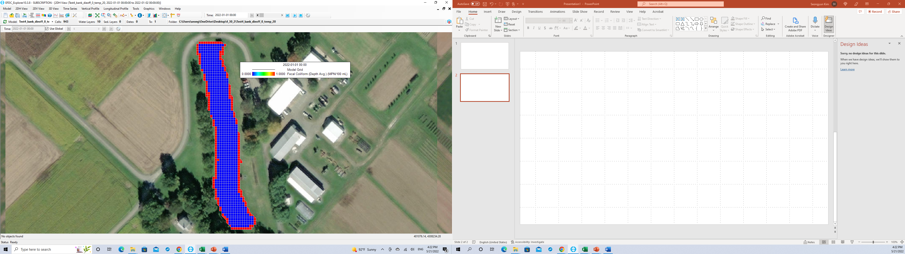
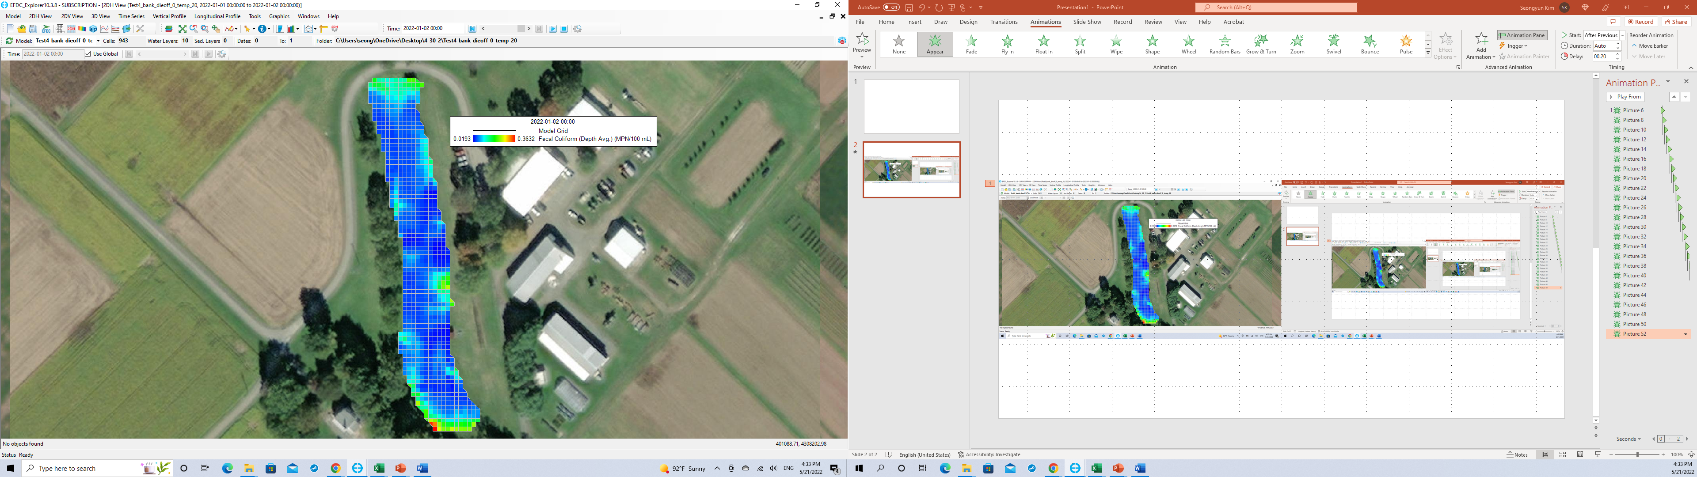
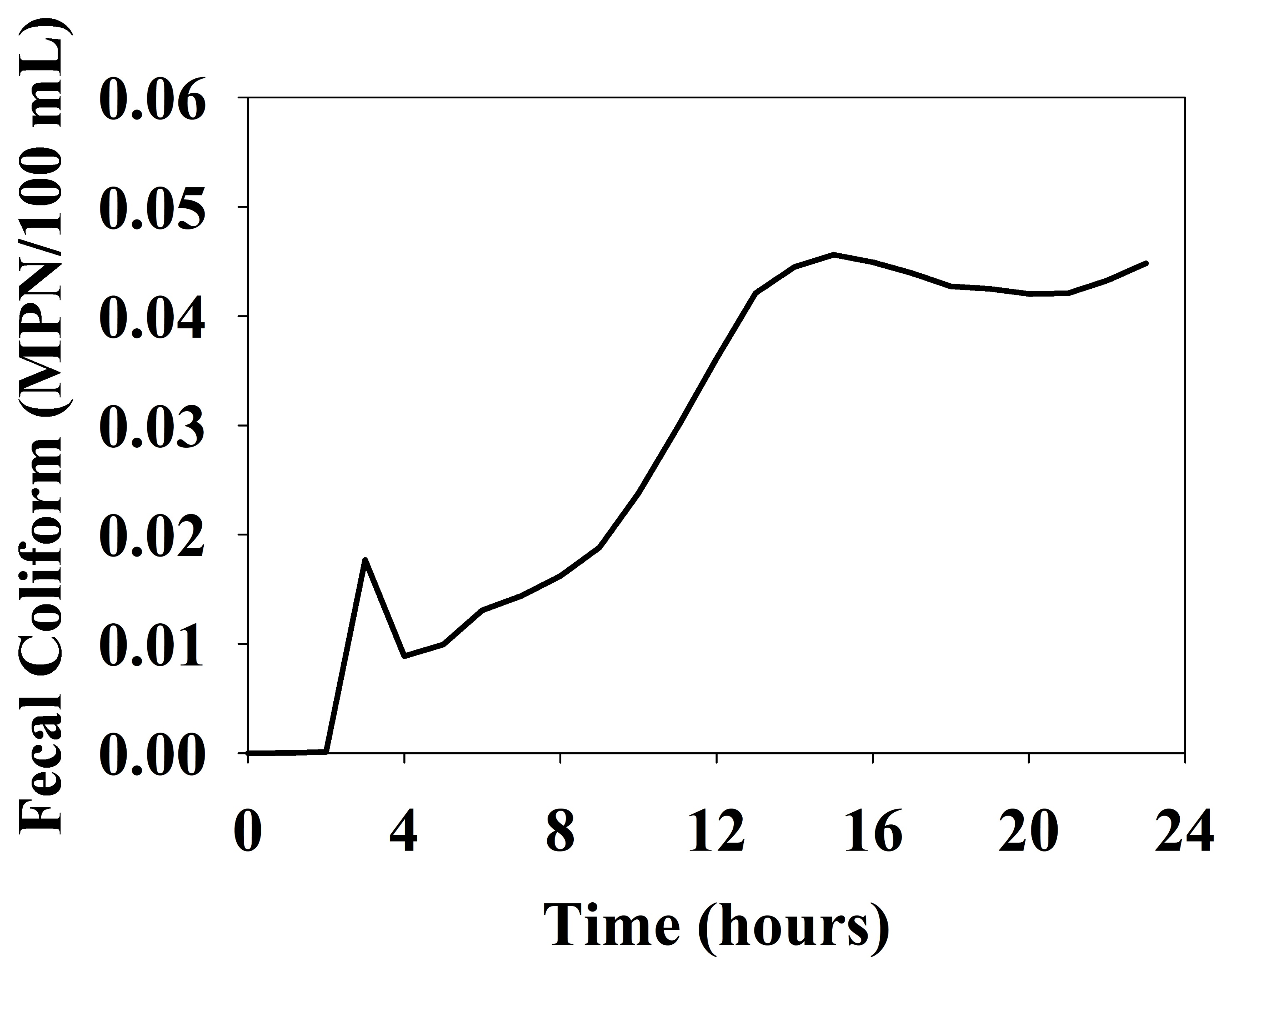
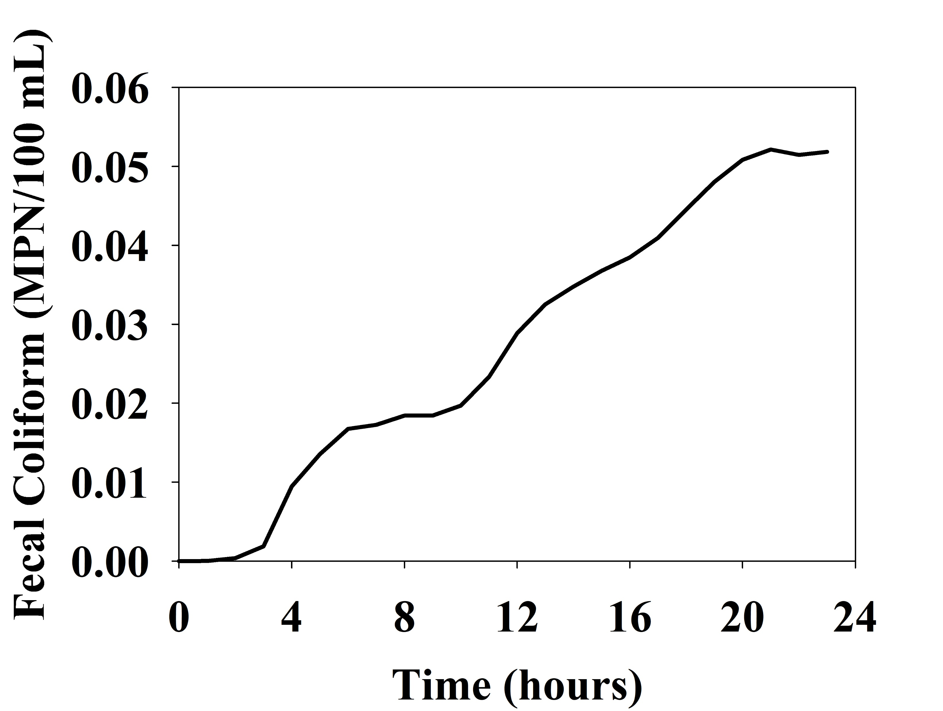
Results and discussion
Scenario A: Interior as zero vs shoreline as one

Slide 9
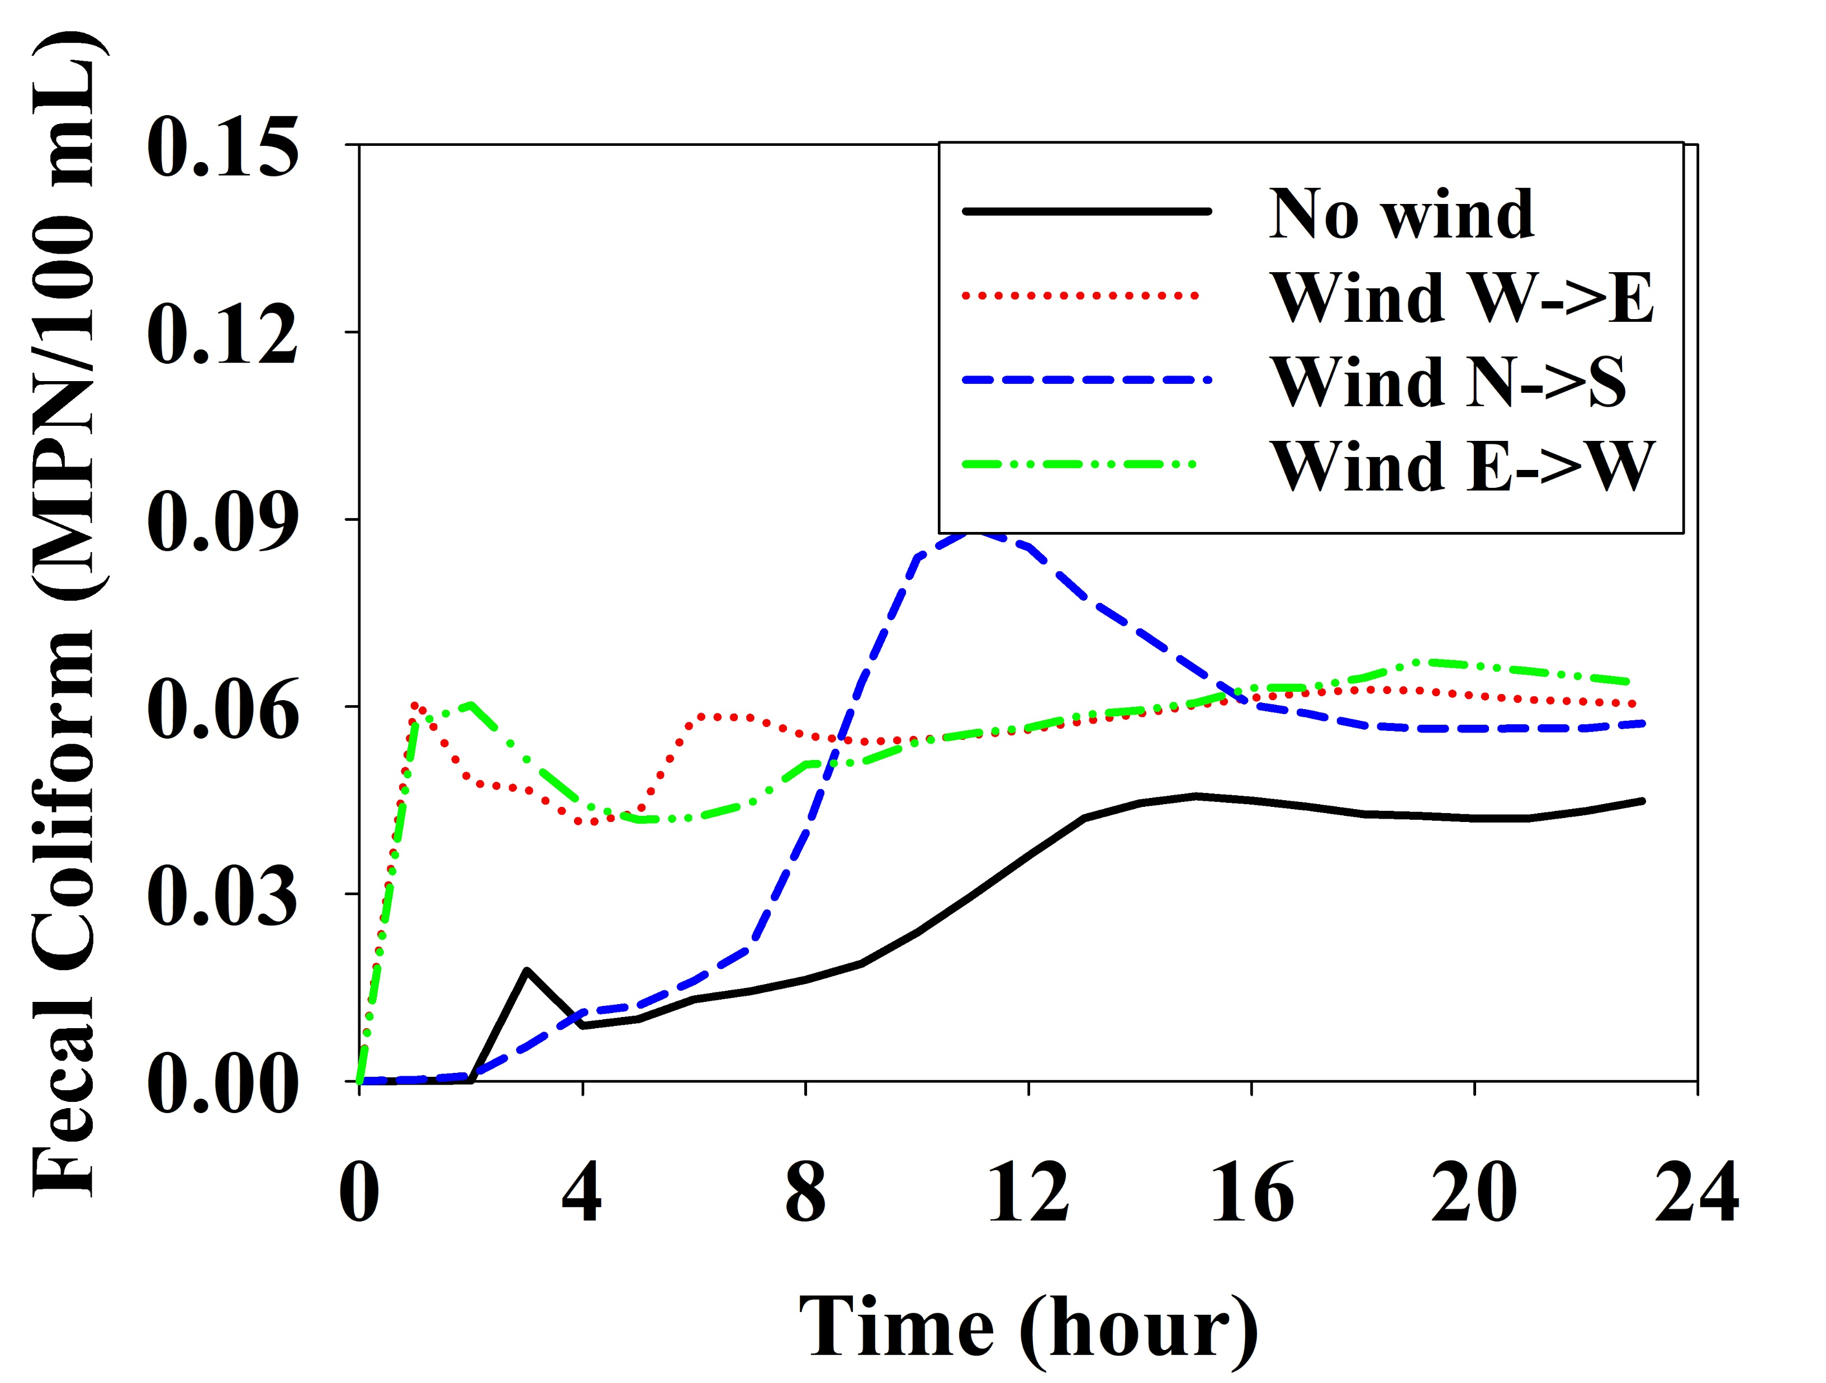
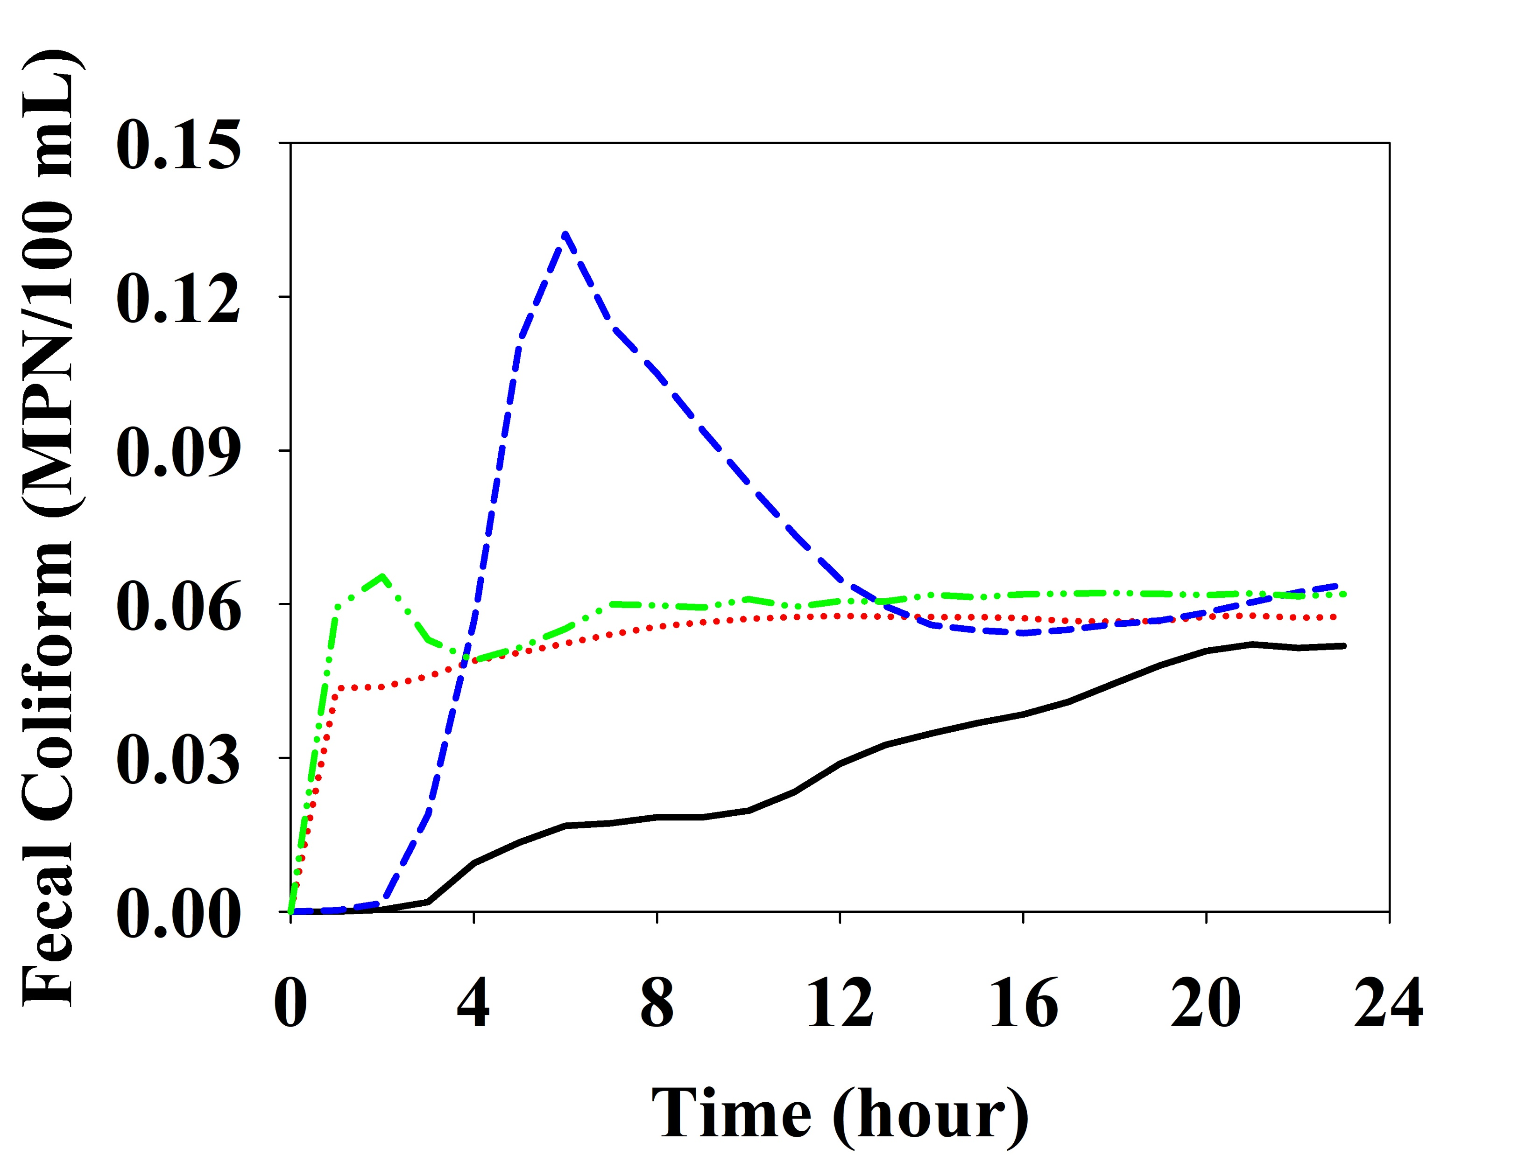
Results and discussion
Scenario A-1: Wind effect

Slide 10
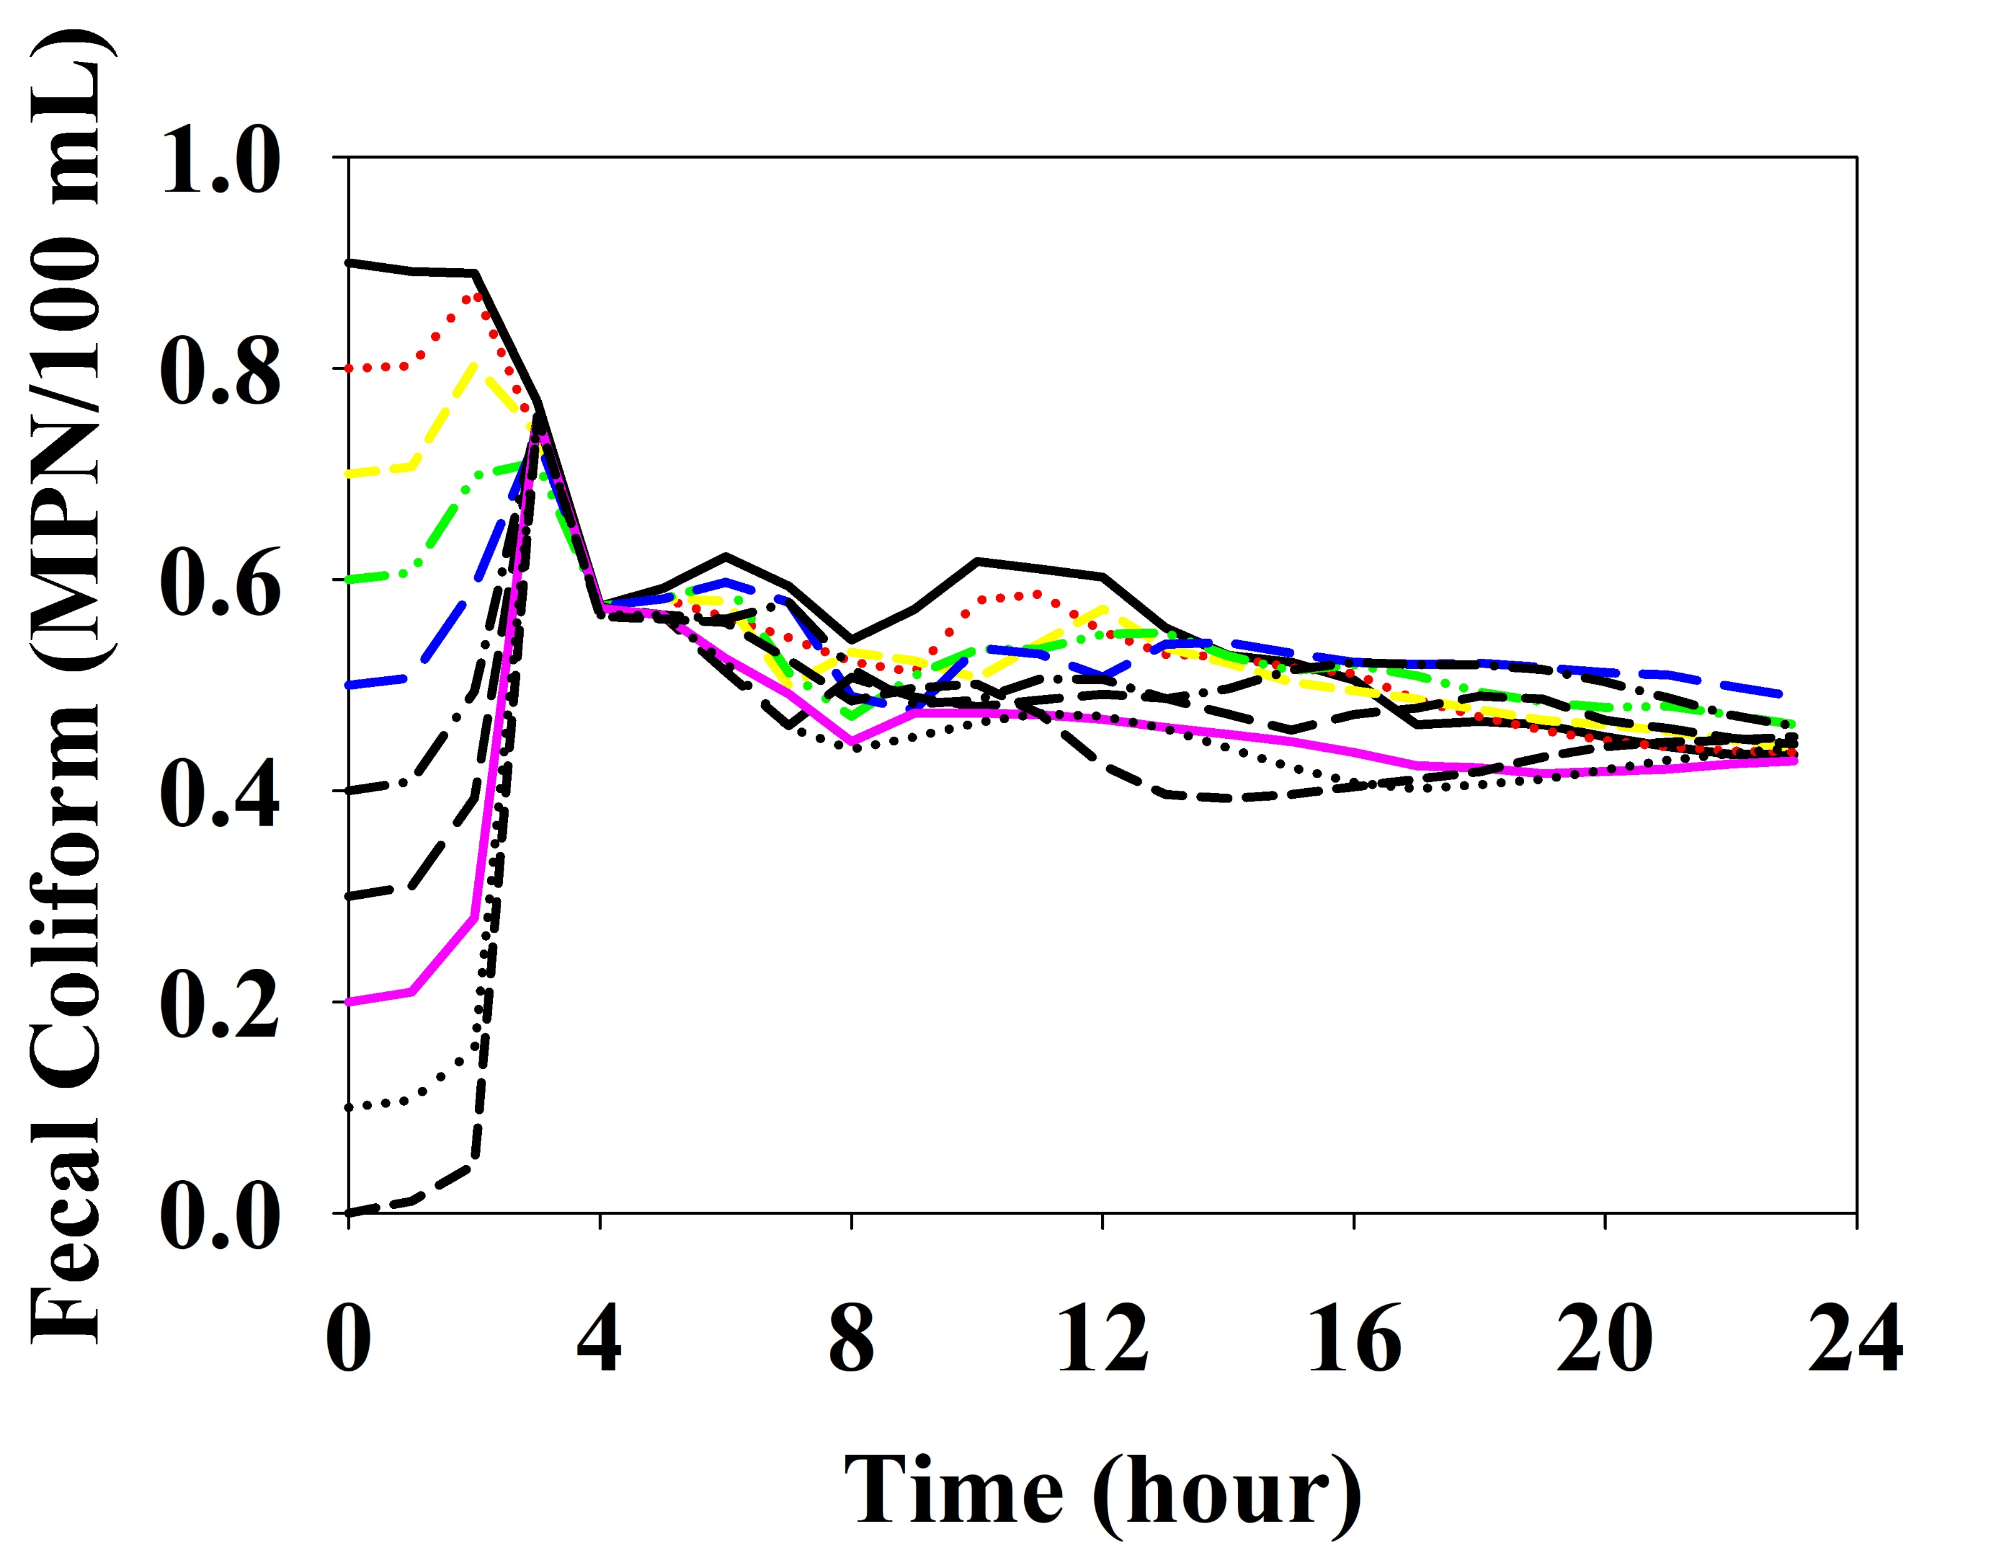
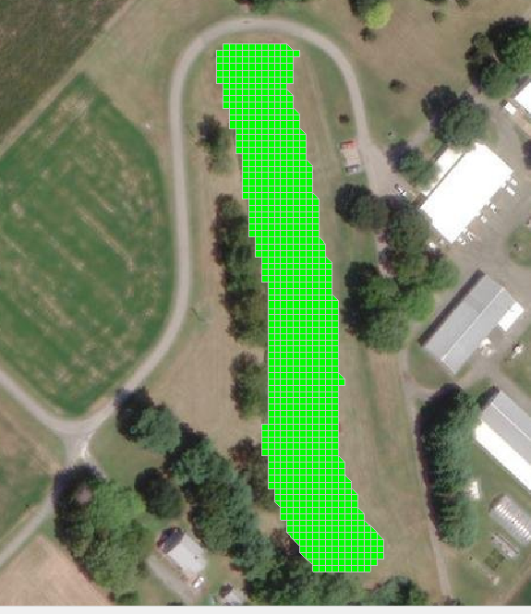
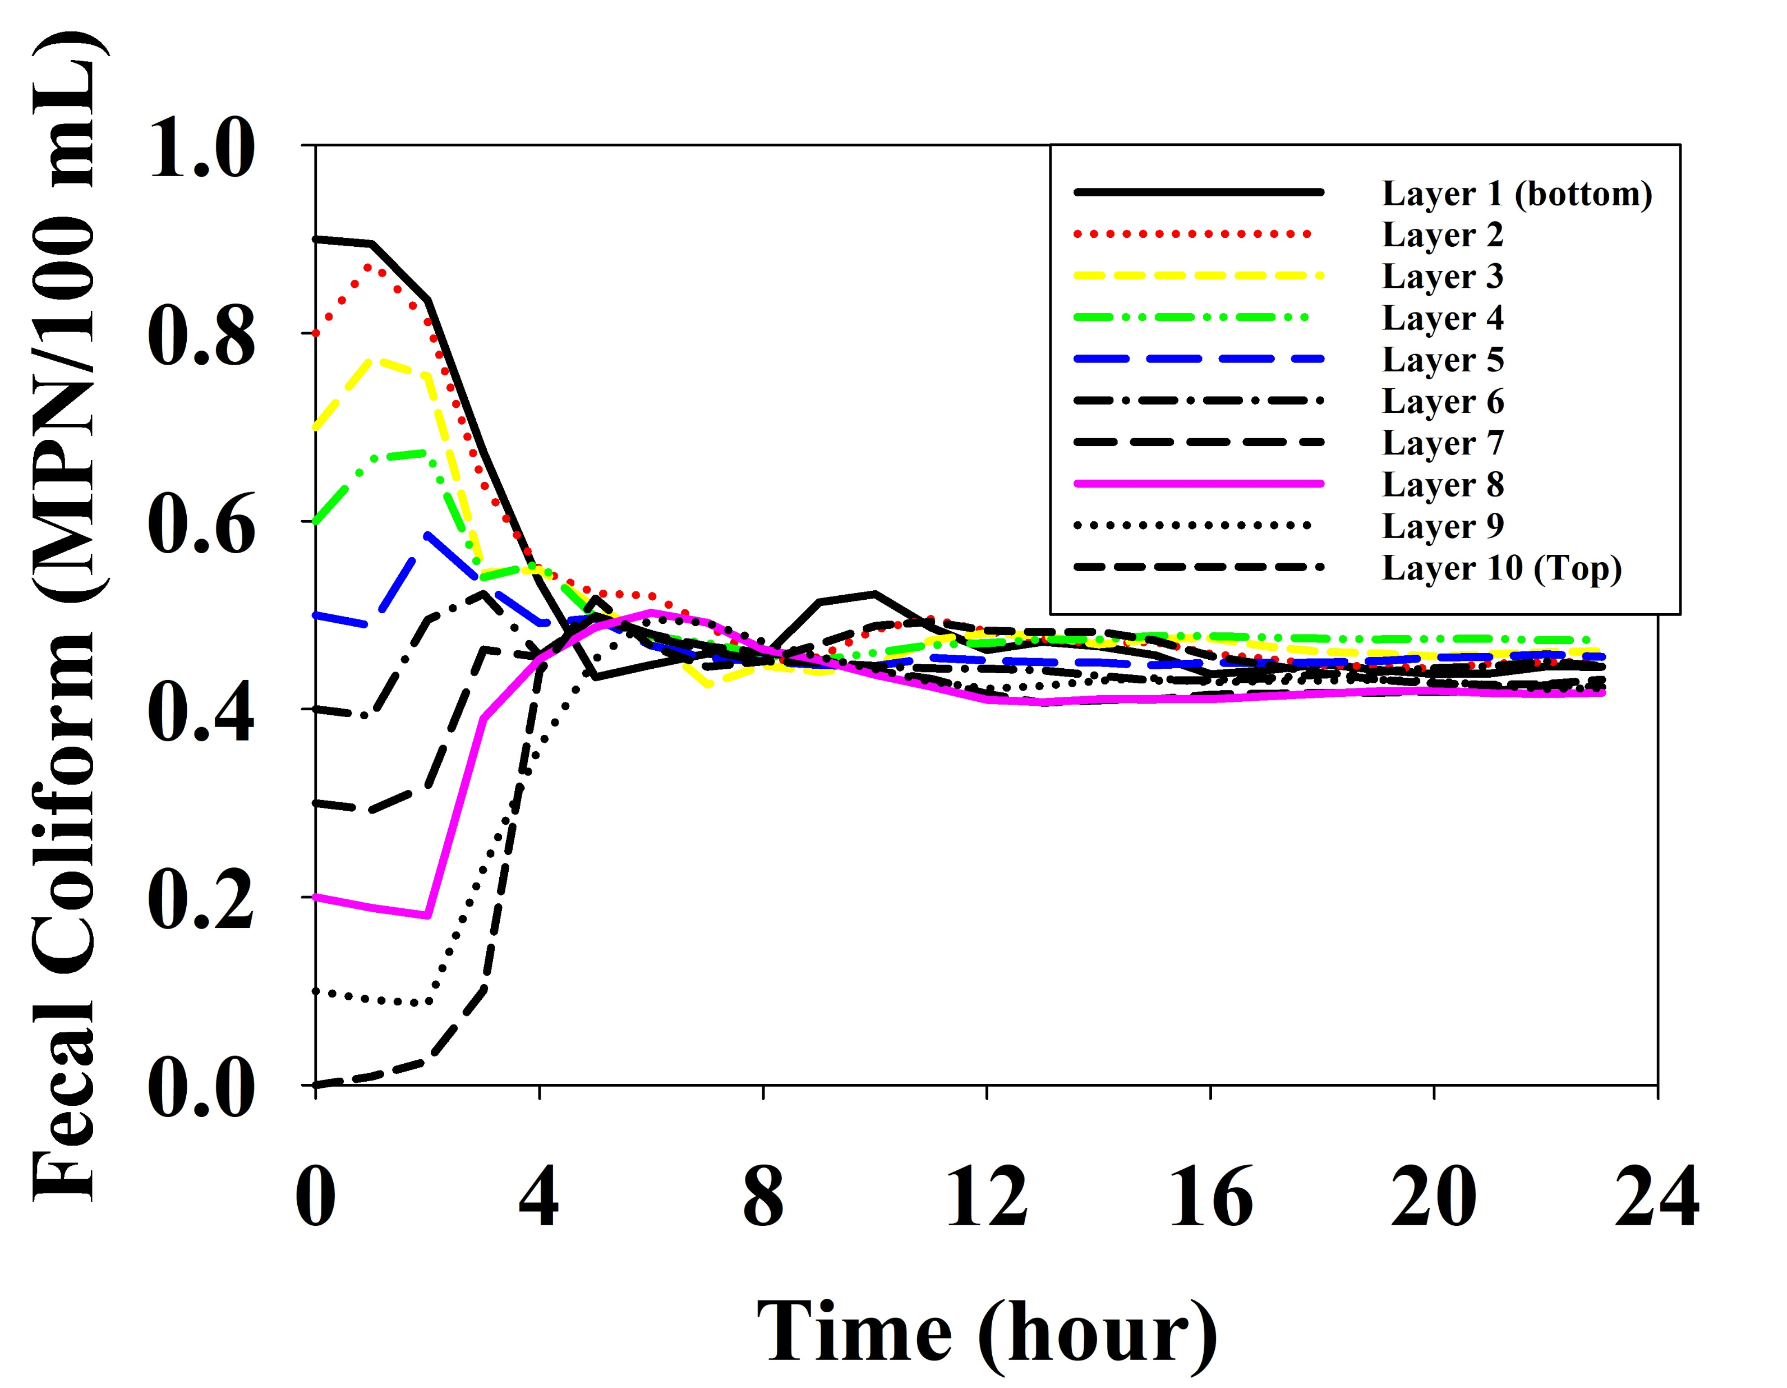
Results and discussion
Scenario B: Top layer as 0 vs bottom layer as 0.9

Slide 11
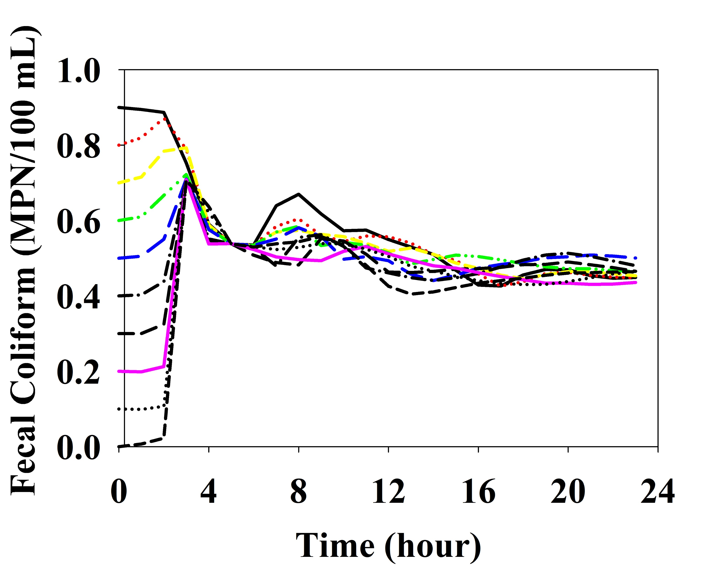
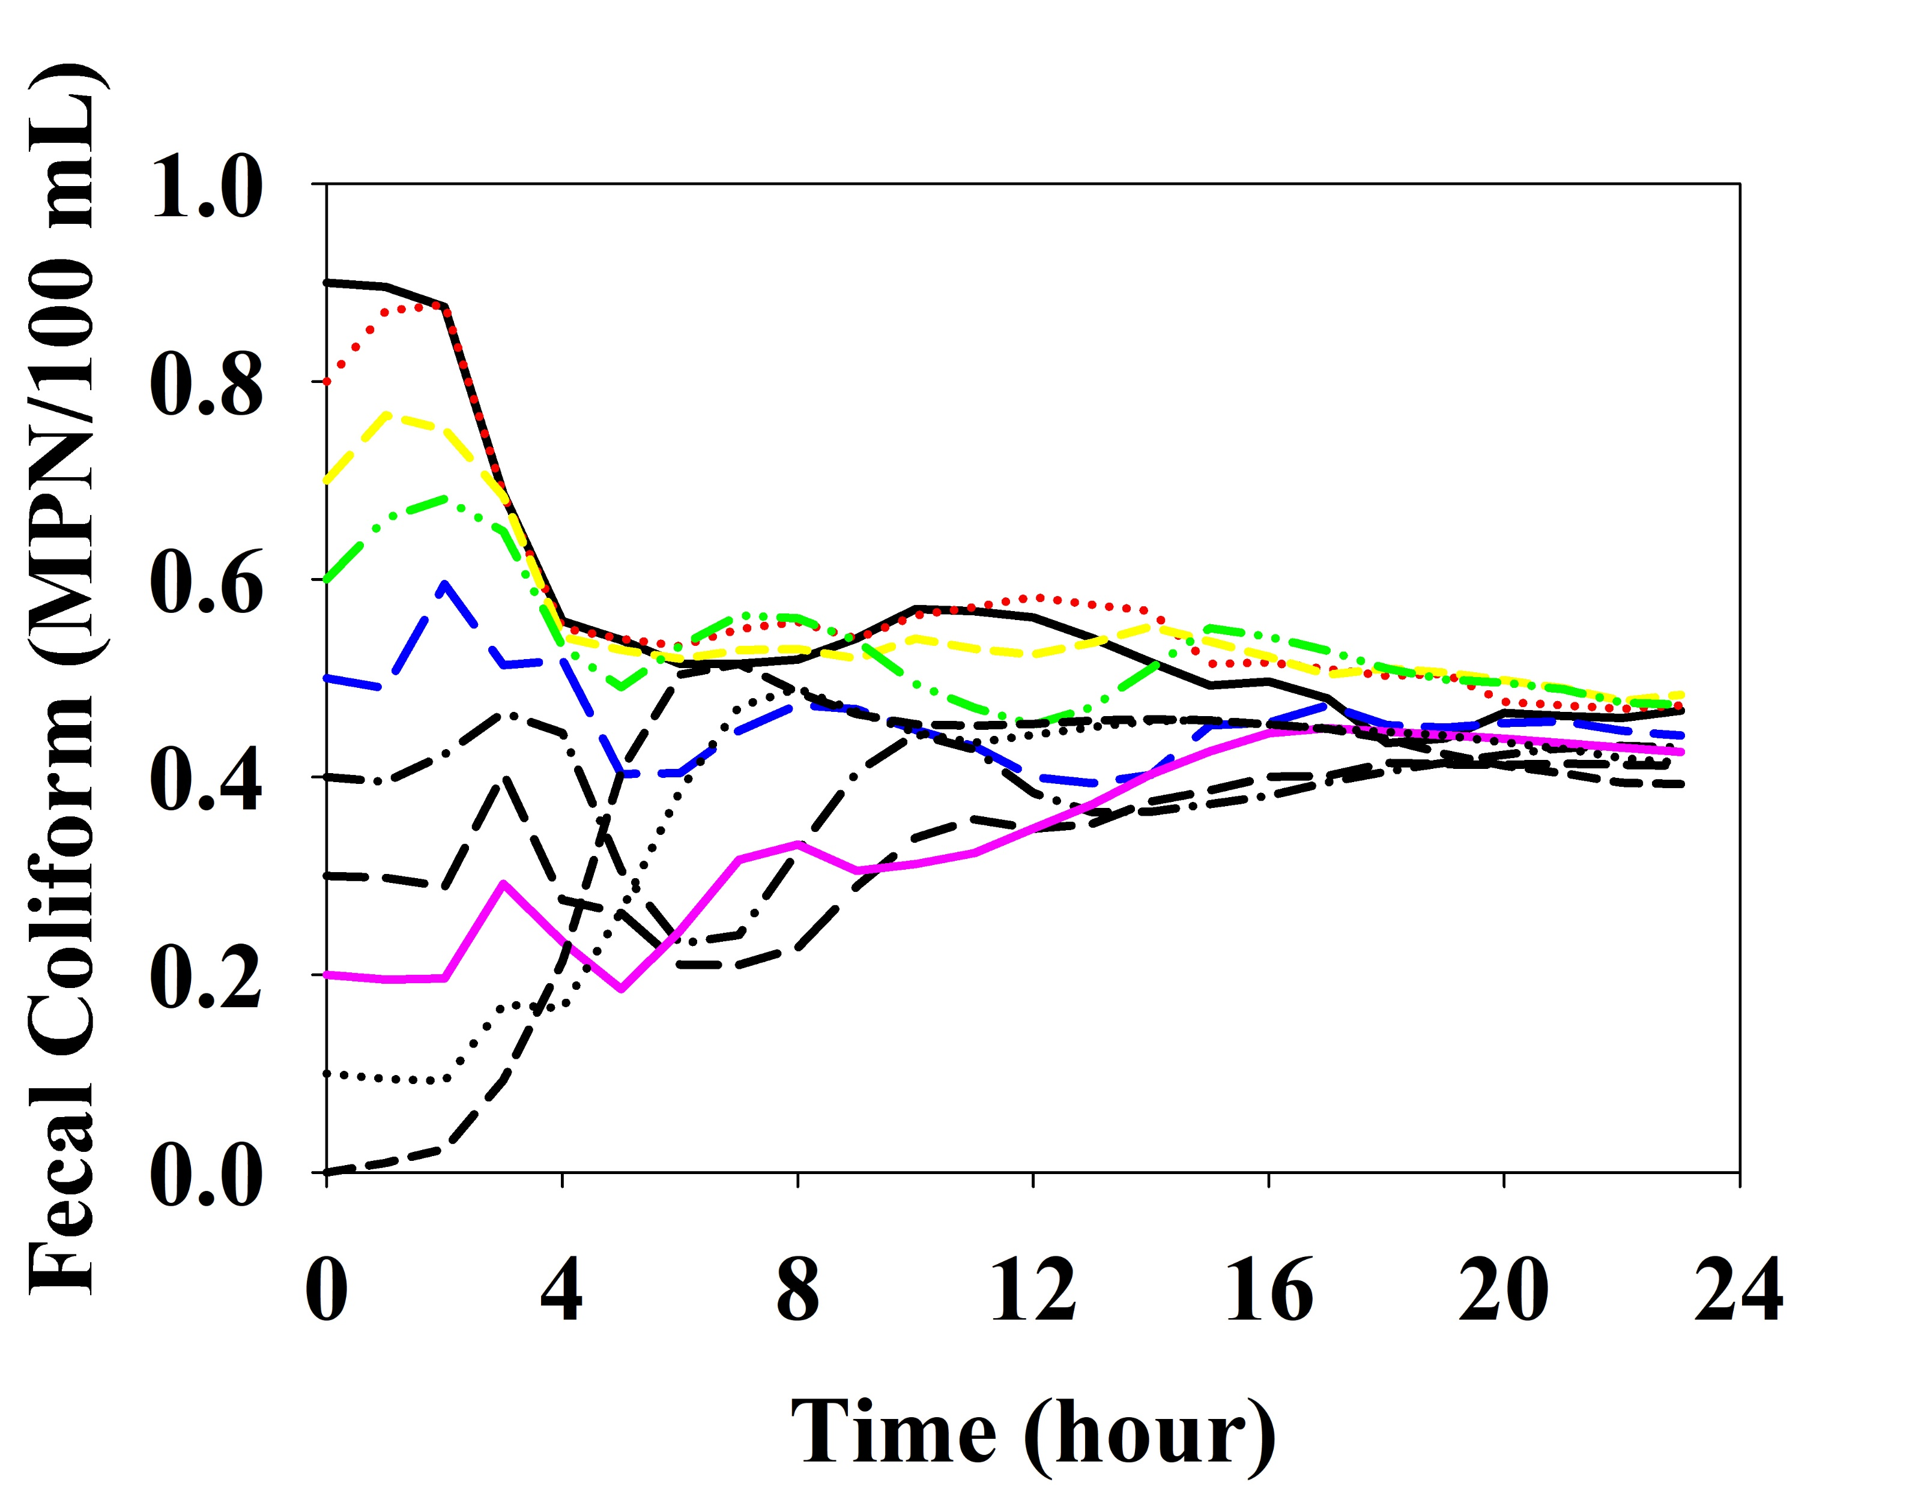
Results and discussion
Scenario B-1: Sediment effect

Slide 12
Conclusions
EFDC model is a useful tool for monitoring microbial water quality (fecal coliforms) of irrigation water while incorporating site-specific environmental characteristics.
EFDC model can trace the fecal coliform concentration based on different initial boundary conditions and environmental impacts such as wind and sediment.
Modeling proved that the initial and boundary conditions significantly affect the 3D distribution of fecal coliform concentration in ponds.
Results and outputs from these models confirmed that water samples should be collected from the pond close to the irrigation water intake, and water must be sampled several times during irrigation events.

