Slide 1



EGU22-6484
CL0 – 27/5/2022, 15:10-16:40 (CEST) – Room F2
https://doi.org/10.5194/egusphere-egu22-6484
Tracking ice-sheet dynamics by detrital feldspar Pb-isotope and ⁸⁷Rb/⁸⁷Sr dating during the Middle Miocene Climatic Transition, Weddell Sea, Antarctica
Roland Neofitu^{1,2}, Chris Mark², Suzanne O’Connell ³, Sam Kelley¹, Delia Rösel ⁴, Thomas Zack⁴, Michael Flowerdew ⁵, and J. Stephen Daly¹
¹School of Earth Sciences, University College Dublin, Dublin, Ireland (roland.neofitu@ucdconnect.ie)
²Dept. of Geosciences, Swedish Museum of Natural History, Box 50007, SE-104 05 Stockholm, Sweden
³Dept. of Earth and Environmental Sciences, Wesleyan University, 265 Church St., Middletown, CT 06459, USA
⁴Department of Earth Sciences, University of Gothenburg, Guldhedsgatan 5A, 41320 Gothenburg, Sweden
⁵CASP, West Building, Madingley Rise, Madingley Road, Cambridge, CB3 0UD, United Kingdom

Slide 2
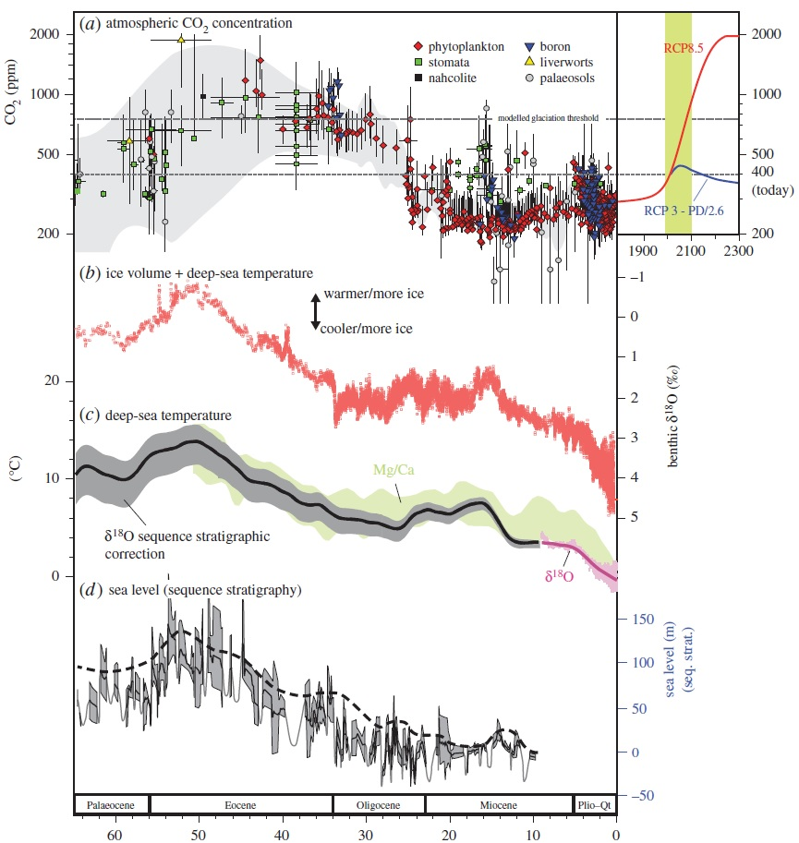
Introduction and Motivation
Antarctic Ice Sheet (AIS) exhibited dynamic behaviour since its inception (c. 34 Ma);
Constraints on ice-sheet behaviour come from proxy marine and lacustrine δ¹⁸O data;
Mid-Miocene Climate Optimum (MMCO) saw ice retreat; Mid-Miocene Climate Transition (MMCT) saw ice expansion.
MMCO/MMCT
Zachos curve
From McKay et al. (2015)

Slide 3
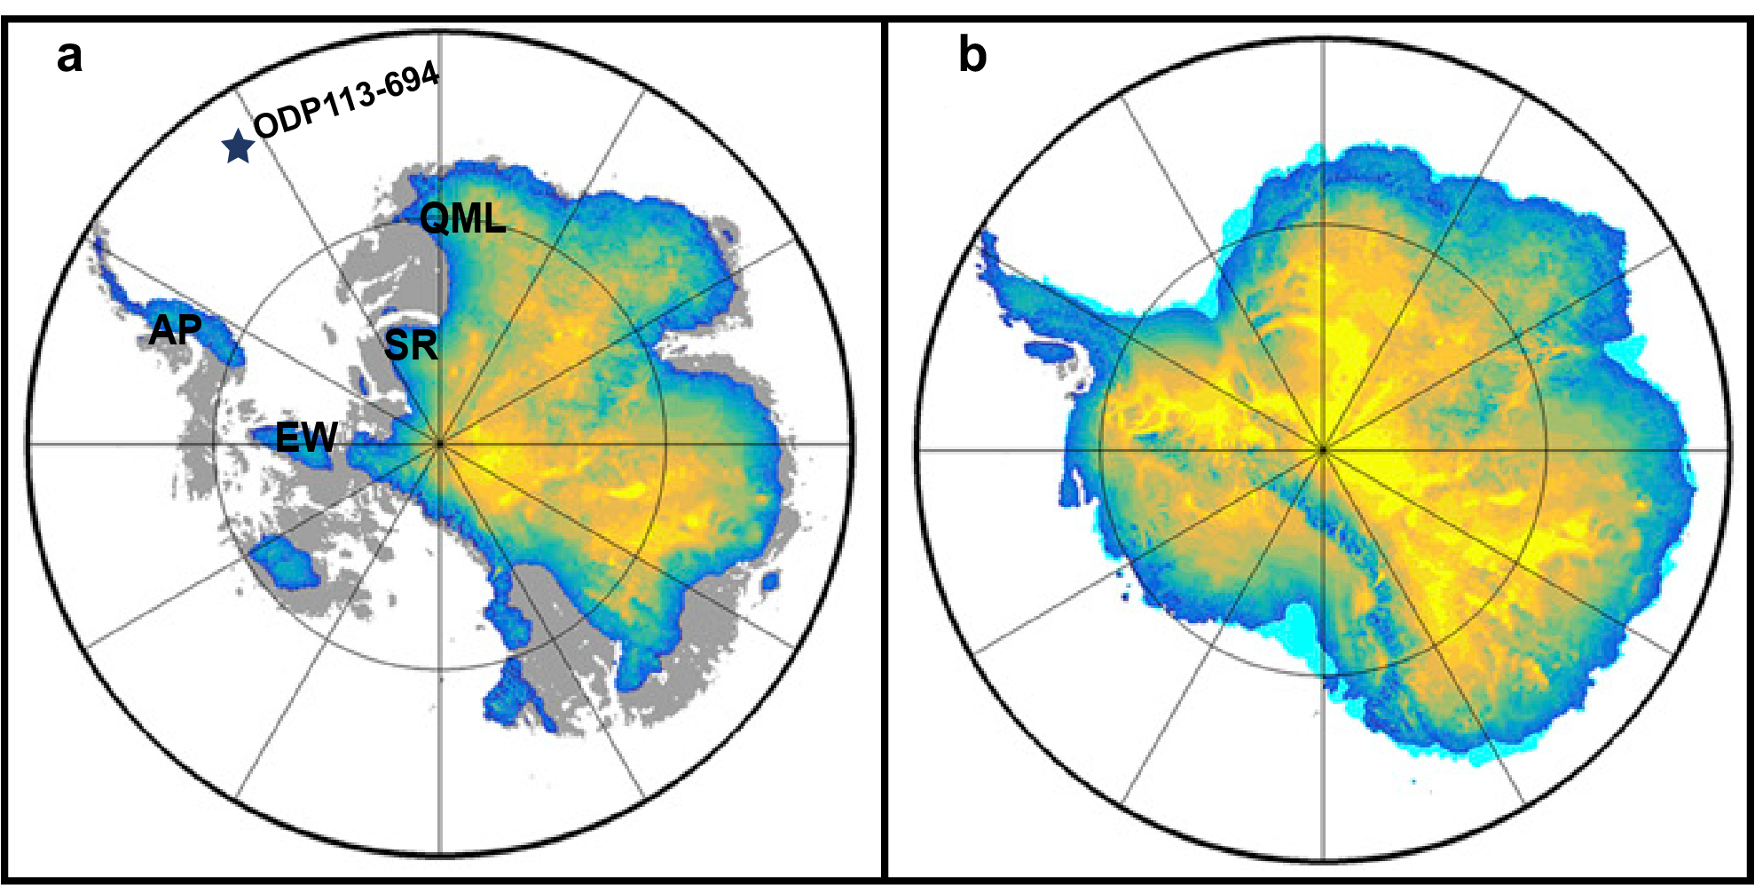
Introduction and Motivation
Warm MMCO interglacial scenario
Cold glacial scenario
Recent developments to paleo-ice sheet models allowed modelling of Mid-Miocene ice-sheet;
Model theorizes large embayments over Weddell Sea sector and Wilkes’ Land.
Weddell Sea
Subglacial basins
Wilkes Land
AP – Antarctic Peninsula, EW – Ellsworth Land, SR – Shackleton Range, QML – Queen Maud Land. Subglacial basins. Modified after Gasson et al., 2016.

Slide 4
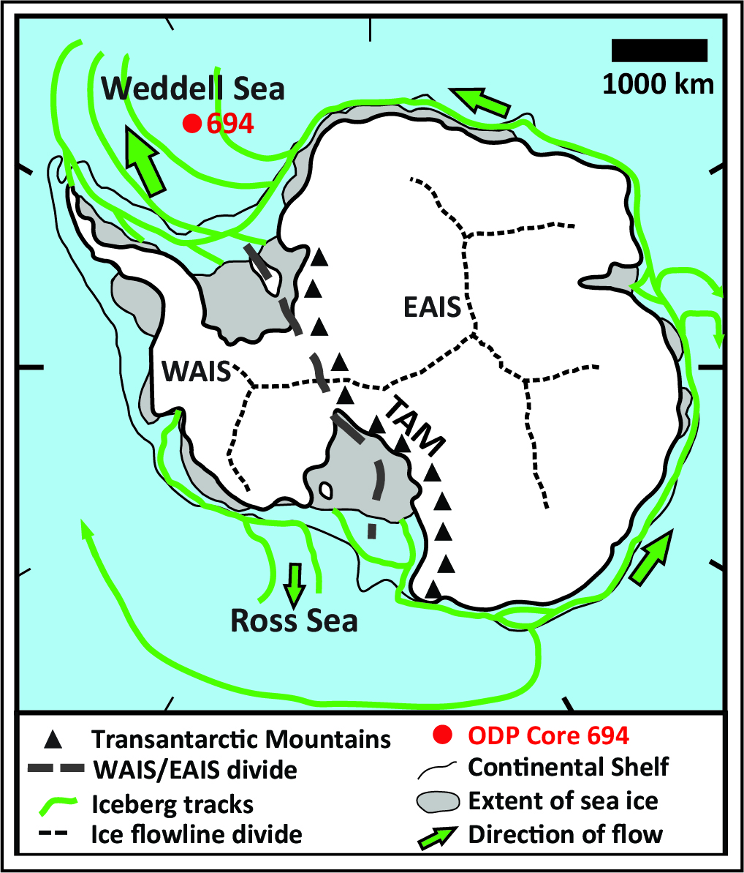
Aims
To understand how the AIS responds to MMCO/MMCT;
To understand ice-sheet behaviour around large Miocene embayments by using provenance analysis;
To identify regions of repeated instability by comparing our results to predictions from model.
Modified after McKay et al. (2017) and Budge and Long (2018)

Slide 5
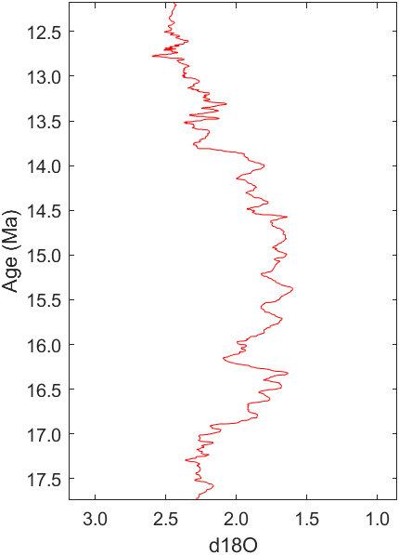
Methods
Sample
deposition
ages
K-feldspar (rock-forming phase, resistance to physical weathering, amenable to ⁴⁰Ar/³⁹Ar and ⁸⁷Rb/⁸⁷Sr dating – no HM fraction found) Pb-isotope (allows fingerprinting with bedrock Pb data) and ⁸⁷Rb/⁸⁷Sr (cost-efficiency) allows dating of sedimentary provenance on IODP core samples;
Plagioclase (rock-forming phase, amenable to Sr- and Pb-isotope fingerprinting).
MMCT
Peak
MMCO
Data from Zachos et al., 2001,
Peak from Warny et al., 2009

Slide 6
Key Bedrock Geology
Sediments sourced from the Weddell Sea sector is divided into 4 subregions:
Antarctic Peninsula (Mesozoic /Cenozoic subduction igneous material)
Ellsworth Land (Palaeozoic deformation events)
Shackleton (Palaeozoic and Precambrian material)
Southern Queen Maud Land (Palaeozoic and Precambrian material)
Core 694
sQML
AP
SR
EW
Main sediment sources for ODP Core 694. AP – Antarctic Peninsula, EW – Ellsworth Land, SR – Shackleton Range, sQML – southern Queen Maud Land. Modified from Grikurov et al., 2003.

Slide 7
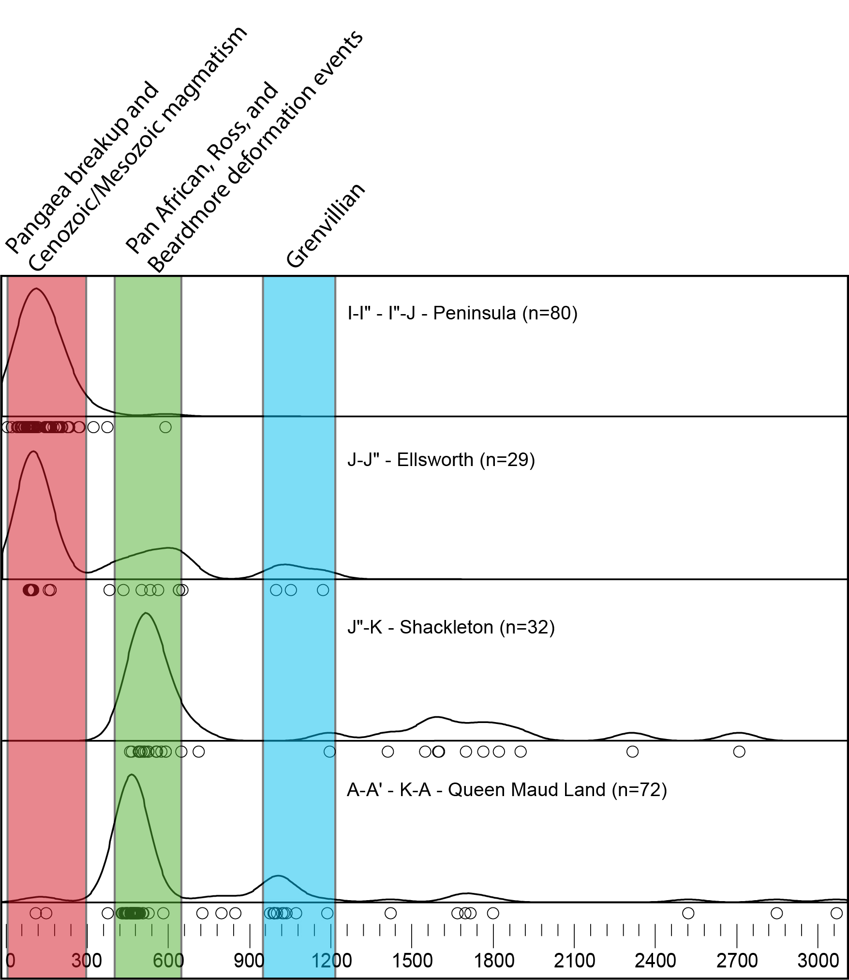
Key Bedrock Geology
Sediments sourced from the Weddell Sea sector is divided into 4 subregions:
Antarctic Peninsula (Mesozoic /Cenozoic subduction igneous material)
Ellsworth Land (Palaeozoic deformation events)
Shackleton (Palaeozoic and Precambrian material)
Southern Queen Maud Land (Palaeozoic and Precambrian material)
Peninsula
Ellsworth Land
Shackleton
Queen Maud Land
Rb-Sr ages collected from around the Weddell Sea region (various sources).

Slide 8
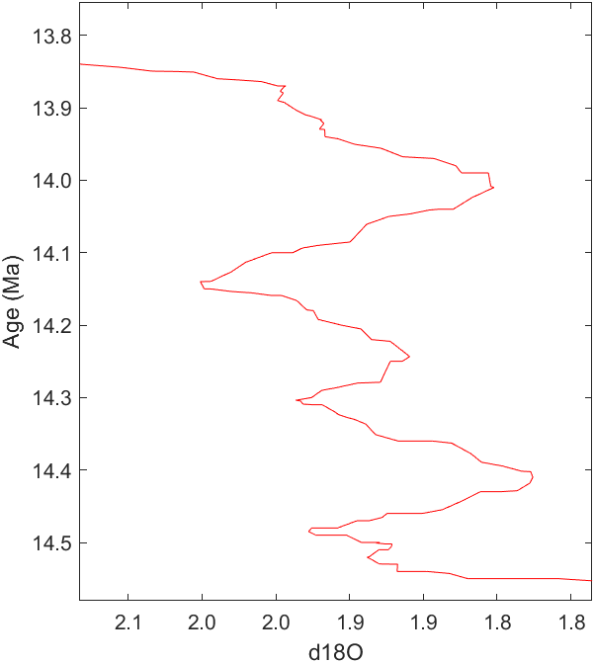
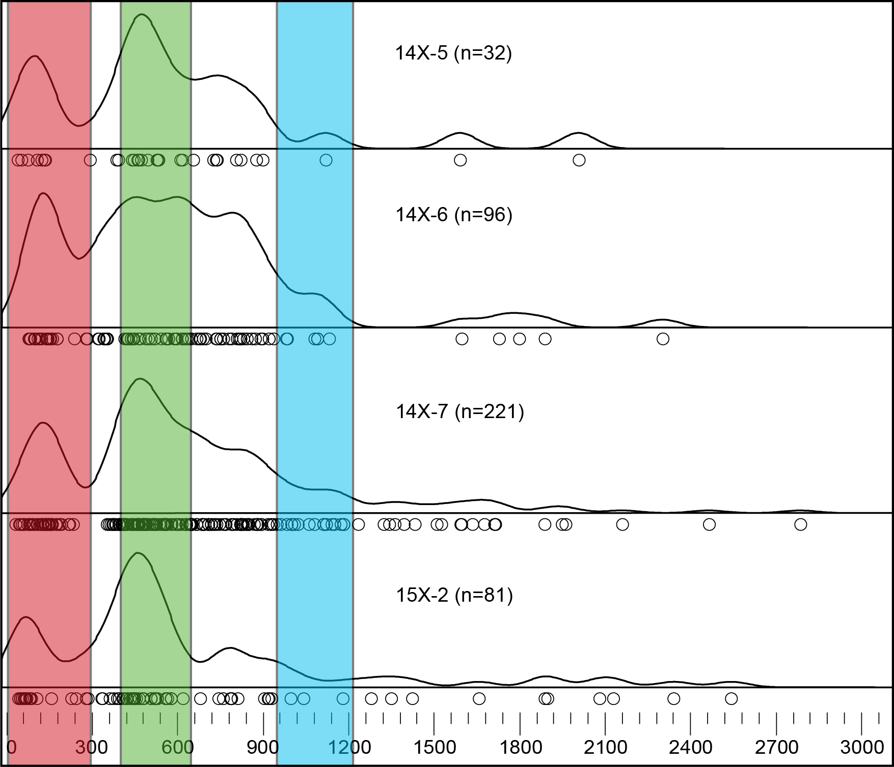
⁸⁷Rb/⁸⁷Sr Results:
14.09 Ma (n=32)
14.12 Ma (n=96)
14.15 Ma (n=221)
14.26 Ma (n=84)

Slide 9
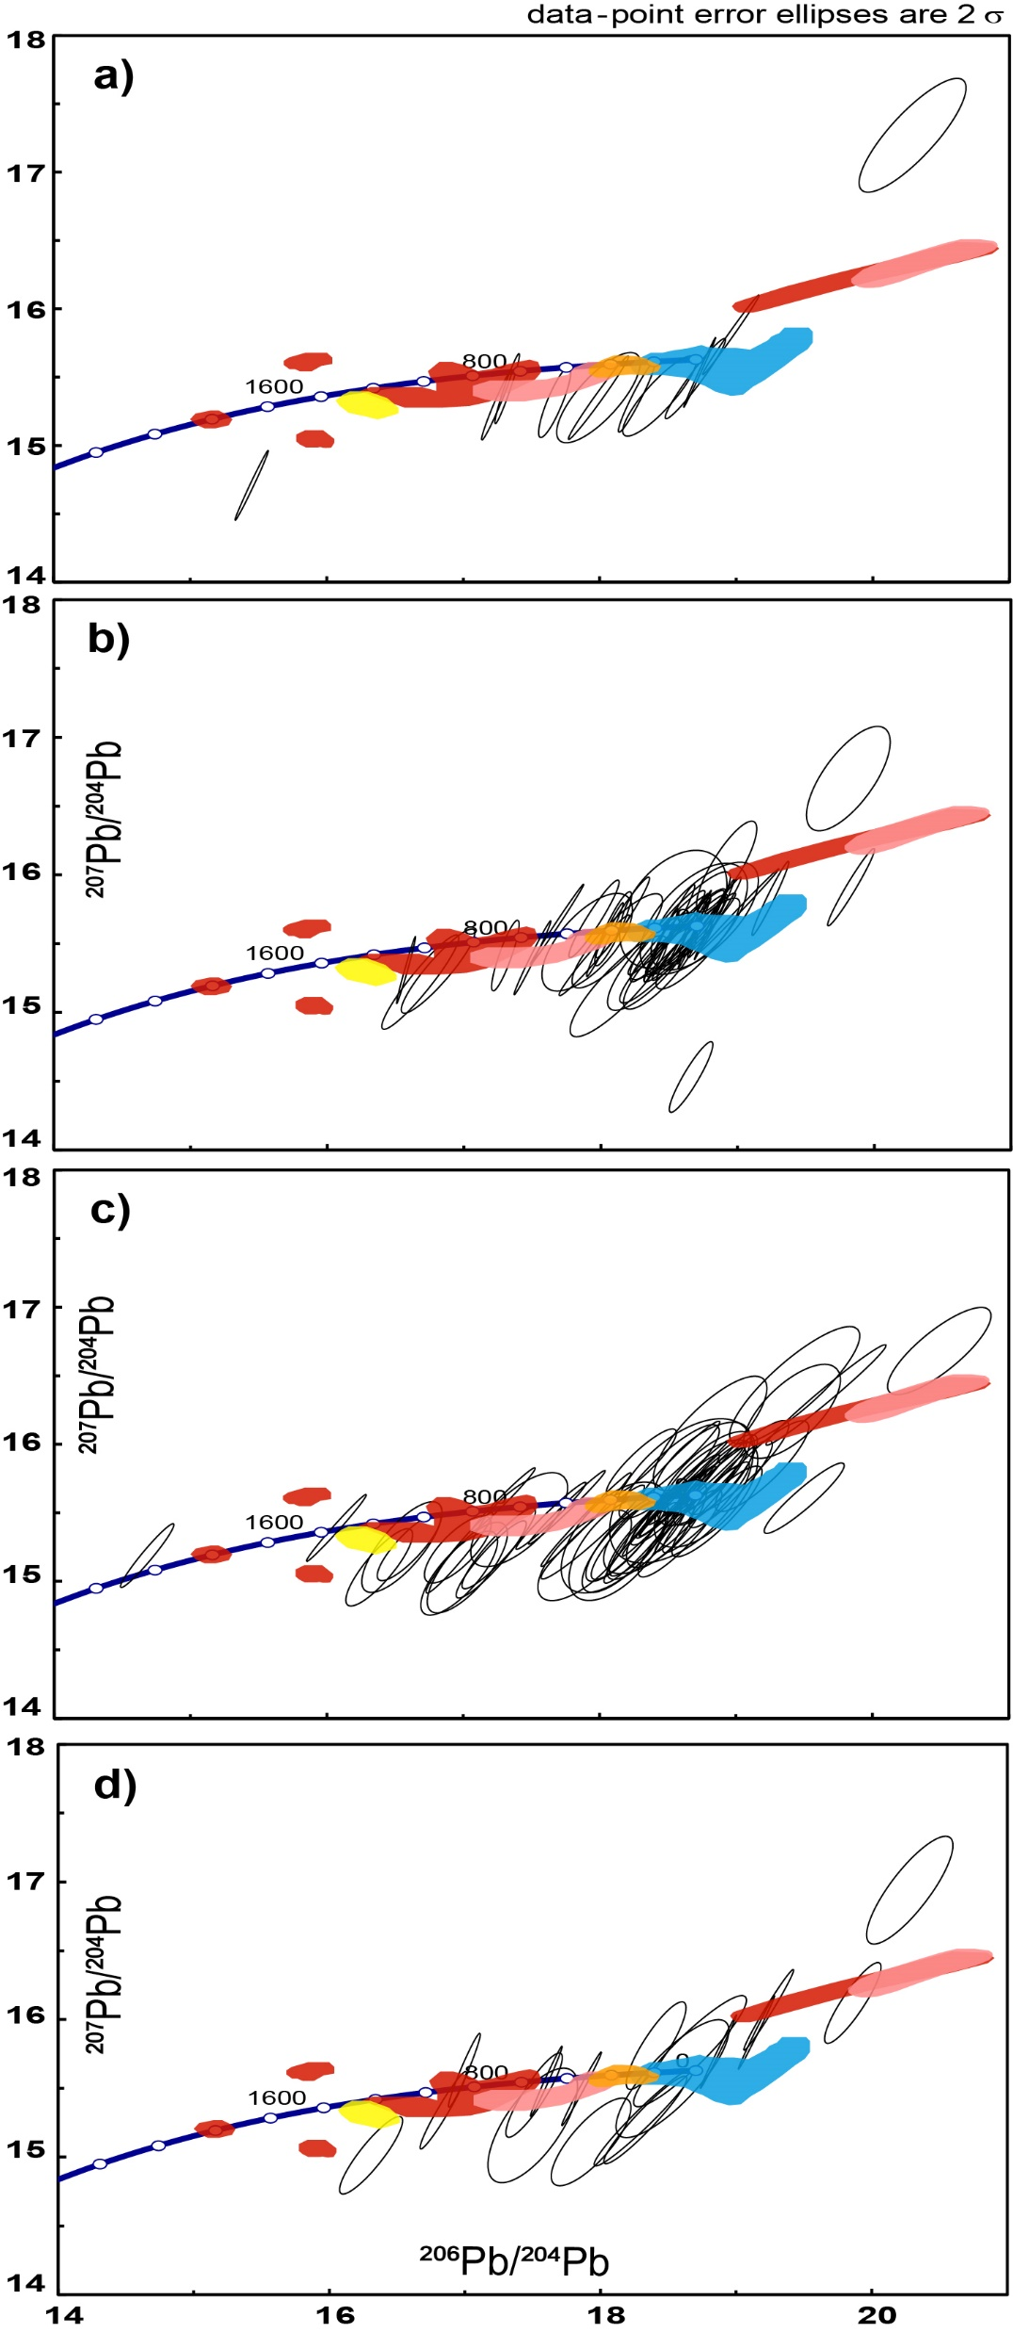

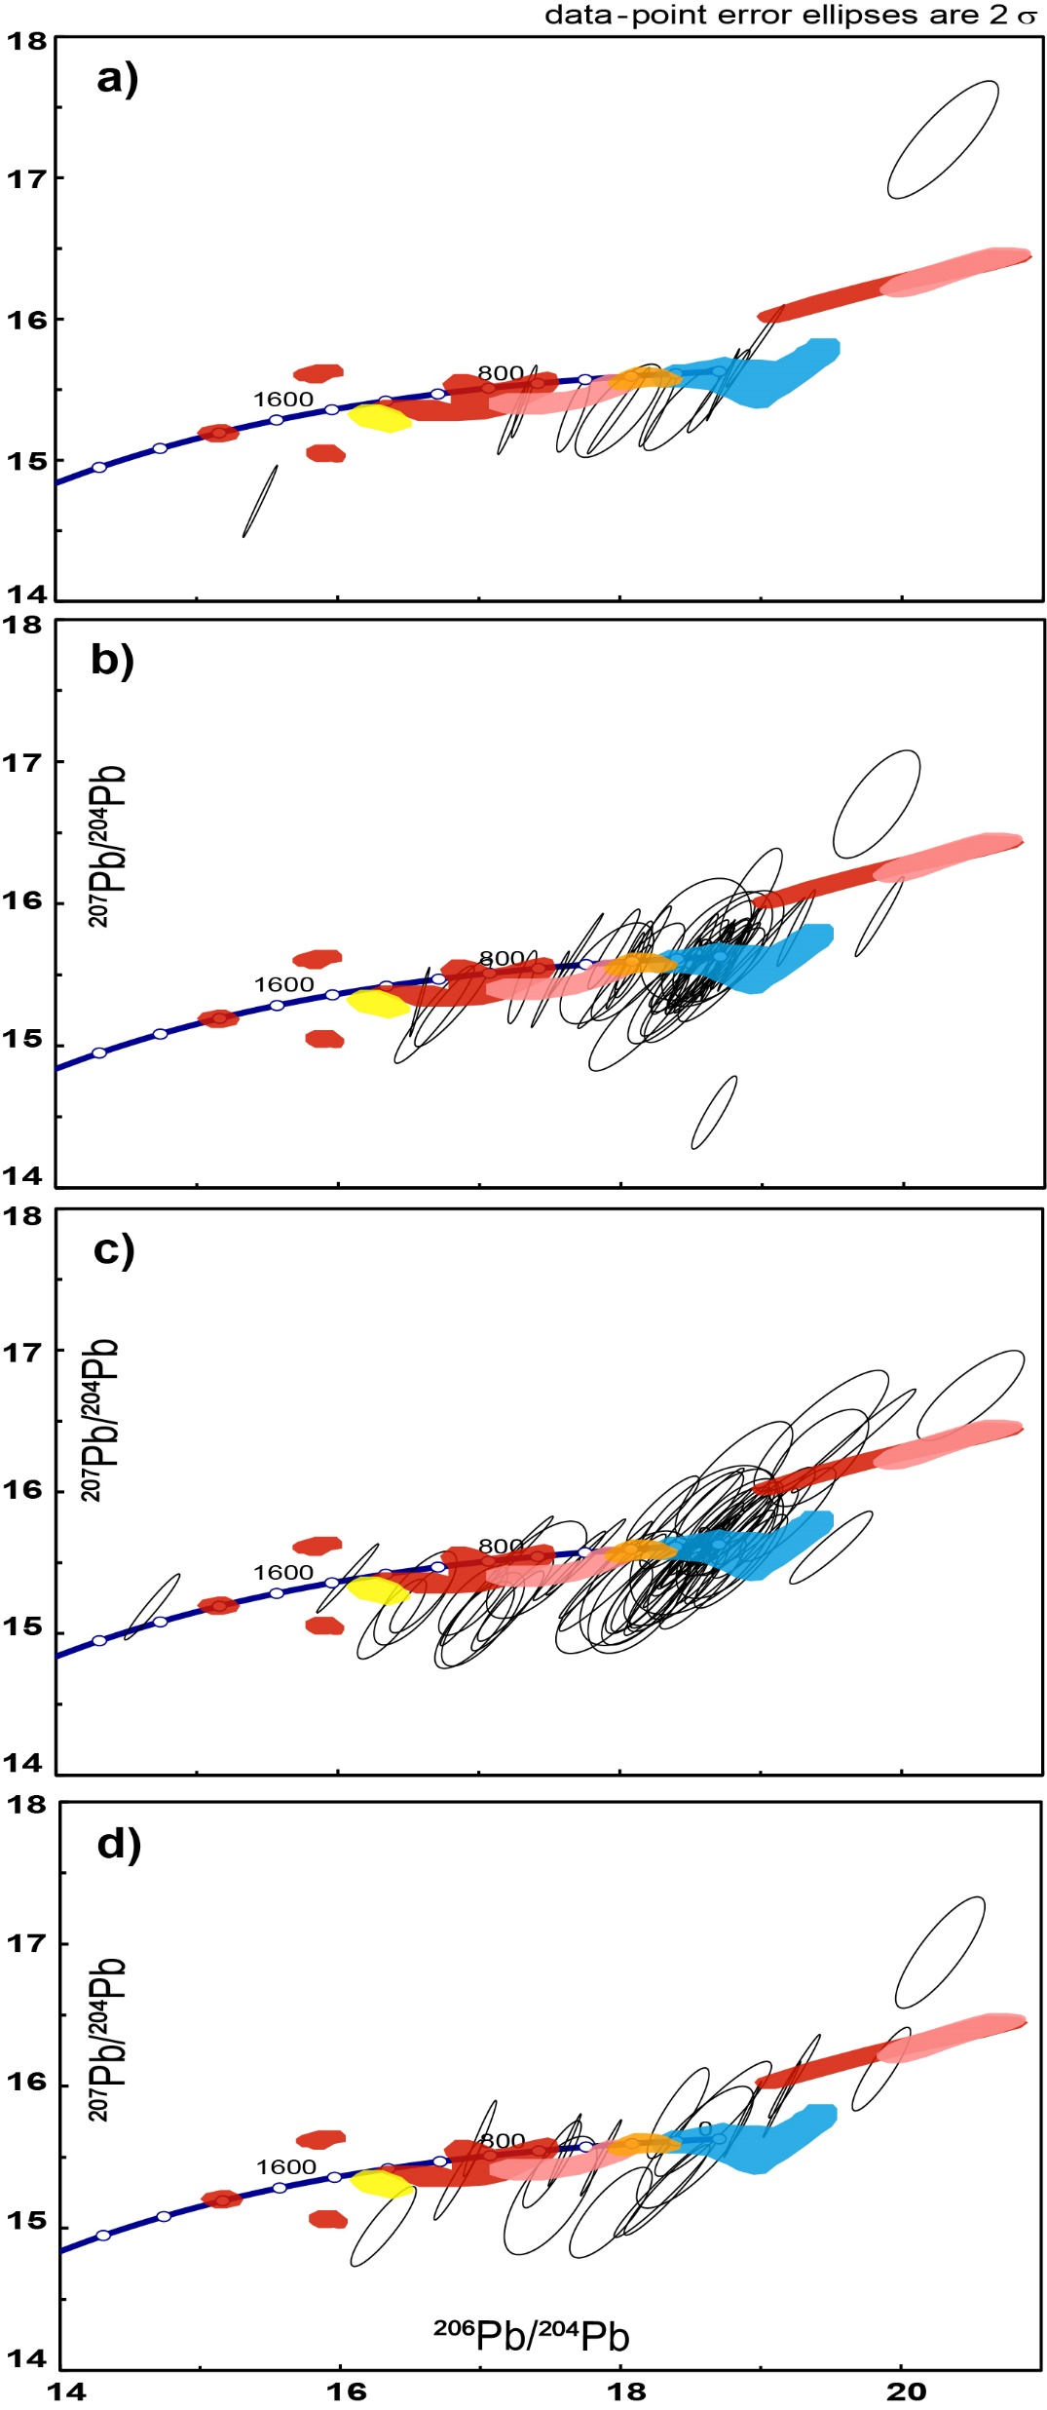
Pb-analysis Results:
14.09 Ma (n=26)
14.12 Ma (n=43)
14.26 Ma (n=20)
14.15 Ma (n=70)
Coloured regions indicate bedrock data by Flowerdew et al. (2012). Queen Maud Land (QML), West Antarctica (AP+EW), Pink - Shackleton Range (SR), Ellsworth (EW), Pensacola (P+EW).

Slide 10
Conclusion
Our data support the recent palaeo-ice sheet models.
We see an abudance of IRD transported from the most unstable regions of the AIS around the Weddell Sea.
Preliminary conclusions that ca. 750 Ma signal originates from below present day AIS.
Detrital ⁸⁷Rb/⁸⁷Sr is a useful tool for samples with no heavy mineral fraction.
Thank you!

Slide 11
Samples
ODP113-694 is the only deep-sea drill core from the central Weddell Sea due to difficulty and danger of drilling here;
This is the only suitable core for our purposes in this region, as no alternative cores are available (other near-shore cores unlikely to capture IRD from southern DML embayment).
From Sullivan, 1987

