Slide 1
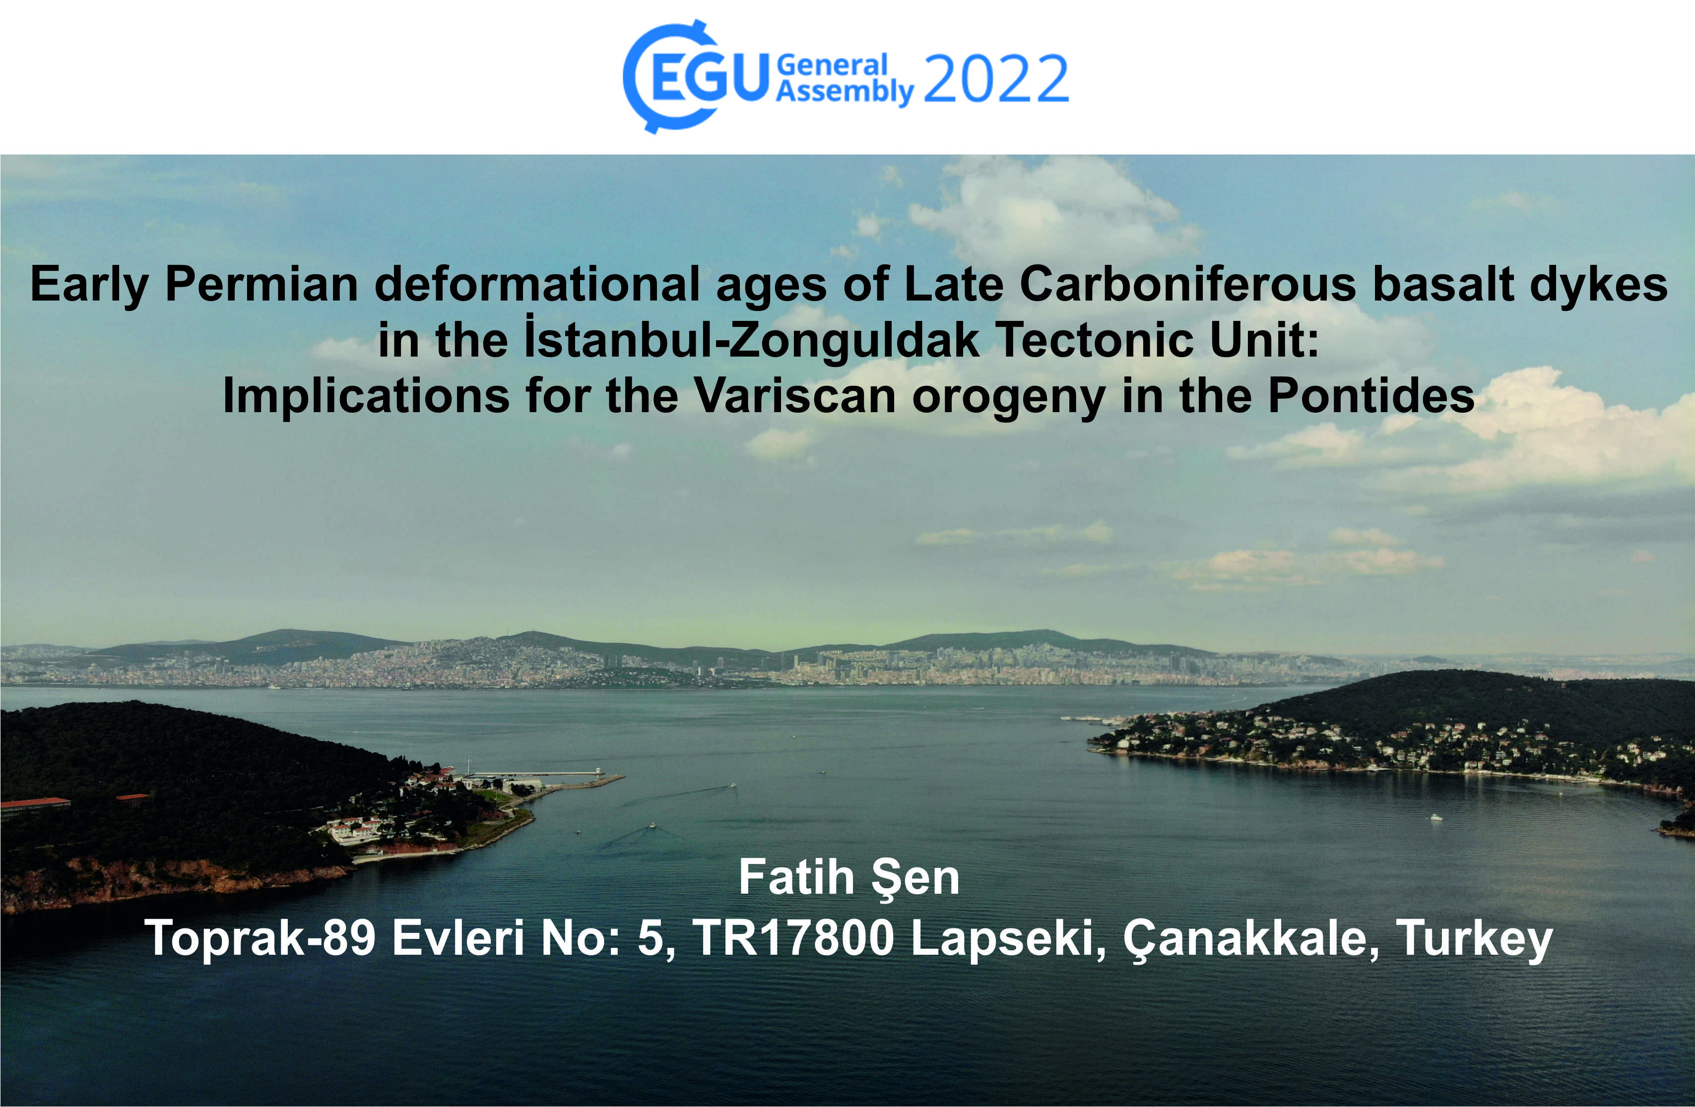

Slide 2
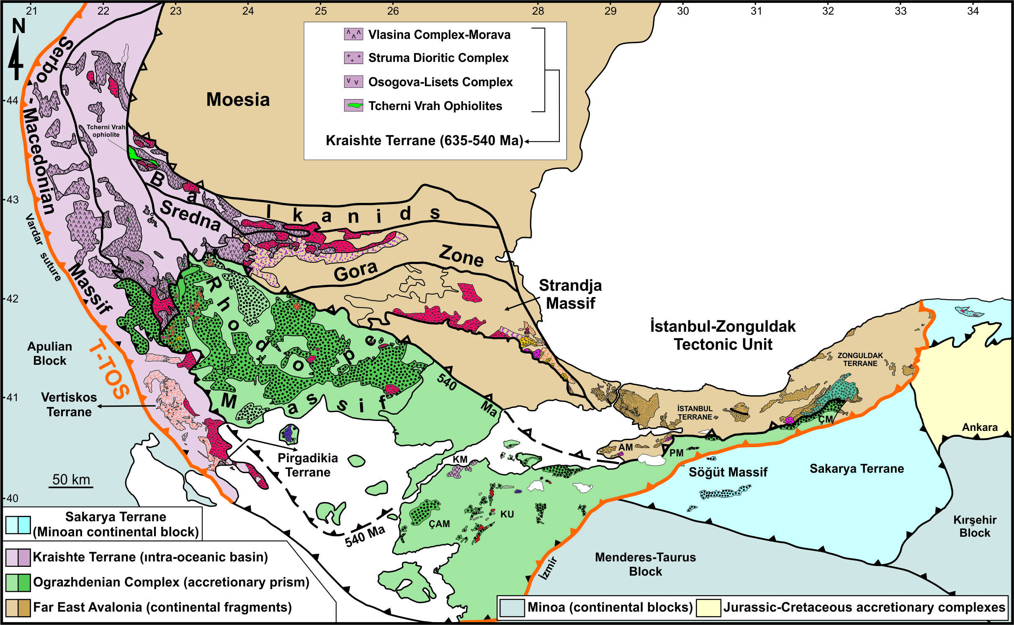
The İstanbul-Zonguldak Tectonic Unit (İZTU) is regarded as the unmetamorphosed continental fragment of Far East Avalonia in the Pontides (Şen, 2021a, b).

Slide 3
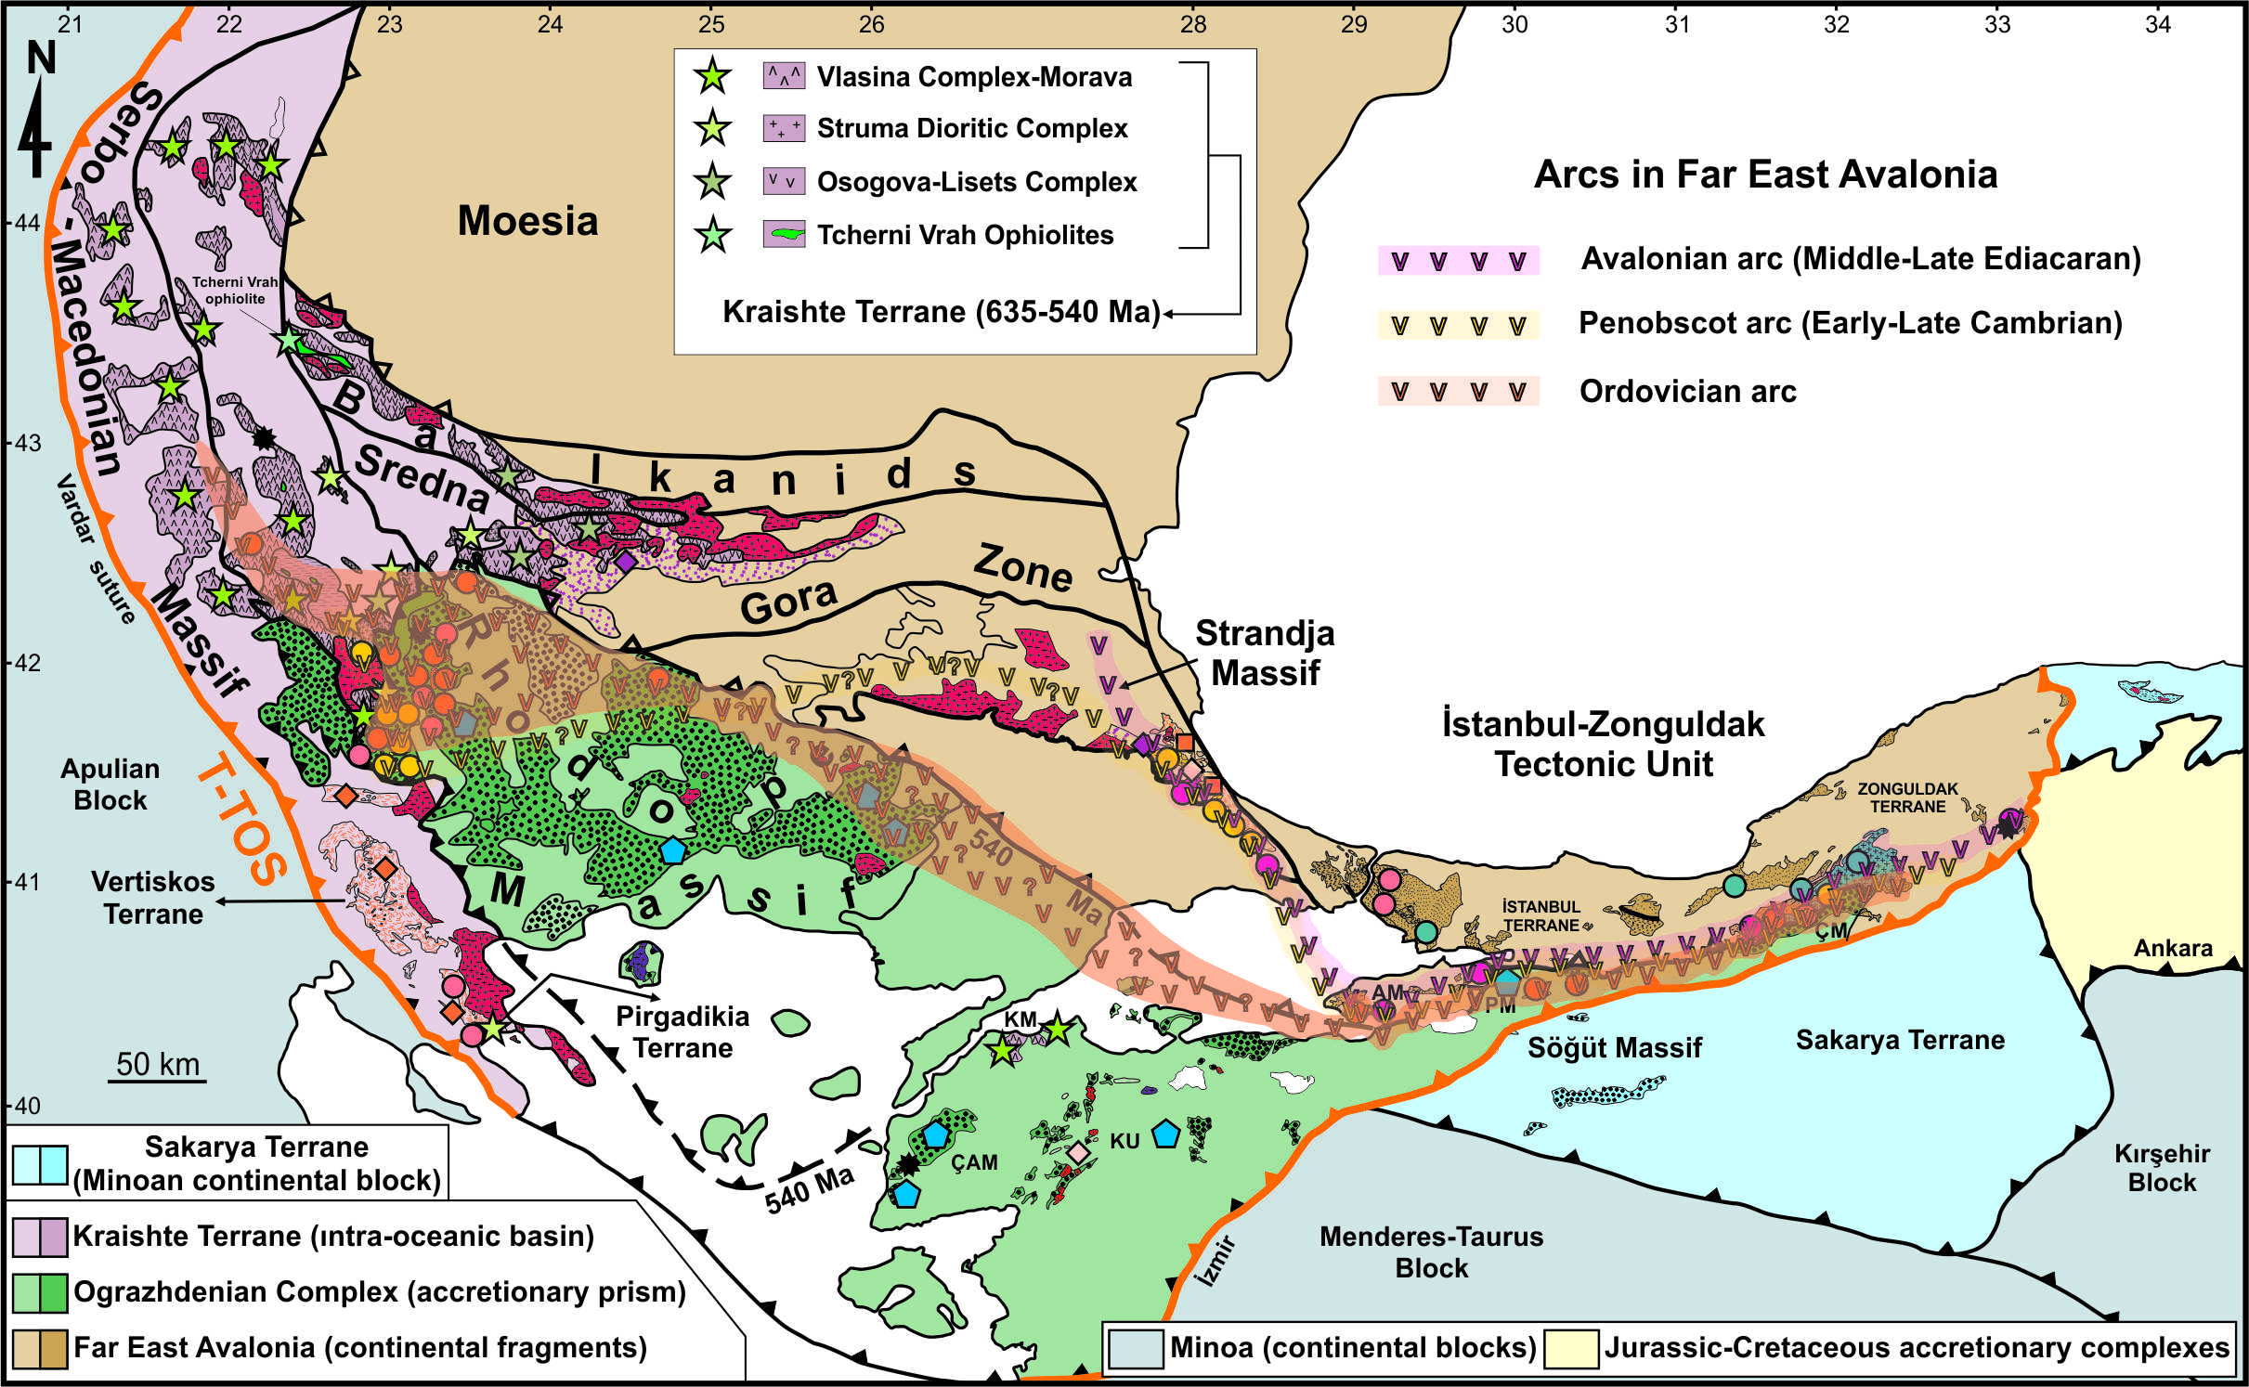
The İZTU is to the east of the Rhodope-Strandja Massif along with the Serbo-Macedonian Massif, which is a part of the metamorphosed section of Far East Avalonia, and is to the north and west of the Sakarya terrane (Şen, 2021a, b; Şen, 2022).

Slide 4
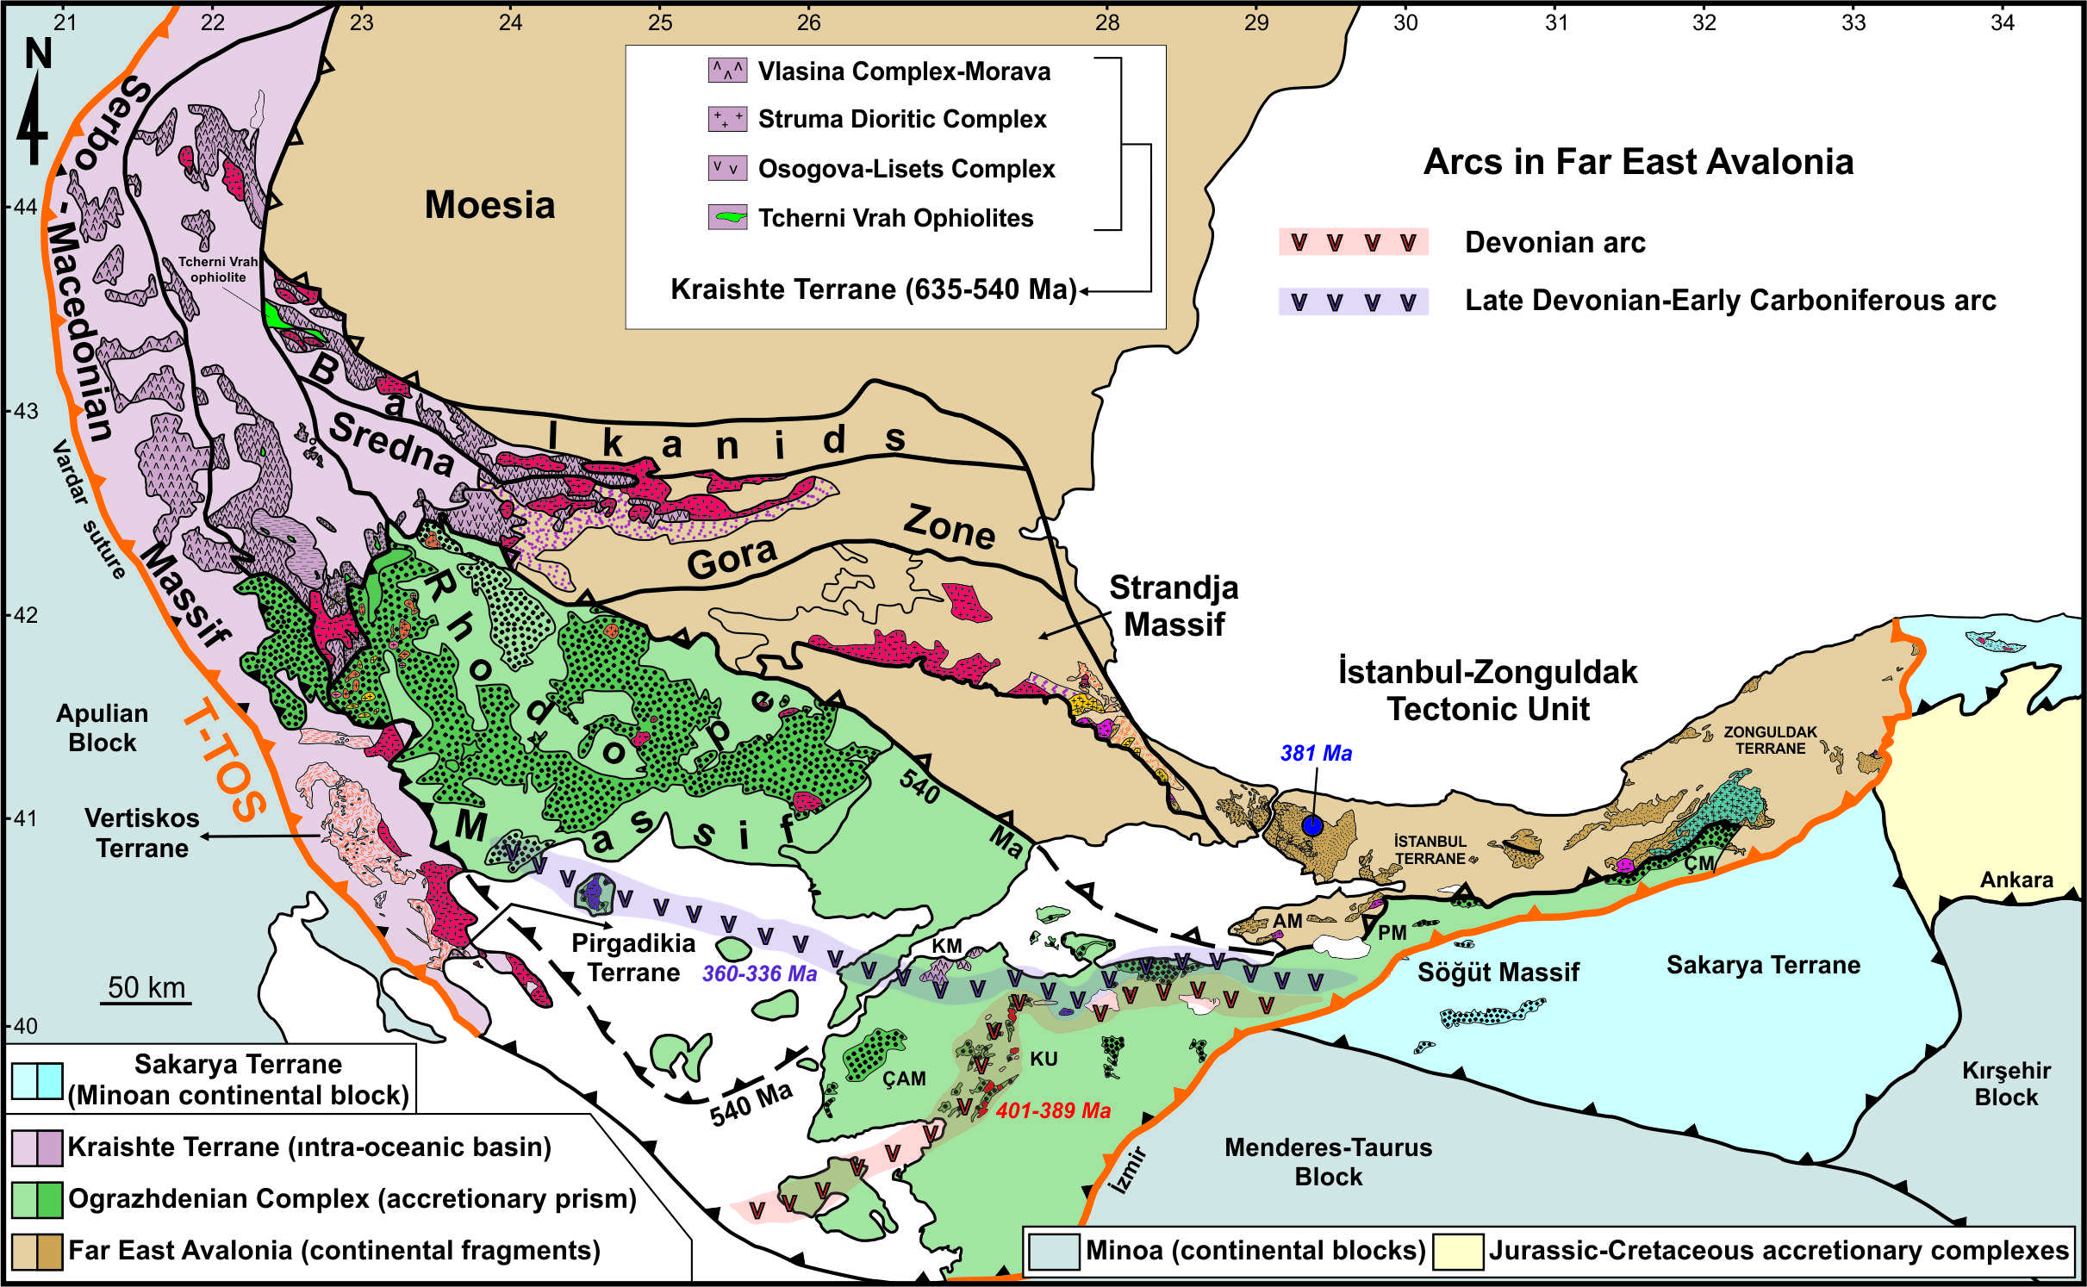
After the Caledonian orogeny, the Rheic Ocean started to subduct under Far East Avalonia during the early to middle Devonian and continued until the late Carboniferous (c. 401-298 Ma) (Şen, 2021b).

Slide 5

The Devonian arc in the Rhodope Massif migrated to the north, creating the Late Carboniferous arc magmatism in the Serbo-Macedonian and Rhodope-Strandja Massifs (c. 315-298 Ma), corresponding to the Late Carboniferous arc magmatism in the İZTU (c. 321-301 Ma).

Slide 6
The Variscan orogeny in the Pontides defines as the collision of the Sakarya terrane with the İZTU during the early Carboniferous (Okay et al, 2011; Okay and Topuz, 2017).

Slide 7
But, the Late Carboniferous arc magmatism (c. 306-301 Ma) in the eastern sector of the İZTU rejects this view (Şen, 2021b).

Slide 8
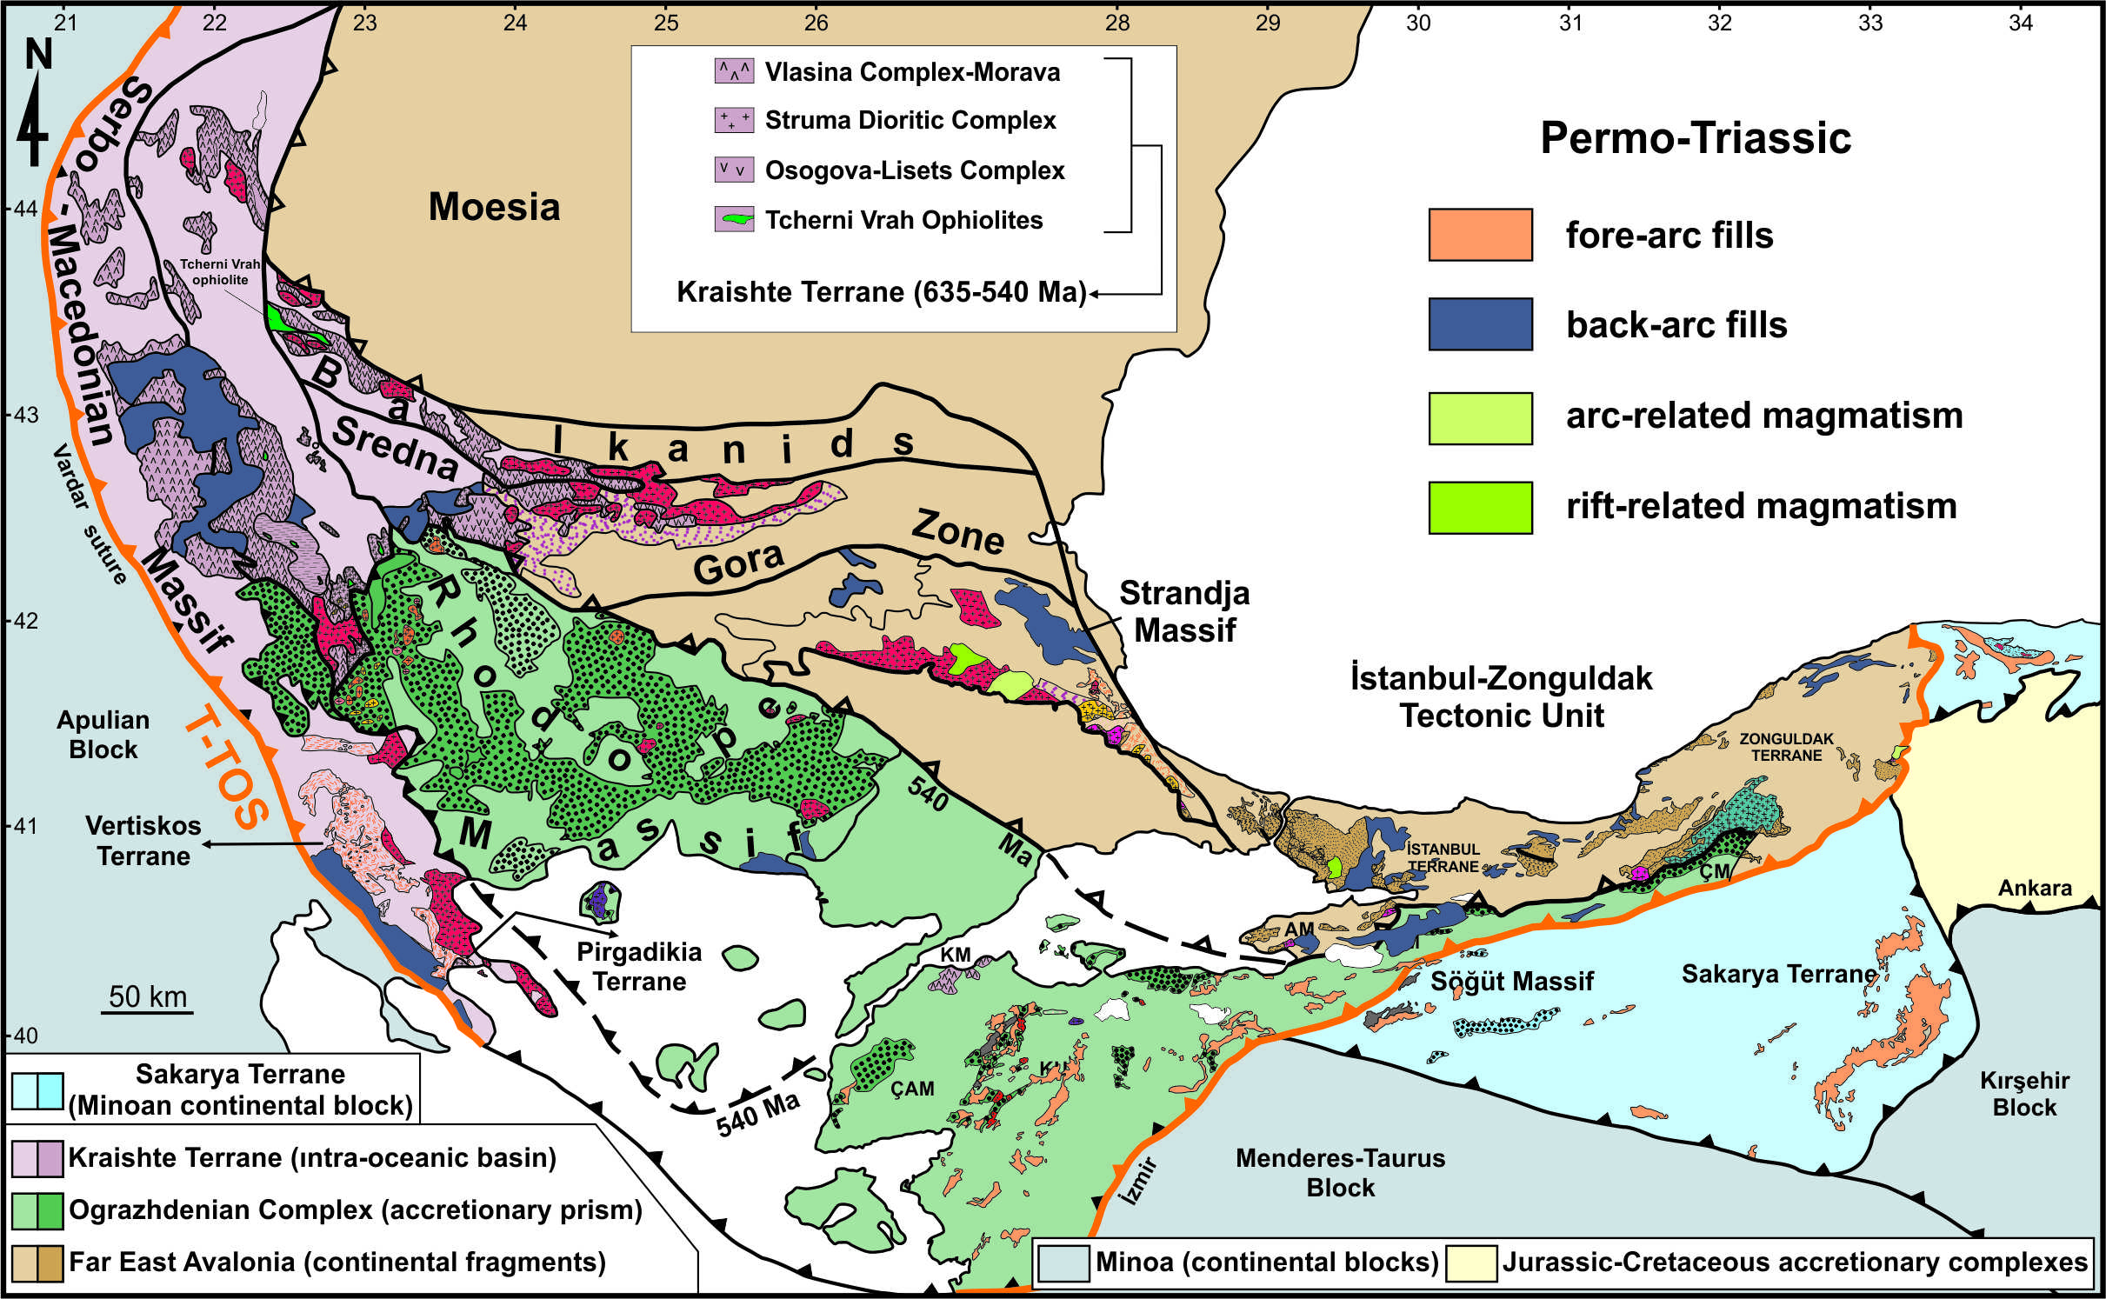
The Middle Permian arc-related intrusion cutting the tectonic contact between the İZTU and Sakarya Terrane (c. 262 Ma; Okay et al., 2013) displays that their collision time was the Early Permian.
The Middle Permian arc granite

Slide 9
The Sakarya Terrane together with the Rhodope Massif was unconformably overlain by Permo-Triassic fore-arc fills and the Strandja Massif along with the İZTU was also unconformably covered by Permo-Triassic back-arc fills (Tüysüz et al., 2004; Bedi et al., 2013; Okay et al., 2015; Ustaömer et al., 2016).

Slide 10
Therefore, the collision of the Far East Avalonian terranes with the Sakarya Terrane should have formed during the early Permian.
In order to test this case, the basalt dykes cutting the pre-Silurian rocks were studied in the western side of the İZTU.
The petrography, U-Pb ages, and geochemistry of basalt dykes were worked.

Slide 11
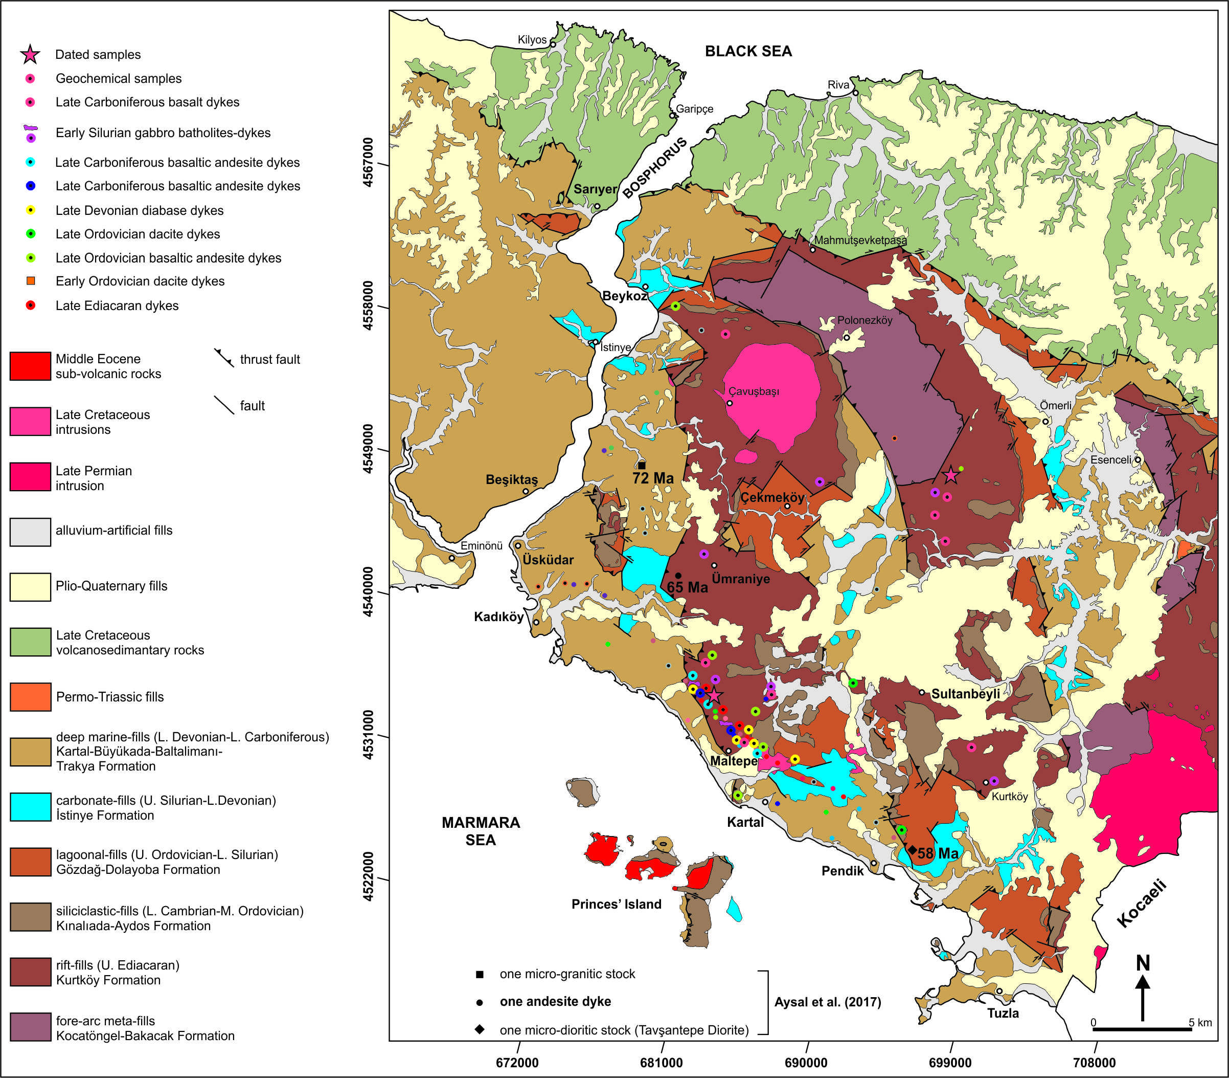
The locations of the basalt dykes intruding the pre-Silurian fills are given on the map.

Slide 12
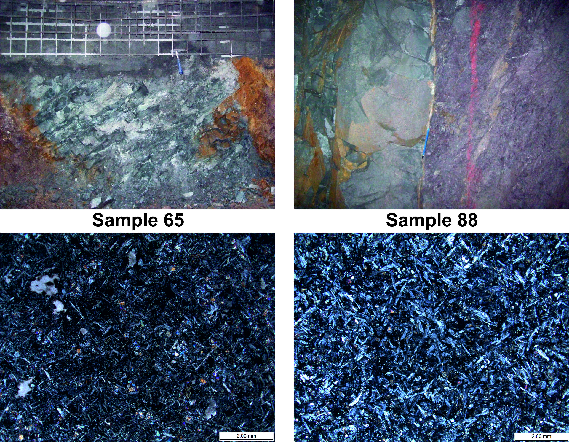
Outcrop views of the basalt dykes intruding the pre-Silurian rocks in the western part of the İZTU. Thin section micrographs showing porphyritic textures in the basalt dykes.

Slide 13
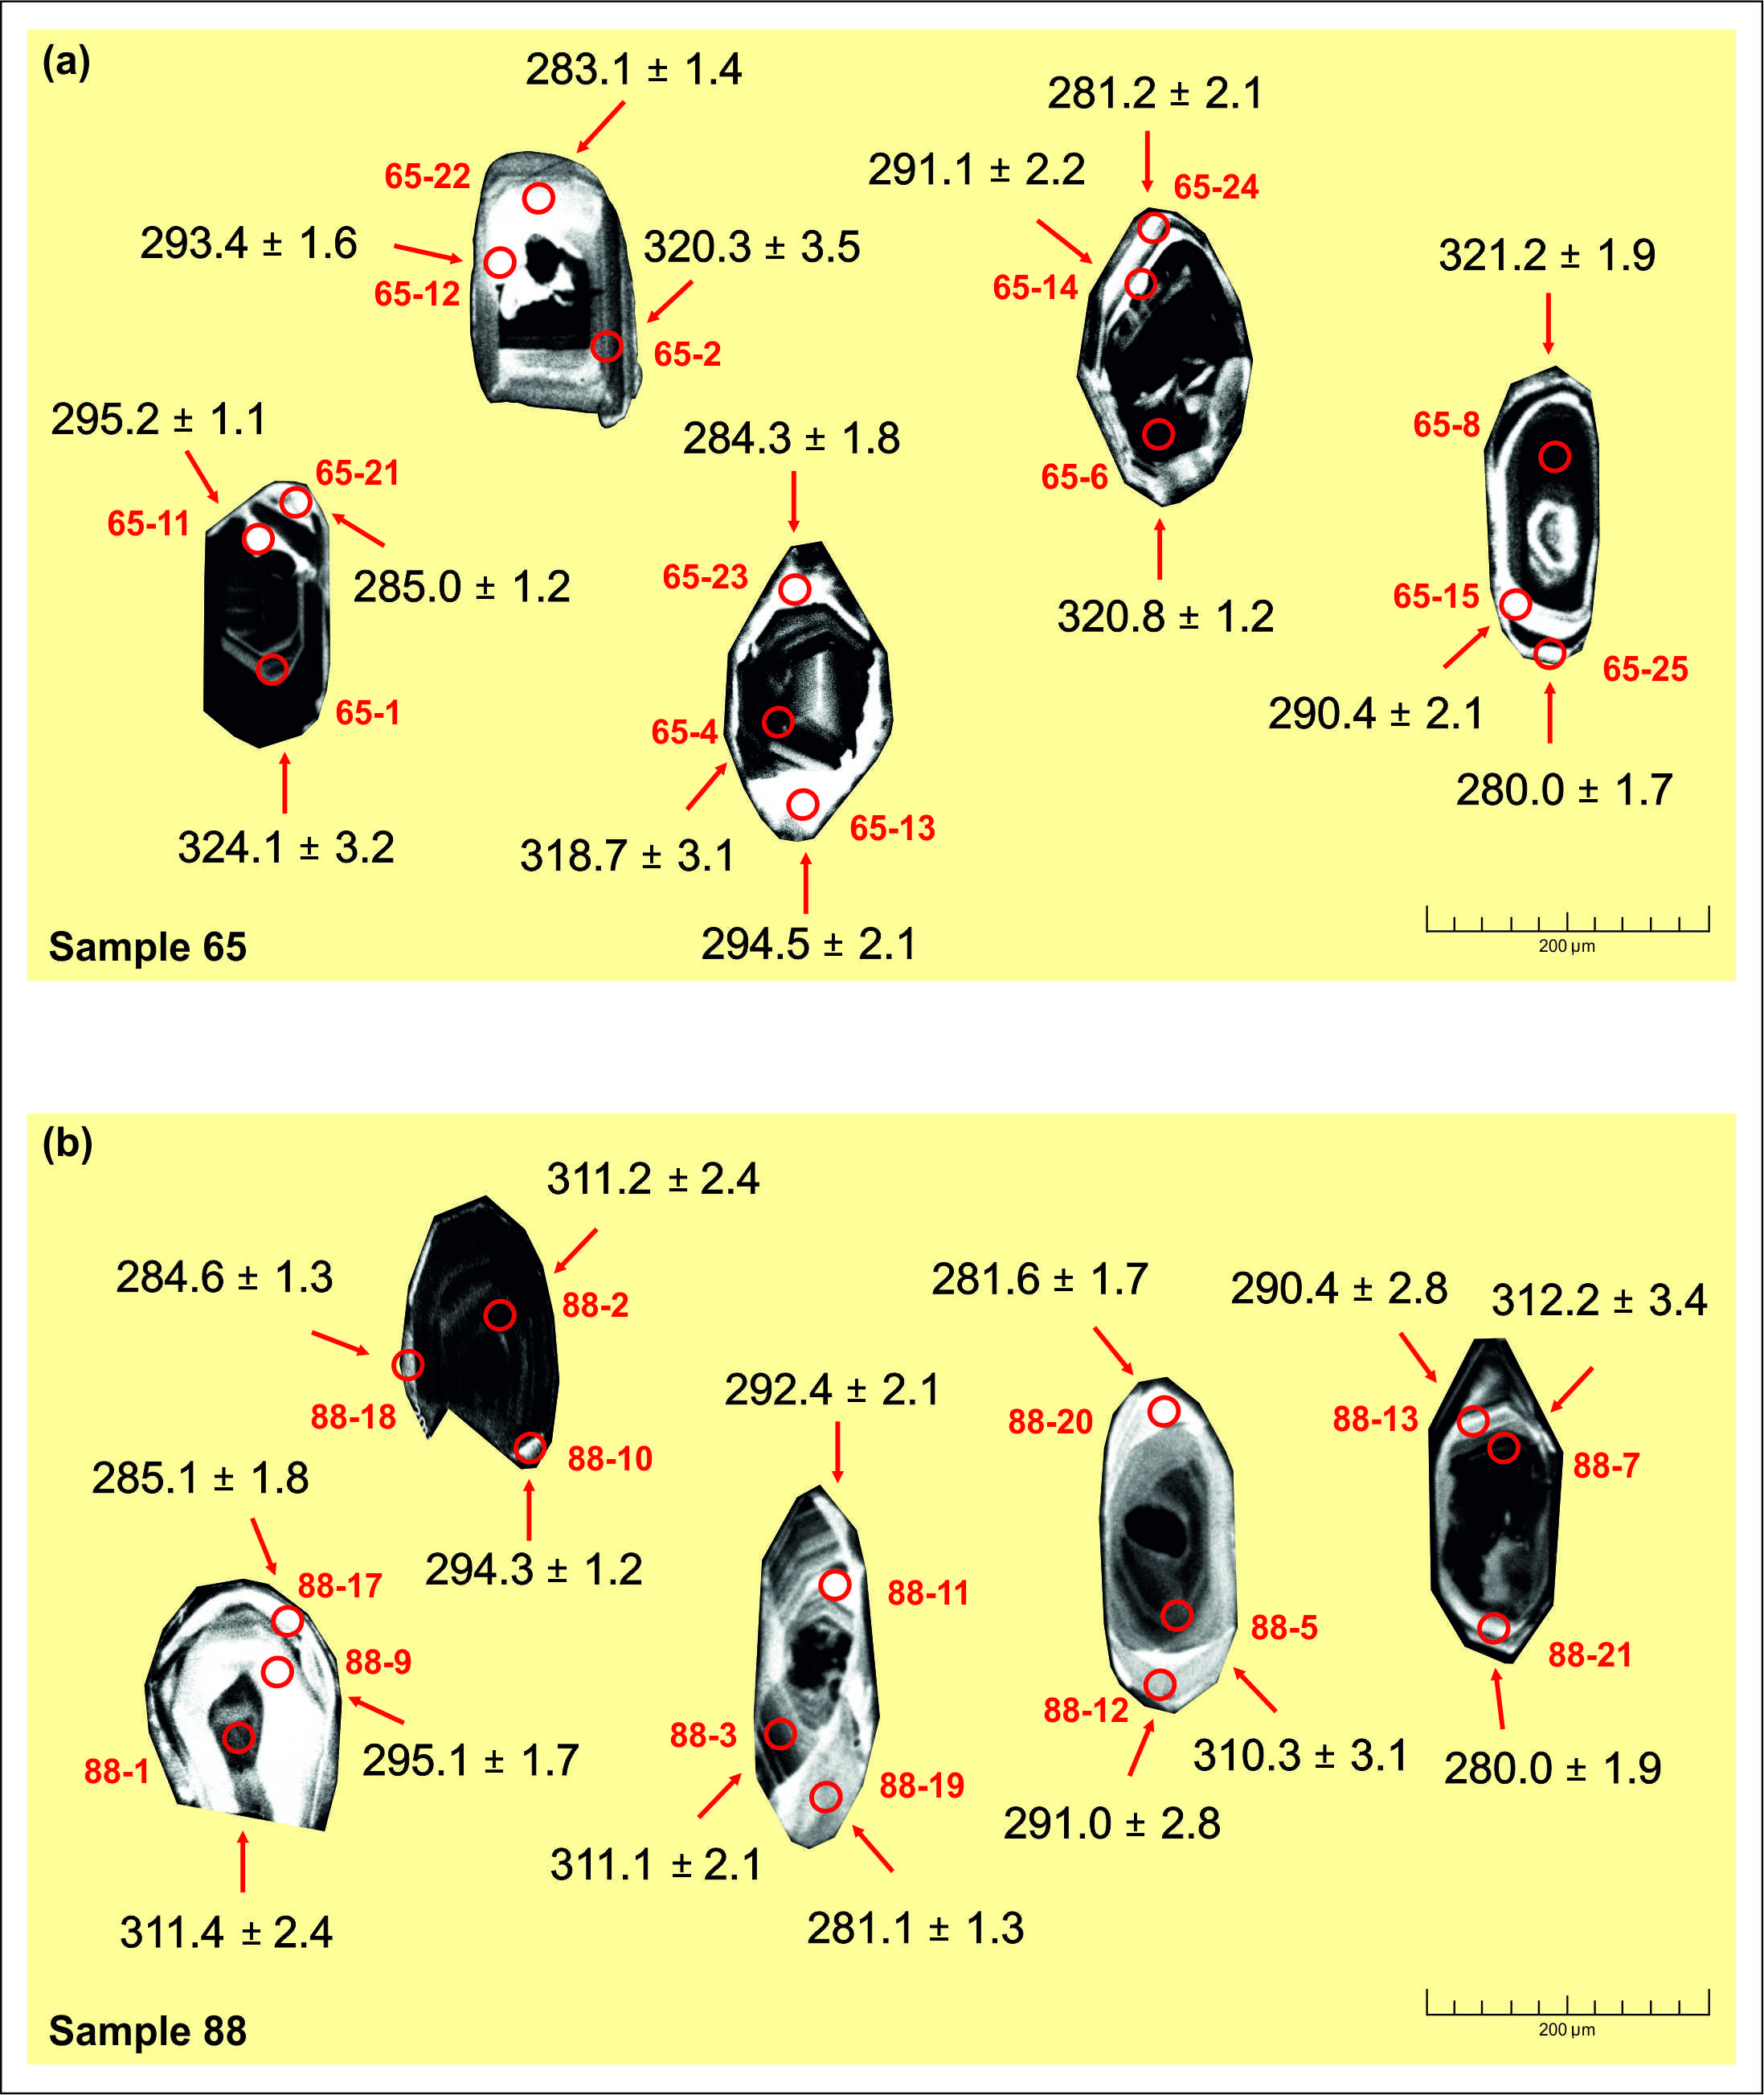
Images of the dated zircon from basalt dykes (samples 65 and 88).

Slide 14
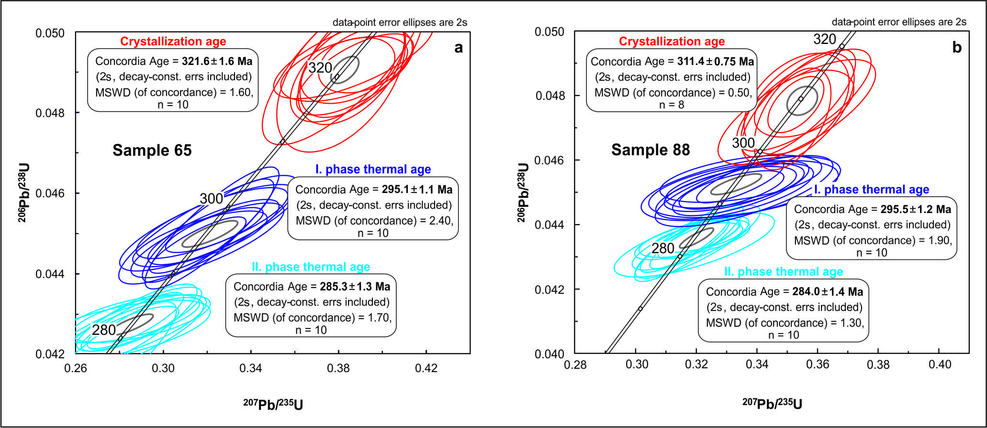
U–Pb dating on igneous zircons from two basalt dykes yielded Late Carboniferous ages of ca. 321.6 ± 1.6 and 311.4 ± 0.75 Ma (2σ), and their Pb-loss ages from the white spot in zircons calculated Early Permian ages of ca. 295.1 ± 1.1 to 285.0 ± 1.3 Ma and 295.5 ± 1.2 to 284.0 ± 1.4 Ma, respectively.

Slide 15
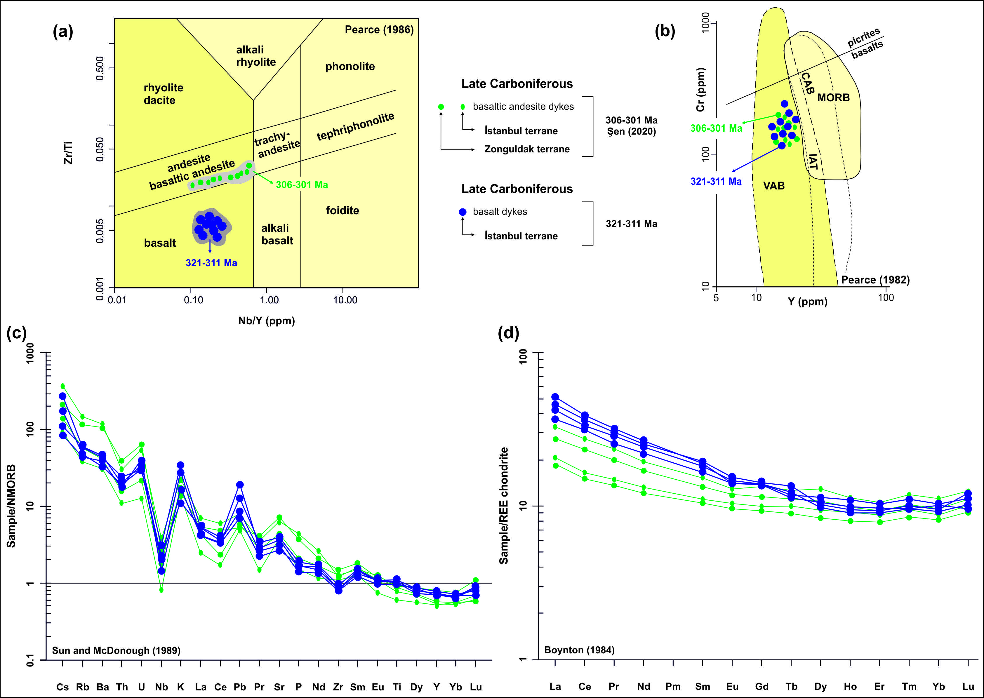
Late Carboniferous basalt dykes display calc-alkaline affinities. They contain subduction components and are associated with the arc-related geodynamic setting.

Slide 16
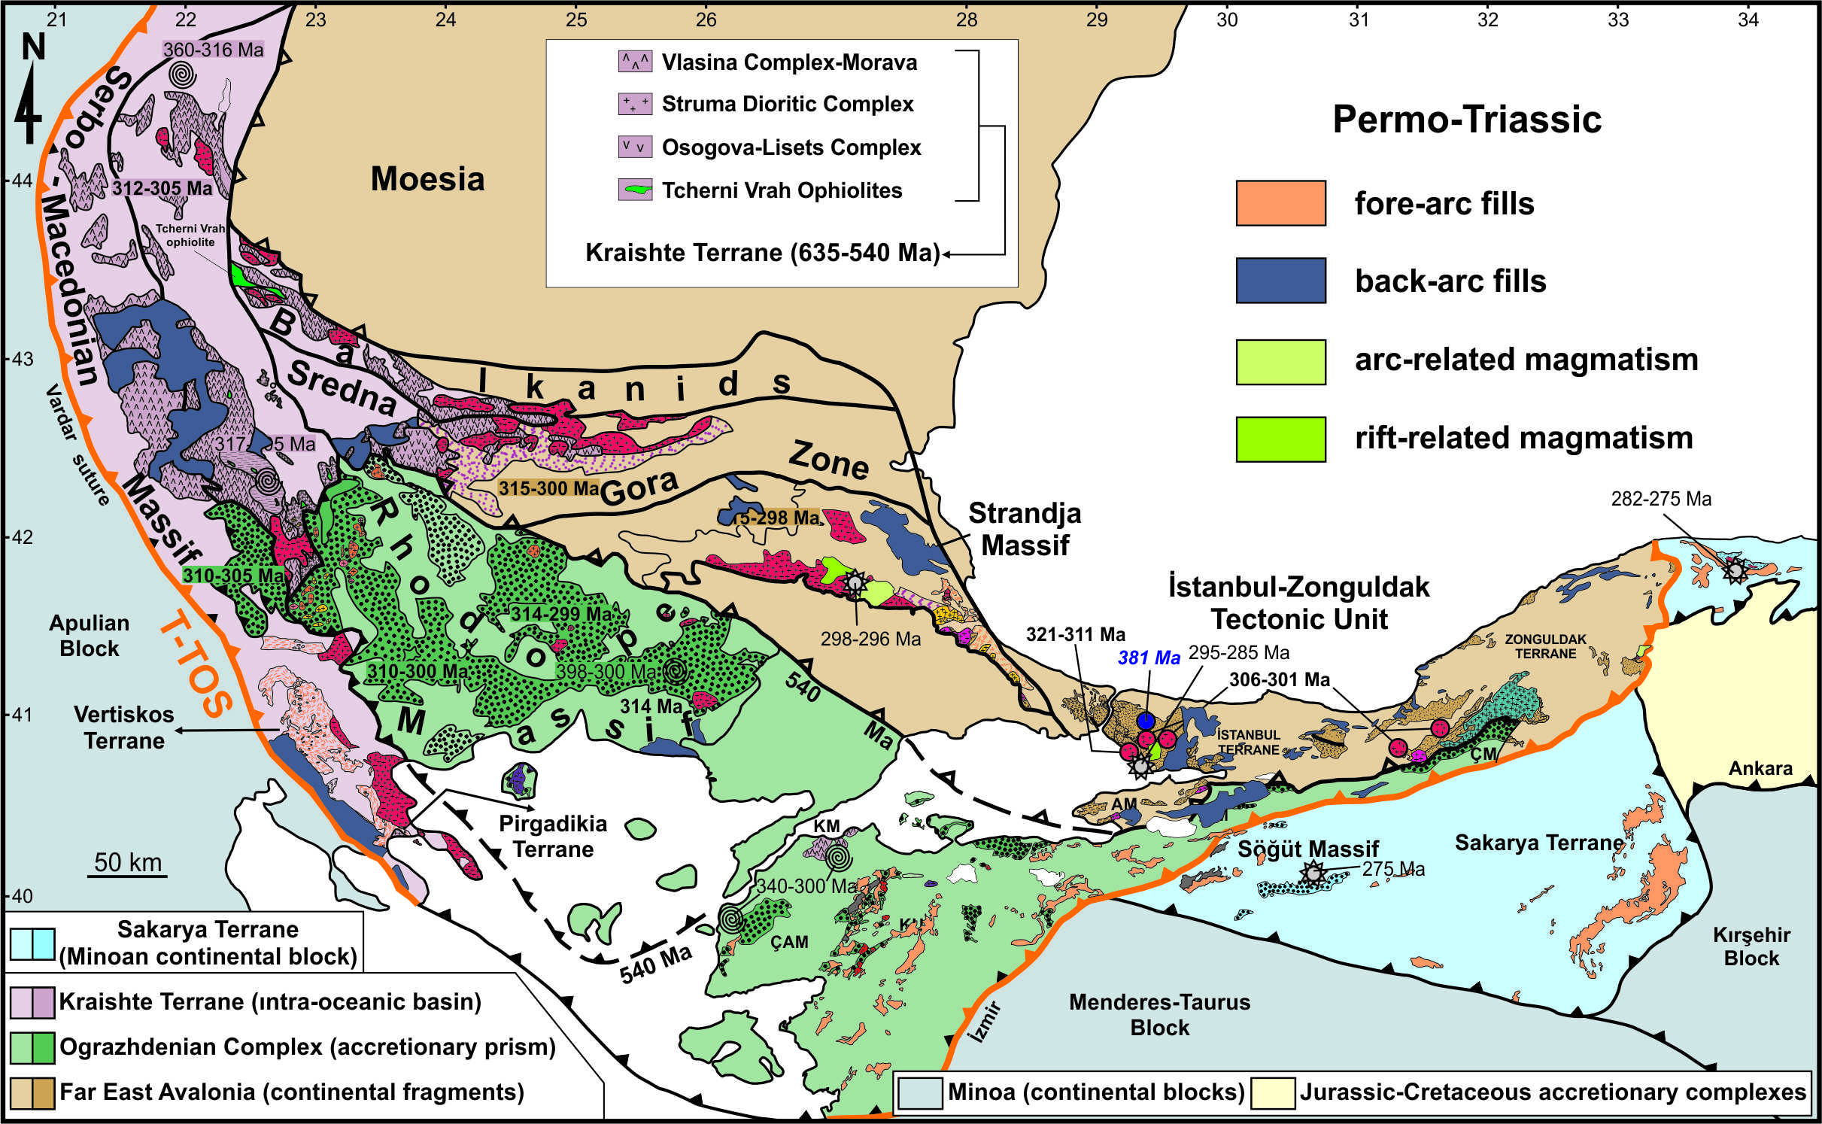
The Late Carboniferous arc magmatism (c. 321-301 Ma) in the eastern side of the İZTU, thus indicating that the Rheic Ocean continued to subduct under Far East Avalonia during the Carboniferous.

Slide 17
The earliest-latest Cisuralian deformational ages (c. 295-285 Ma) correspond to regional deformation events at the Carboniferous-Permian boundary in the Rhodope-Strandja Massif (c. 298-296 Ma; Okay et al., 2001) and at the ending of the early Permian in the Sakarya Terrane (c. 282-275 Ma; Okay et al., 2002; Nzegge, 2008).

Slide 18
Conclusion
All in all, I suggest that the docking of the Far East Avalonian terranes with the Sakarya terrane formed during the early Permian instead of the early Carboniferous.

Slide 19
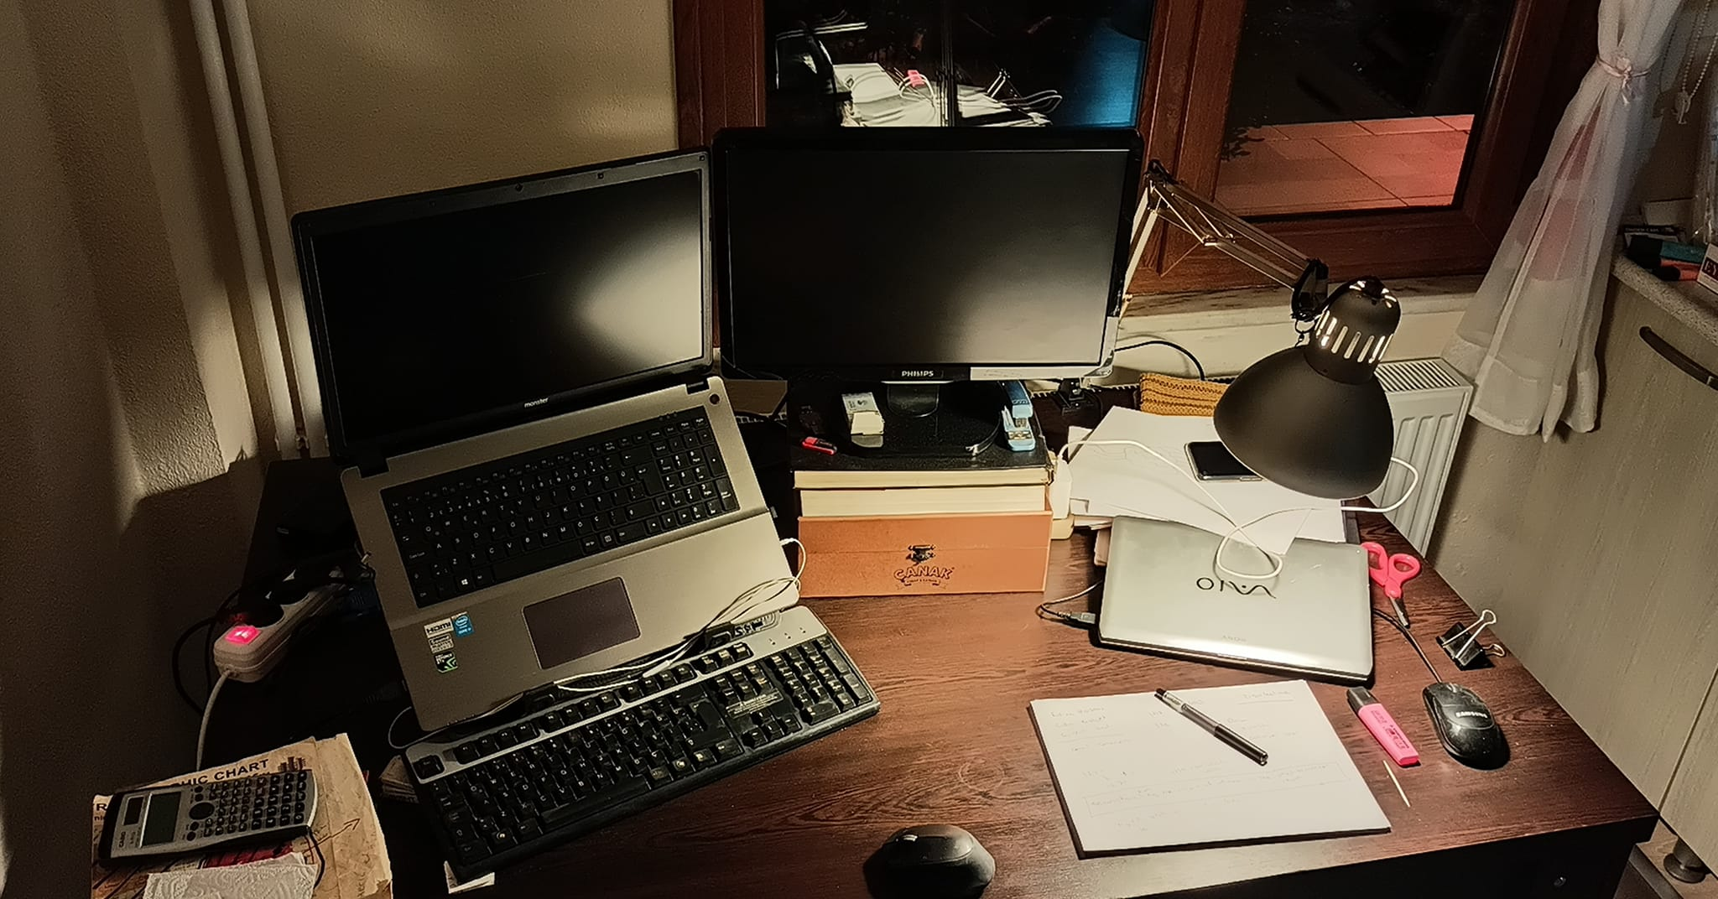
Thank you for listening.

