Slide 1






Solar wind conditions suppressing the production of magnetosheath jets during CME occurrence
Introduction
Florian Koller¹, Ferdinand Plaschke², Luis Preisser³,
Manuela Temmer¹, Owen W. Roberts³
1 Institute of Physics, University of Graz, Austria
2 Institut für Geophysik und extraterrestrische Physik, TU Braunschweig, Germany
3 Space Research Institute, Austrian Academy of Sciences, Graz, Austria

Slide 2
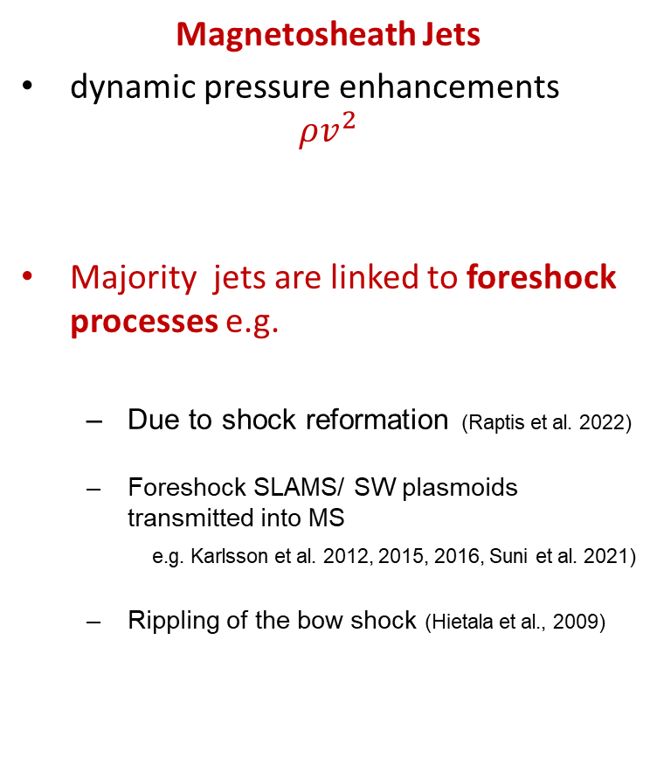
Introduction
Earth’s dayside magnetosphere and magnetosheath
Magnetosheath Jets
dynamic pressure enhancements $ρv^{2}$
Majority jets are linked to foreshock processes e.g.
  Due to shock reformation (Raptis et al. 2022)
  Foreshock SLAMS/ SW plasmoids transmitted into MS
  e.g. Karlsson et al. 2012, 2015, 2016, Suni et al. 2021)
  Rippling of the bow shock (Hietala et al., 2009)
Bow shock
IMF lines
Magnetosheath
Foreshock
Jets
Solar wind
THEMIS
2

Slide 3
Motivation
Introduction
Incoming solar wind structures : CMEs
Coronal mass ejections (CMEs) - large clouds of plasma expelled from the star
Inside the magnetic cloud: high B field, “rolling B-Vector”
Magnetosheath
Foreshock
Jets
THEMIS
CMEs
Magnetic ejecta from the Sun‘s atmosphere

Slide 4
Results
Motivation
Introduction
Research Motivation
We want to learn how CMEs affect jets, meaning:
  Effects on number of the jets (Koller et al. 2022)
  Effects on generation mechanisms
    What happens to the foreshock in a CME?
Magnetosheath
Foreshock
Jets
THEMIS
CMEs
Magnetic ejecta from the Sun‘s atmosphere
4

Slide 5
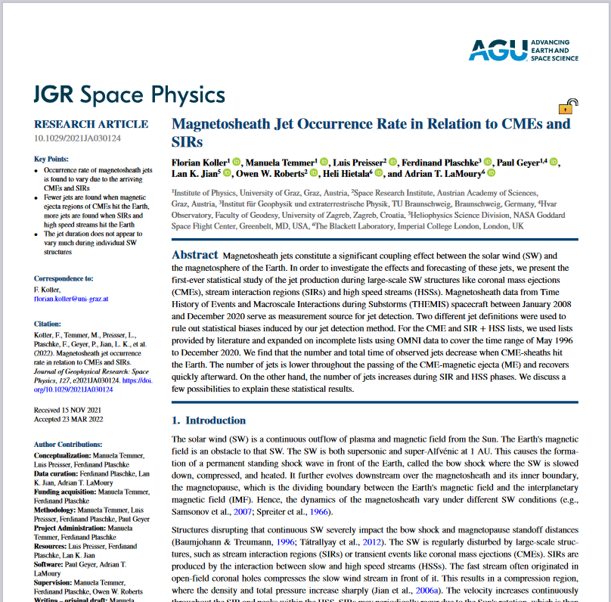
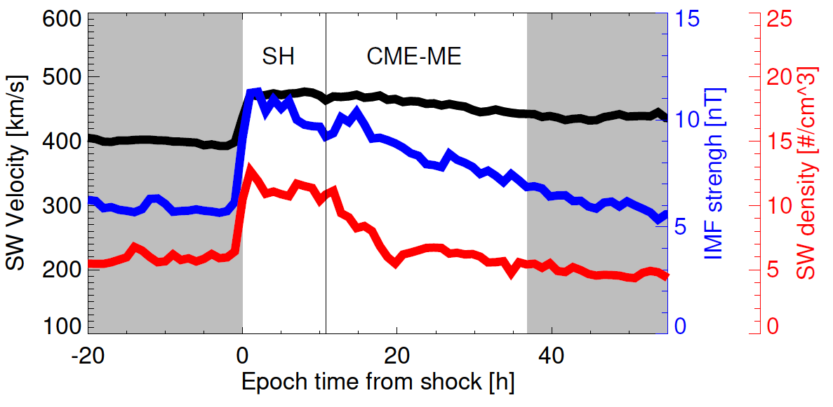

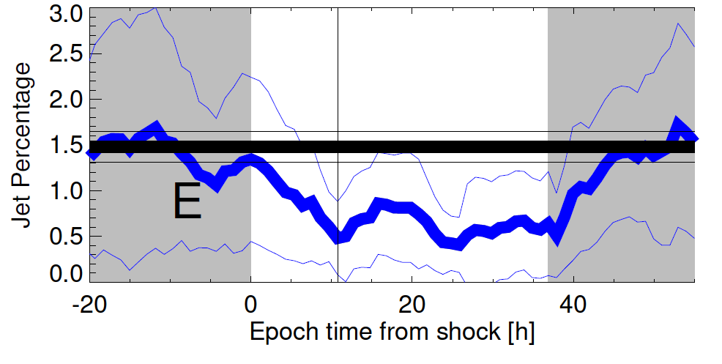
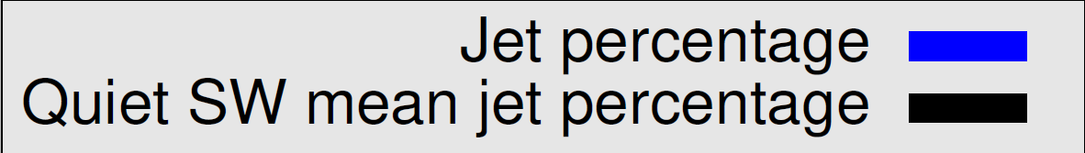
Motivation
Introduction
Results
Decrease of jets during CMEs ( → Koller et al. 2022)
Number of jets continously low during CME-Magnetic ejecta
Relation was previously unknown
We further investigate this trend in jet occurrence
5

Slide 6
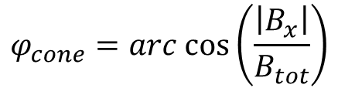

Motivation
Introduction
Results
Analysis based on Solar wind (OMNI) data
We make 2D histogram parameter plots using
  IMF cone angle
  Alfvén Mach number
Why those two parameters?
Foreshock is directly dependent on both
  Low cone angle better for foreshock
  High Mach numbers needed build foreshock
CMEs changes both parameter!
$$φ_{cone}=arc cos\left(\frac{\left|B_{x}\right|}{B_{tot}}\right)$$
$M_{A}=\frac{v_{SW}}{v_{A}}$ = $v_{SW} ∗\frac{\sqrt{μ_{0}ρ}}{|B|}$
Jet time intervals based on magnetosheath times of THEMIS 2008 – 2021 using Archer & Horbury (2013) criterion
6

Slide 7
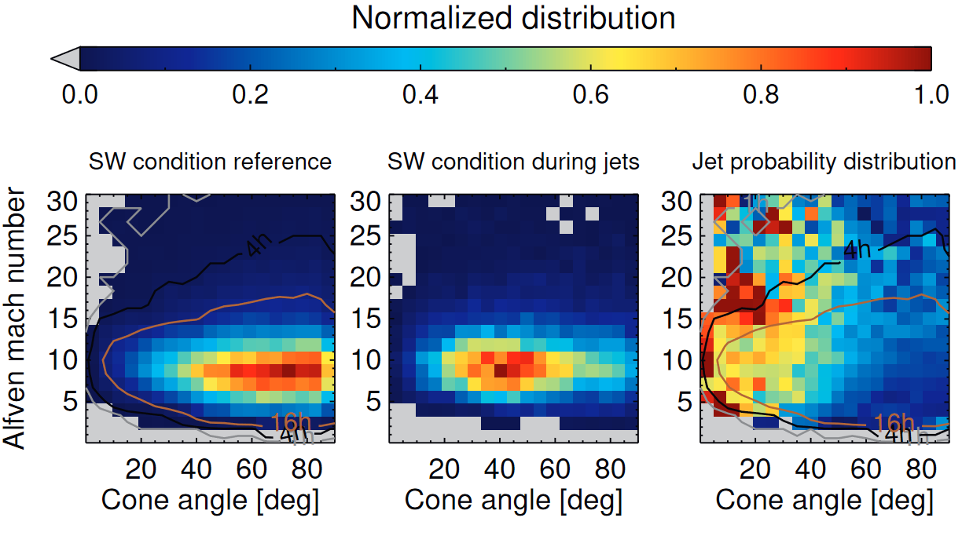
Motivation
Introduction
Results
SW condition distribution: SW Mach number & cone angle
Koller et al. in preparation
7

Slide 8
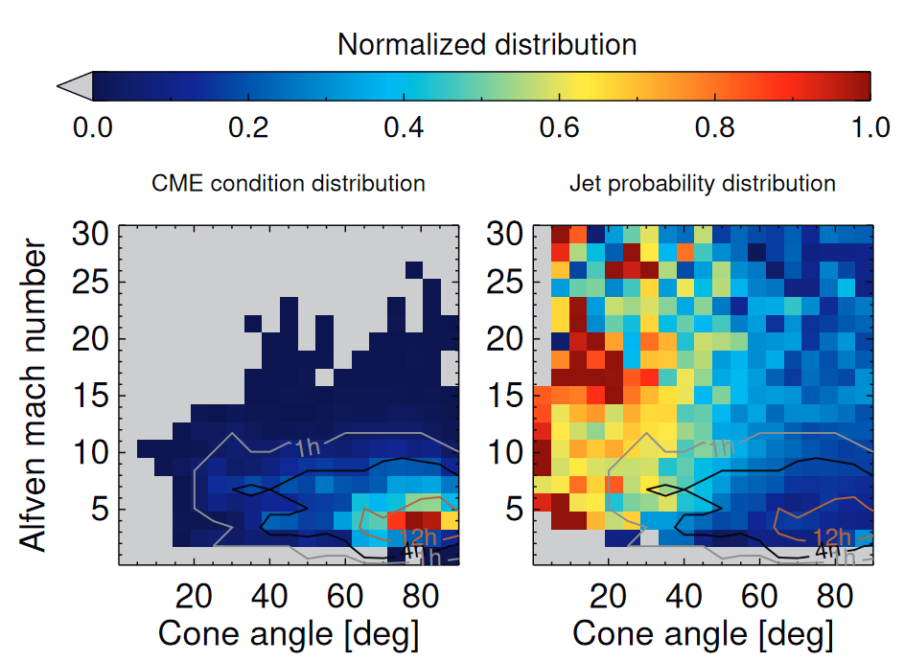
Conclusions
Motivation
Introduction
Results
SW condition during CMEs
Koller et al. in preparation
8

Slide 9
Motivation
Introduction
Conclusions
Results
Conclusion and summary
Conditions within CMEs unfavorable for jets
This is due to a mix of low Alfvén Mach number & high cone angles
We hypothesize that this inhibits the production of a proper foreshock
Gives implications to other magnetosheaths (e.g. low Alfvén Mach numbers at Mercury)
Outlook on effects on jet properties and other SW structures (CIRs, HSS)… lot’s to come!
9

