Slide 1
New features, broader accessibility, and improved performance of Hector v3 a simple carbon/climate model
Kalyn Dorheim, Ben Bond-Lamberty, Leeya Pressburger,
Dawn Woodard, Skylar Gering, & Alexey Shiklomanov
Notes:
Image: Sequim Bay

Slide 2
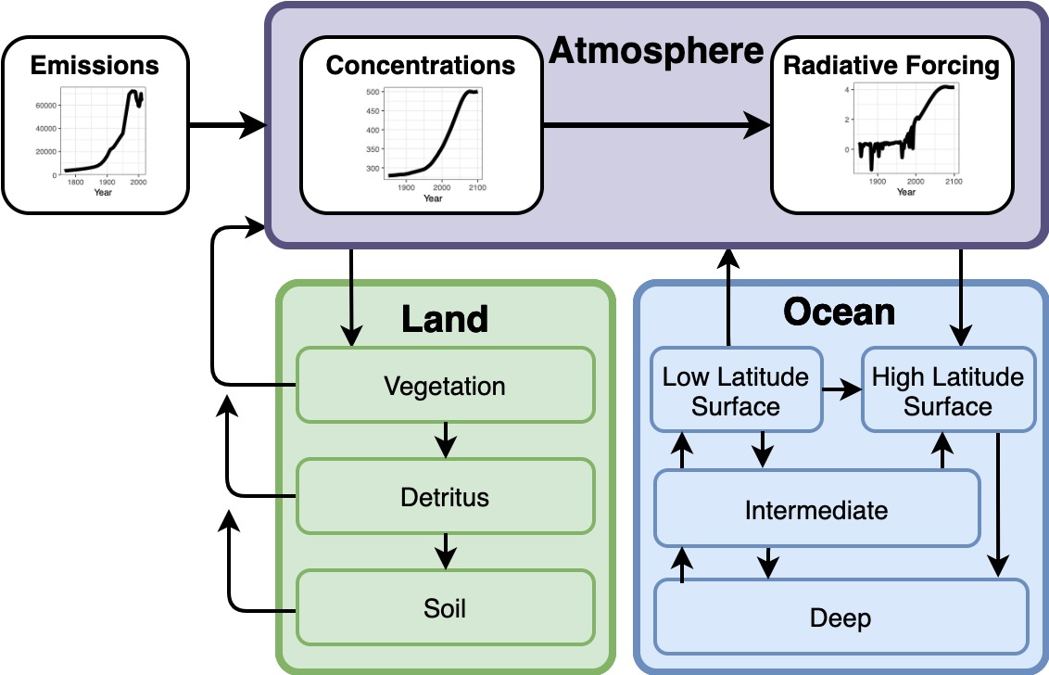
Hector is a simple climate model
Computationally efficient
Open source
Flexible design
Three box model
Atmosphere
Land
Arbitrary number of user defined biomes
Ocean
Diffusive ocean
Actively solves carbon chemistry in ocean surface boxes
Notes:
Hector is an open source simple climate model
Traded off high resolution & complexity to be a computationally efficient climate model
Guiding developmental principles
Accessible open source, flexible design (complexity where warranted while remaining simple)
Three boxes atmosphere, ocean, and land
Atmosphere component
reads in time series for 40 different emission species
Major ghgs and aerosols, CO2, CH4, N2O, SO2, BC, CFCs, & HFCs
Methane oxidized in the atmosphere
Concentrations
Effects the energy balance → heat diffuses into the ocean
Hector’s ocean broken into 4 boxes
Two surface boxes, high and low latitudes
Intermediate & deep
Actively solves carbon chemistry in the ocean a unique feature
Land component represents the terrestrial biosphere important in the carbon cycle
CO2 is fixed via photosynthesis, growth, broken down into detritus, and then soil, at each step respired
Users are able to define an arbitrary biomes
Feedbacks & carbon cycle interactions
CO2 fertilization
Temperature carbon interaction

Slide 3
Multiple ways to run Hector https://github.com/jgcri/hector
C++ core
Science code
Run from command line
HectorUI
R package
Run, analyze, and visualize in R
Hector UI
Simplified web interface
Run on desktop, tablet, or smartphone
R package
C++ core

Slide 4
Hector v3 Upgrades &
New Features
Software upgrades
Testing code (R and C++)
Overhaul of a command-line build system XCode and Visual Studio project file updates
New online documentation
New parameters
Updated to AR6 radiative forcing calculations
Switched to SPP scenarios
Permafrost feedback
Carbon tracking

Slide 5
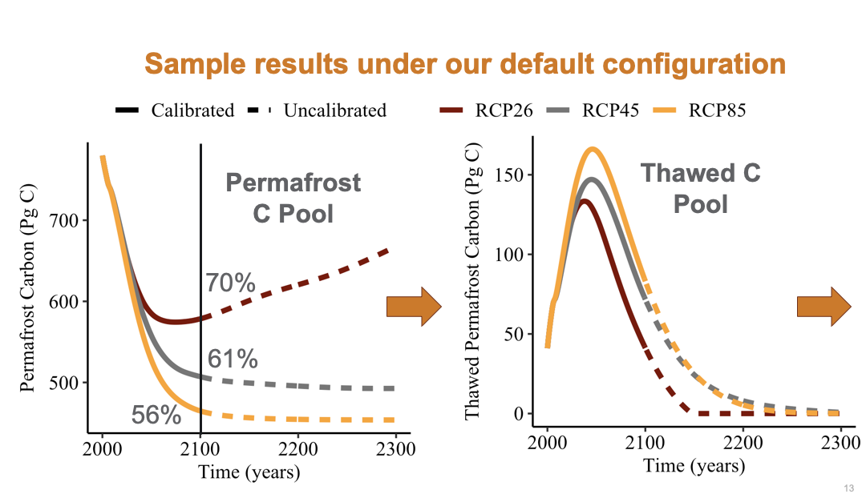
Permafrost in Hector
Permafrost is soil that remains frozen for 2 or more years
Thaw releases CO₂ and CH₄
Woodard et al. 2021 added a permafrost biome
Added pool of permafrost is inaccessible to the carbon cycle
Thaws as function of temperature emitting CO₂ and CH₄
Woodard et al. 2021
Notes:
When we run Hector with the permafrost sub module
See how the permafrost pool changes over time across three scenarios
High end climate change, middle of the road, and low climate
Across all three scenarios the permafrost pool declines uputil 2100
RCP 26 scenarios grows -- some refreeze
Permafrost thaws releases CO2 and CH4 → temperature
The difference in temperature between Hector with and without the permafrost feedback turned on
Plug Dawn Woodard’s work v

Slide 6
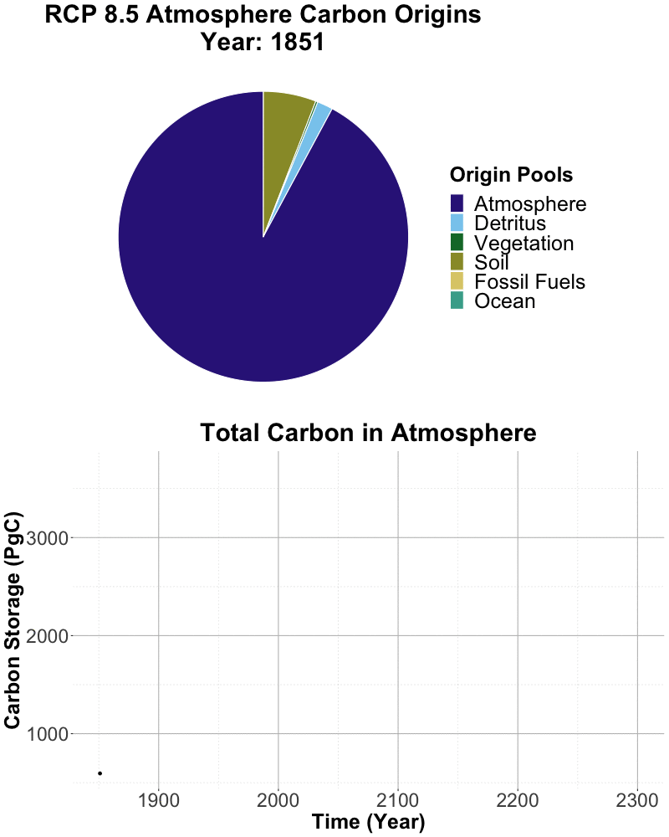
Carbon Tracking in Hector
This feature allows users to track the origin & fate of C within Hector’s carbon cycle.
Pressburger in prep.
Notes:
Plug Leeya’s Work

Slide 7
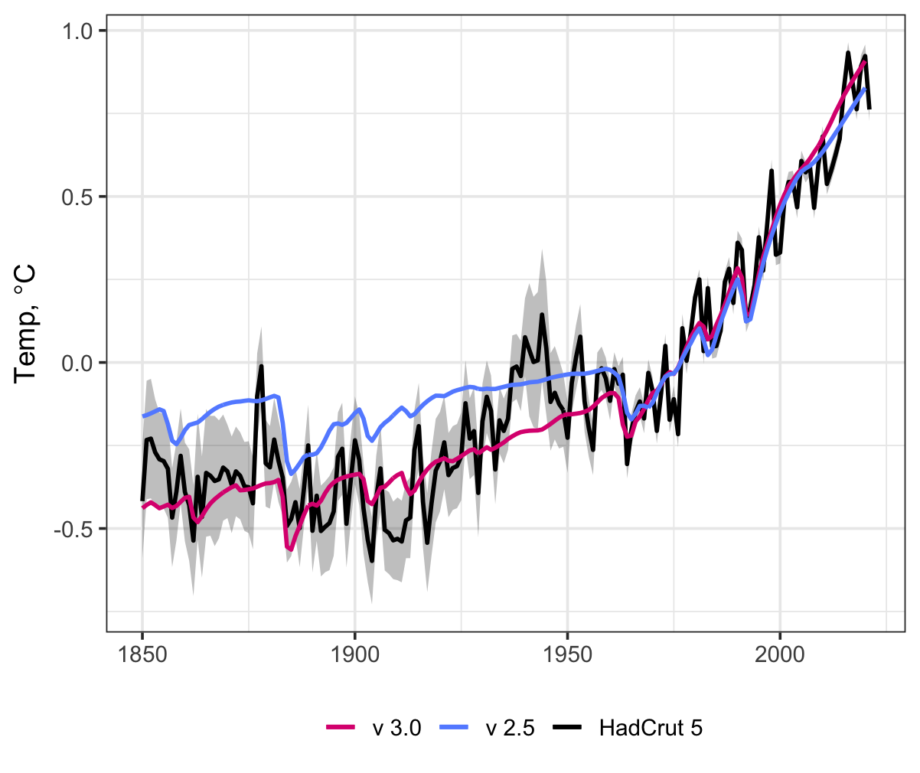
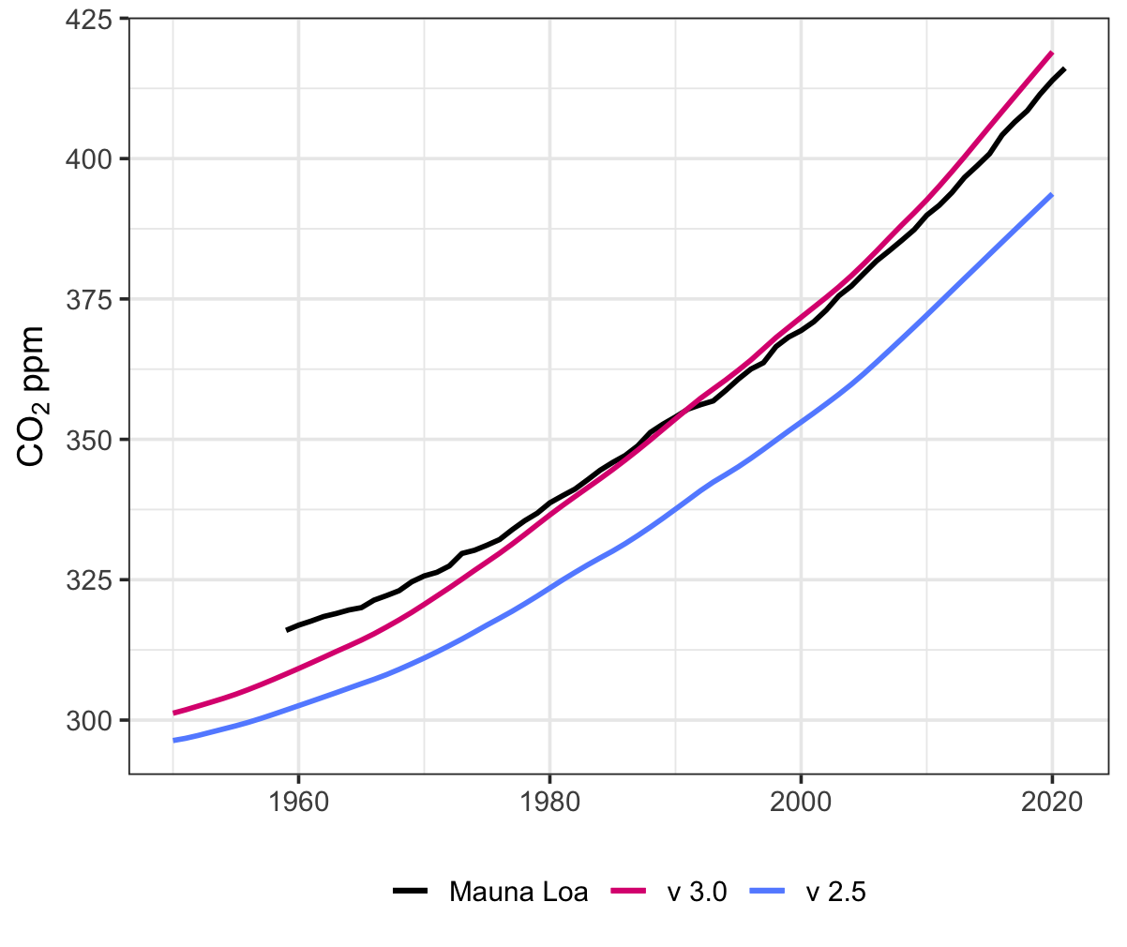
Hector vs. Observations
Temperature
Atmospheric CO₂
Dorheim in prep.

Slide 8
Hector v3 coming soon
Currently available on https://github.com/jgcri/hector (v3_dev branch)
Expected v3 release summer 2022
Thanks to all the Hector developers over the years
Skylar Gering Corinne Hartin Robert Link Pralit Patel Stephanie Pennington Leeya Pressburger | Adria Schwarber Alexey Shiklomanov Steve Smith Ben Vega-Westhoff Chris Vernon Dawn Woodard

Slide 9
Questions?
https://github.com/jgcri/hector
kalyn.dorheim@pnnl.gov

