Slide 1

Contribution of SLR to combined hlSST+SLR solutions for bridging the gap between GRACE and GRACE Follow-On
S. Ebadi¹, M. Weigelt¹, A. Jäggi² , U. Meyer², D. Arnold², T. Mayer-Gürr³
1) Institute of Geodesy, Leibniz Universität Hannover
2) Astronomical Insitute, University Bern
3) Institute of Geodesy, Graz University of Technology
26 May 2022

Slide 2

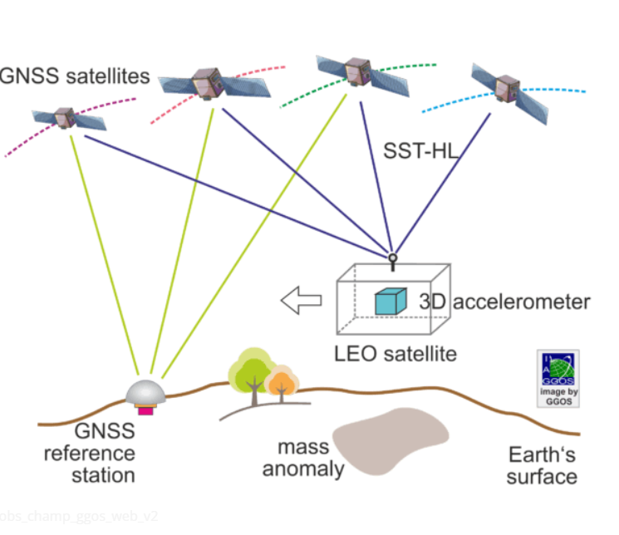
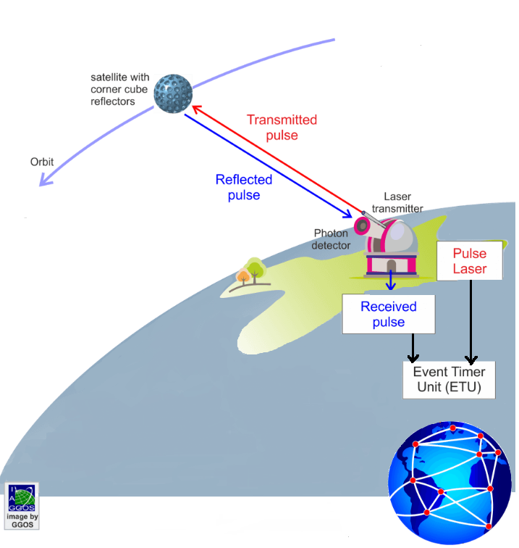
Motivation
Find the best combination of hlSST and SLR data
hlSST
(high-low Satellite to Satellite Tracking)
SLR
(Satellite Laser Ranging)
Sahar Ebadi et al., EGU22-6526

Slide 3
Methodology
Combination on the normal equation level
N Normal matrix
y The contribution of the observations
Weighting factor
Variance Component Estimation (VCE)
Unit weighting
Sahar Ebadi et al., EGU22-6526

Slide 4
Combination with Unit weighting
Ocean RMS after reducing climatology
year
Sahar Ebadi et al., EGU22-6526

Slide 5
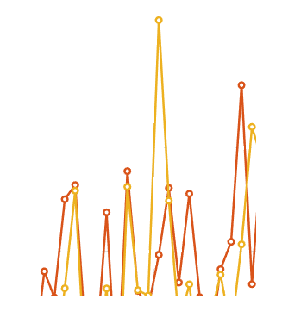
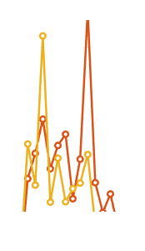
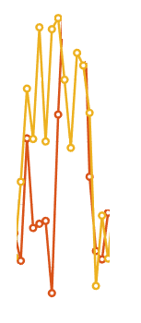
Combination with Unit weighting
Ocean RMS after reducing climatology
year
Sahar Ebadi et al., EGU22-6526

Slide 6
Combination with Unit weighting
Ocean RMS after reducing climatology
Because of the Peaks,
Unit Weighting fails
year
Sahar Ebadi et al., EGU22-6526

Slide 7
Combination with VCE
year
Sahar Ebadi et al., EGU22-6526

Slide 8
Combination with VCE
year
Sahar Ebadi et al., EGU22-6526

Slide 9
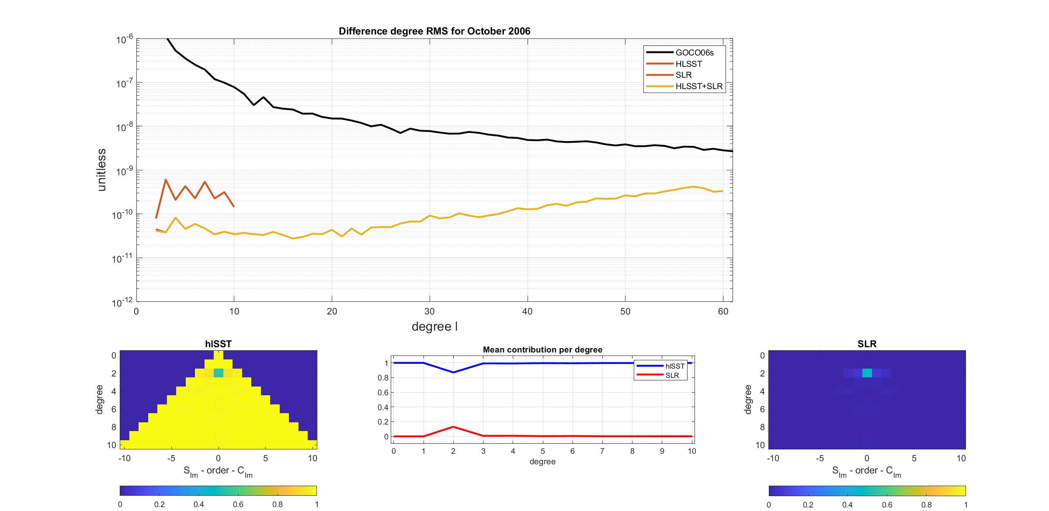
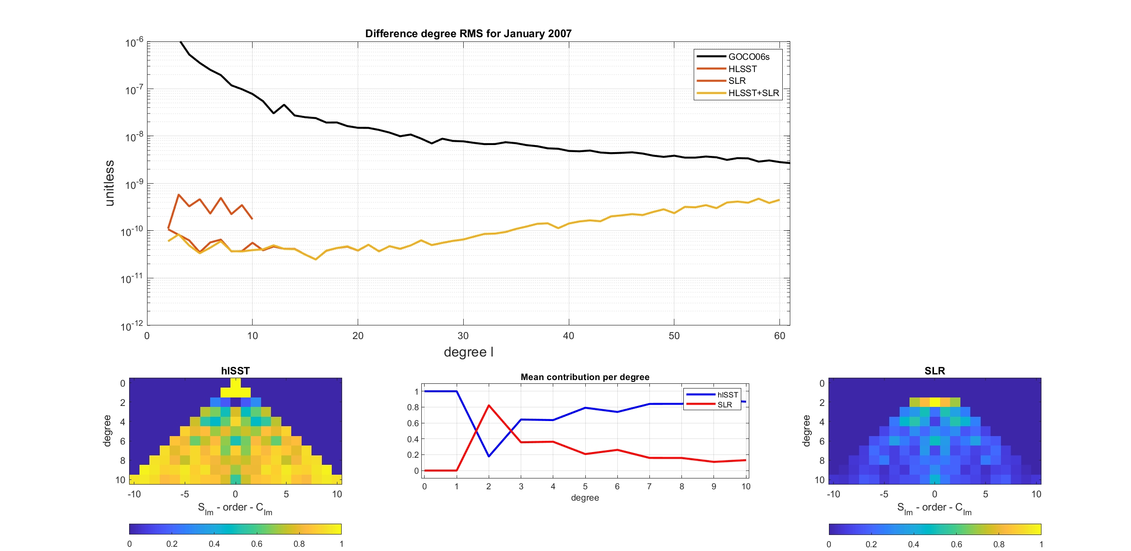
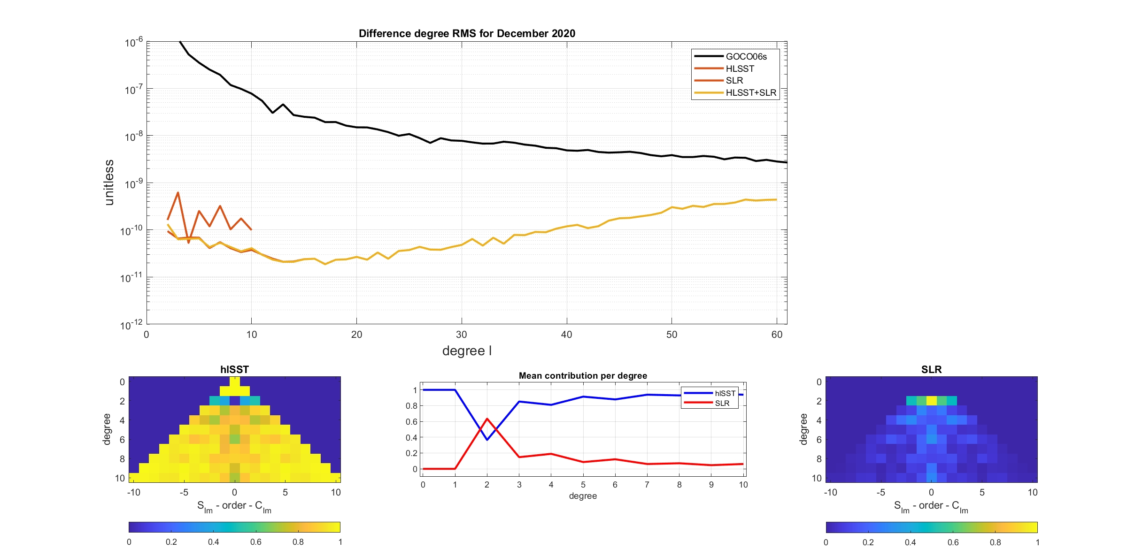
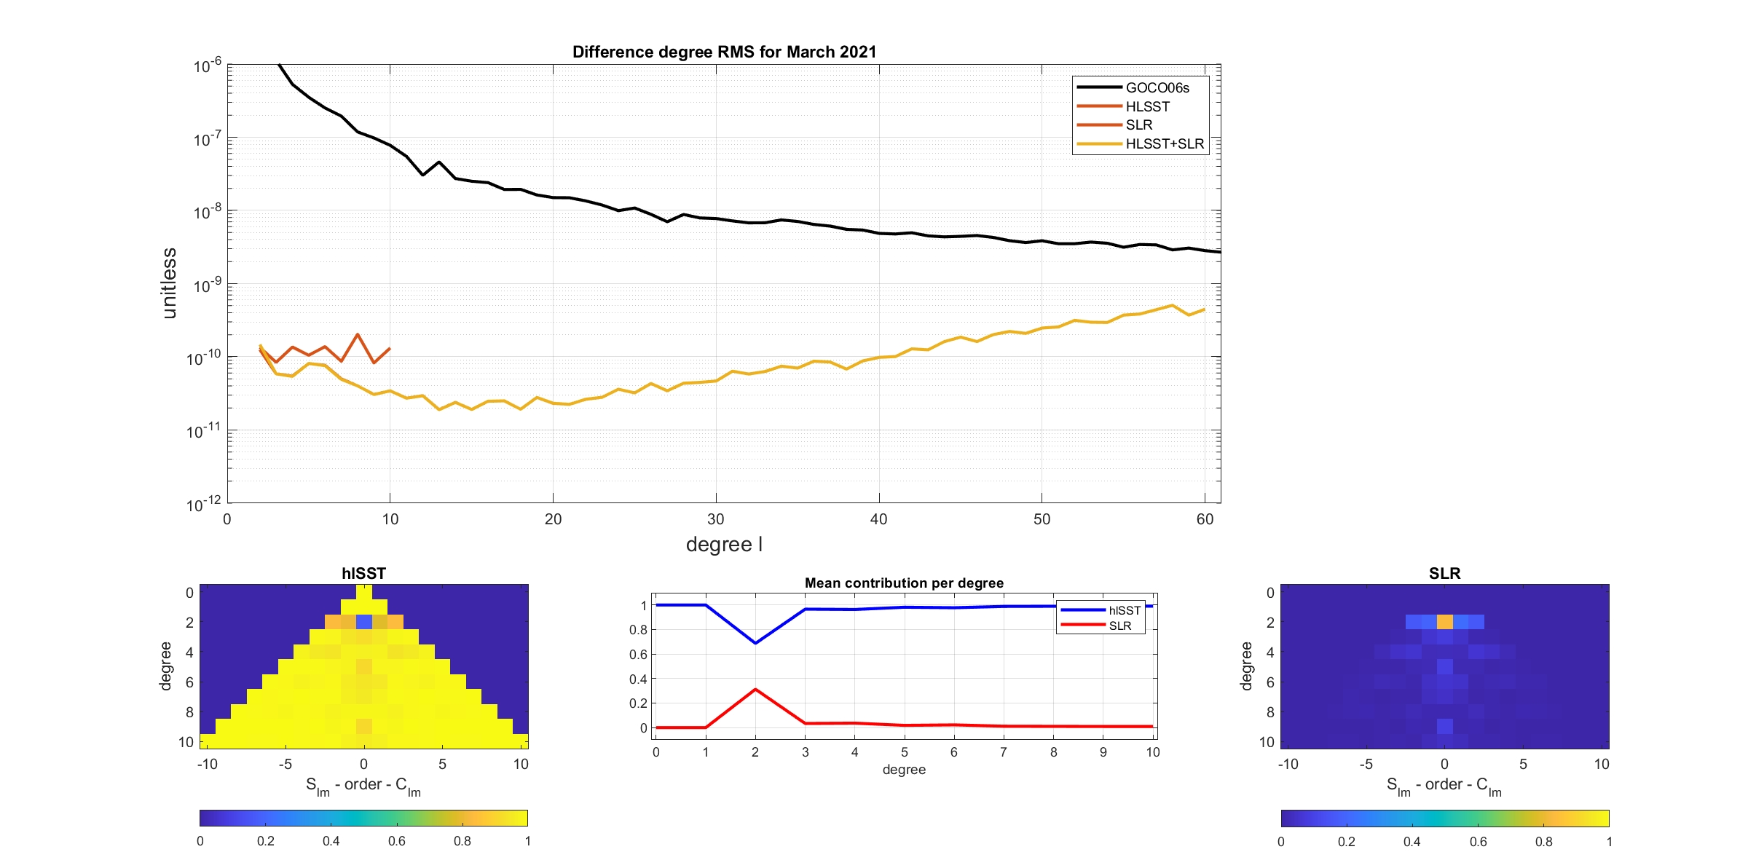
Relative contribution with VCE
Oct 2006
Jan 2007
Dec 2020
March 2021
Sahar Ebadi et al., EGU22-6526

Slide 10
Relative contribution with VCE
Because of neglecting correlation in the error information of the SLR data,
VCE fails
Oct 2006
Jan 2007
Dec 2020
March 2021
Sahar Ebadi et al., EGU22-6526

Slide 11
Methodology
Combination on the normal equation level
N Normal matrix
y The contribution of the observations
Weighting factor
Variance Component Estimation (VCE)
Ocean RMS
Unit weighting
Sahar Ebadi et al., EGU22-6526

Slide 12
Methodology
Combination using empirical weighting factors based on the ocean RMS
,
,
SH coefficients
,
min
Ocean RMS
No
Ocean RMS
Yes
Select the best
Sahar Ebadi et al., EGU22-6526

Slide 13
Combination with Ocean RMS
year
Sahar Ebadi et al., EGU22-6526

Slide 14

Relative contribution with Ocean RMS
Sahar Ebadi et al., EGU22-6526

Slide 15
Validation of the three solutions
Comparison between Unit Weighting, VCE and Ocean RMS
year
Sahar Ebadi et al., EGU22-6526

Slide 16
Conclusions
The best combination is provided by Ocean RMS method; although that is an empirical method, but it works!
Finally, we could bridge the data gap between GRACE and GRACE Follow-On.
Data available at
Combined hlSST+SLR solution:
https://seafile.cloud.uni-hannover.de/f/e55646a0dd484dfca428/?dl=1
year
Sahar Ebadi et al., EGU22-6526

