Slide 1




Thermal History of Miocene – Pliocene strata in the Well LKB, Kutei Basin, Indonesia
Jamaluddin^{1,2}*, Michael Wagreich¹, Mostafa Mohamed Sayed^{1,3}
¹Department of Geology, University of Vienna, Vienna, 1090, Austria
²Geological Engineering Study Program, Sekolah Tinggi Teknologi Migas Balikpapan, Indonesia
³Geology Department, Faculty of Science, Beni-Suef University, 65211, Egypt

Slide 2
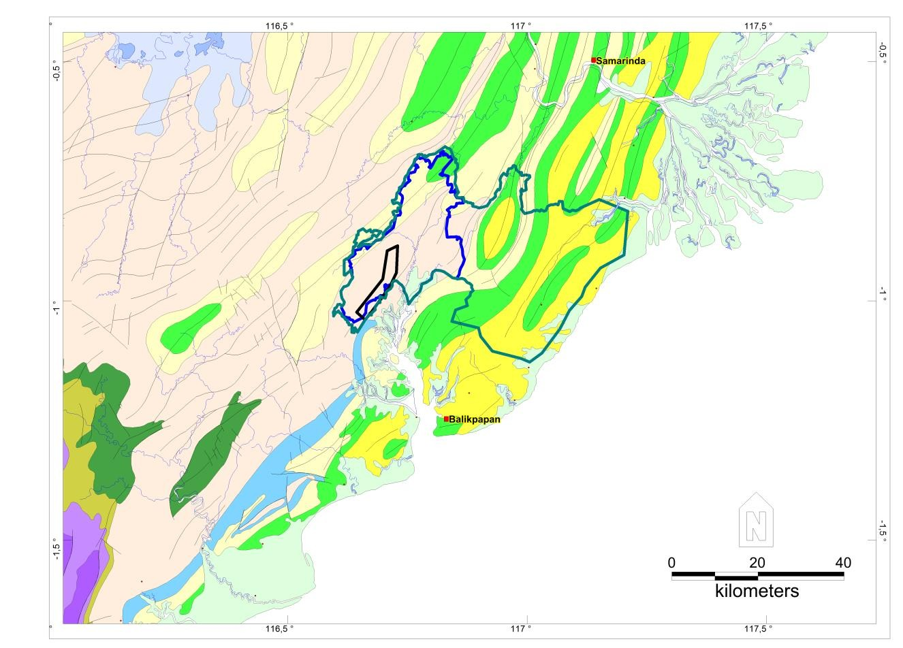
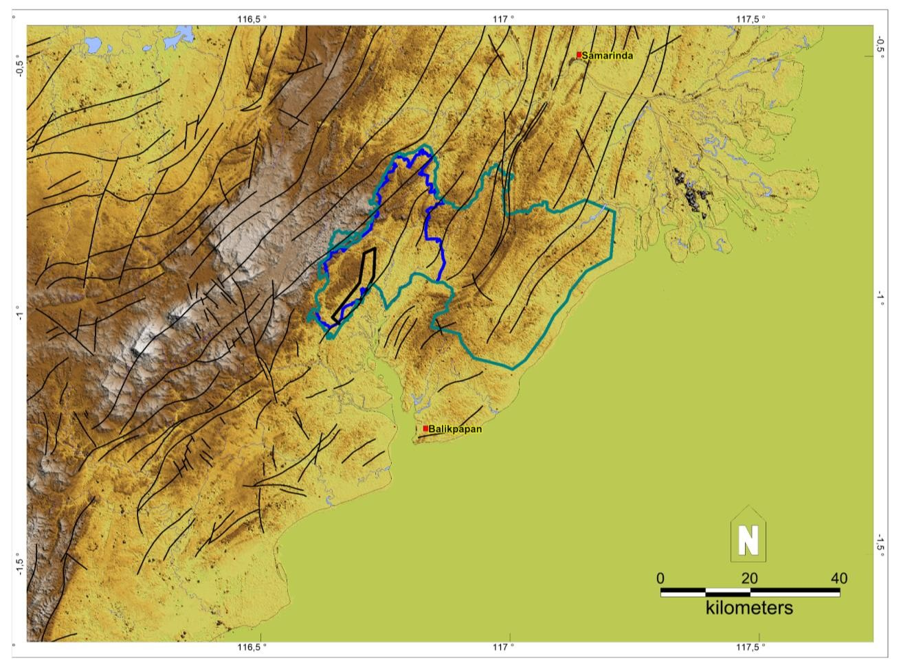
Geological background
(Tmbp)
(Tpkb)
(Tmpb)
(Tmbp)
Qa
(Tomp)
(Tomp(Tmpb)
(Tmbp)
(Tomp)
(Tmbp)
F. Kampung Baru (Tpkb)
F. Balikpapan (Tmbp)
(Tomp)
F. Pulau Balang (Tmpb)
(Tpkb)
F. Pamaluan (Tomp)
(Toty)
(Toty)
(Tet)
(Tmbl
B
F. Tuyu (Toty)
F. Tanjung (Tet)
Adang Fault
Pre-Tertiary
Qa
The Kutai Basin generally consists of three regional stratigraphic units of Eocene to recent age that formed a major regressive and transgressive cycle.
Regional geological map Lower Kutai Basin (Bachtiar, A., 2004)

Slide 3
The mean maximum vitrinite reflectance of the section ranges from 0.64% at 3,941 feet (±1200 m) to 0.77% at 6,759 feet (± 2060 m).
Maturity (%Ro) versus depth plot
Tmax. (°C) versus depth plot
Mature (Oil window)
Immature
Early Mature
Peak Mature

Slide 4
Maturity (%Ro) versus depth plot
The conventionally defined principal zone of oil generation (oil window) probably lies in the section from about 1066 to 3962 m.
The measured maximum formation temperature at
2286 m is 93,9 °C.
Assuming a surface temperature of 26 °C, the bottom hole temperature (BHT) corresponds to a geothermal gradient of 34,55 °C /km.
Mature (Oil window)

Slide 5
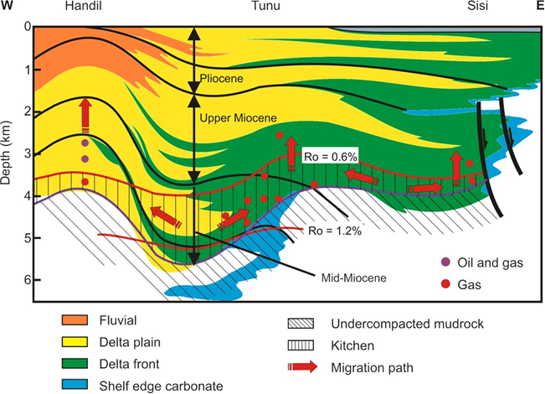
0
M
P
P
2000
4000
Depth (feet)
6000
Ro = 0.6 %
8000
Top of oil window
10000
12000
14000
16
14
12
10
8
6
4
2
0
Schematic of the Neogene petroleum system
(simplified from Duval et al., 1998).
Time (Ma)

Slide 6
Conclusions
The top of mature zone (Ro= 0.6%) is relatively shallow (906 m) and most likely coincides with the top of overpressure zone.
The average geothermal gradient calculated from the other five measurements is more normal by 38,5 °C /km.
The uplift in Anggana deep location was 1524 m in the hanging wall
The highest temperature gradient results from a single mesurement at depth of about 225 m which would indicate a geothermal gradient of 158,1 °C /km

Slide 7
Thank You

