Slide 1

A comparison of multi-criteria and machine learning weighting for flood risk assessment in Southern Ontario watersheds, Canada
Rahma Khalid, Usman T. Khan
EGU22 Session NH1.2 – Advances in Pluvial and Fluvial Flood Forecasting, Assessment and Flood risk management
May 23rd 2022

Slide 2

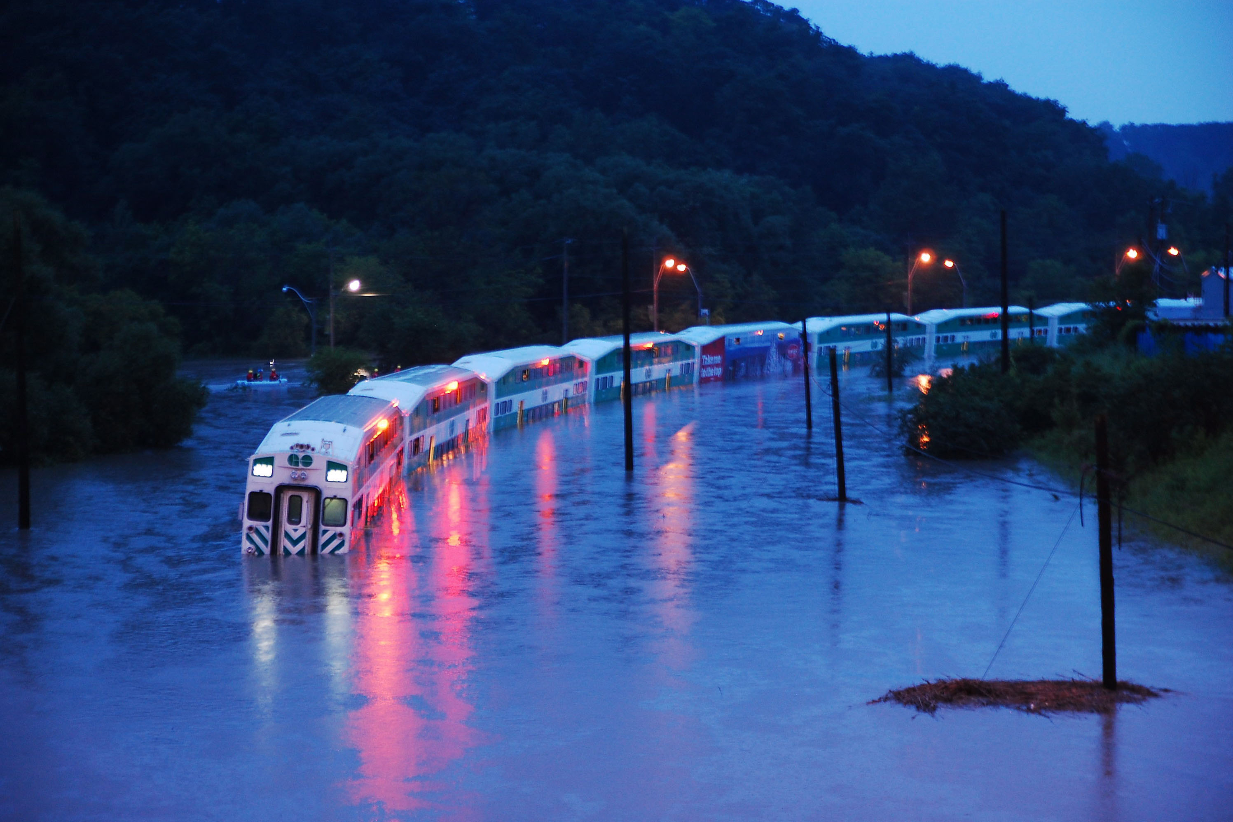

Toronto floods – hazard and risk
$65.2 million in damages
400,000 – 500,000 people without power
Notes:
Protect people and reduce damage to know where flooding is occurring – not just hazard but the risk to develop mitigation strategies
Floodplain maps – need to focus risk not just hazard to focus on socioeconomic data

Slide 3
Modelling flood occurrence
Flood risk modelling: integrates flood hazard with socioeconomic factors
Hazard modelling:
Multi-Criteria Decision Making models (MCDM)
Combines spatial data with stakeholder preference
Notes:
Fix figure to lock scale
Create another slide to show examples for AHP (explain AHP and entropy)
Include flood hazard AHP and flood entropy maps at the right
Animation – mention that the three are examples and not all inputs

Slide 4
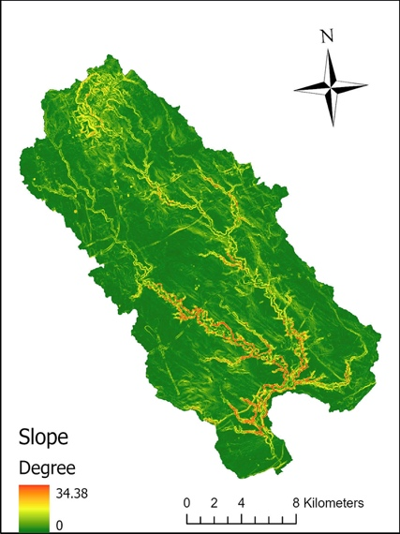
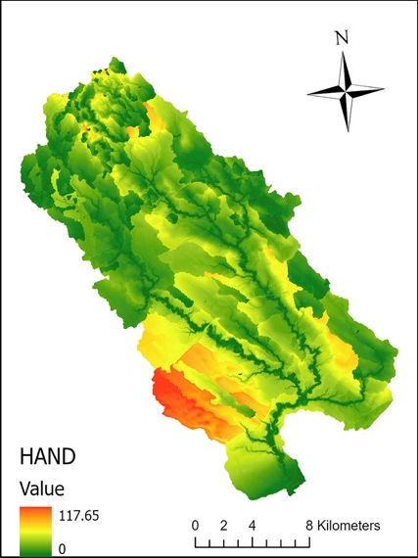
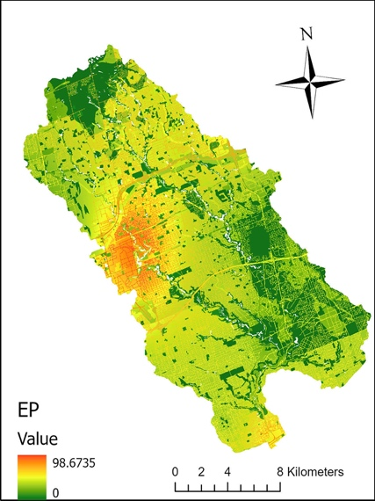
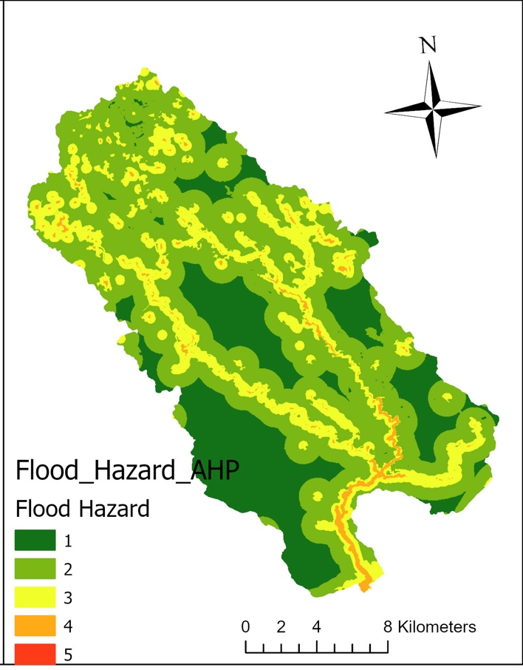
AHP – Most popular; Subjective
Slope
Height Above Nearest Drainage
Effective Precipitation
Flood Hazard by AHP

Slide 5
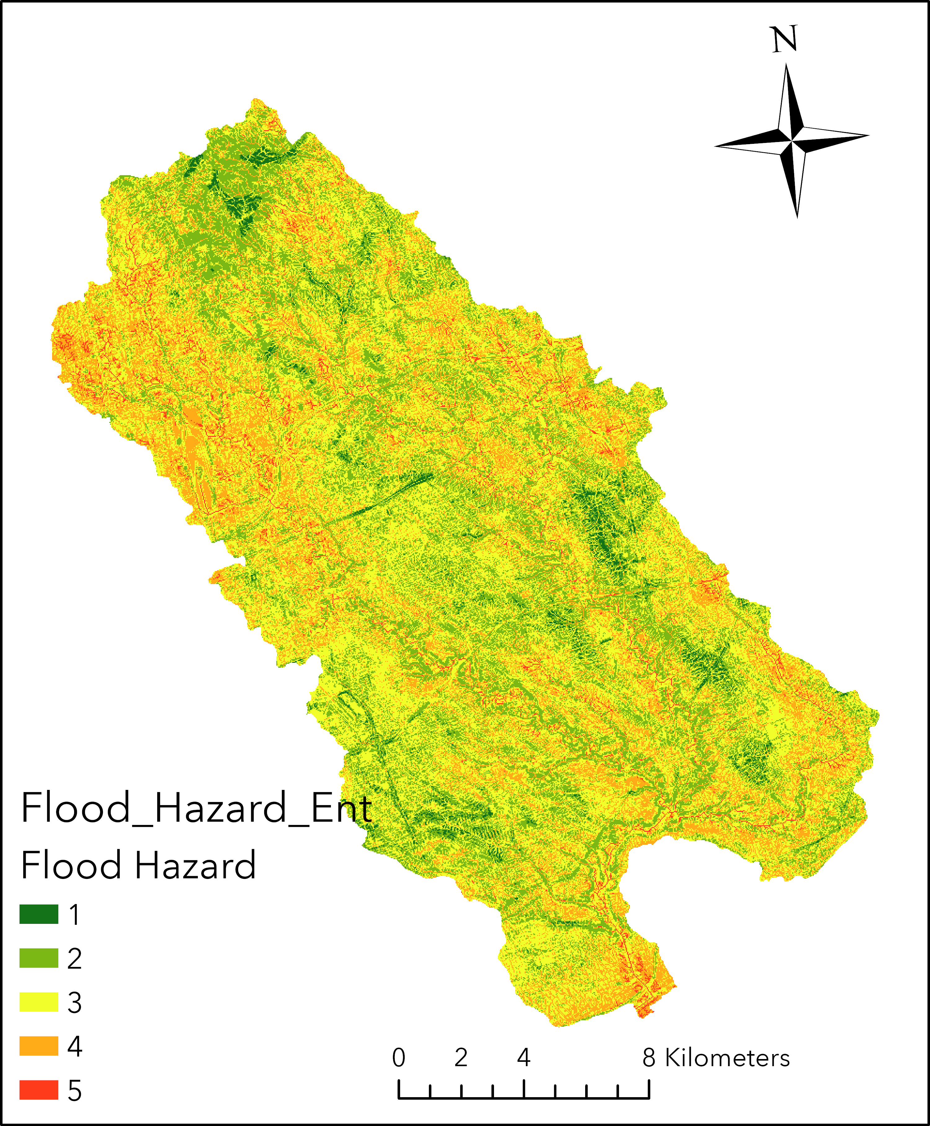
Entropy – Based on diversity in the dataset; Objective
Slope
Height Above Nearest Drainage
Effective Precipitation
Flood Hazard by Entropy

Slide 6
Flood hazard modelling
Multi-Criteria Decision Making models (MCDM)
Machine learning methods – ANN
Derives data-dependent relationships
Notes:
Insert flood hazard ANN figure
Took the data and did balancing – show confusion matrix or flood hazard and floodplain map comparison

Slide 7
Derives data-dependent relationships

Slide 8
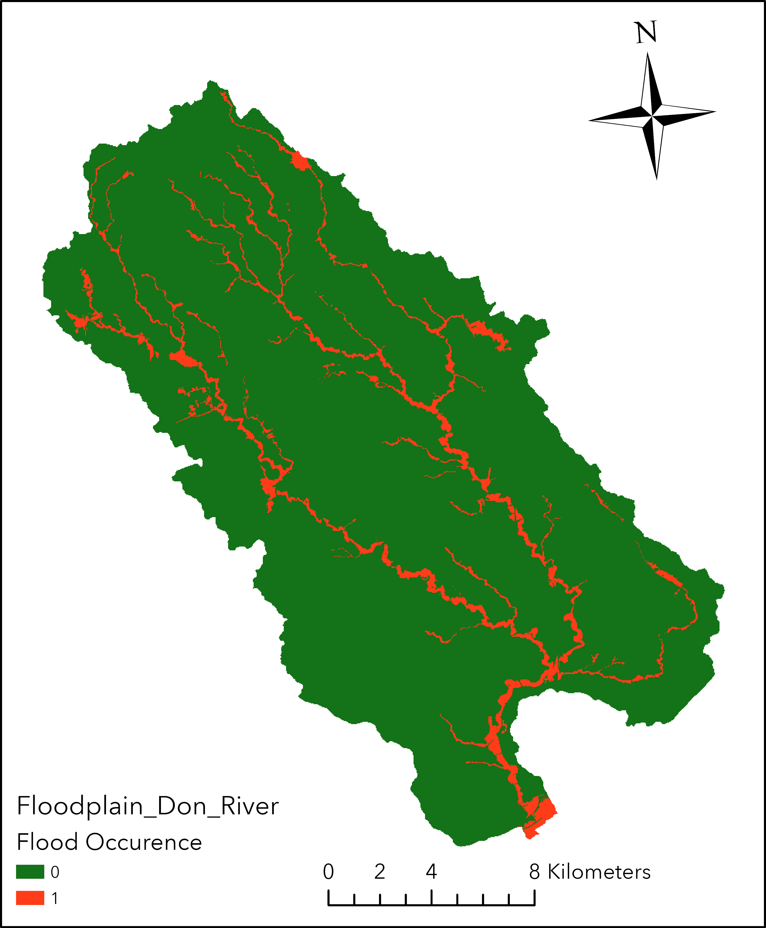
Derives data-dependent relationships
Supervised learning requires floodplain maps

Slide 9
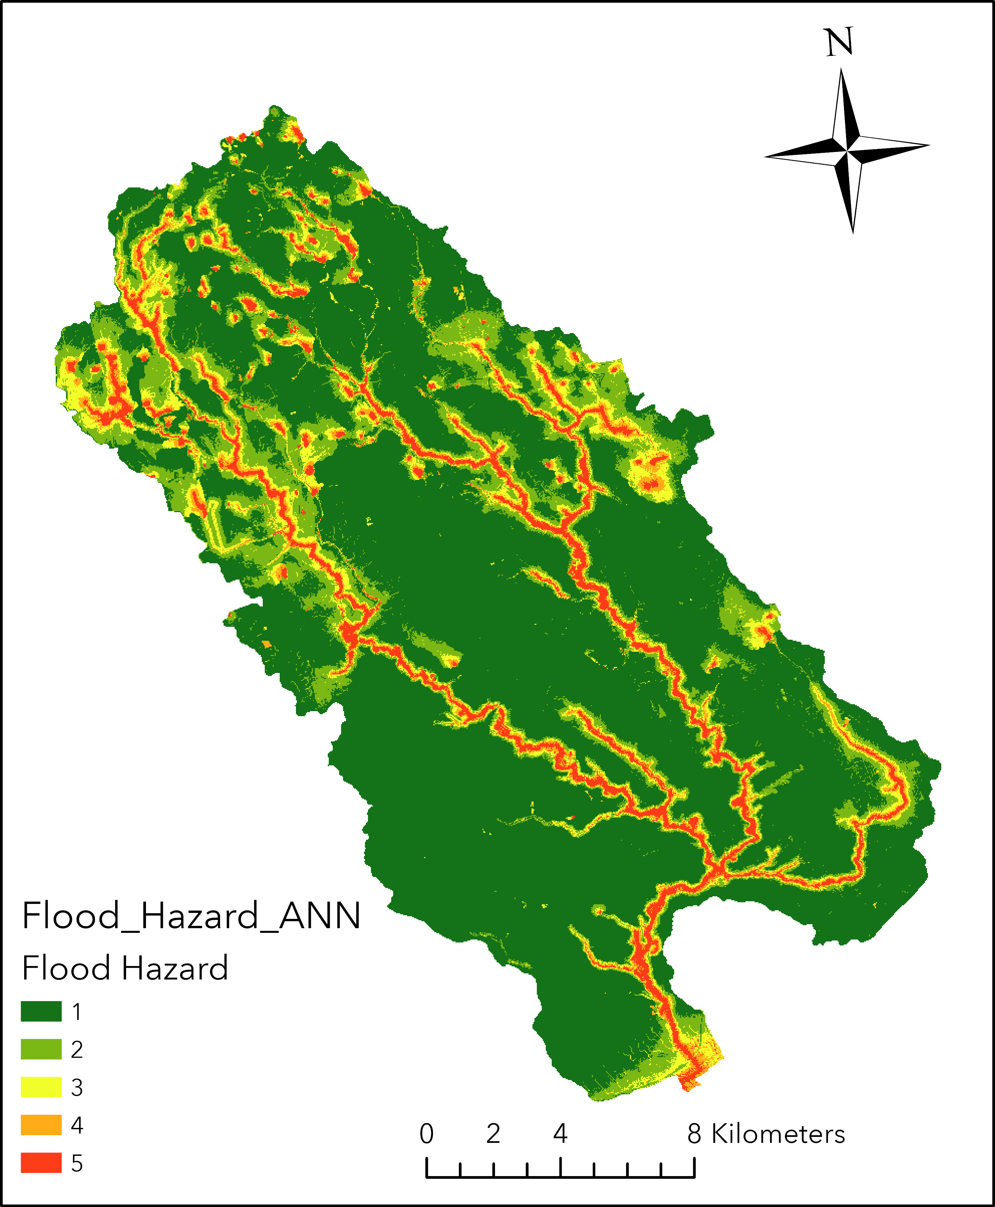

Slide 10
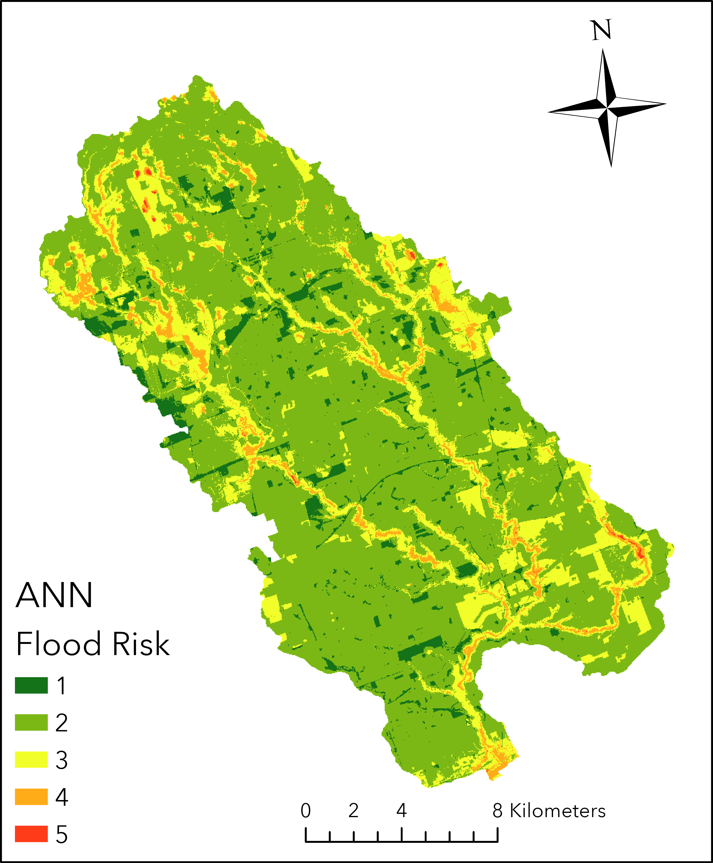
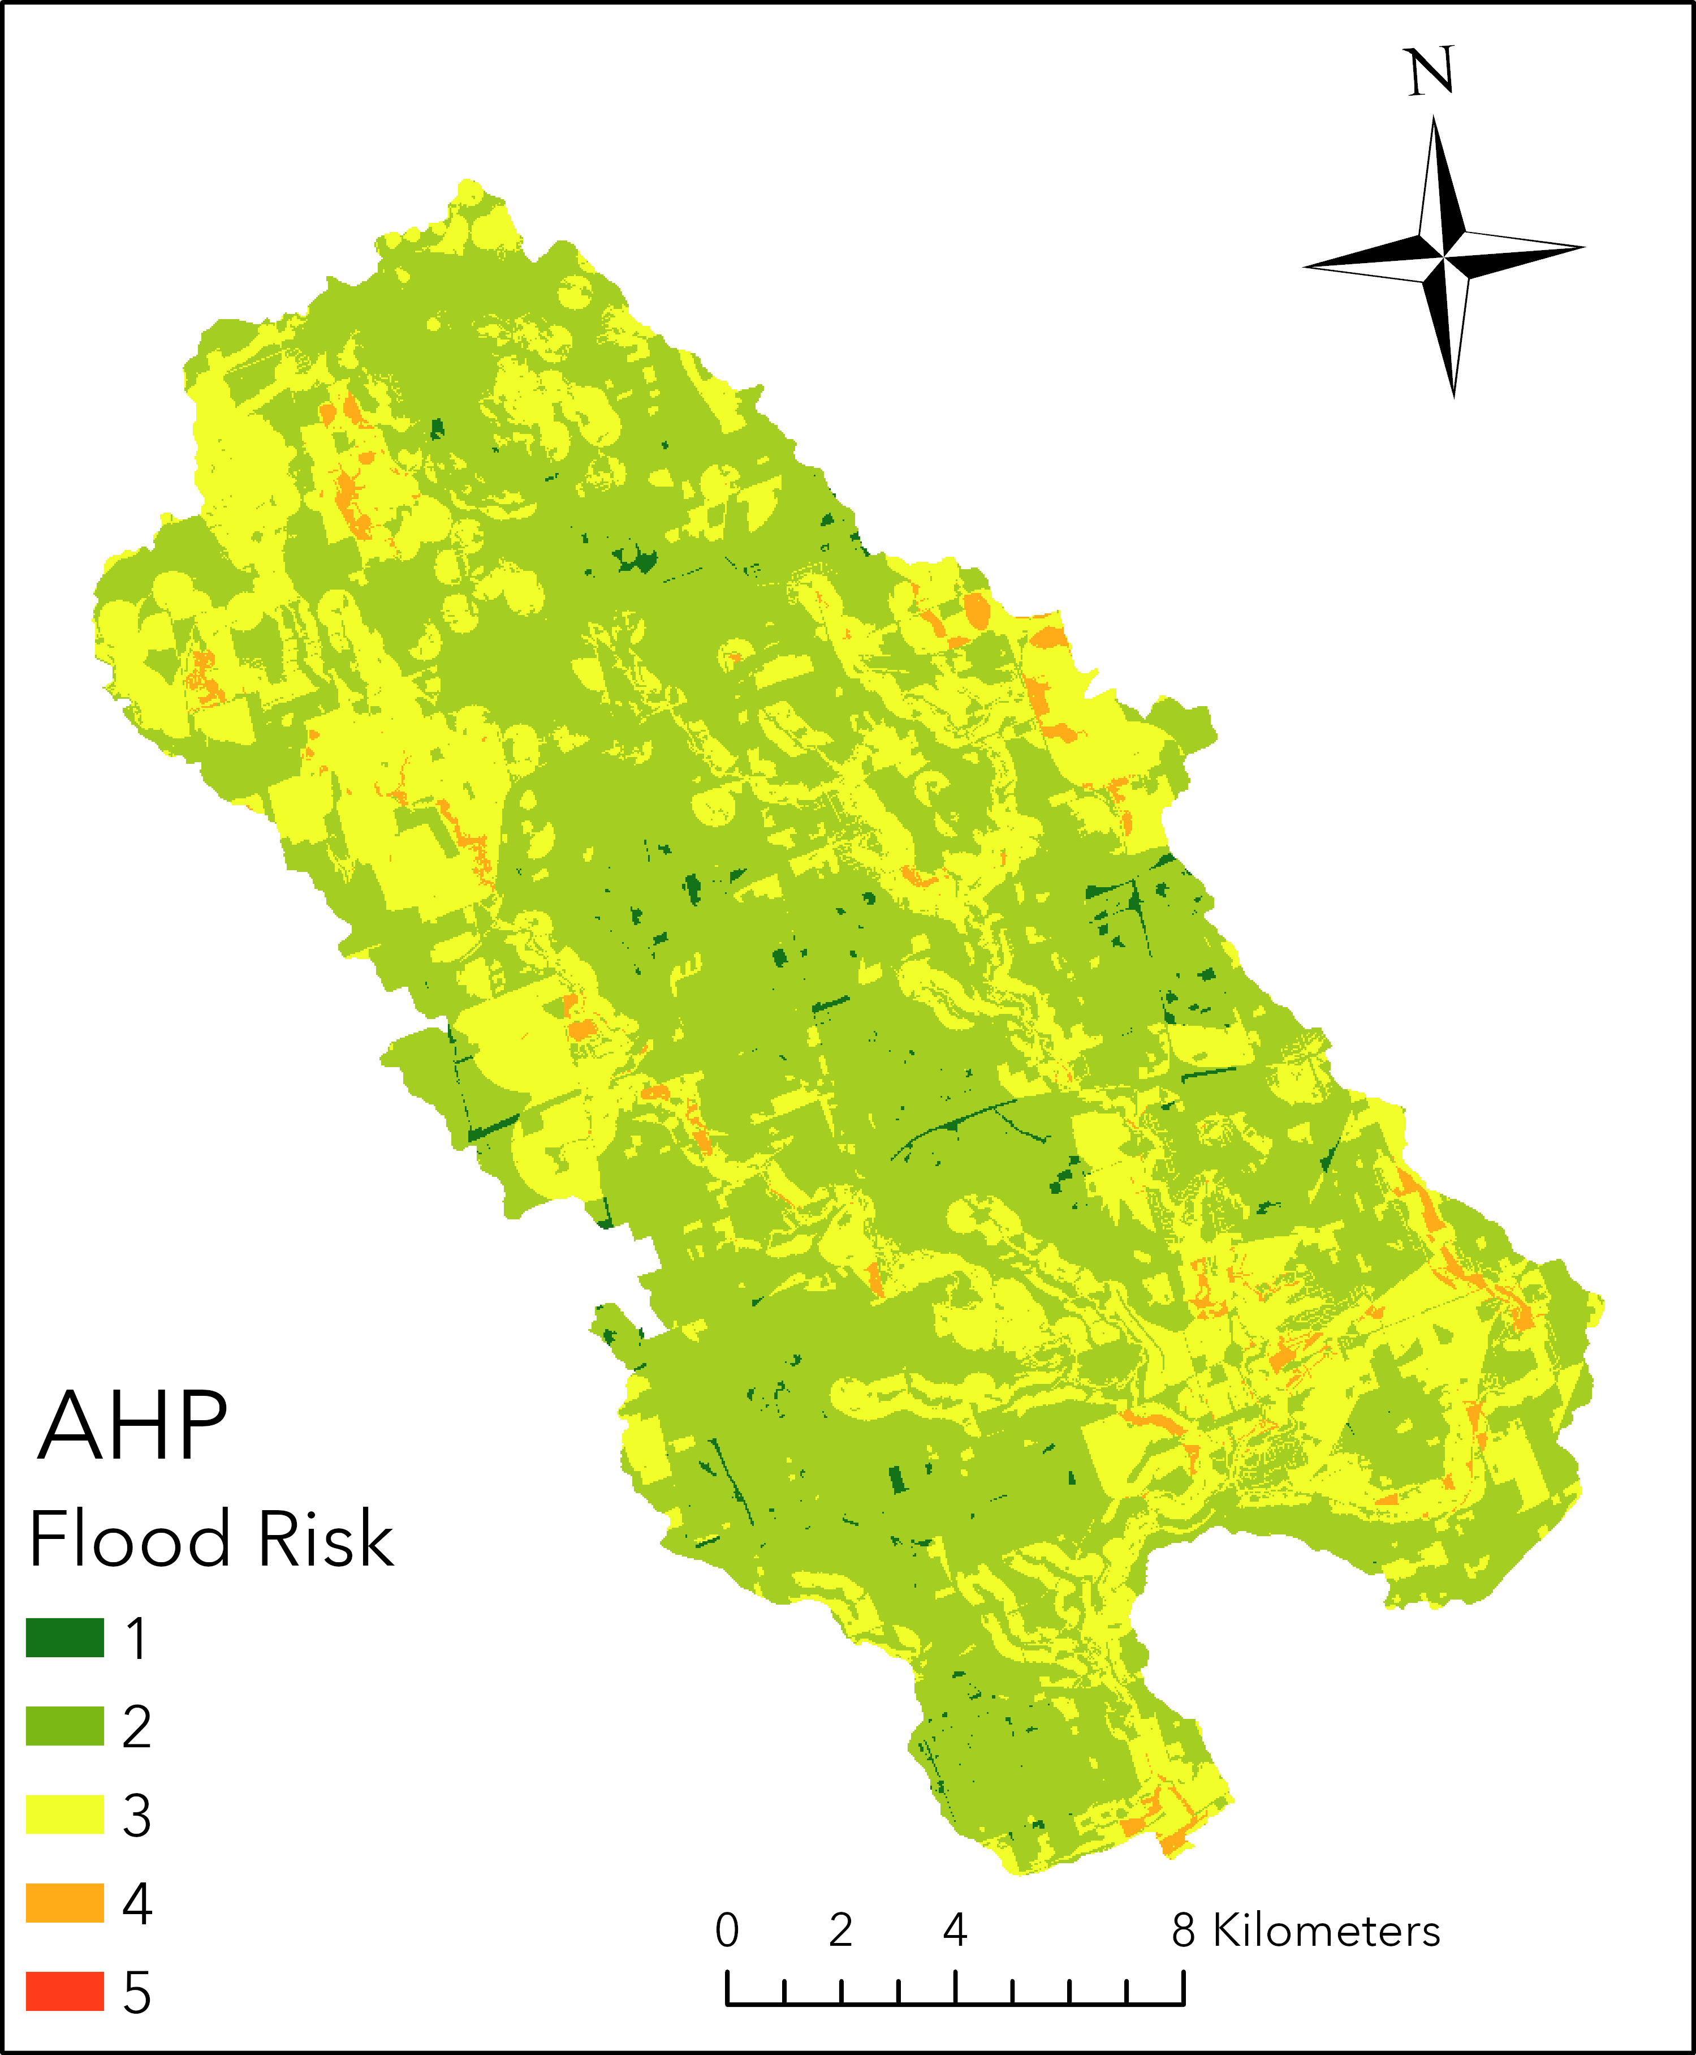
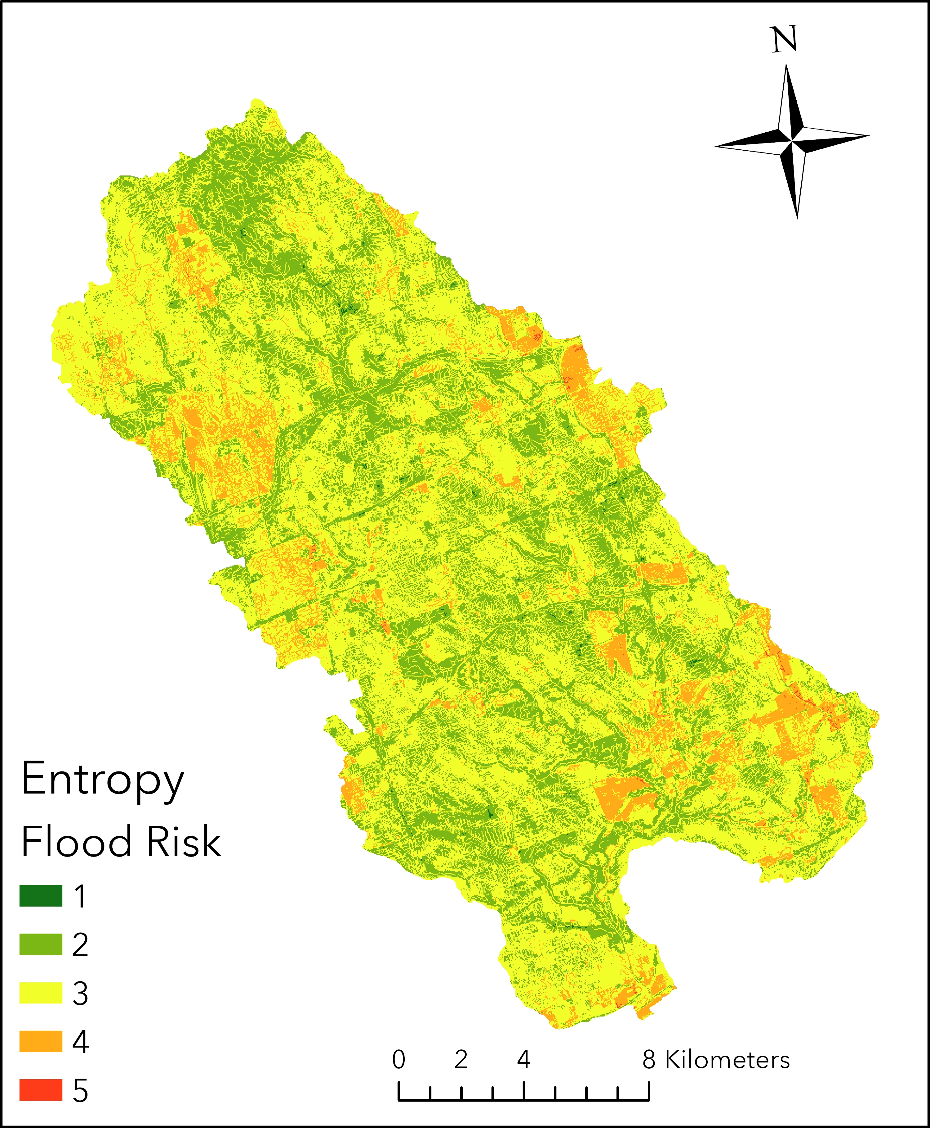
Flood Risk
Notes:
FOR ann : chosen :
HAND, DS, SLOPE, TWI, CN, EP – 1, 1, 0.94, 0.68, 0.58, 0.56
Explain the differences in the flood maps – what inputs and how do they differ across the maps.
Mention socioeconomic factors some
Give example of how ANN can be applied
Copy paste legend from ANN to include 5 in AHP

Slide 11
Conclusion
Flood risk incorporates hazard and socioeconomic factors
3 methods investigated – AHP, Entropy, ANN
ANN is objective and more computationally efficient
Future work:
Extend to other Southern Ontario watersheds
Incorporate climate change into flood risk modelling
Notes:
Insert flood hazard ANN figure
Took the data and did balancing – show confusion matrix or flood hazard and floodplain map comparison

Slide 12
Thank you
Rahma Khalid – rshakir@my.yorku.ca

Slide 13


Acknowledgments

Slide 14
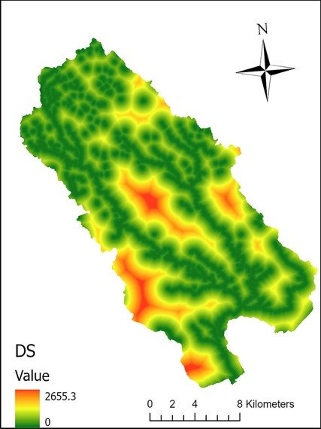
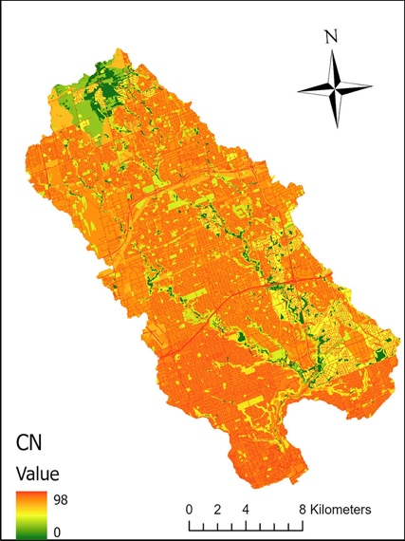
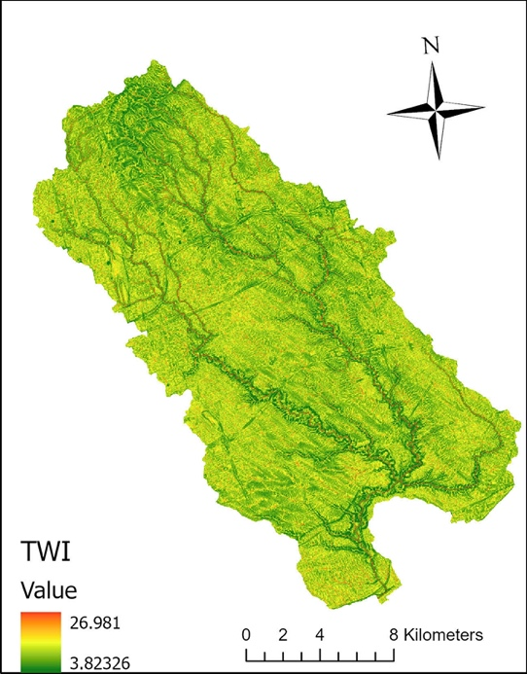
Additional environmental inputs
Distance to Streams
Curve Number
Topographic Wetness Index

Slide 15
Social vulnerability indicators
Economic vulnerability indicators
Demographic indicator | Specific Indicators
Demographic indicators | People 85 year and older
 | Children 4 years and younger
 | Lone parents
Socioeconomic status | Non-English or French-speaking people
 | People with low Income
 | High school education or less
Land tenure | Rented apartments
Neighborhood characteristics | Population density per km²
Vulnerability indicator | Specific Indicators
Very high | Resource and Industrial
High | Commercial
Medium | Governmental and institutional
Low | Residential
Very low | Parks and recreational
 | Open spaces

Slide 16
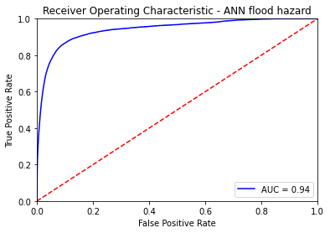
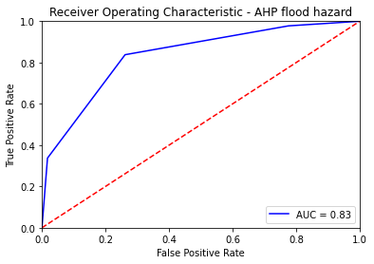
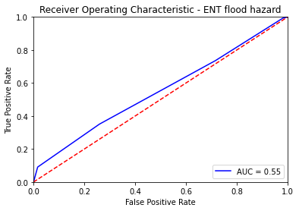
ROC results
Notes:
FOR ann : chosen :
HAND, DS, SLOPE, TWI, CN, EP – 1, 1, 0.94, 0.68, 0.58, 0.56
Explain the differences in the flood maps – what inputs and how do they differ across the maps.
Mention socioeconomic factors some
Give example of how ANN can be applied
Copy paste legend from ANN to include 5 in AHP

