Slide 1
Examination of magnetic map variability and uncertainty: crustal magnetic anomalies in oceanic areas
EGU22 – Vienna
Rick Saltus¹, Arnaud Chulliat¹, Brian Meyer¹, Martin Bates²
Good maps need uncertainty
Sources of magnetic map uncertainty
A methodology for propagated uncertainty
A test of the method – the Caribbean experiment
What to do next
¹CIRES, ²Sander Geophysics

Slide 2

All Maps are Wrong
All Magnetic Maps are Wrong

Slide 3
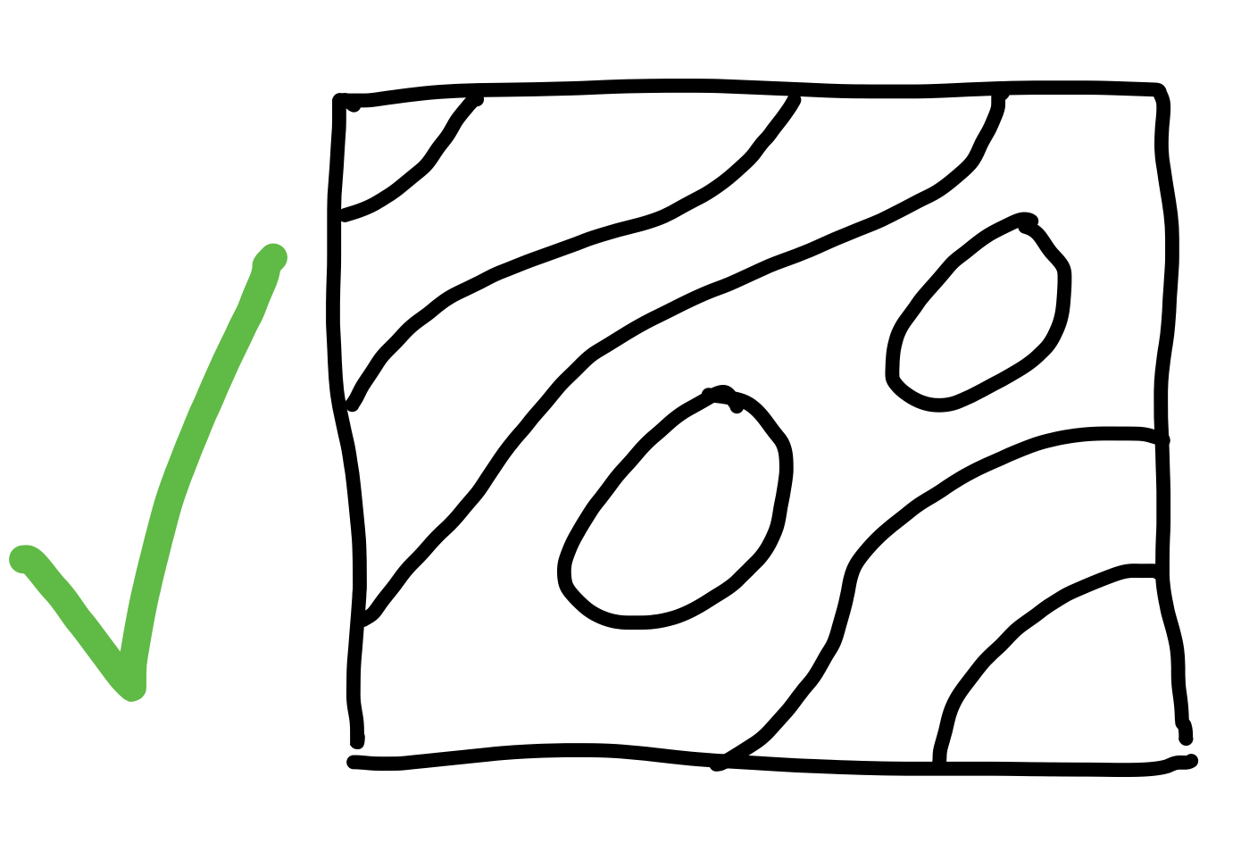
It Depends on What You Need
Some Maps are Useful

Slide 4
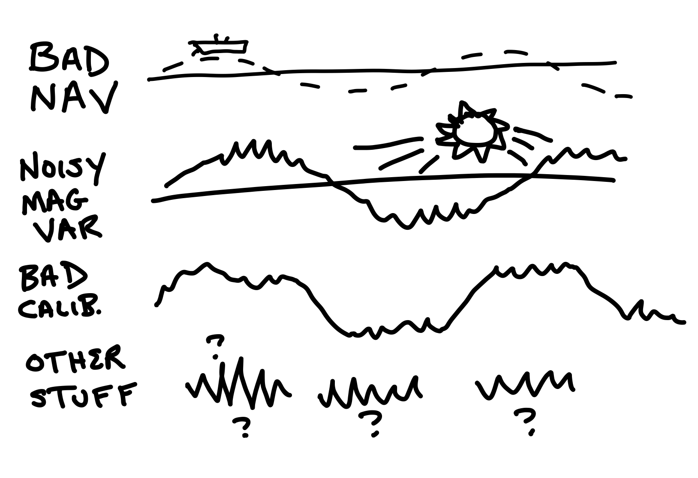
Sources of Magnetic Uncertainty
Why Are They Wrong?

Slide 5
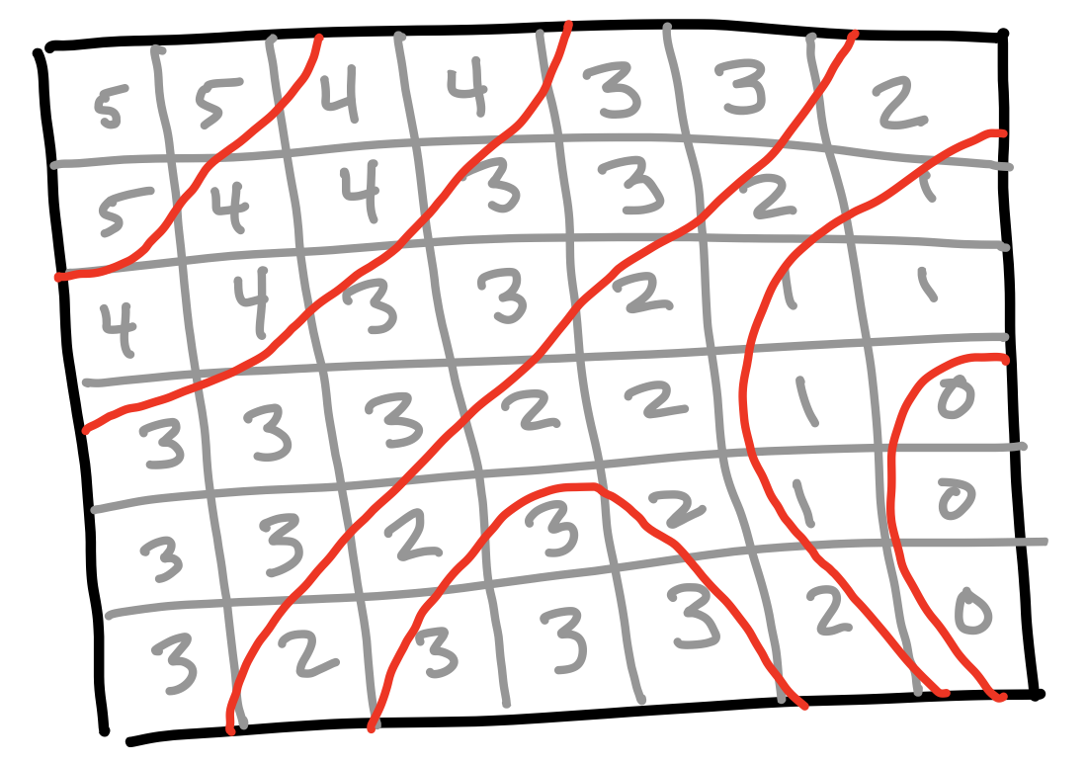
What are Grid Cell Values?
Maps are Drawn From Grids

Slide 6
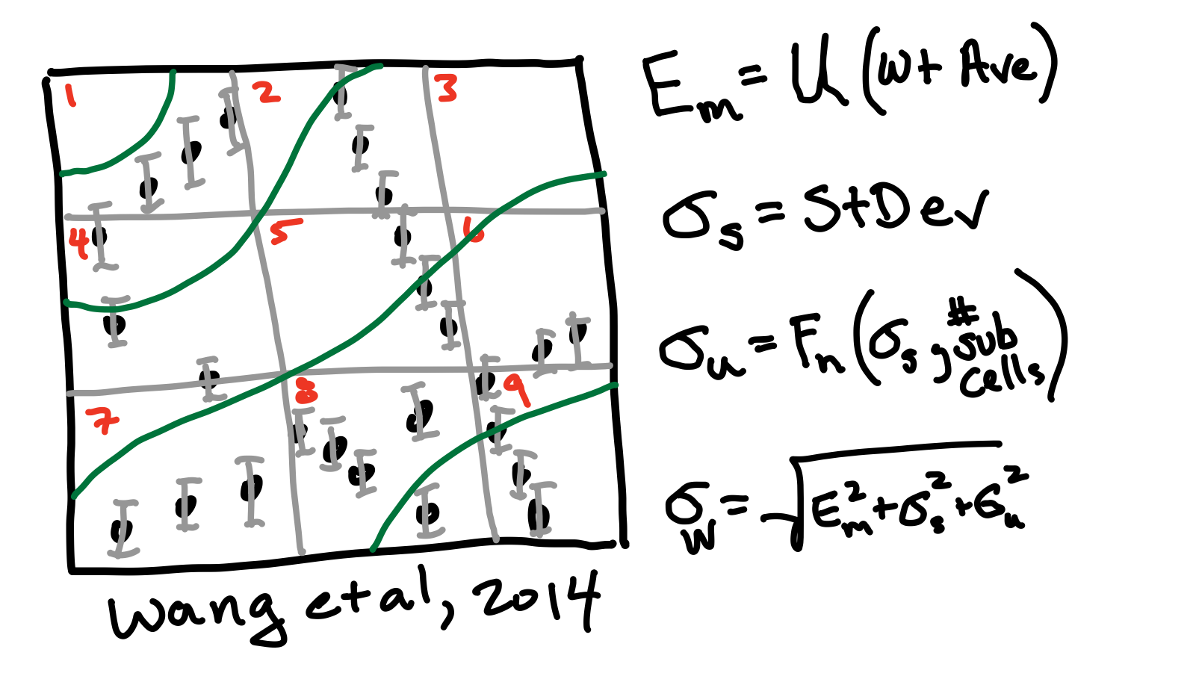
Some Grid Cells Have Data
Uncertainty From Data Stats

Slide 7
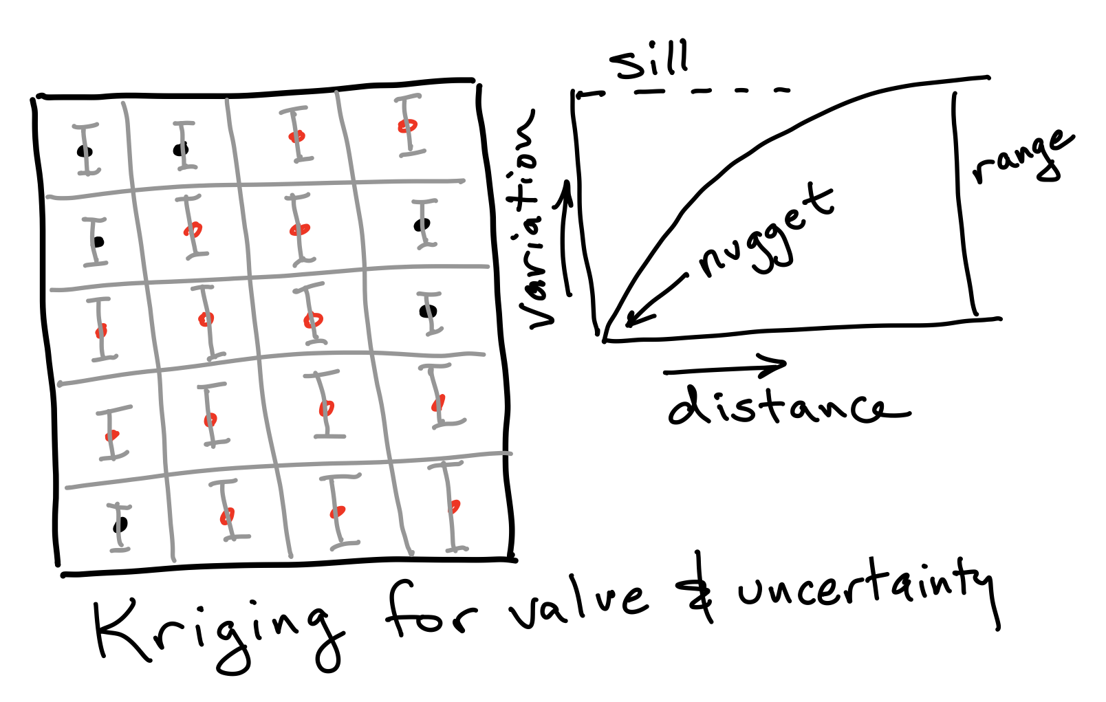
Some Grid Cells are Empty
Uncert. from Dist. and Variogram

Slide 8
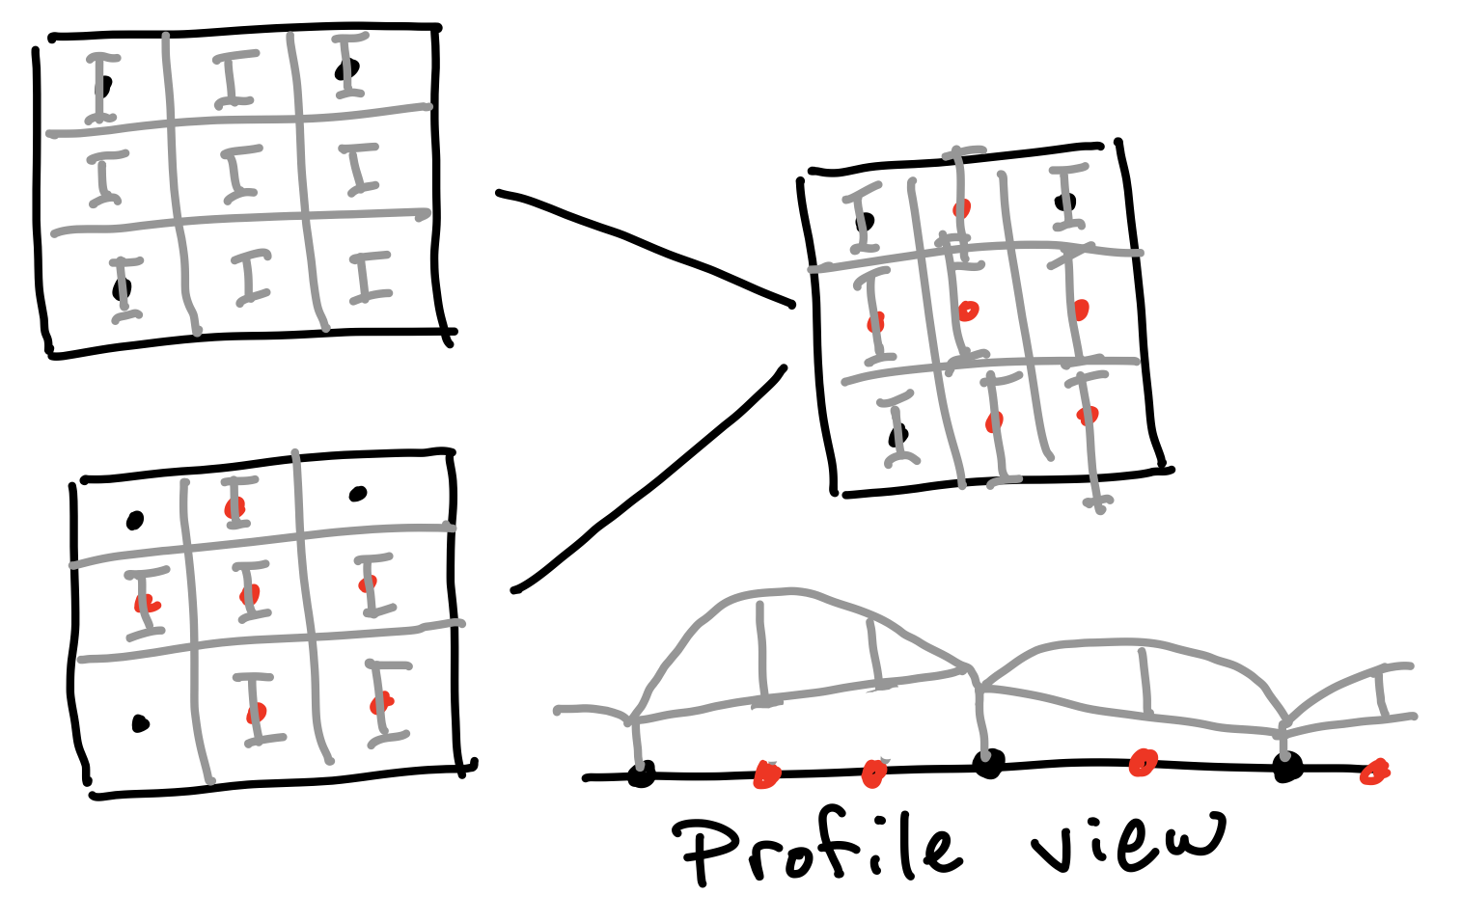
Add Up Uncertainties
Grid Cell Uncert Lifts Kriging Estimate

Slide 9
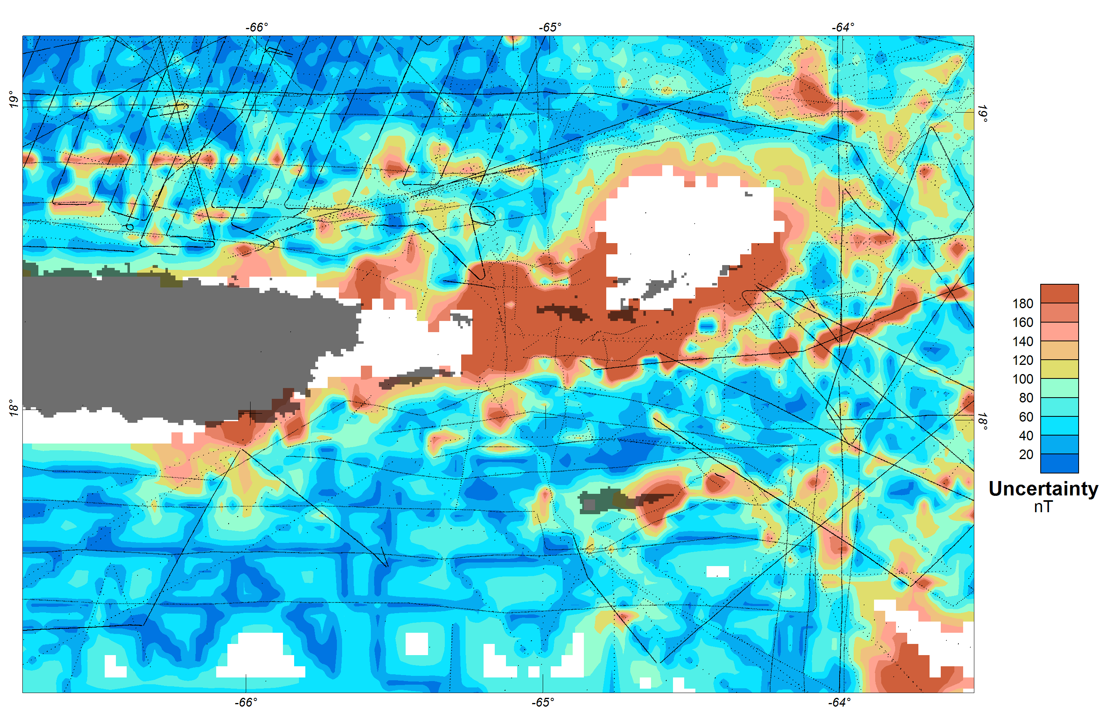
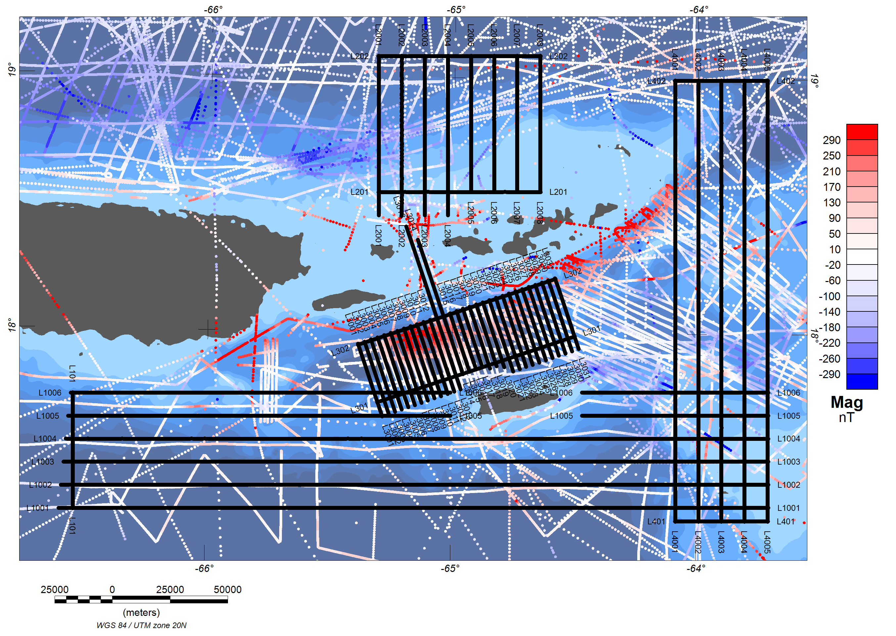
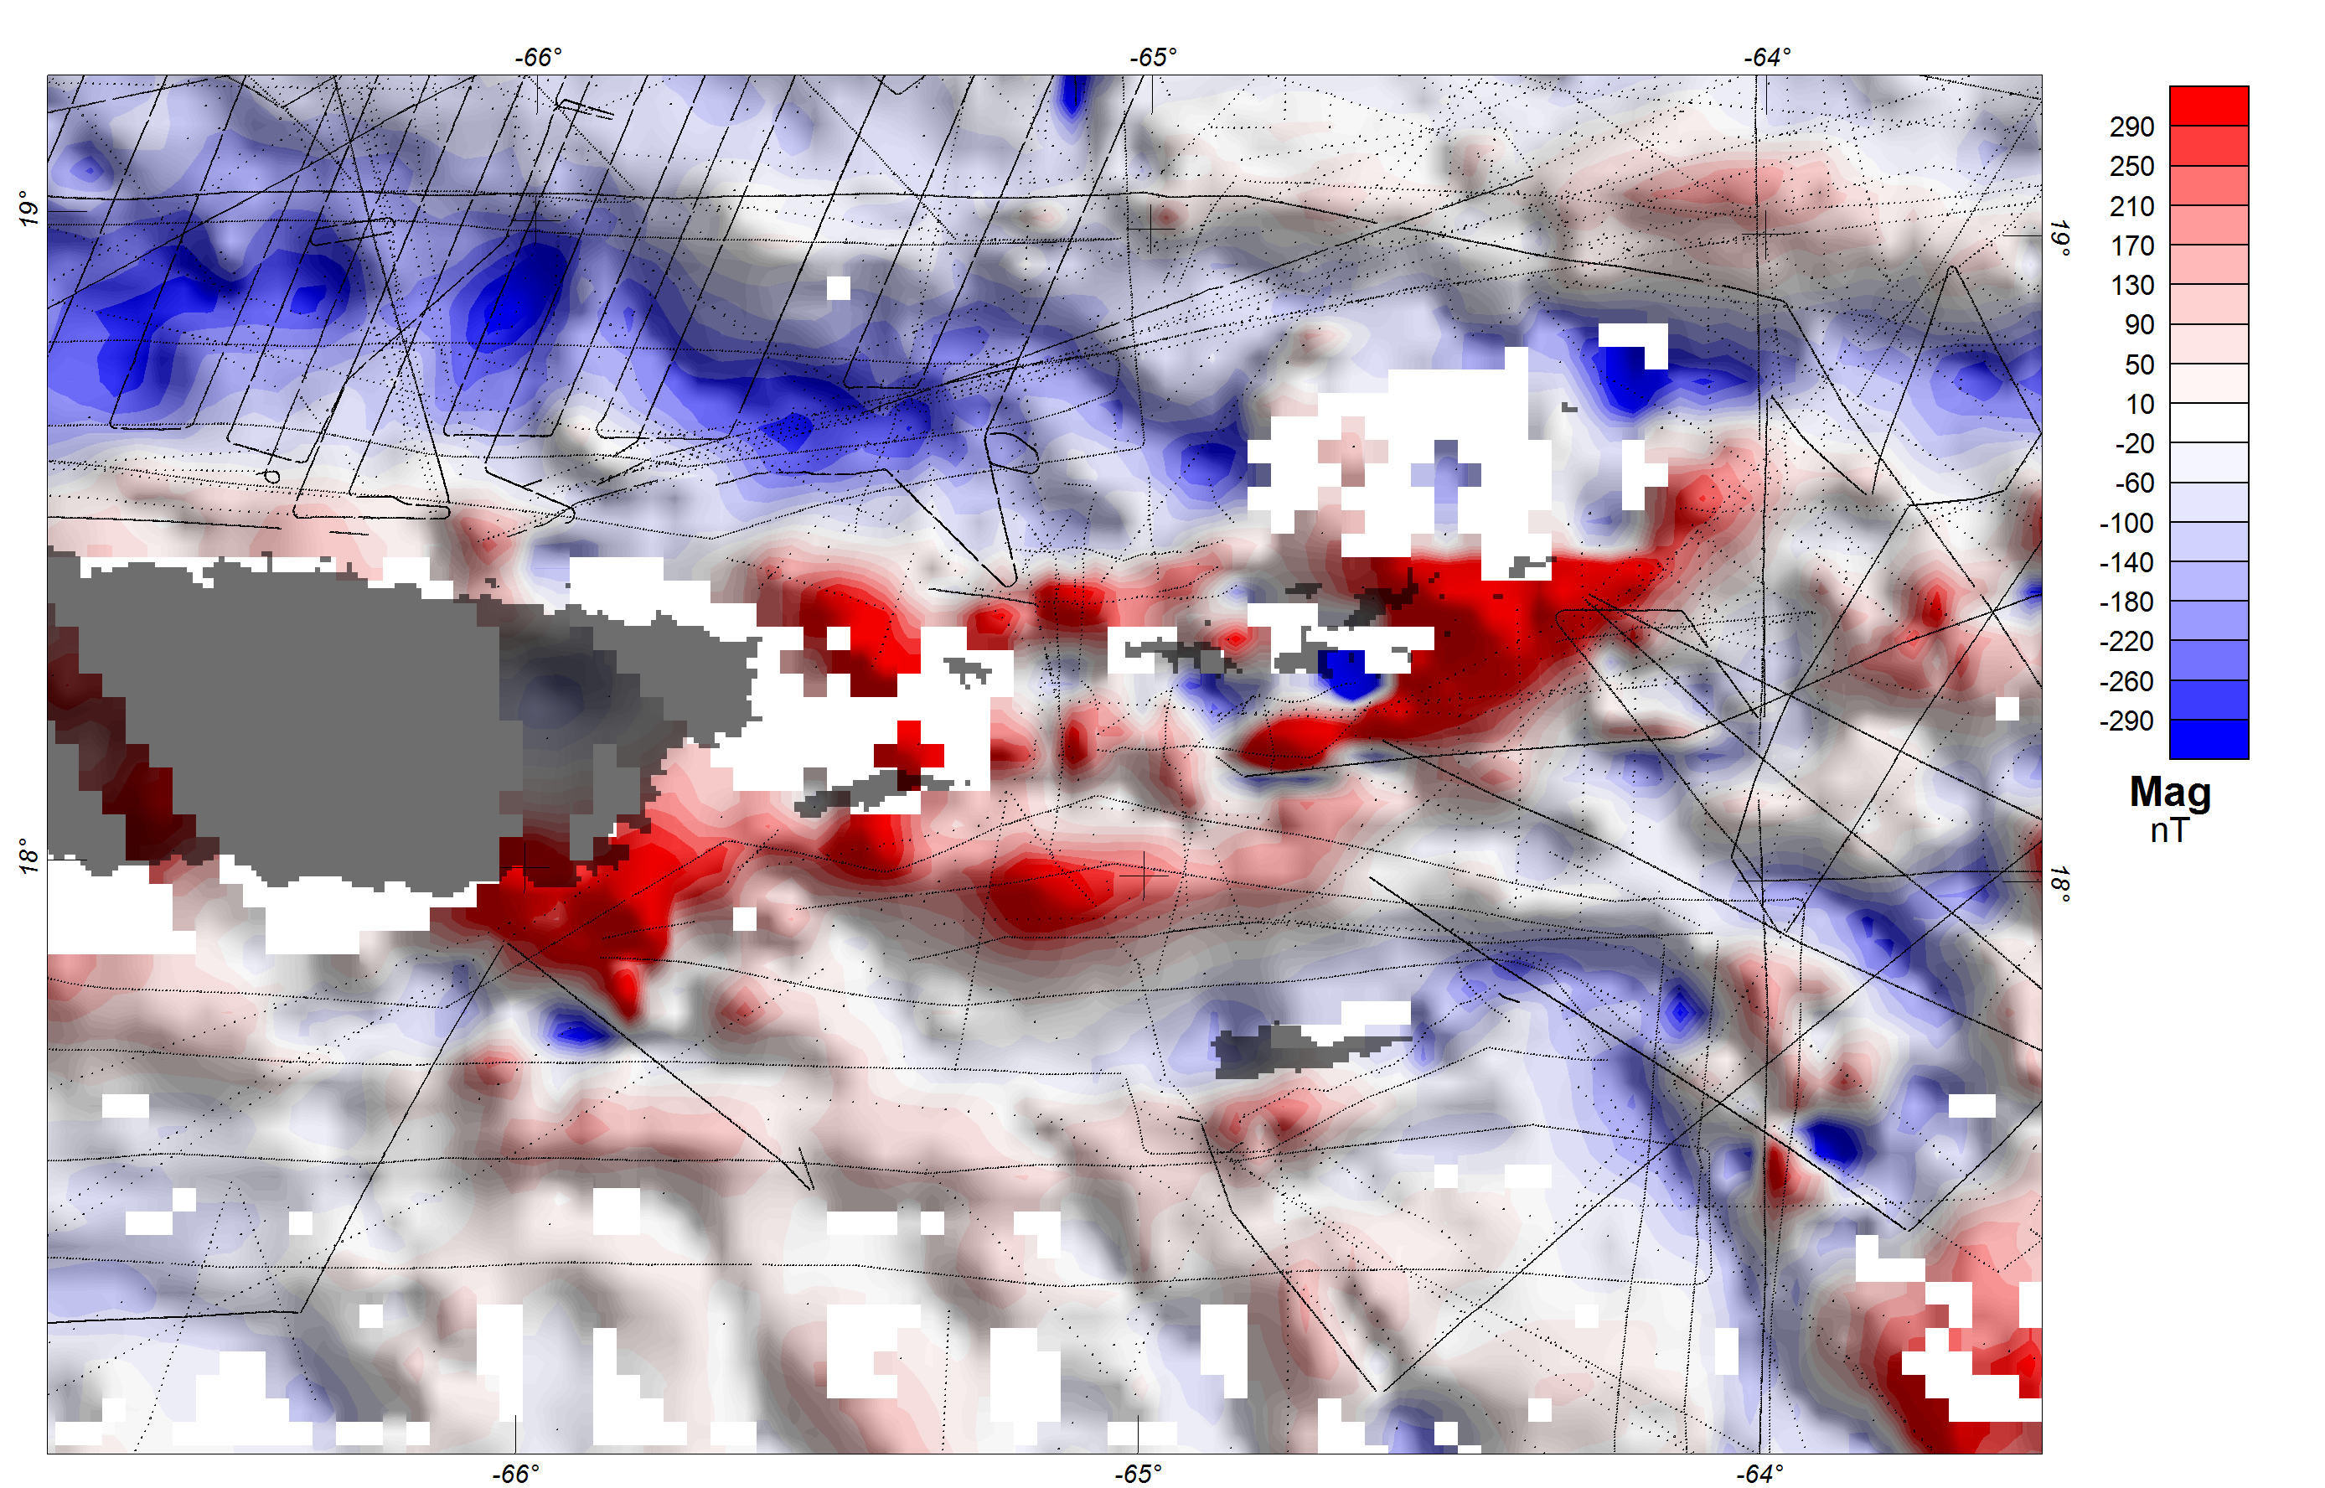
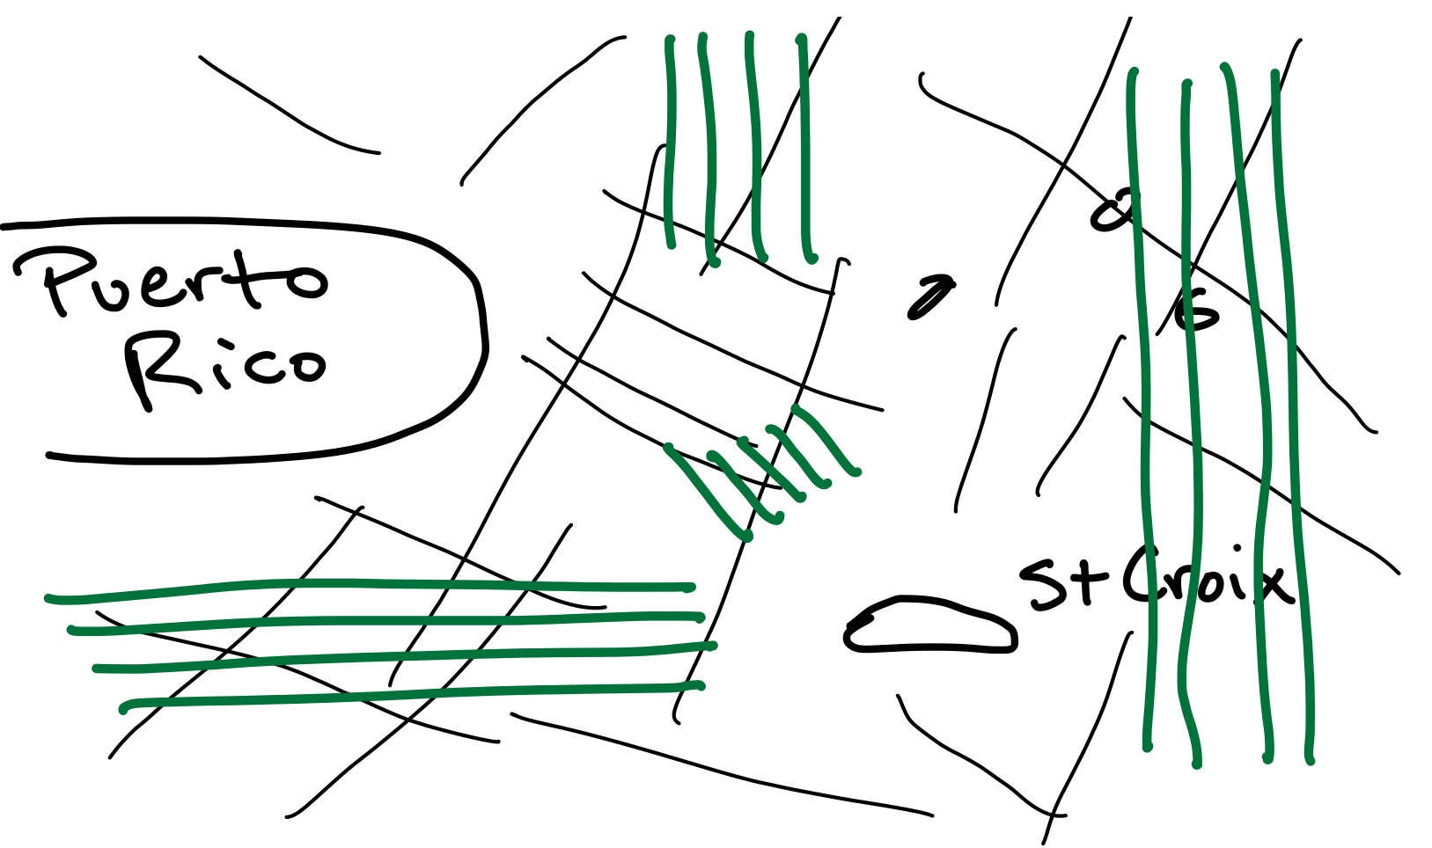
Caribbean Test – Part 1
How Well Does This Work?

Slide 10
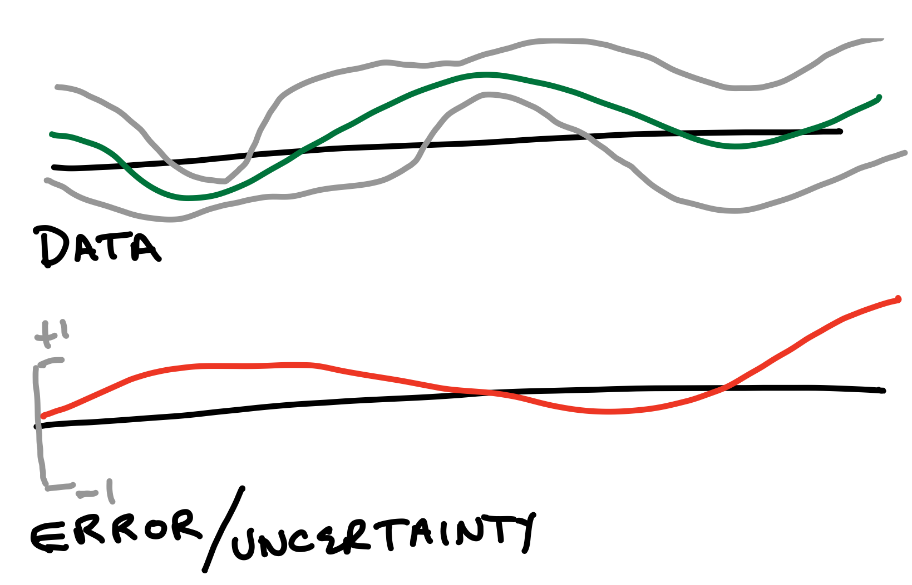
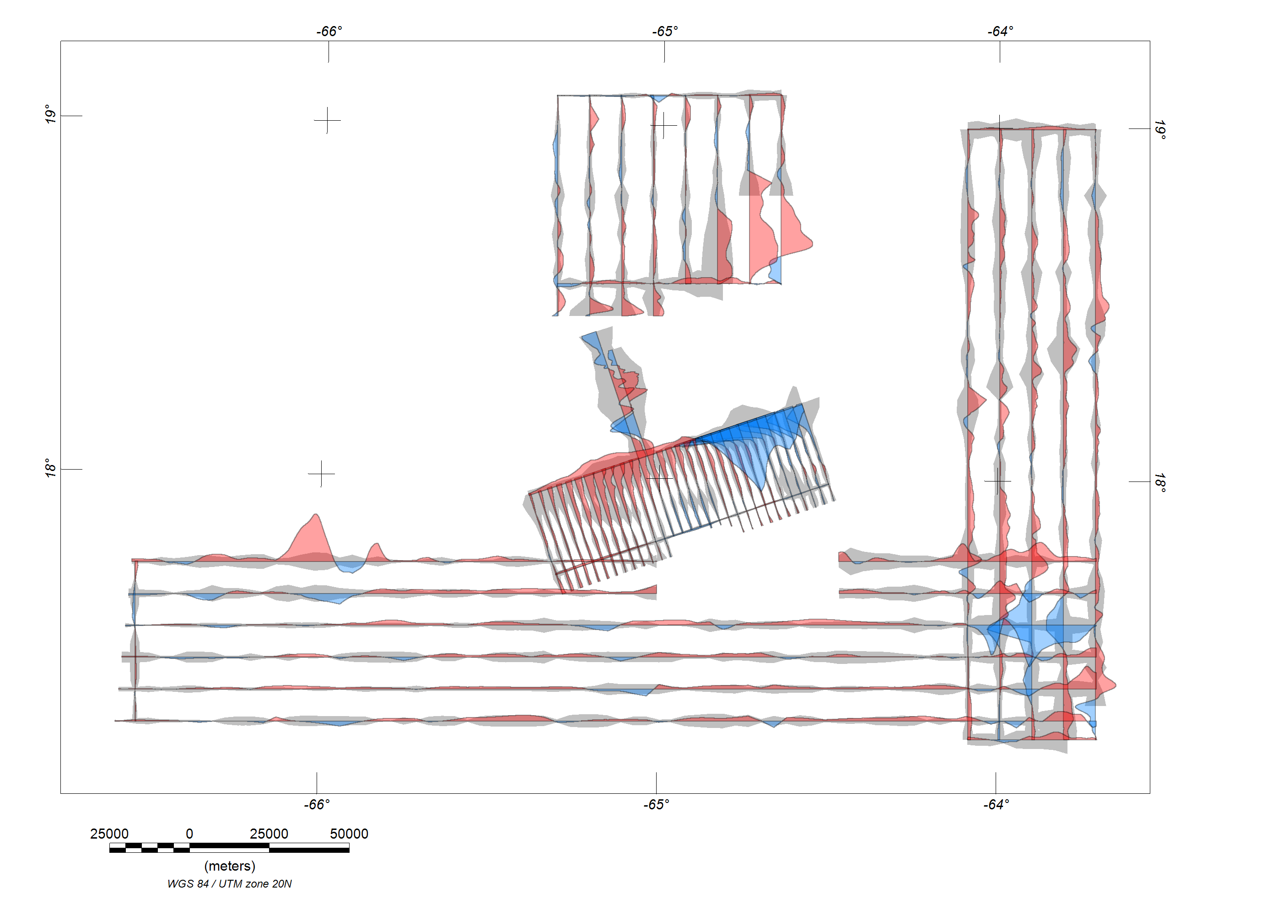
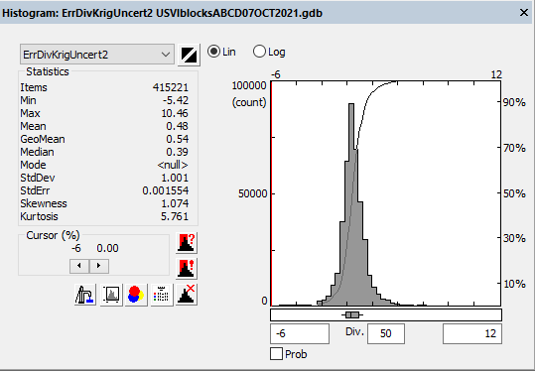
Caribbean Test – Part 2
Testing/Validation

Slide 11

Next steps:
Additional validation
Regional zonation of kriging parameters
Within cell optimization/data assimilation

Slide 12


