Slide 1
Numerical investigation of the effects of water evaporation and mineral reaction on reservoir performances in CO₂-plume geothermal systems
Applied Geology
Dejian Zhou¹, Alexandru Tatomir¹, Martin Sauter¹
¹Department of Applied Geology, Geoscience Center Göttingen, University of Göttingen, Germany

Slide 2
Introduction
This work focuses:
ScCO₂ dissolution into brine
acidified brine induced reactions
Important geochemical reactions caused by CO₂ injection. (1) Supercritical CO₂ dissolution into brine, (2) acidified brine induced reactions, (3) wet scCO₂ driven interactions, and (4) scCO₂ -wellbore interactions. (Jun et al., 2013)

Slide 3
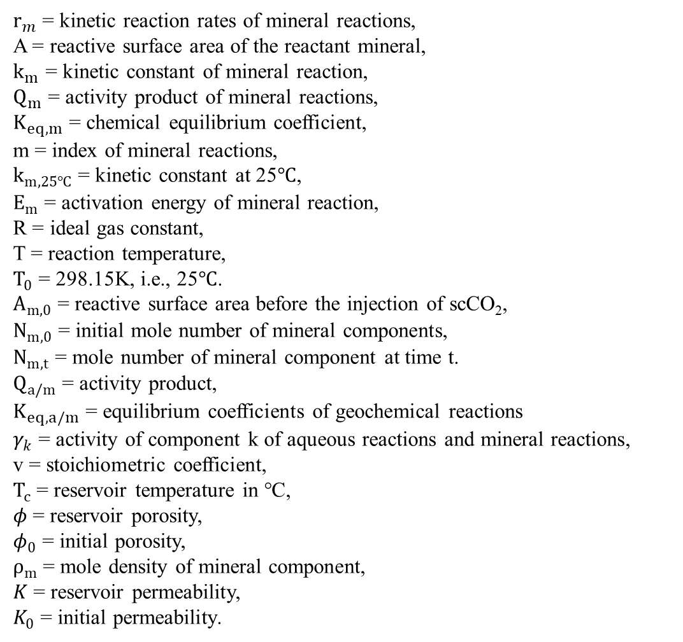
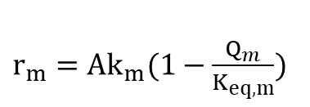
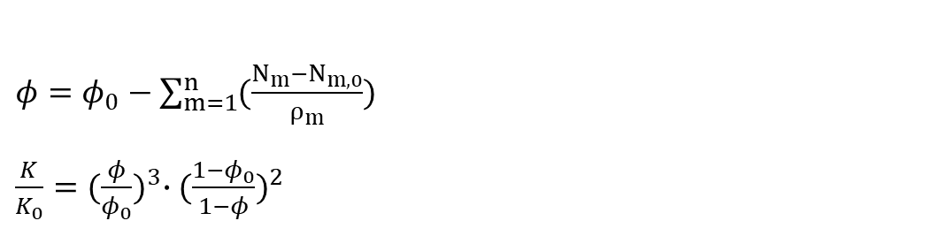
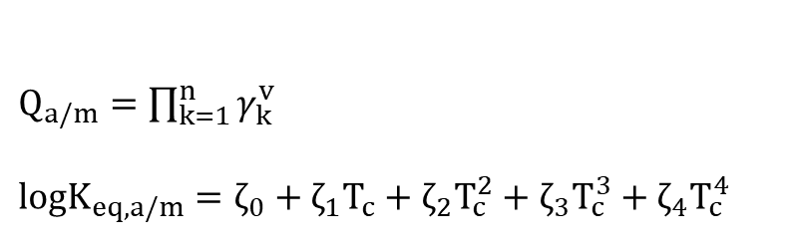
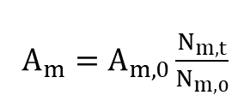
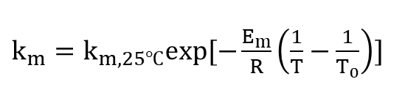
Reaction Kinetics
$r_{m}$ = kinetic reaction rates of mineral reactions,
A = reactive surface area of the reactant mineral,
$k_{m}$ = kinetic constant of mineral reaction,
$Q_{m}$ = activity product of mineral reactions,
$K_{eq,m}$ = chemical equilibrium coefficient,
m = index of mineral reactions,
$k_{m,25℃}$ = kinetic constant at 25$℃$,
$E_{m}$ = activation energy of mineral reaction,
R = ideal gas constant,
T = reaction temperature,
$T_{0}$ = 298.15K, i.e., 25$℃$.
$A_{m,0}$ = reactive surface area before the injection of scCO₂,
$N_{m,0}$ = initial mole number of mineral components,
$N_{m,t}$ = mole number of mineral component at time t.
$Q_{a/m}$ = activity product,
$K_{eq,a/m}$ = equilibrium coefficients of geochemical reactions
$γ_{k}$ = activity of component k of aqueous reactions and mineral reactions,
v = stoichiometric coefficient,
$T_{c}$ = reservoir temperature in ℃,
$φ$ = reservoir porosity,
$φ_{0}$ = initial porosity,
$ρ_{m}$ = mole density of mineral component,
$K$ = reservoir permeability,
$K_{0}$ = initial permeability.
Geochemical reaction rate
$r_{m}=Ak_{m}(1−\frac{Q_{m}}{K_{eq,m}})$
$k_{m}=k_{m,25℃}exp⁡[−\frac{E_{m}}{R}\left(\frac{1}{T}−\frac{1}{T_{0}}\right)]$
$A_{m}=A_{m,0}\frac{N_{m,t}}{N_{m,0}}$
Reaction equilibrium
$Q_{a/m}=\prod_{k=1}^{n}{γ_{k}^{v}}$
$logK_{eq,a/m}=ζ_{0}+ζ_{1}T_{c}+ζ_{2}T_{c}^{2}+ζ_{3}T_{c}^{3}+ζ_{4}T_{c}^{4}$
Porosity and permeability variation
$φ=φ_{0}−\sum_{m=1}^{n}{(\frac{N_{m}−N_{m,0}}{ρ_{m}}})$
$\frac{K}{K_{0}}={(\frac{φ}{φ_{0}})}^{3}∙{(\frac{1−φ_{0}}{1−φ})}^{2}$

Slide 4
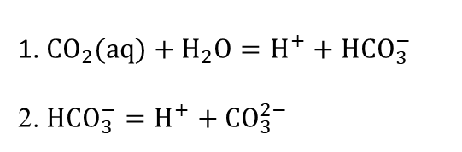
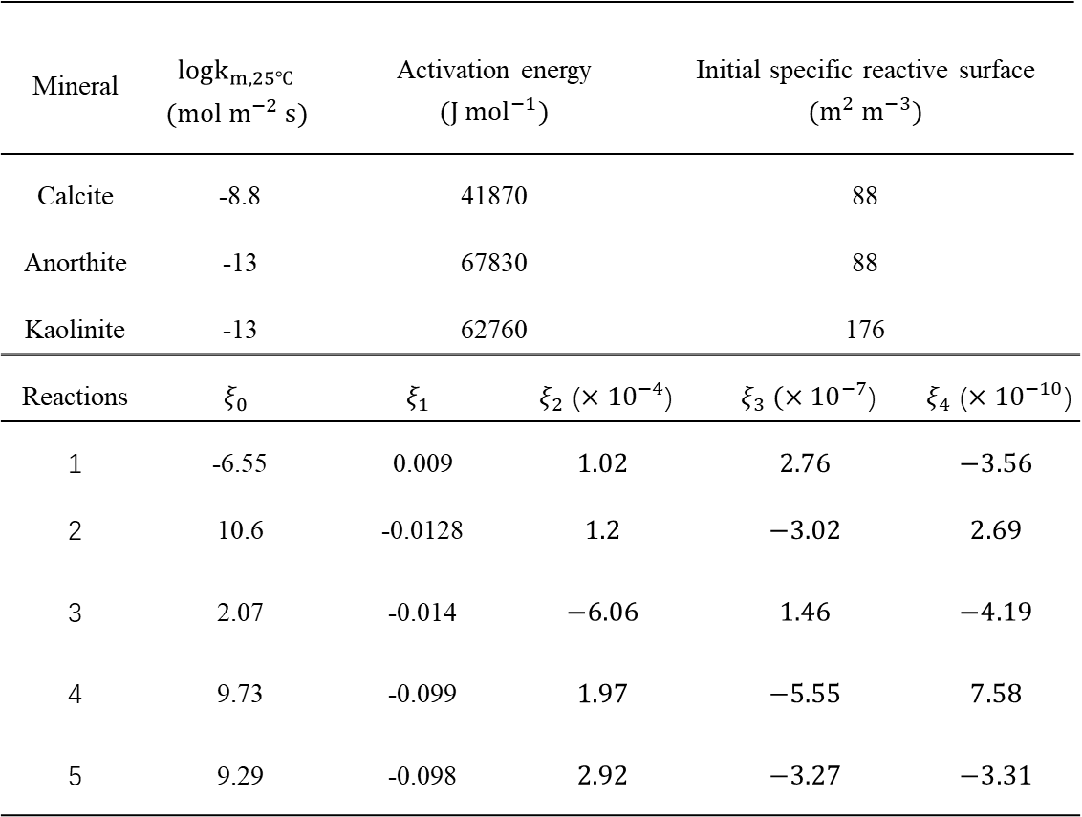
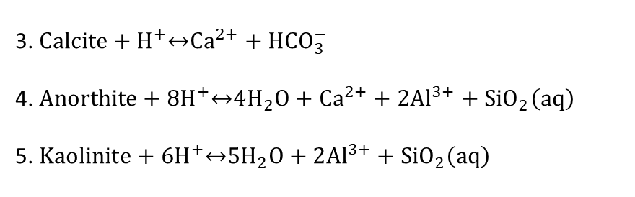
Geochemical reactions
Main aqueous reactions
Kinetic parameters of geochemical reactions
1. ${CO}_{2}(aq)+H_{2}O=H^{+}+{HCO}_{3}^{−}$ 2. ${HCO}_{3}^{−}=H^{+}+{CO}_{3}^{2−}$
Mineral | $$logk_{m,25℃}$$ $$(mol m^{−2} s)$$ | Activation energy $$(J {mol}^{−1})$$ |  | Initial specific reactive surface $$(m^{2} m^{−3})$$
Calcite | -8.8 | 41870 |  | 88
Anorthite | -13 | 67830 |  | 88
Kaolinite | -13 | 62760 |  | 176
Reactions | $$ξ_{0}$$ | $$ξ_{1}$$ | $ξ_{2}$ ($×{10}^{−4}$) |  | $ξ_{3} (×{10}^{−7}$) | $ξ_{4}$ ($×{10}^{−10}$)
1 | -6.55 | 0.009 | $$1.02$$ |  | $$2.76$$ | $$−3.56$$
2 | 10.6 | -0.0128 | $$1.2$$ |  | $$−3.02$$ | $$2.69$$
3 | 2.07 | -0.014 | $$−6.06$$ |  | $$1.46$$ | $$−4.19$$
4 | 9.73 | -0.099 | $$1.97$$ |  | $$−5.55$$ | $$7.58$$
5 | 9.29 | -0.098 | $$2.92$$ |  | $$−3.27$$ | $$−3.31$$
Main mineral reactions
3. $Calcite+H^{+}\underset{↔}{ }{Ca}^{2+}+{HCO}_{3}^{−}$
4. $Anorthite+8H^{+}\underset{↔}{ }4H_{2}O+{Ca}^{2+}+2{Al}^{3+}+{SiO}_{2}\left(aq\right)$
5. $Kaolinite+6H^{+}\underset{↔}{ }5H_{2}O+2{Al}^{3+}+{SiO}_{2}\left(aq\right)$

Slide 5
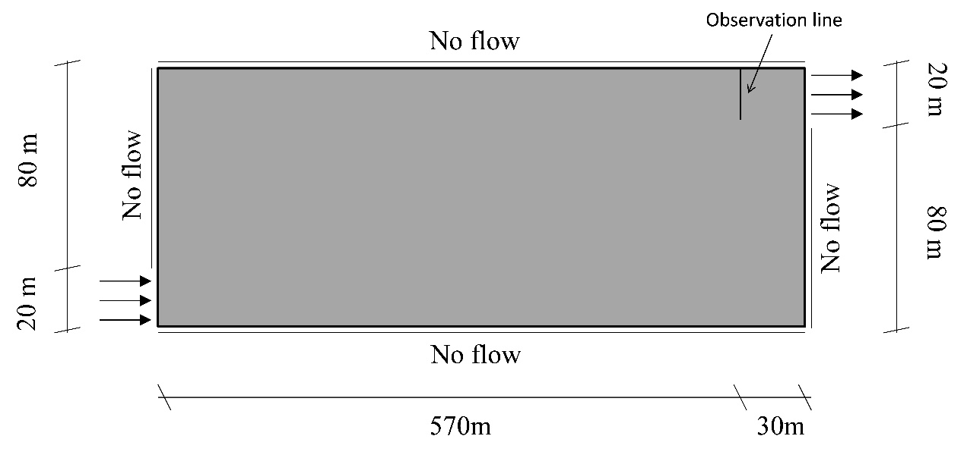
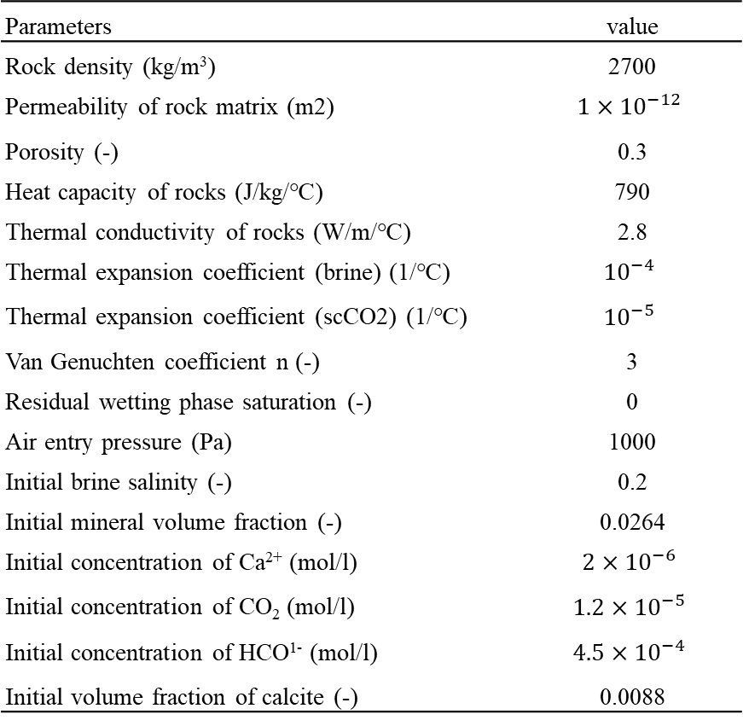
Problem definition
Parameter for the simulation
Parameters | value
Rock density (kg/m³) | 2700
Permeability of rock matrix (m2) | $$1×{10}^{−12}$$
Porosity (-) | 0.3
Heat capacity of rocks (J/kg/℃) | 790
Thermal conductivity of rocks (W/m/℃) | 2.8
Thermal expansion coefficient (brine) (1/℃) | $${10}^{−4}$$
Thermal expansion coefficient (scCO2) (1/℃) | $${10}^{−5}$$
Van Genuchten coefficient n (-) | 3
Residual wetting phase saturation (-) | 0
Air entry pressure (Pa) | 1000
Initial brine salinity (-) | 0.2
Initial mineral volume fraction (-) | 0.0264
Initial concentration of Ca²⁺ (mol/l) | $${2×10}^{−6}$$
Initial concentration of CO₂ (mol/l) | $${1.2×10}^{−5}$$
Initial concentration of HCO¹⁻ (mol/l) | $${4.5×10}^{−4}$$
Initial volume fraction of calcite (-) | 0.0088
Case1: the dissolution between water and scCO₂ and the geochemical reactions are considered.
Case2: the CO₂-water-mineral reactions are ignored, only the dissolution between water and scCO₂ is taken into consideration.
Case3: it is assumed that water and scCO₂ are immiscible, both the component dissolution and geochemical reactions are ignored.

Slide 6
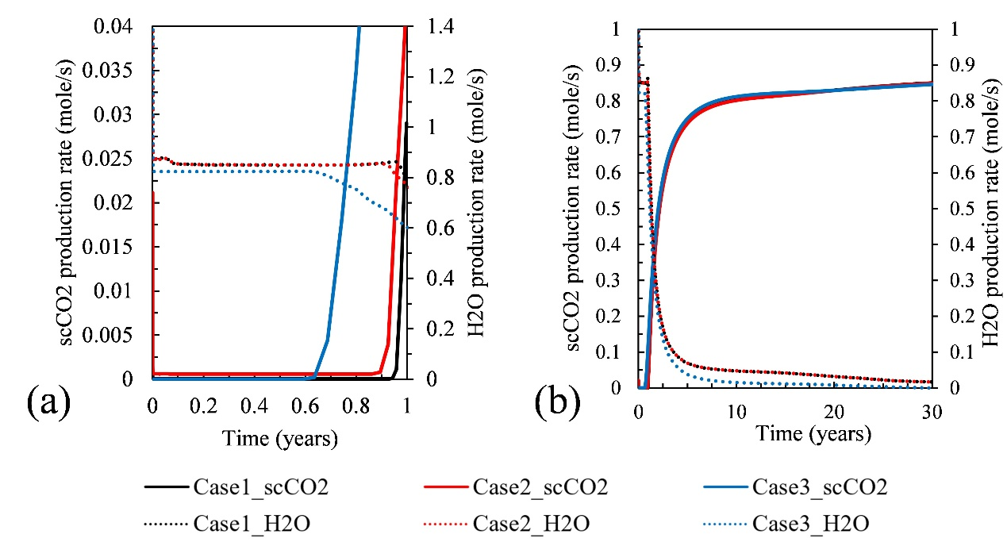
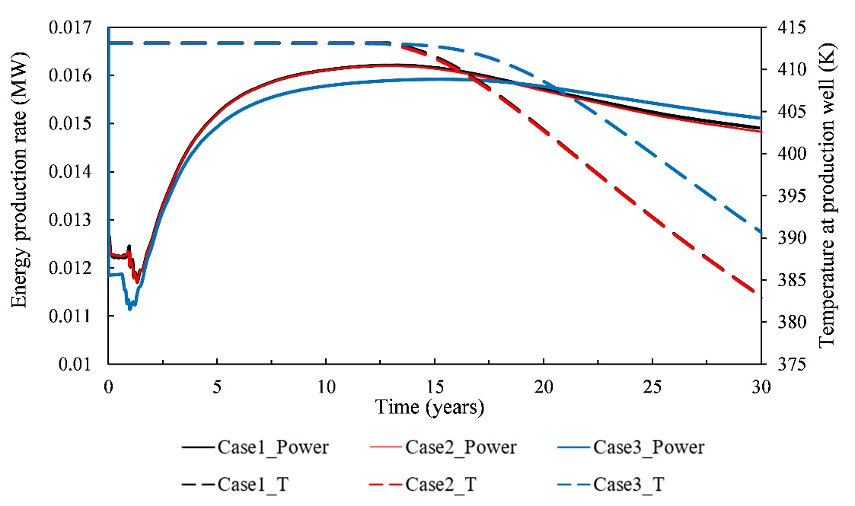
Results
Effects of component dissolution and geochemical reactions
Mass produced rate of scCO₂ and H₂O
Production temperature and energy production rate
Mass produced rate of scCO₂ and H₂O at production well over time for the three cases for (a) short-term production and (b) long-term production.
Production temperature and energy production rate over time for the three cases.
Notes:
The effects of component dissolution and geochemical reactions play a role during the short-term production.
For long-term production, their effects are minimal.

Slide 7
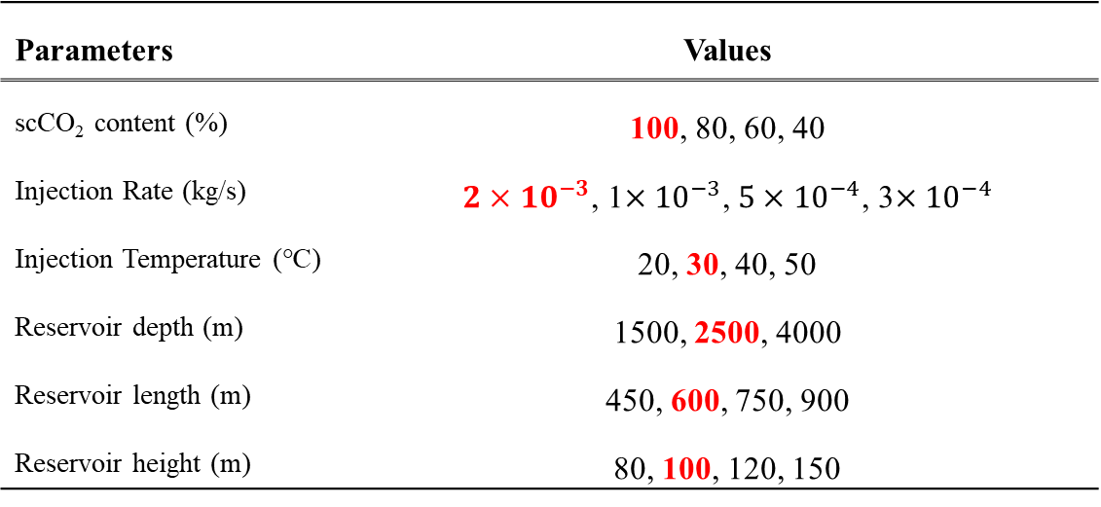
Results
Sensitive analysis on reservoir parameters
The base value and studied parameters
Parameters | Values
scCO₂ content (%) | 100, 80, 60, 40
Injection Rate (kg/s) | $2×{10}^{−3}$, 1$×{10}^{−3}$, $5×{10}^{−4}$, 3$×{10}^{−4}$
Injection Temperature (℃) | 20, 30, 40, 50
Reservoir depth (m) | 1500, 2500, 4000
Reservoir length (m) | 450, 600, 750, 900
Reservoir height (m) | 80, 100, 120, 150
Discrepancy of performance = $\frac{Performances of case 2 or case 3}{performance of case 1} ∗100\%$

Slide 8
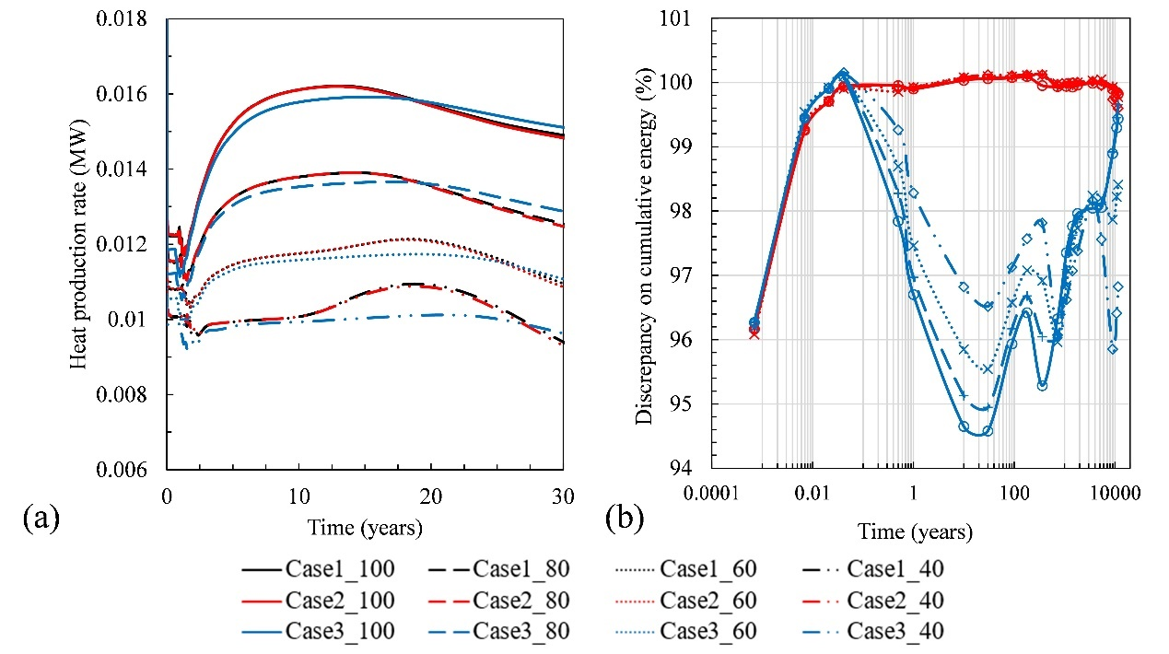
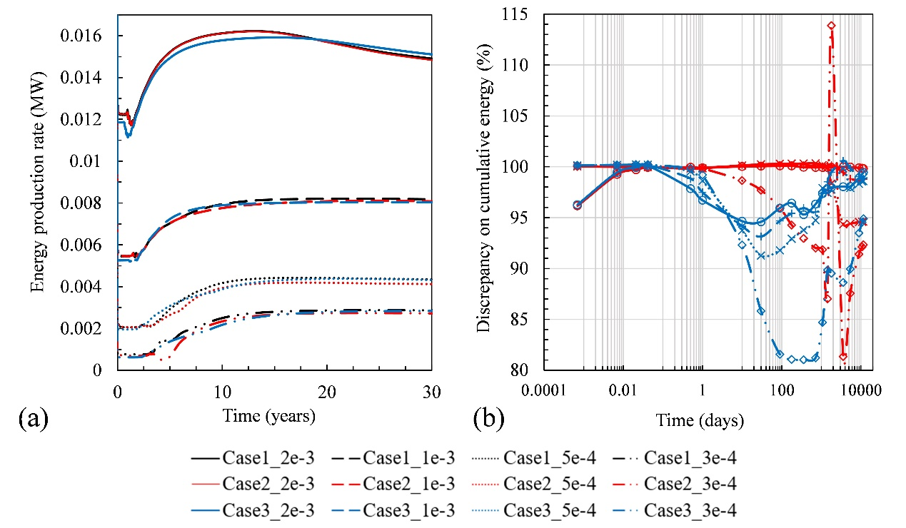
Results
Sensitive analysis on reservoir parameters
Working fluid scCO₂ content (%)
Injection rate (kg/s)
Effects of working fluid composition on reservoir heat production rate and discrepancy of case 1 with case 2 and case 3 on cumulatively produced energy.
Effects of injection rate on reservoir heat production rate and discrepancy of case 1 with cases 2 and 3 on cumulatively produced energy.

Slide 9
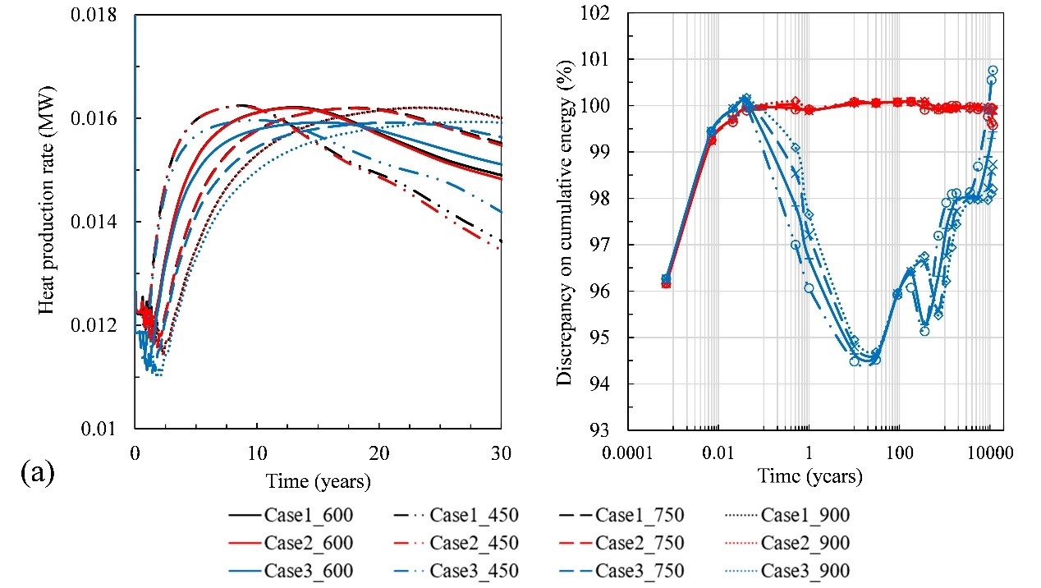
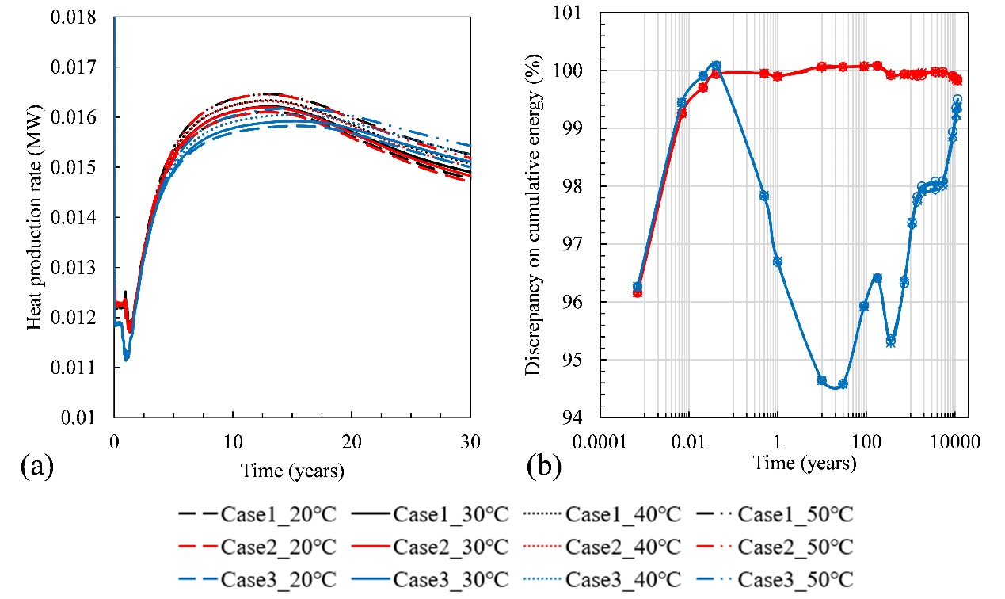
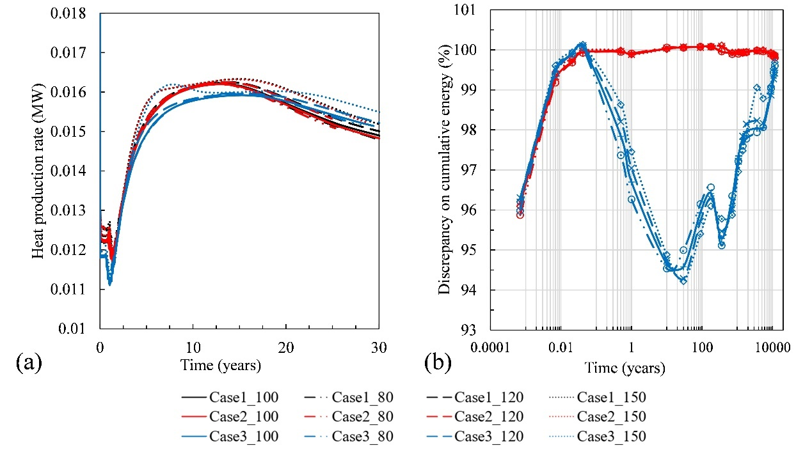
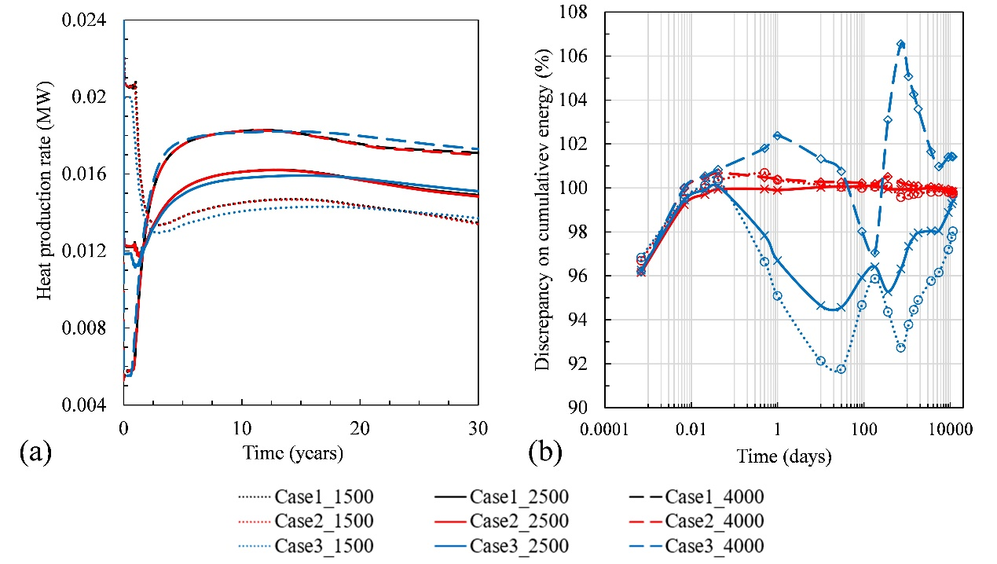
Reservoir length (m)
Injection temperature (℃ )
Reservoir height (m)
Reservoir depth (m)

Slide 10
Conclusion
(1) The geochemical reactions only play a role during the initial production period, and lead to a later scCO₂ breakthrough time of case 1 compared to those of cases 2 and 3. On the other time, water evaporation affects the reservoir energy performance over the entire production period. The reduction in cumulatively produced energy resulting from water evaporation is approximately 10% before the scCO₂ breakthrough.
(2) The effects of geochemical reactions on reservoir energy performance are minimal and can be regarded as independent of some operation and reservoir parameters, such as the composition of the working fluid, the injection rate, the injection temperature, and the reservoir depth and size. Conversely, the influences of water evaporation vary with the parameters, in which the reservoir depth has the most considerable impact.

Slide 11
Thanks for your listening！

