Slide 1




Evaluating the vegetation-atmosphere coupling strength of ORCHIDEE
Yuan Zhang, Devaraju Narayanappa, Philippe Ciais, Wei Li, Daniel Goll, Nicolas Vuichard, Martin G. De Kauwe, Laurent Li, Fabienne Maignan
EGU 2022 May

Slide 2
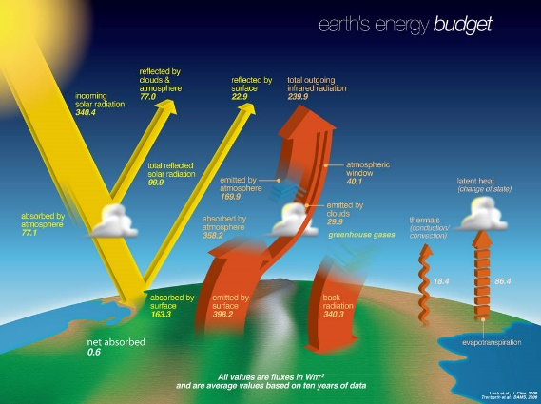
Motivation
Evapotranspiration (ET) is one of the most important atmosphere-surface interactions in the climate system.
But ET is difficult to simulate, especially on land, due to the complexity of processes.

Slide 3
How do models simulate ET
& get calibrated?
Multiple processes
Different processes controlled by different factors
Boundary layer mixing
Vapor from stomata
Vapor from soil surface
Other sources …
Fluxnet GPP, ET, …
Observation Ref
Land surface model
Calibrated model
Calibration
One variable used to constrain many processes!

Slide 4
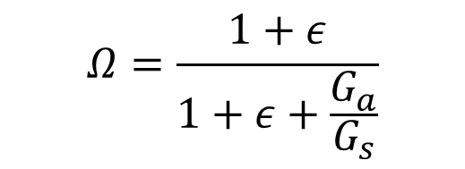
Decoupling coefficient
Ga
(aerodynamic conductance)
Jarvis and McNaughton (1986) developed a coefficient to separate contribution of Ga and Gs
$$Ω=\frac{1+ε}{1+ε+\frac{G_{a}}{G_{s}}}$$
Gs (stomatal/surface conductance)
Ω=0, perfect coupling: ET controlled by Gs, i.e. stomata open/closure fully controls ET
Ω=1, complete decoupling: ET controlled by Ga, i.e. boundary layer turbulence fully controls ET
ET = Ω * ET_{eq}+(1-Ω) * ET_{imp}
ET with very small Ga
ET with very large Ga
Ω dataset at fluxnet sites (De Kauwe et al., 2017)
Benchmarking the Ω of ORCHIDEE model
Investigate the whether ORCHIDEE model captures the dependence of Ω on different factors

Slide 5

Does the model simulate the processes well?
Flux
Model
ORCHIDEE has good Ω in forests and underestimated Ω in grasslands and croplands
However, the good Ω is due to compensation of biases in both Ga and Gs

Slide 6
Investigating the controls of Ω
Ω (Y) and explanatory variables (X)
SHAP: A game theory-based method (Shapley value) to show the expectance of the contribution of each factor to deviate sample Y from the average Y of all sample.
Random forest model
Example for one sample:
SHAP (SHapley Additive exPlanations) values

Slide 7
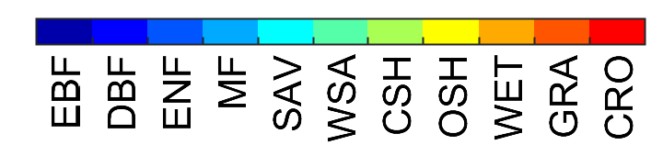
Factors controlling the coupling strength
Vegetation more decoupled to atmosphere at low wind speed, high temperature, low VPD and large LAI conditions and in short vegetation.

Slide 8
Factors controlling the coupling strength
Model
Wrong dependence at high Tair
Too small VPD impact in model
Model too sensitive to LAI
Differences mainly from Gs

Slide 9
Summary
A framework is developed to benchmark vegetation decoupling and its controls in LSM.
ORCHIDEE generally has a good Ω but due to compensation of biases in Ga and Gs
Vegetation tends to be more decoupled to atmosphere at low wind speed, high temperature, low VPD and large LAI conditions and in short vegetation.
ORCHIDEE underestimated the VPD impacts, overestimated the contribution of LAI and did not correctly simulate the temperature dependence when temperature is high.
References:
Jarvis, P. G., and McNaughton, K. G.: Stomatal control of transpiration: scaling up from leaf to region, in: Advances in ecological research, Elsevier, 1-49, 1986.
De Kauwe, M. G., Medlyn, B. E., Knauer, J., and Williams, C. A.: Ideas and perspectives: how coupled is the vegetation to the boundary layer?, Biogeosciences, 14, 4435-4453, 2017.

Slide 10
Thanks!
Contact: yuan.zhang@lsce.ipsl.fr

