Slide 1

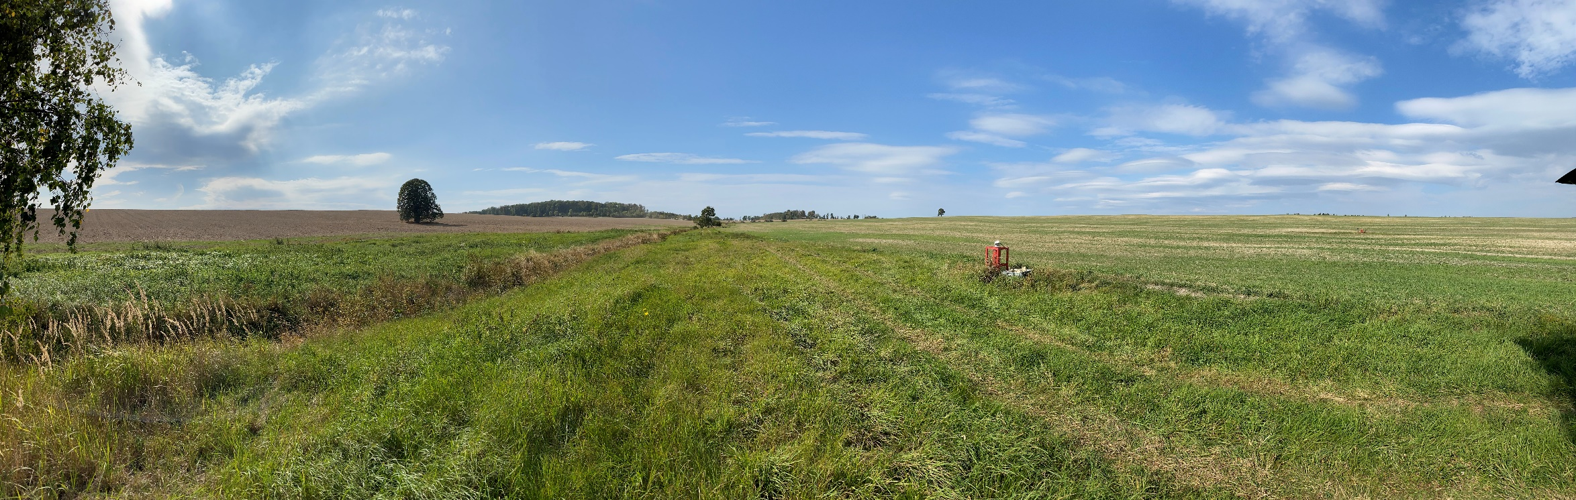
Nitrate and Water Isotopes as Tools to Resolve Nitrate Travel Times in a Mixed Land Use Catchment
Christina F. Radtke¹, Stefanie R. Lutz², Christin Müller¹, Jarno Rouhiainen¹, Ralf Merz¹, Xiaoqiang Yang³,
Rohini Kumar⁴, Paolo Benettin⁵, Kay Knöller¹
¹ Helmholtz-Centre for Environmental Research UFZ, Department of Catchment Hydrology, Germany
² Copernicus Institute of Sustainable Development, Utrecht University, the Netherlands
³ Helmholtz-Centre for Environmental Research UFZ, Department of Aquatic Ecosystem Analysis and Management, Germany ⁴ Helmholtz-Centre for Environmental Research UFZ, Department of Computational Hydrosystems, Germany
⁵ École Polytechnique Fédérale de Lausanne EPFL, Lausanne, Switzerland

Slide 2
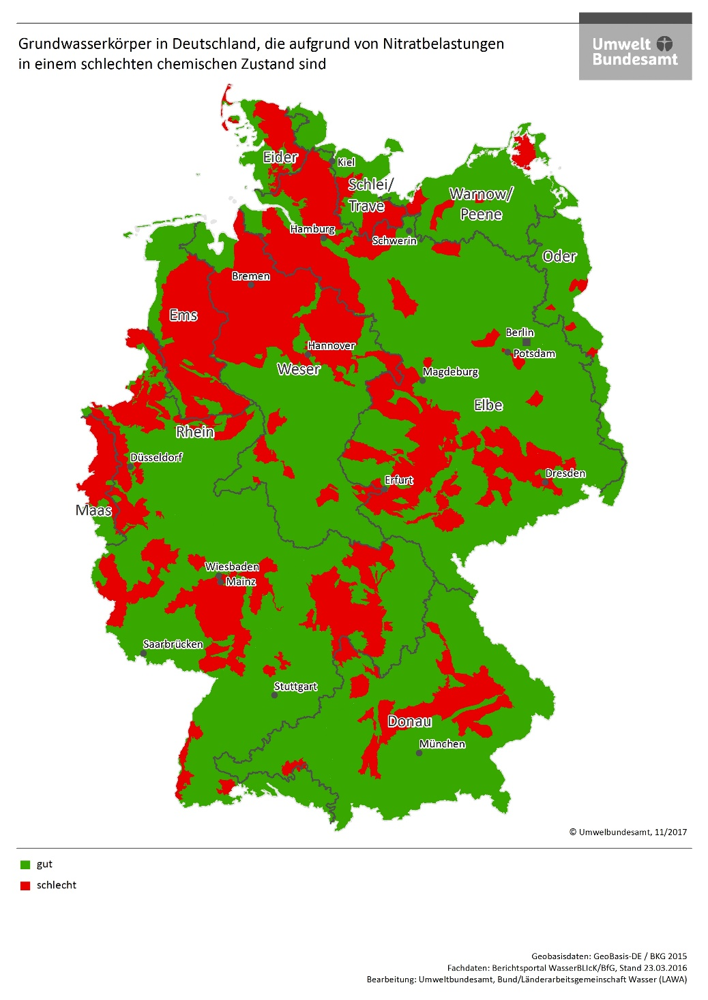

Background Information
Chemical state of groundwater bodies in Germany
Problem:
High nitrate concentrations
Legacys and time lag
Gain more information about nitrate and flow paths:
Usage of stable isotopic signatures: δ¹⁸O-H₂O, δ²H-H₂O & δ¹⁸O-NO₃, δ¹⁵N-NO₃
Hypotheses:
Transit times of water and nitrate vary during changing hydrological conditions
Decoupling of nitrate transit times and water transit times
Nitrate is younger than water
Good
Bad

Slide 3
Methods
Meisdorfer Sauerbach (11.5 km²)
Isotope data
Precipitation: Stream: 2013-2017 monthly, 2017-2019 biweekly, 2017-2020 daily 2019-2020 daily
Mesoscale Hydrological Model Nitrate¹
Water fluxes (ET,P,Q,Leaching)
Nitrate concentrations (in Leaching, Q)
Modified tran-SAS²
Based on isotopic signatures: δ¹⁸O
To simulate transit times and age
Modifications:
Second storage for biogeochemical processes
Processes: nitrification, denitrification
¹ Yang, X., & Rode, M. (2020). A Fully Distributed Catchment Nitrate Model - mHM-Nitrate v2.0. Zenodo. doi:10.5281/zenodo.3891629
² Benettin, P., & Bertuzzo, E. (2018). tran-SAS v1.0: a numerical model to compute catchment-scale hydrologic transport using StorAge Selection functions. Geoscientific Model Development, pp. 1627-1639.

Slide 4
Methods: laboratory
Water isotopes
Water sample filtration (0.45 µm)
Picarro L1120-I analyser based on laser spectroscopy
standard deviation of ± 0,6 ‰_{VSMOW} for δ²H and ± 0,2 ‰_{VSMOW} for δ¹⁸O
Nitrate isotopes and nitrate concentration
Water sample filtration (0.45 µm)
denitrifier method with bacteria strains of Pseudomonas chlororaphis was used for the measurement of isotopic composition of dissolved nitrate
Nitrate isotope analysis with mass spectrometer DELTA V Plus in combination with a GasBench II from Thermo Scientific
the analytical precision for nitrogen and oxygen isotope measurements of nitrate are 0.4 and 1.6 ‰, respectively, international standards (USGS32, USGS34, USGS35 and IAEA NO3) were applied for calibration
nitrate concentration was measured by ion chromatography with a Dionex ICS-2000 combined with AS50

Slide 5


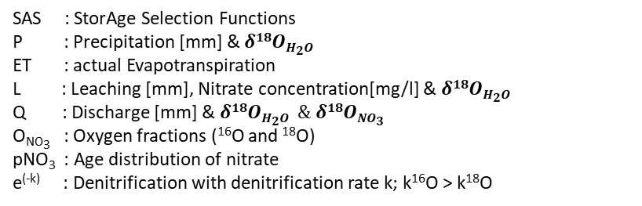



Conceptual model tran-SAS-nitrate
P
ET
SAS
ET
Infiltration layer
SAS
Water
L H₂O & NO₃
Water & Nitrate
Routing storage
$$δ18ONO3=\frac{1}{3}δ18OO2+\frac{2}{3}δ18OH2O$$
SAS
SAS : StorAge Selection Functions
P : Precipitation [mm] & $δ18OH2O$
ET : actual Evapotranspiration
L : Leaching [mm], Nitrate concentration[mg/l] & $δ18OH2O$
Q : Discharge [mm] & $δ18OH2O$ $\& δ18ONO3$
O_{NO3} : Oxygen fractions (¹⁶O and ¹⁸O)
pNO₃ : Age distribution of nitrate
e^{(-k)} : Denitrification with denitrification rate k; k¹⁶O > k¹⁸O
$${dO}_{NO3}=O_{NO3}∗pNO3 ∗e^{(−k)}$$
SAS
Q H₂O & NO₃
$$δ18ONO3 δ18OH2O$$
5

Slide 6
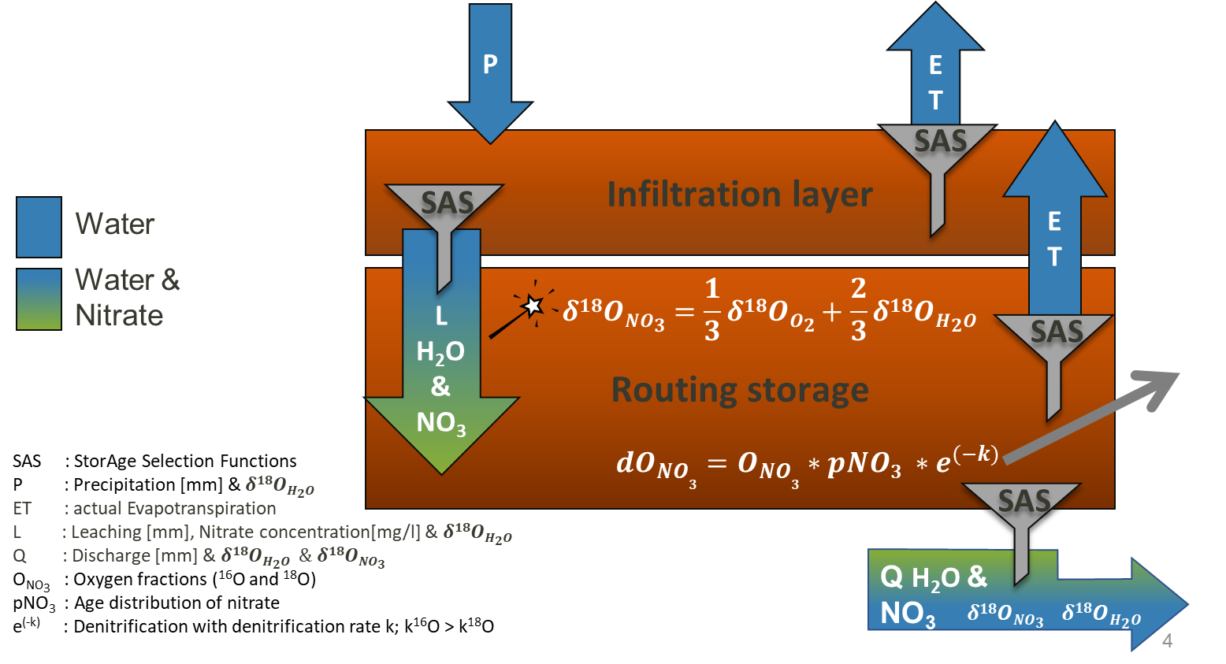
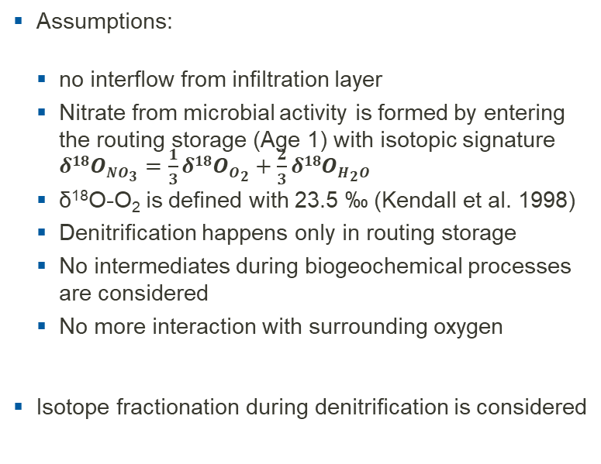
Model description
Assumptions:
no interflow from infiltration layer
Nitrate from microbial activity is formed by entering the routing storage (Age 1) with isotopic signature $δ18ONO3=\frac{1}{3}δ18OO2+\frac{2}{3}δ18OH2O$
δ¹⁸O-O₂ is defined with 23.5 ‰ (Kendall et al. 1998)
Denitrification happens only in routing storage
No intermediates during biogeochemical processes are considered
No more interaction with surrounding oxygen
Isotope fractionation during denitrification is considered
Description:
Water fluxes (in this case modelled by mHM-nitrate) with it‘s isotopic signatures are inputs for the model as well as nitrate concentration (modelled by mHM-nitrate)
Isotopic signature δ¹⁸O is used as fingerprint for dating
With storage selection functions (SAS) the release of water isotopes and nitrate isotopes is controlled
The model is calibrated against measured isotopic signatures of water in stream
The model could also be set up with measured data if available, but in our case we didn‘t had all necessary measurements

Slide 7
Data

Slide 8
Water isotopes: Age distribution in stream Meisdorfer Sauerbach KGE_{δ18O} =0.33

Slide 9
Water isotopes: Age distribution in stream Meisdorfer Sauerbach
Comparing discharge since 2013 with discharge in 2018 and the following years we can see that discharge peaks are lowered by more than 50 %, therfore we are talking about dry conditions already since 2018
In 2018 the proportion of old water from groundwater bodies is higher than the proportion of old water during discharge peaks in 2019 and 2020
The fraction of young water, either event water (<7days) or water up to 2 months old is higher during dry conditions compared to wetter periods until 2018
We assume it may be that there is a lowered connectivity between surface water and groundwater due to prolonged dry conditions
 | water age contribution [%]
Year | > 7 days | > 14 days | > 28 days | > 60 days | > 180 days
2017 | 0.187 | 0.253 | 0.309 | 0.375 | 0.486
2018 | 0.061 | 0.088 | 0.129 | 0.208 | 0.388
2019 | 0.143 | 0.201 | 0.260 | 0.329 | 0.447
2020 | 0.144 | 0.208 | 0.266 | 0.337 | 0.450

Slide 10
Nitrate isotopes in stream
Range of values for denitrification rate as well as fractionation factor are gained from literature (Granger & Wankel, 2016)
A fixed value over time is set for denitrification rate k of δ¹⁶O, with a fix fractionation factor α over time the k of δ¹⁸O is achieved; both values are visually compared to measured isotopic signature of δ¹⁸O-NO₃ in stream
The grey interval shows all possible combinations of the whole range of denitrification rates and fractionation factors, while the black line shows the average matching observed isotopic signatures
The intensity of denitrification is controlled by transit times in the routing storage at the release of water and nitrate to the stream

Slide 11
Water and nitrate isotopes Transit times
Water TT
Nitrate is ∅ 41 days younger than water in the Meisdorfer Sauerbach catchment
Difference higher during spring an summer: younger nitrate in spring and summer caused by higher microbial activity and nitrification due to higher temperatures, older water due to drier climate conditions
Autumn lowest: caused by water availability which is higher during autumn and newly applied fertilizer (in Germany there are periods during summer where it‘s not allowed to apply fertilizer)
Nitrate TT

Slide 12
Discussion
Transit times of water are higher compared to transit times of nirate
Decoupling: Flow paths of water, that does not transport nitrate (e.g. forested area)
More young water fractions during dry years – Why?
Precipitation falls on fast responding areas (e.g. drainage dominated areas) in catchment → Bypass of old water
Domininant surface runoff due to soil which was drying out
Highfrequency data is necessary compared to monthly/biweekly data
Complex regional and geological characteristics in Meisdorfer Sauerbach catchment
Plan: Apply model to other catchments

Slide 13
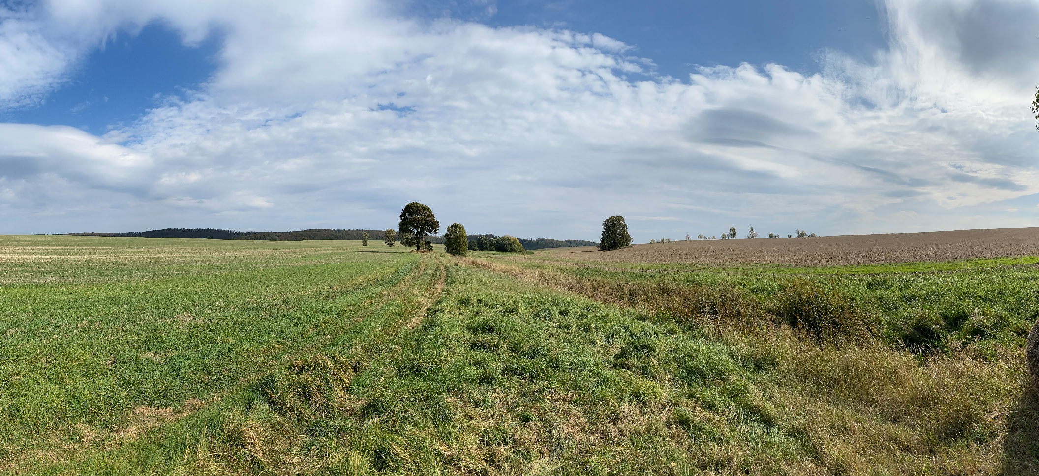
Thank you for your attention!
Thank you for your attention!
Contact: christina.radtke@ufz.de

