Slide 1





SCAN NOW!
A Lagrangian study of globally emitted aviation NO_{x} and associated short-term O₃ radiative forcing effects
Jin Maruhashi¹, Volker Grewe^{1,2}, Christine Frömming², Patrick Jöckel² and Irene Dedoussi¹
¹Faculty of Aerospace Engineering, Section Aircraft Noise and Climate Effects, Delft University of Technology, Delft, the Netherlands
²Institut für Physik der Atmosphäre, Deutsches Zentrum für Luft- und Raumfahrt, Oberpfaffenhofen, Germany
Aircraft illustration from openclipart.org

Slide 2
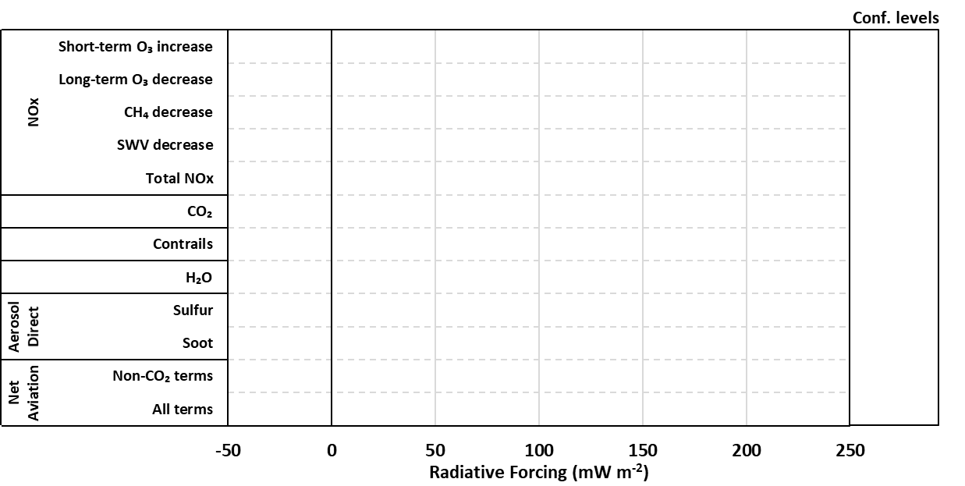
How does aviation affect the climate?
Adapted from Lee et al. 2021 [1]
2

Slide 3
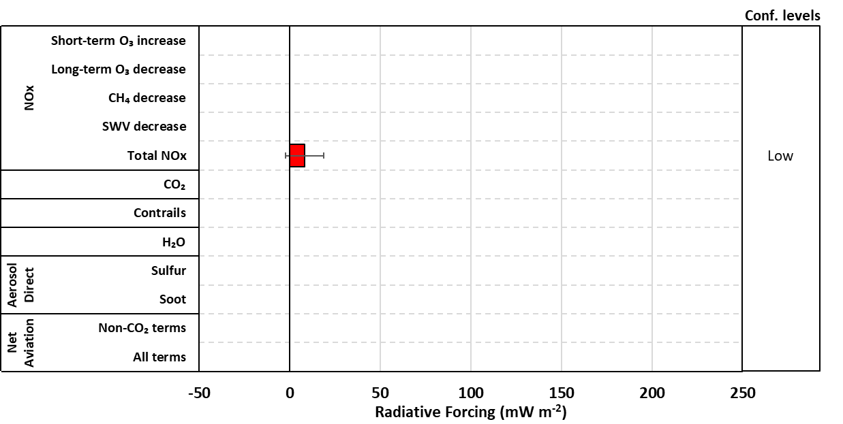
How does aviation affect the climate?
Adapted from Lee et al. 2021 [1]
2

Slide 4
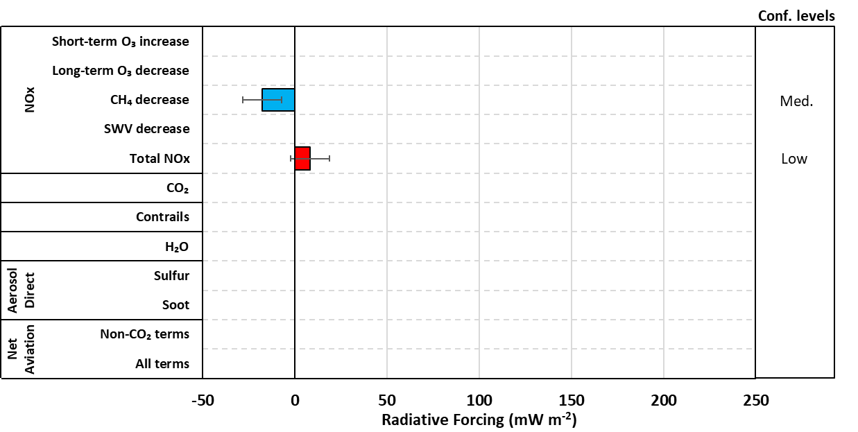
How does aviation affect the climate?
Adapted from Lee et al. 2021 [1]
2

Slide 5
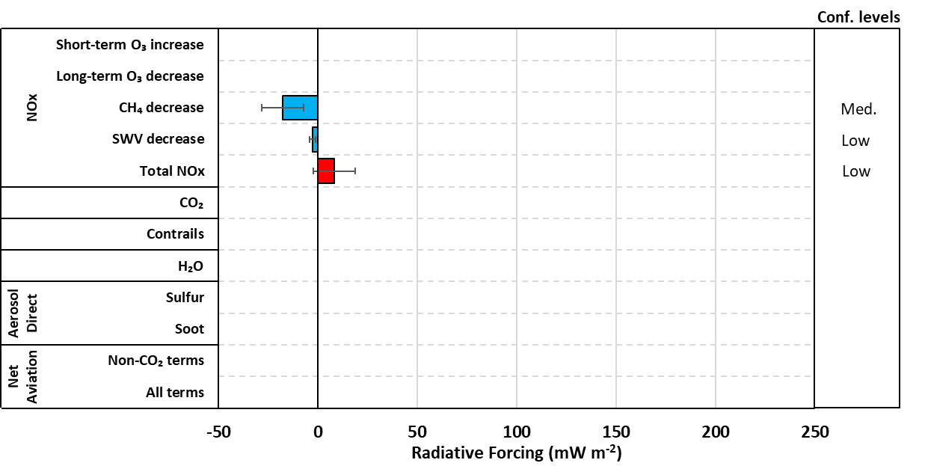
How does aviation affect the climate?
Adapted from Lee et al. 2021 [1]
2

Slide 6
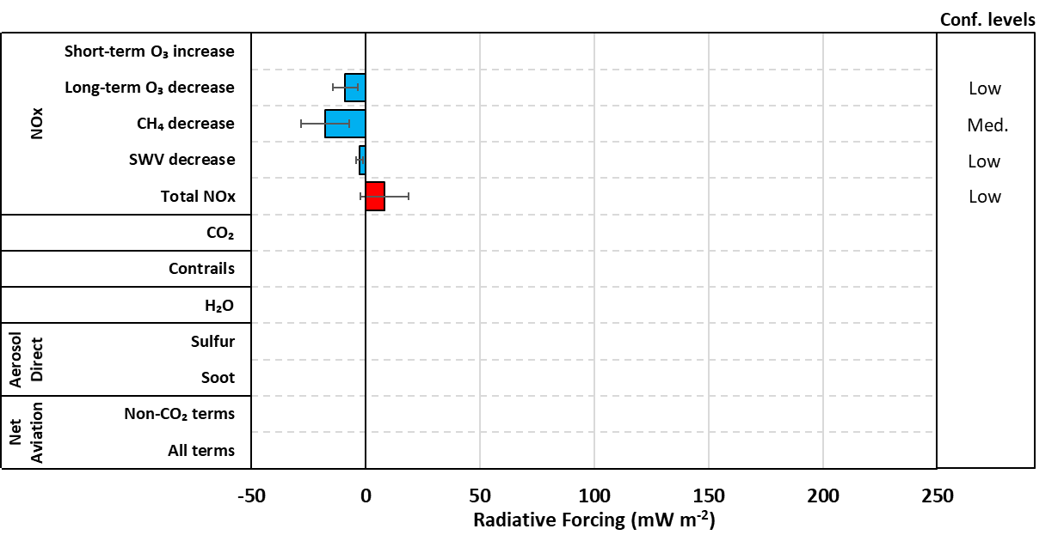
How does aviation affect the climate?
Adapted from Lee et al. 2021 [1]
2

Slide 7
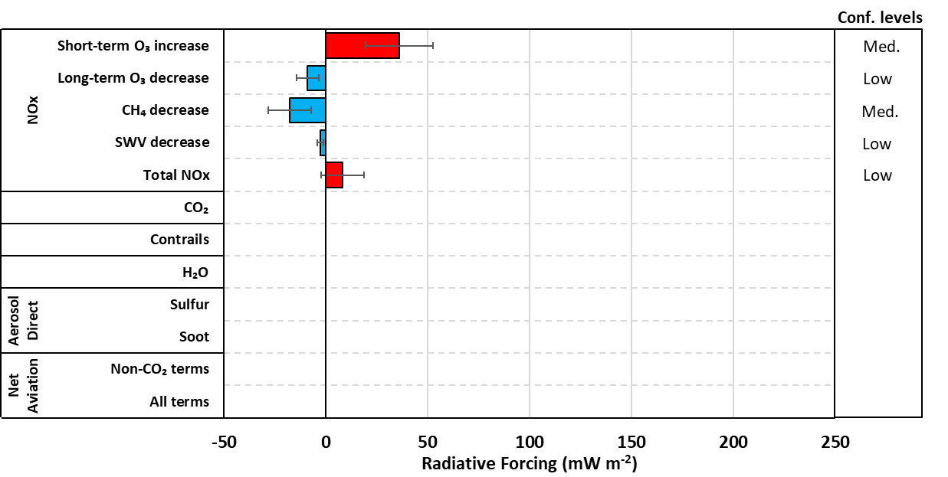


How does aviation affect the climate?
Only warming term from NO_{x}
2nd largest warming term globally
Adapted from Lee et al. 2021 [1]
2

Slide 8
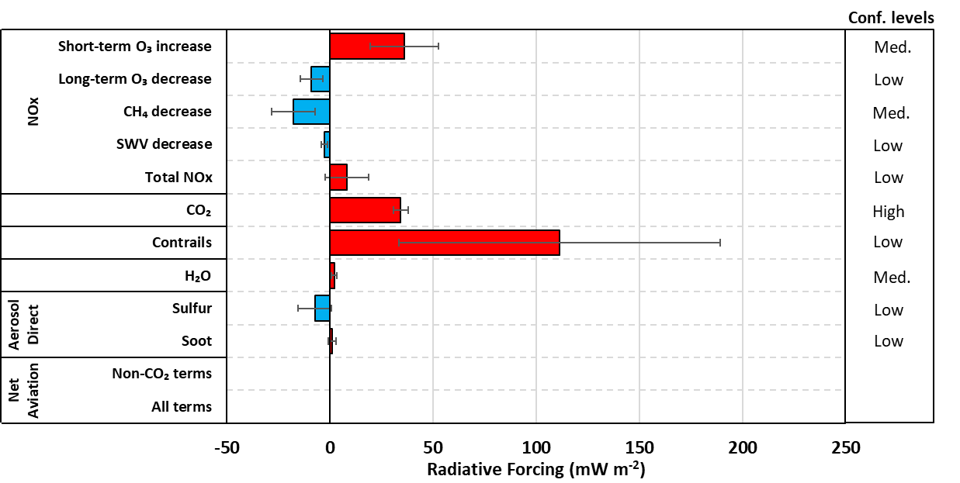
How does aviation affect the climate?
Only warming term from NO_{x}
2nd largest warming term globally
Adapted from Lee et al. 2021 [1]
2

Slide 9
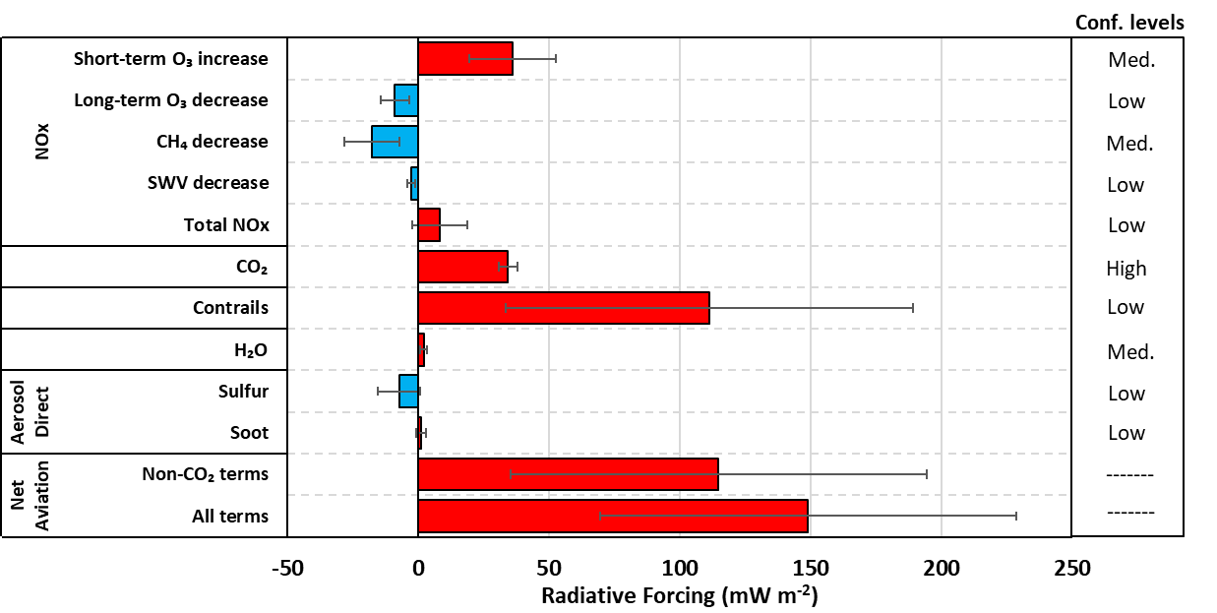



How does aviation affect the climate?
Only warming term from NO_{x}
2nd largest warming term globally
3-5% of anthropogenic RF [2]
Adapted from Lee et al. 2021 [1]
Fast growth [3]
Resilient [4]
2

Slide 10





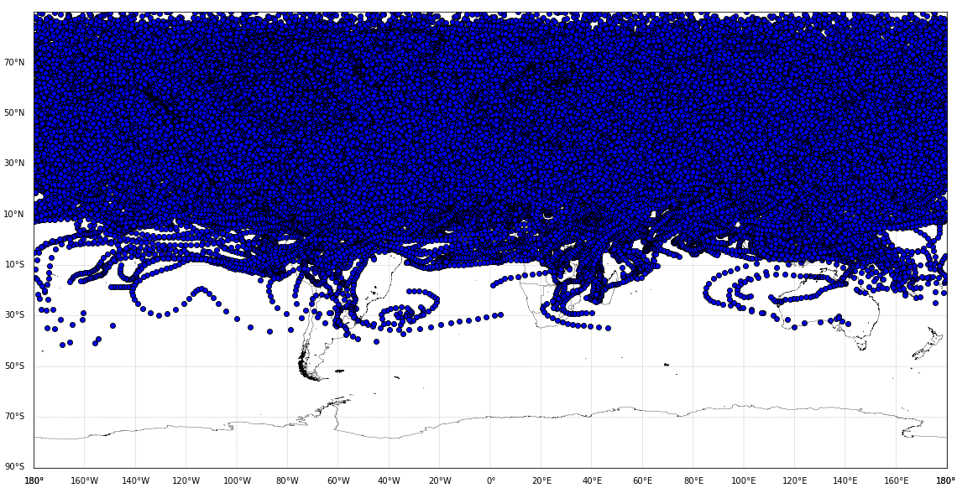
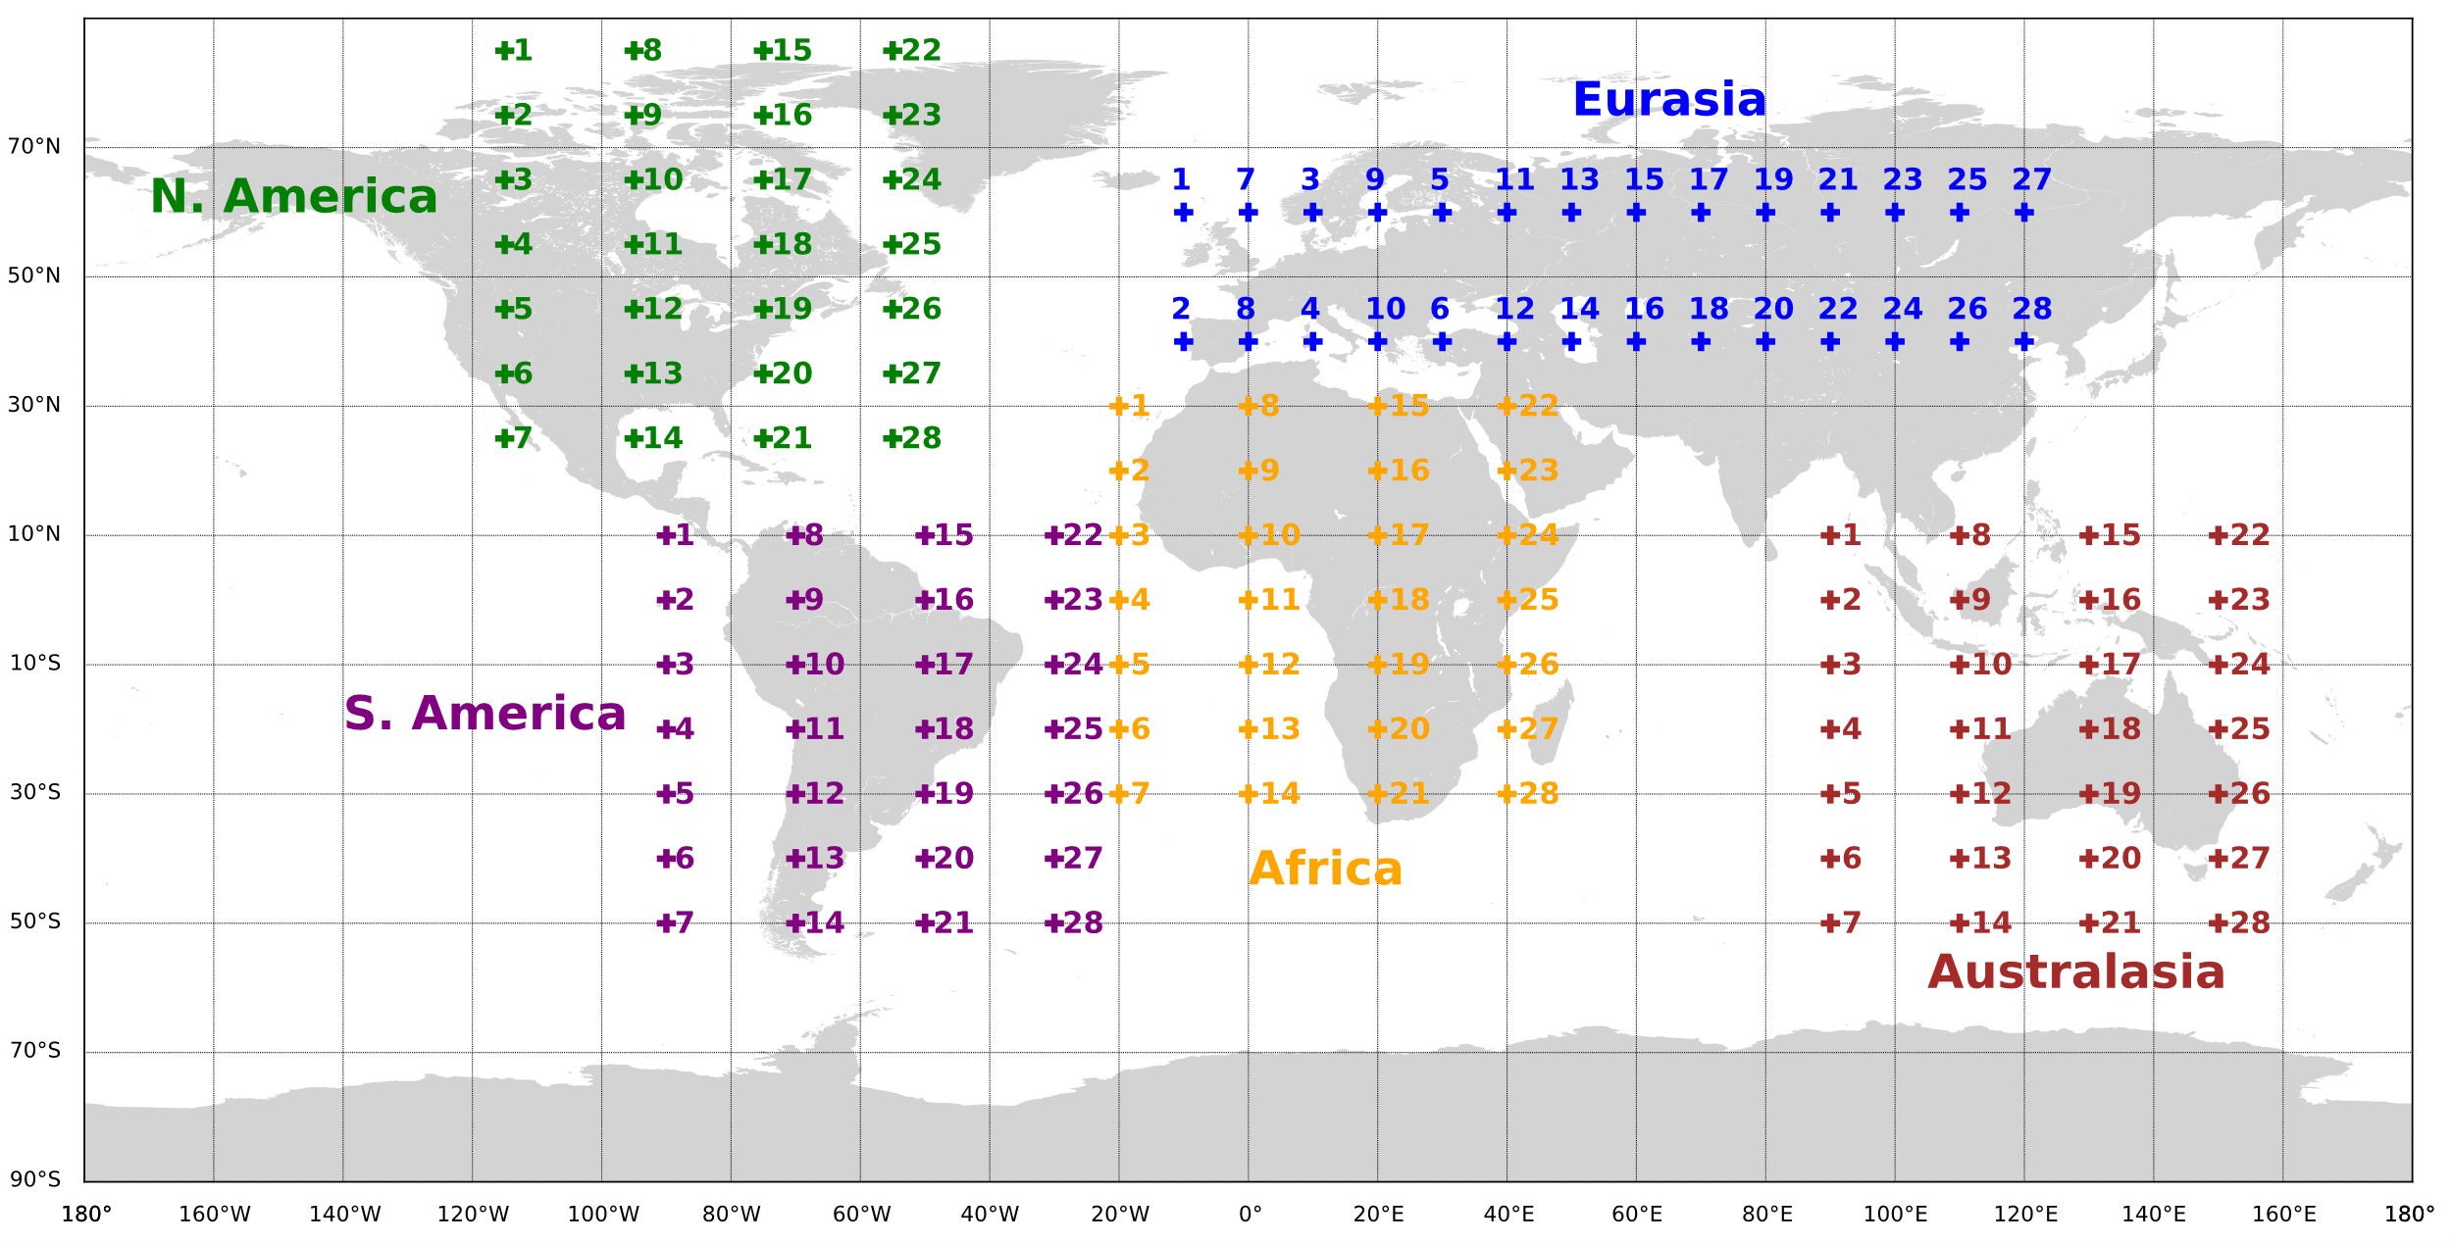
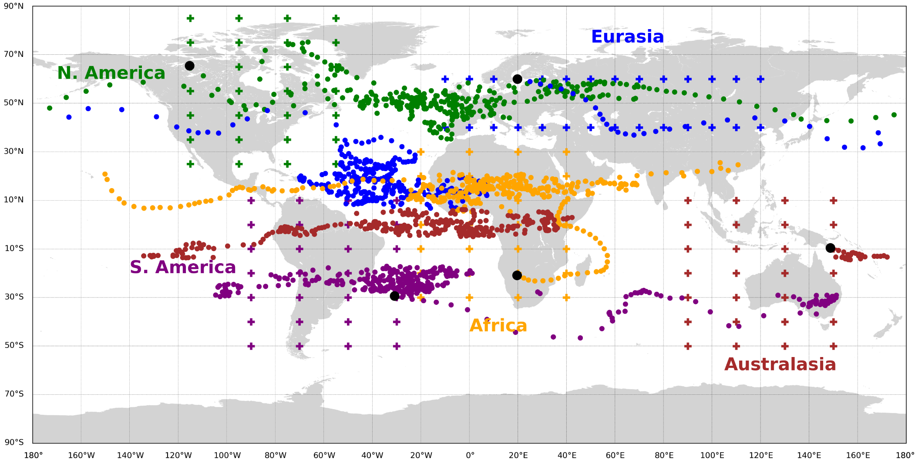

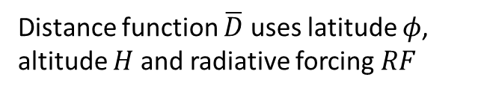
How do we study the O₃ production?
EMAC Model Simulation Setup
Clustering Algorithm
Emit 5×10⁵ kg NO at 250 hPa in 28 points per region
Used in neuroscience [5]
Emissions occur during first day of January and July in 2014
Distance function $\overline{D}$ uses latitude $φ$, altitude $H$ and radiative forcing $RF$
50 air parcel trajectories per point transport emitted NO (Lagrangian)
14 000 NO_{x} – carrying trajectories were simulated
Time steps
i^{th} streamline
j^{th} streamline
3
https://dipy.org/documentation/1.5.0/examples_built/segment_quickbundles/#example-segment-quickbundles

Slide 11
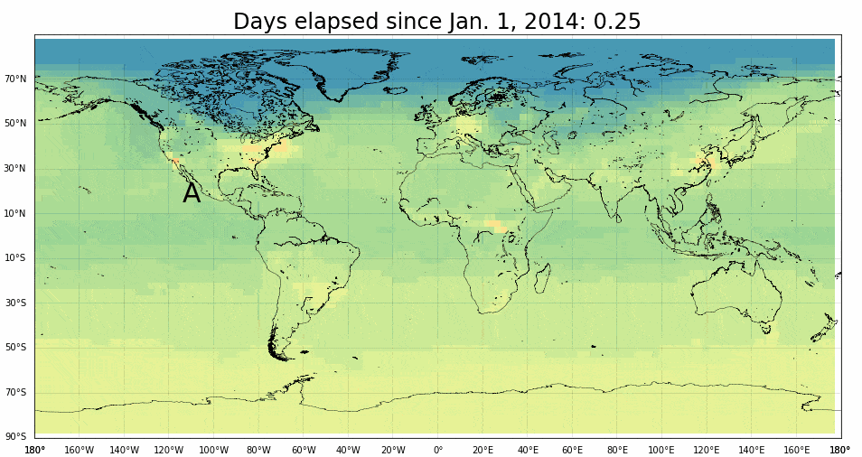
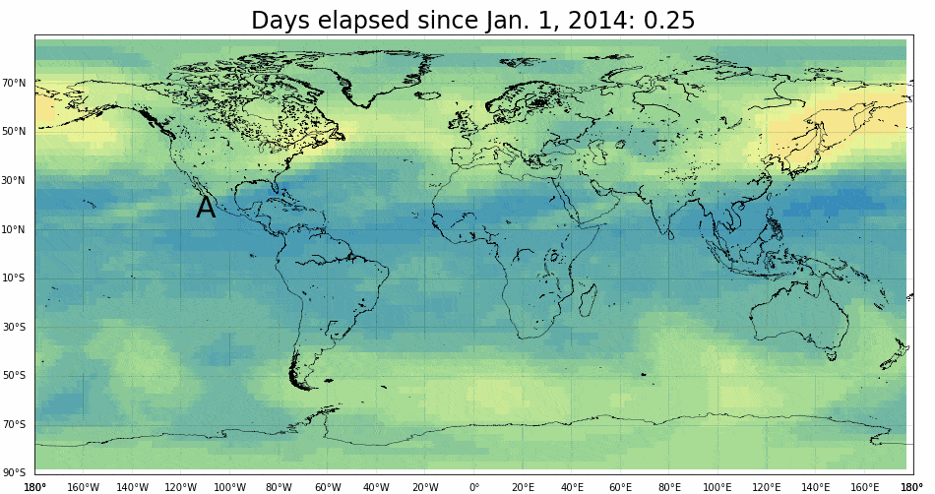
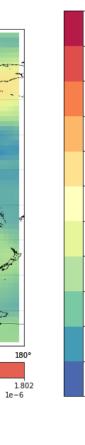
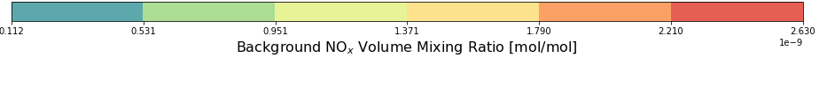
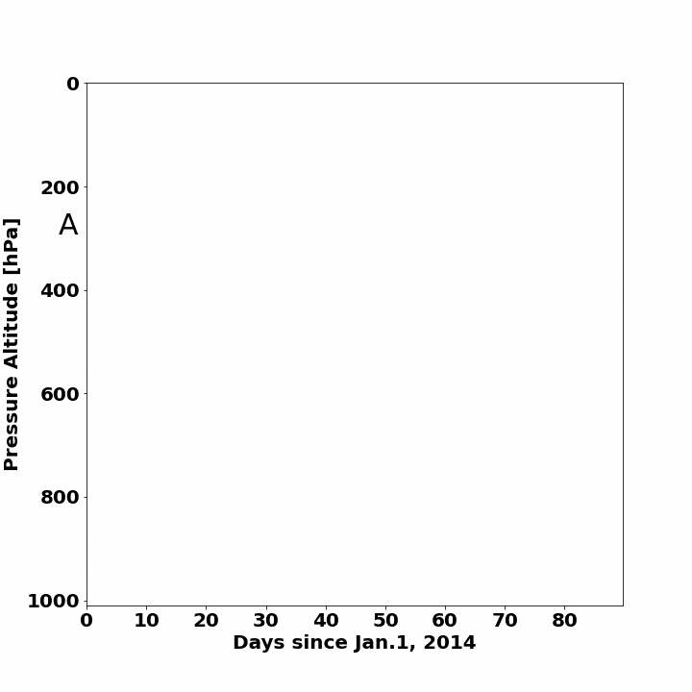

Tracking NO_{x} and O₃
330
40
300
36
NO_{x}
270
O₃
33
240
29
210
25
180
22
NO_{x} Volume Mixing Ratio along Trajectory [pmol/mol]
O₃ Volume Mixing Ratio along Trajectory [nmol/mol]
0.1
0.5
1.0
1.4
1.8
2.2
2.6
150
0.7
0.9
1.0
1.2
1.4
1.6
1.8
18
Background NO_{x} Volume Mixing Ratio [nmol/mol]
Background O₃ Volume Mixing Ratio [μmol/mol]
NO_{x}
120
O₃
14
90
11
60
7
30
4
0
0
4

Slide 12
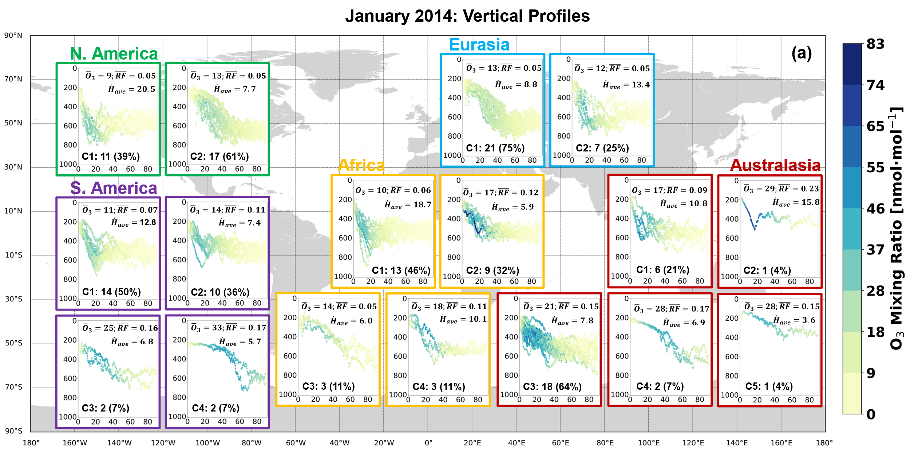


Clustering output: most probable transport paths
Largest cluster in a region
$\left[{\overline{O}}_{3}\right]=$nmol∙mol⁻¹;$\left[\overline{RF}\right]=$mWm⁻²;$\left[{\dot{H}}_{ave}\right]$=hPa∙day⁻¹
5

Slide 13
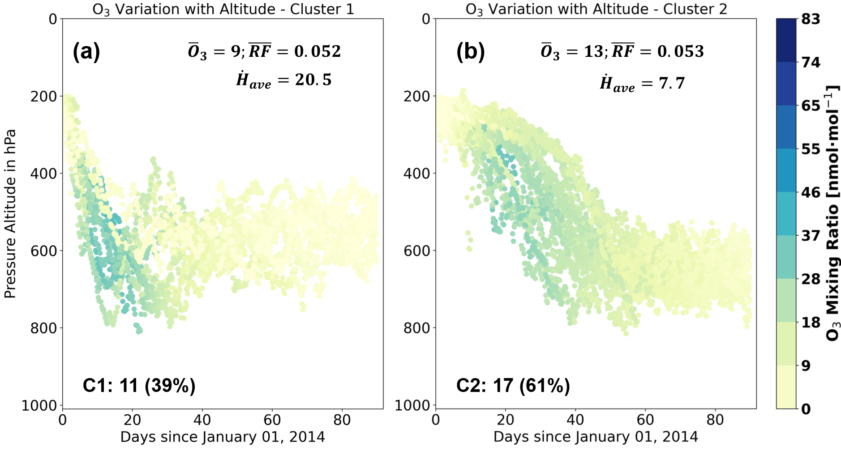

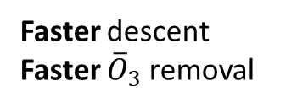
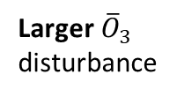

Clustering output: most probable transport paths
Faster descent
Faster ${\overline{O}}_{3}$ removal
Slower descent
Slower ${\overline{O}}_{3}$ removal
Smaller ${\overline{O}}_{3}$ disturbance
Larger ${\overline{O}}_{3}$ disturbance
Largest cluster in a region
$\left[{\overline{O}}_{3}\right]=$nmol∙mol⁻¹;$\left[\overline{RF}\right]=$mWm⁻²;$\left[{\dot{H}}_{ave}\right]$=hPa∙day⁻¹
5

Slide 14
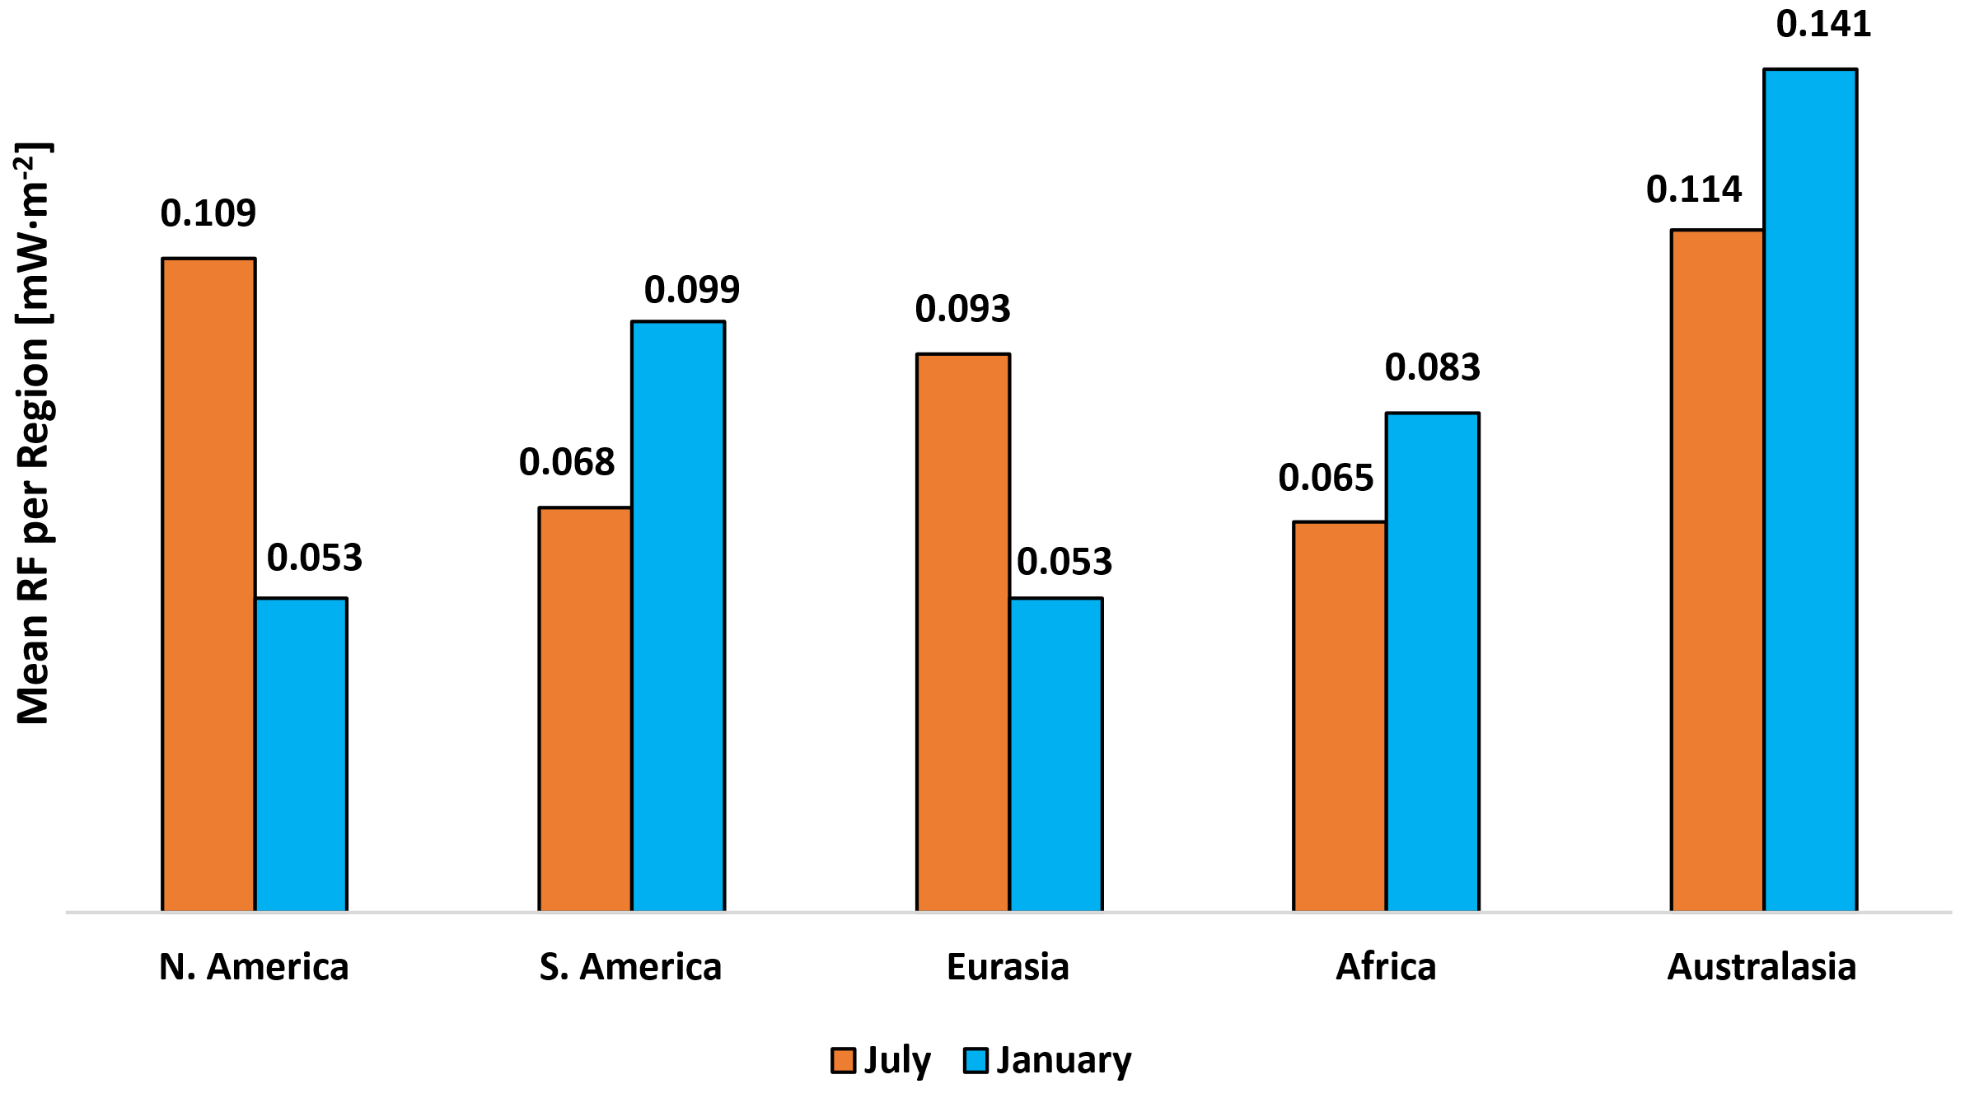
Spatio-temporal heterogeneity of NO_{x} – O₃ effects
Spatial dependence: emitting in cleaner backgrounds leads to higher O₃ production efficiencies (Australasia).
Temporal dependence: larger warming when flying in a region’s summer (or dry) season due to increased photochemistry.
Mean RF per Region for a 5×10⁵ kg (NO) Emission
X2.7
X1.2
Larger warming, increased photochemistry from seasonality
6

Slide 15

Summary and concluding remarks
NO_{x} was emitted in 5 regions during January and July of 2014, its impact on O₃ was studied.
EMAC model produces Lagrangian trajectories, which are then clustered with a neuroscience algorithm.
Most commonly occurring transport paths were highlighted for January 2014.
  Most probable paths in the Northern regions tend to have smaller rates of descent, excluding Australasia.
Spatial dependence of NO_{x}: emitting in Australasia will lead to the greatest radiative forcing out of the 5 regions.
Temporal dependence of NO_{x}: O₃ production is larger in a region when emitting NO_{x} during their corresponding summer season.
j.maruhashi@tudelft.nl
Thank you for your time!
SCAN NOW!
7

Slide 16
References
[1] Lee, D.S., Fahey, D.W., Skowron, A., Allen, M.R., Burkhardt, U., Chen, Q., Doherty, S.J., Freeman, S., Forster, P.M., Fuglestvedt, J., Gettelman, A., De León, R.R., Lim, L.L., Lund, M.T., Millar, R.J., Owen, B., Penner, J.E., Pitari, G., Prather, M.J., Sausen, R. and Wilcox, L.J.: The contribution of global aviation to anthropogenic climate forcing for 2000 to 2018, Atmospheric Environment, Volume 244, 117834, ISSN 1352-2310, https://doi.org/10.1016/j.atmosenv.2020.117834, 2021.
[2] Kärcher, B.: Formation and Radiative Forcing of Contrail Cirrus. Nature Communications 9, no. 1: 1824. https://doi.org/10.1038/s41467-018-04068-0, 2018.
[3] European Environmental Agency (EEA). Emissions from planes and ships: facts and figures. https://www.europarl.europa.eu/news/en/headlines/society/20191129STO67756/emissions-from-planes-and-ships-facts-and-figures-infographic, 2019.
[4] ICAO Air Transport Reporting Form A and A-S plus ICAO estimates
[5] Garyfallidis, E., Brett, M., Correia, M.M., Williams, G.B., Nimmo-Smith, I. QuickBundles, a Method for Tractography Simplification. Frontiers in Neuroscience, 6, 175. https://doi.org/10.3389/fnins.2012.00175, 2012.
8

Slide 17
Additional Slides
8

Slide 18

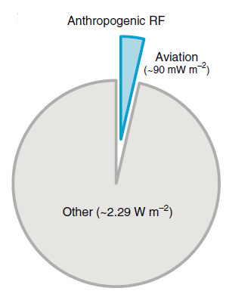
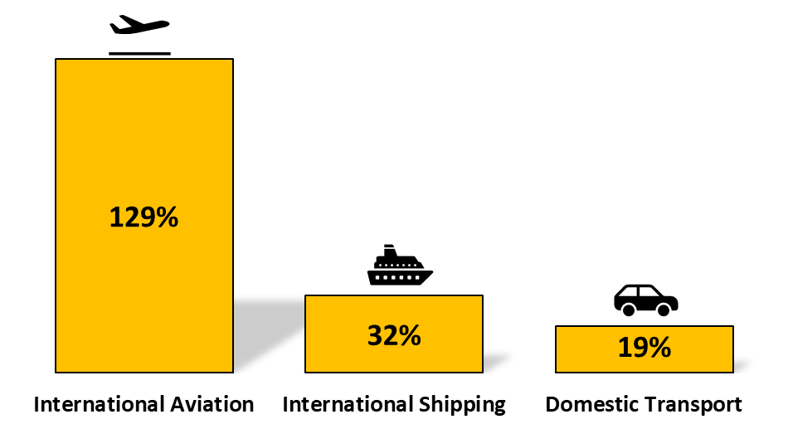
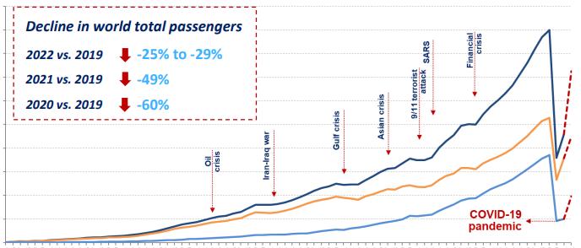
Why is aviation relevant for climate change?
Change in Greenhouse Gas Emission by Sector from 1990 to 2017
World Passenger Traffic Evolution
1945 – 2022
~3-5%
5000
4500
4000
3500
3000
Number of passengers carried
(million)
2500
2000
1500
1000
500
1945
1982
2022
Data from the European Environmental Agency [3]
^{Total passengers}
^{Domestic passengers}
^{International passengers}
Adapted from ICAO Air Transport Reporting [4]
Adapted from Karcher et al. 2018 [2]
2

