Slide 1
Impact of malfunctions on urban drainage for different design rainfall events
Fabian Funke⁽¹⁾, Stefan Reinstaller⁽²⁾ & Manfred Kleidorfer⁽¹⁾
(1) University of Innsbruck, Unit of Environmental Engineering (Austria)
(2) Graz University of Technology, Institute of urban water management and landscape engineering (Austria)

Slide 2
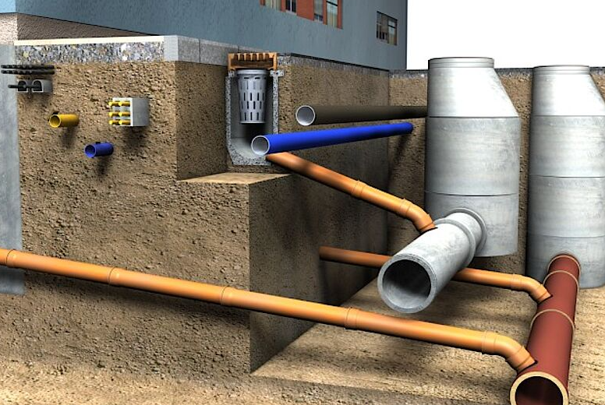
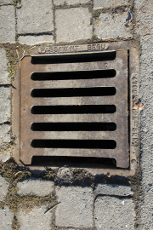
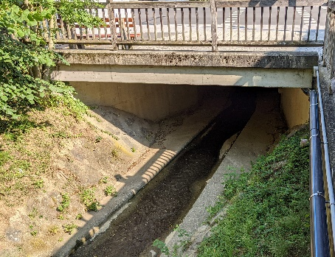
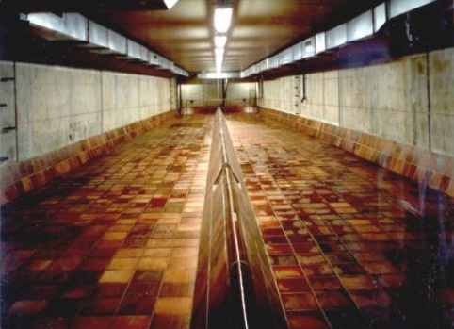
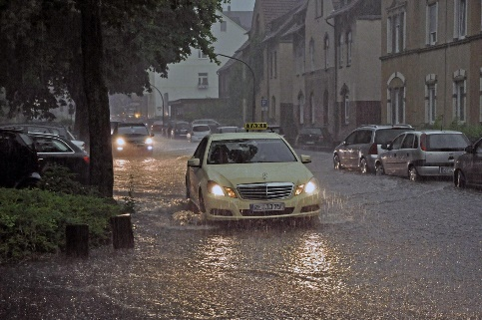
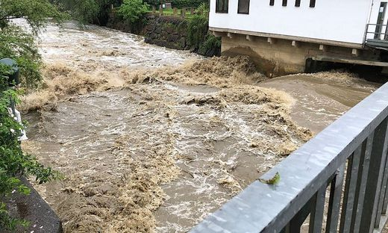
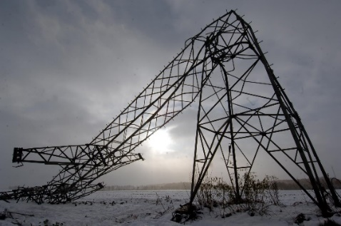
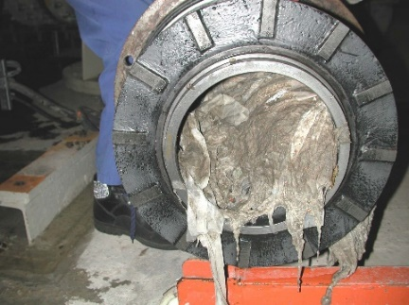
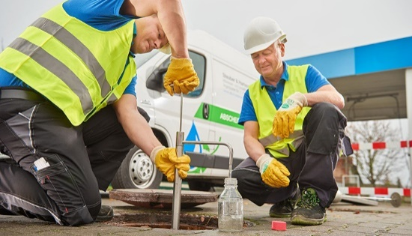
Extreme events and malfunctions
Weather & Climate
Technical (external)
Technical (internal)
Staff & planning
Natural
Notes:
As a quick introduction: In our reseach project Bejond, we are interested in different kinds of urban drainage infrastructures, including technical grey infrastructures like sewers or storage basins but also green and blue infrastructures better known as SUDS or LIDs and how vulnerable they are to extreme events and different malfunctions, arising from weather/climate or natural extremes or external or internal technical problems.
All of them decrease the infrastructures performance and i want to show you how they

Slide 3
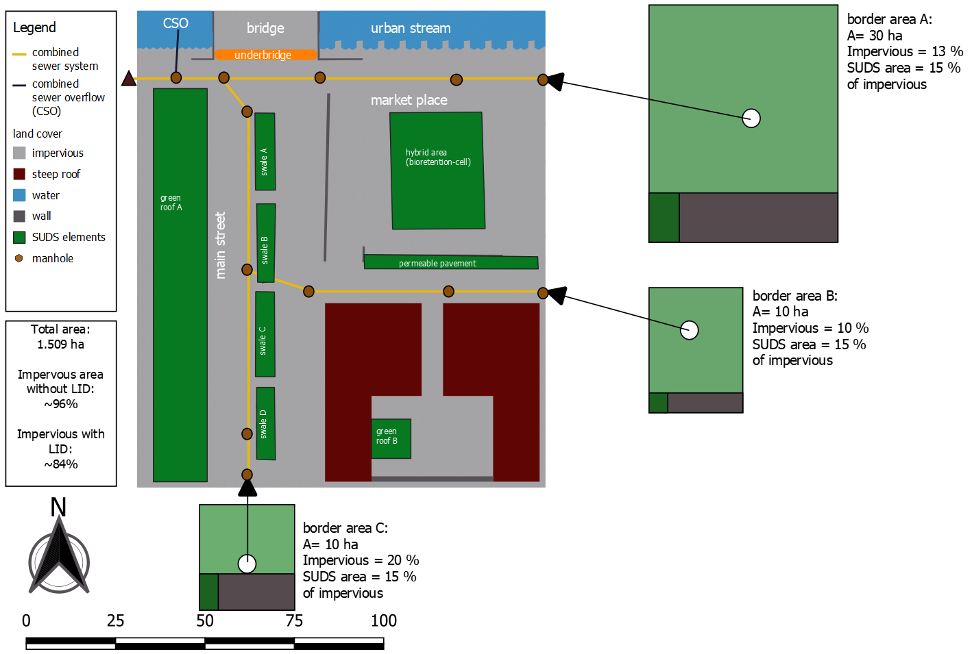
Case study
Virtual urban case study
1.5 ha
different Urban structures
Combined sewer system
3 border areas
LID systems
  Green roof
  Permeable pavement
  Swale
  Bioretention cell
Notes:
To study the effect of malfunctions in urban drainage systems we used a virtual urban case study that represents a city center. It is 1.5ha big and consists of different urban structures, like streets
The area is drainage by a combined sewer system with 3 border areas connected from outside.

Slide 4

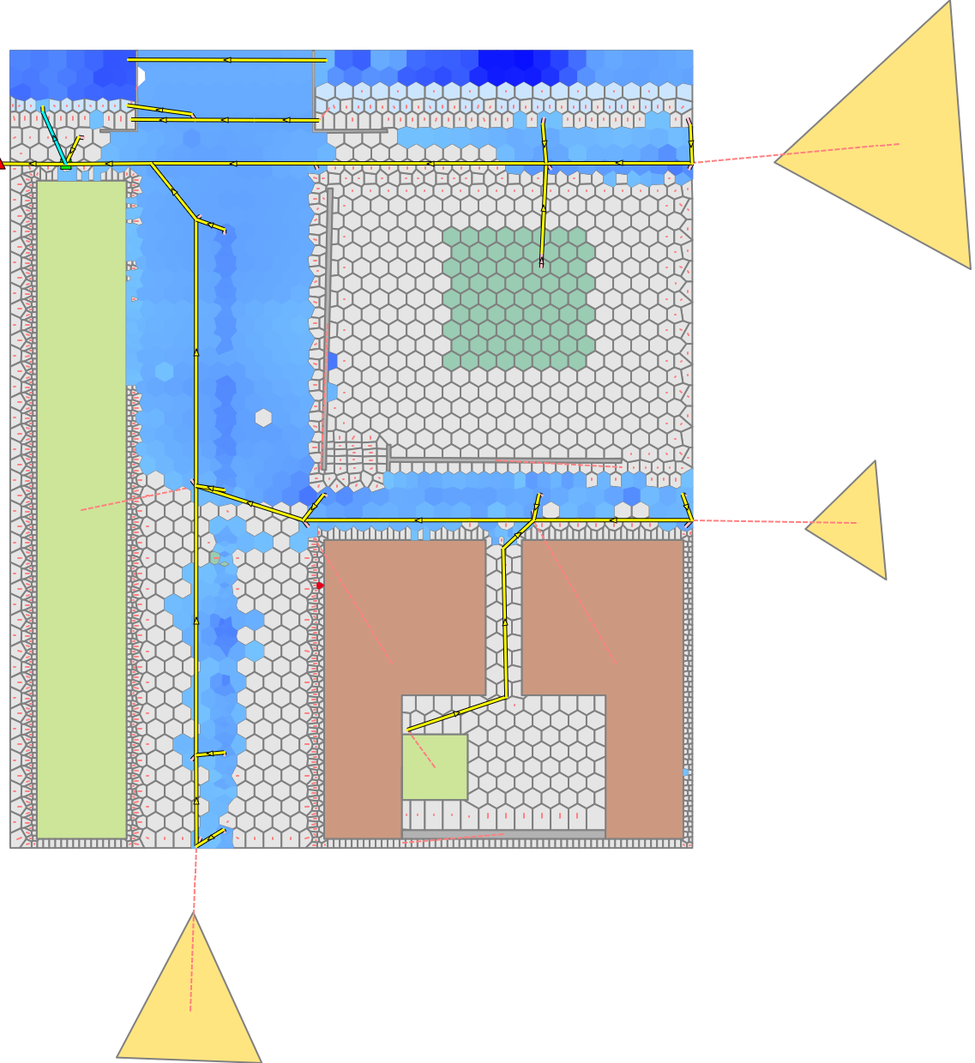
Integrated 1D/2D urban flood modelling
PCSWMM
Integrated 1D-2D Model
  2 dimensional representation of the surface and 1 dimensional of the sewer system
  2D cell size (2 – 8m²) - full distributed
  LIDs implemented at
  2D cells and normal
  subcatchments
Objective Value
  Flooding area (m²) > 10 cm water depth
Notes:
The virtual case study was modelled with an integrated 1D/2D urban flood model with the commercial software PCSWMM.
To assess the severity of malfunctions in different infrasturctures we used the flooding area with a water depth greater than 10cm as our objective value
Impact of malfunctions in urban drainage on flooding during severe rainfall events

Slide 5
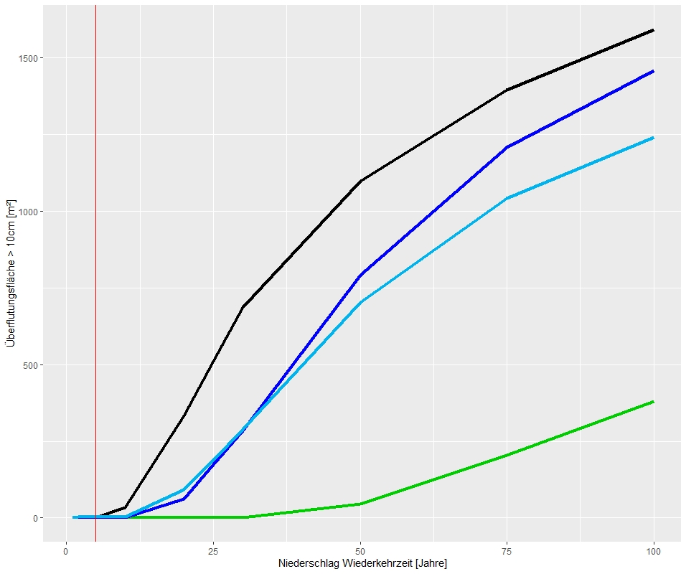
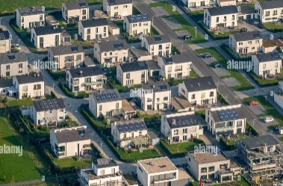
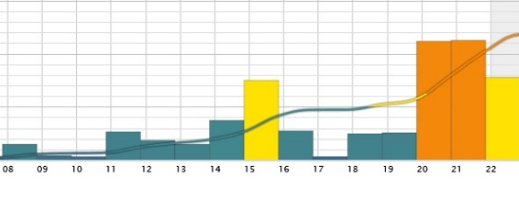
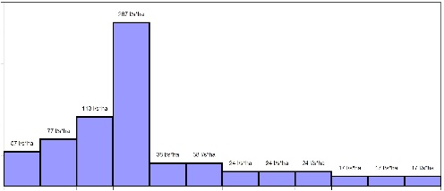
Results – flooding area
Reference scenarios
Urbanization
Wet preconditions
Flooding area >10cm [m²]
Climate change
Base
Base case
Rainfall return period [years]
Notes:
On to the results you can see the flooding area plotted for Euler 2 design rainfall events with a return period from 1 to 100 years.
the left side you can see the model results for the base case without any malfunctions and three different reference scenarios. The graph show the flooding area for design rainfall events with return periods from 1 to 100 years.

Slide 6
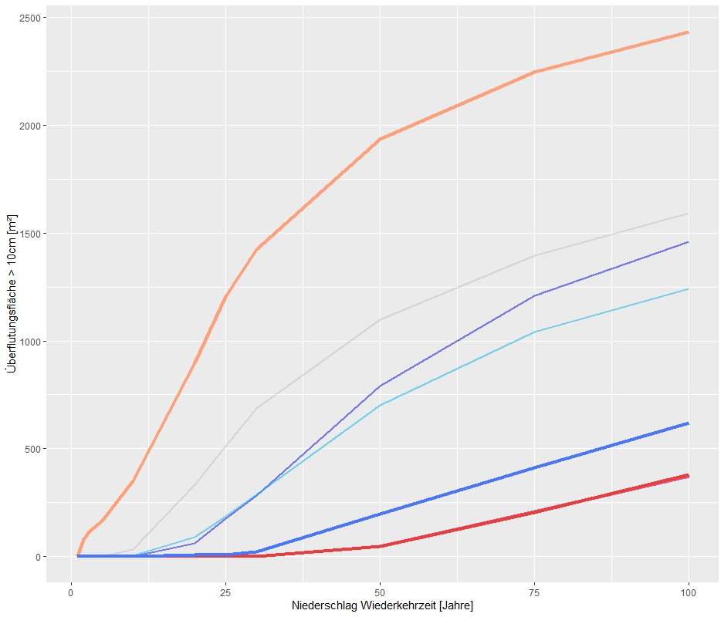
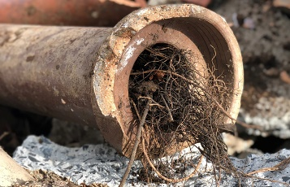
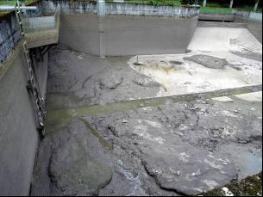
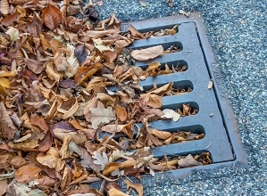
Malfunctions in „grey“ infrastructure
Conduit blockage
Conduit blockage
Reference scenarios
River flood
Flooding area >10cm [m²]
Overflow basin sedimentation
River flood
Blocked inlets
Blocked inlets
Base
Overflow basin
Rainfall return period [years]
Notes:
For the grey infrastructure we testet 4 different

Slide 7
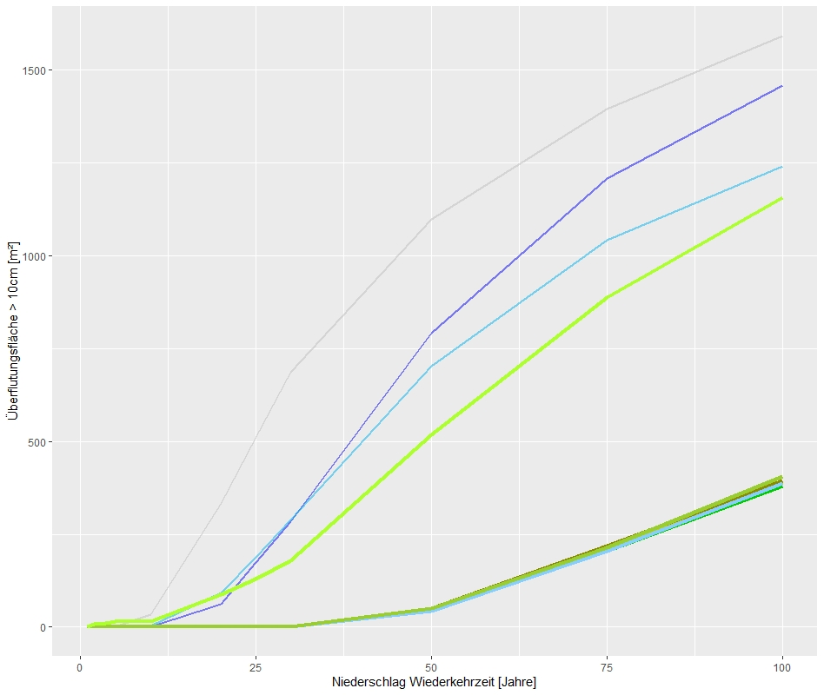
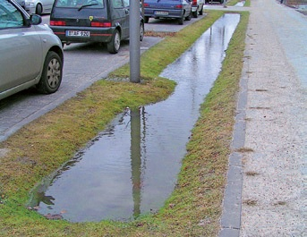
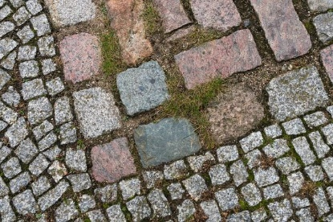
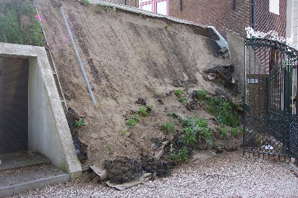
Malfunctions in LIDs
Reference scenarios
Swale sedimentation
Flooding area >10cm [m²]
Permeable pavement clogging
Swale sedimentation (max)
Green roof substrate erosion
Base
Rainfall return period [years]
Notes:
Coming to the results for malfunctions in green infrastructures we testet 3 different scenarios. Highlighted by the red box, all of them are showing no significant increase compared to the base case.

Slide 8
Malfunctions in LIDs
Reference scenarios
Swale sedimentation
Flooding area >10cm [m²]
Permeable pavement clogging
Swale sedimentation (max)
Green roof substrate erosion
Base
Rainfall return period [years]
Notes:
To test the overall influence of green infrastructures we also did a unrealistic complete sedimentation of all swales scenario, which

Slide 9
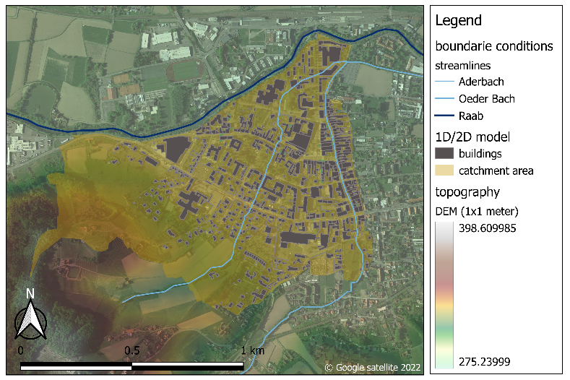
Real world case study
Small city Feldbach (Austria)
1.3 km²
2021 event (100 mm/1h)
  Caused severe flooding
Notes:
Right now we are testing this approach in a real world case study in the small city of Feldbach in Austria with a case study size of 1.3km² where we had a severe flash flood event last year with up to 100mm of precipitation last year.

Slide 10

Thank you for your attention!
Fabian Funke (Universität Innsbruck)
Notes:
So keep an eye on your infrastructure condition and thank you for your attention

