Slide 1
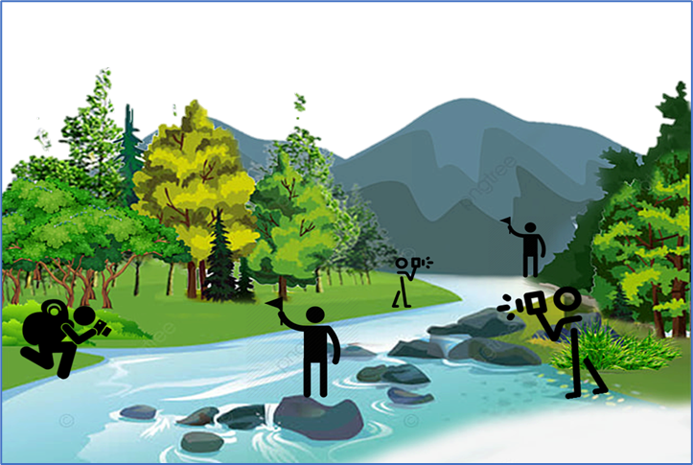

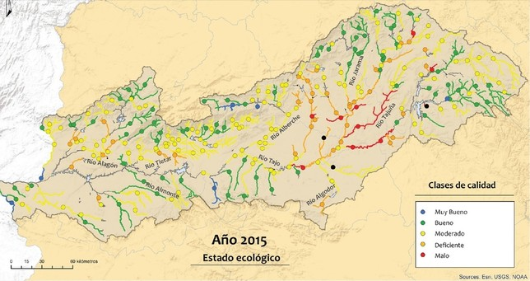


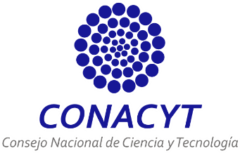
A framework proposal for river health assessment integrating citizen science and machine learning
PhD Fellow: Enya Roseli Enriquez Brambila
Co-promoter: Prof. Dimitri Solomatine (IHE Delft; TU Delft)
Co-promoter: Prof. Michael McClain (IHE Delft)
Supervisor: Dr. Gerald Corzo (IHE Delft)
EGU22-6656

Slide 2

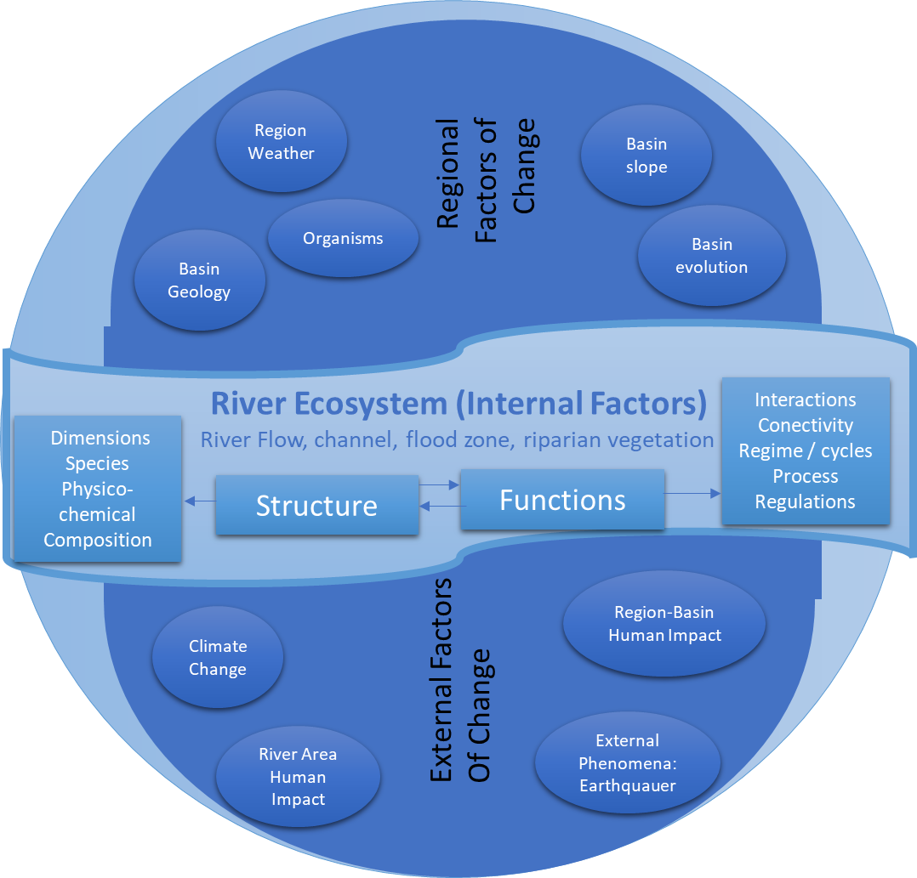
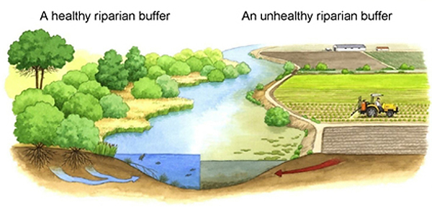
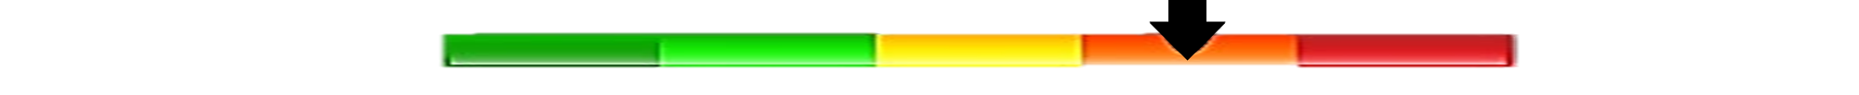
River health as a principal concept in this research
River Health is "the ability of the river to support and maintain key ecological processes and a community of organisms that depend on it (…) as comparable as possible to its ecosystem’s structure and function within a region" (Adapted from Karr and Dudley, 2021, NRHP and SRA).
FLOOD ZONE
NO ROOM FOR RIVERS
RIPARIAN VEGETATION
DEFORESTATION
CHANNEL
FLOW
WASTEWATER
River Health Atributes
20 Indicators
Direct Human Impact Pressures
14 Indicators
Mechanism of a river system adapt from Xiu et. al. 2013 ; Clapcott et. al. 2020, Dickens et. al. 2021
Rapport 1998 ; Karr 1999

Slide 3
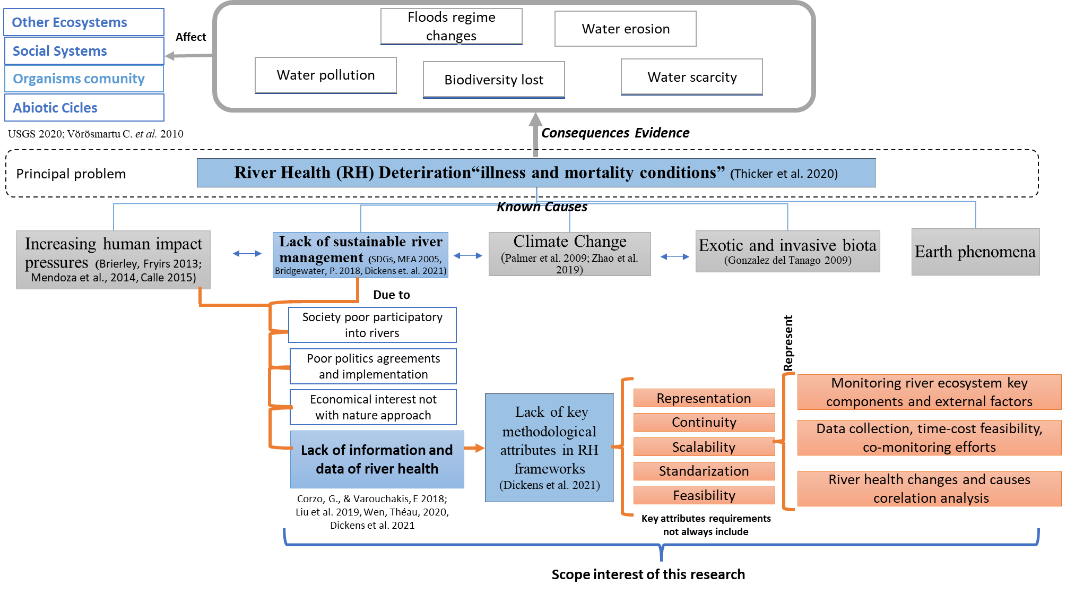
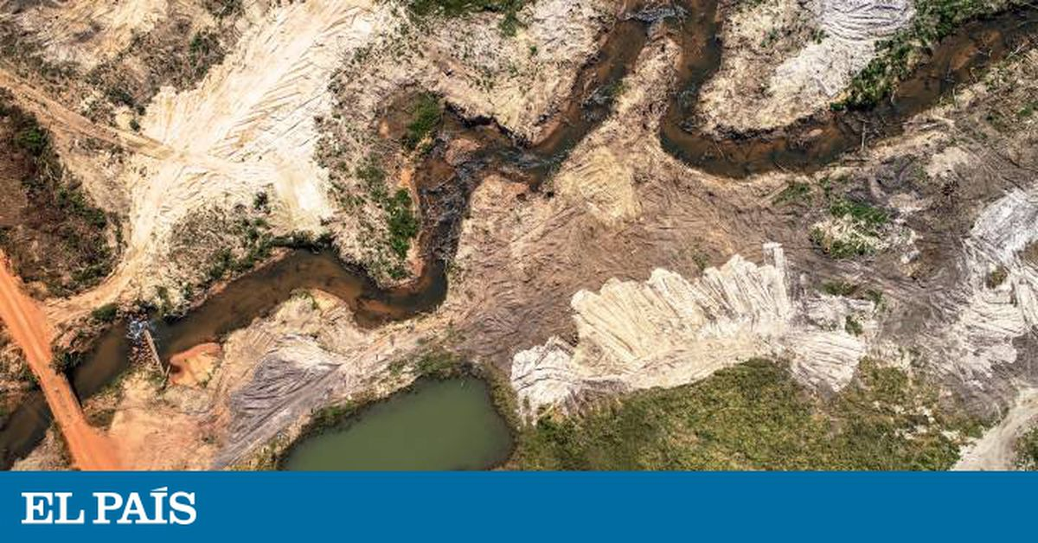
Motivation
Channel erosion
Tropical America

Slide 4
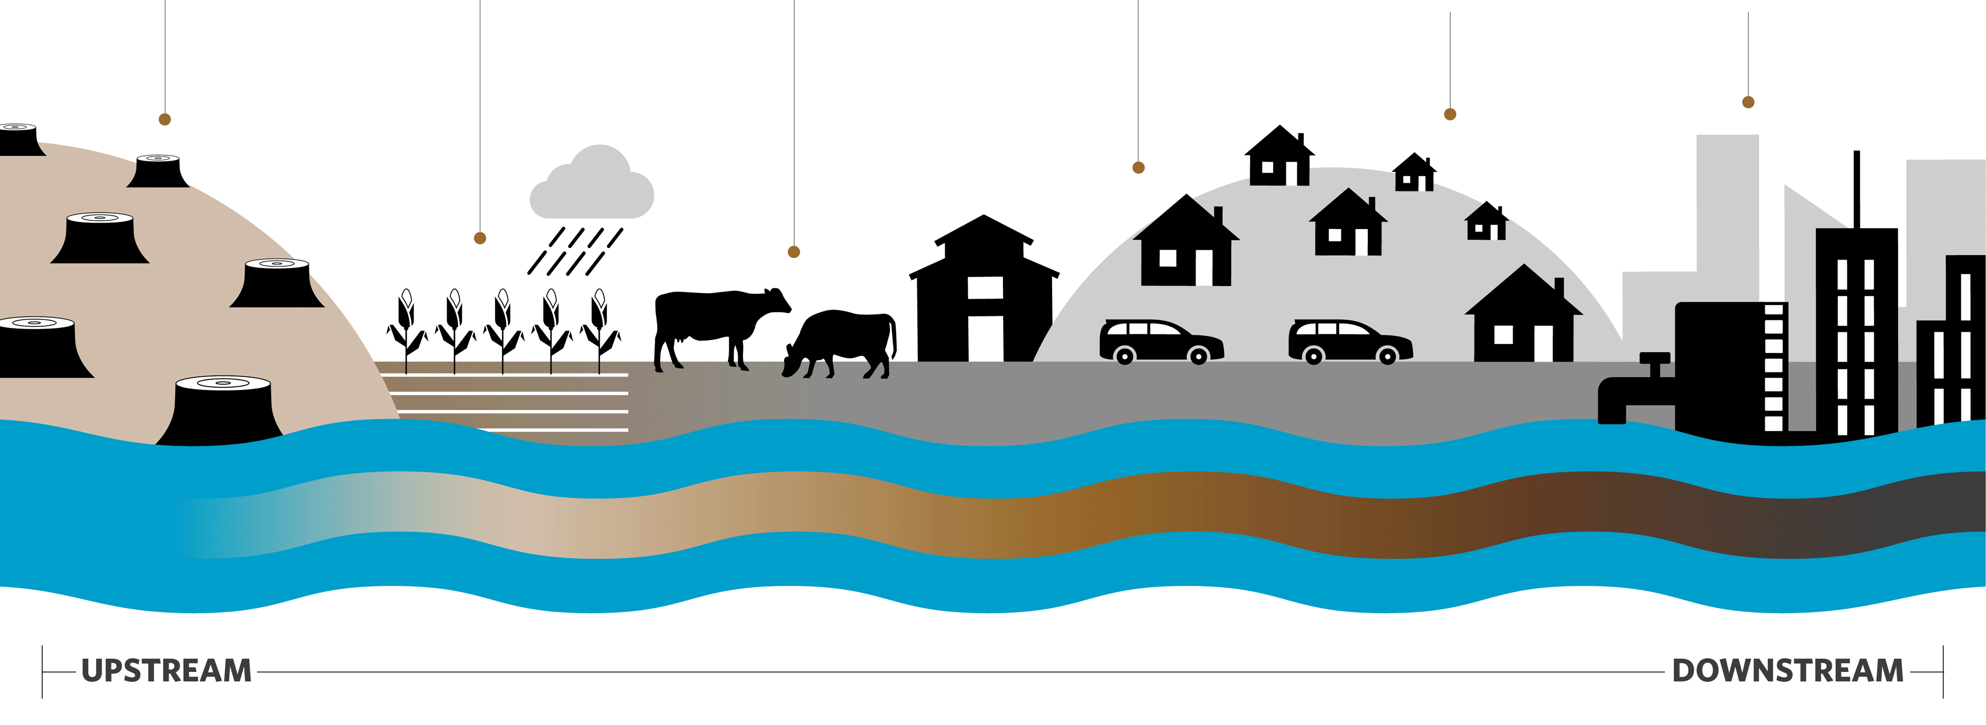
Citizen Science and Machine Learning Goal in RHA framework
Develop a continuous and integral framework to generate information about river health changes and its causation at local and large scales
River Health Changes and Human Impact Pressures. By The Nature Conservancy. GIFT images in https://www.nature.org/en-us/what-we-do/our-insights/perspectives/better-water-security-we-sink-or-swim-together/
Notes:
This study aims to develop a dynamic framework for smart river health ecosystem monitoring, employing citizen science and remote sensing. This concept uses hydro-morphological and biological river indicators, combined with machine learning algorithms to analyze spatiotemporal data.

Slide 5
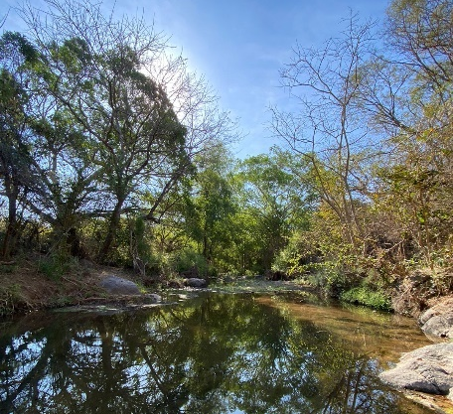

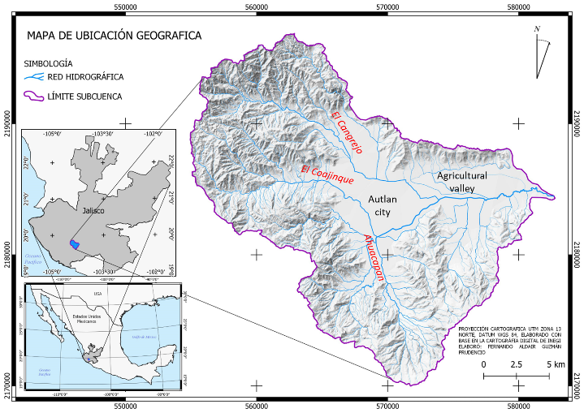
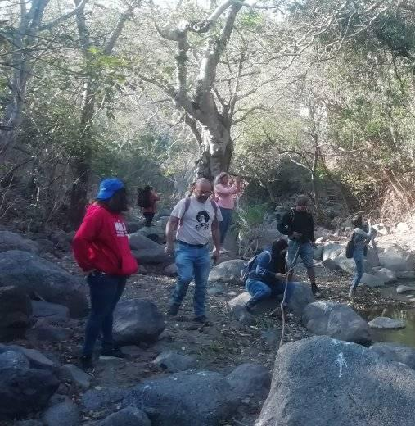
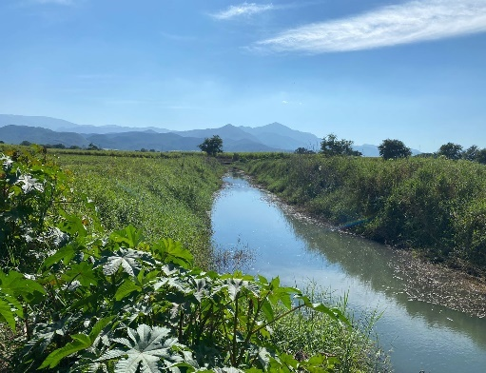


Methodology
Study area
Local Institutions and Citizens
The Coajinque subbasin is part of the Ayuquila Basin located in the State of Jalisco in Mexico country (Demterio 2006; Cotler, Caire 2009; Ortiz-Arrona 2021).
Vigilando Rios
UpStream Coajinque
Amigos Coajinque
University
DownStream Coajinque
River Asossiation

Slide 6
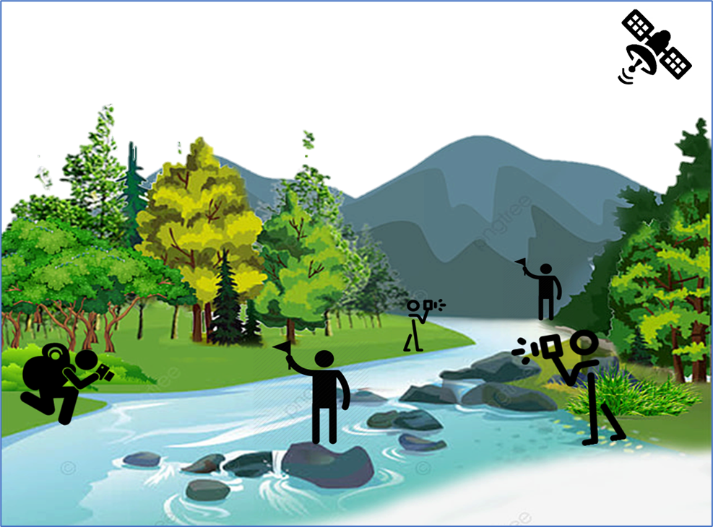
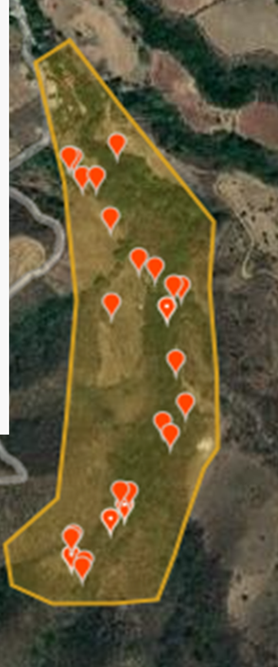
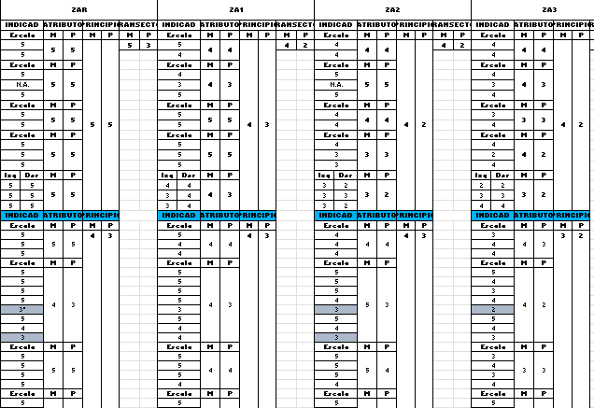
Citizen science workflow to collect river health data indicators
Flow
Channel
Matrix of Indicators
Raw data per Segment
Flood Zone
Riparian Vegetation
Human Impact
Citizen Science Protocols
Shuker et.al. 2017; Thornhill et. al. 2018

Slide 7
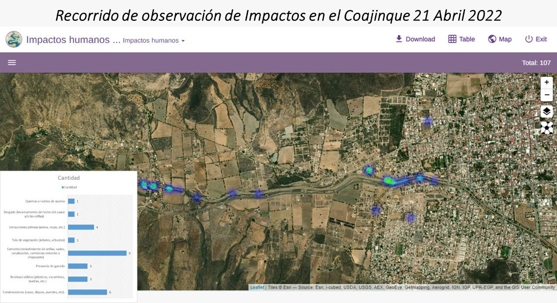
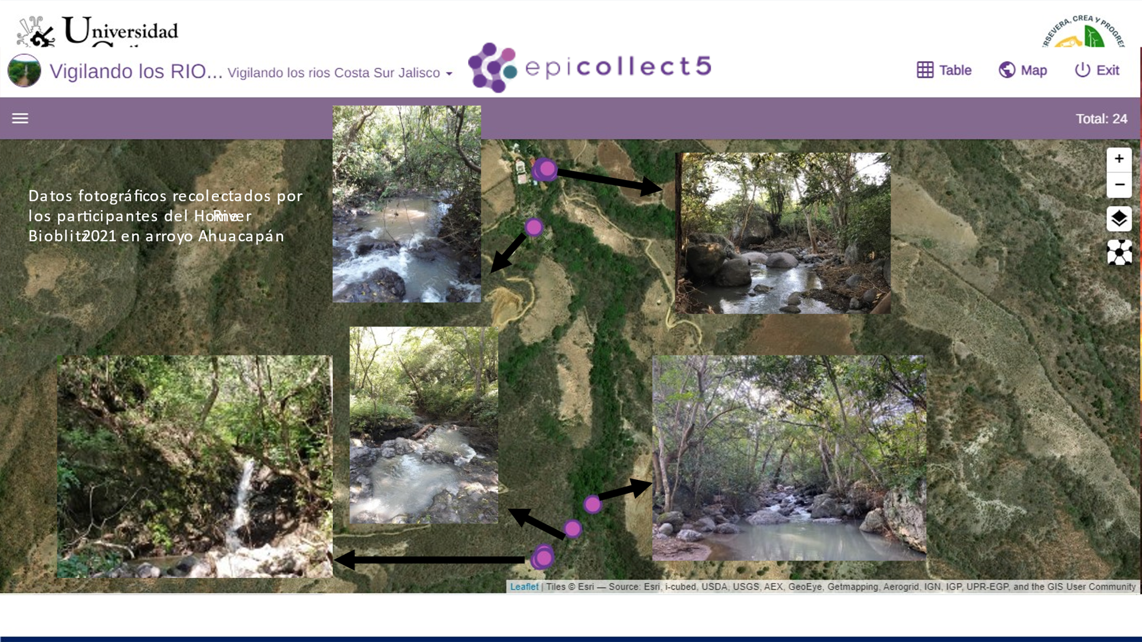

Examples of citizen science data collection

Slide 8
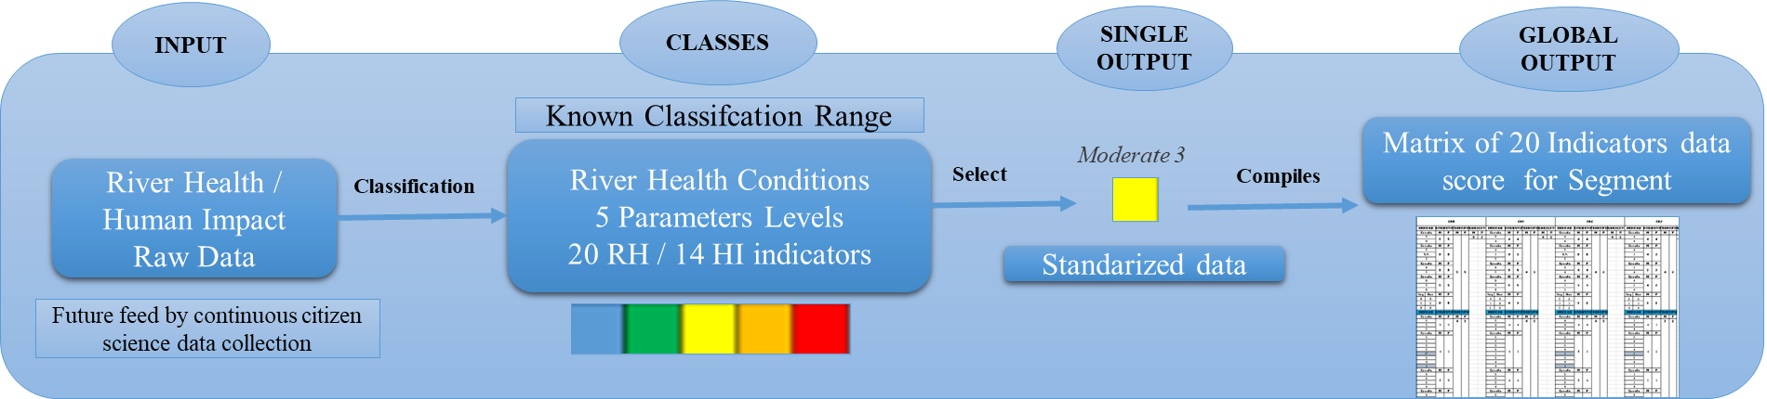
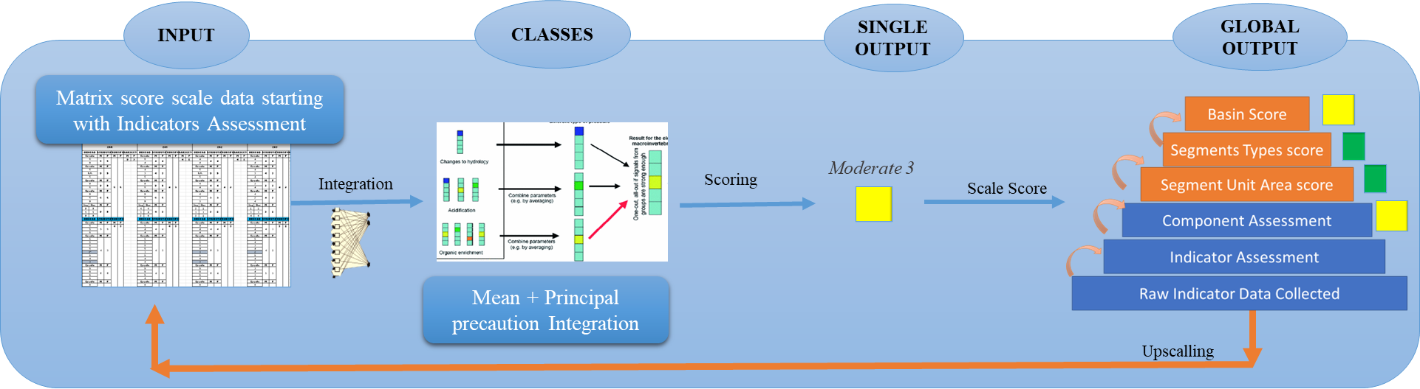
Machine Learning and River Health
Machine Learning Supervised Clasification for river health and human impact assessment
(13 indexes of river health; Goethals et al. 2006; Crisci, C. et al. 2012; Bourel, M., & Segura, A. M. 2018)
Machine Learning Classification for upscalling integration
(Gislason et al. 2006, Bourel, Segura, 2018 Clapcott et al. 2020 .

Slide 9
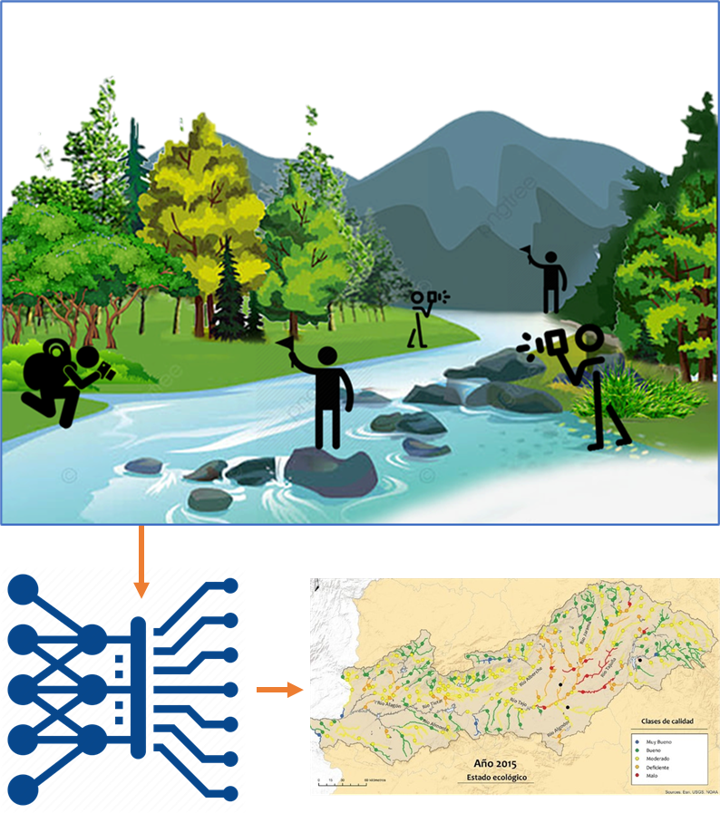
Conclusions
River health “more than water quality”, is a complex representation of river ecosystem structure and function capacity to maintain organisms and proceses that depend on it
Awareness of Latin America River Health current deterioration due to the loss of physical attributes that affect inner key functions (ES) cause by a complex sinergy of management challenges, climate change and unkowns
Framework Assessment next improvents about representiveness, continuity, scalability, standarization and feasibility (Dickens et al. 2021)
Citizen Science participation to collect data about river health key components and connect with field experience
Machine learning as a tool to automatized and increase the continuity to classify the river health indicators raw data into health condition classess and scales aim to improve the time and effort in processing and visualize data
“CO” efforts
Co-data collection | Co-participation | Co-Assessment | Co-Manage

Slide 10
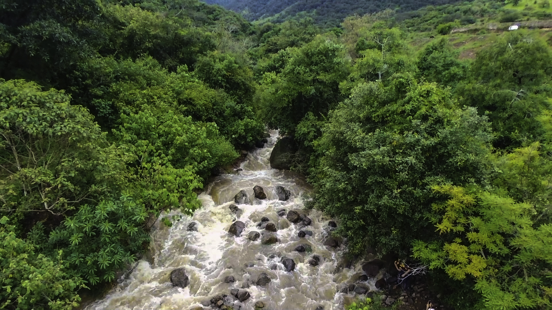
Gracias / Thank you
Linkedin: Enya Roseli Enriquez
Email: e.enriquezbrambila@un-ihe.org

Slide 11
ANEXUS

Slide 12
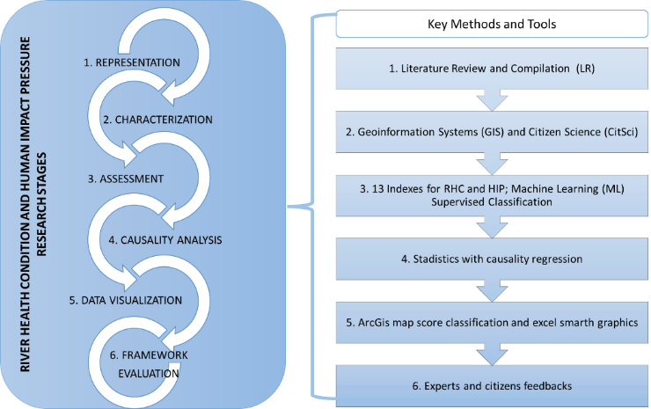
River Health Condition Framework Assessment integrating geoinformation, citizen science and machine learning
PhD process by Enya Roseli Enriquez Brambila
RHC: River Health Condition HIP: Human Impact Pressure

Slide 13
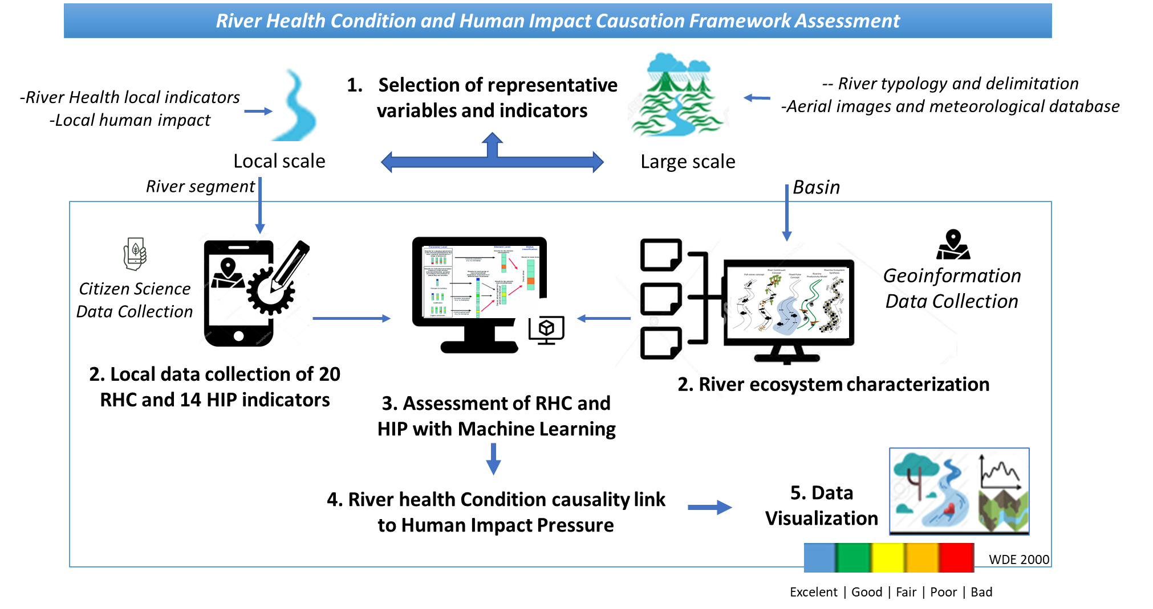

Slide 14
Available datasets to use with machine learning for River Health

Slide 15
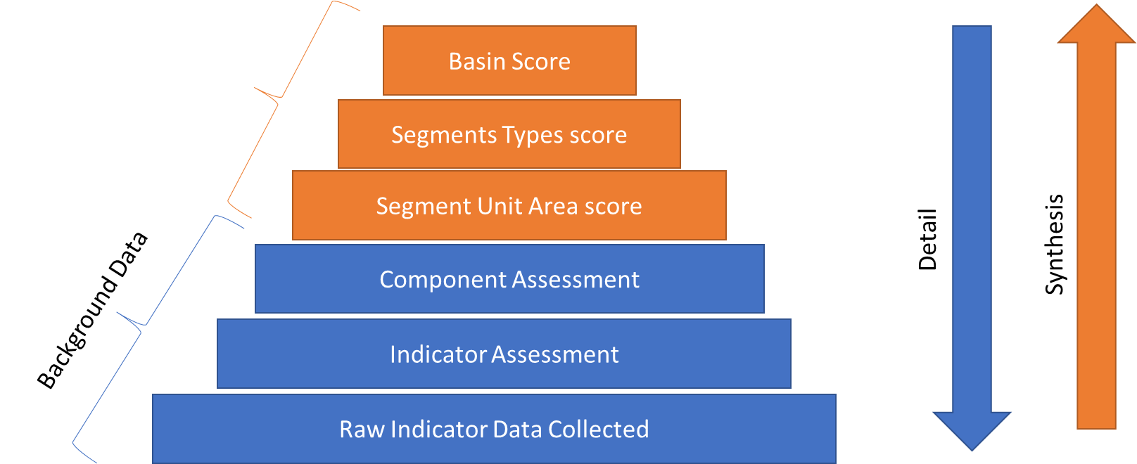
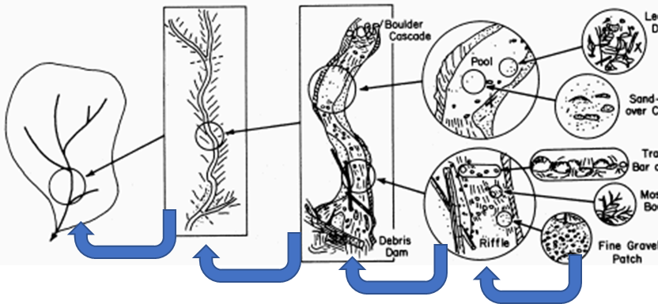
Integrating through Scalability of data
Hypothetical Example of Different Scalable Integration Methods:
1) Simple Mean: 40+80+40+50 / 4 =52.5
2) Weighted Mean: (2X40) + (1X80) + (1X40) + (1X50) / 5 = 50
3) Geometric Mean: 4√40X80X40X50N= 50.2
4) Mode: 40, 80, 40, 50 = 40
5) Principal Precaution: 40, 80, 40, 50 =40
Clapcott et al. (2018)

Slide 16
Storyline about river health assessment frameworks *
Framework Assessment Process
Data Collection
Health Assessessment
Scalability Assessment
Causation Analysis
Experts Observations
Field Work Efforts
Geoinformation Systems
Experts Observation and Perception of River Health
Indexes guidance and experts analysis
Indexes and Stadistics
Citizen Science
Examples:
Home River Bioblitz
RiuNet
Garbage Debbries
iNaturalist Platform
RiverHealthChecker
FreshWaterWatch
MorPh
Machine Learning analysis in river water quality
Examples:
Classification Scheme (RIVPACS) for water quality using macroinvertebrates 2000
Artificial intelligence for ecosystem services (ARIES), 2009.
Supervised machine learning algorithms to ecological data, 2012.
Water Quality: Ecological Integrity Conformance of Run-of-River Hydropower 2018
Evaluating the impact of land uses on stream integrity using machine learning 2019
Mapping vegetation types in semi-arid riparian regions using random forest and object-based image approach 2020
TimeLine -Tools – Actors
TimeLine -Tools – Actors
Notes:
Where does citizen science and machine learning fit in the river health assessment contribution?

Slide 17
To Know more about the Project:
Links to vigilando los ríos y arroyos de mexico:
https://www.facebook.com/VigilandoRiosArroyos
Link to Smart River Health:
https://sites.google.com/view/smart-and-dynamic-river-health/home
Link to IHE and River Health:
https://www.un-ihe.org/news/ihe-delft-phd-researcher-supports-citizen-science-river-biodiversity-mexico
iNaturalist Project:
https://www.inaturalist.org/projects/ahuacapan-river-bioblitz-2021
Epicollect Project:
https://five.epicollect.net/project/impactos-humanos-en-rios-y-arroyos-mx

Slide 18
References of the 13 frameworks indexes baseline
Stream Visual Assessment Protocol (Bjorkland, R. et al. 2009);
Riparian Quality Index (Gonzalez del Tánago, García 2011);
Rapid Appraisal of Riparian Condition (Jansen A. et al. 2005);
Hydro-geomorphological Index of Fluvial Systems (Ollero, A. et al., 2009);
Stream Habitat Survey (Georgia Volunteer Program 2000);
Index of bio-indicators of water quality based on macroinvertebrates (Vazquez D. et al., 2010)
BMWP (Gutierrez-Fonseca & Lorion 2014)
MoRPh: citizen science tool for monitoring and appraising rivers (Shuker et.al. 2017)
Fluvial Ecosystem Ecological Status Assessment (Enriquez-Brambila E. 2018);
Framework for Evaluating Freshwater Health in China (Xie et al. 2020);
Freshwater biophysical ecosystem health framework New Zealand (Clapcott et al. 2018);
The Freshwater Health Index (Vollmer et. al. 2018).
Monitoring biological and chemical trends in temperate still waters using citizen science (Thornhill et al. 2018).

Slide 19
References
Shuker, L. J., Gurnell, A. M., Wharton, G., Gurnell, D. J., England, J., Finn Leeming, B. F., & Beach, E. (2017). MoRPh: a citizen science tool for monitoring and appraising physical habitat changes in rivers. Water and Environment Journal, 31(3), 418–424.
la Calle, M. 2015. Nuevos enfoques institucionales en la gestión del agua: directiva marco de agua. In Moral Ituarte, L; Agudo, PA; Grao, TH (ed.). El agua: Perspectiva ecosistémica y gestión integrada. Zaragoza, España, Fundación Nueva Cultura del Agua.
Mendoza M.; Quevedo-Nolasco, A.; Bravo Vinaja, A.; Flores Magdaleno, H.; de la Isla, D.; de Lourdes, M.; Zamora Morales, B. 2014. Estado ecológico de ríos y vegetación ribereña en el contexto de la nueva Ley General de Aguas de México. Revista internacional de contaminación ambiental 30(4):429-436.
Clapcott, J. E., Young, R. G., Hicks, A. S., & Haidekker, A. N. (2020). The 1st step to healthy ecosystems: Application of a new integrated assessment framework informs stream management in the Tukituki catchment, New Zealand. Freshwater Science, 39(4), 635-651.
Karr, J. R. (1999). Defining and measuring river health. Freshwater biology, 41(2), 221-234.
Rapport, D. J., Costanza, R., & McMichael, A. J. (1998). Assessing ecosystem health. Trends in ecology & evolution, 13(10), 397-402.

