Slide 1
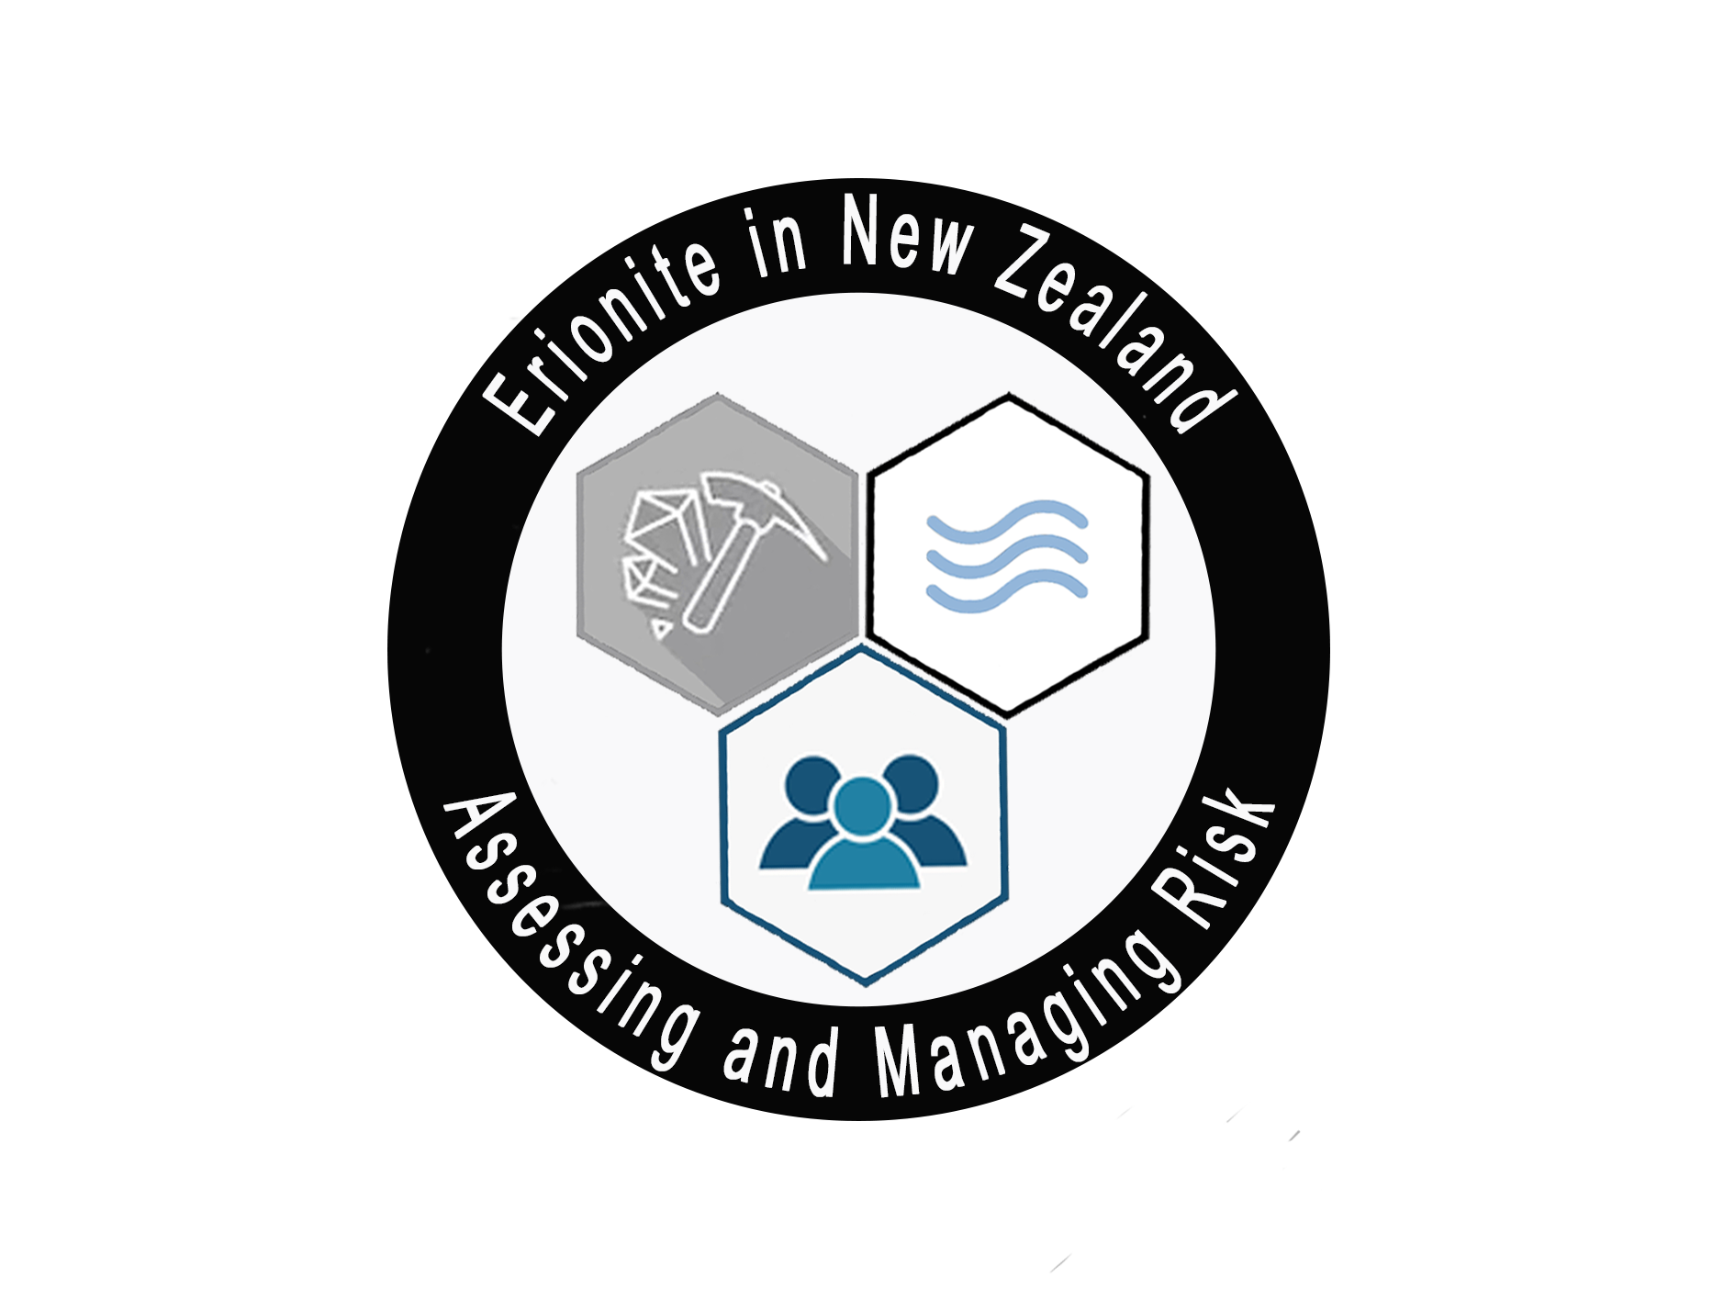

Erionite in New Zealand: initial assessment and characterization
Janki Patel¹, Martin Brook¹, Dario Di Giuseppe², Valentina Scognamiglio² Alessandro F. Gualtieri², Melanie Kah¹ & Ayrton Hamilton¹
¹School of Environment, The University of Auckland, Auckland 1010, New Zealand
²Department of Chemical and Geological Sciences, University of Modena and Reggio Emilia, Via G. Campi 103, I-41125 Modena, Italy

Slide 2
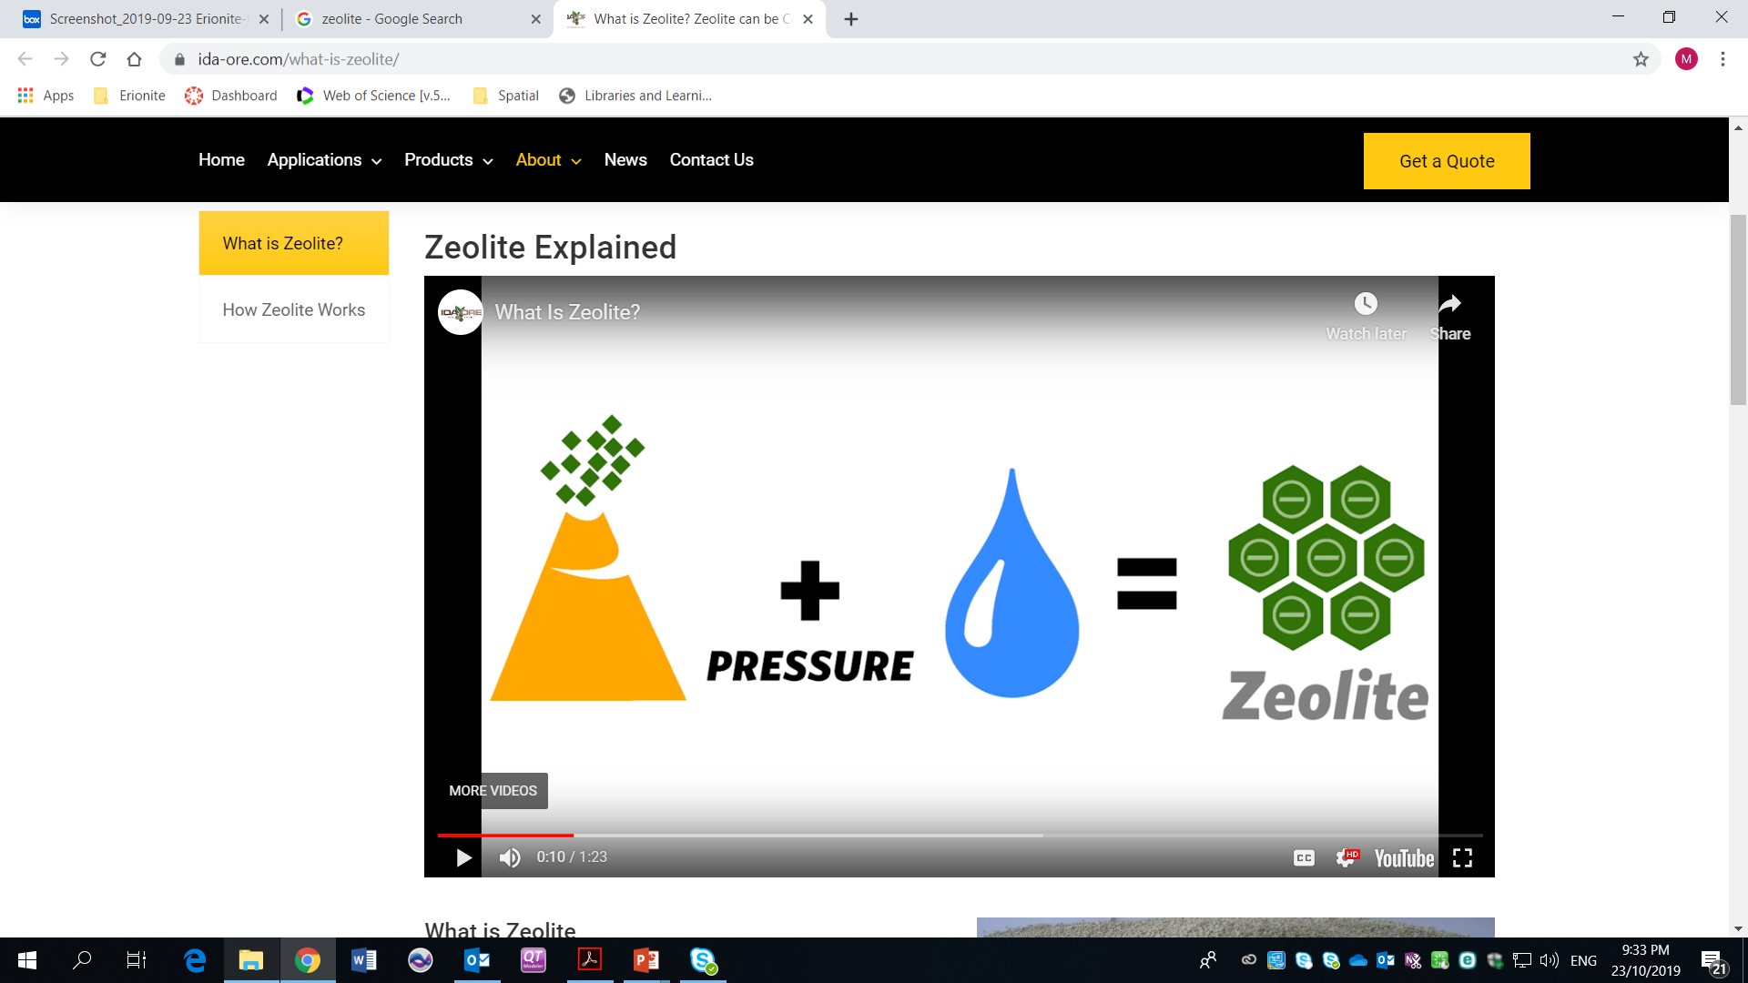
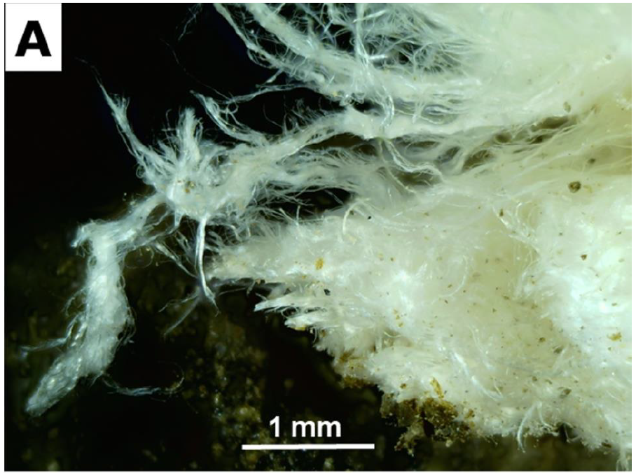
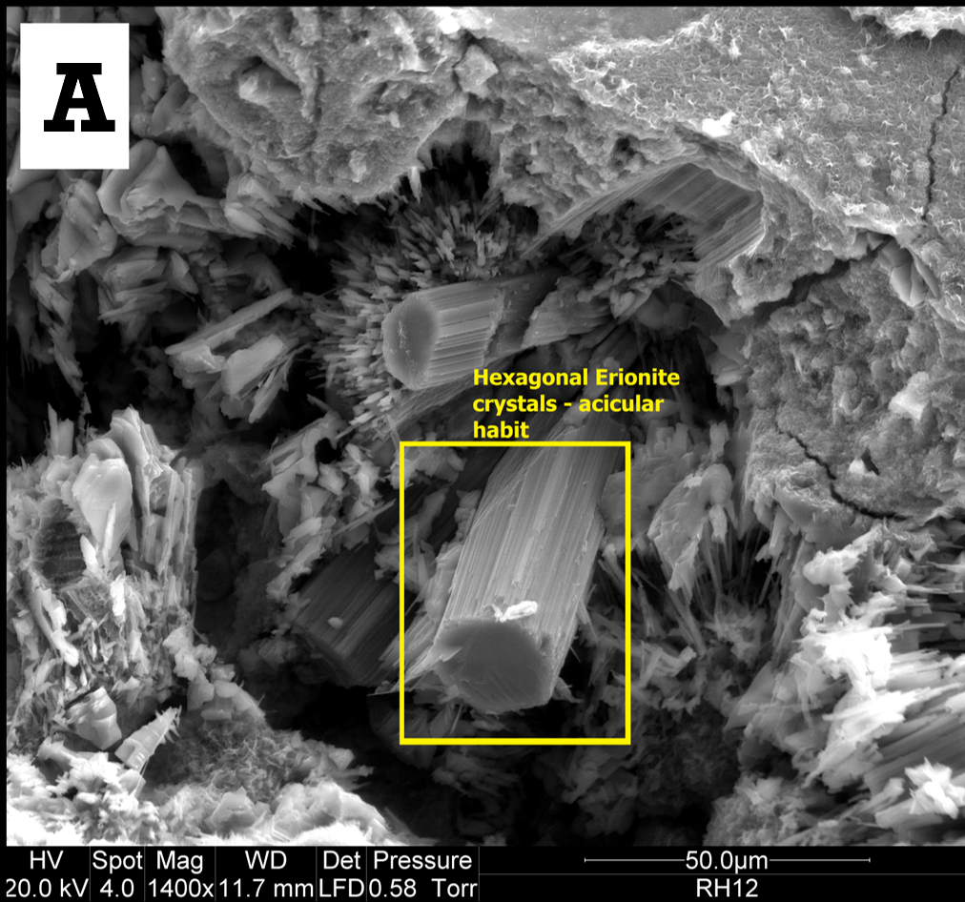
Erionite Overview
Erionite - naturally occurring fibrous zeolite
Zeolites - hydrated alumino-silicates mainly Na, K, Ca
Erionite -the only known carcinogenic zeolite
Inhalation of fibres linked to malignant mesothelioma
Found in Auckland, NZ within altered volcaniclastics
Forms at <110°C in pore spaces/voids
A
B

Slide 3
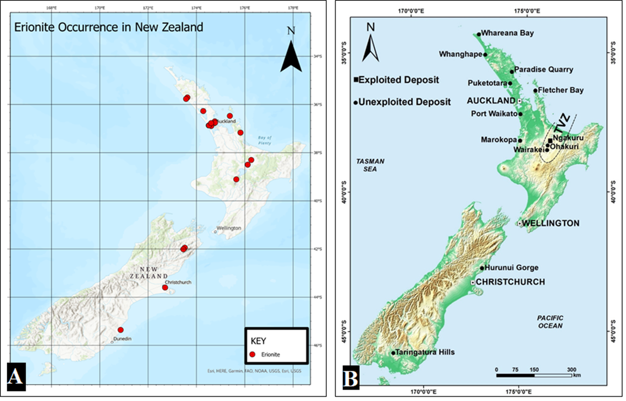
Erionite in NZ
North Island
Auckland region: Miocene Waitemata Group sediments & Waitakere Group volcanics
Taupo Volcanic Zone: Pleistocene ash
South Island
Moeraki point: Paleocene tuff
Christchurch: Late Miocene basaltic andesite

Slide 4
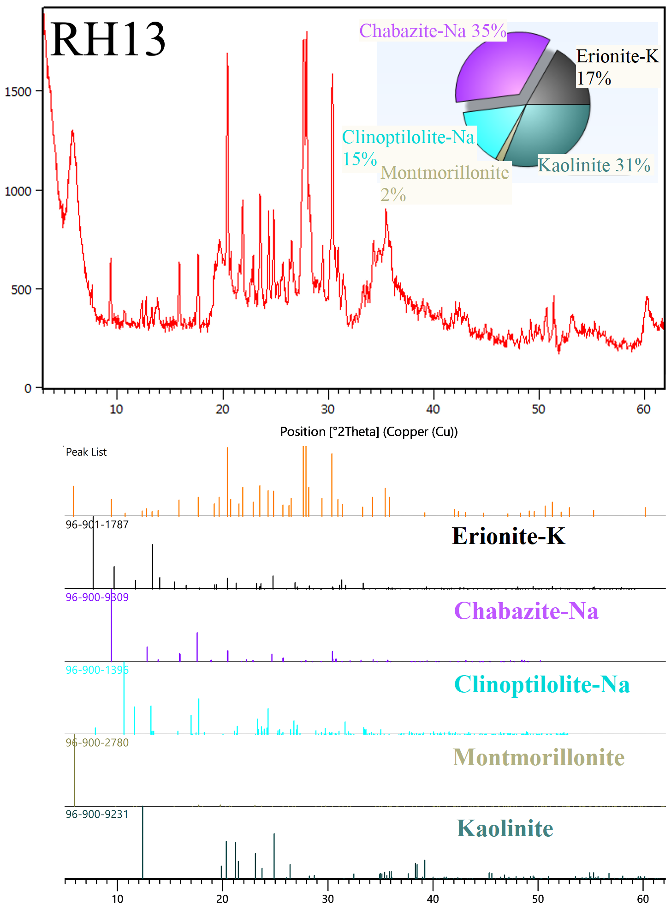
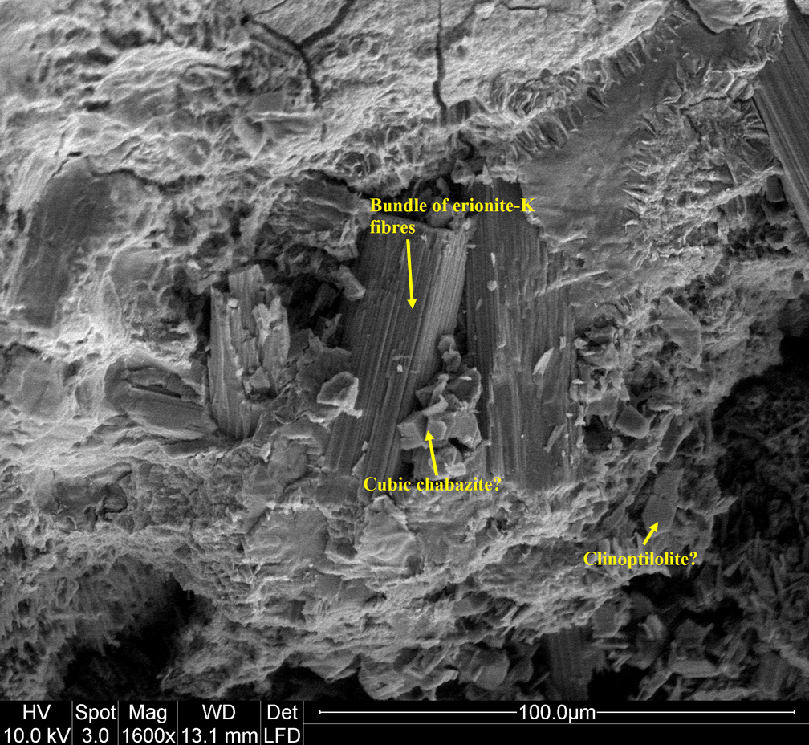
Preliminary Results
Miocene Waitemata Group ash studied
Techniques include: SEM, TEM, XRPD, FT-IR Spectroscopy and Raman Spectroscopy
XRPD determined erionite-K was present.

Slide 5
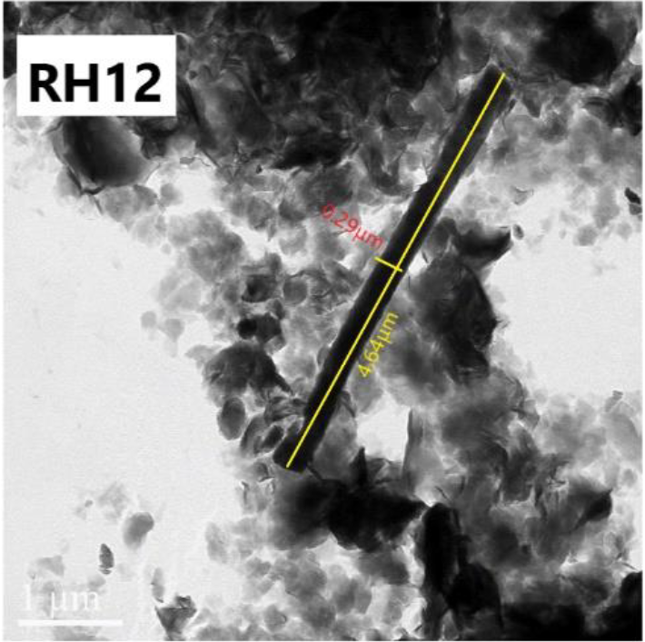
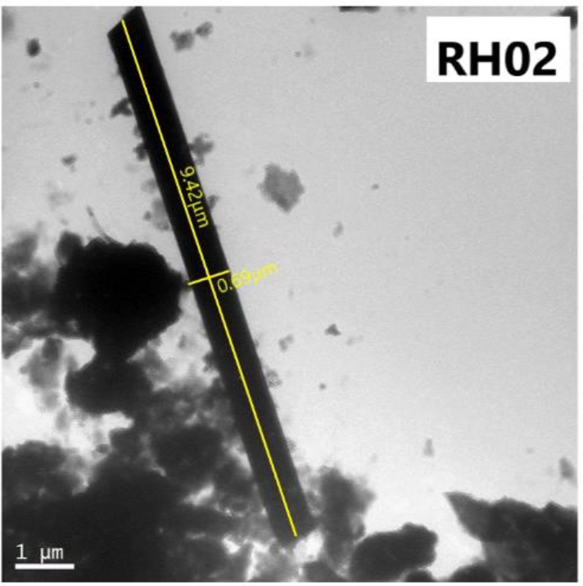
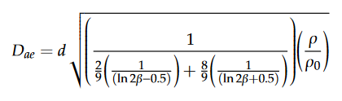
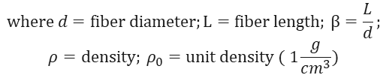
Morphological Analysis
TEM depicted several elongated particles
~45% of zeolite fibres of (WHO^{1,2}) respirable size: L ≥ 5 μm, d ≤ 3 μm, and L/d value ≥ 3:1
D_{ae} = 1.60 μm
Aerodynamic diameter (D_{ae}) also indicates fibres can reach alveolar region³
$$where d=fiber diameter;L=fiber length; β=\frac{L}{d};$$
$$ρ=density; ρ_{0}=unit density ( 1\frac{g}{cm^{3}})$$

Slide 6


Thank you!
References:
1. WHO. (1986). Asbestos and other natural mineral fibres. World Health Organization.
2. WHO. (1997). Determination of airborne fibre number concentrations: A recommended method, by phase-contrast optical microscopy (membrane filter method). World Health Organization.
3. Di Giuseppe, D. (2020). Characterization of Fibrous Mordenite: A First Step for the Evaluation of Its Potential Toxicity. Crystals, 10(9), 769.

