Slide 1

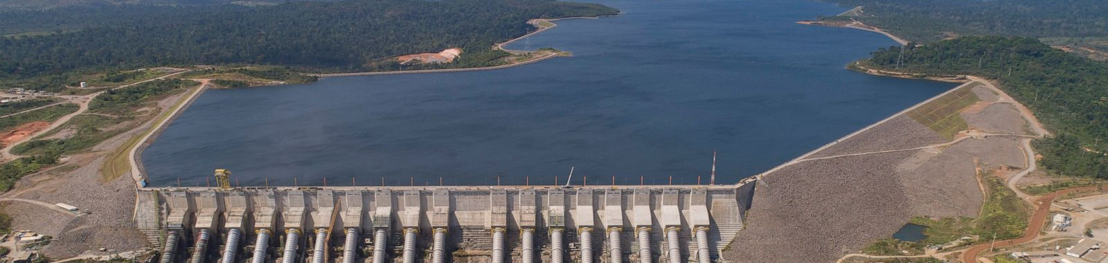






Prioritizing investment into hydropower catchments under climate change
EGU22-6680 Session HS5.3
Zhaowei Ding,
Hector Angarita, Christian Montesino Cárceres ,Waldo Lavado ,Cesar David Barreto Escobedo, Leo Guerrero ,Hua Zheng, Rafael Schmitt
Vienna, Austria，
May 27, 2022

Slide 2
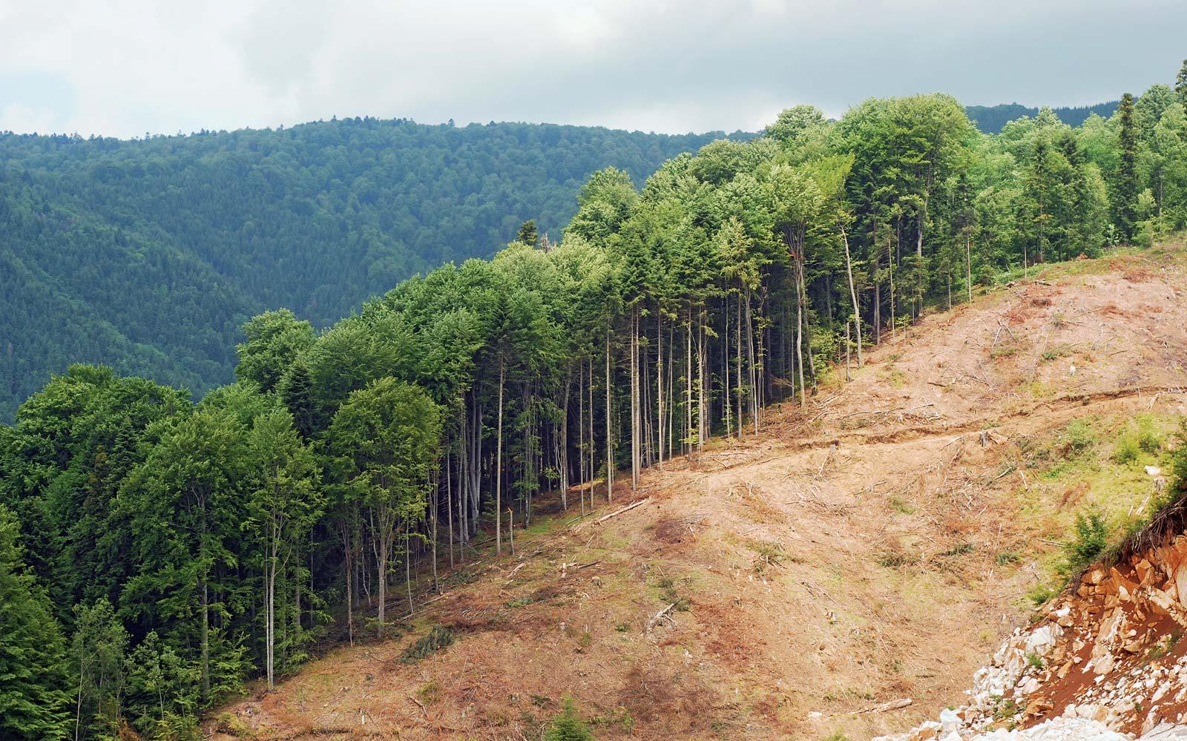
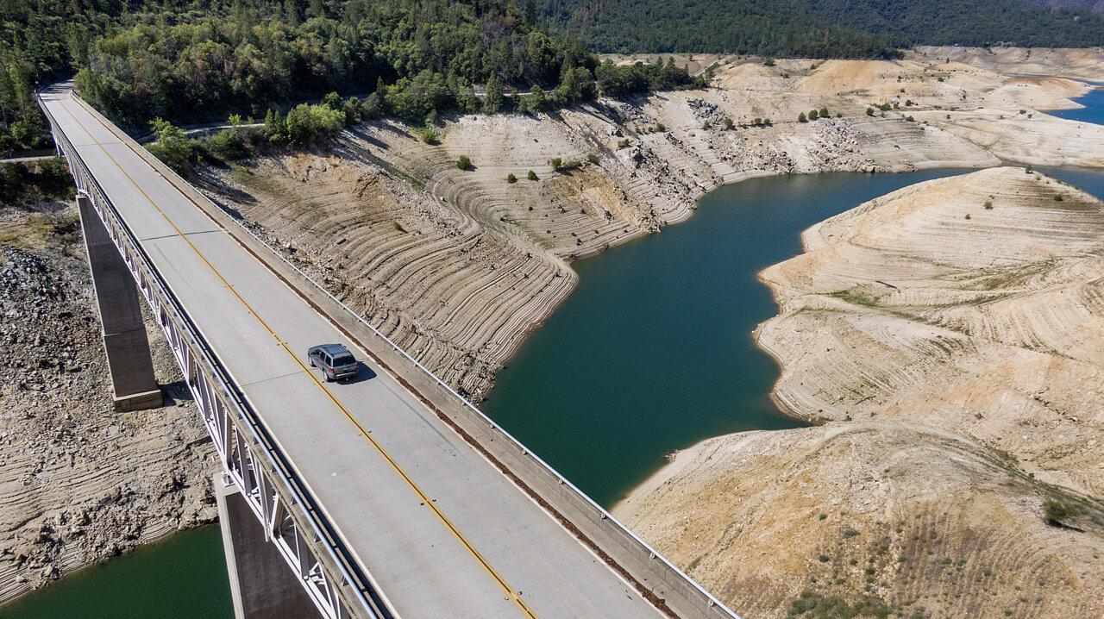
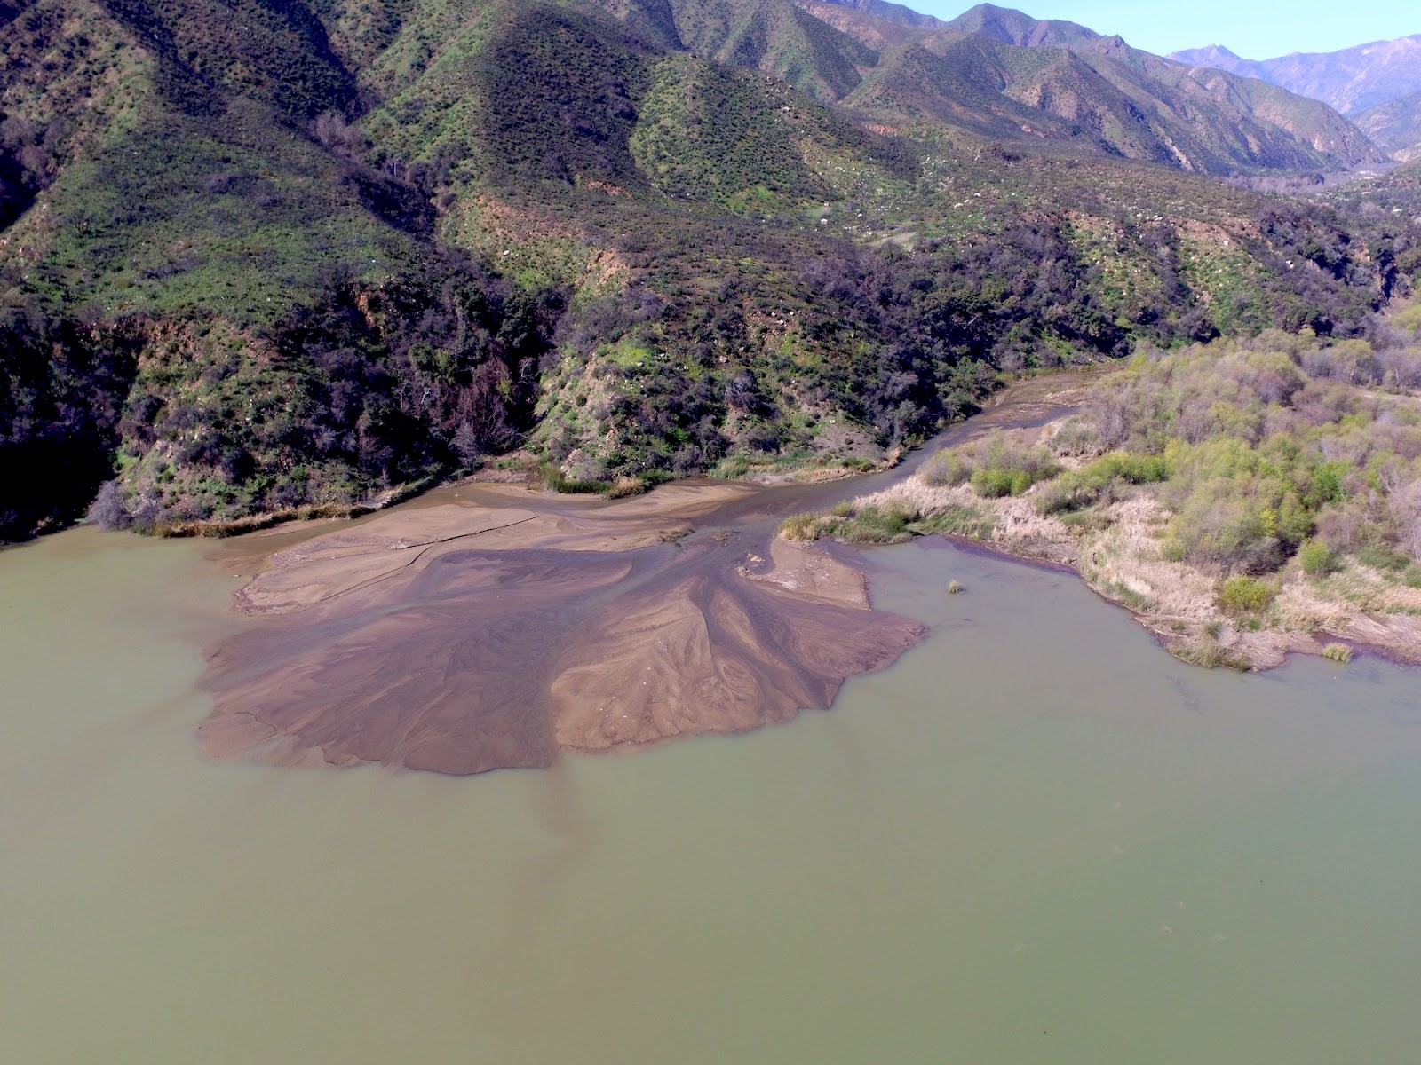
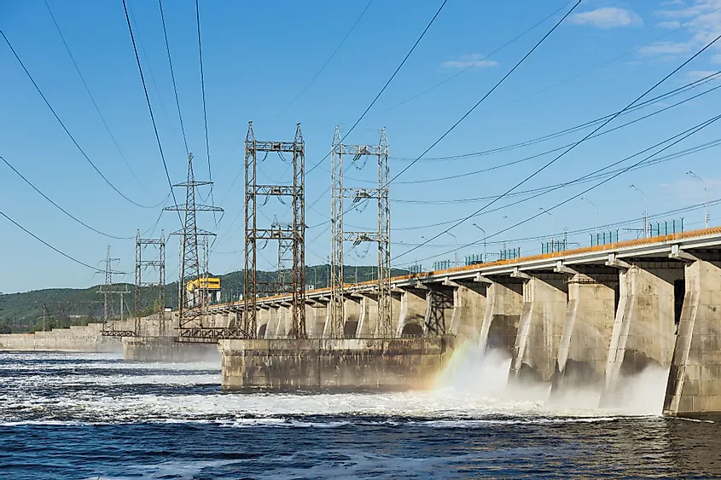
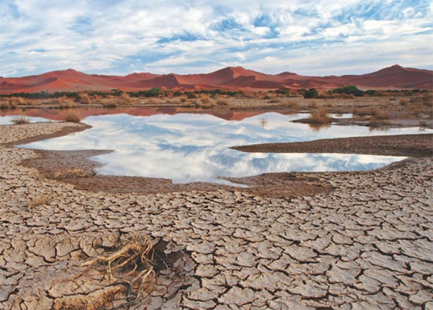
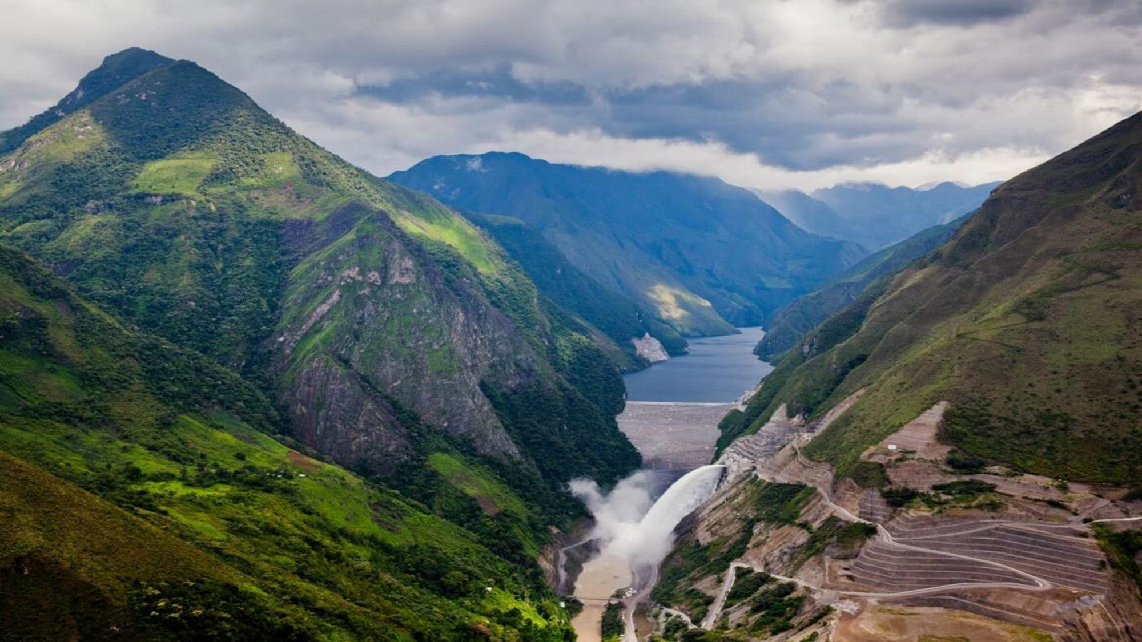
Hydropower is essential for a net-zero economy, but it faces uncertain future
Challenges for hydropower and renewable energy in future
Land use change
Less baseflow
Reservoir sedimentation
Reduced power generation and higher maintenance
Climate change
High-resolution models to understand links between land use conservation and hydropower
Anticipated results and real-world applications
Climate change scenarios
Provide the general framework for analyzing nature's contribution to energy systems in the face of uncertainty about future climatic driver
Quantify the role of sustainable land use management for hydropower generation and maintenance
Prioritize effective investments in catchment stewardship for hydropower
Biophysical models
(Water &sediment simulations)
Where to invest under uncertain future conditions ?
Hydropower operation model
Future application
Electricity generation and revenue

Slide 3
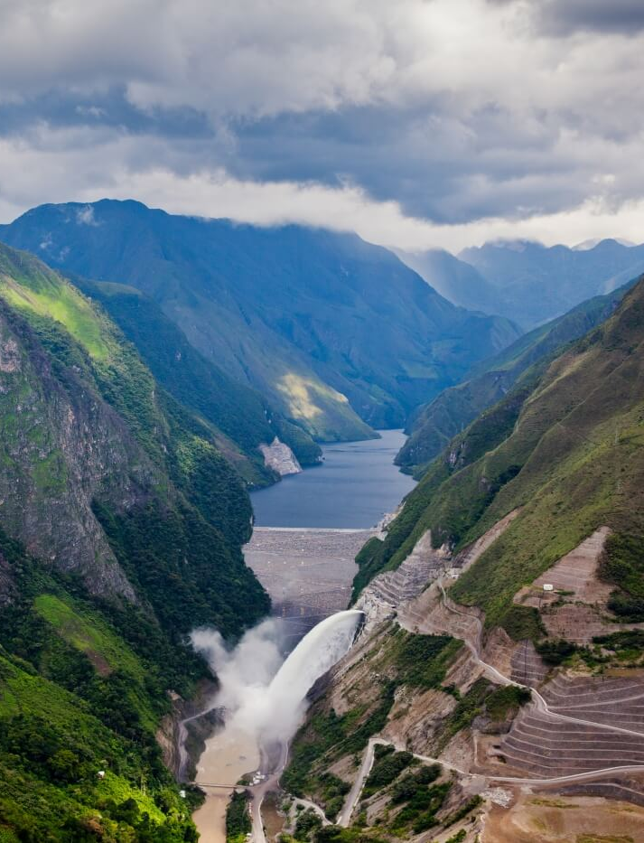
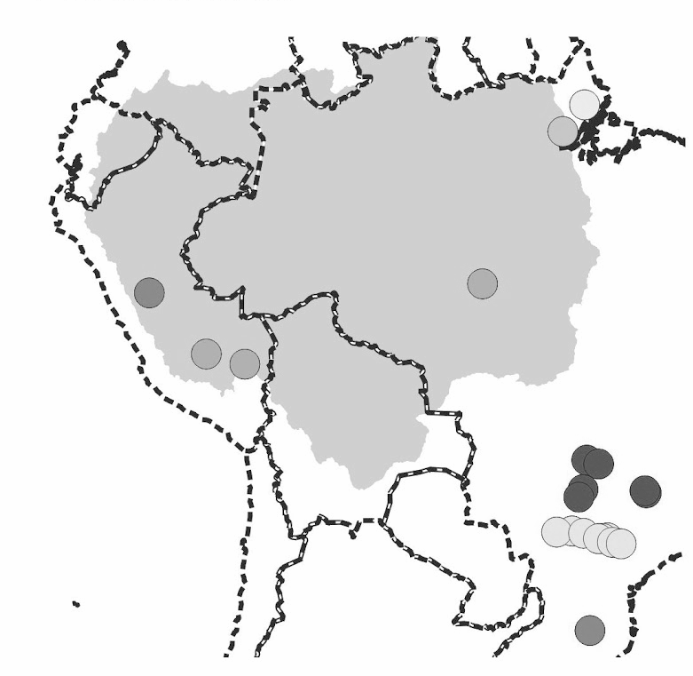
The workflow of analyzing links between land use conservation and hydropower
Workflow Study area
CMIP6
36 downscaled climate projections
LULC scenarios
(Forestation, Agriculture expansion, irrigation)
Chaglla Dam, Huallaga River
SWAT
Chaglla dam
Operation models
Energy demands
462 MW Chaglla Dam is Peru’s third largest hydropower generator
Chaglla Dam is operated as run-off river, and significantly affected by changing discharge
Firm power optimization

Slide 4
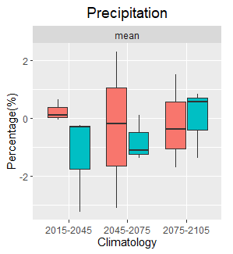
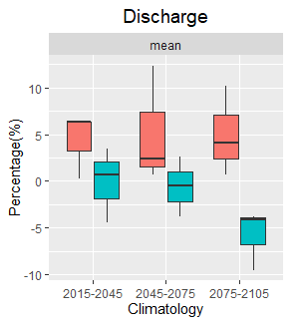
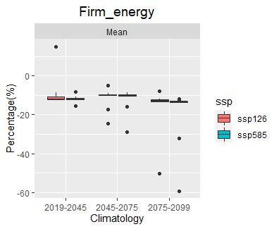
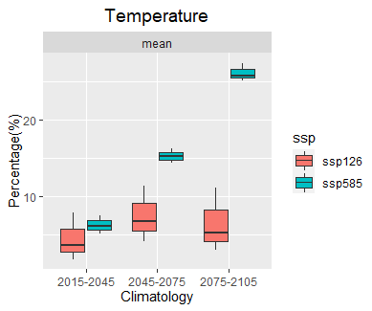
Case study – Chaglla Dam, Peru
What’s climate change impact on hydropower generation?
Major difference between annual discharge and firm energy illustrates the available water mismatch for hydropower generation in future
Chaglla Dam hydropower generation will decrease around 10% in uncertain future

Slide 5
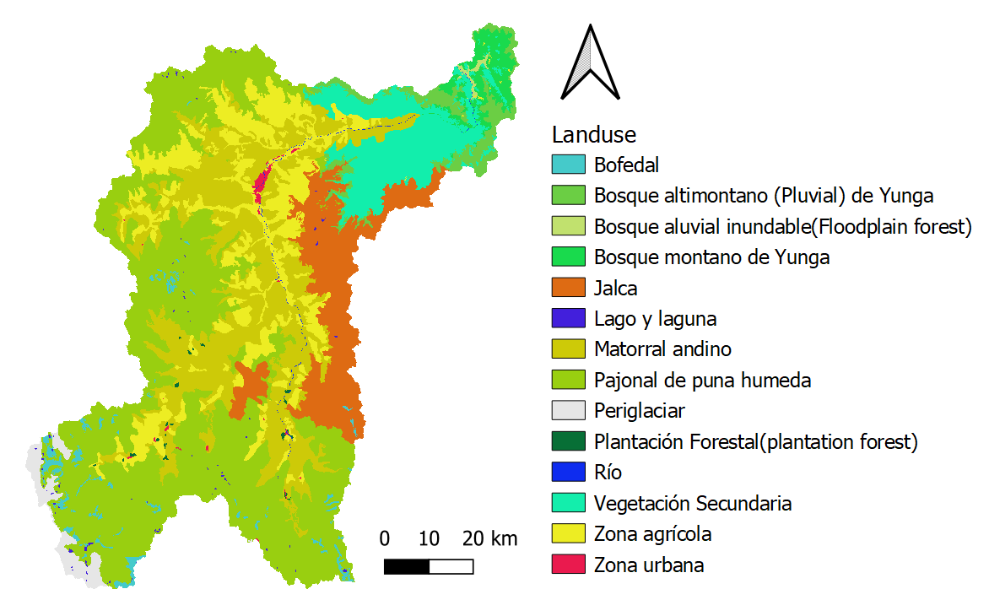


Case study – Chaglla Dam, Peru
Can land stewardship (e.g., reforestation) alleviate the impacts of climate change on hydropower generation?
Land stewardship scenarios
S1: Business as usual
Reforestation can decrease the impacts of climate change on hydropower.
S2: Reforestation
Where to invest reforestation for most cost-effective outcomes?

Slide 6


Conclusions
Quantify hydropower outcomes under wide range of climate scenarios
Provide spatial prioritization to identify where to invest into land conservation
Land conservations can significantly improve hydropower outcomes under a wide range of CMIP 6 climate scenarios
Rafael Schmitt

