Slide 1



Homogenization of poroelastic media without a representative elementary volume for seismic applications
Edith Sotelo¹, Nicolás D. Barbosa¹, Santiago G. Solazzi¹, Marco Favino¹, J. Germán Rubino², and Klaus Holliger¹
¹ Institute of Earth Sciences, University of Lausanne, Switzerland,
² CONICET, Centro Atómico Bariloche – CNEA, Argentina.

Slide 2

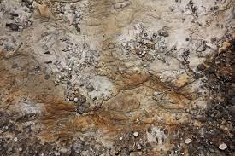
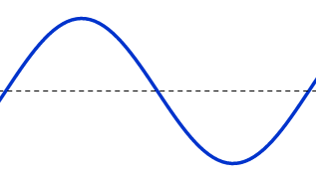
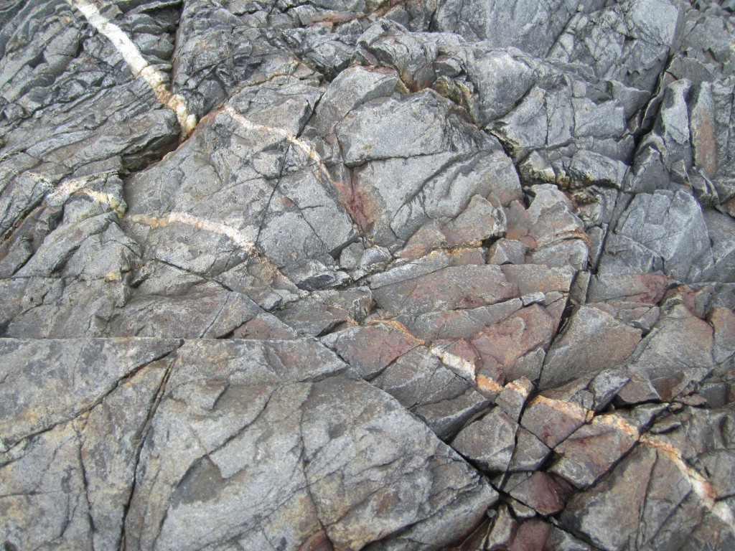
Applications of seismic characterization
Geothermal energy, carbon capture and storage, ground water extraction …
Underground rocks are in general highly heterogeneous and saturated with different fluids.

Slide 3
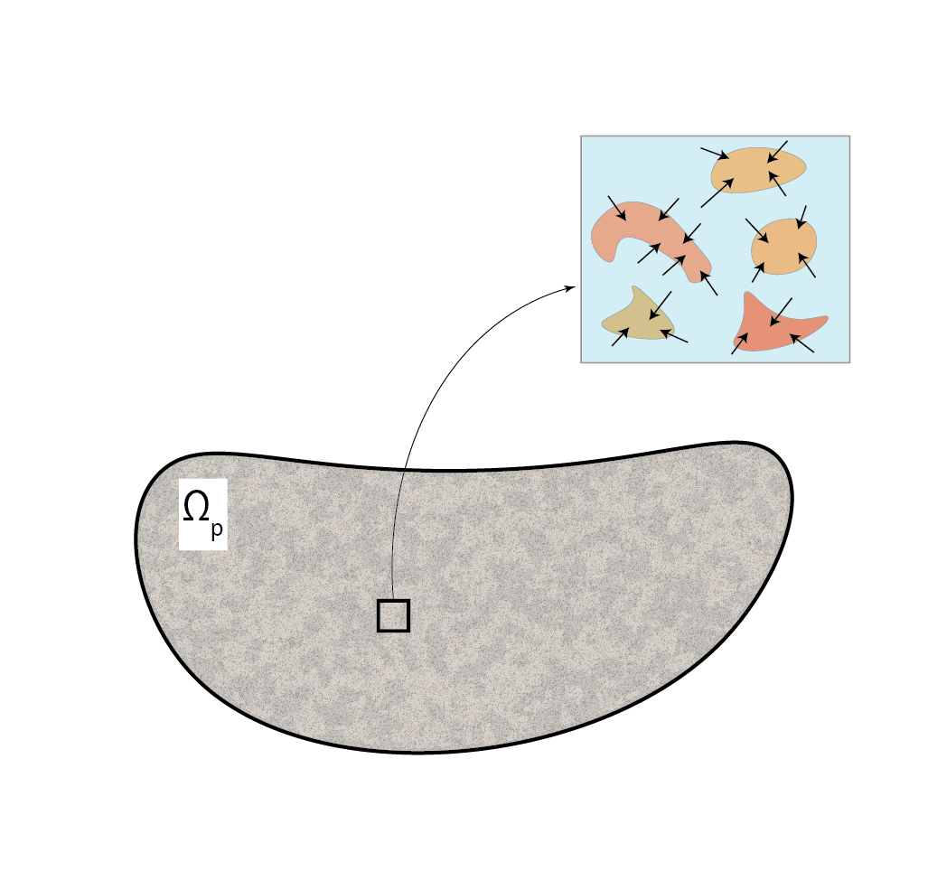

Wave induced fluid flow in poroelastic media
Mesoescale:
Heterogeneities that are
greater than the pore size
but smaller wavelength
$$∆P$$
Poroelastic media present an effective viscoelastic behavior

Slide 4
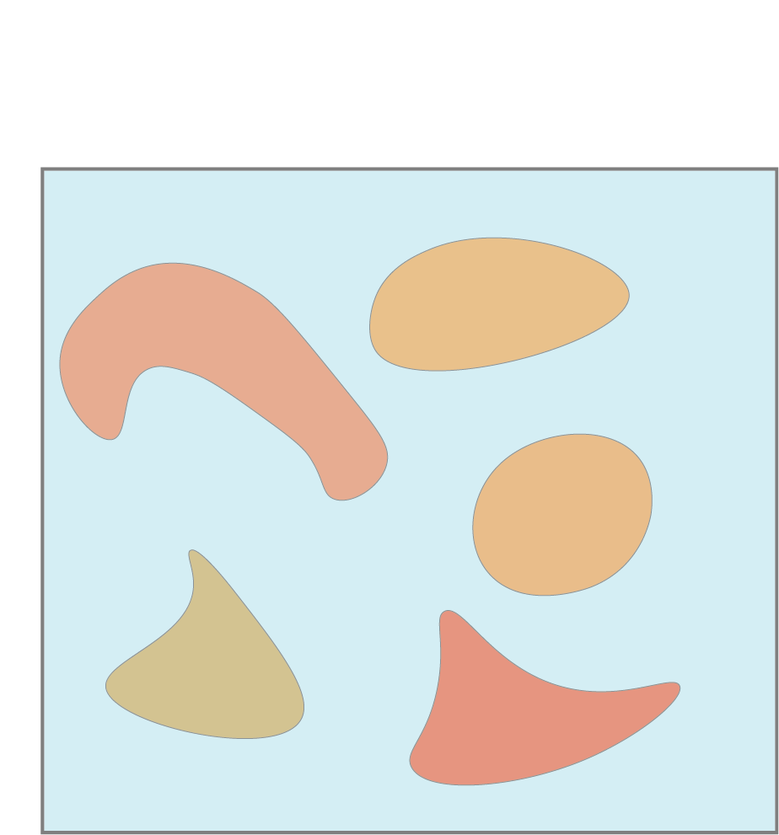
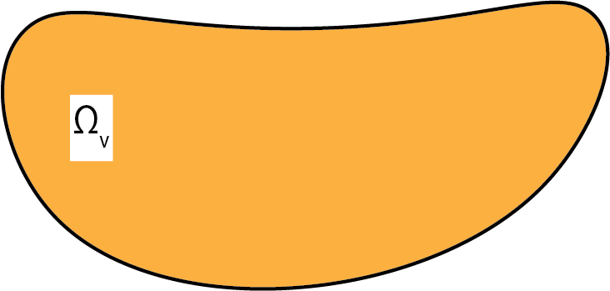


Classical homogenization procedures rely on the existence of an REV
REV of the porelastic medium (PM)
Effective viscoelastic medium
$$C\left(ω\right)$$
$$\left\langle σ\right\rangle =C\left(ω\right) : \left\langle ε\right\rangle$$
Average stress and strain are found by solving Biot’s quasi-static equations.

Slide 5
What if the poroelastic medium does not have an REV ?

Slide 6
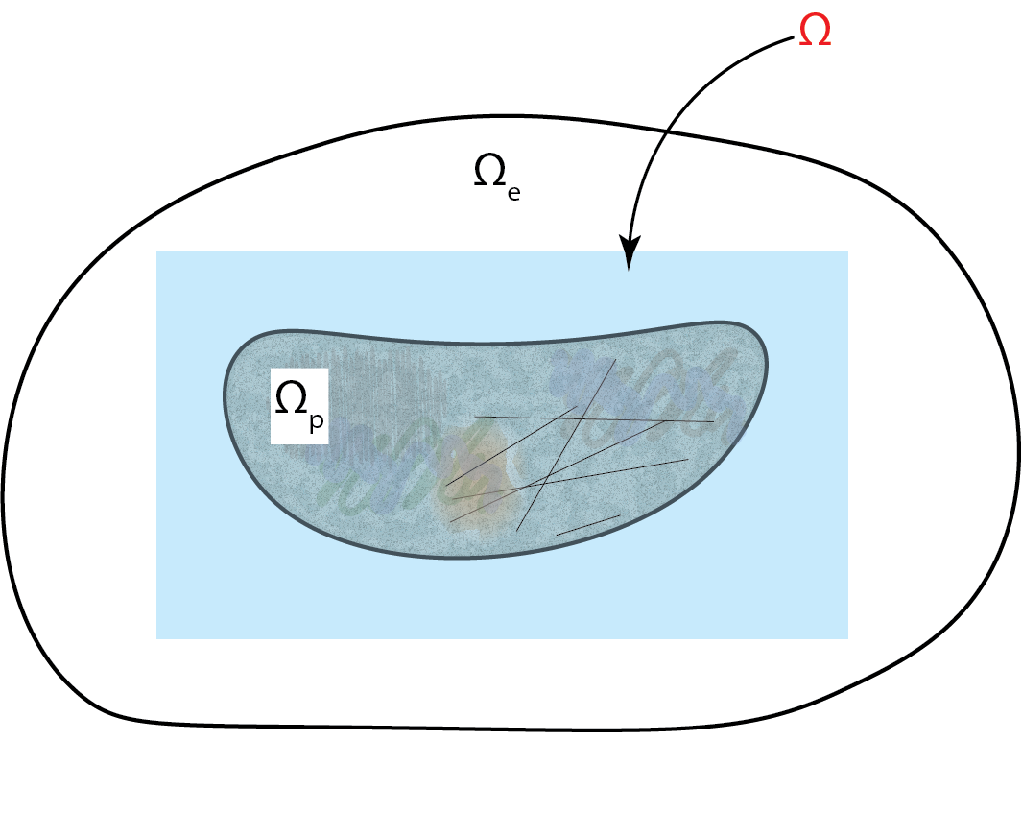
Proposed homogenization procedure
Sample Ω consists of poroelastic medium Ω_{p} and part of the enclosing domain
Average strain and stress calculated only over Ω_{p} .
Size of Ω_{p} is smaller than the wavelength (Ω_{p} is sampled as effective)
Poroelastic medium Ω_{p} is affected by the boundaries of the enclosing domain Ω_{e}.

Slide 7
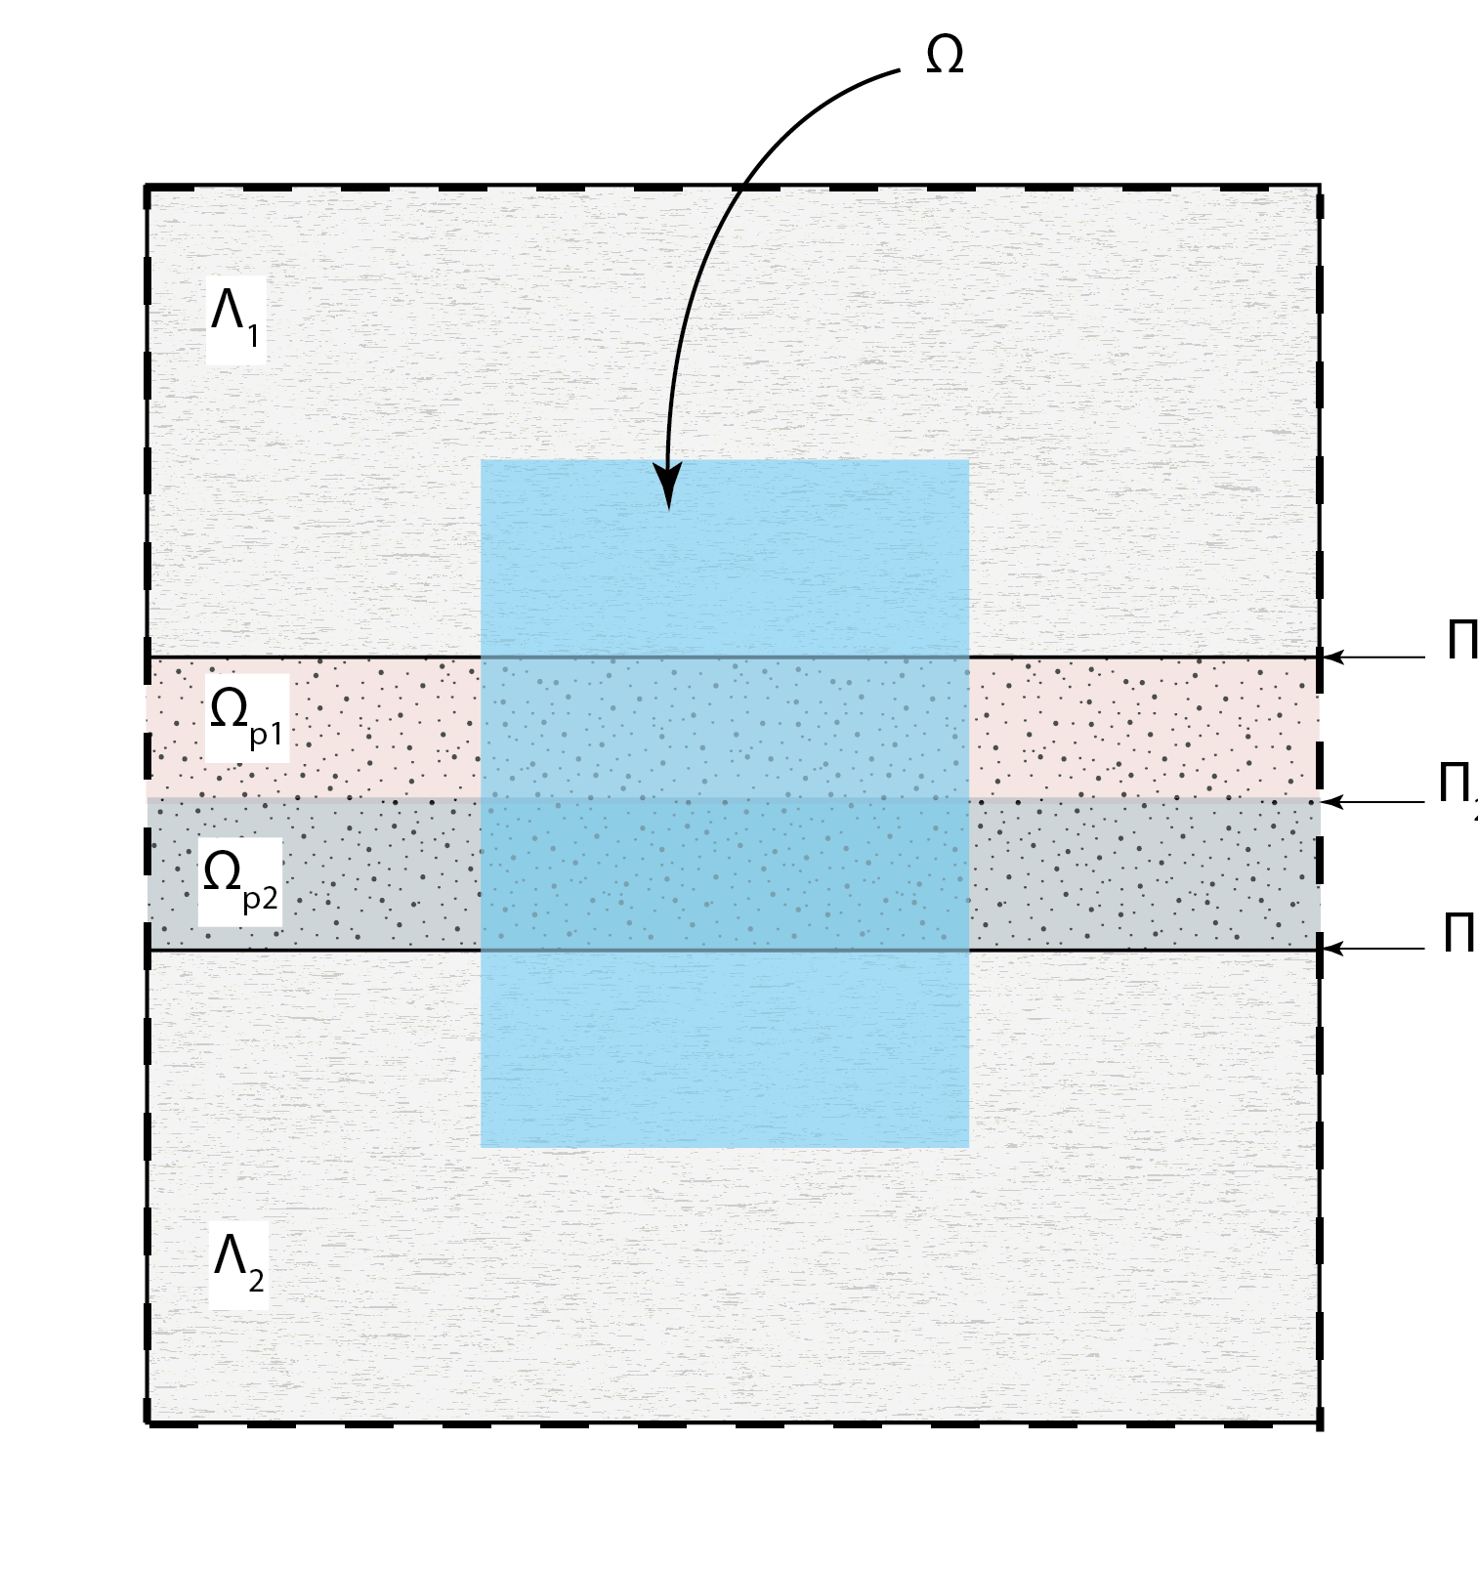
Example: Gas-water saturated sand embedded in impermeable half-spaces
Part 1: Find effective C(ω) using:
Proposed method: using sample Ω consisting of the PM (Ω_{p1} U Ω_{p2}) and part of the embedding medium
Using a sample consisting of the PM only

Slide 8
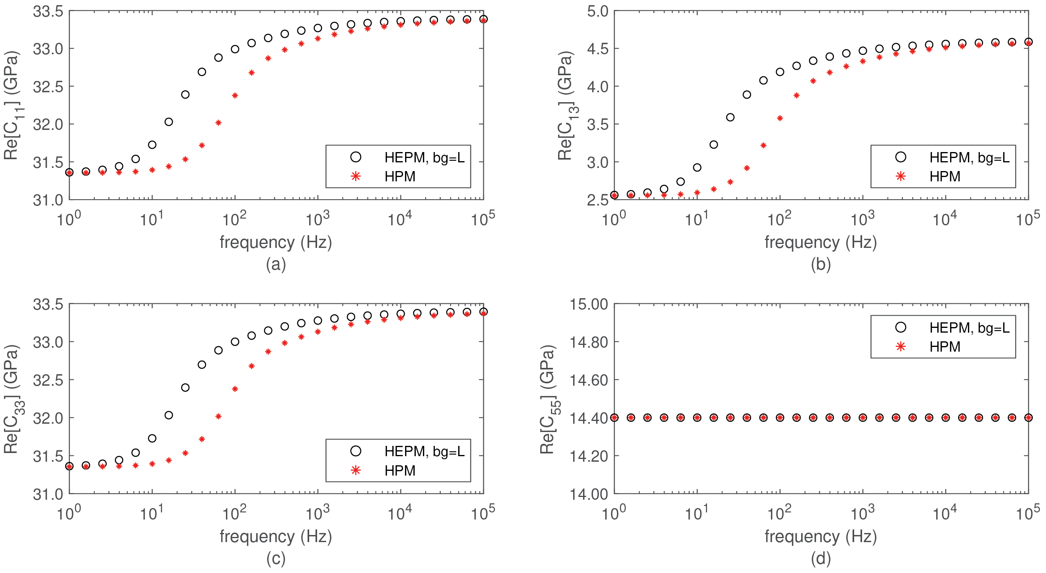
Paer 1: Effective moduli of the viscoelastic media

Slide 9
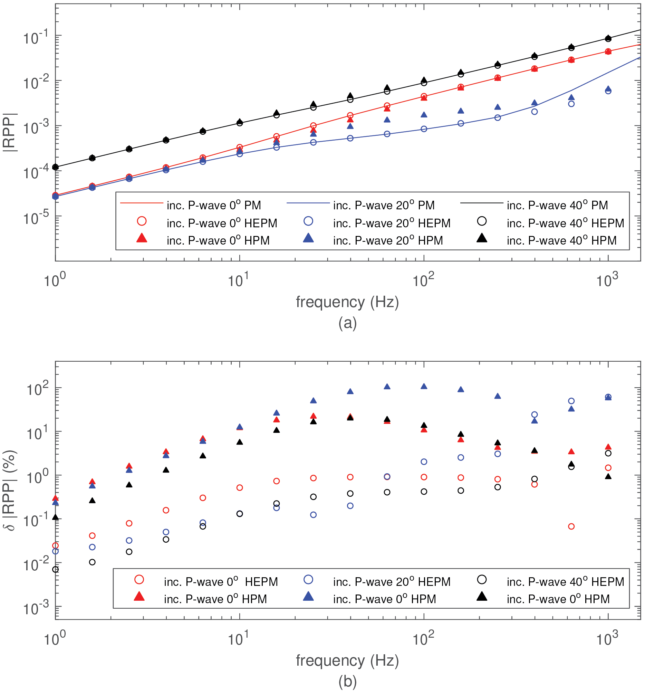
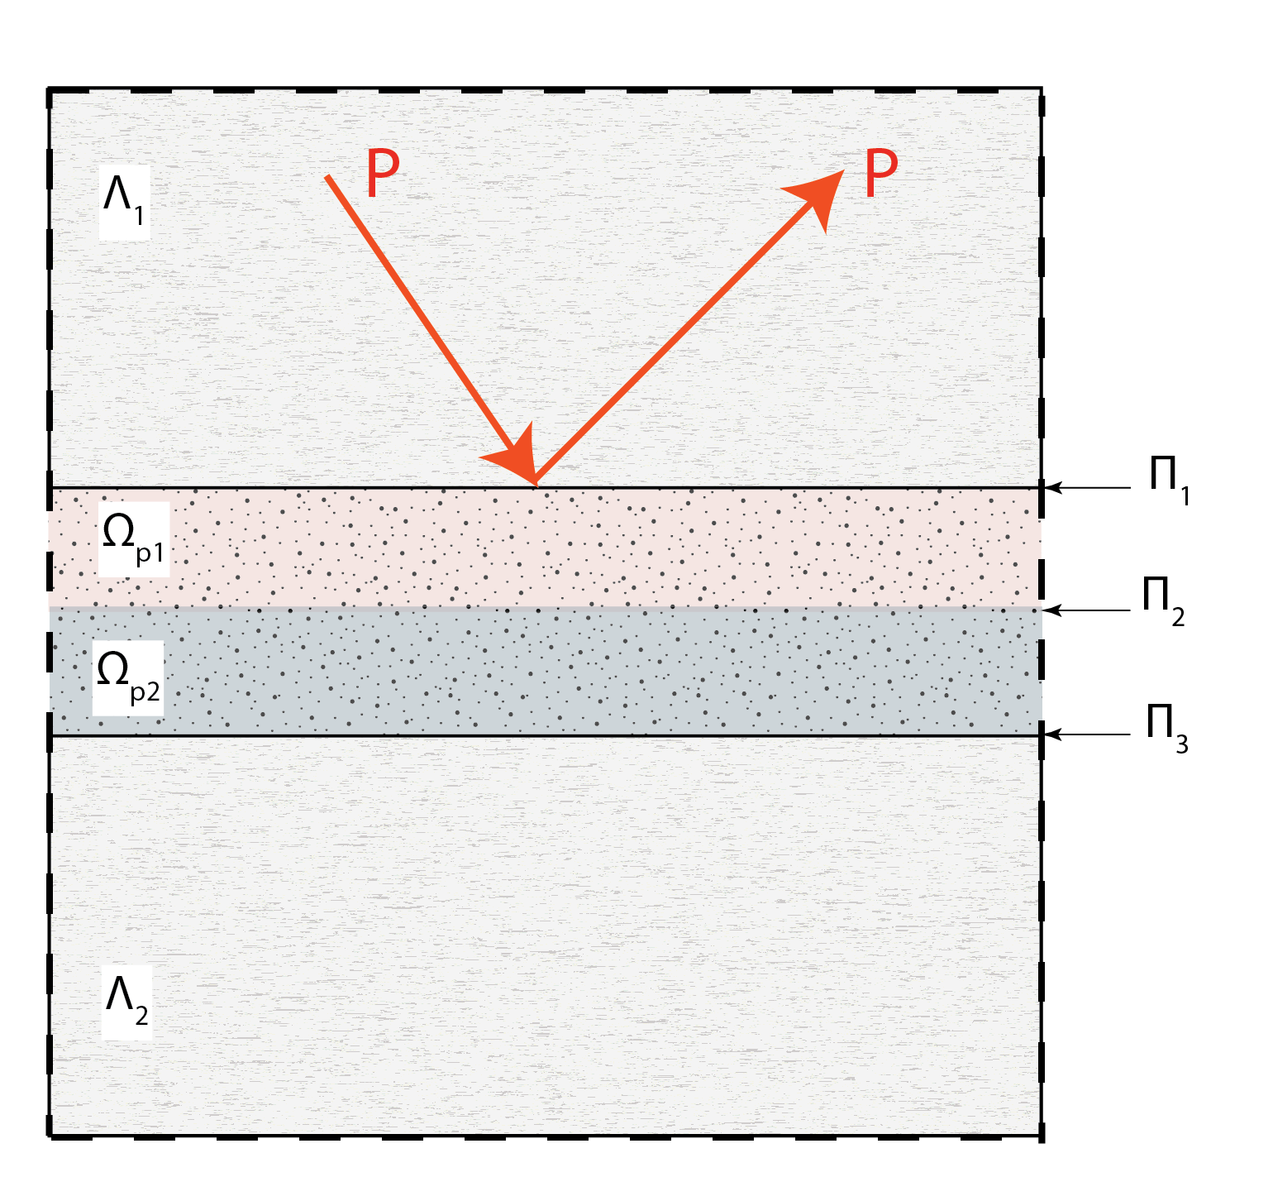
Part 2: PP Reflectivity

Slide 10
Conclusions
Proposed a poroelastic-to-viscoelastic homogenization procedure that is suitable for PM that do not present REVs and have sizes that are smaller than the prevailing wavelength.
The method is based on considering a sample that incorporates part of the surrounding domain to include its influence on the calculated moduli.
PP reflectivity results show that the viscoelastic representation reproduces with minimal error the response of the respective PM for frequencies within the seismic band.

