Slide 1
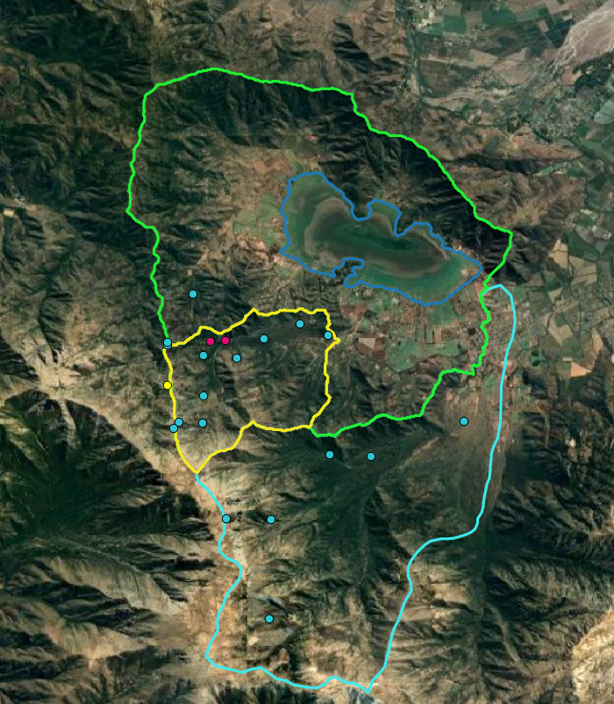


EGU 2022
Modelling Hydrological Ecosystem Services of native forest for Integrated Water Resources Management on a poorly monitored basin of Central Chile
Pilar Barría
Anahí Ocampo
Alejandro Venegas
Claudia Cerda
May 26th, 2022
Fondecyt N° 11200854

Slide 2
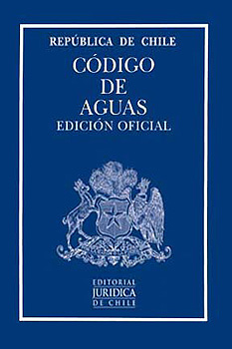


Context
Recognition of the multiple functions of water
Recognition of the water human right
Ecosystem for sustainability
Recent reforms to the Water Code
New Constitution – recognize nature constitutional rights, and includes water statute (12 articles)
Climate change law will be promulgated this week
Water governance at the basin scale
Native Forest Law
To reach water security by 2030
Sectorial commitments toward mitigation and adaptation to climate change
Water resources Strategic Plans
Diagnosis of the water gap at the basin scale
Surface-groundwater coupled water balance models (WEAP – MODFLOW)
Analysis of climate change impacts and actions toward water security

Slide 3

Challenges of the water resources strategic plans
Scarce ecohydrological data challenge the quantification of the ecosystem gaps
Native forest ecosystem services quantification
Synergies between research projects and water policies
Opportunity
We will have WEAP models for every basin of the country!
These models will be part of legally-binding instruments for decision making
How can we quantify the water-forest relationship in the WEAP model?

Slide 4
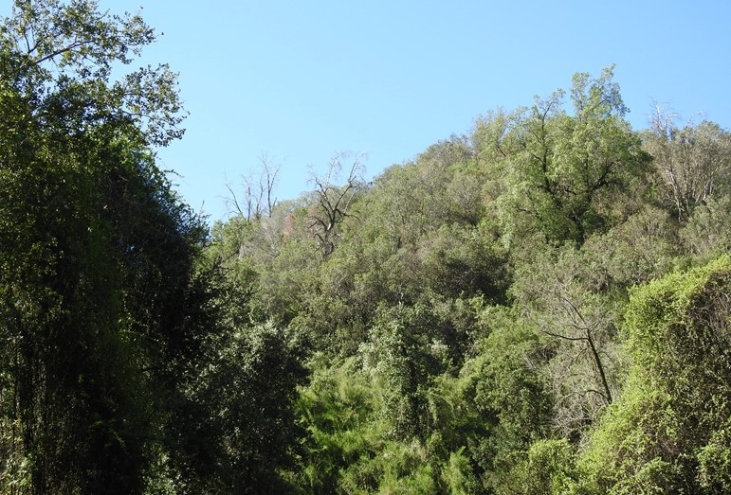
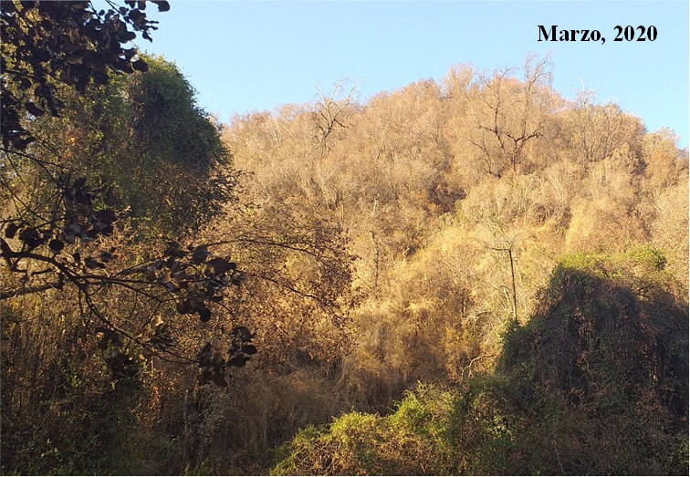
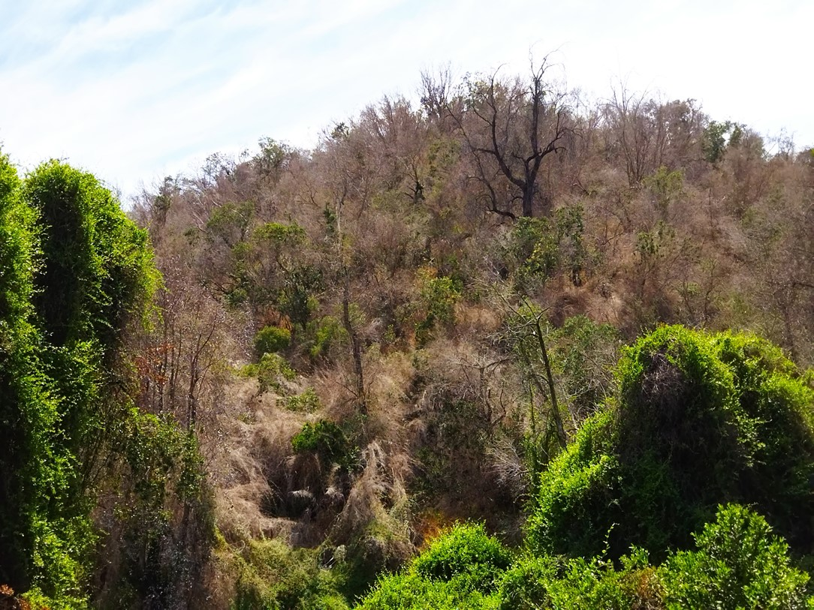
Extreme drought year 2019
10 years of persistent MD
October, 2018
November, 2021

Slide 5
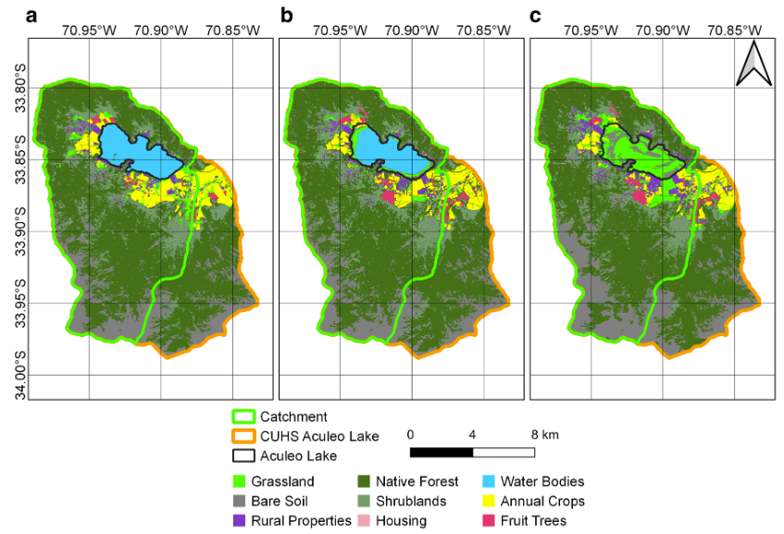
LULC dynamics in the basin
Fruit trees 38%
Annual crops 31%
Rural plots 15%

Slide 6
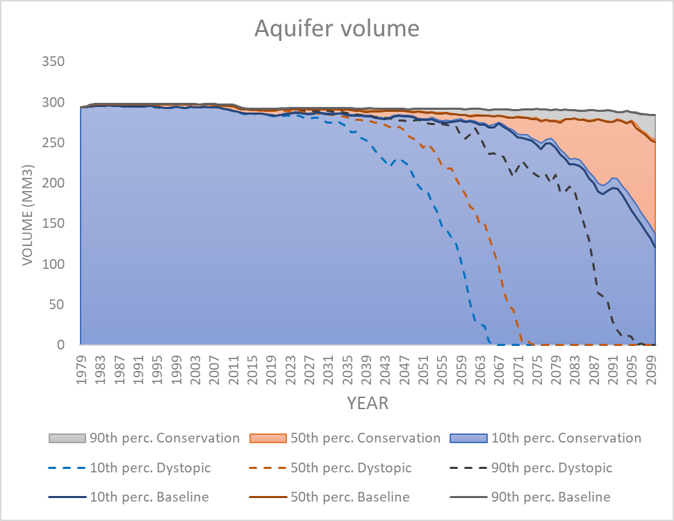
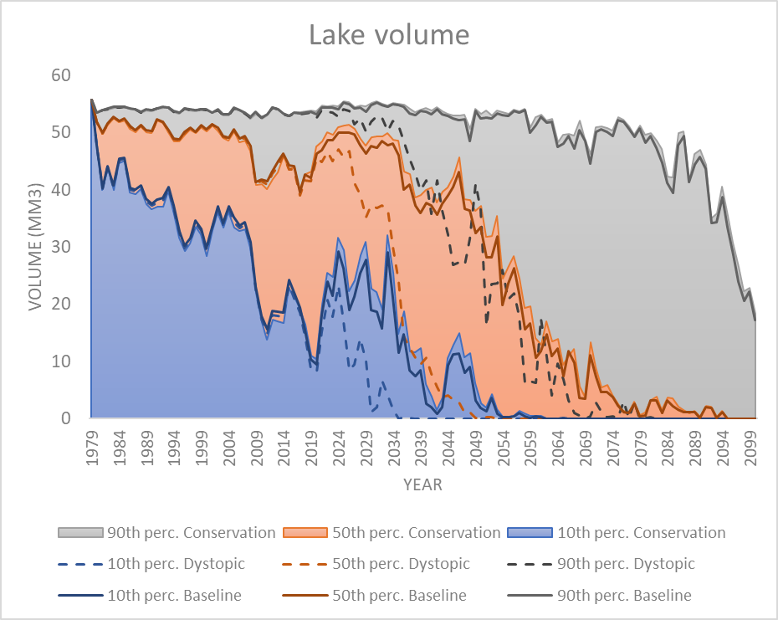
Some results
21 Mm3
23 Mm3
283 Mm3
284 Mm3
149 Mm3
9 Mm3

