Slide 1



The society interactions with floods in the modern Chinese history: a comparison between 1931 and 1954 floods
Chang Liu, REEL, the University of Tokyo
Akiyuki Kawasaki, IFI, the University of Tokyo
Tomoko Shiroyama, Graduate School of Economics, the University of Tokyo
20220526
Photo from @Fengguangliu in Ezhou City, Hubei Province, 2020
© C. Liu, 2022

Slide 2

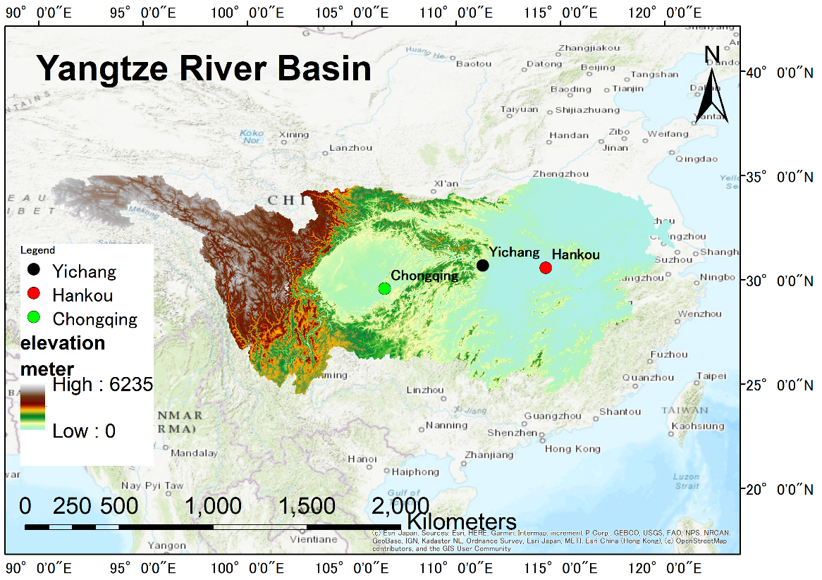
0. Background
Area
Length: 6357 km;
Discharge: 30,170 m³/s;
Area: 1982500 km²

Slide 3
0. Background
List of deadliest floods
Questions
Rank | Death toll | Event
1 | 500,000-4,000,000 | 1931 China floods
5 | 145,000 | 1935 Yangtze river flood
8 | up to 100,000 | 1911 Yangtze river flood
13 | 30,000 | 1954 Yangtze river flood
39 | 3,656 | 1998 Yangtze river flood
What’s the mechanism of a single flood causing enormous damage?
Why the damage of 1931 and 1954 is so different, although the hydrological condition is quite similar?
https://en.wikipedia.org/wiki/List_of_deadliest_floods
The change of society may have intensified the vulnerability of flood;
Some hydrological extremes may have accelerated the social transformations.

Slide 4
Prep 1954 > 1931
1. Cumulative prep, 1923-2021
1954 is one of the ten years with most rainfall, 1923-2020. (the others are 2013-2019)

Slide 5
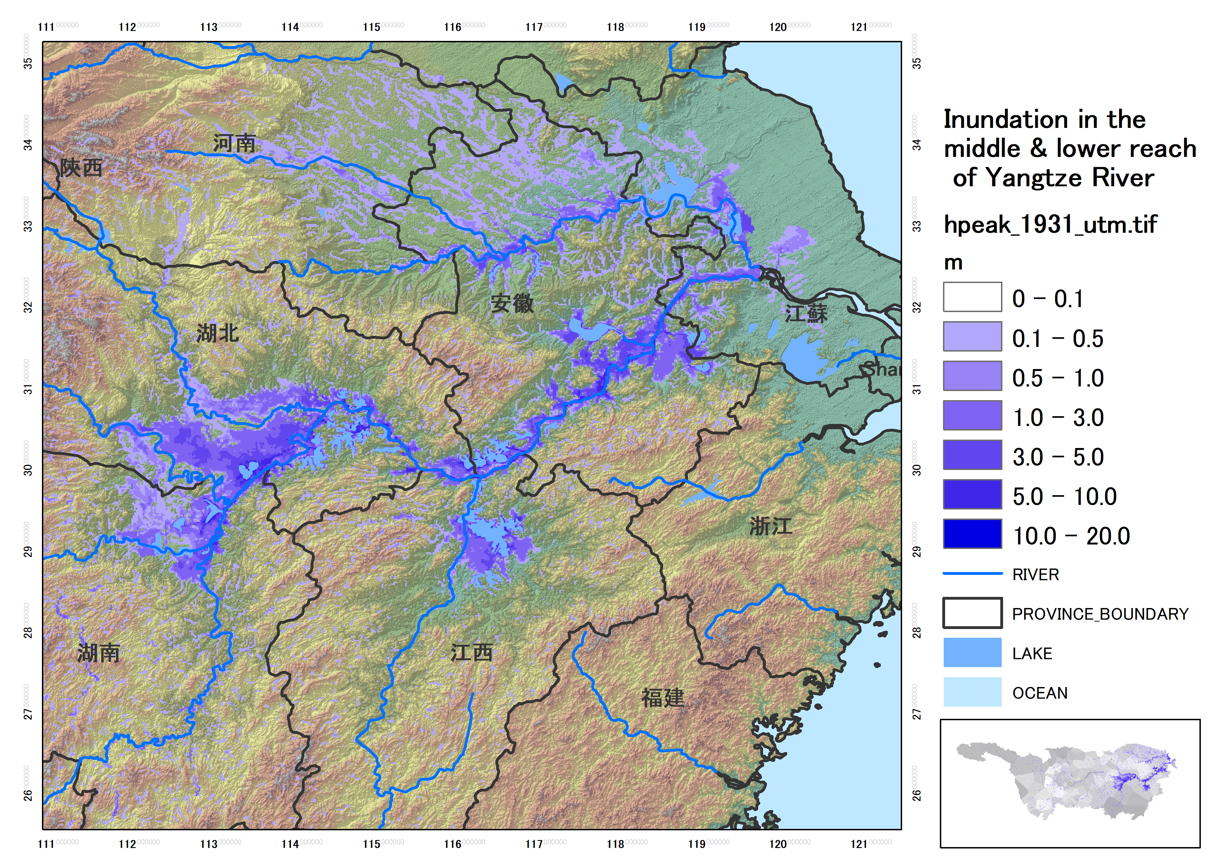
1. 1931 inundation

Slide 6
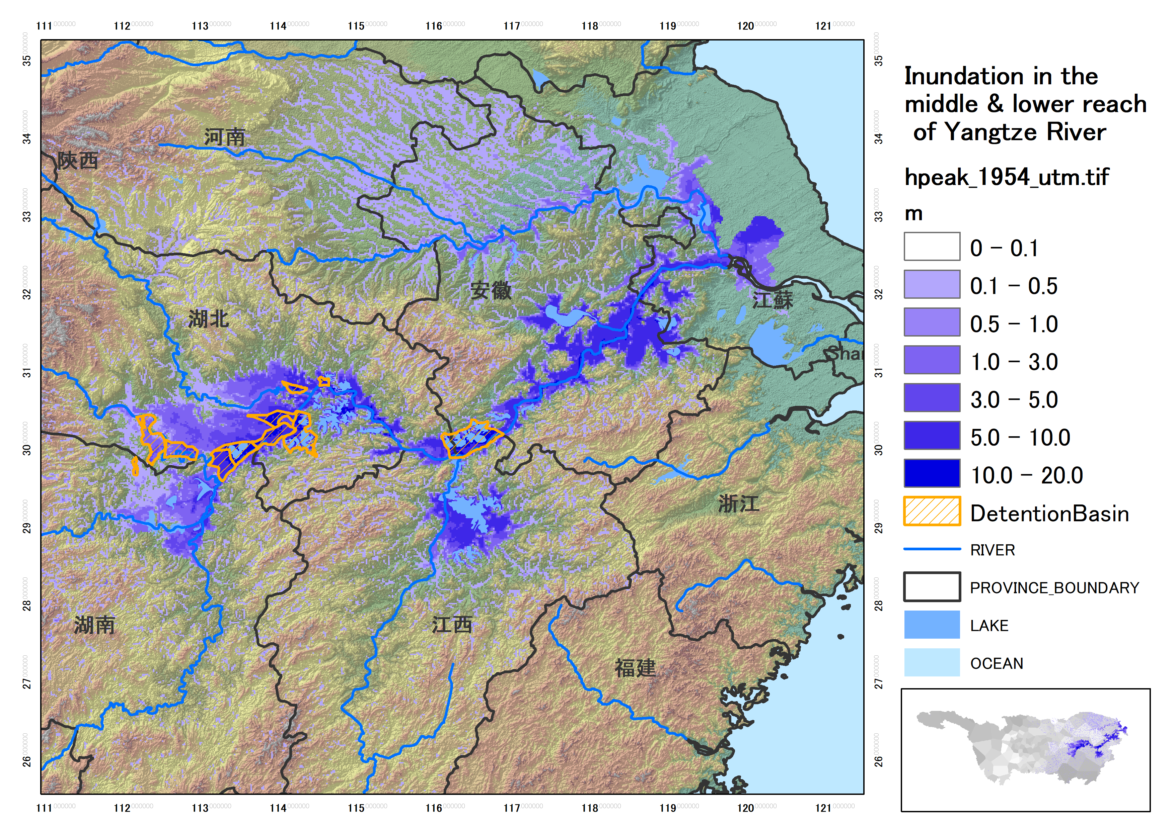
1. 1954 inundation
What is the real damage situation of 1931 & 1954?
Overall, the inundation duration & depth is much worse than 1931.
The detention basins are of little effect in lower reach of Yangtze River, e.g., Anhui Province.

Slide 7
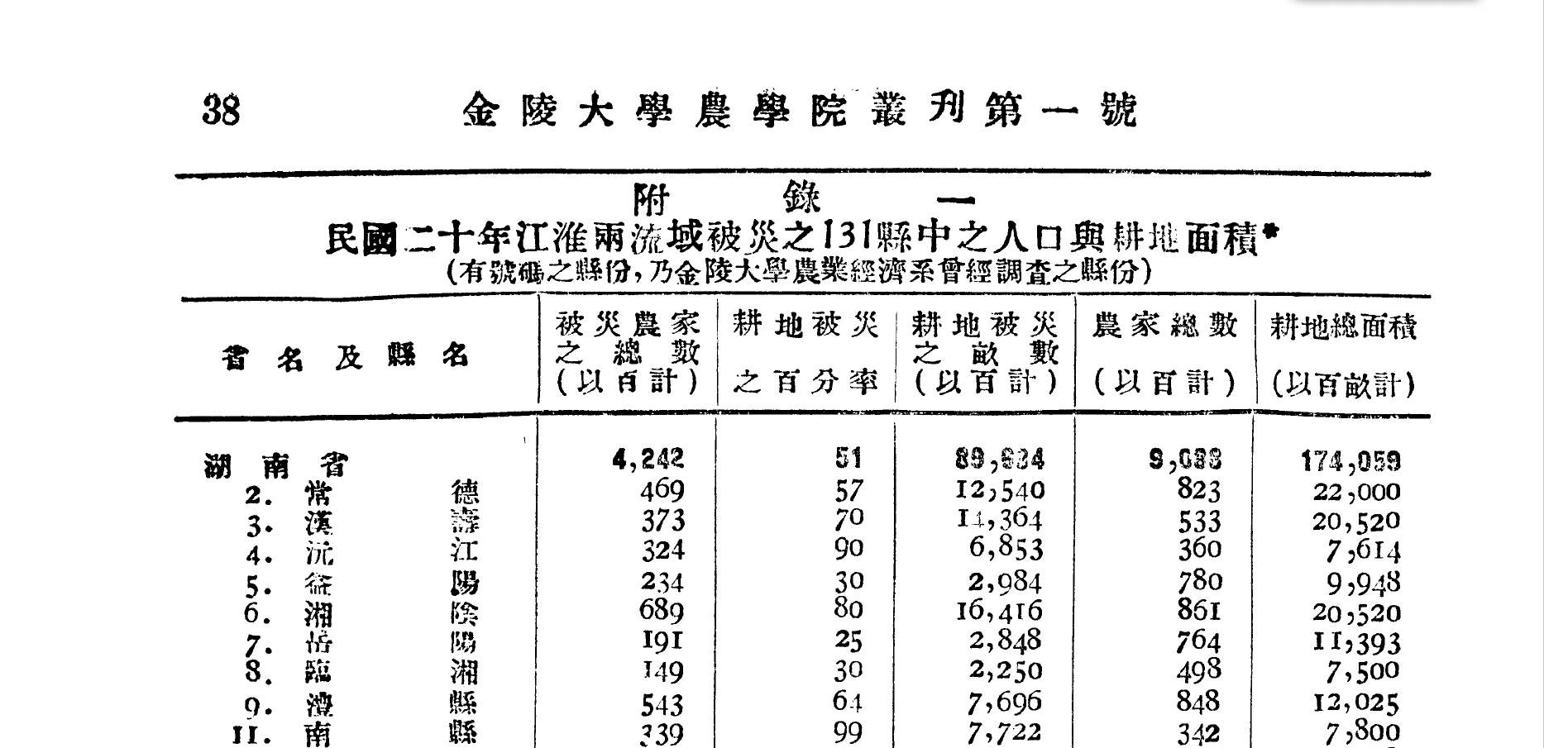
2. Economic investigation, 1931
Ratio of inundated farmland
Total farmer households
Prefecture
Influenced farmers
Inundated farmland area
Total farmland area
The investigation was completed at 11th, Jan., 1932;
About 2,366 villages of 89 prefectures were investigated in-situ.

Slide 8
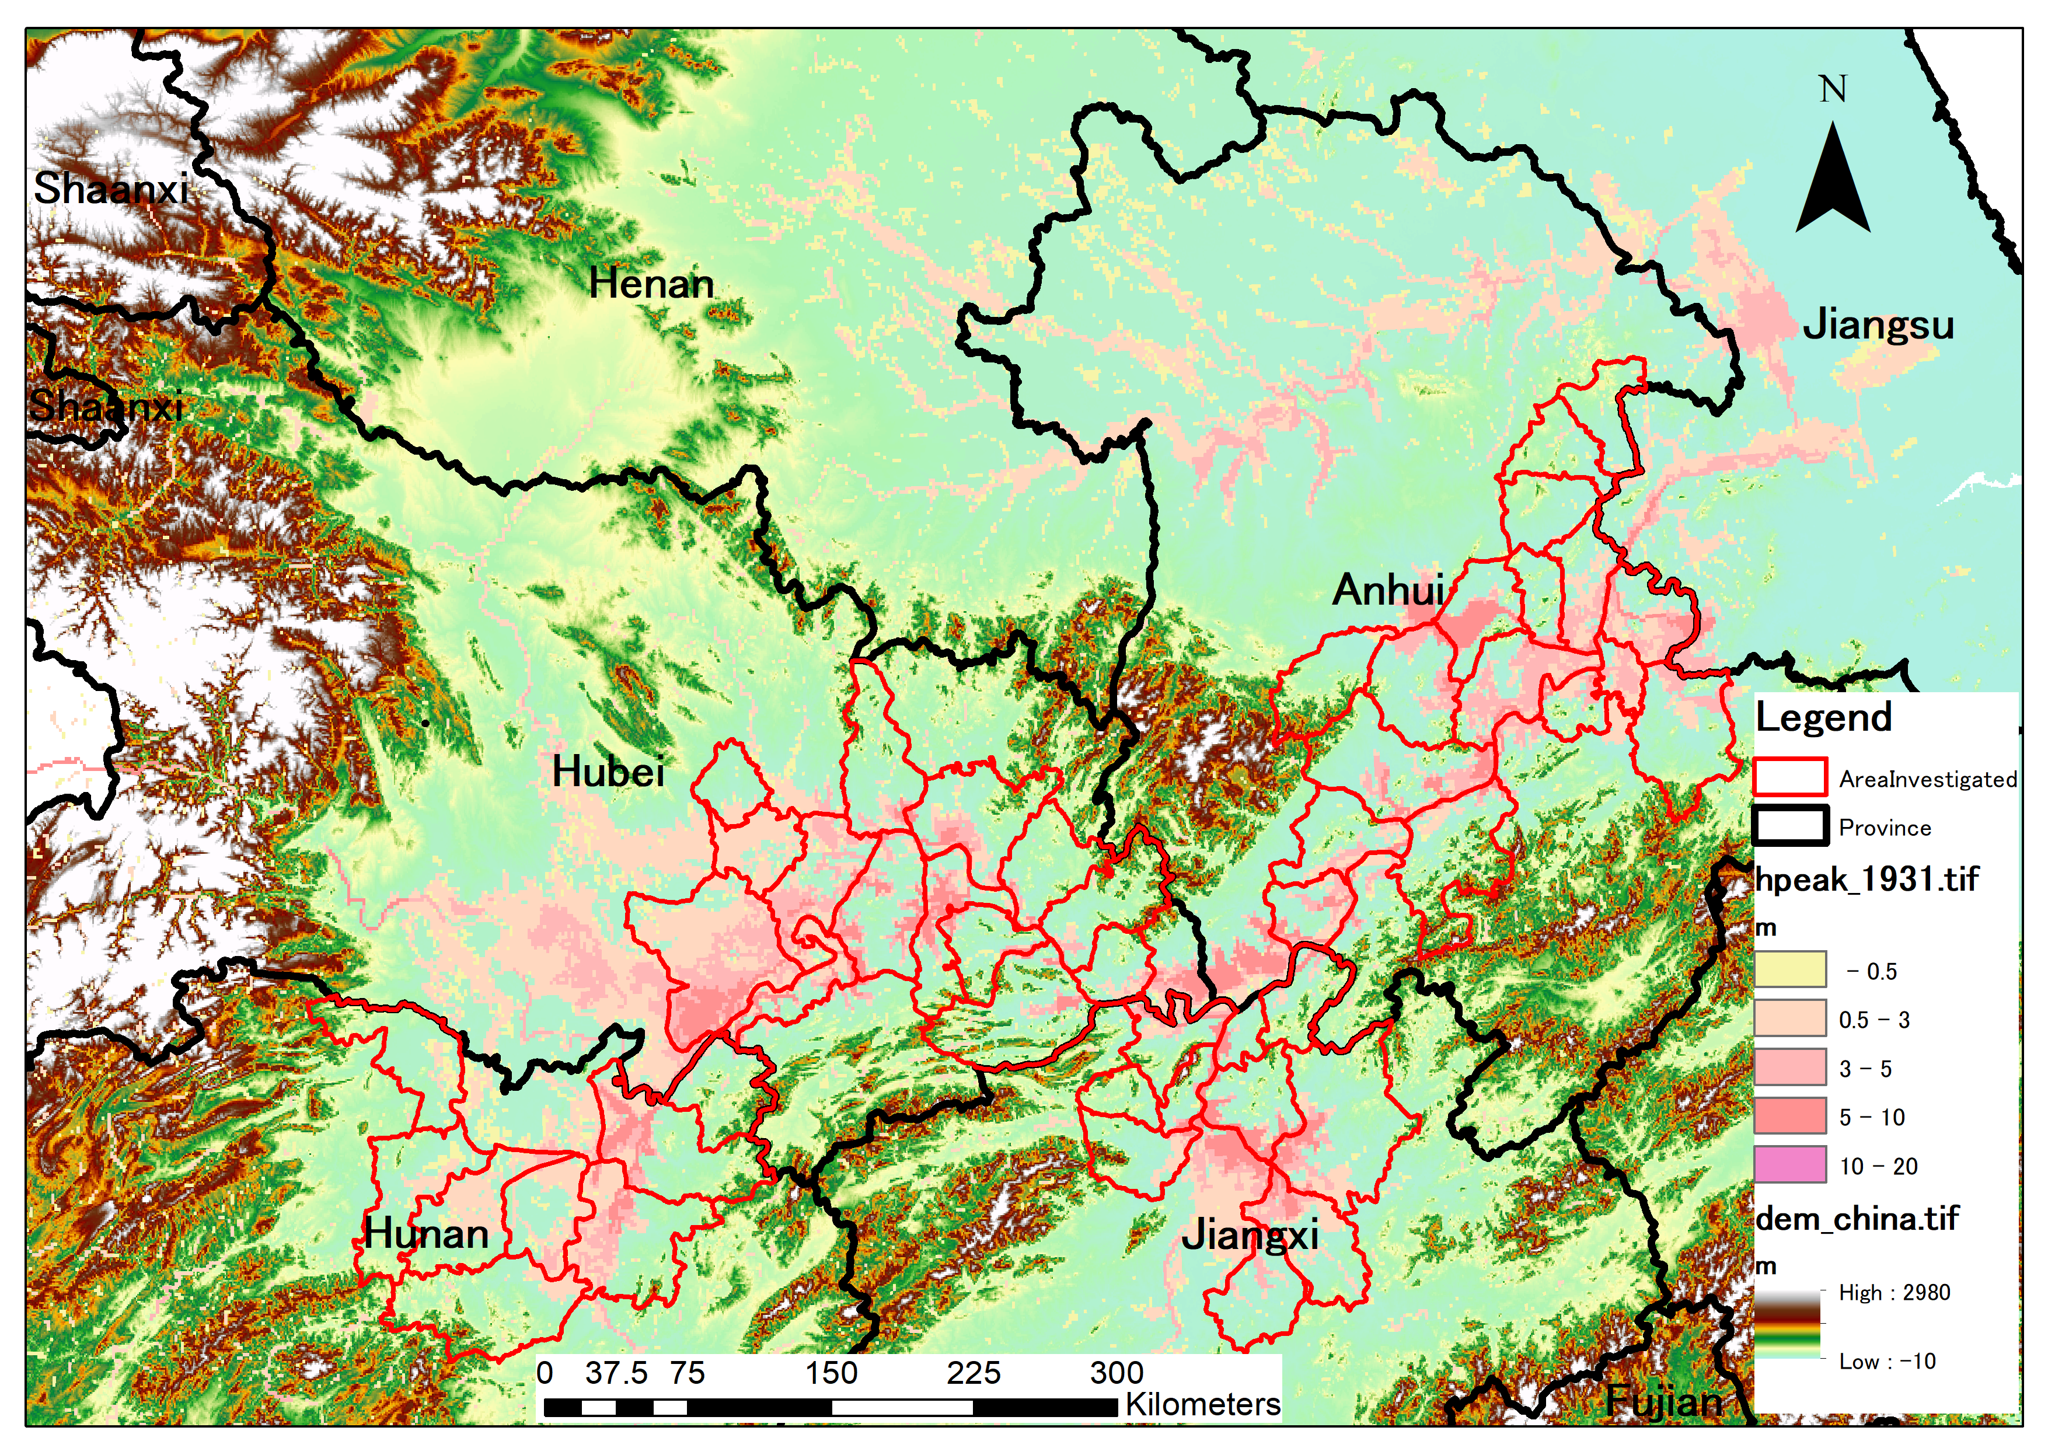
2. Investigated prefectures in 1931
62 prefectures were recorded;
Large inundated area of Hubei, Anhui and Jiangxi Province is neglected.

Slide 9
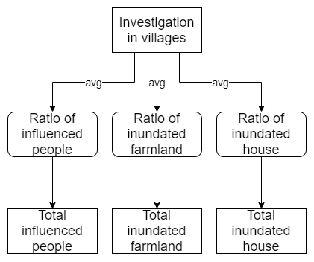
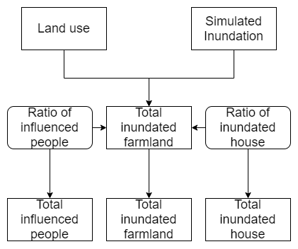
2. Calculation methodology
Before
After
Previous calculation depends on the investigated ratio of inundated farmland, difficult to estimate when in-situ data is not available;
Land use and simulated inundation is applied to generate inundation area in the whole region.

Slide 10
2. Modified statistics of damage
After modification, in 1954, the inundated houses and influenced people are higher than 1931;
The inundated farmland of 1931 is about 83% more than former;
The total increase of influence farmland in 1954 is around 50%

Slide 11
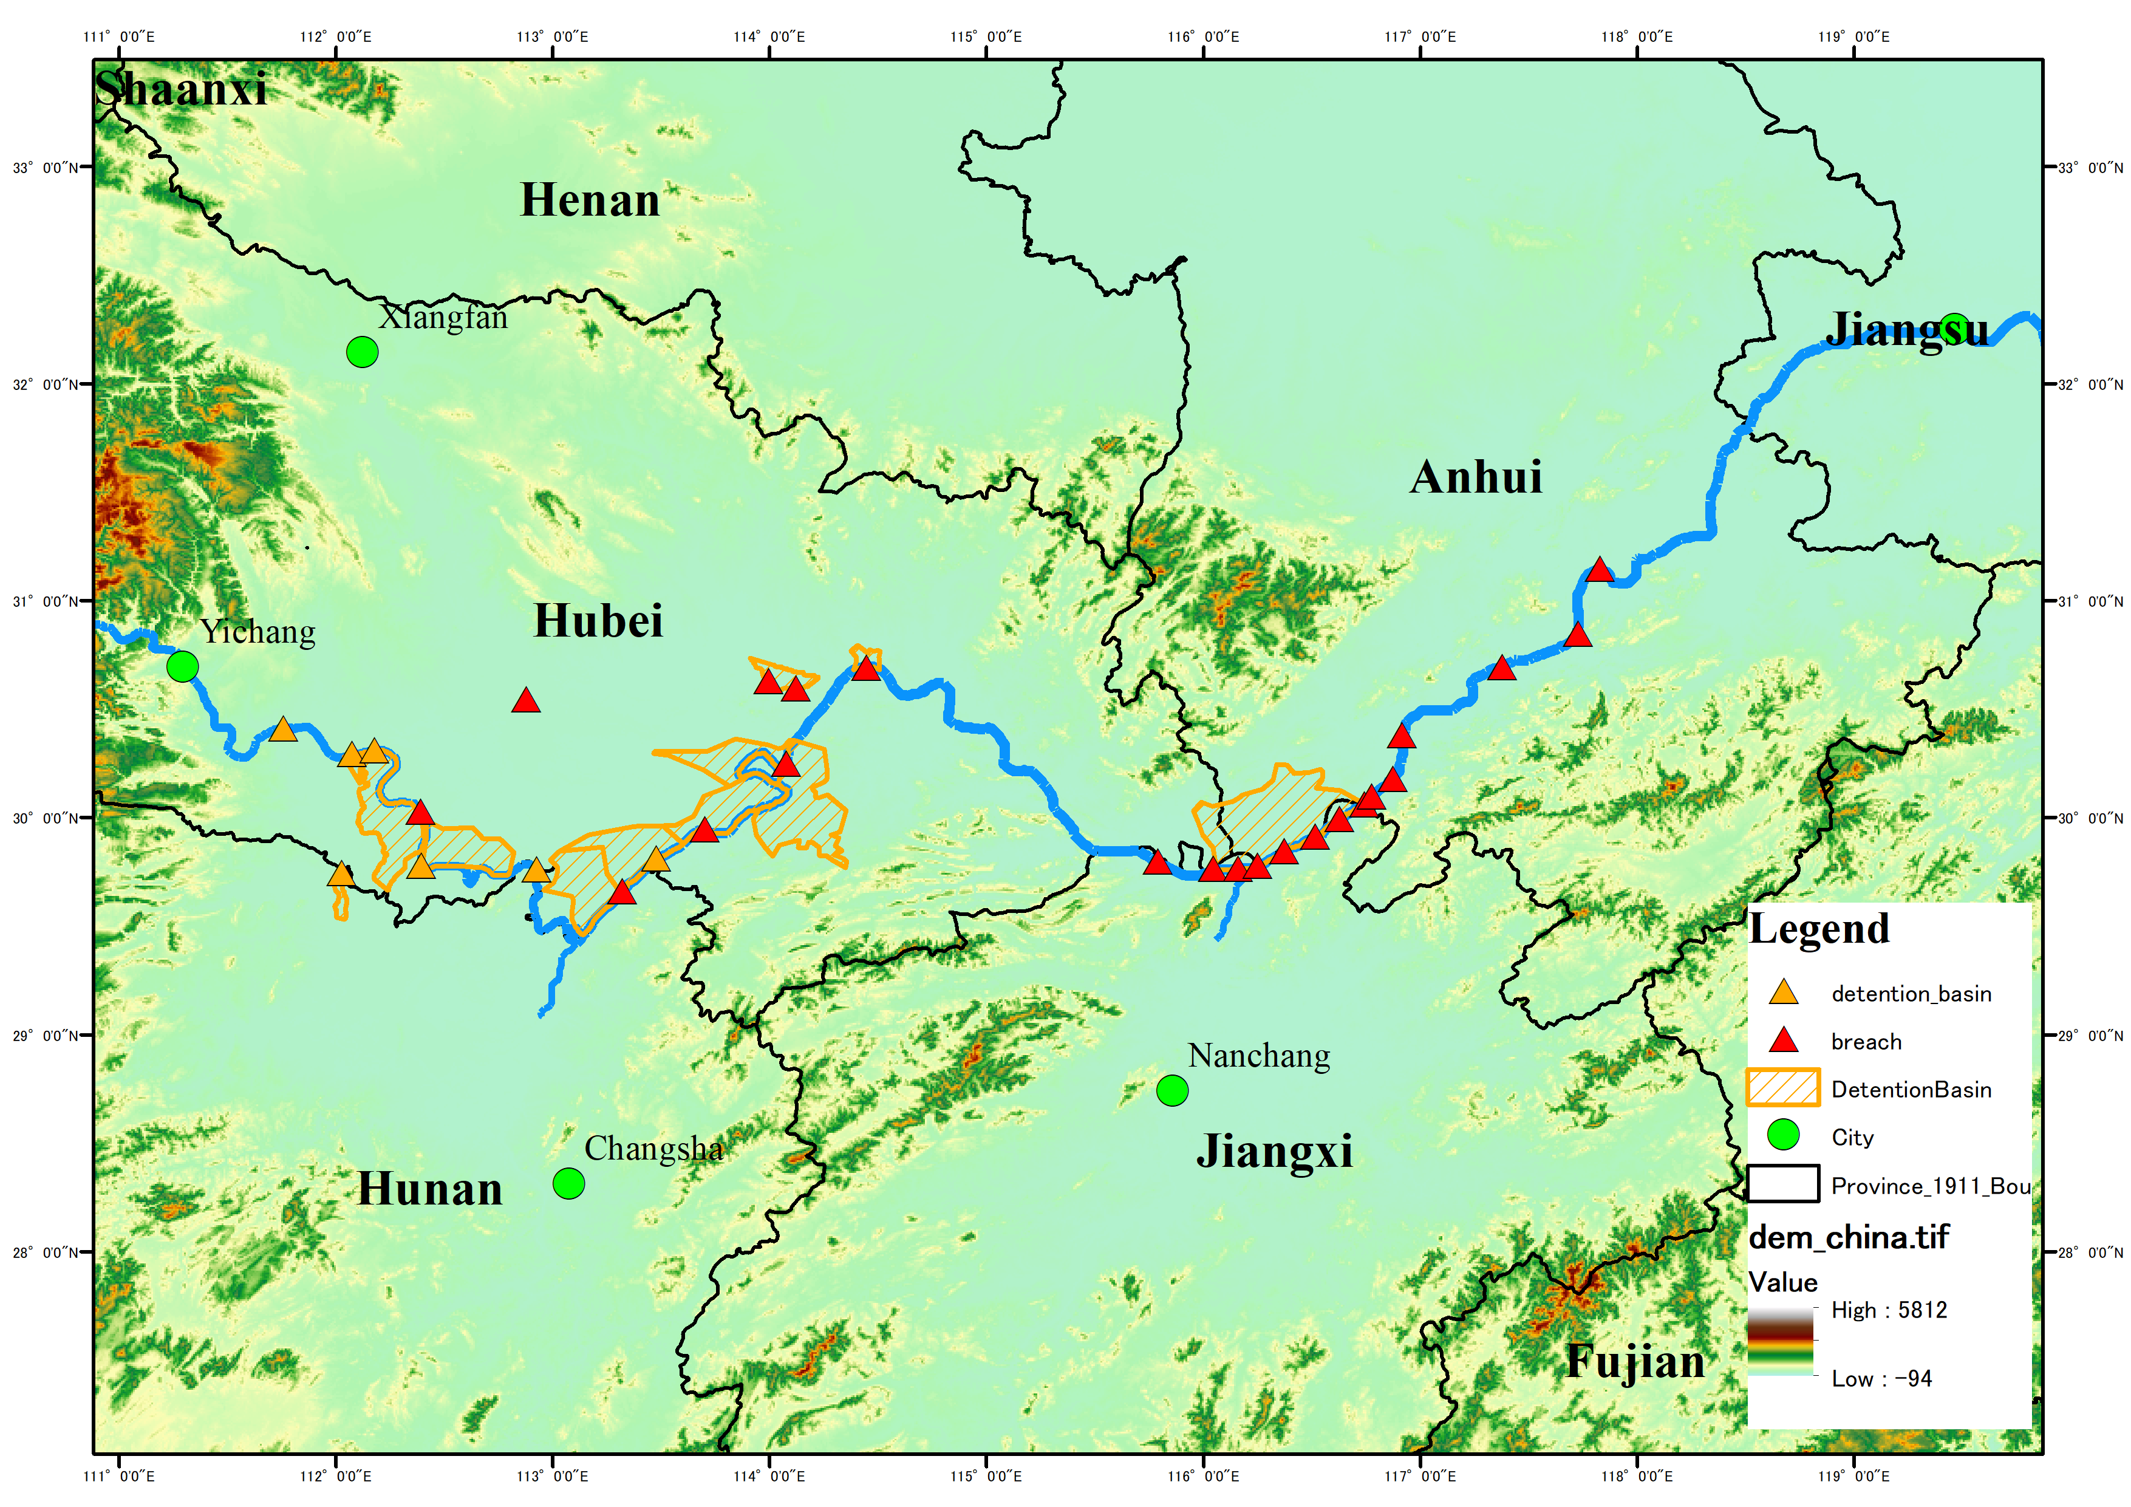
2. Flood detention basins
11 detention basins of total 8806 km2 are included in the calculation of 1954 flood;
All detention basins are assumed to operate at 7/16, 1954;
The average inundation depth of detention basin is set to be 5.0 m.

Slide 12
2. Reduced inundation area %
Both detention basin and levee reinforcement are effective in reducing area;
Levee reinforcement seems to be more effective;
For ≥1.5 m, the whole effect is greater than parts summed up.

Slide 13
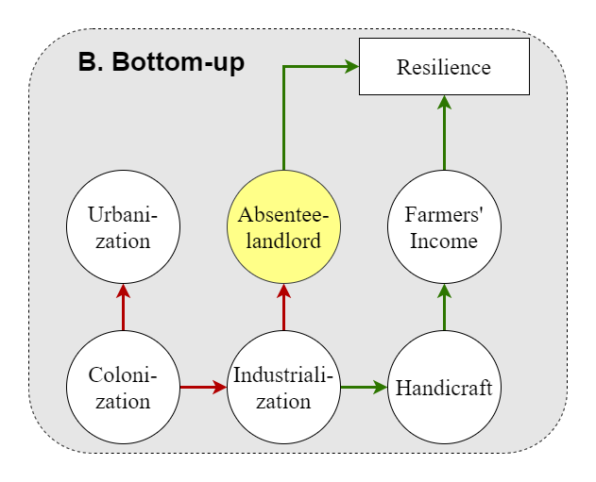
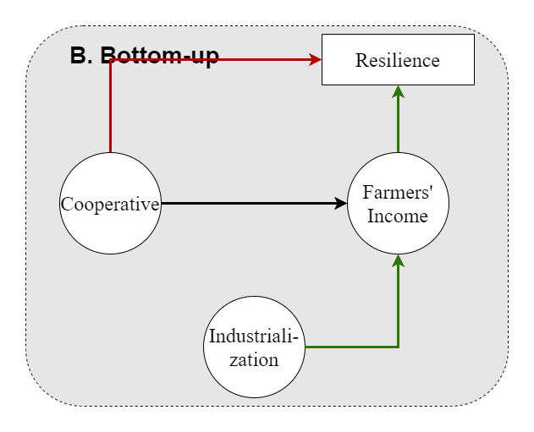
3. 1931 & 1954 important elements
1931
1954
① 85%
agricultural population
① 86%
agricultural population
Crop Product
Crop Product
② 40%
affected → refugees
② 17%
affected → refugees
Refugees
Refugees
Notes:
1930s数据来源于1935年的调查统计，Chen Han-seng, Landlord and Peasant in China (Westport, Connect, 1936), p.2.
1950s数据整理自国家统计局国家数据网站，来源为1953年第一次人口普查。
2021数据来源于国家统计局网站（http://www.stats.gov.cn/tjsj/zxfb/202105/t20210510_1817176.html），居住在乡村的人口比例为36.11%。
1954灾民比例数据整理自Chirs Courtney, At war with water: the Maoist state and the 1954 Yangzi floods, 2018. P1826

Slide 14
3. Society changes → rice yield difference
12%↑
29%↓
In 1930s, the village society had become more vulnerable to flood (1931) and drought (1934).
The social responses of 1954 was quite successful as the rice yield > potential.

Slide 15
4. Summary
Conclusion
The natural condition of 1954 flood is more severe than 1931:
The inundated area > 2m of 1954 is 50% larger than 1931;
The cumulative precipitation of 1954 is 18% higher than 1931.
The effect of different countermeasures are compared for 1954:
Under all threshold cases, both detention basin and levee reinforcement are effective in reducing inundation area;
Detention basin is more effective in reducing inundation area deeper than 2 m.
The countermeasures of 1954 were more effective than 1931.
The observed rice yield in Jiangxi Province during 1931 flood is 26% less than the simulated PCP, while during 1954 flood, the observed rice yield is 13% more than simulated PCP.

