Slide 1




Rainfall thresholds for shallow landslide triggering in El Salvador
Mario Reyes
Observatory of Hazards and Natural Resources
Ministry of Environment and Natural Resources
El Salvador

Slide 2
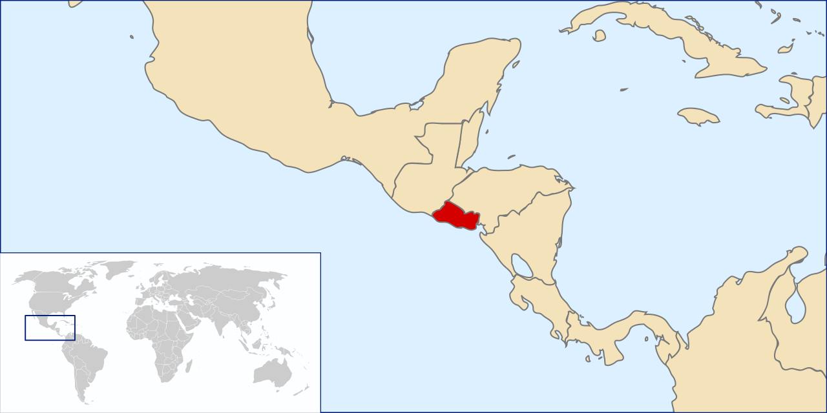
El Salvador at a glance
Area: 21,041 km²
Population density: 313 hab/km² (https://data.worldbank.org/indicator/EN.POP.DNST?locations=SV)
Rainy season: May to October
Average rainfall: ~ 1800 mm
Frequently affected by large hurricanes and tropical storms that result in floods and landslides
https://commons.wikimedia.org/wiki/File:LocationElSalvador.svg

Slide 3
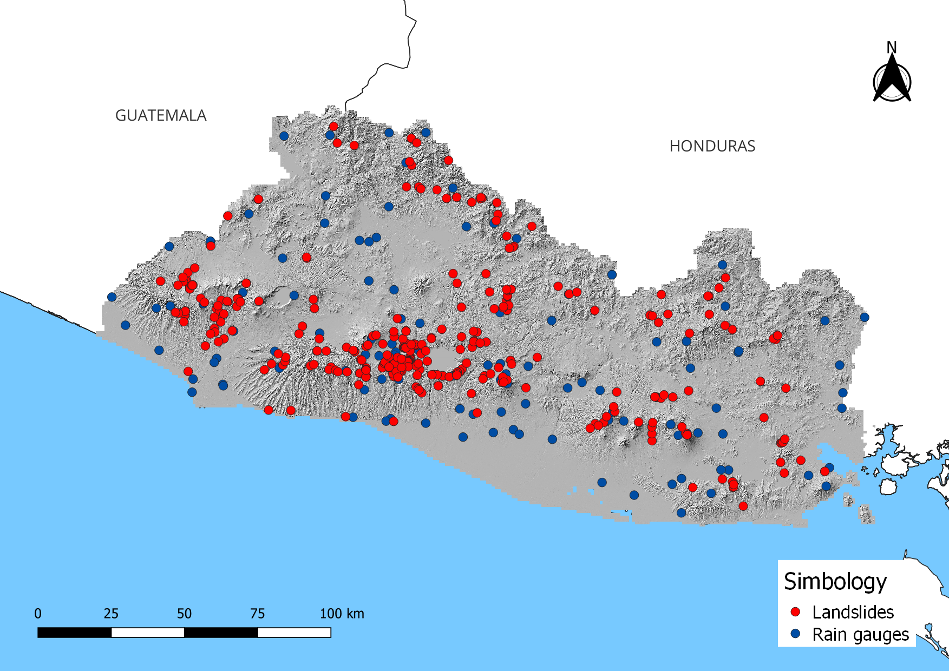
Data
Landslide data: 366 shallow landslides ocurred between 2004 and 2019
Rainfall data: hourly rainfall for 120 rain gauges for the same period

Slide 4
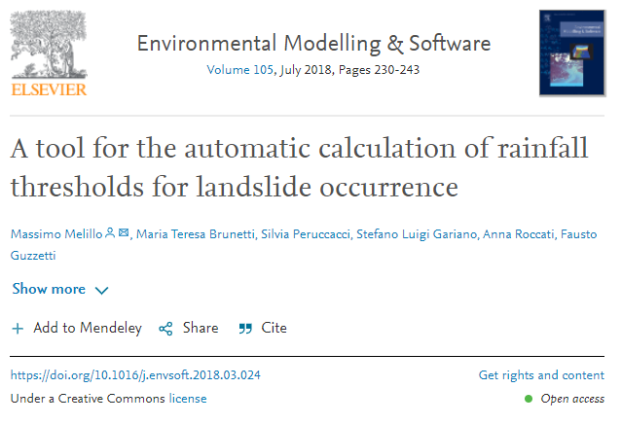
Methodology
The CTRL-T (Calculation of Thresholds for Rainfall-induced Landslides Tool) (Melillo et al, 2018) code was used to reconstruct the rainfall conditions associated to landslides and calculate the thresholds.
A no rainfall period of 24 hours was selected as a parameter for the rainfall conditions reconstruction, after a trial and error process.
The results were validated with 63 landslides ocurred in 2020 that were not used to créate the thresholds

Slide 5
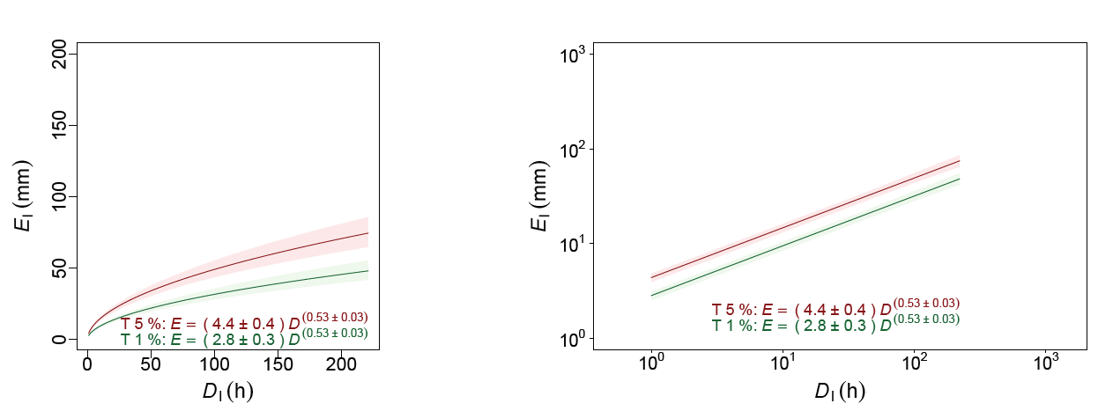
Results

Slide 6
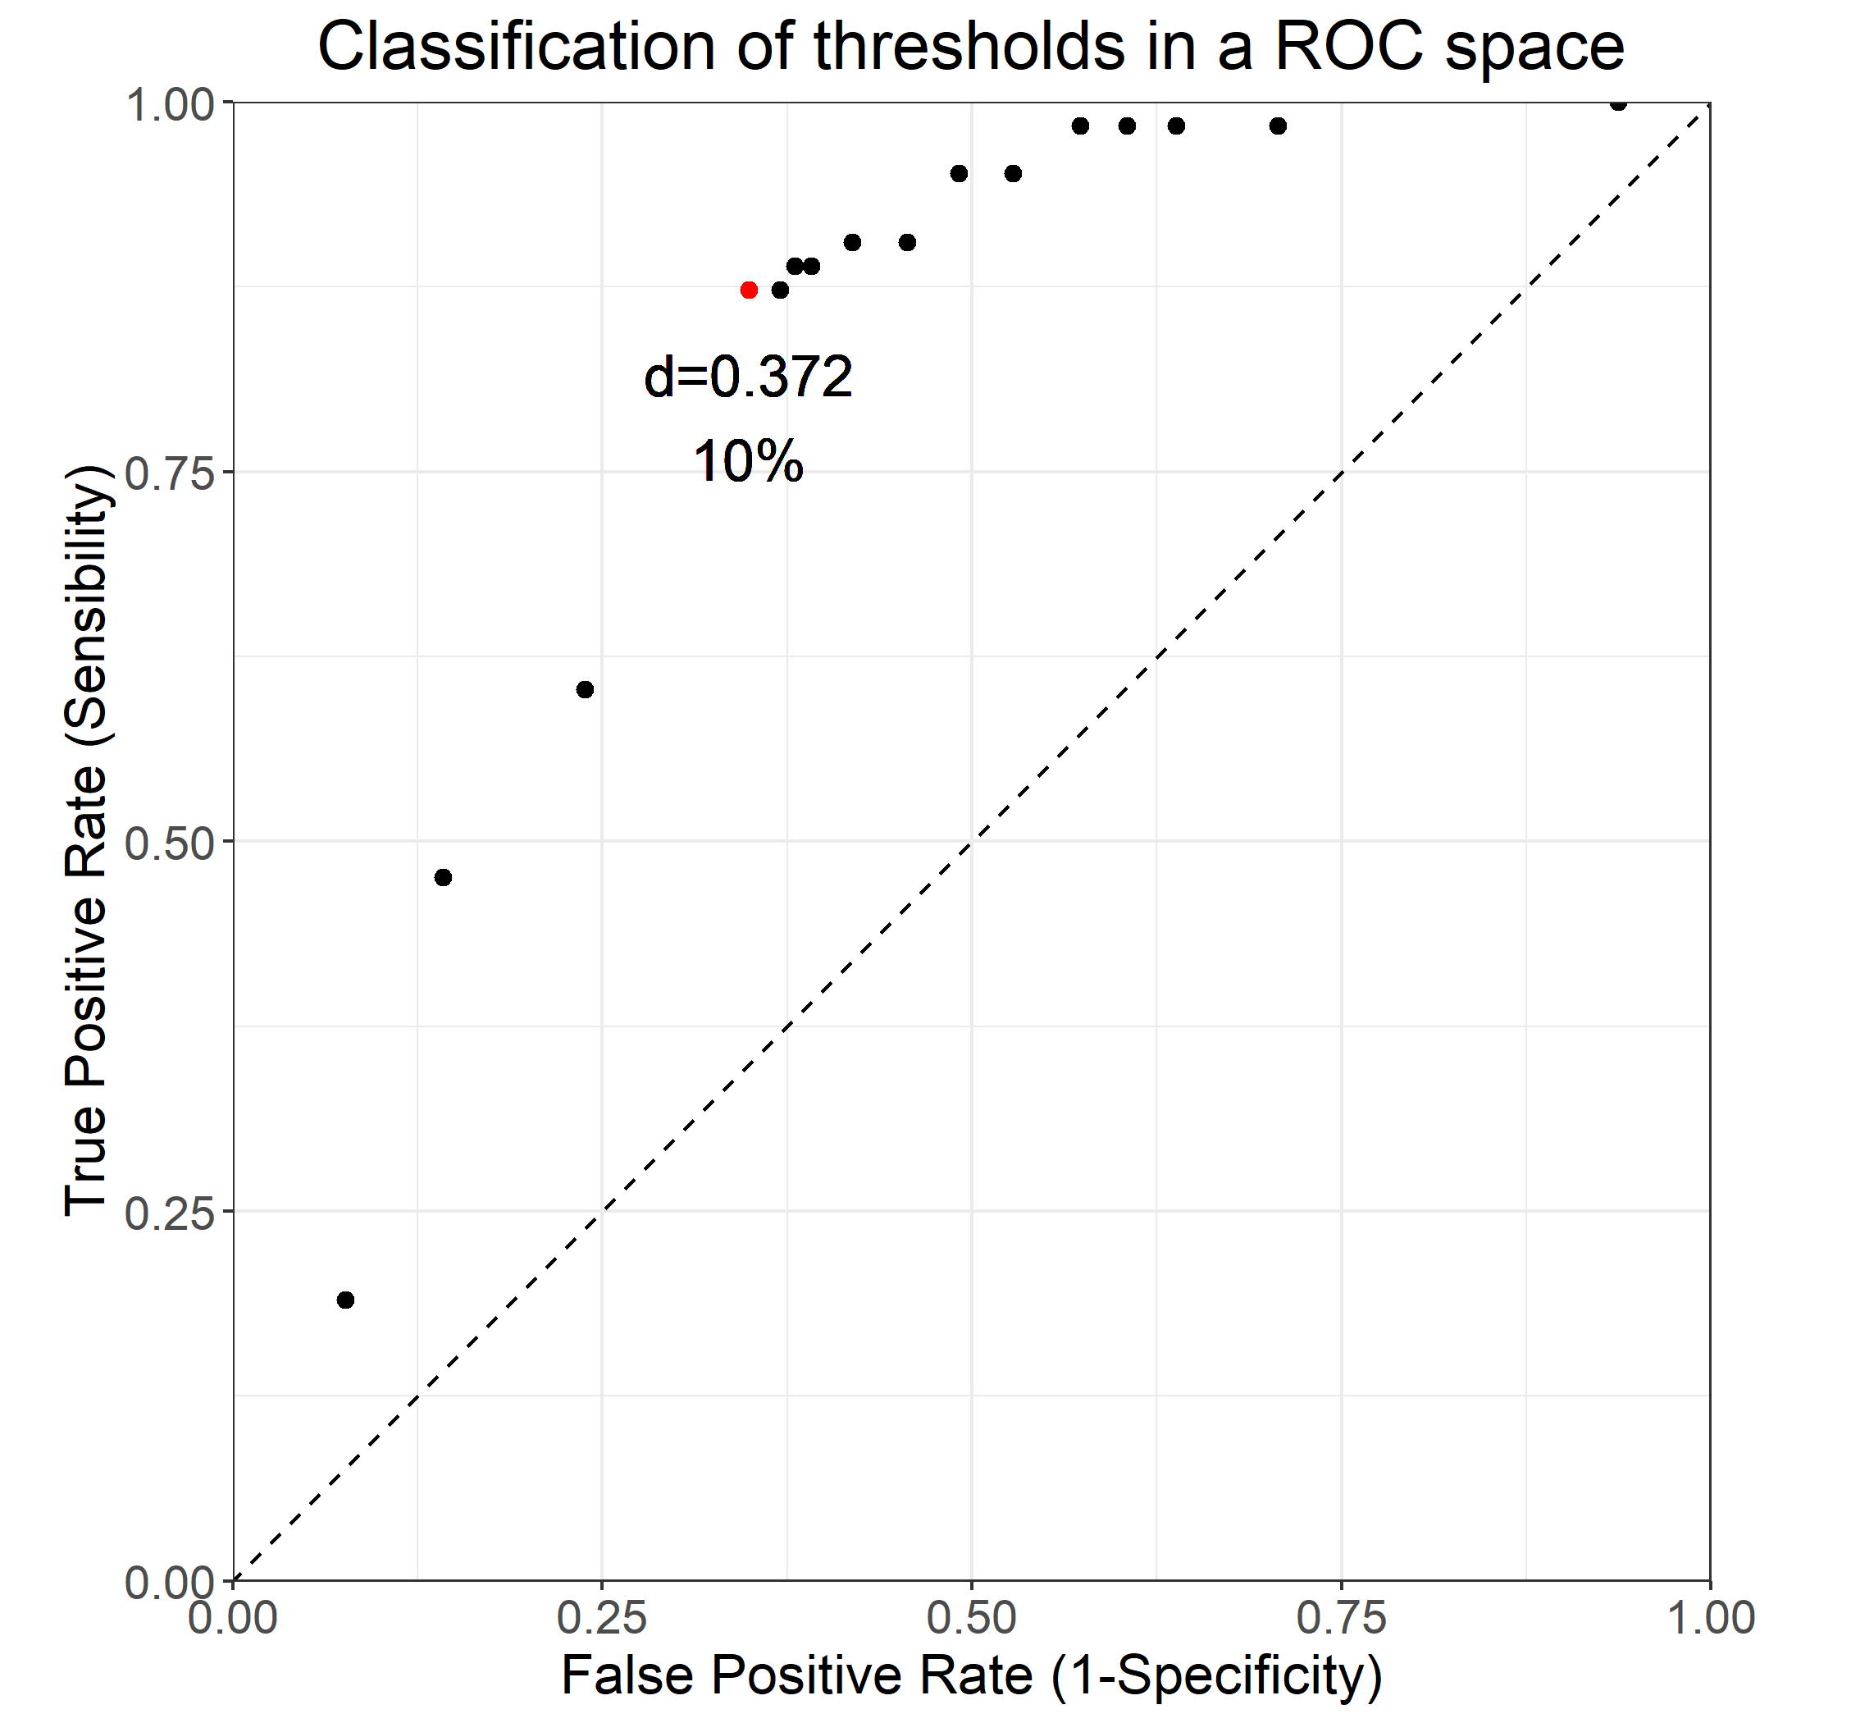
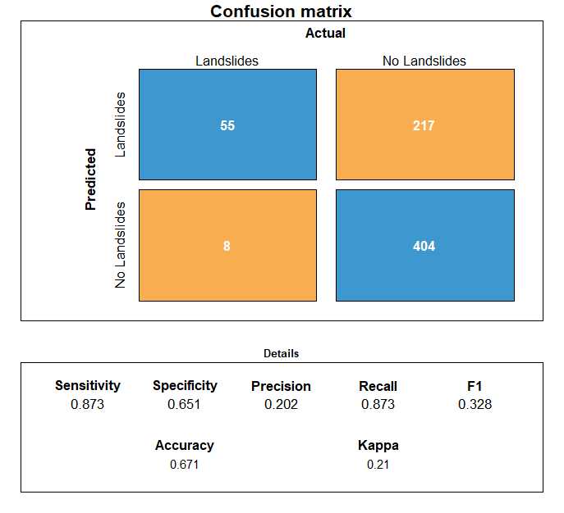
Validation

Slide 7
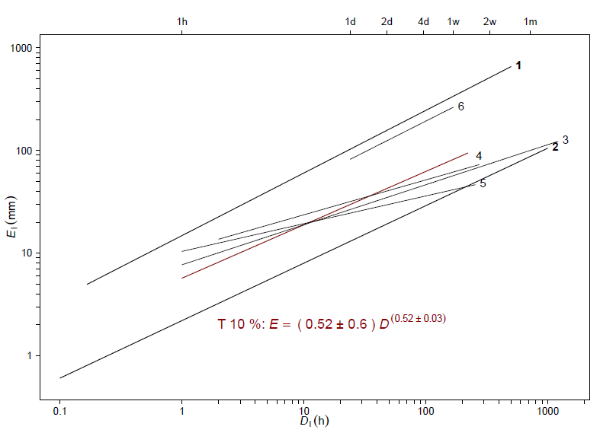
Comparison with other thresholds
Caine (1980), Global
Guzzetti et al (2007), Global
Perucacci et al (2017), Italia, 5%
Melillo et al (2018), Liguria, Italia, 5%
Gariano et al (2015), Sicilia, Italia, 5%
Garcia y Axelsson (2015), Tegucigalpa, Honduras (duration in days)

Slide 8
References
Caine, N. (1980) The Rainfall Intensity: Duration Control of Shallow Landslides and Debris Flows. Geografiska Annaler, 62, 23-27. https://doi.org/10.2307/520449
Melillo, M., Brunetti M.T., Peruccacci S.., Gariano S.L., Roccati A., Guzzetti F. (2018) CTRL-T: a tool for the automatic calculation of rainfall thresholds for landslide occurrence. Environmental Modelling & Software 105 230–243, https://doi.org/ 10.1016/j.envsoft.2018.03.024
Garcia-Urquia, E. & Axelsson, K. (2015). Rainfall thresholds for the occurrence of urban landslides in Tegucigalpa, Honduras: An application of the critical rainfall intensity. Geografiska Annaler. Series A, Physical Geography, 97(1), 61-83
Gariano S.L., Brunetti, M.T., Iovine, G., Melillo, M., Peruccacci, S., Terranova, O., Vennari, C., Guzzetti, F. (2015). Calibration and validation of rainfall thresholds for shallow landslide forecasting in Sicily, southern Italy. Geomorphology 228:653–665.
Guzzetti, F., Peruccacci, S., Rossi, M. et al (2007). Rainfall thresholds for the initiation of landslides in central and southern Europe. Meteorol. Atmos. Phys. 98, 239–267. https://doi.org/10.1007/s00703-007-0262
Peruccacci, S., Brunetti, M. T., Gariano, S. L., Melillo, M., Rossi, M., & Guzzetti, F. (2017). Rainfall thresholds for possible landslide occurrence in Italy. Geomorphology, 290, 39-57.

Slide 9

mreyes@marn.gob.sv

