Slide 1


EGU22-6782
Strike-slip motion in the Late Mesozoic on the East Asian continental margin: Insight from 3-D numerical models with the Tan-Lu fault
Meng Zhou¹, Ting Yang¹, Lijun Deng¹, Peng Guo¹
1.Southern University of Science and Technology Shenzhen 518055
Correspondence to: M. Zhou, 11930418@mail.sustech.edu.cn

Slide 2

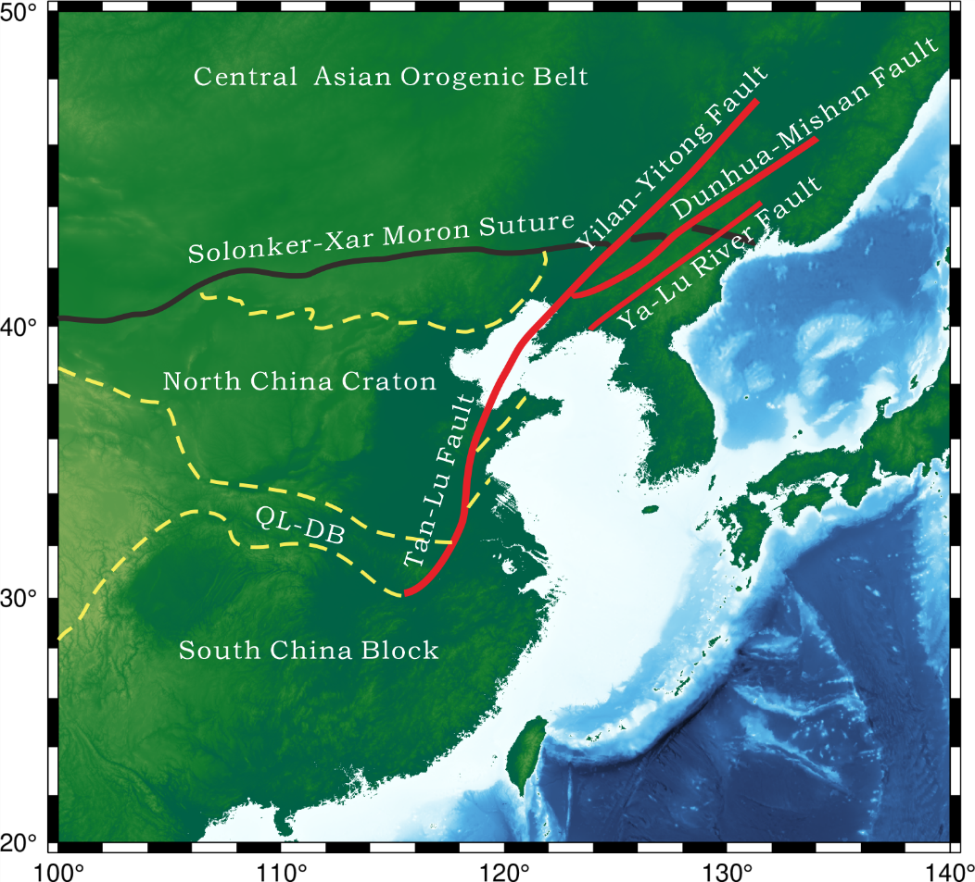
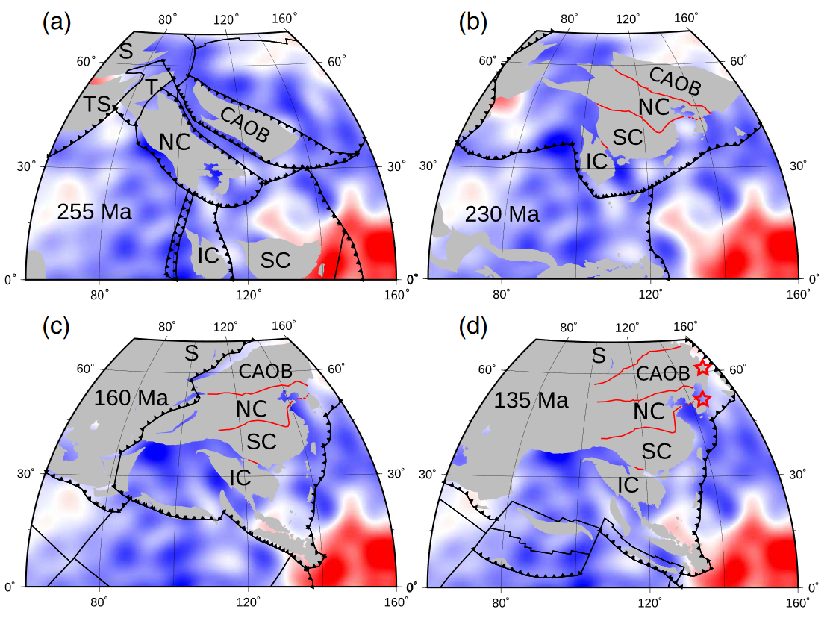
Figure 1. Main tectonic features of the East Asian
Figure 2. Plate reconstruction ( Yang et al. 2020 )

Slide 3
?:
The formation mechanism of the large strike-motion of the Tan-Lu fault in the Late Mesozoic?
Main Previous studies:
the paleo-Pacific NNW-ward subduction

Slide 4
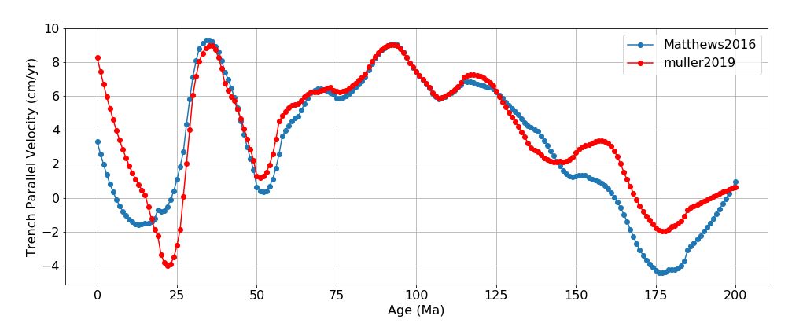
The average velocity of the paleo-Pacific plate in the trench‐parallel direction between 150~60Ma:
5.84 cm/yr
( Matthews et al., 2016 )
5.98cm/yr
( Müller et al., 2019 )
The paleo-Pacific motion history in the trench‐parallel direction from different reconstructions.

Slide 5


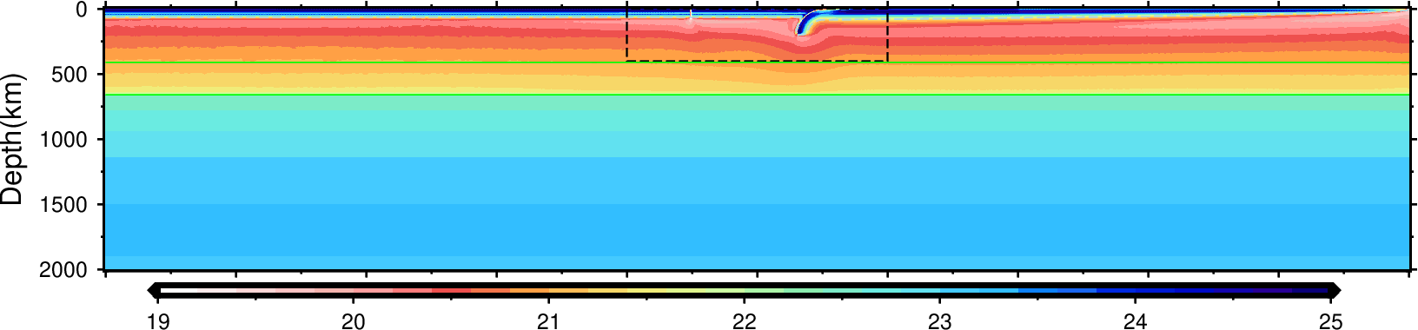
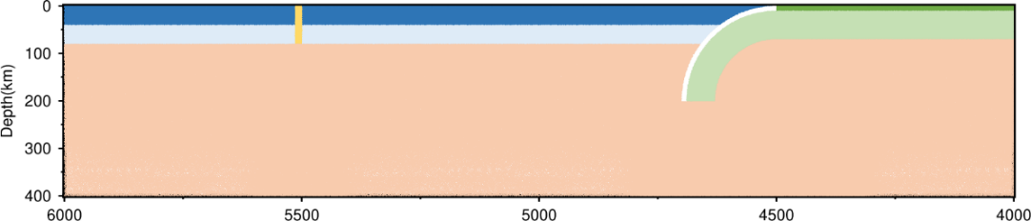
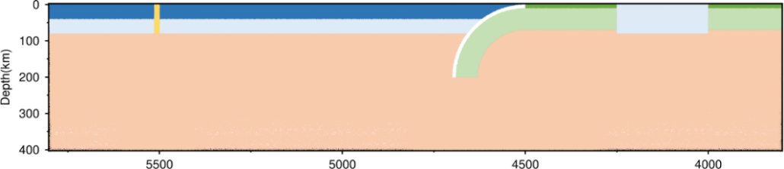
Reference 3-D experiment
3-D model diagram
Profile-map
Micro-block
Figure 2. Initial viscosity field and compositional field near the subduction zone.
Figure 1. compositional field near the subduction zone of experiment with a micro-block on the subducting plate.

Slide 6


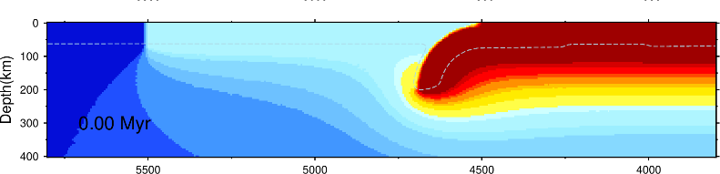
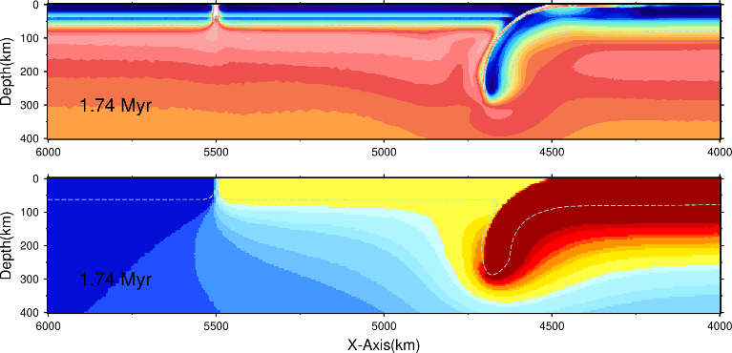

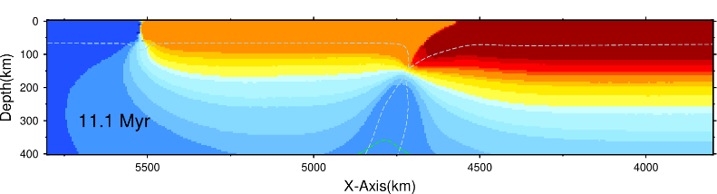
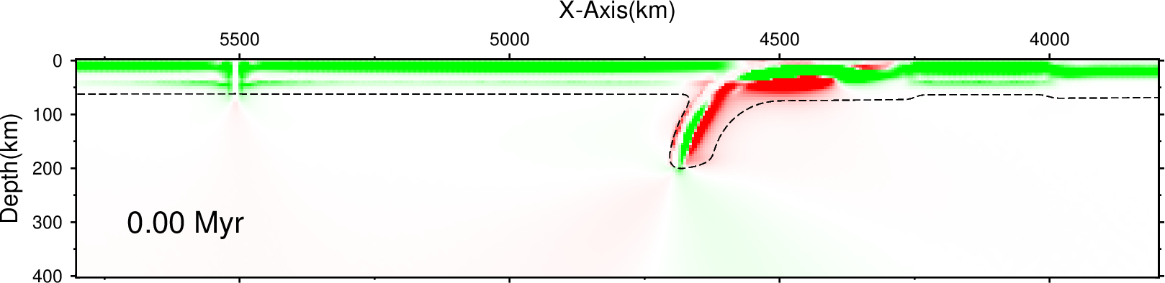
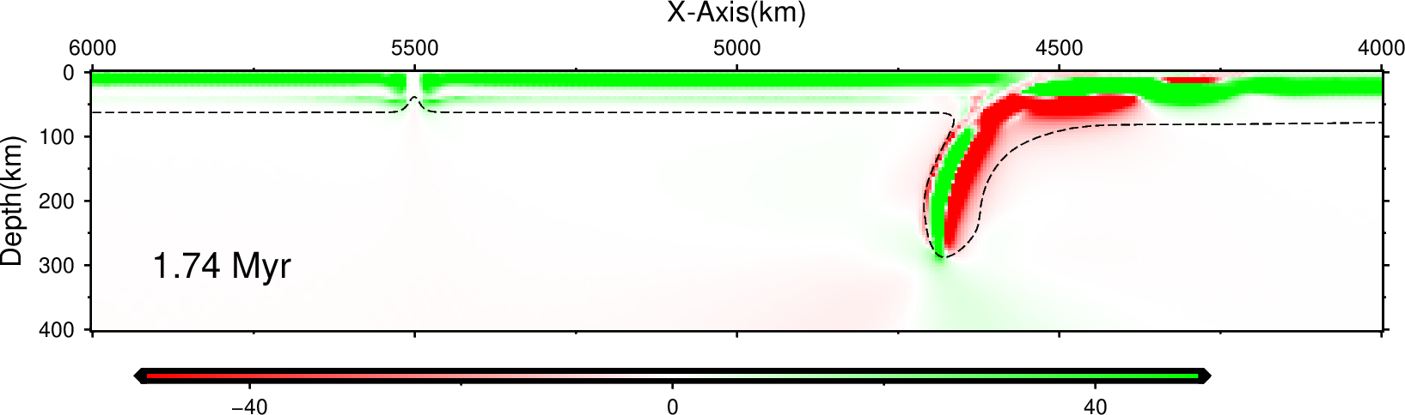
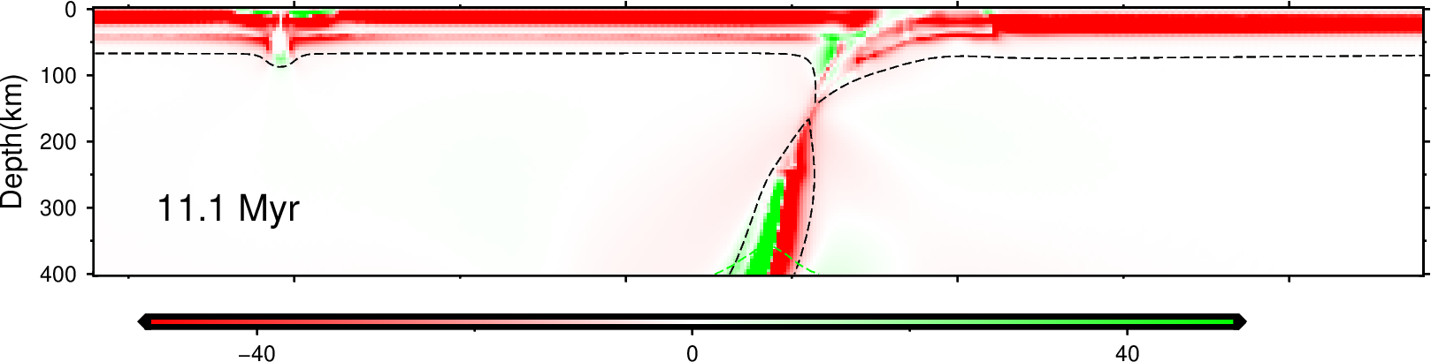

Reference model
Model with a micro-block
Figure 1. model results. viscosity field、velocity filed in the trench‐parallel direction and stress filed
Figure 2. model revolution. velocity filed in the trench‐parallel direction and stress filed

Slide 7
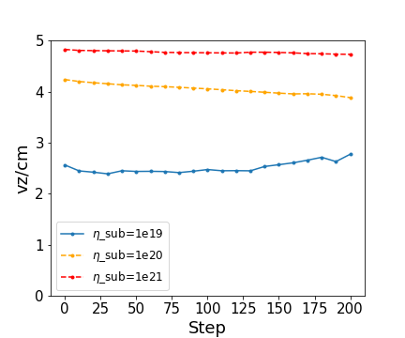
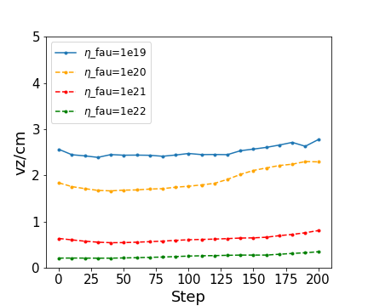
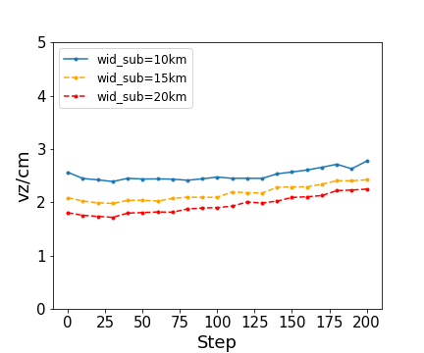
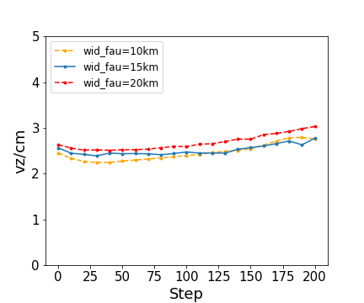
[1] The NNW-ward subduction of the paleo-Pacific leads the strike-slip motion
[2] The weakening of The Tan-Lu fault zone is a necessary factor for its’ strike-slip motion.
[3] the strike-slip motion can be influenced the coupling degree between two plates.

Slide 8
Answer:
[1]: the paleo-Pacific subduction accompanying trench-parallel component of velocity.
[2]: the paleo-Pacific subduction could lead large-scale strike-slip motion of the Tan-Lu fault on the continent.

