Slide 1



Numerical Simulations of
Internal Solitary Wave Evolution
Beneath an Ice Keel
Peiwen Zhang^{1,2,3}, Zhenhua Xu^{1,2,3,4,5}, Qun Li⁶, Jia You^{1,2,3}, Baoshu Yin1^{,2,3,4,5}, Robin Robertson⁷ and Quanan Zheng⁸
¹CAS Key Laboratory of Ocean Circulation and Waves, Institute of Oceanology Chinese Academy of Sciences, Qingdao, China
²Center for Ocean Mega-Science, Chinese Academy of Sciences, Qingdao, China
³College of Earth and Planetary Sciences, University of Chinese Academy of Sciences, Beijing, China
⁴Pilot National Laboratory for Marine Science and Technology, Qingdao, China
⁵CAS Engineering Laboratory for Marine Ranching, Institute of Oceanology, Chinese Academy of Sciences, Qingdao, China
⁶MNR Key Laboratory for Polar Science, Polar Research Institute of China, Shanghai, China,
⁷China-Asean College of Marine Science, Xiamen University Malaysia, Sepang, Malaysia
⁸Department of Atmospheric and Oceanic Science, University of Maryland, College Park, MD, USA

Slide 2
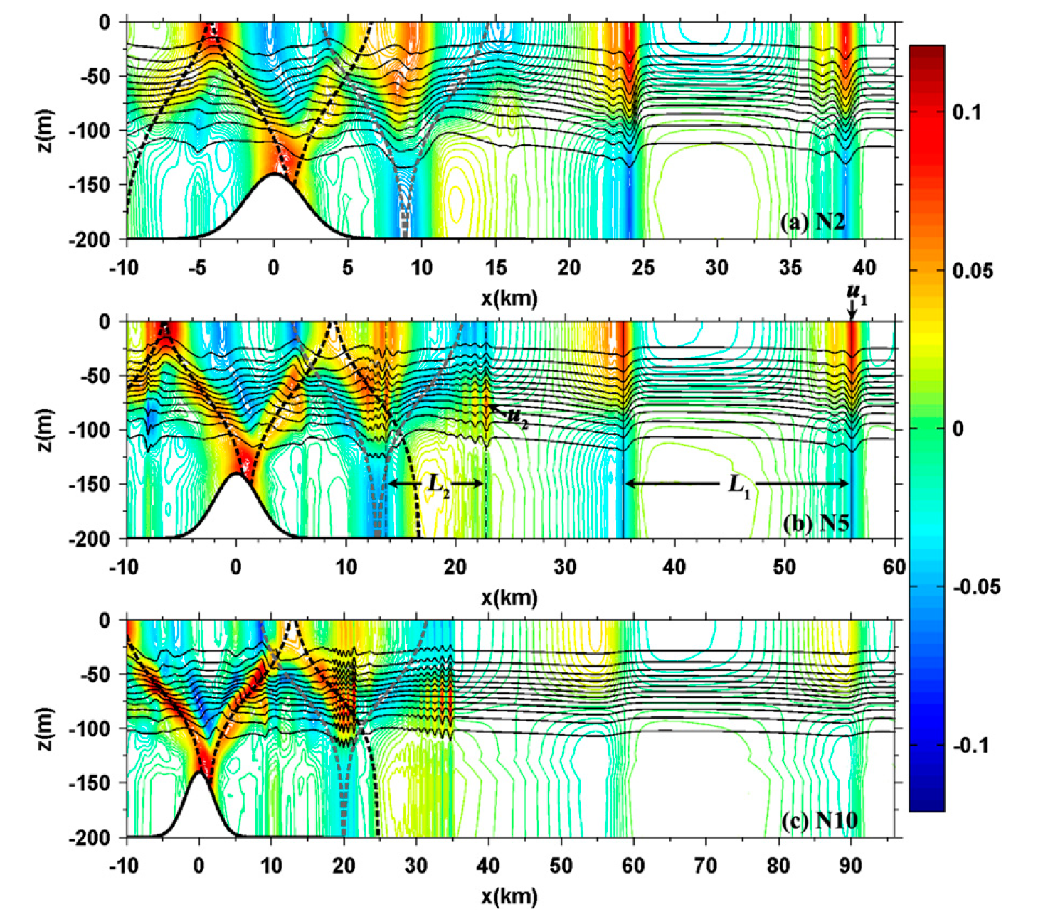
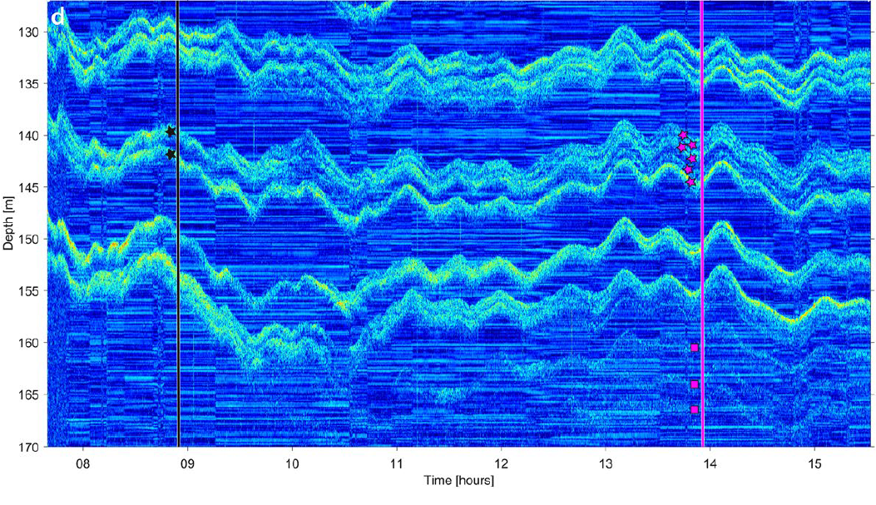
Introduction
ISWs in mid and low latitude region:
Generation: tides, lee-wave mechanism
Evolution: background current, topography
ISWs in High latitude region:
ISW generated by interaction of barotropic tide and topography
(Xie et al., 2015)
?
Sea Ice
ISWs
Make the ISW theory system
more complete
Acoustic observations of internal waves under the sea ice (Stranne et al., 2017)

Slide 3
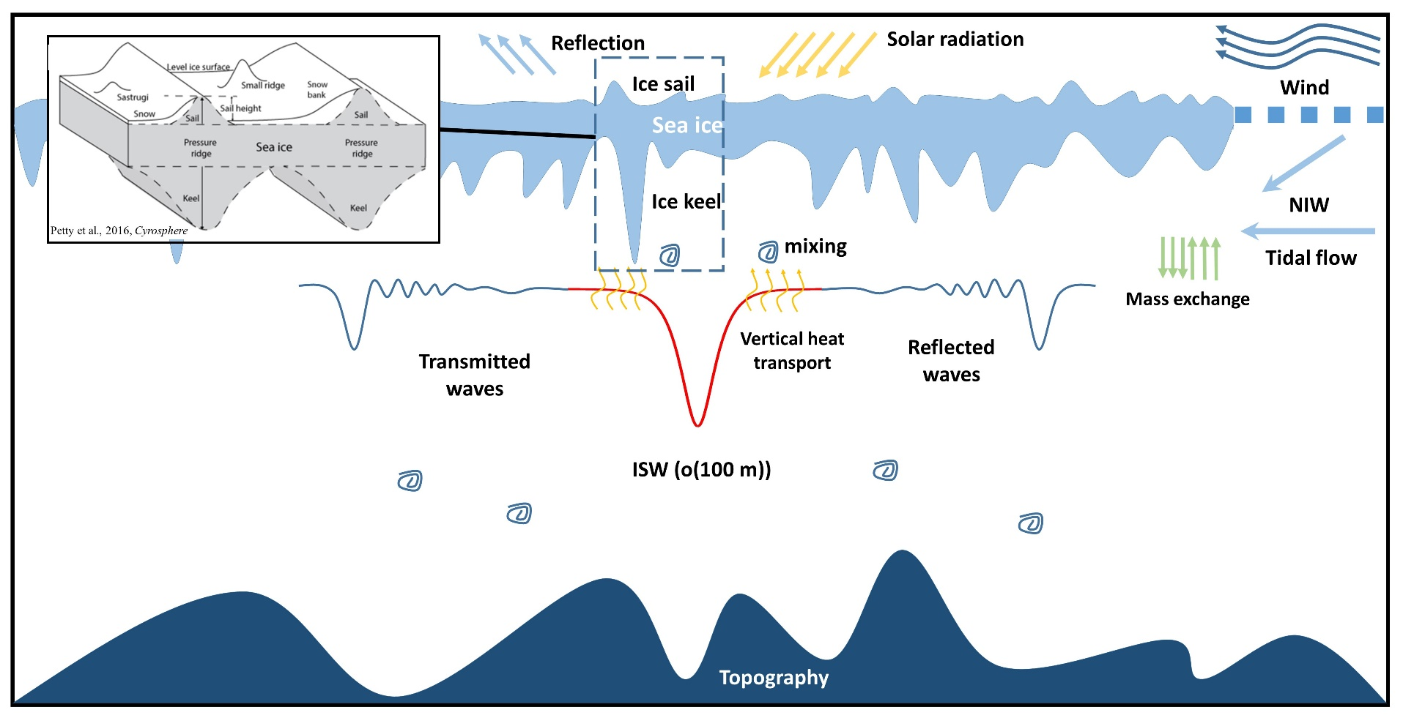
Introduction
In the Arctic Ocean:
Wind effect confined by ice cover
Internal tides can not freely propagate
Freely propagated ISW
under the sea ice
could be important
The configurations of ice keels and the pycnocline are more similar to the evolution of an elevated ISW over a bottom ridge.

Slide 4
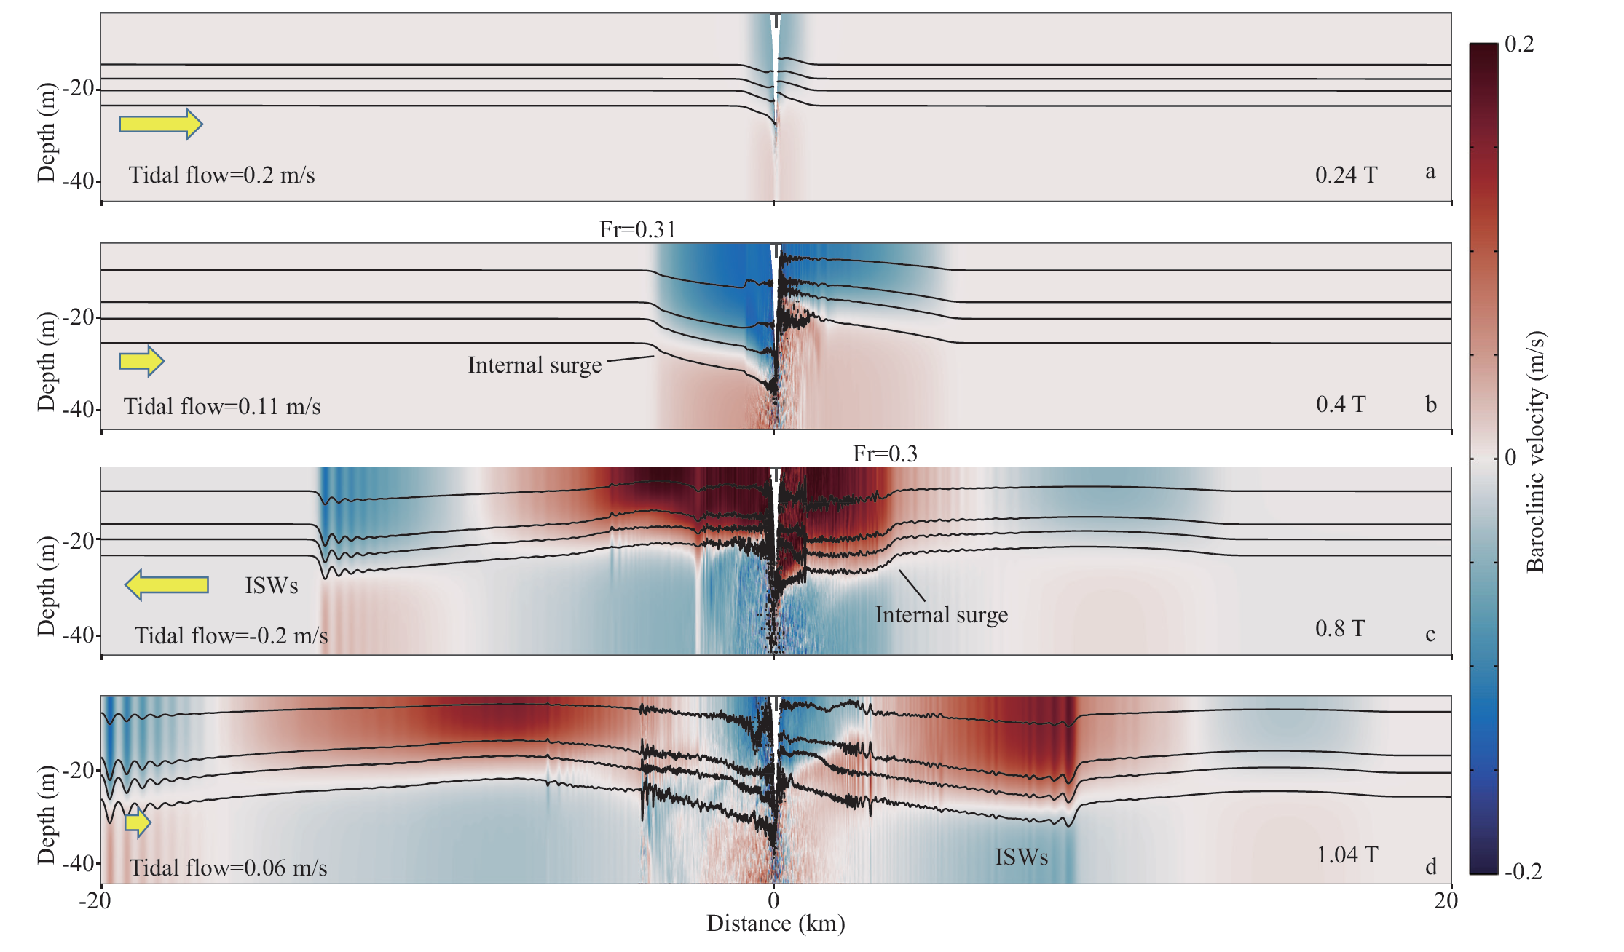
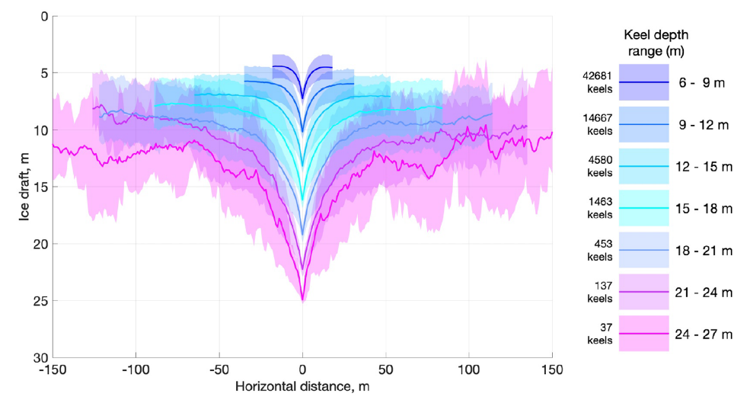
Results
Ice keel ---- A downward projecting ridge on the underside of the sea ice
MITgcm
The interaction between barotropic tides and ice keel can generate ISWs
The ISWs can freely propagated away from the critical latitude

Slide 5
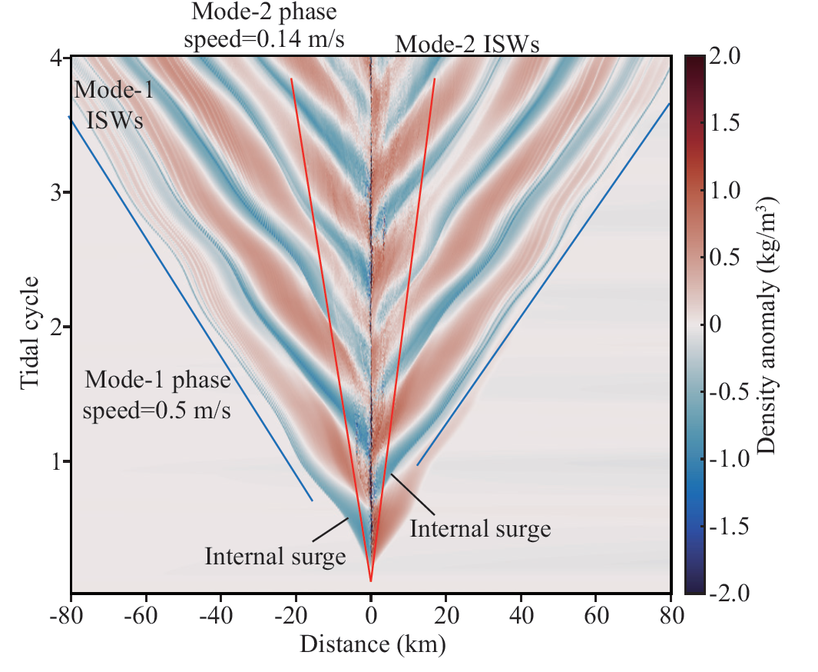
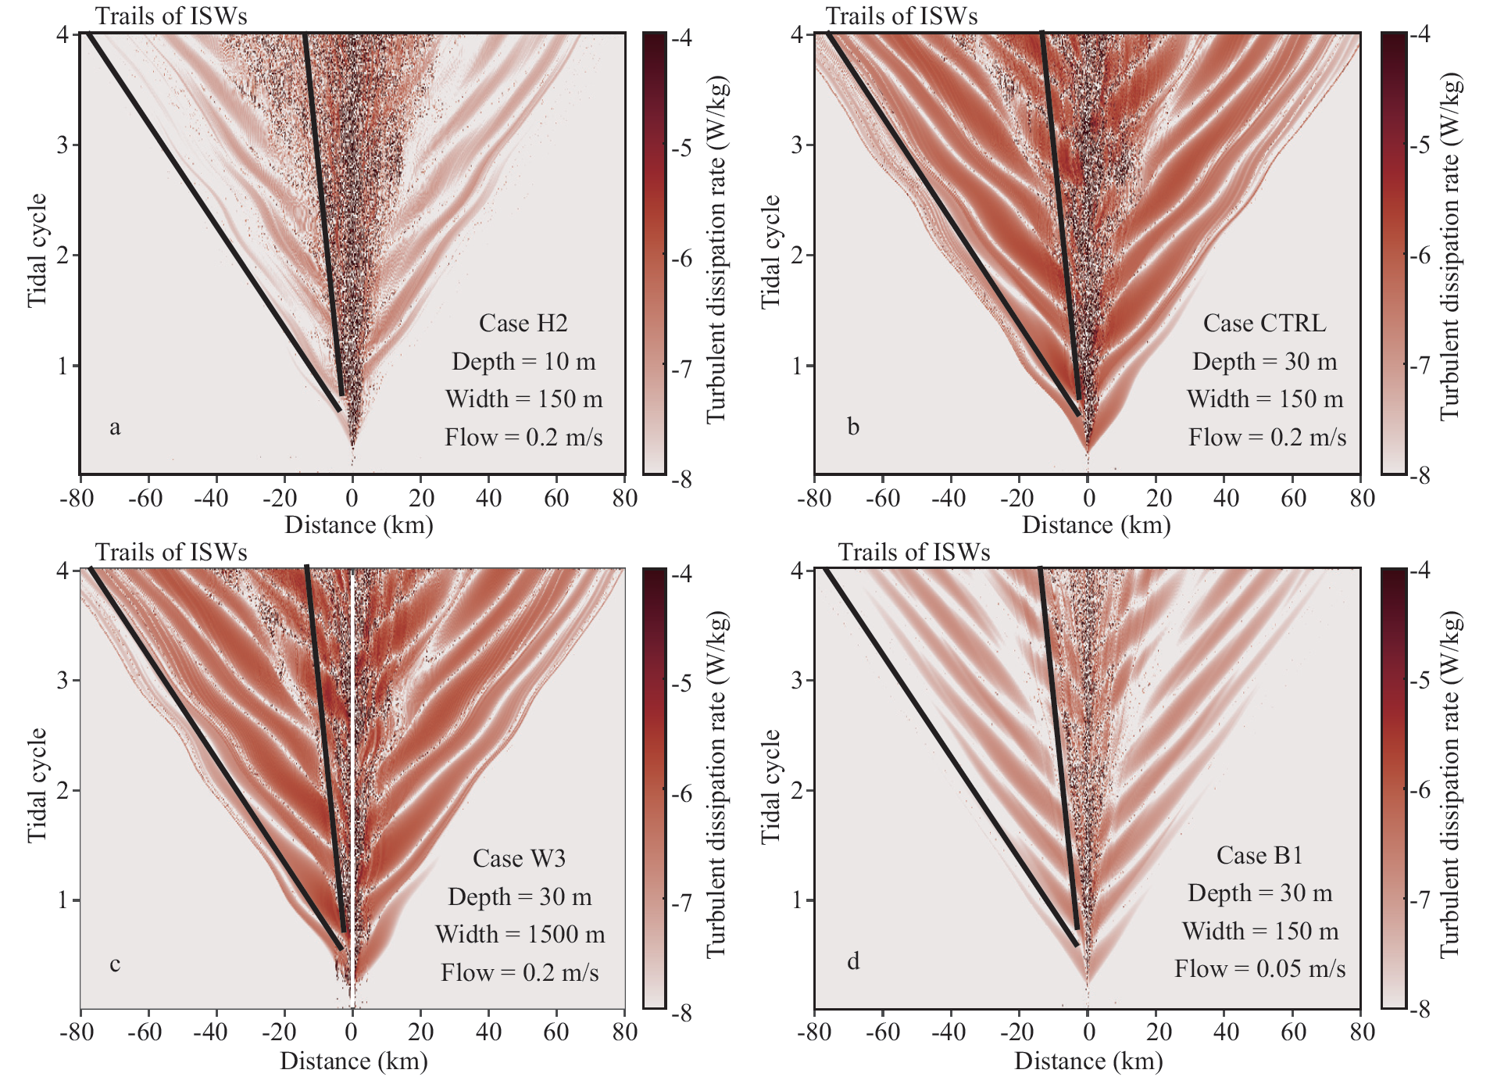
Results
Generated ISWs including mode-1 and mode-2 ISWs
The turbulent dissipation rate is enhanced along the propagation path of ISWs
More sensitive to the ice keel depth and amplitude of tidal flow

Slide 6
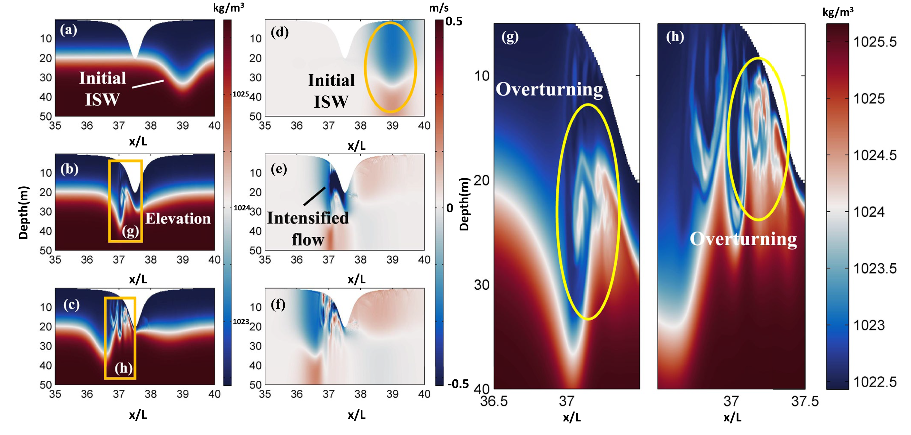
Results
MITgcm
Ice keel can destabilize the ISW and make it disintegrate
Convectively unstable and a low Richardson number (< 0.1)
Trigger overturning, enhanced local mixing and heat transport
Snapshots of density and horizontal velocity at (a, d) 8 T_{p}, (b, e) 10 T_{p} and (c, f) 10.67 T_{p} . The zoom-in plots show the overturning at (g) 10 T_{p} and (h) 10.67 T_{p} .

Slide 7
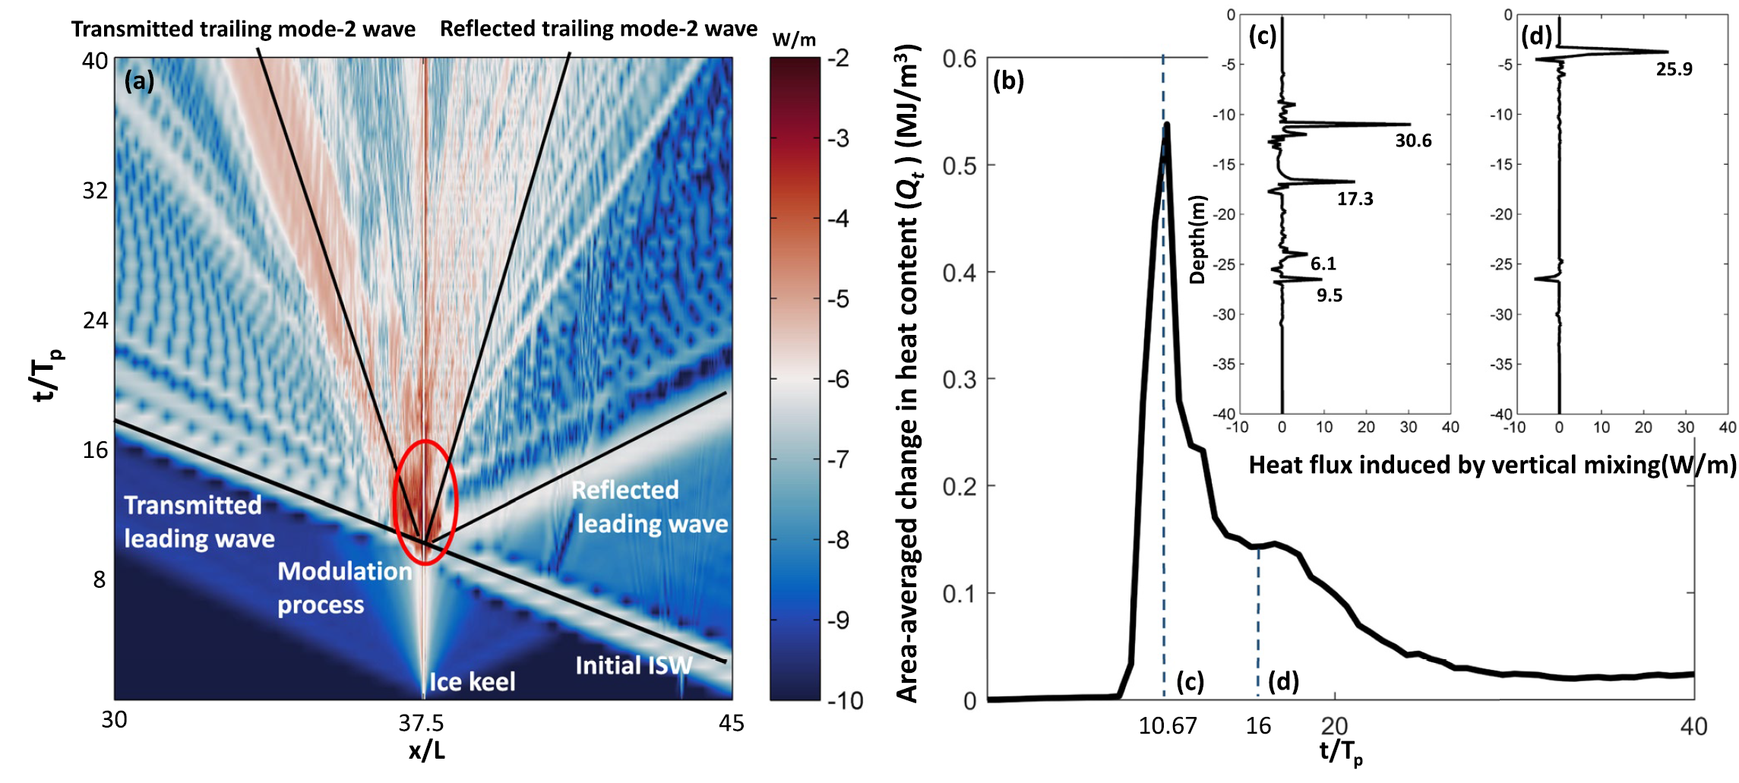
Results
(a) The logarithmic turbulent dissipation rate. Black lines indicate the propagation trails of waves.
(b) the area-averaged change in heat content near ice keel. The vertical heat flux at 10.67 T_{p} and 16 T_{p} are shown in (c) and (d), respectively.
During the interaction, the turbulent dissipation rate can reach o(10⁻³) near ice keel, 4 orders higher than the background dissipation rate.
The interaction causes an area-averaged change in heat content of 0.54 MJ/m³ at 10.67 Tp (Figure b). Heat flux induced by vertical mixing can reach 30 W/m
The heat stores in ocean interior was transport upward by this interaction

Slide 8
Summary
The role of ice keel in the generation and evolution of ISW is revealed for the first time.
The mode-1 and mode-2 ISW could be generated by the interaction between barotropic tides and ice keel
Ice keel depth and amplitude of tidal flow control the generation of ISW
ISWs will destabilize and disintegrate under an ice keel, with the energy radiating into secondary waves.
Turbulent mixing and vertical heat flux are significantly enhanced during ISW-ice interactions.

Slide 9

Thanks!
Questions?

