Slide 1



Geocenter motions derived from BDS
Shi Huang, Yongqiang Yuan, Keke Zhang, and Xingxing Li
School of Geodesy and Geomatics, Wuhan University
2022.5.26

Slide 2
Overview
We focus on the solar radiation pressure (SRP) models of BDS satellites to improve the BDS-derived geocenter coordinates (GCC).
The impact of SRP modeling on GCC
The contribution of IGSO satellites in GCC estimation
The correlations between GCC-Z and SRP parameters
The comparison to the external GNSS and SLR solutions
Background
Method
Result
Summary
Navigation: Click buttons for more information

Slide 3
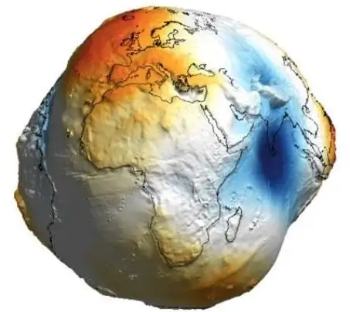
Background
Determination of Geocenter coordinates (GCC)
The GCC is defined as the vector offset of CM relative to CF
Precise determination of the instantaneous GCC is one of tasks of geodesy, and is important for the geophysical interpretation of geodetic measurements
Z
CM
ITRF
GCC
Y
CF
X
Fig. 1 Definition of GCC.

Slide 4
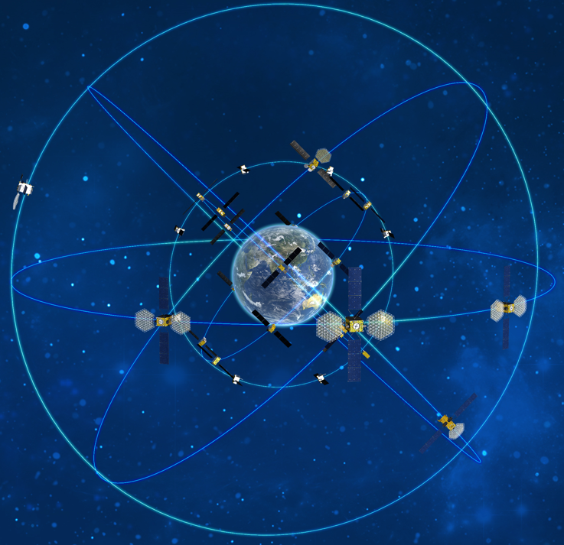
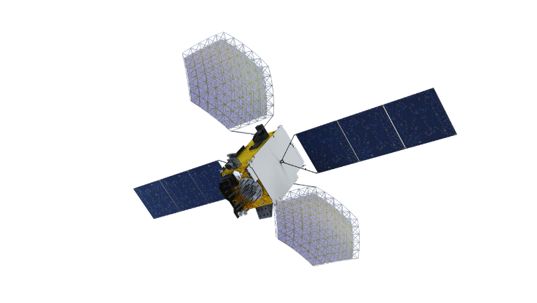
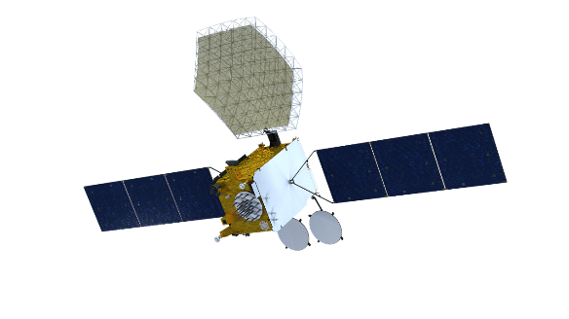
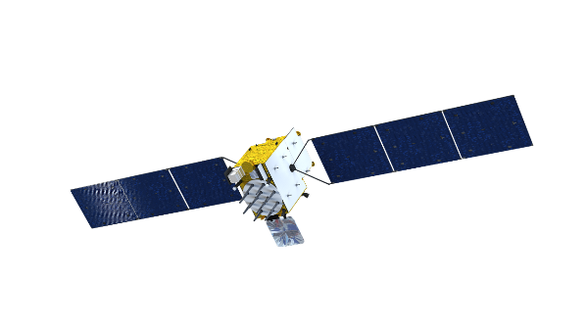
Background
BeiDou Navigation Satellite System (BDS)
BDS constellation:
7 Geostationary Earth Orbit
(GEO) satellites
10 Inclined Geosynchronous Orbit
(IGSO) satellites
27 Medium Earth Orbit
(MEO) satellites
Fig. 2 Schematic diagram of BDS constellation.
http://www.csno-tarc.cn
BDS-3 has been completed in June 2020.
As a member of GNSS, BDS has the ability to determine the GCC independently

Slide 5
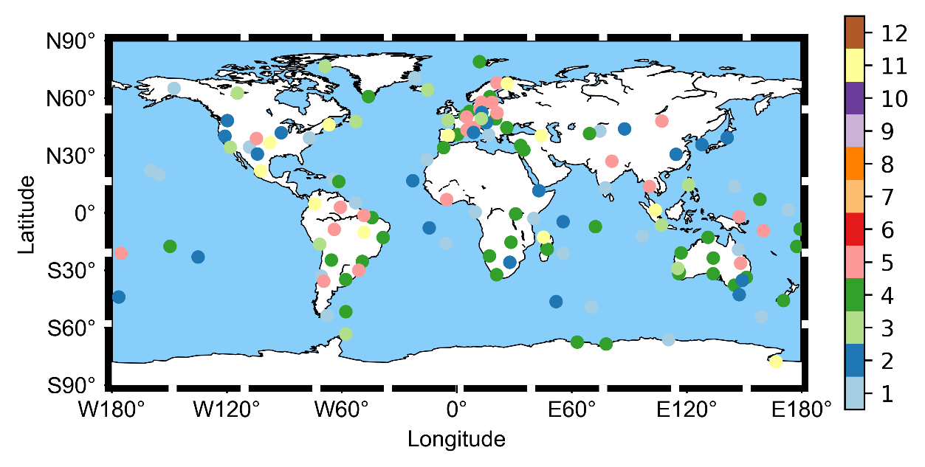
Method
Strategy
SRP models used in this study:
The Empirical CODE Orbit Model (ECOM) with 5 parameters
The extended ECOM (ECOM2) with 9 parameters
Adjustable box-wing model (ABW)
A maximum of 130 globally homogenous IGS/iGMAS stations during the period 2019-2021 were selected as shown in Fig. 3:
The geocenter coordinates (GCC) are determined together with the satellite orbits, station coordinates, troposphere parameters and Earth rotation parameters
Fig. 3 The distribution of stations, and the color of the dot indicates the station’s priority

Slide 6
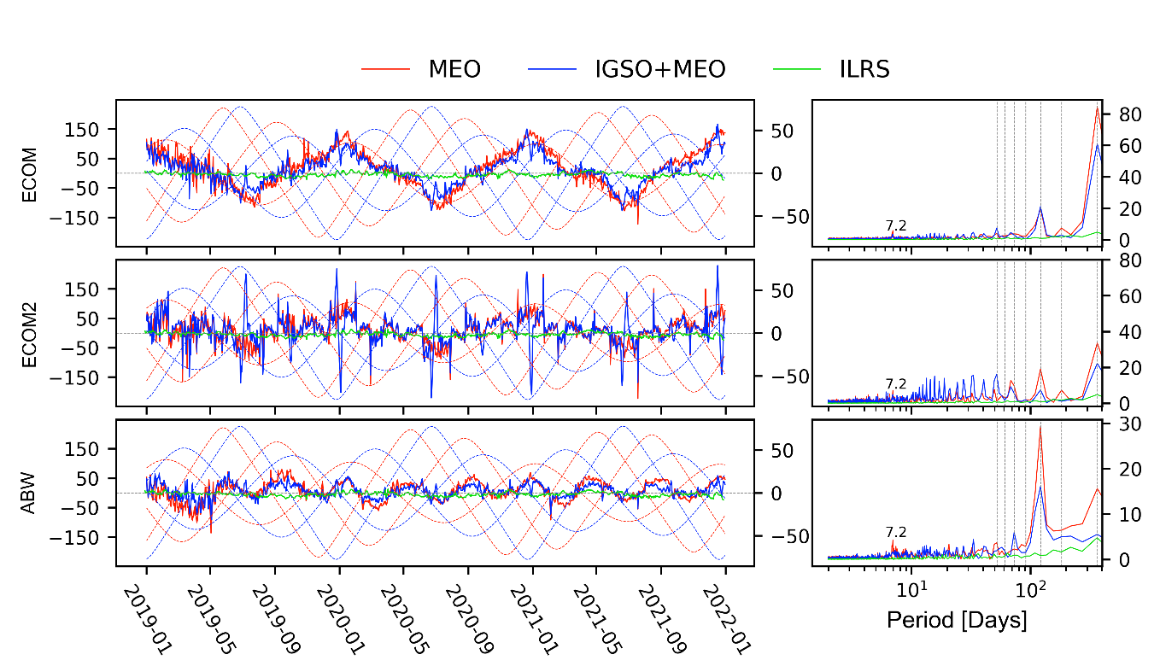
Results
Time series of GCC-Z derived from BDS
ECOM case
In MEO solution, the annual signal with an amplitude of 84.6 mm takes great domination
The inclusion of IGSO reduced the amplitude of annual signal by 27.8%
Fig. 5 Time series (left) and spectrum analysis (right) of GCC-Zs derived separately from MEO, IGSO+MEO satellites of BDS with respect to the SLR-based solution provided by ILRS.

Slide 7
Results
Time series of GCC-Z derived from BDS
ECOM2 case
In MEO-only solutions, the switch from ECOM to ECOM2 model reduces the amplitude of the annual signal by a factor of 2.5 (from 84.6 mm to 33.5 mm).
After the inclusion of IGSO, the signals of 1, 2, 3 cpy (cycle per year) have decreased by a factor of 1.5, 7.8, 2.5 respectively.
Fig. 5 Time series (left) and spectrum analysis (right) of GCC-Zs derived separately from MEO, IGSO+MEO satellites of BDS with respect to the SLR-based solution provided by ILRS.

Slide 8
Results
Time series of GCC-Z derived from BDS
ABW case
In the MEO-only solutions, the ABW model appears to reduce the amplitude of annual signal by factors of 5.4 and 2.1 with respect to ECOM and ECOM2 models.
The inclusion of IGSO largely reduces the annual signal by a factor of 2.8 (from 15.6 mm to 5.5 mm). Also, the dominant 3 cpy signal is significantly improved, dumping from 29.3 mm to 16.1 mm.
Fig. 5 Time series (left) and spectrum analysis (right) of GCC-Zs derived separately from MEO, IGSO+MEO satellites of BDS with respect to the SLR-based solution provided by ILRS.

Slide 9
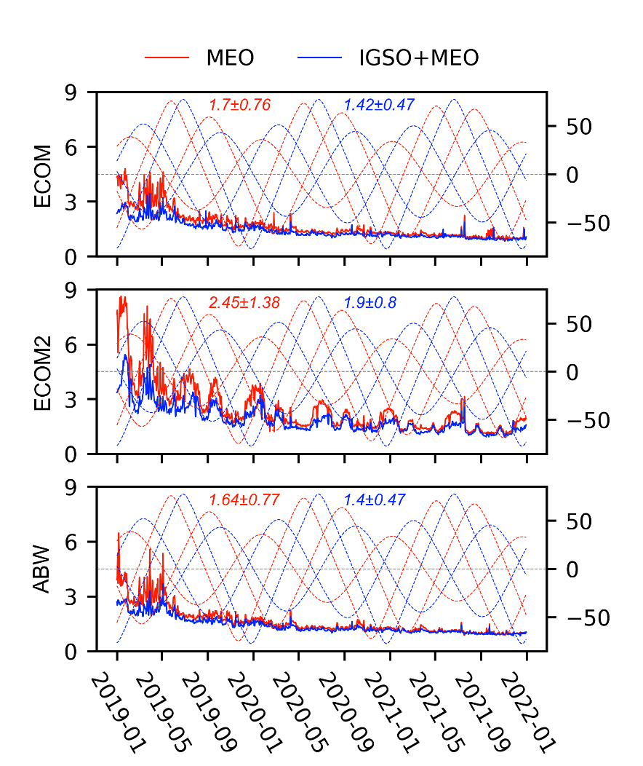
Results
Analysis of formal errors
The time series of formal errors of GCC-Z shows a tendency towards lower due to the increasing number of observations of BDS during this time period
The inclusion of IGSOs decreases the averages of formal errors by 16.5%, 22.0% and 13.4%, the STDs are also reduced by 38.2%, 36.2% and 28.6% for the ECOM, ECOM2 and ABW solutions respectively.
Fig. 6 Time series of formal error of the GCC-Z in mm.

Slide 10
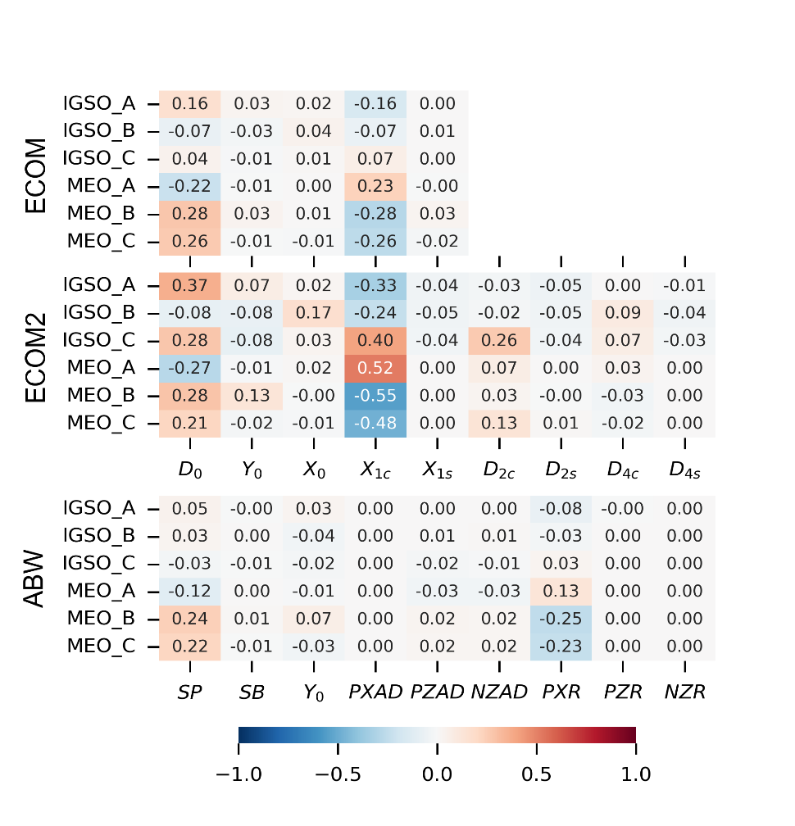
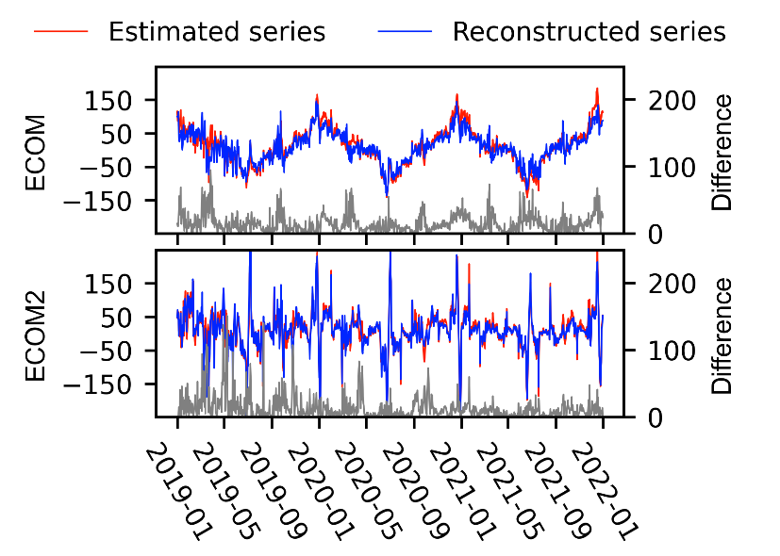
Results
Correlations between GCC-Z and SRP parameters
For the ECOM and ECOM2 cases,
the GCC-Z is correlated with
Fig. 8 Correlations between the GCC-Z estimate and the SRPs in July 1, 2020. The correlations of satellites in the same orbital plane is averaged.
Fig. 9 Time series of GCC-Z separately obtained by estimation and reconstruction using the formula above, and the grey lines represent the absolute difference between them.

Slide 11
Results
Correlations between GCC-Z and SRP parameters
For the ABW case,
the GCC-Z is correlated with
and are similar to and in ECOM/ECOM2 model, for both of them might bring an non-zero out-of-plane acceleration which will disturb the GCC-Z estimation
The physical model with prior optical information helps de-correlating the SRP parameters and the GCC-Z
Fig. 8 Correlations between the GCC-Z estimate and the SRPs in July 1, 2020. The correlations of satellites in the same orbital plane is averaged.

Slide 12
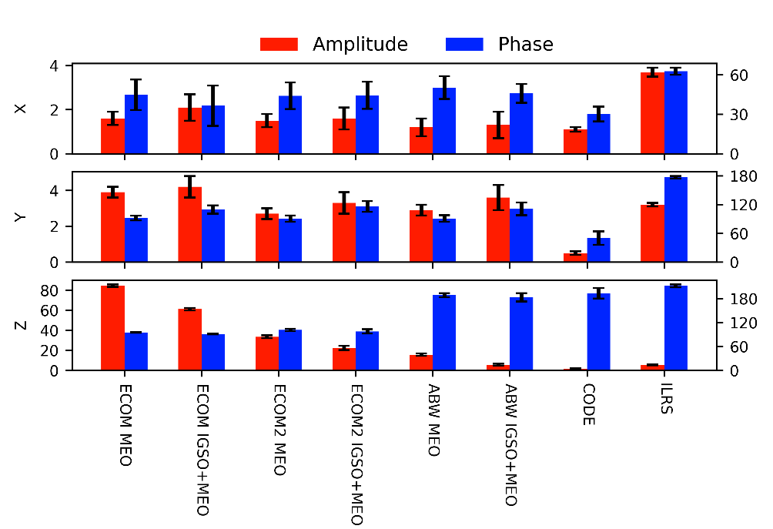
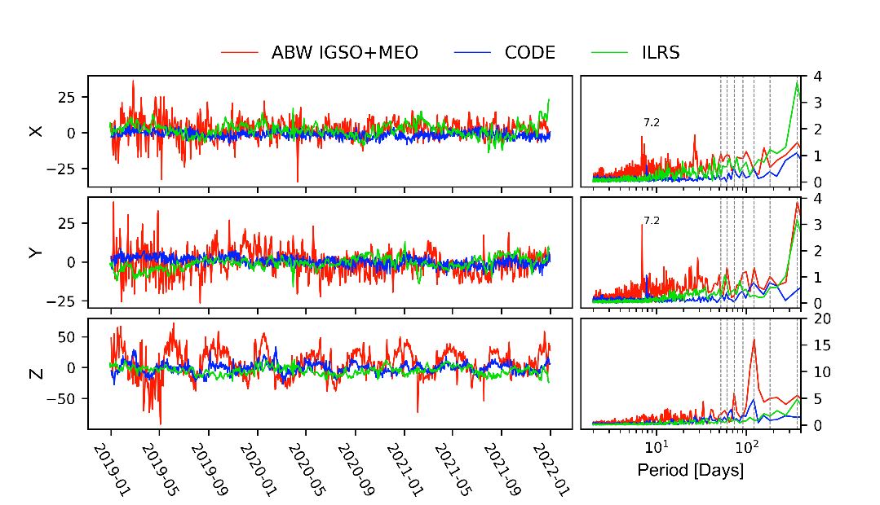
Results
Comparison to external solutions
Fig. 9 Amplitudes and phases of the annual signals
Fig. 10 Time series of three components of GCC estimates derived from IGSO+MEO of BDS.
Difference of SRP modeling and inclusion of IGSO satellites have little impact on the annual signals of X and Y components of GCC.
IGSO+MEO solution using ABW model is in the best agreement with CODE and ILRS solutions.

Slide 13
Summary
Compared to ECOM and ECOM2 models, the ABW model is more suitable for BDS to determine the GCC;
The inclusion of IGSO satellites can reduce the MEO-specific signal and the annual signal of GCC-Z series;
The time series of GCC derived from MEO and IGSO satellites of BDS using ABW model is in the best agreement with CODE and ILRS solutions.

Slide 14
Thanks！

