Slide 1





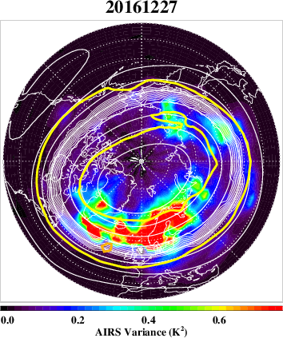
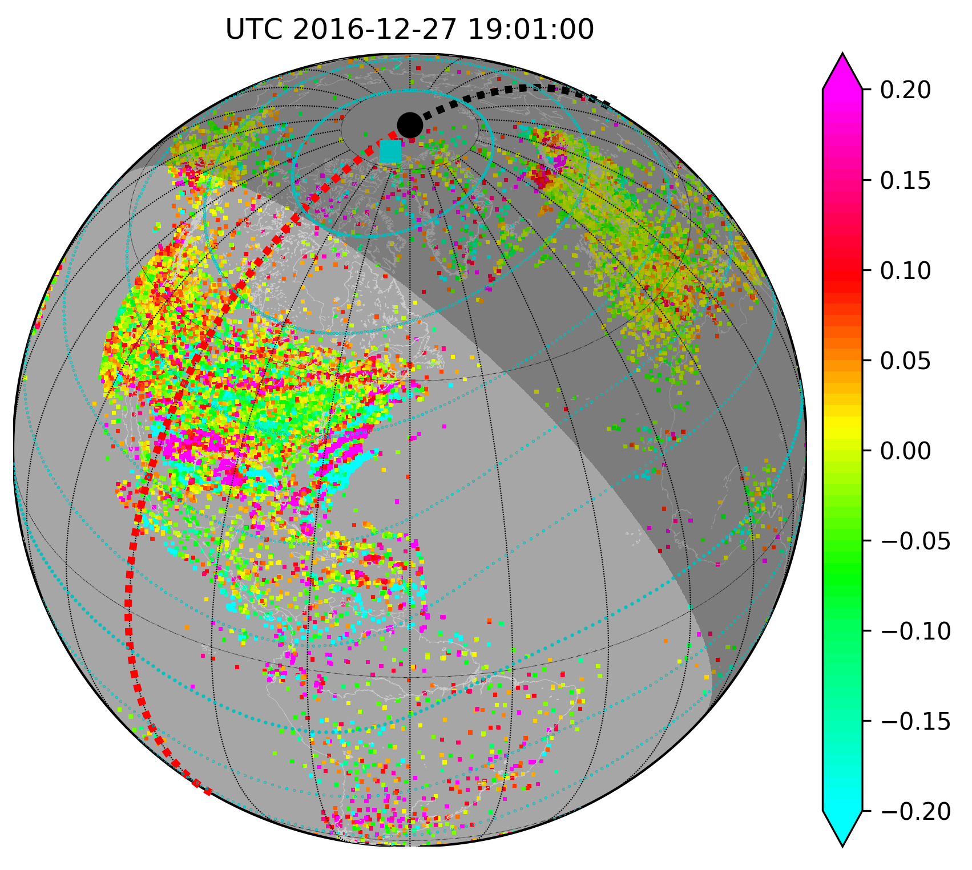
Influence of stratospheric gravity waves on TIDs at mid-latitudes
Larisa Goncharenko¹ , V Lynn Harvey², Chihoko Cullens², Erich Becker³, Shun-Rong Zhang¹, Anthea Coster¹, Grace Kwon¹
⁽¹⁾MIT Haystack Observatory, Westford, MA, United States,
⁽²⁾Laboratory for Atmospheric and Space Physics, Boulder, CO, United States,
⁽³⁾NorthWest Research Associates, Boulder, CO, United States
Hypothesis: a ‘hotspot’ in stratospheric gravity wave activity can be imprinted on the ionosphere/thermosphere as a ‘hotspot’ in thermospheric gravity waves and traveling ionospheric disturbances
Question: is this hypothesis correct?
Answer: YES and NO
YES – TIDs with higher amplitudes are observed during time periods of high stratospheric GW activity
NO – GW ‘hotspots’ evolve with altitude and latitude; enhanced TID activity is observed in a wide range of latitudes and longitudes
TID observations agree well with GW simulations with HIAMCM model
?

Slide 2
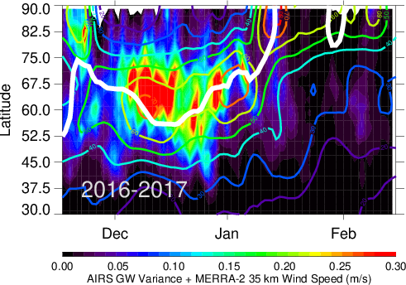
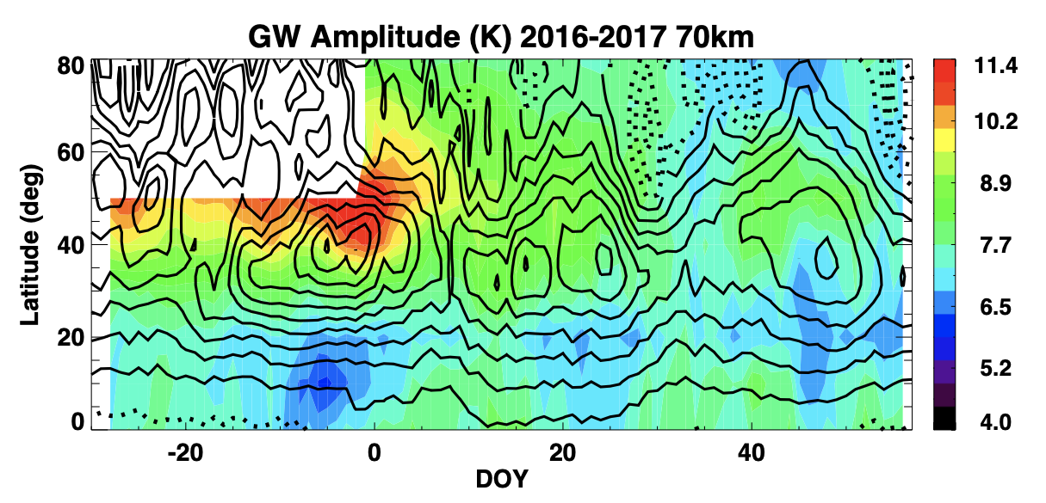
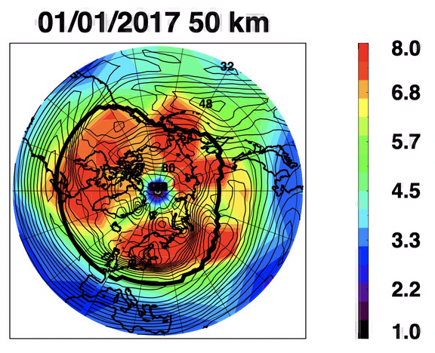
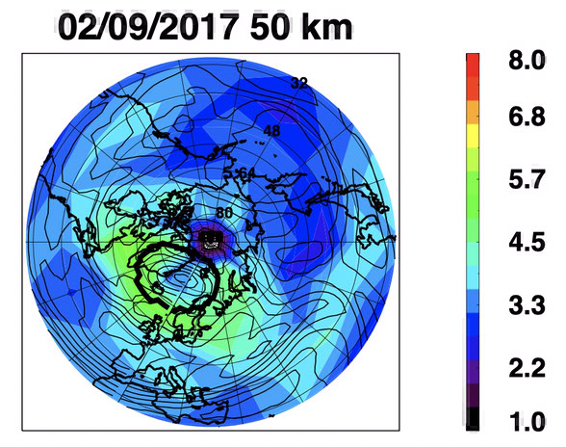
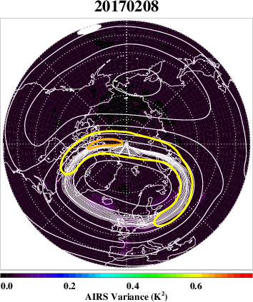
Gravity waves evolve with altitude, latitude, and longitude
AIRS GW, 35km
SABER
Dec 15
Jan 15
Feb 15
Winter 2016-2017: strong polar vortex from mid-Dec to mid-Jan; minor sudden stratospheric warming in the end of Jan
Aqua satellite, AIRS data (35 km): peak GW activity at 55-75ºN, GW hotspot over Europe
TIMED satellite, SABER data: enhanced GW activity in Dec down to 35-40ºN; extended range of longitudes

Slide 3
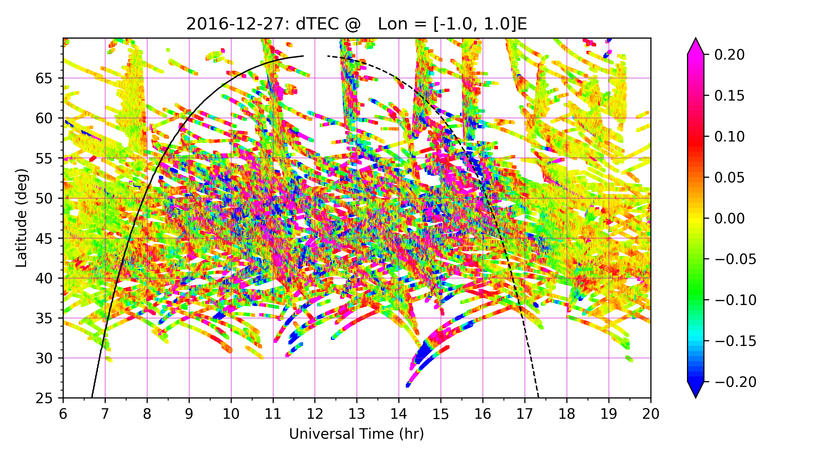
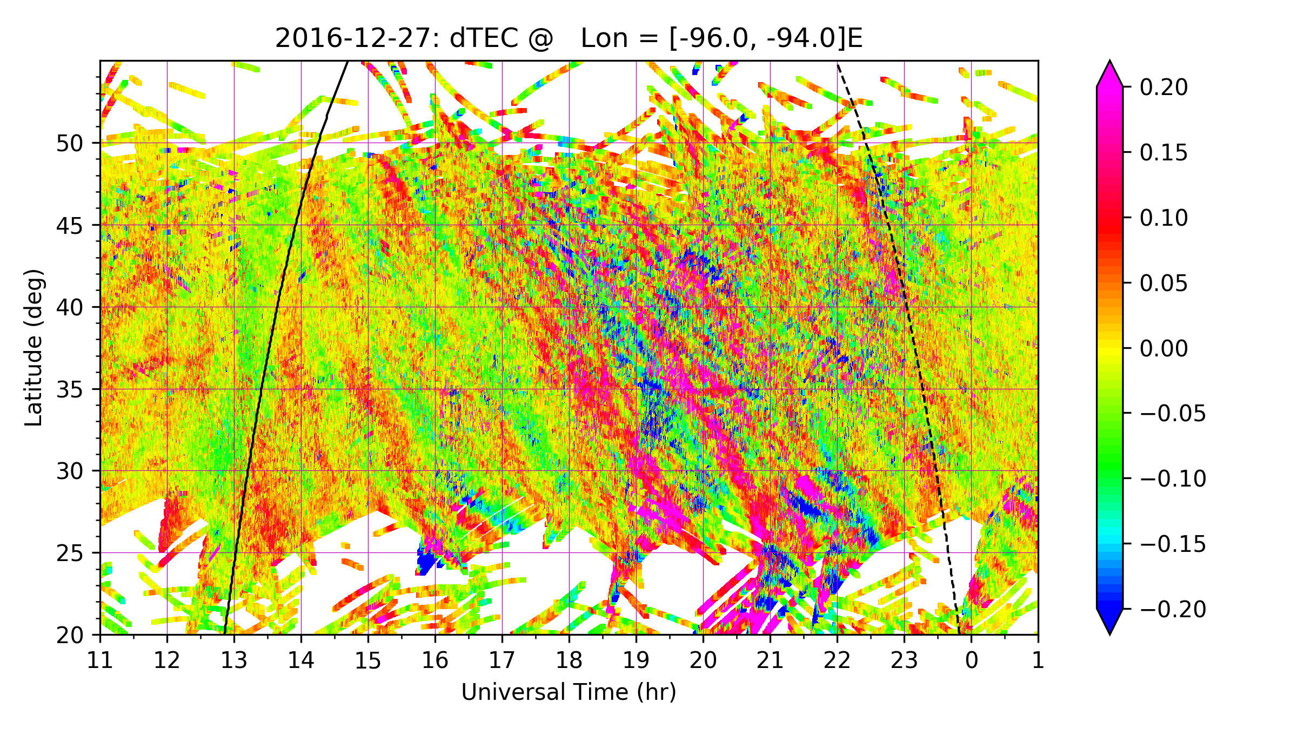
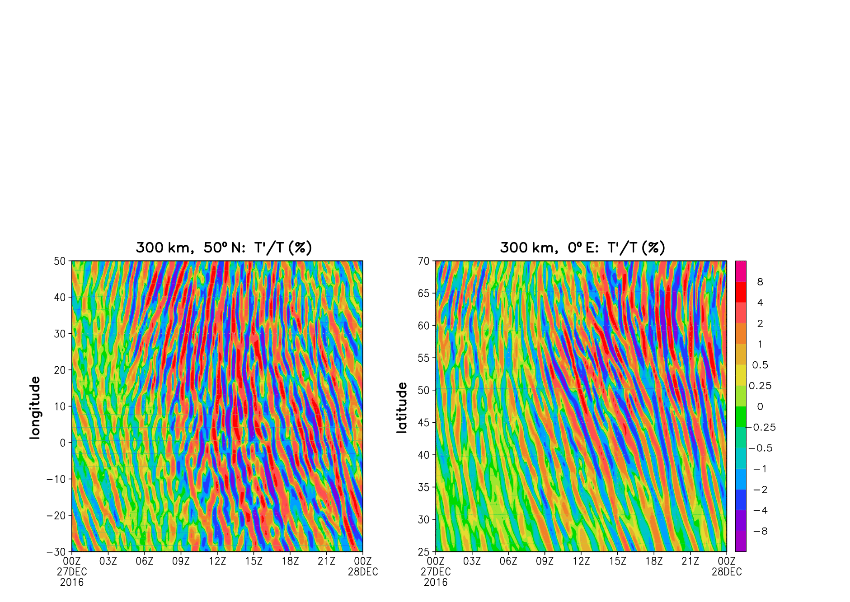
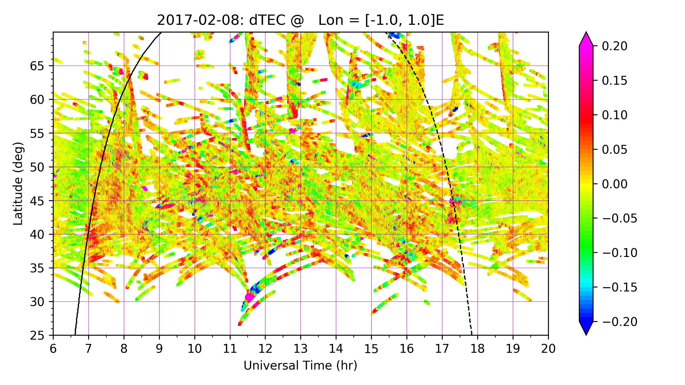
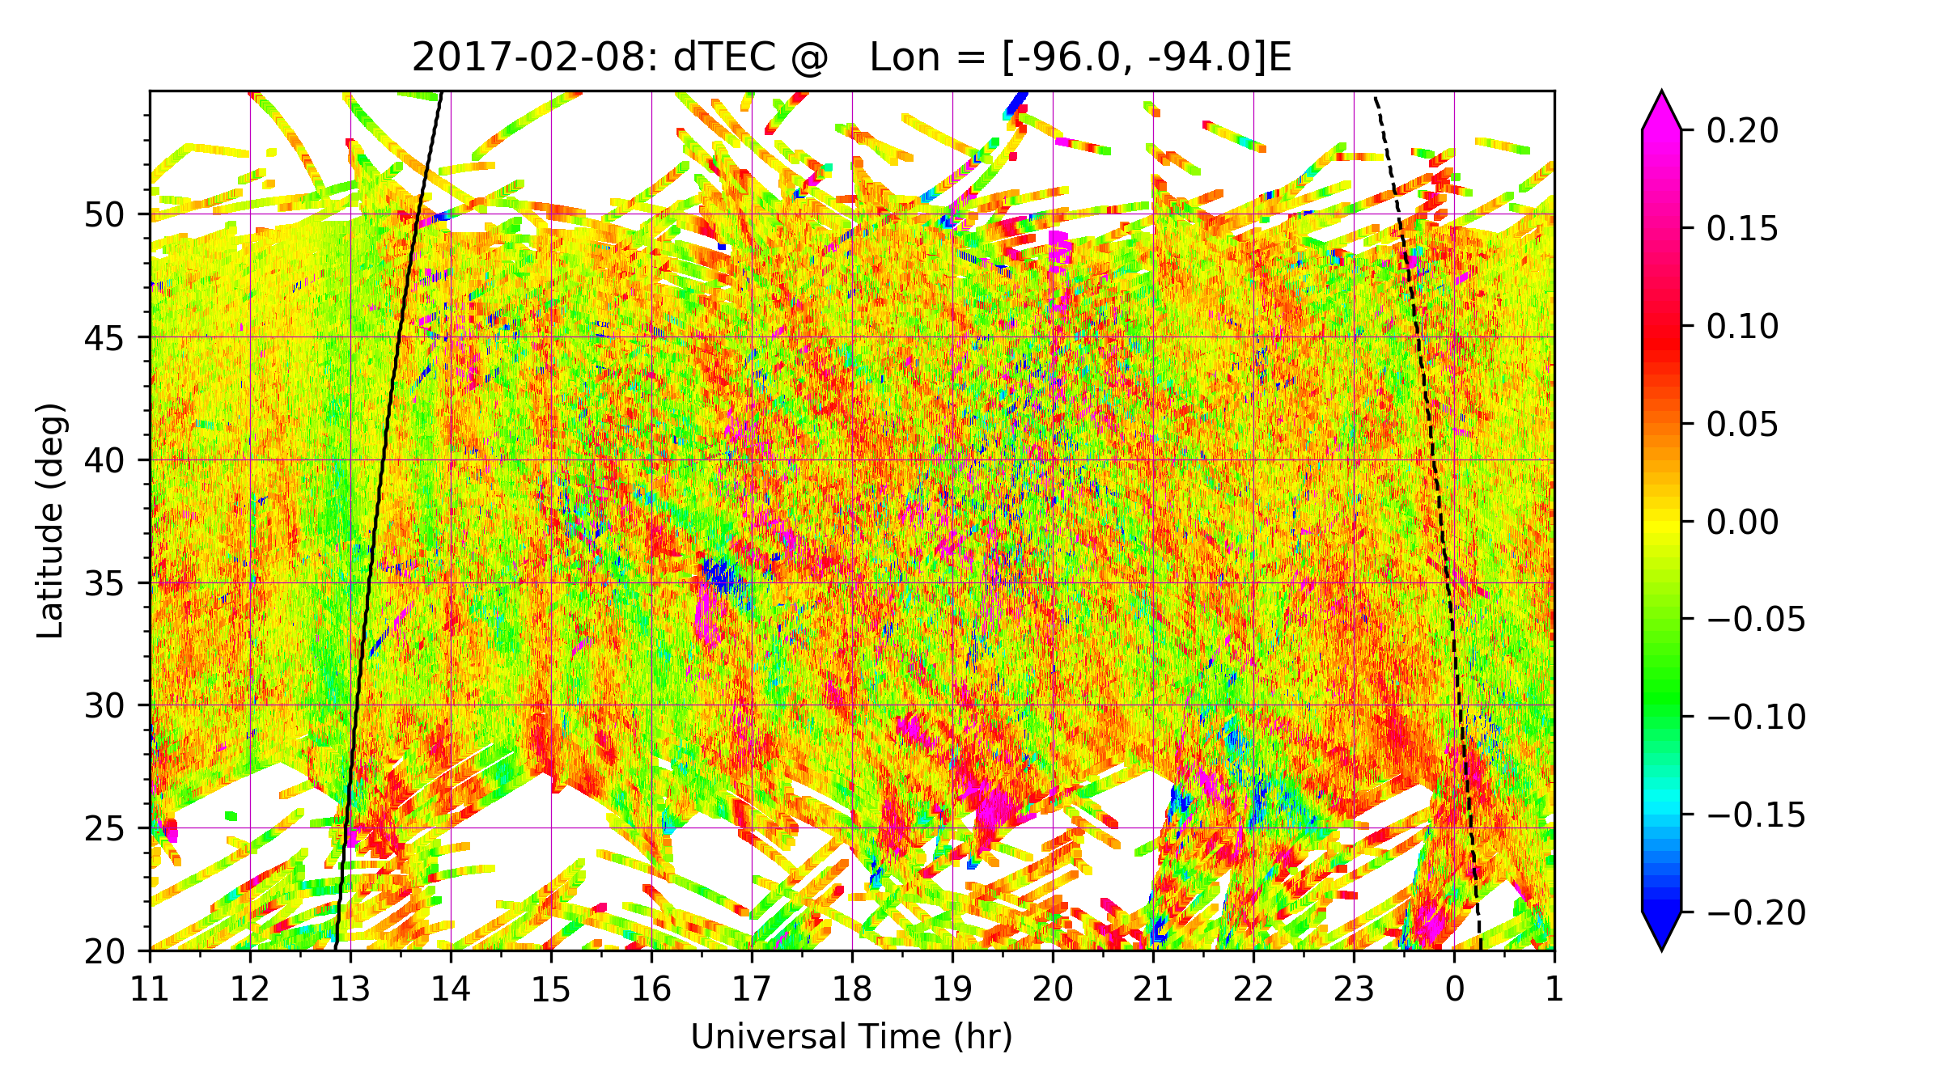
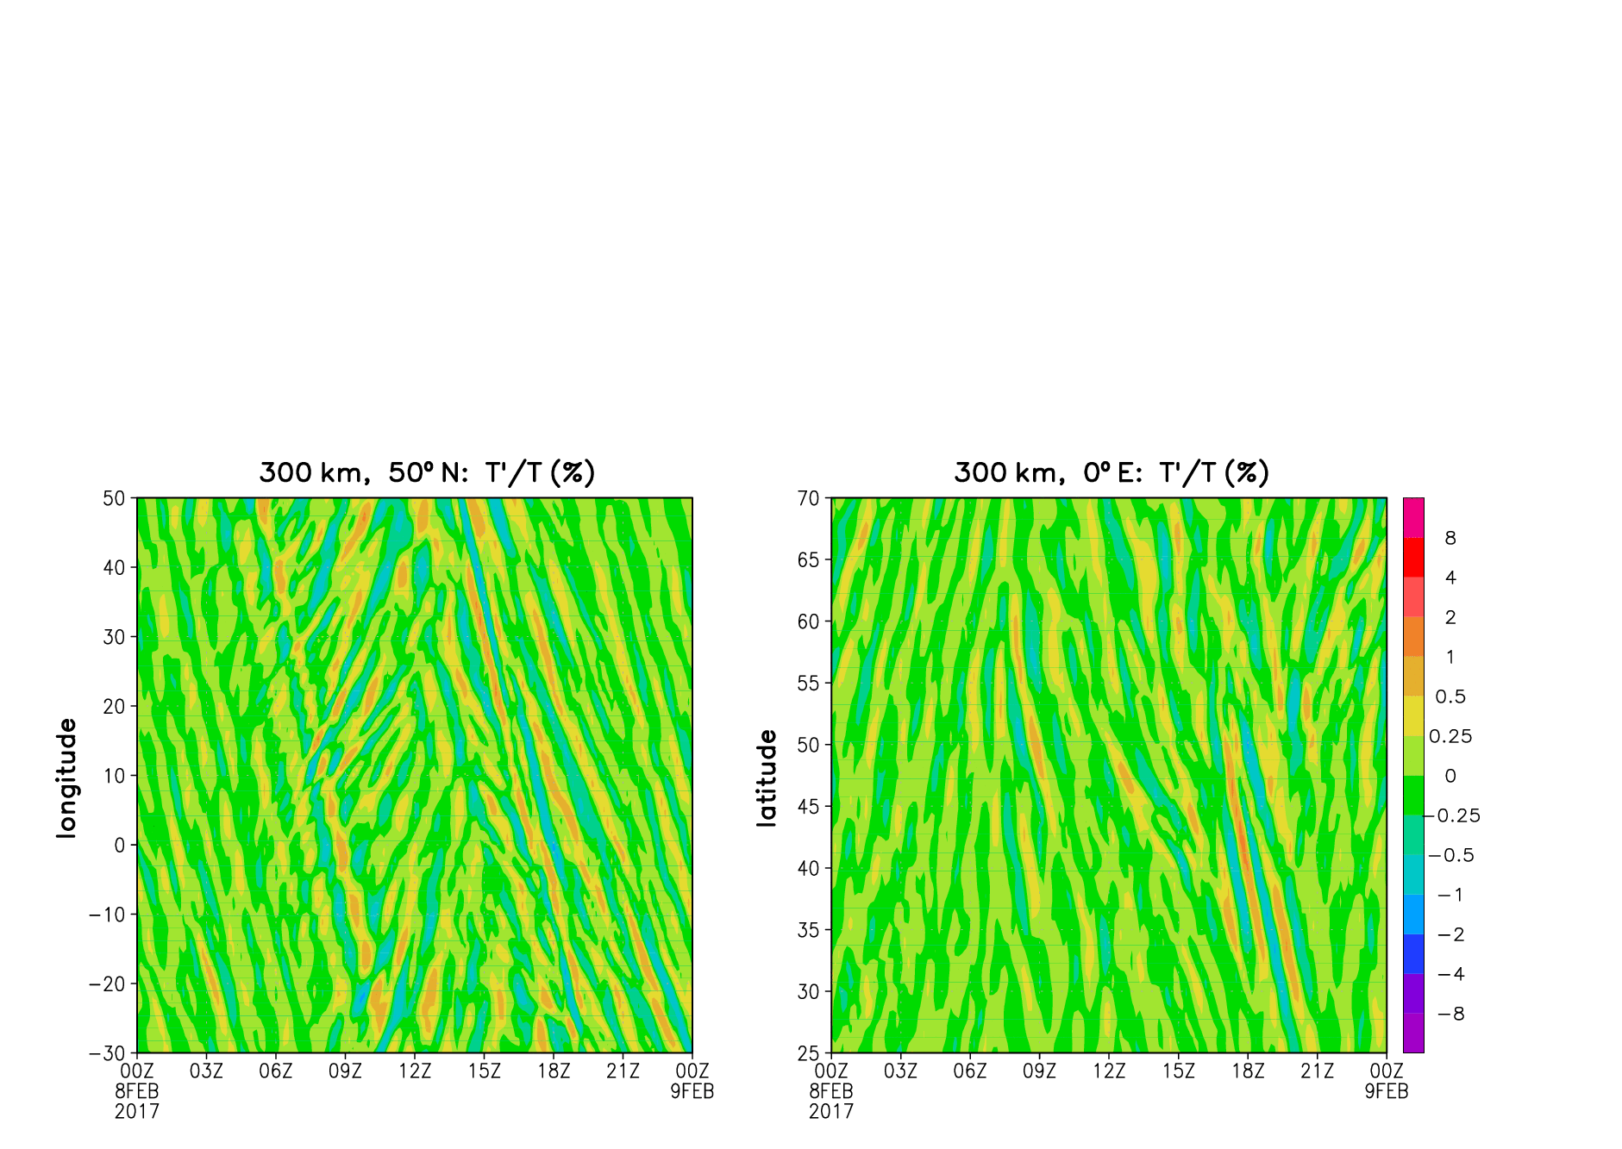
TIDs and GW in the ionosphere/thermosphere are amplified during high GW activity in the stratosphere
GNSS dTEC, Europe, 0ºE
GNSS dTEC, central US, 95ºW
HIAMCM simulations, Europe, 0ºE
High stratospheric GW activity
Dec 2016
Low stratospheric GW activity
Feb 2017
Analysis of GNSS TEC data shows amplification of daytime small and medium-scale TIDs in December 2016 as compared to February 2017
TIDs are amplified in a large range of latitudes (25-60ºN) and longitudes (Europe, Asia, eastern and central US)
Simulations with HIAMCM model show good agreement with observations

Slide 4
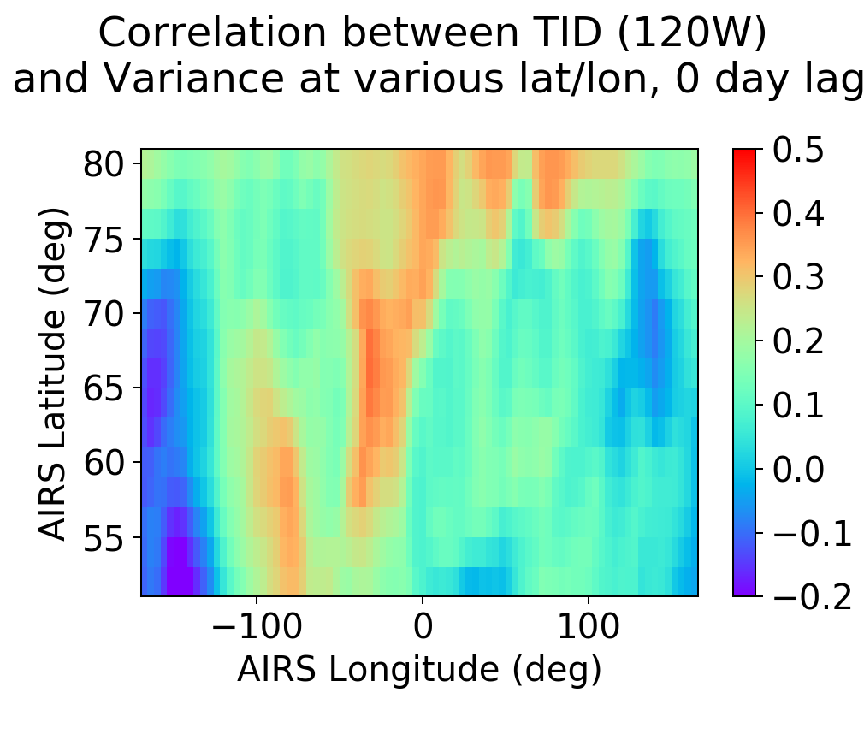
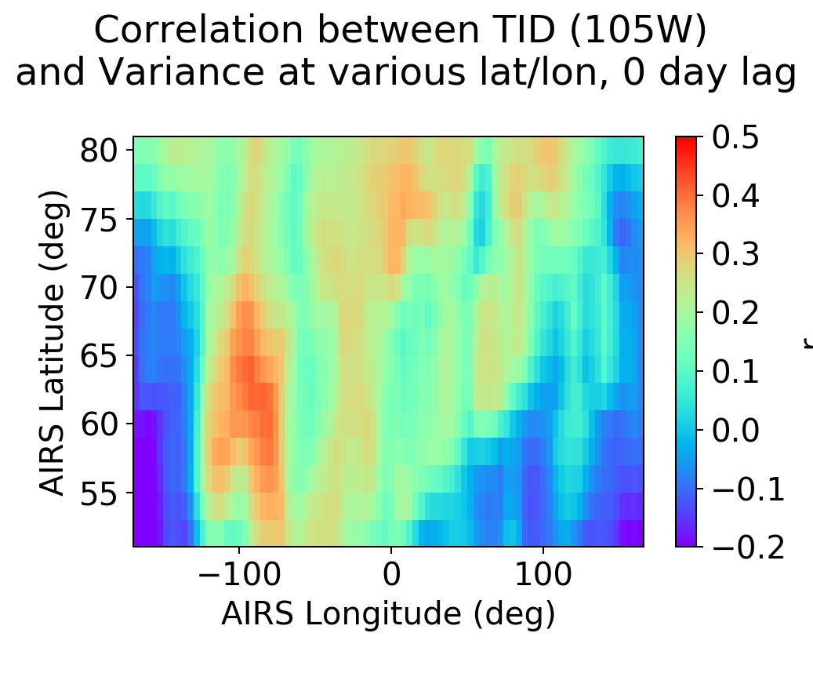
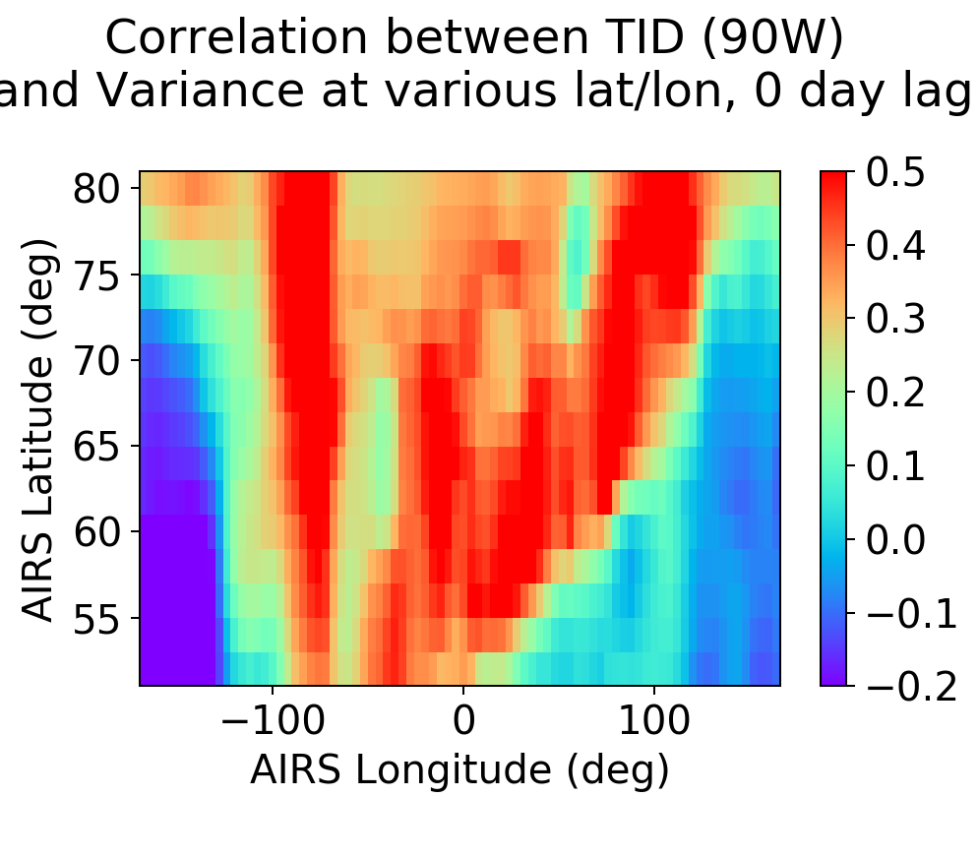
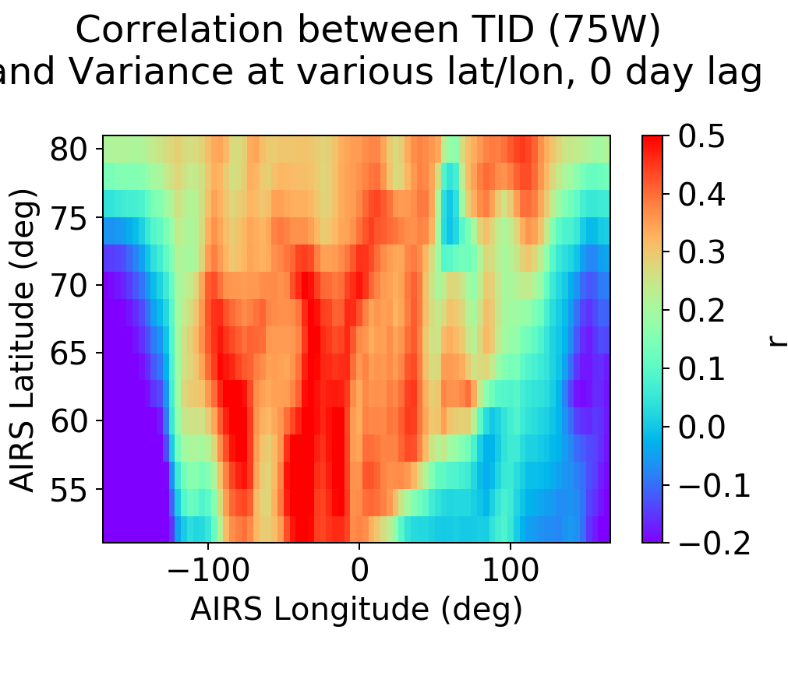
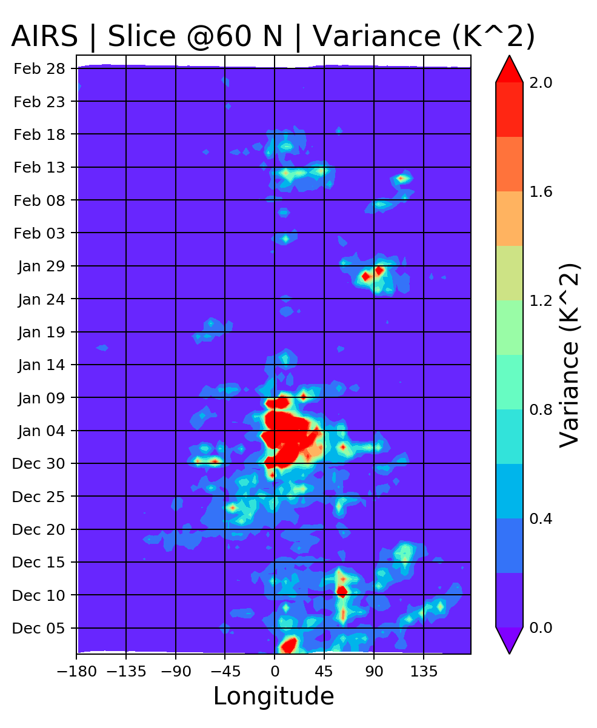
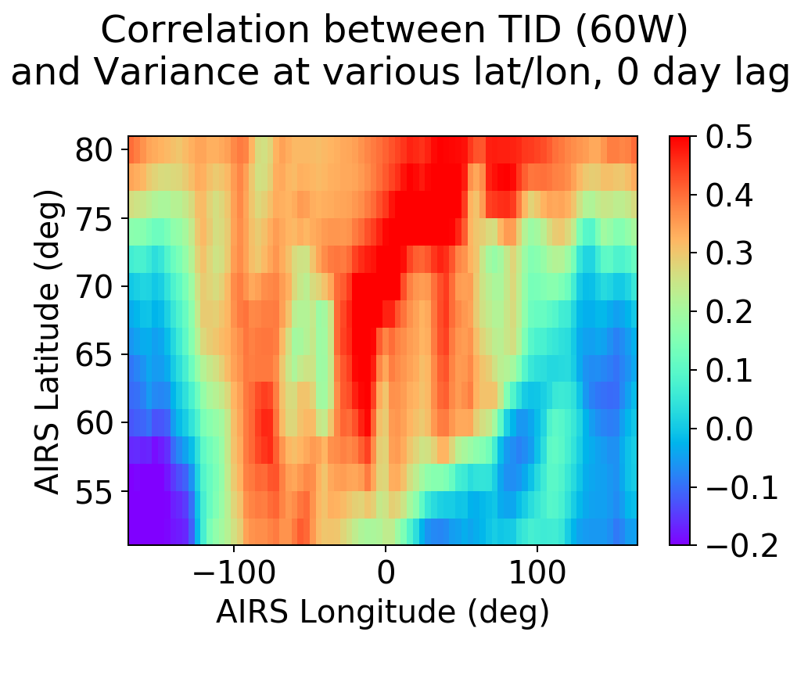
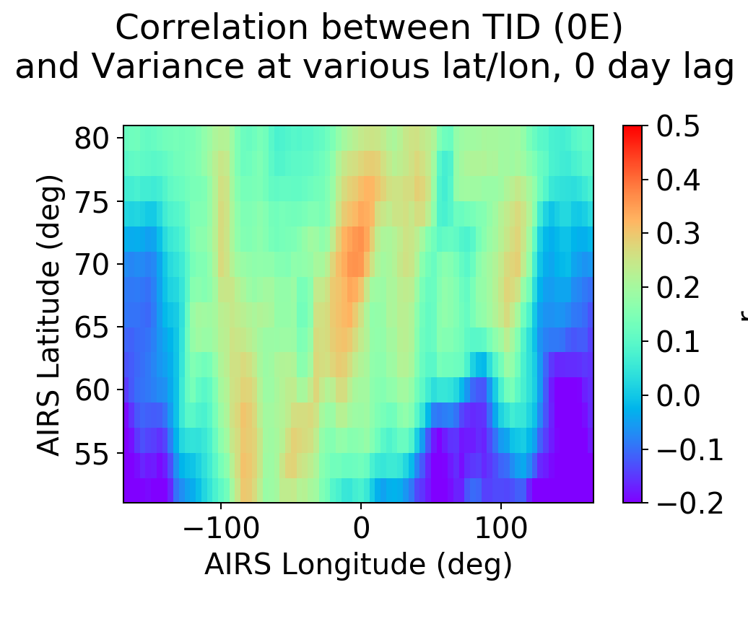
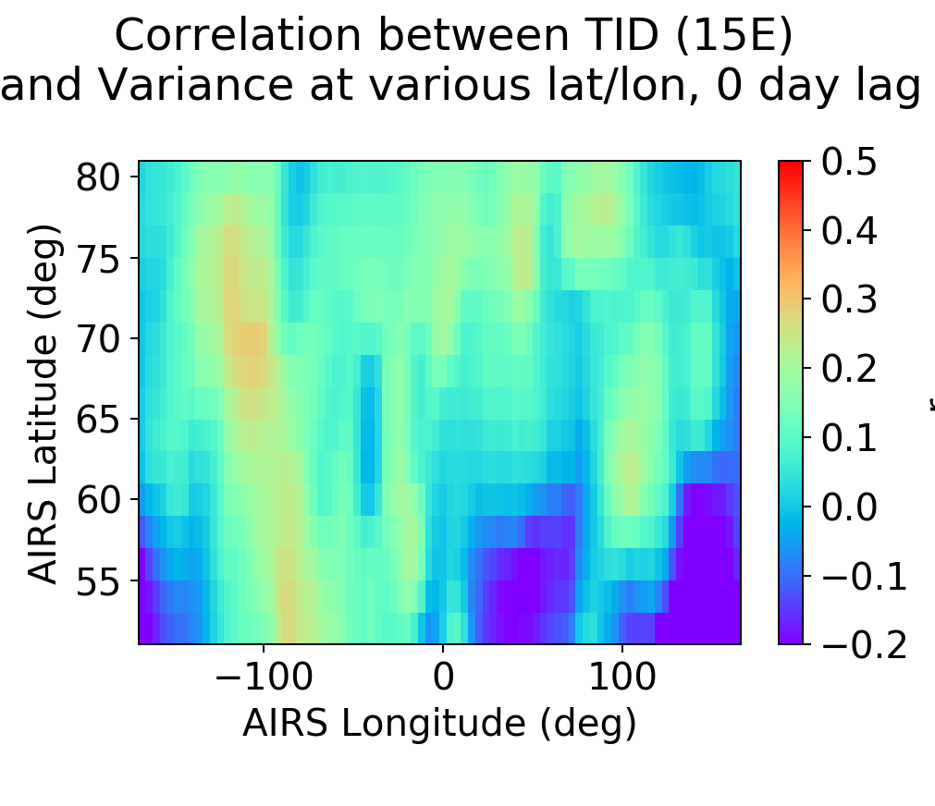
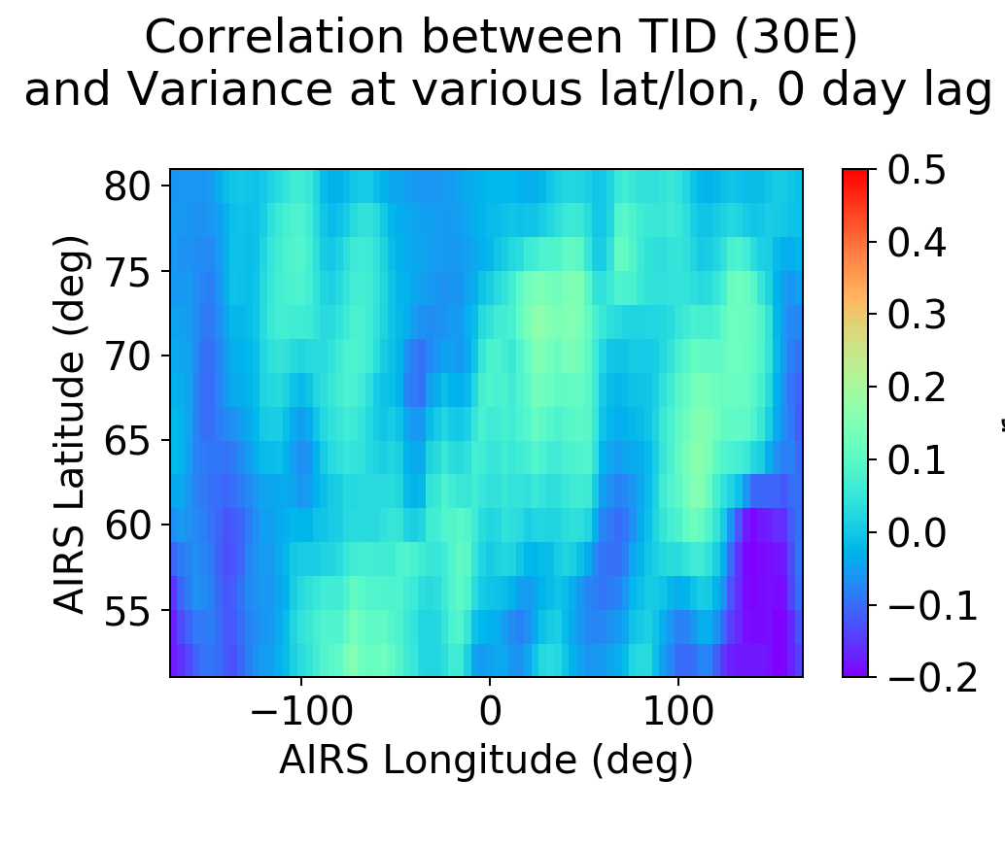
Winter 2019/2020: correlation of GW Variance and TIDs
120W
105W
90W
75W
60W
0E
15E
30E
Stratospheric GWs are enhanced over Europe
TID analysis at different longitudes, 45ºN
Correlation between TID at a given longitude and stratospheric GW variance, over whole winter
Used “daytime mean” (9 hrs between sunrise and sunset) of absolute value of TID
Stronger correlation between TIDs and AIRS GW at 60-90W

