Slide 1




Persistent warm and dry extremes over the Eastern Mediterranean during winter:
the role of upstream Rossby wave pattern
Sigalit Berkovic (IIBR) and Shira Raveh-Rubin (WIS)
EGU General Assembly, 27 May 2022

Slide 2
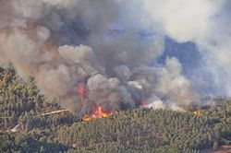
MOTIVATION
Most yearly precipitation falls in winter, in association with Cyprus Lows
Key for water resources in the EM
Damage to agriculture
Conditions for fires
e.g., Carmel forest fire of December 2010
Q1: What causes the extreme surface warm and dry conditions?
Q2: What maintains the persistent (>5 days) warm and dry conditions?
Q3: What is the upstream large-scale Rossby wave configuration, and why does it support such events?
DATA & METHODOLOGY: radiosonde data, ERA5, objective selection of events in Israel, Lagrangian and Eulerian diagnostics. Teaser: 1-7 December 2008

Slide 3
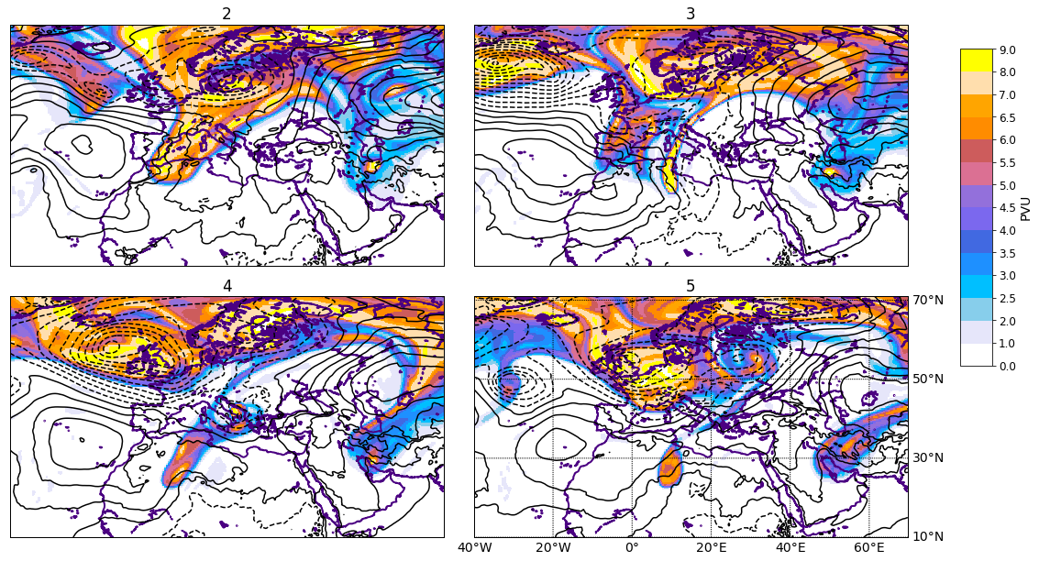
December 2008 event
[PVU]
320-K PV [PVU]
SLP [hPa]
L
H
H
L
EM ridge, H extension from Russia
Mediterranean trough (later streamer and cutoff) and surface cyclone
N. Atlantic block

Slide 4
December 2008 event
[PVU]
320-K PV [PVU]
SLP [hPa]
L
H
H
L
EM ridge, H extension from Russia
Mediterranean trough (later streamer and cutoff) and surface cyclone
N. Atlantic block

Slide 5
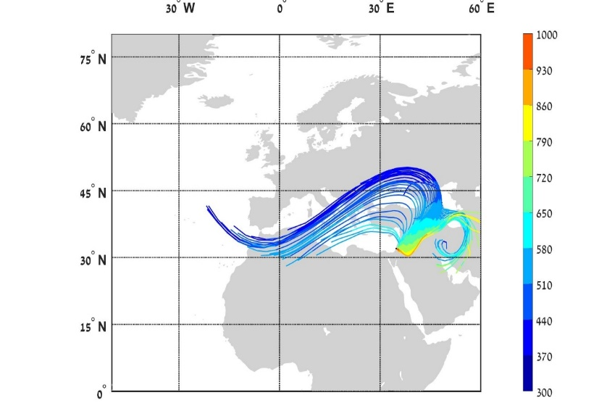
Q1. Mechanisms: high T, low q
Airmass trajectories reaching the lower troposphere, tracing of the air parcels’ pressure, temperature and humidity evolution identified 3 governing mechanisms:
(a)
[hPa]
Adiabatic heating due to compression during slantwise descent around EM ridge
Advection of warm and dry continental air
Diabatic surface heat fluxes warm continental air
Quantification of relative contributions
Any of the mechanisms can be dominant!

Slide 6
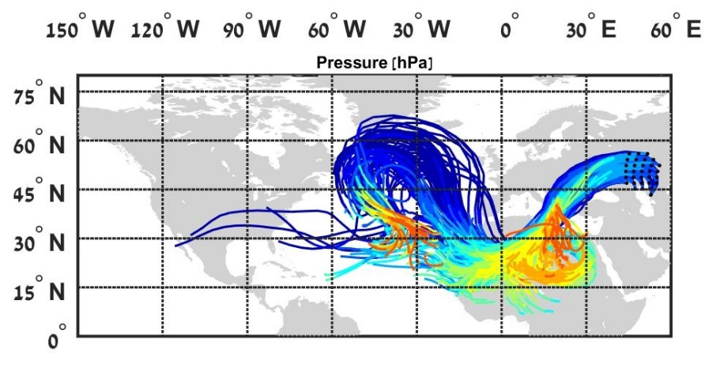
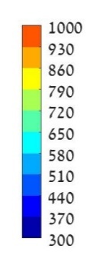
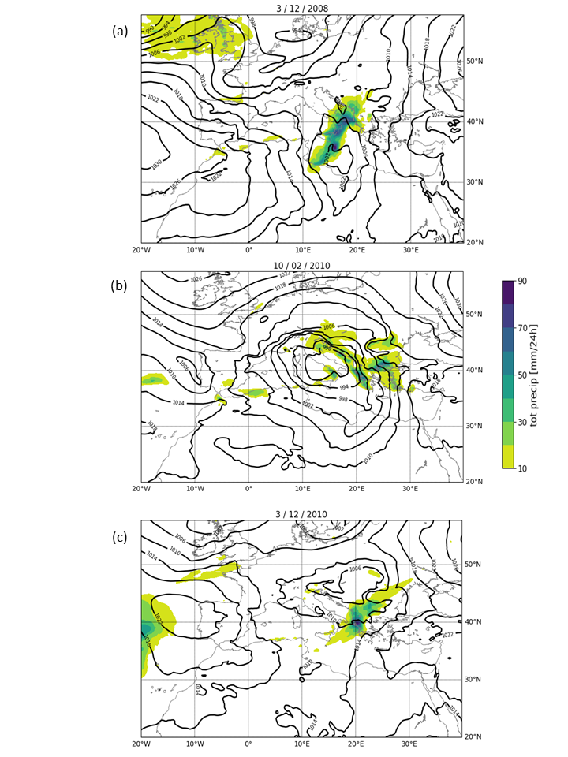
Q2. Mechanism: ridge enhancement
Airmass trajectories reaching the upper-tropospheric EM ridge peak
(a)
[hPa]
Upper-tropospheric adiabatic flow
Latent heating in ascending trajectories due to precipitation near Med. cyclone
(Grams et al., 2011; Pfahl et al. 2015; Steinfeld and Pfahl 2019)
61-86% of airmasses reaching EM ridge peak during 3 different events
(b)
(c)

Slide 7


Q3. Upstream Rossby wave
Key role of EM ridge, upstream trough, upstream Atlantic block
Q1: mechanisms for high T, low q: adiabatic warming during descent, advection and latent heating by surface fluxes
Q2: Importance of diabatic heating near Med cyclone for maintenance of EM ridge
Q3: Rossby wave pattern maintained downstream of Atlantic blocking. Its stationarity fixes the Med. trough and cyclone in place, to further support the persistent EM ridge
Atlantic block
EM ridge
L
Med cyclone
Persistent dry and warm winter events over Israel - not merely ‘lack of cyclones’
Future of Med cyclones vs. EM dry periods interlinked!
Berkovic S. and S. Raveh-Rubin (2022). Persistent warm and dry extremes over the Eastern Mediterranean during winter: the role of North-Atlantic blocking and central Mediterranean cyclones. Q.J.R. Meteorol. Soc.

