Slide 1
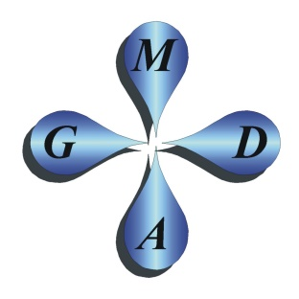
A Plausible Explanation for Common Fractal Temporal-Spectral Slopes of Drainage Flows and Chemistries at Full-Scale Mining Operations
Kevin A. Morin, Ph.D., P.Geo., L.Hydrogeo.
Minesite Drainage Assessment Group
(www.MDAG.com)
British Columbia, Canada

Slide 2
Two Helpful Quotations about the Earth and Electricity
“It has been known for over two centuries that the solid and liquid Earth and its atmosphere are almost permanently electrified.” (National Research Council, 1986)
“EMFs (electrical and magnetic fields) are all around us, occurring naturally in every atom of matter. The surface of the Earth is covered with a natural electric field, created by electrical charges in the upper atmosphere. Similarly, a powerful electric field is required to keep the cells of living organisms alive.” (Hydro Québec, 2011)

Slide 3
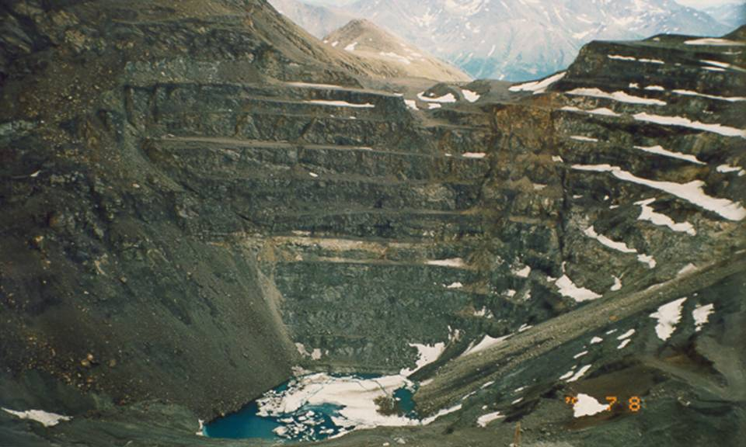
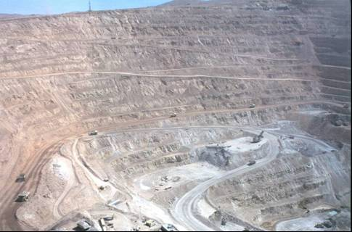
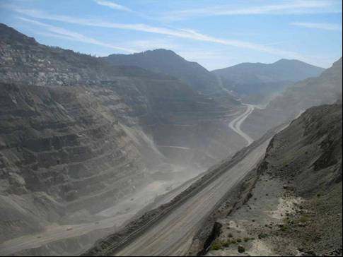
A Minesite Has Many Components
A minesite is often composed of one or more large-scale open-system components like: open pits.

Slide 4
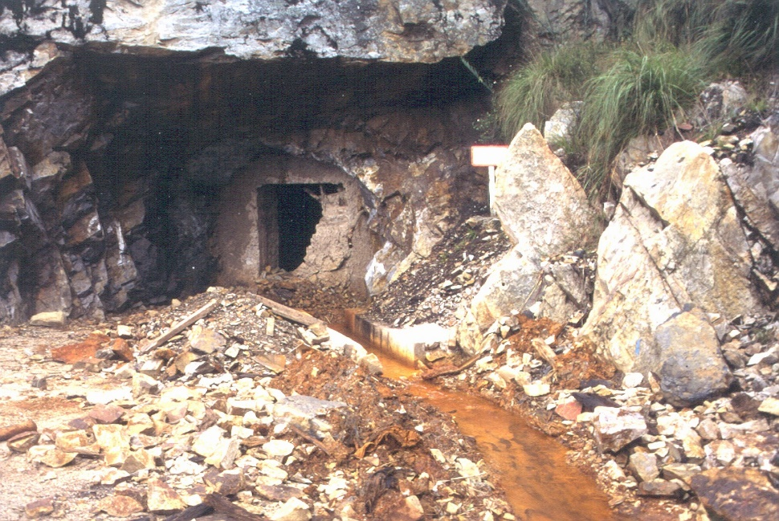
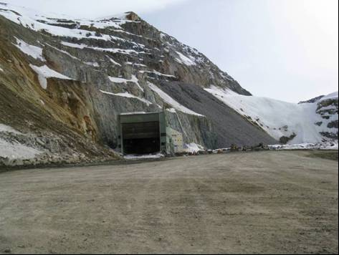
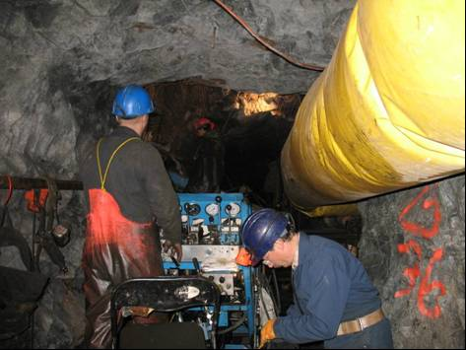
A Minesite Has Many Components
A minesite is often composed of one or more large-scale open-system components like: underground workings.

Slide 5
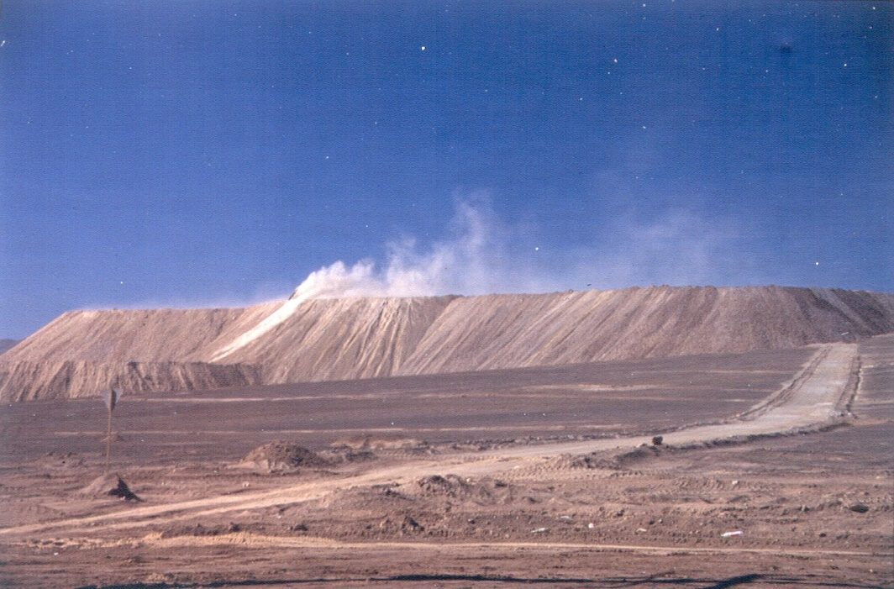
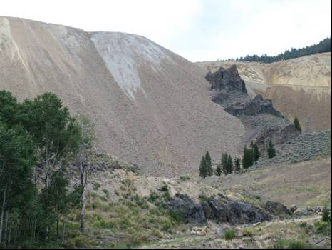
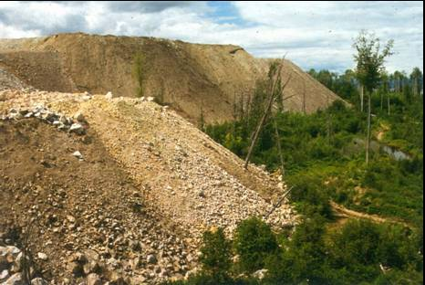
A Minesite Has Many Components
A minesite is often composed of one or more large-scale open-system components like: waste-rock piles and ore stockpiles.

Slide 6
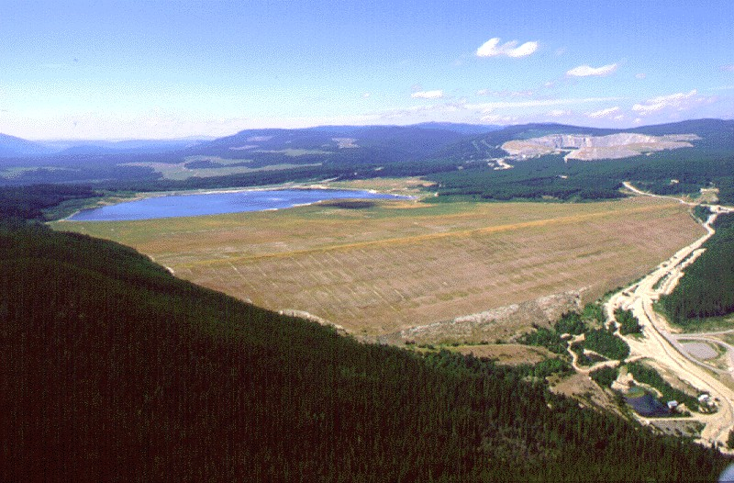
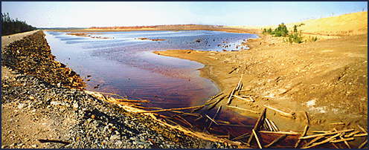
A Minesite Has Many Components
A minesite is often composed of one or more large-scale open-system components like: tailings impoundments.

Slide 7
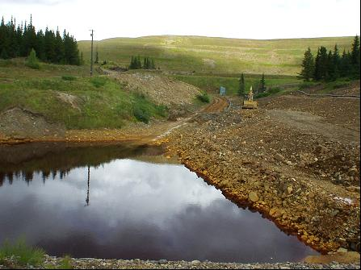
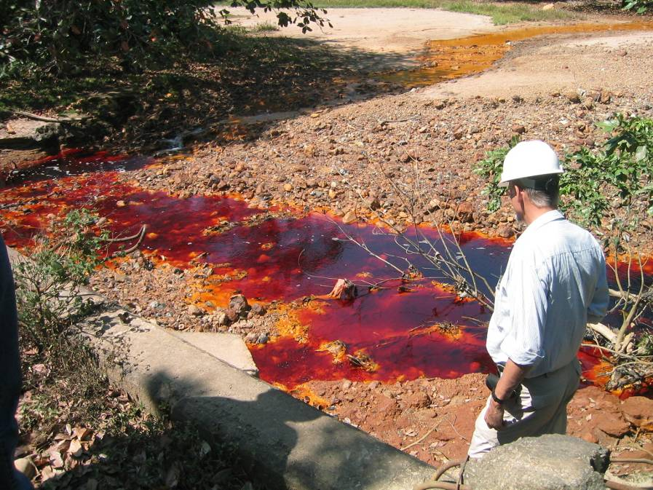
Objectives
To answer two questions.
1) What mechanisms and processes can introduce periodicity into minesite-drainage chemistry and flow? In other words, why do flow and chemistry “pulsate” at many wavelengths? This effect can be more “ubiquitous” in non-mining catchments (J.W. Kirchner, ETH Zürich).
2) How do these mechanisms apparently “self organize” so that their amplitudes and spectral powers generally decrease with decreasing wavelength, often forming fractal spectral slopes? This includes the very common yet mysterious “1-over-f” with a spectral fractal slope of 1.0, which should not appear and should not persist according to mathematics.

Slide 8
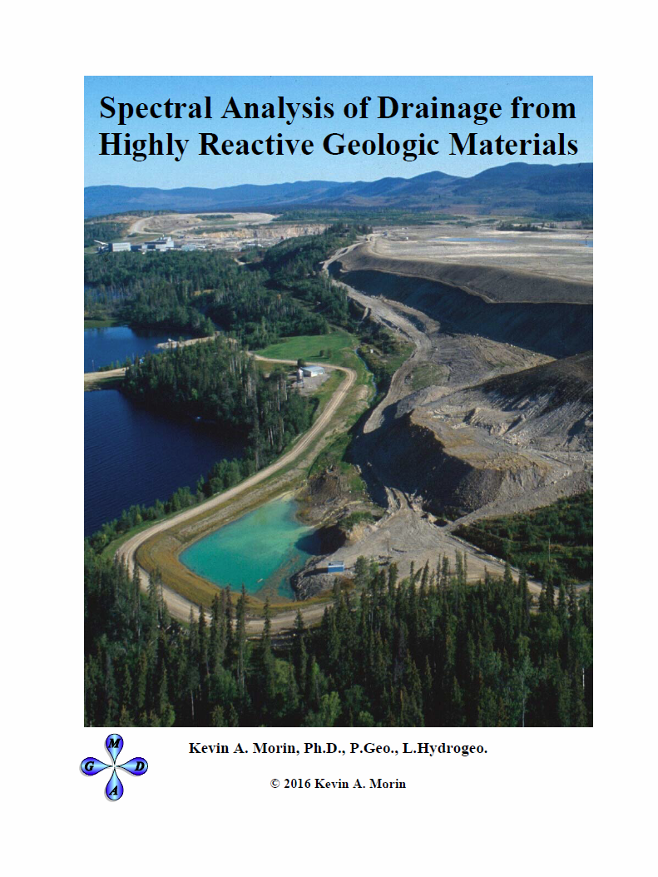
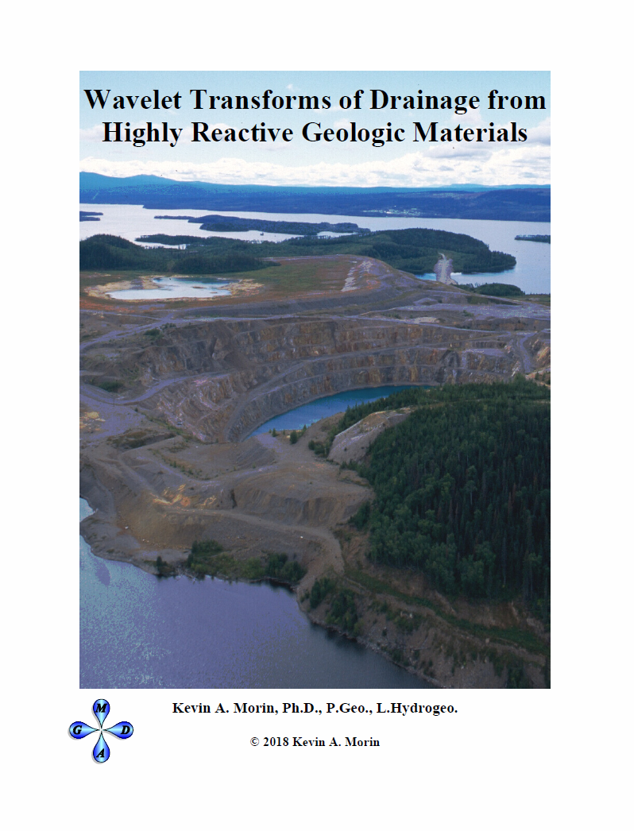
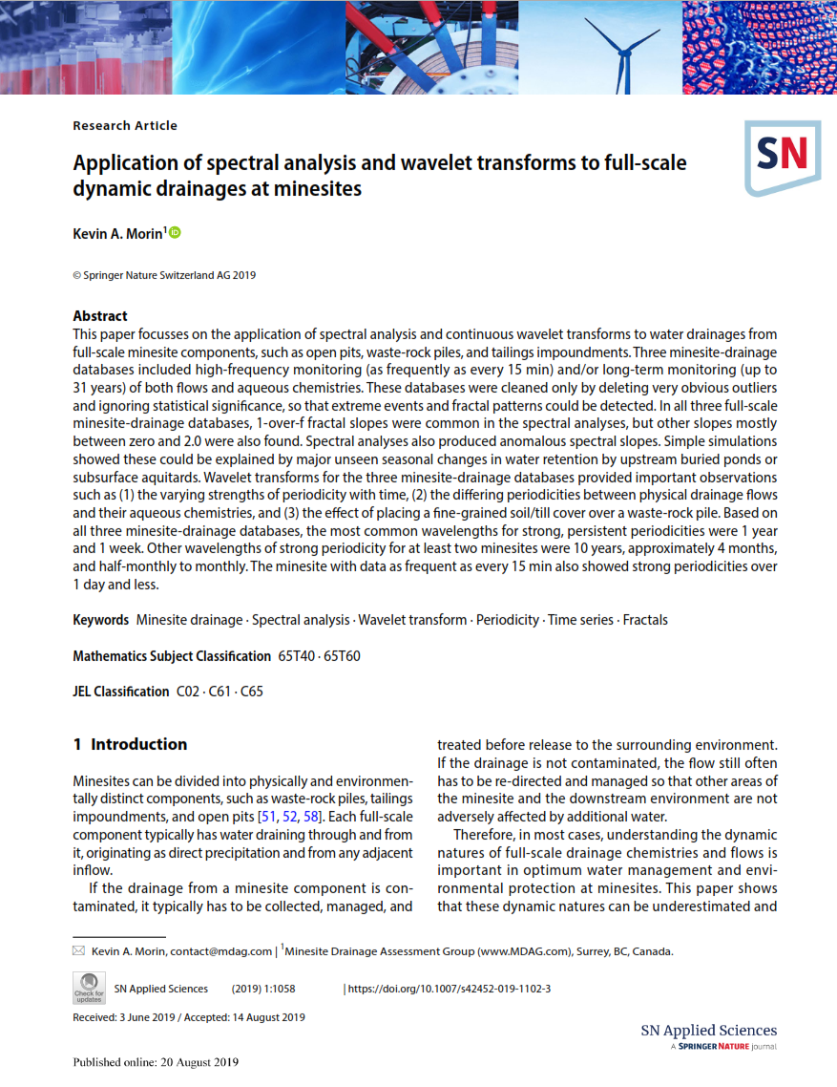
Free MDAG Books on Periodicity, Spectral Analysis,
and Wavelet Transforms
What you are about to hear is based on the books and related publications below and on case studies like:
Morin, K.A. 2020. MDAG-com Case Study 64 - Minesite components as large physical analogues of first-order low-pass signal filters, explaining 1-over-f and other fractal spectral slopes for flows and chemistries. MDAG Internet Case Study #64, www.mdag.com/case_studies.html.
Morin, K.A. 2019. Application of Spectral Analysis and Wavelet Transforms to Full-Scale Dynamic Drainages at Minesites. Springer Nature (SN) Applied Sciences 1:1058, published online August 2019. DOI: 10.1007/s42452-019-1102-3

Slide 9
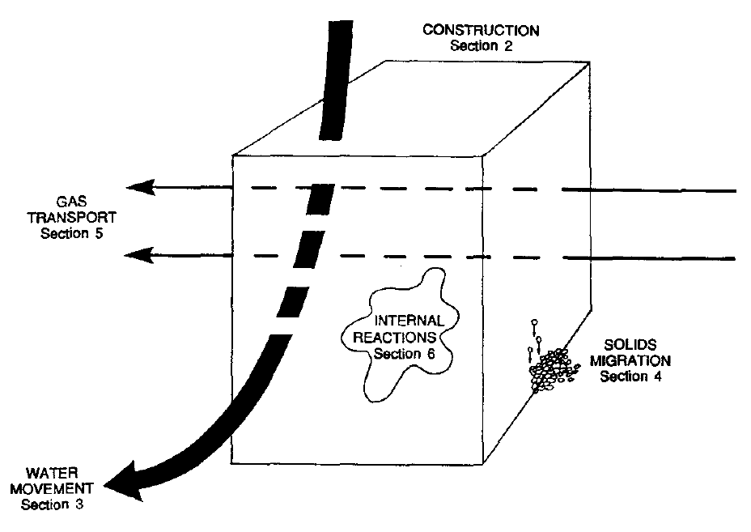
A Waste-Rock Pile, or Any Minesite Component, as a Simple Conceptual “Open” System
from Morin et al., 1991
Minesite components like waste-rock piles, tailings impoundments, and open pits are “open” environmental systems. They experience in inflow, transit, and then outflow (“drainage”) of water, other mass like air and fine particles, and many forms of energy.

Slide 10
Signal Filters and Signal Generators
At most minesites, the myriad physical, geochemical, and biological processes affecting drainage through time are not necessarily known.
Spectral analysis can help in this by looking at each minesite component as a signal filter and/or a signal generator.
What Goes In ≠ What Comes Out
Therefore, the minesite component is changing the strengths of the periodicities (“pulsations”) as water passes through.
No significant
Input (e.g., Cu)
Spectral plot
of Input
Minesite Component
as a Signal Generator
Minesite Component
as a Signal Filter
Spectral plot
of Output
Spectral plot
of Output

Slide 11
The Energy Balance and Conservation for an Environmentally Open Minesite Component
E_{t} = TS + Vp + ∑µ_{i}N_{i} + qφ + mΨ + ½ mv² + ... (Equation 2-2)
where:
E_{t} = total energy, in joules
V = volume, in meter³
p = pressure, in pascal (joules/meter³)
µ_{i} = chemical potential of the ith species, in joules/mole
N_{i} = number of moles (particles) of the ith species, in moles
φ = electrical potential in volts
q = electrical charge, in coulombs
Ψ = gravitation potential, in joules/kg
m = mass, in kg
v = velocity, in meter/second
(note: positive and negative signs can sometimes shift with parameter and methodology)
Other terms can be added to Equation 2-2, such as radiation and biological energy. Therefore, Equation 2-2 is not exhaustive and complete, but is a good example of Earth-System Science linking many aspects of the Earth into one interactive open system.

Slide 12
The Energy Balance and Conservation for an Environmentally Open Minesite Component
When we are tracking a change in total energy (dE_{t} ≠ 0) with time and/or distance, we can delete terms, or ignore terms, or consider certain terms constant in Equation 2-2 above. This leads to many common equations. For example:
Gibbs Free Energy: dE_{t} = Vdp - SdT + ∑µ_{i}dN_{i} (Equation 2-3)
Physical Movement of Subsurface Groundwater: dE_{t} = Vdp + mdΨ (Equation 2-4),
which reduces to:
dh = dυ + dz
where:
h = hydraulic or piezometric head, in meters, measured as the elevation of groundwater level in a piezometer
υ = pressure head, in meters, measured as the height of the water column inside a piezometer
z = elevation, in meters, of the piezometer intake screen.
Aqueous Geochemistry: dE_{t} = ∑µ_{i}dN_{i} (Equation 2-7)
Electrochemistry: dE_{t} = ∑µ_{i}dN_{i} + qdφ (Equation 2-8)

Slide 13
Periodicity in One Energy Term, Like Electrical Potential, Can Cause Periodicity in Other Terms Like Flow and Aqueous Chemistry
In our previous publications, major links of planetary electricity (including ground and atmosphere) were shown with aqueous chemistry and physical flow. These were related to periodicities in electrical fields due to principles in electrohydrodynamics, electrochemistry, thermogalvanic processes, etc.
As a result, periodicity in any one term in Equation 2-2, such as in electrical potential, can create periodicity in one or more other terms like aqueous concentrations and flows.

Slide 14
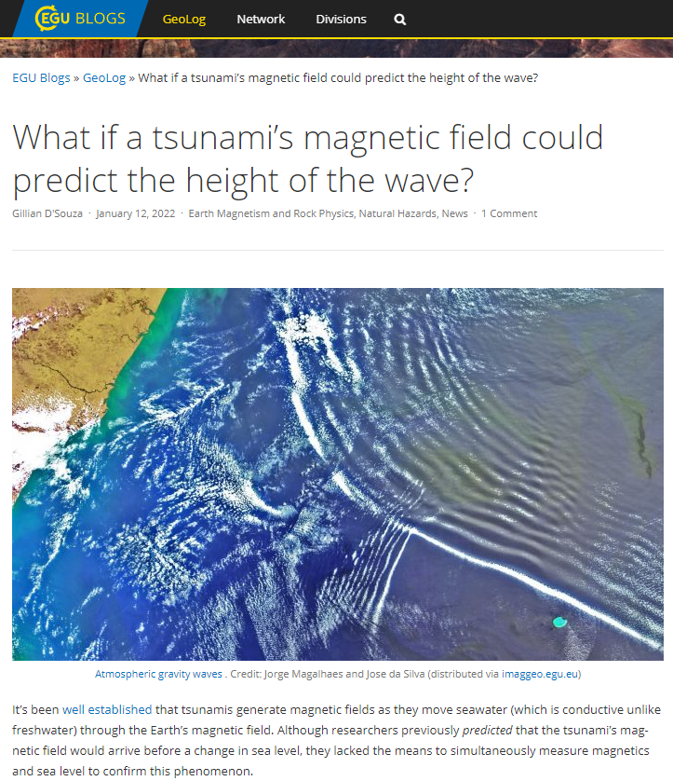
General Energy Balance for an Environmentally Open Minesite Component
In January 2022, the EGU Blog GeoLog had an article discussing such large-scale linkages of open-system energies, “What if a tsunami’s magnetic field could predict the height of the wave?”
Thus, the variation in one form of earth energy can cause variations in other forms.

Slide 15
Periodicity in One Energy Term, Like Electrical Potential, Can Cause Periodicity in Other Terms Like Flow and Aqueous Chemistry
The following two slides contain some examples of periodicities in physical flow and aqueous chemistry caused by various large-scale processes such as the 11-yr sunspot cycle, the 2.38-yr quasi-biennial oscillation in tropical zonal winds, rotational gravity waves, and various tides driven by motions of the moon and sun relative to the earth.

Slide 16
Periodicity in Flow and Aqueous Chemistry Caused by Other Periodicities

Slide 17
Periodicity in Flow and Aqueous Chemistry Caused by Other Periodicities

Slide 18
Objectives
To answer two questions.
1) What mechanisms and processes can introduce periodicity into minesite-drainage chemistry and flow? In other words, why do flow and chemistry “pulsate” at many wavelengths? This effect is more “ubiquitous” in non-mining catchments.
Answer: Based on “Equation 2-2”, the oscillation in any energy term can produce periodicity in one or more other energy terms. This includes the 11-yr sunspot cycle, the 2.38-yr quasi-biennial oscillation in tropical zonal winds, rotational gravity waves, and various tides driven by motions of the moon and sun relative to the earth. These appear to be linked to flow and aqueous concentrations primarily through oscillations in large-scale electrical fields based on electrodynamics, electrochemistry, thermogalvanic processes, etc.
NEXT:
2) How do these mechanisms apparently “self organize” so that their amplitudes and spectral powers generally decrease with decreasing wavelength, often forming fractal spectral slopes? This includes the very common yet mysterious “1-over-f” with a spectral fractal slope of 1.0, which should not appear and should not persist according to mathematics.

Slide 19
First-Order Low-Pass Filters
A common type of signal filter is called a “low-pass filter”. At wavelengths longer than the “cutoff wavelength”, there is no filtering. The cutoff wavelength is important as explained below.
At shorter wavelengths, a first-order low-pass filter reduces spectral power on a fractal slope of 2. Please note: a fractal slope of 2 for power is a fractal slope of 1 for amplitude.

Slide 20
First-Order Low-Pass Filters
Fractal power slopes of 1 (1-over-f) are “mysterious” and found in many sciences and arts. One explanation for them is the superposition of many first-order low-pass filters operating at one time. This can include many physical, geochemical, and biological processes operating at one time inside a minesite component.

Slide 21
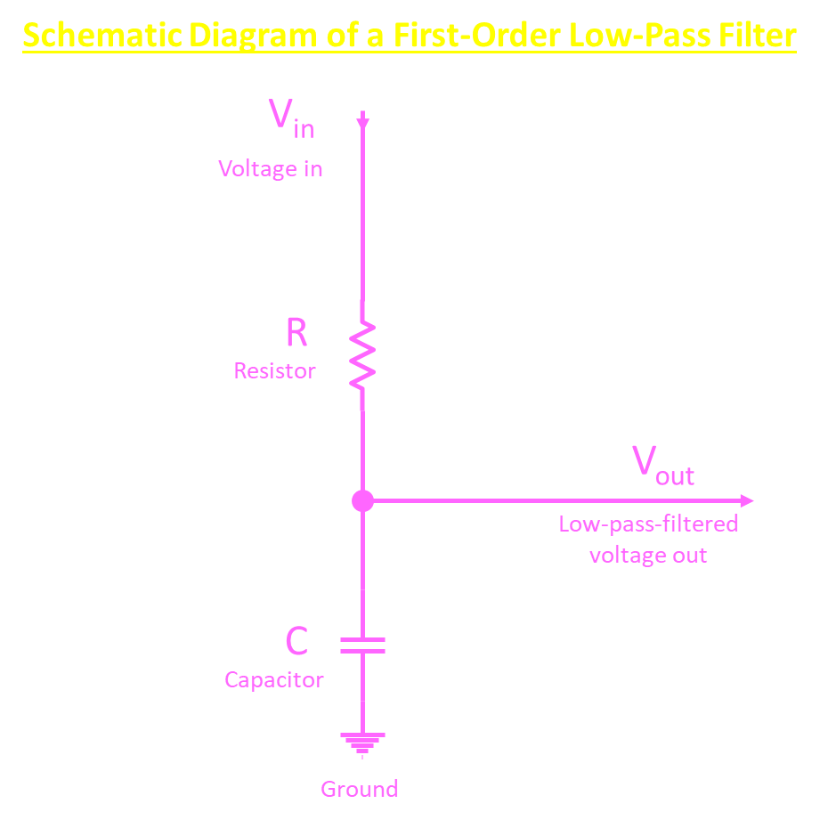
First-Order Low-Pass Filters
A first-order low-pass “RC” filter is a relatively simple electrical circuit containing one resistor and one capacitor. At wavelengths shorter than the cutoff wavelength, this combination reduces the amplitudes of the inputs as wavelengths decrease, with a fractal slope of 2 for power and of 1 for amplitude. At wavelengths longer than the cutoff, there is no filtering.
Various periodicities of energy go in, along with water (rainfall).
At minesites, the rock, its minerals, and the interstitial water create spatial and temporal variations in electrical resistance.
Various periodicities of flow and chemistry come out, with decreasing amplitude as wavelength decreases below the cutoff.
The largest capacitor on earth is the earth itself and its atmosphere. The capacitance (C) of the earth has been calculated at 0.0007 farads.

Slide 22
Minesite Components as First-Order Low-Pass Filters
If we can show that minesite components can be physical analogues of low-pass filters, then spectral slopes of 2 should be expected and other slopes including 1-over-f slopes can be expected when many low-pass-filtered processes operate at the same time.
The first step in showing this is the realization that many minesite components are well “grounded” to the earth. For geotechnical stability, vegetation, loose soil, and broken rock are often removed, and then the component is built in contact with intact rock.
The second step is recognizing that the largest capacitor on earth is the earth itself and its atmosphere. The capacitance (C) of the earth has been calculated at 0.0007 farads.
The third and last step is recognizing that rock and tailings have relatively large, finite resistances and thus act as large electrical resistors.
Therefore, here is evidence of the first step:

Slide 23
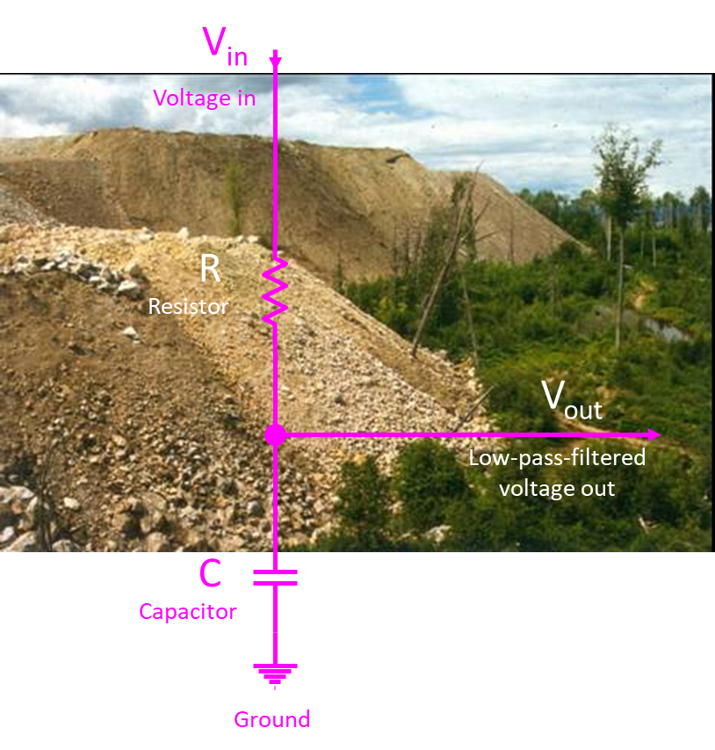
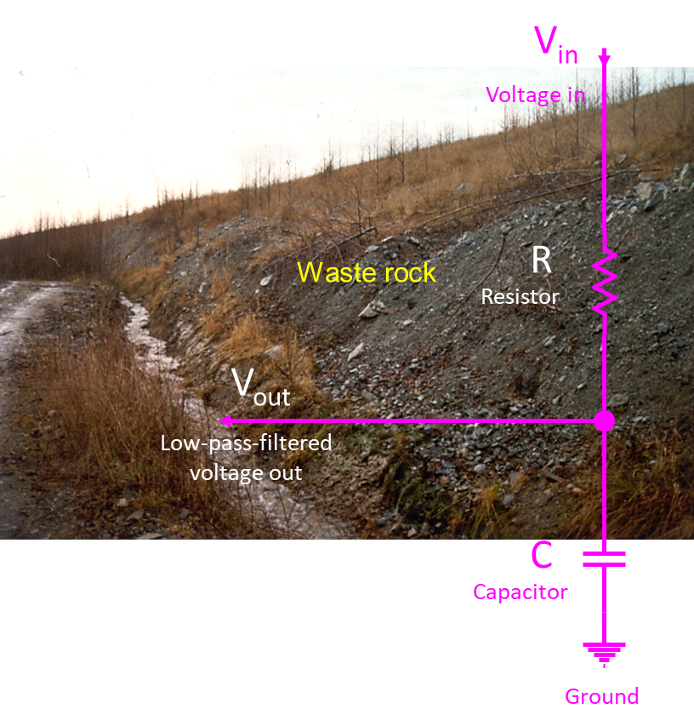
Minesite Components as First-Order Low-Pass Filters

Slide 24
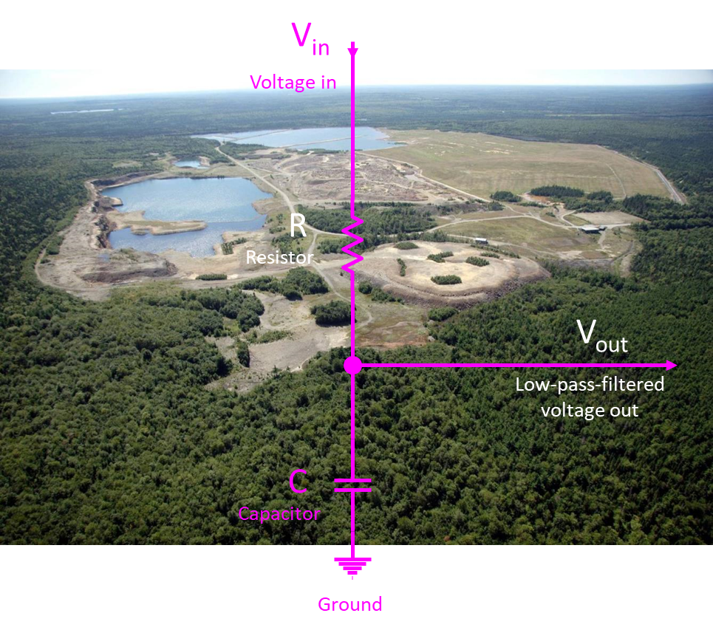
Minesite Components as First-Order Low-Pass Filters

Slide 25
Calculating the Resistance of a Minesite Component
There is a simple equation relating the cutoff wavelength to the resistance of a minesite component.
w_{c,sec} = 2 π R C (Equation 3-1)
where:
w_{c,sec} = cutoff wavelength, in seconds
R = resistance, in ohms = 1/siemens = (volts*seconds)/coulomb
C = capacitance, in farads = coulomb/volt
Replacing C with the earth’s capacitance of 0.0007 farads:
w_{c,sec} = 0.00440 * R
Or
w_{c,yr} = 1.40x10⁻¹⁰ * R
where:
w_{c} = cutoff wavelength, in years

Slide 26
Calculating the Resistance of a Minesite Component
For example, some spectral periodograms shown above had a cutoff wavelength of ~0.5 years for one full-scale example of waste-rock-pile drainage flow and of pH. Thus, the calculated R is 3.94x10⁹ ohms or siemens⁻¹ for this waste-rock pile.
The resistivity (r) is related to resistance (R) by:
R = r*L/A (Equation 3-2)
where:
R = resistance, in ohms = 1/siemens = siemens⁻¹ = (volts*seconds)/coulomb
r = resistivity, in ohm⋅meter = meter/siemen
L = length of system, in meters
A = cross-sectional area of system in meter²

Slide 27
Calculating the Resistivity of a Minesite Materials
As examples of relevant resistivities,
for dry solid quartz, r ~ 10⁺¹² to 10⁺¹⁴ meter/siemen (equivalent to the old units of ohm⋅meter) depending on direction of measurement relative to crystal axis;
for sulphide minerals and graphite, r ~ 10⁻⁵ to 1 meter/siemen;
for groundwater with hundreds to thousands of mg/L typical of minesite drainage, r ~ 10 - 15 meter/siemen; and
for air, r ~ 10⁺⁹ to 10⁺¹⁵ meter/siemen.
If L/A = 1.0, the r of this example’s waste rock would be 3.94x10⁹ ohm⋅meters or meters/siemens. This value is typical of, for example, relatively dry metamorphic and igneous rocks as found at this minesite. This supports the plausible explanation of low-pass filtering presented here.
But is L/A = 1.0?

Slide 28
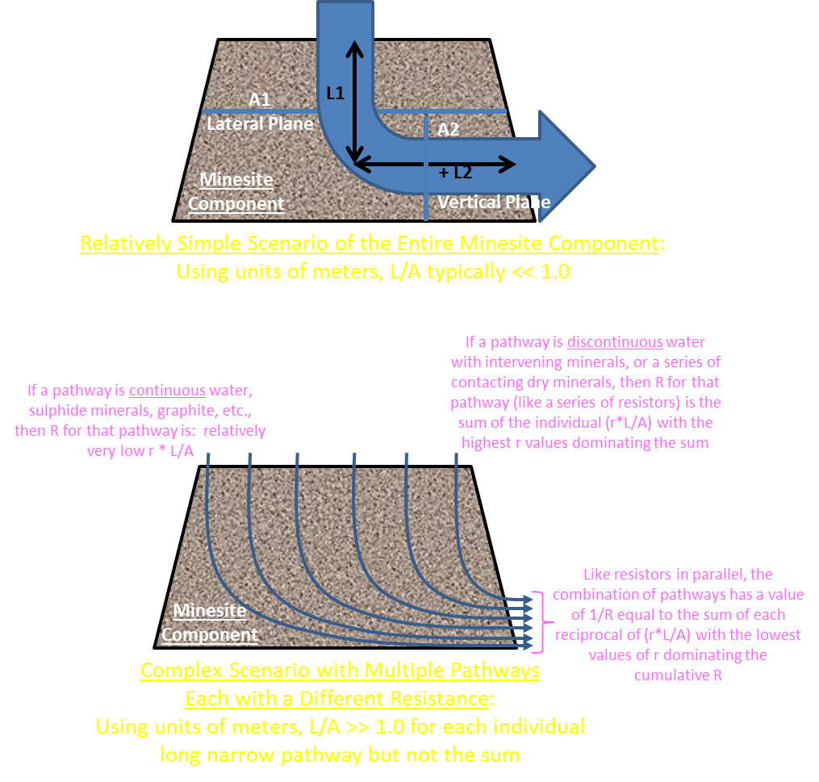
Calculating the Resistivity of Minesite Materials
The practical difficulty is obtaining values for L/A.
In the relatively simple scenario (upper right), L/A would be much less than 1.0. Thus, r >> R and in the example above r >> 3.94x10⁹ meters/siemens, typical of relatively dry quartz-rich rock.
In the complex scenario (lower right), each pathway has a resistance R equal to the sum of its (r*L/A) like a series of resistors. The higher values of individual R dominate that pathway’s R. However, at the exit, the combination of pathways reflects resistors in parallel, with the cumulative R for the minesite component reflecting the lower values of R.

Slide 29
Calculating the Resistivity of a Minesite Materials
The preceding complex scenario showed several flowpaths in parallel entering and exiting a minesite component.
Each flowpath consisted of a series of resistors reflecting spatial variations in the geological materials and their degree of water saturation. As a result, the highest value of resistivity (r) along the flowpath dominates the cumulative resistance (R) of that particular flowpath. Due to the relatively small cross-sectional area (A) of each flowpath, L/A is relatively high, increasing the R for that flowpath even further.
At the exit, all flowpaths come together like resistors in parallel. Thus, the cumulative R for all flowpaths mixed together (the minesite component) mostly reflects the lower R values among the flowpaths.

Slide 30
Calculating the Resistance of a Minesite Component
In general, the resistance R and the cutoff wavelength above which no fractal filtering occurs decreases with:
decreasing resistivity r, such as due to abundant interstitial water and electrically conductivity minerals like pyrite,
decreasing length of flowpath L, such as smaller-scale testing,
increasing cross-sectional area A.
Therefore, fractal spectral slopes caused by low-pass filtering, which are only visible at times shorter than the cutoff wavelength, may only be detected with ultra-high-frequency monitoring:
in some smaller-scale tests with lower L/A values,
in geological materials containing highly conductivity minerals or abundant interstitial water with lower r values.

Slide 31
Answers
1) What mechanisms and processes can introduce periodicity into minesite-drainage chemistry and flow? In other words, why do flow and chemistry “pulsate” at many wavelengths? This effect is more “ubiquitous” in non-mining catchments.
Answer: Based on “Equation 2-2”, the oscillation in any energy term can produce periodicity in one or more other energy terms. This includes the 11-yr sunspot cycle, the 2.38-yr quasi-biennial oscillation in tropical zonal winds, rotational gravity waves, and various tides driven by motions of the moon and sun relative to the earth. These appear to be linked to flow and aqueous concentrations primarily through oscillations in large-scale electrical fields based on electrodynamics, electrochemistry, thermogalvanic processes, etc.

Slide 32
Answers
2) How do these mechanisms apparently “self organize” so that their amplitudes and spectral powers generally decrease with decreasing wavelength, often forming fractal spectral slopes? This includes the very common yet mysterious “1-over-f” with a spectral fractal slope of 1.0, which should not appear and should not persist according to mathematics.
Answer: Minesite components are open systems in the surficial environment well grounded to the earth that behaves like a capacitor. Thus, relatively large components can act as first-order low-pass filters. These filters cause the spectral powers of various periodicities entering them to (1) decrease along a fractal slope of 2 at wavelengths shorter than the “cutoff wavelength” and (2) remain unfiltered at longer wavelengths. When several mechanisms are simultaneously acting as low-pass filters, various fractal slopes including 1-over-f can appear.

Slide 33
Conclusion
Therefore, based on large-scale low-pass filtering, fractal spectral slopes should be common in full-scale minesite drainage and in large non-mining catchments.
And they are indeed found to be common to ubiquitous in high-frequency and long-duration monitoring.
Thus, fractal spectral slopes in large-scale natural water flows and chemistries are not mysterious and unexplainable.
At smaller scales with lower L/A values (such as in a laboratory), the cutoff wavelength can decrease to less than one day or one hour. Thus, their signal filtering and fractal spectral slopes would not be detected except at very short wavelengths by very-high-frequency monitoring.

Slide 34
THE END

