Slide 1







Rise in the frequency and intensity of extreme temperature events over New Zealand in connection to synoptic circulation features
Anjali Thomas¹, Adrian McDonald¹, James Renwick², Jordis Tradowsky^{3,4}, Greg Bodeker^{2,3} , Suzanne Rosier⁵
¹University of Canterbury, School of Physical and Chemical Sciences, Christchurch, New Zealand
²Victoria University of Wellington, School of Geography, Environment and Earth Science, New Zealand
³Bodeker Scientific, Alexandra, New Zealand
⁴Deutscher Wetterdienst, Regional Climate Office Potsdam, Stahnsdorf, Germany
⁵National Institute of Water and Atmospheric Research (NIWA), New Zealand

Slide 2
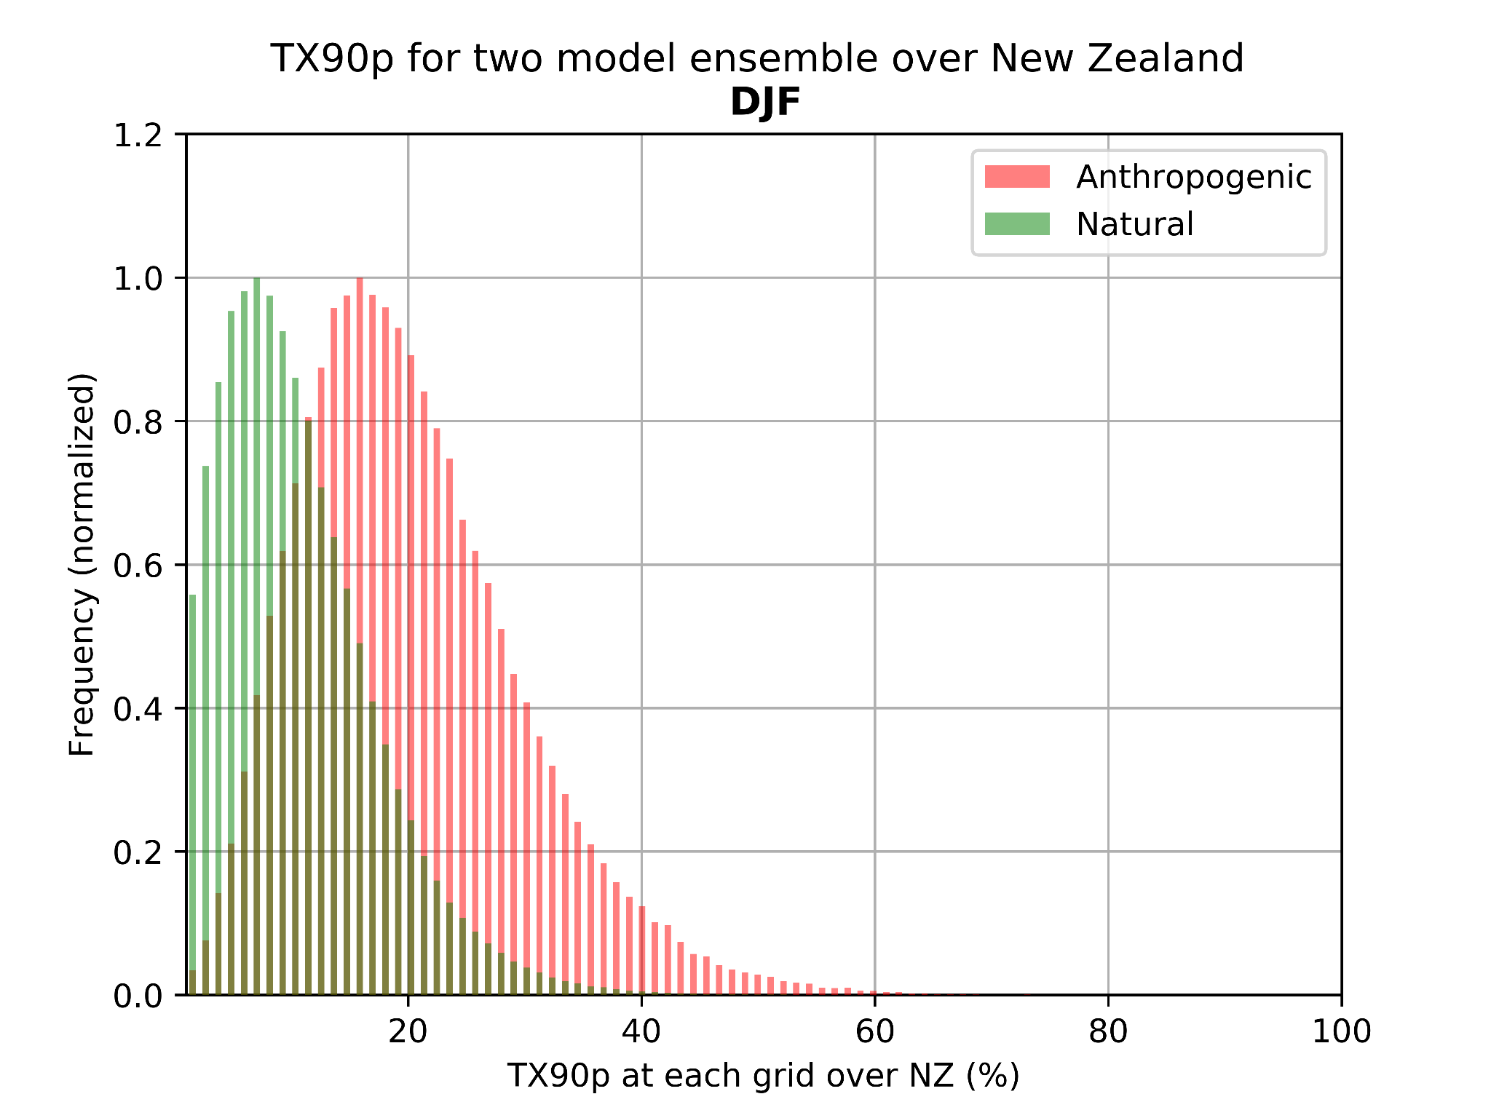
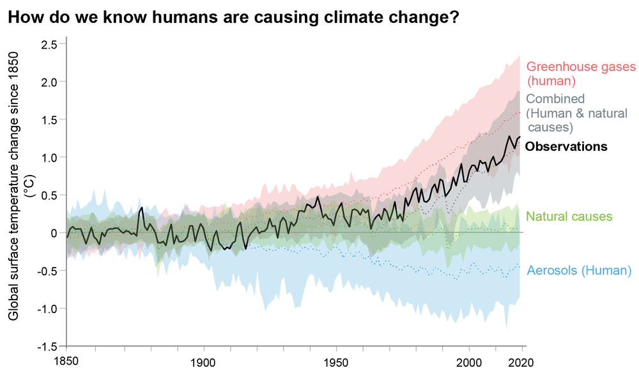
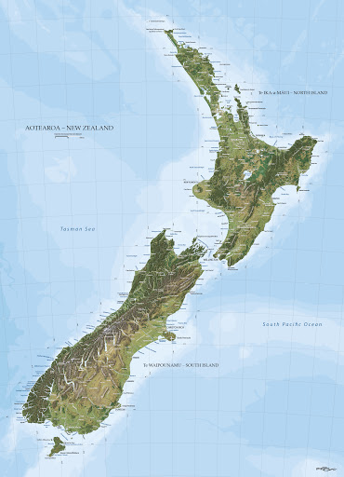
Climate Change and Extreme Temperatures
With every degree of warming→unprecedented extreme weather events are to be expected.
Largest contributors to this change are human-induced GHG emissions.
Estimate how temperature over New Zealand changes with and without anthropogenic GHG emissions.
Anthropogenic ensembles has a higher occurrence of extreme warm days than the natural ensembles.
Notes:
CC → Primarily driven by human activities →increases heat-trapping greenhouse gases (GHG) in Earth’s atmosphere →raising Earth’s average surface temperature.
The contribution of anthropogenic increase in GHG concentration to the rise of surface temperatures from 1951 is more than 50%.
With every degree of warming unprecedented EWE are to be expected and the largest contributors to this change are human-induced GHG emissions. (Fischer and Knutti 2015)
Future temperature projection for New Zealand is estimated to increase about 1°C by 2040, and 2°C by 2090 in the all scenario average.
Anthropogenic forcing causing more warm days in anthropogenic simulation than natural simulations.
The extremes in the pre-industrial scenario occur only due to natural variability whereas both natural variability and changes due to anthropogenic signals contribute towards the extremes in the ANT world which explains the higher occurrence of the percentage of warm days in the ANT ensemble.

Slide 3
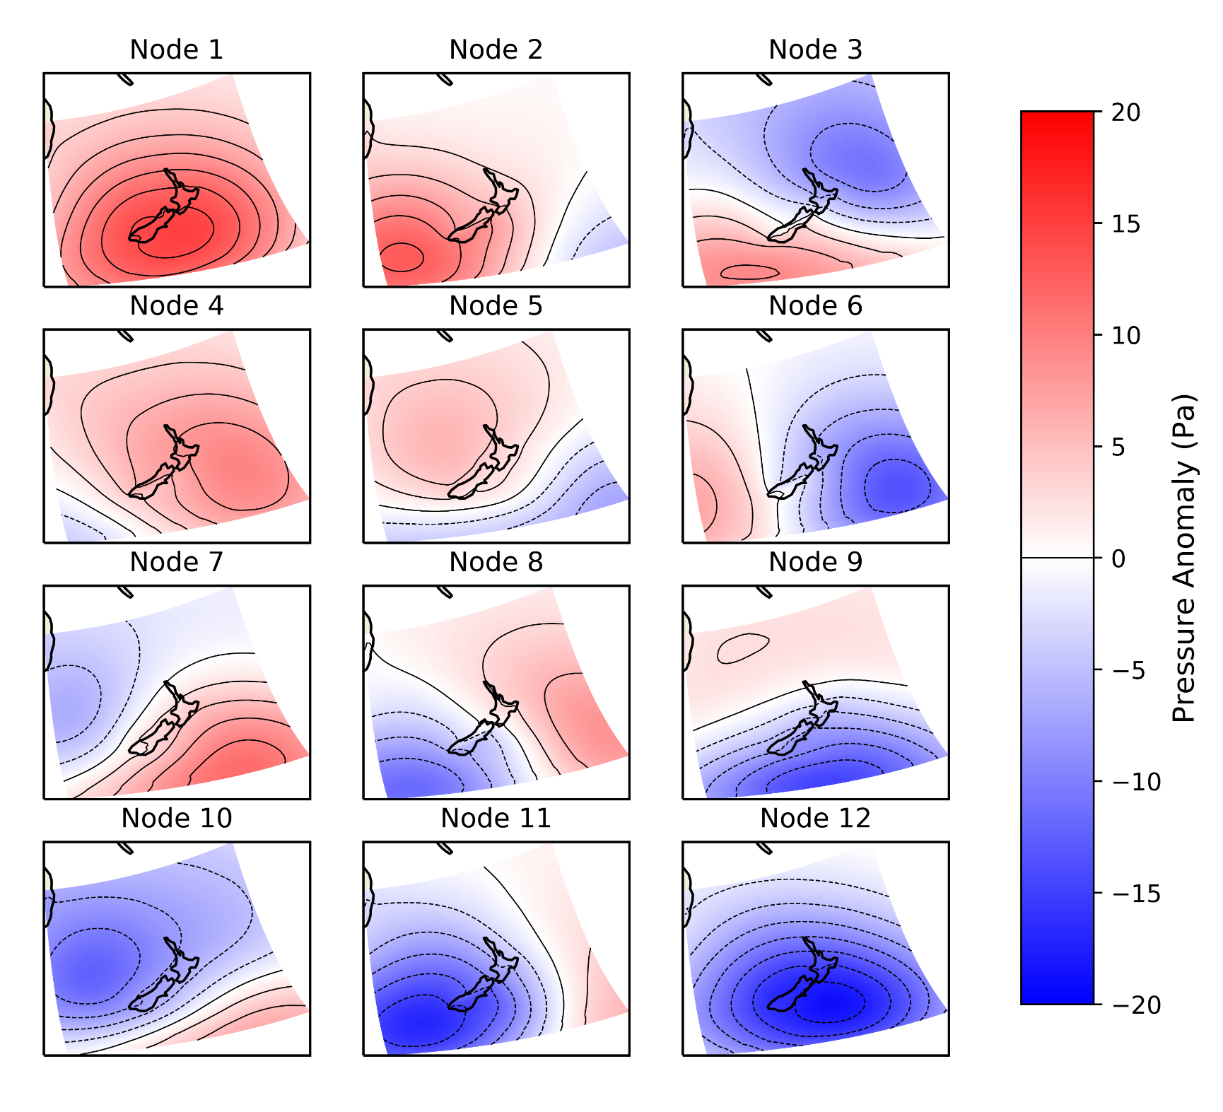
We estimate how the frequency and intensity of extreme temperature events in New Zealand changes with increasing GHG concentrations.
Using weather@home (w@h) ensemble simulations
ANT - post-industrial conditions (with all forcings)
NAT - natural pre-industrial conditions (with forcings set to pre-industrial levels - with no rise in GHG)
Self-Organizing Map (SOM) to classify the major circulation patterns over New Zealand.
Examine the influence of different synoptic states on temperature between ANT and NAT.
Notes:
We identify the major synoptic circulation states in the atmosphere in NZ, using the Self-Organizing Map and then to understand the connection between these patterns to a range of meteorological variables such as Tmax and Tmin for the conditions with and without GHGs, such that the likelihood of EWE in the NAT and NAT world can be quantified and assessed.

Slide 4
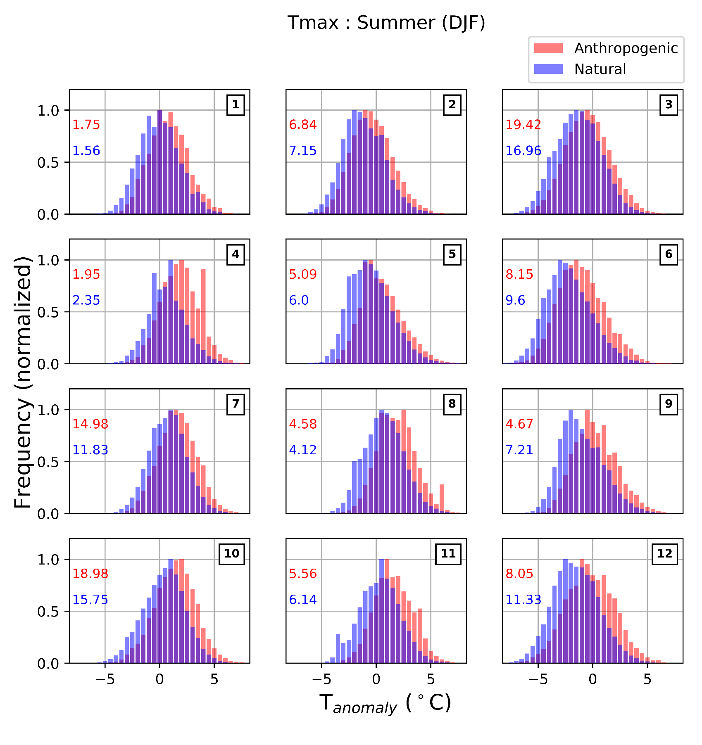
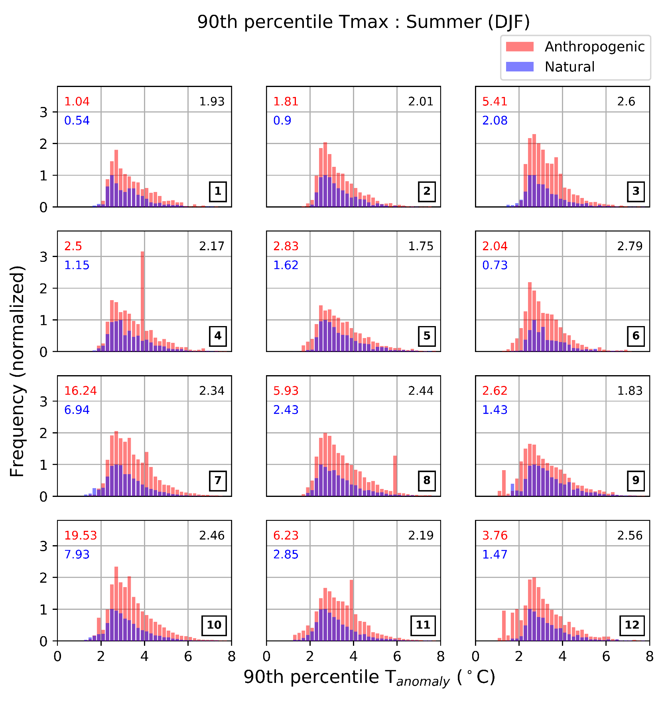
Distribution of temperature anomalies
Circulation types with low pressure centered to the north-west of New Zealand are frequently associated with extreme temperature events NODE 7 and 10
These circulation types advect warm air from the Tropics, an important determinant of extreme heat.
Anthropogenic forcing causes higher temperatures in all the synoptic weather regimes.
On average in summer, New Zealand experiences a 2.5 fold rise in the frequency due to the anthropogenic forcing.
Notes:
Certain synoptic circulation types, changes as large as a 7 to 7.5-fold rise in Tmax extremes are observed in the ANT simulations compared to the NAT simulations, though these circulation patterns occur rarely. This highlights the importance of circulation type in determining how the frequency of extreme temperature events may change as GHG concentration rises
Out of the 12 different synoptic circulation types defined in this work, the ones with a low pressure center to the north-west of New Zealand are associated most with the frequent extreme temperature events. These circulation types are accompanied by advection of warm air masses from the tropics due to the meridional airflow, which is an important determinant of extreme heat.
These circulation types are accompanied by advection of warm air masses from the tropics due to the meridional airflow, which is an important determinant of extreme heat.

Slide 5
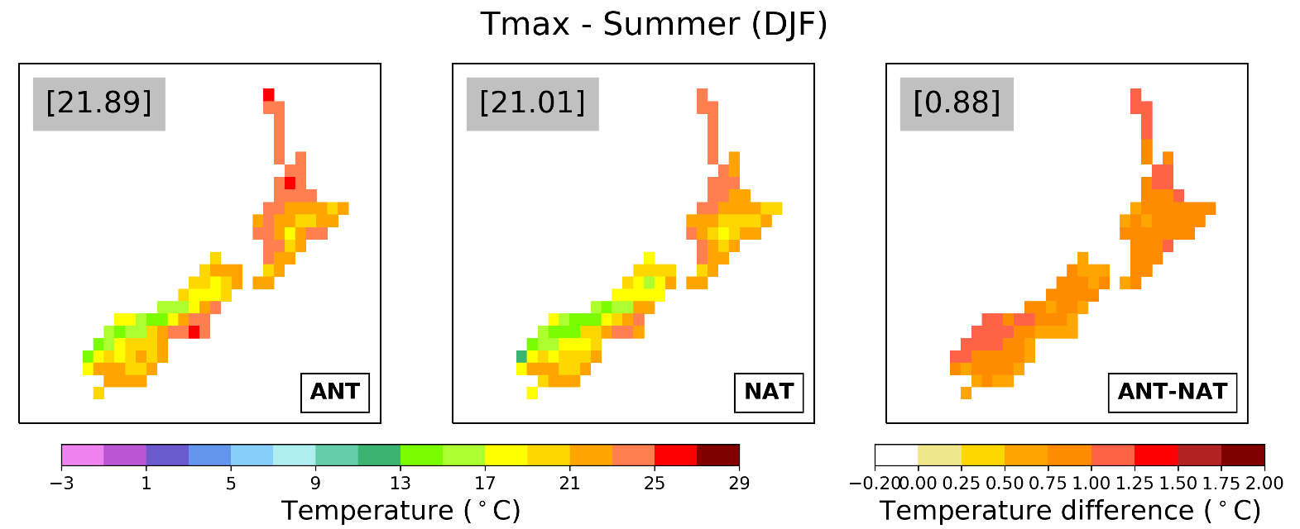
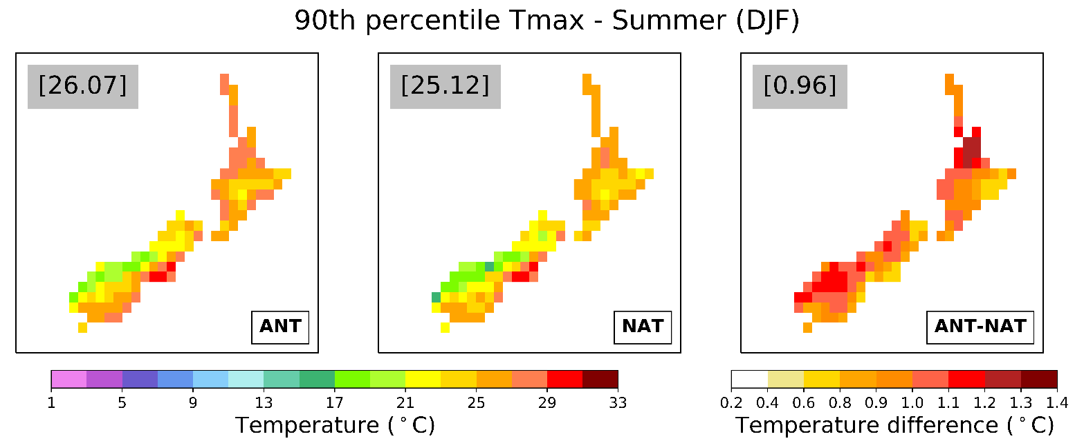
Extremes in the composite circulation types (Node 7 & 10)
Intensity
New Zealand experienced at least 1°C of temperature rise in all regions due to anthropogenic climate change.
The West Coast region, Auckland and Waikato have the highest change in extreme temperatures when these types of synoptic circulation occurs.
Frequency
Frequency of occurrence of extreme temperature in the ANT simulations is on average 2 times more than that of the NAT simulations.
Notes:
Looking into the composites of these circulation patterns, the frequency of occurrence of Tmax in the anthropogenically forced simulations is almost 2.8 times more than that of the NAT simulations and Tmin is 1.6 times that of NAT simulation in winter season. Seasonal variability shows that the summer season is more prone (almost double) to GHG forced extreme temperatures than the winter.
The spatial variability of the temperatures shows seasonality in the composite synoptic conditions (types with a low pressure center to the north-west of New Zealand i.e., nodes 7 and 10), with winters having the highest the temperatures in Northland and Auckland regions. Whereas in summer, highest temperatures are observed in the Canterbury region and it extends through the east coast of the country to Southland along with the Northland and coastal regions in the North Island. Analyzing differences caused by anthropogenic GHGs in the ANT and NAT simulations, winter seasons exhibit a north-south variation with the southern part of the South Island having 1.5°C to 2°C extra warming compared to the NAT simulations for the Tmax and Tmin and almost 1.4°C variation when coming to extreme temperatures. While in summer there is an east-west variation with an average of 1.5°C more warming in the ANT simulations for both Tmax and Tmin and their extreme temperatures (90th percentiles).

Slide 6




Thank you for listening
anjali.thomas@pg.canterbury.ac.nz
0000-0001-5745-0166
@anjali_thomas95

