Slide 1
Reconstruction of the composition of the kimberlite melt of the Bultfontein pipe, Kaapvaal craton.
Alexey Tarasov, Alexander Golovin, and Igor Sharygin
Sobolev Institute of Geology and Mineralogy and
Novosibirsk State University, Novosibirsk, Russian Federation

Slide 2
How to study the composition of deep primitive kimberlite fluids?
Information about the composition of primitive kimberlite melts is important for developing models of kimberlite petrogenesis and reconstruction of the diamond deposits formation processes.
The composition of these melts differs significantly from the bulk composition of kimberlite rocks.
One approach for determining of primitive kimberlite melts compositions is to study secondary melt inclusions in olivine from mantle xenoliths.
According to different models, such inclusions are microportions of primary kimberlitic melt that was trapped at the beginning of rise of xenoliths or shortly before.

Slide 3
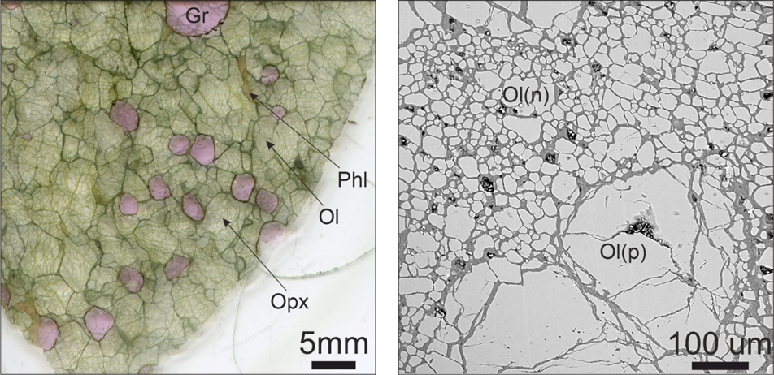
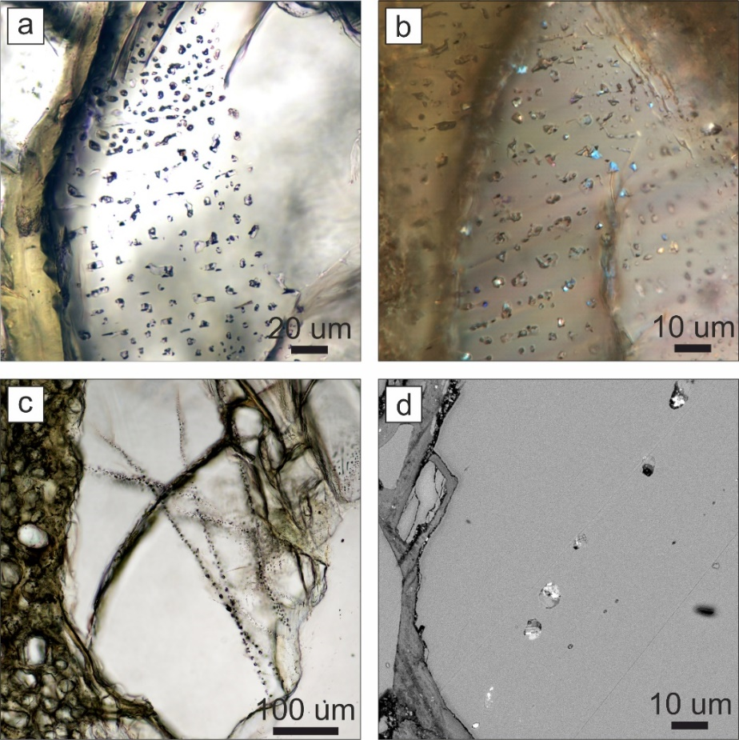
Mantle peridotites and melt inclusions in them.
5 xenoliths of mantle peridotite from kimberlites of the Bultfontein pipe was studied.
Geothermobarometry shows that the PT parameters of the last equilibrium of the rock-forming minerals of these peridotites were 895-1112 °C and 3.8-4.9 GPa (120-152 km).
Melt inclusions were found along healed cracks within olivine grains.
Photograph and BSE image of mantle peridotite xenolith

Slide 4
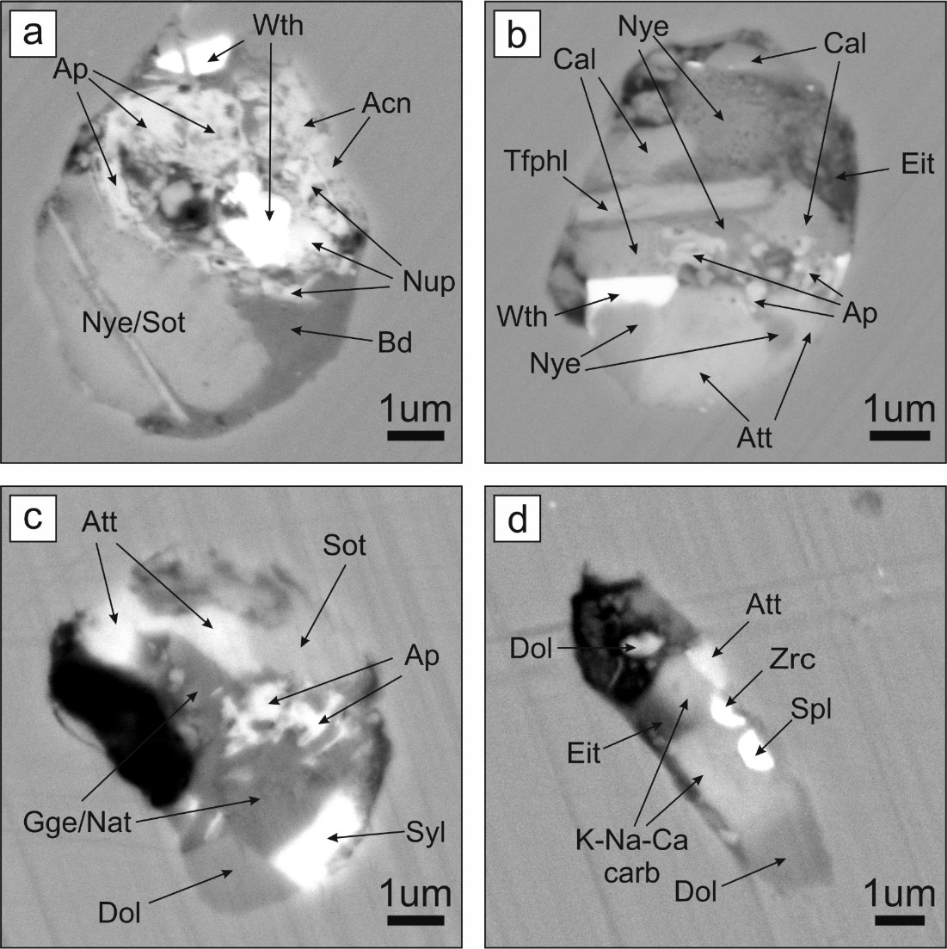
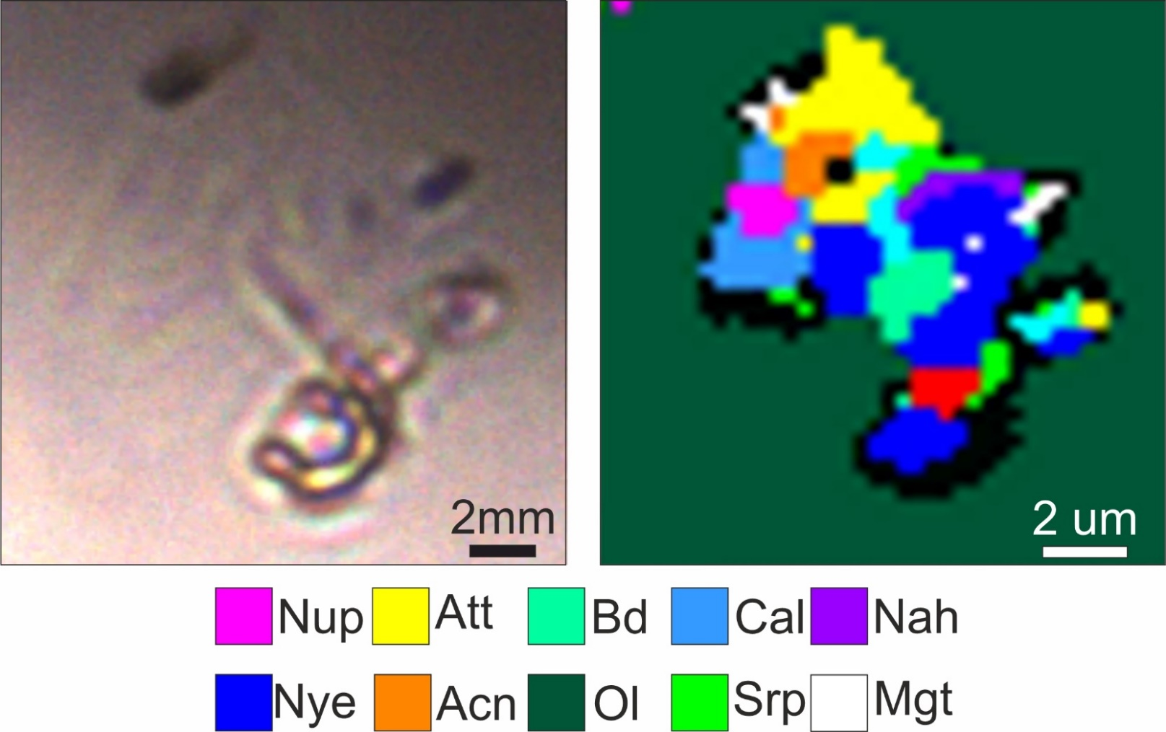
Mineral composition of melt inclusions.
BSE images of melt inclusions in olivine.
Raman-map of melt inclusion in olivine.
Ap-apatite, Wth-witherite, Acn-arcanite, Nup-northupite, Bd-bradleyite, Nye-nyerreite, Sot-shortite, Cal-calcite, Eit-atelite, Att-aphthalite, Dol-dolomite, Slv-sylvite, Zrc- zirconolite, Gge-gregorite, Nat-natrite, Spl Fe-Ti-Mg spinel, Tphl-tetraferriphlogopite.

Slide 5
Mineral association of melt inclusions.
Carbonates
Calcite | CaCO₃
Magnesite | MgCO₃
Dolomite | CaMg(CO₃)₂
Eitelite | Na₂Mg(CO₃)₂
Nyerereite | Na₂Ca(CO₃)₂
Gregoryite | (Na,K,Ca)₂CO₃
Natrite | Na₂CO₃
K-Na-Ca-сarbonate | (K,Na)₂Ca(CO₃)₂
Shortite | Na₂Ca₂(CO₃)₃
Witherite | BaCO₃
Carbonates with additional anions
Nahcolite | NaHCO₃
Bradleyite | Na₃Mg(PO₄)(CO₃)
Northupite | Na₃Mg(CO₃)₂Cl
Burkeite | Na₆CO₃(SO₄)₂
Tychite | Na₆Mg₂(CO₃)₄(SO₄)
Phosphates
Apatite | Ca₅(PO₄)₃(F,Cl,OH)
Sulfides
Heazlewoodite | Ni₃S₂
Oxides
Rutile | TiO₂
Ilmenite | FeTiO₃
Fe-Ti-Mg Spinel | (Mg,Fe)(Fe,Ti)₂O₄
Magnetite | FeFe₂O₄
Zirconolite | CaZrTi₂O₇
Silicates
Phlogopite | KMg₃AlSi₃O₁₀(F,Cl,OH)
Tetraferriphlogopite | KMg₃FeSi₃O₁₀(F,Cl,OH)
Richterite | Na₂Ca(Mg,Fe,Al)₅ [Si₄O₁₁](OH,F)₂
Serpentine | Mg₃(Si₂O₅)(OH)₄
Sulfates
Aphthitalite | K₃Na(SO₄)₂
Arcanite | K₂SO₄
Thenardite | Na₂SO₄
Glauberite | Na₂Ca(SO₄)₂
Baryte | BaSO₄
Halides
Halite | NaCl
Sylvite | KCl

Slide 6
The composition of the melt according to the data of the study of inclusions using Raman mapping and SEM-EDS.
Quantitative ratios between daughter minerals in a group of 25 inclusions, vol.%.
The chemical composition of the trapped melt, mass.%.
Mineral | Raman-mapping and SEM-EDS data
Nyerereite | 22,3%
Bradleyite | 13,9%
Dolomite | 12,7%
Aphthitalite | 12,4%
Serpentine | 12,1%
Spinel and magnetite | 6,1%
Mica | 3,8%
Calcite | 2,4%
Northupite | 2,4%
Nahcolite | 1,9%
Arcanite | 1,8%
Sylvite | 5,0%
Halite | 1,0%
SiO₂ | 6,4%
FeO | 12,2%
MgO | 11,8%
CaO | 11,2%
Na₂O | 15,2%
K₂O | 7,7%
P₂O₅ | 4,1%
Cl | 2,5%
SO₃ | 7%
CO₂ | 20,6%
H₂О | 1,8%
Total | 100,6%
O=Cl₂ | 0,6%
Carbonates | 57,37%
Silicates | 15,91%
Sulfates | 14,27%
Oxides | 6,13%
Halides | 6,00%
Atomic ratios Na:Ca:K
2,0 : 0,5 : 1,0
Calculation
Secondary inclusions are microportions of alkali-carbonatite melt with high content of Cl and SO₃ and low concentrations of SiO₂ and H₂O.
Notes:
Дочерние фазы представлены карбонатами, карбонатами дополнительными анионами, фосфатами, сульфатами и силикатами. Так 10 из 15 обнаруженных минеральных видов представлено карбонатами, а в 11 минеральных видах среди катионов присутствуют Na и K. По нашим оценкам количество карбонатов во включениях составляет более 60%, поэтому можно предположить, что химический состав родительского расплава – щелочно-карбонатитовый с высоким содержанием серы, хлора и фосфора. Согласно модели щелочно-карбонатитового состава примитичных кимберлитовых расплавов, существует два механизма захвата включений. Они формируются либо незадолго до захвата ксенолита при инфильтрации примитивного кимберлитового расплава через мантию, либо во время подъёма ксенолита к поверхности, когда кимберлитовая магма проникает в трещины в минералах ксенолитов. В любом случае включения являются реликтами глубинного, обогащенного щелочами, серой и хлором карбонатитового расплава, который генетически связан с кимберлитовым вулканизмом, результатом которого стало формирование трубки Бултфонтейн

Slide 7
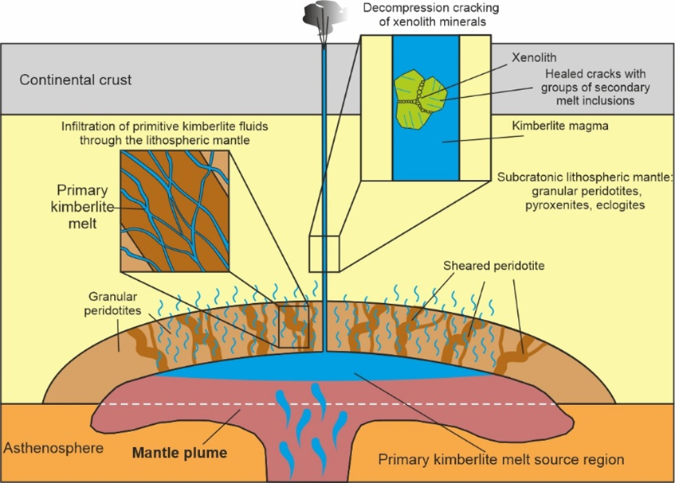
Models for the formation of secondary melt inclusions.
There are two models for the formation of secondary melt inclusions in the minerals of mantle xenoliths.
Infiltration of primitive kimberlite melts through the lithospheric mantle close to their generation source. And the subsequent entry of fragments of such a mantle into kimberlite magma.
Decompression cracking of xenolith minerals during rapid ascent (occurs 15-25 km higher from the xenolith capture depth).

Slide 8
Сonclusions.
Secondary inclusions are microportions of alkali-carbonatite melt with high content of Cl and SO₃ and low concentrations of SiO₂ and H₂O.
The composition of the inclusions probably reflects the composition of the primitive kimberlite melt of the Bultfontein pipe.

Slide 9
Thank you for your attention.

