Slide 1



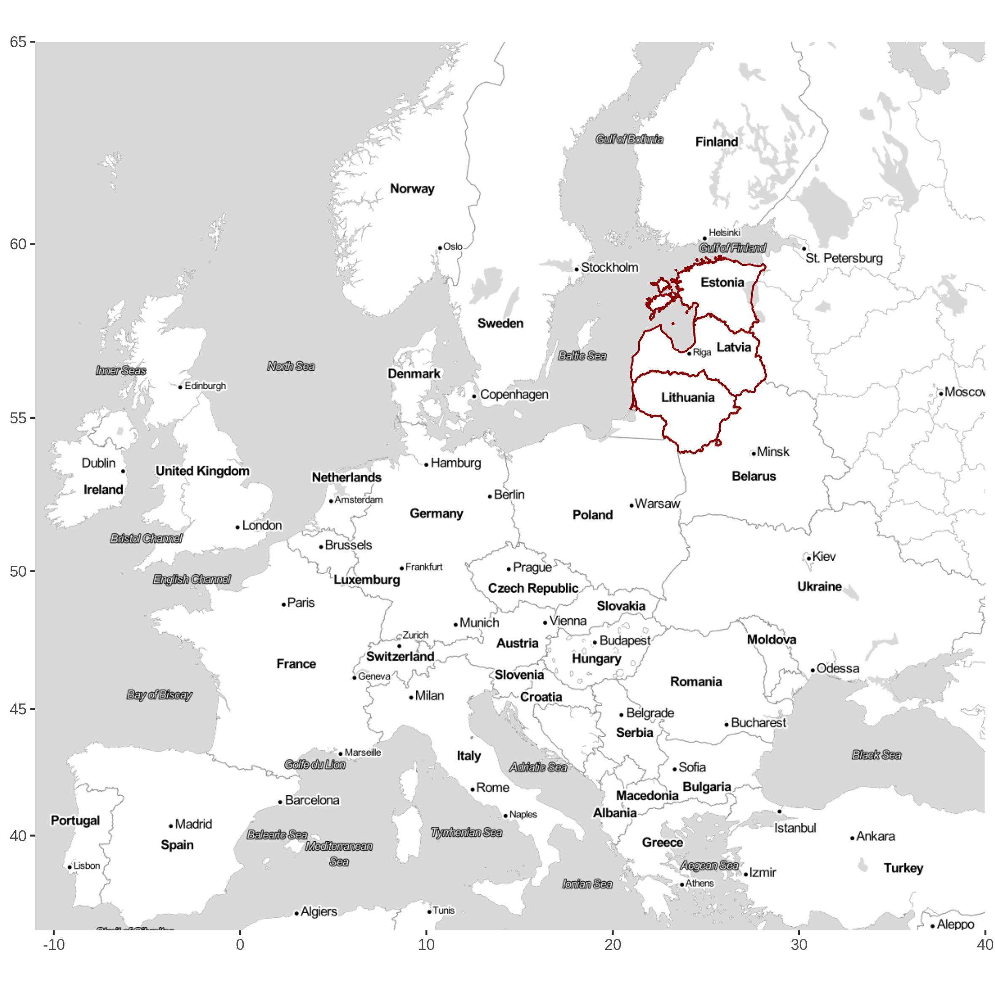
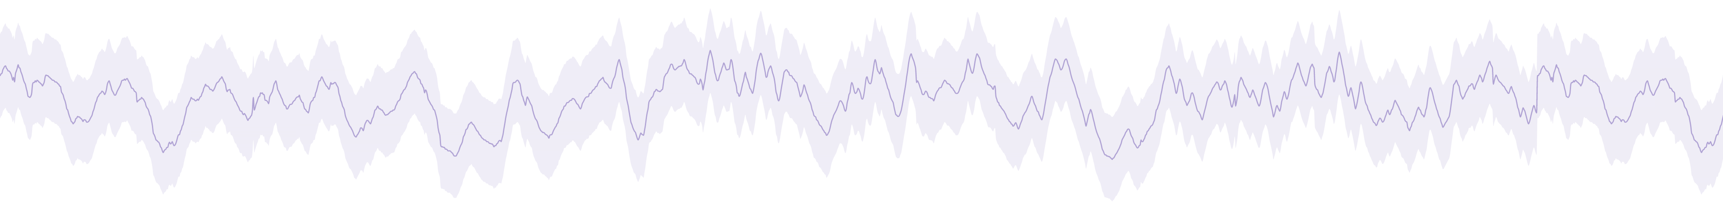
Phenological and thermal growing season changes in the Baltics
"Spatial and temporal prediction of groundwater drought with mixed models for multilayer sedimentary basin under climate change" (LZP-2019/1-0165)
Dr.geogr. Gunta Kalvāne| gunta.kalvane@lu.lv
Dr.geol. Andis Kalvāns | andis.kalvans@lu.lv
Dr.geogr. Agrita Briede| agrita.briede@lu.lv
175 015 km²

Slide 2
Growing season
Frost free seson:
period between last spring frost and first autumn frost
T_daily_min <0 °C*
Thermal growing season:
the number of days with mean temperatures above 5°C
T_daily_AVG >5°C
>6days*
Phenological growing season: leaf unfolding (BBCH11) - senescence (coloring (BBCH92) or leaf fall (BBCH93)).**
* calculated using the gridded daily temperature from the E-OBS data set version v24.0e (Cornes et al., 2018);
** open source phenological observations data set (Kalvāne et al, 2021).

Slide 3
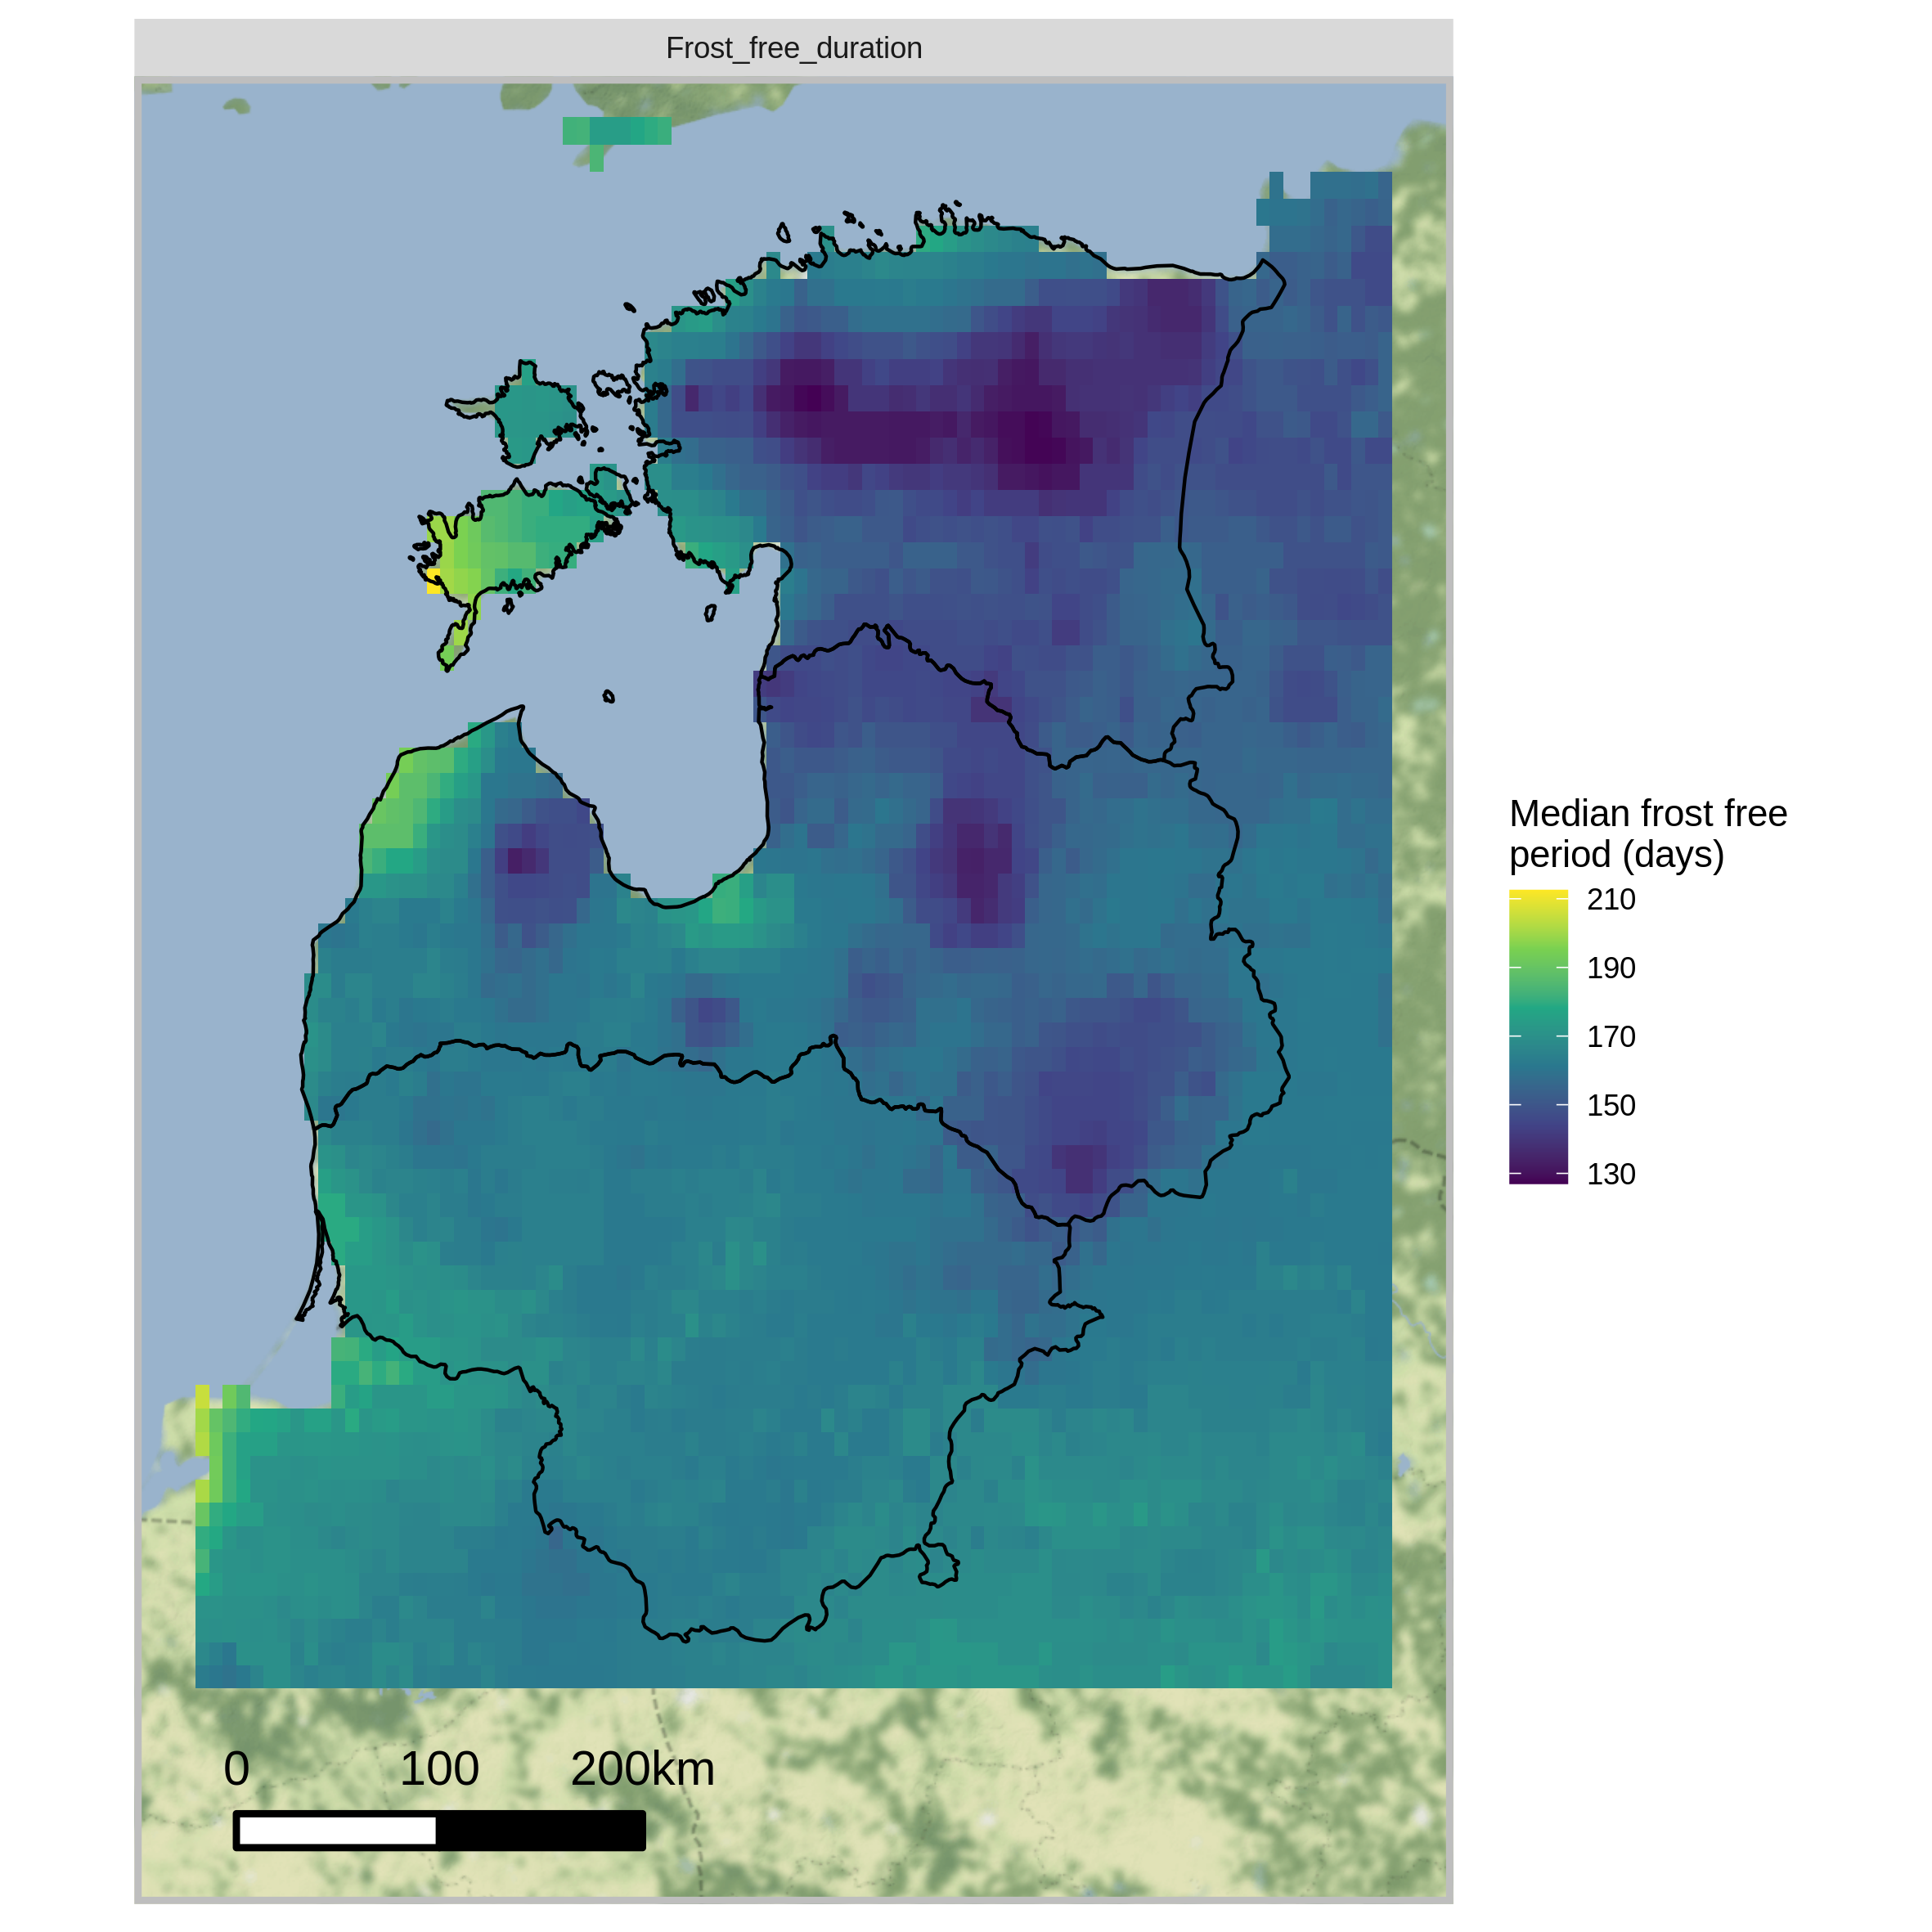
Frost free season in Baltics
<130 days
>210 days
Length of frost free season in Baltics, 1991-2020, in days (median)
GSB – 123 DOY
GSE – 281 DOY

Slide 4
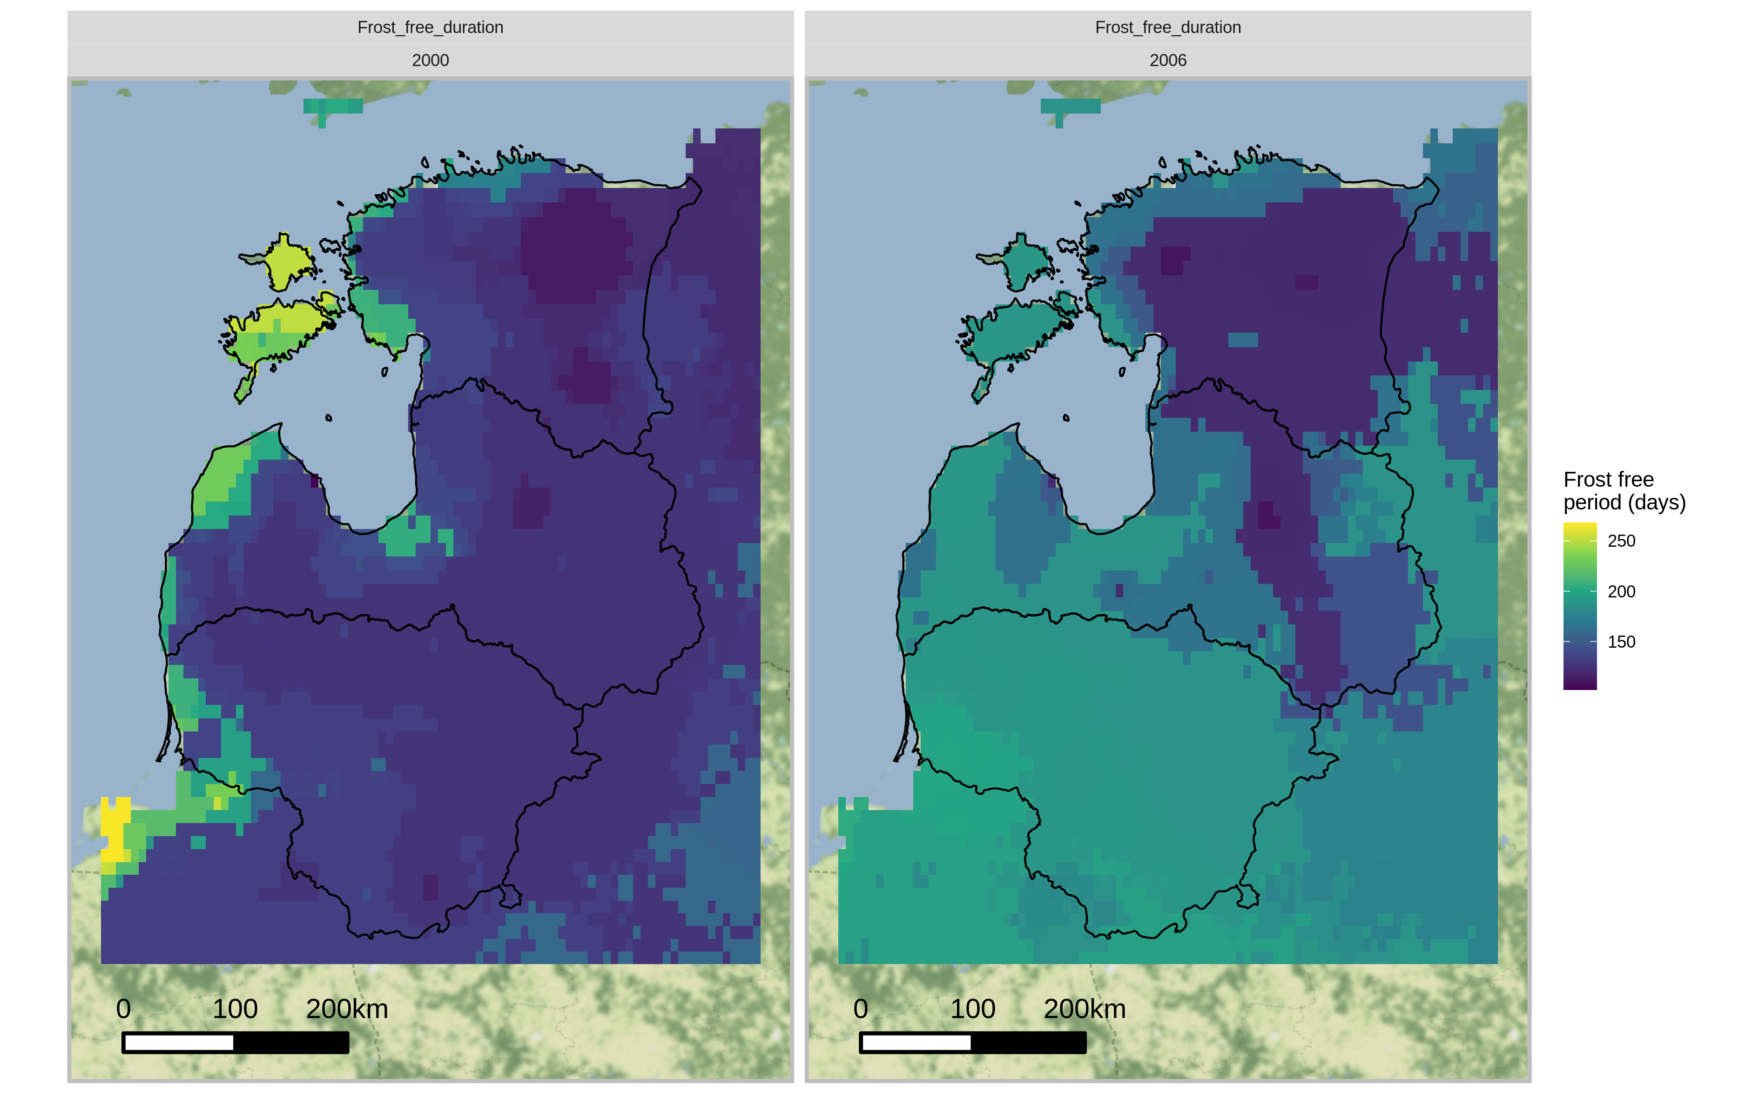
2000
2006
>250 days

Slide 5
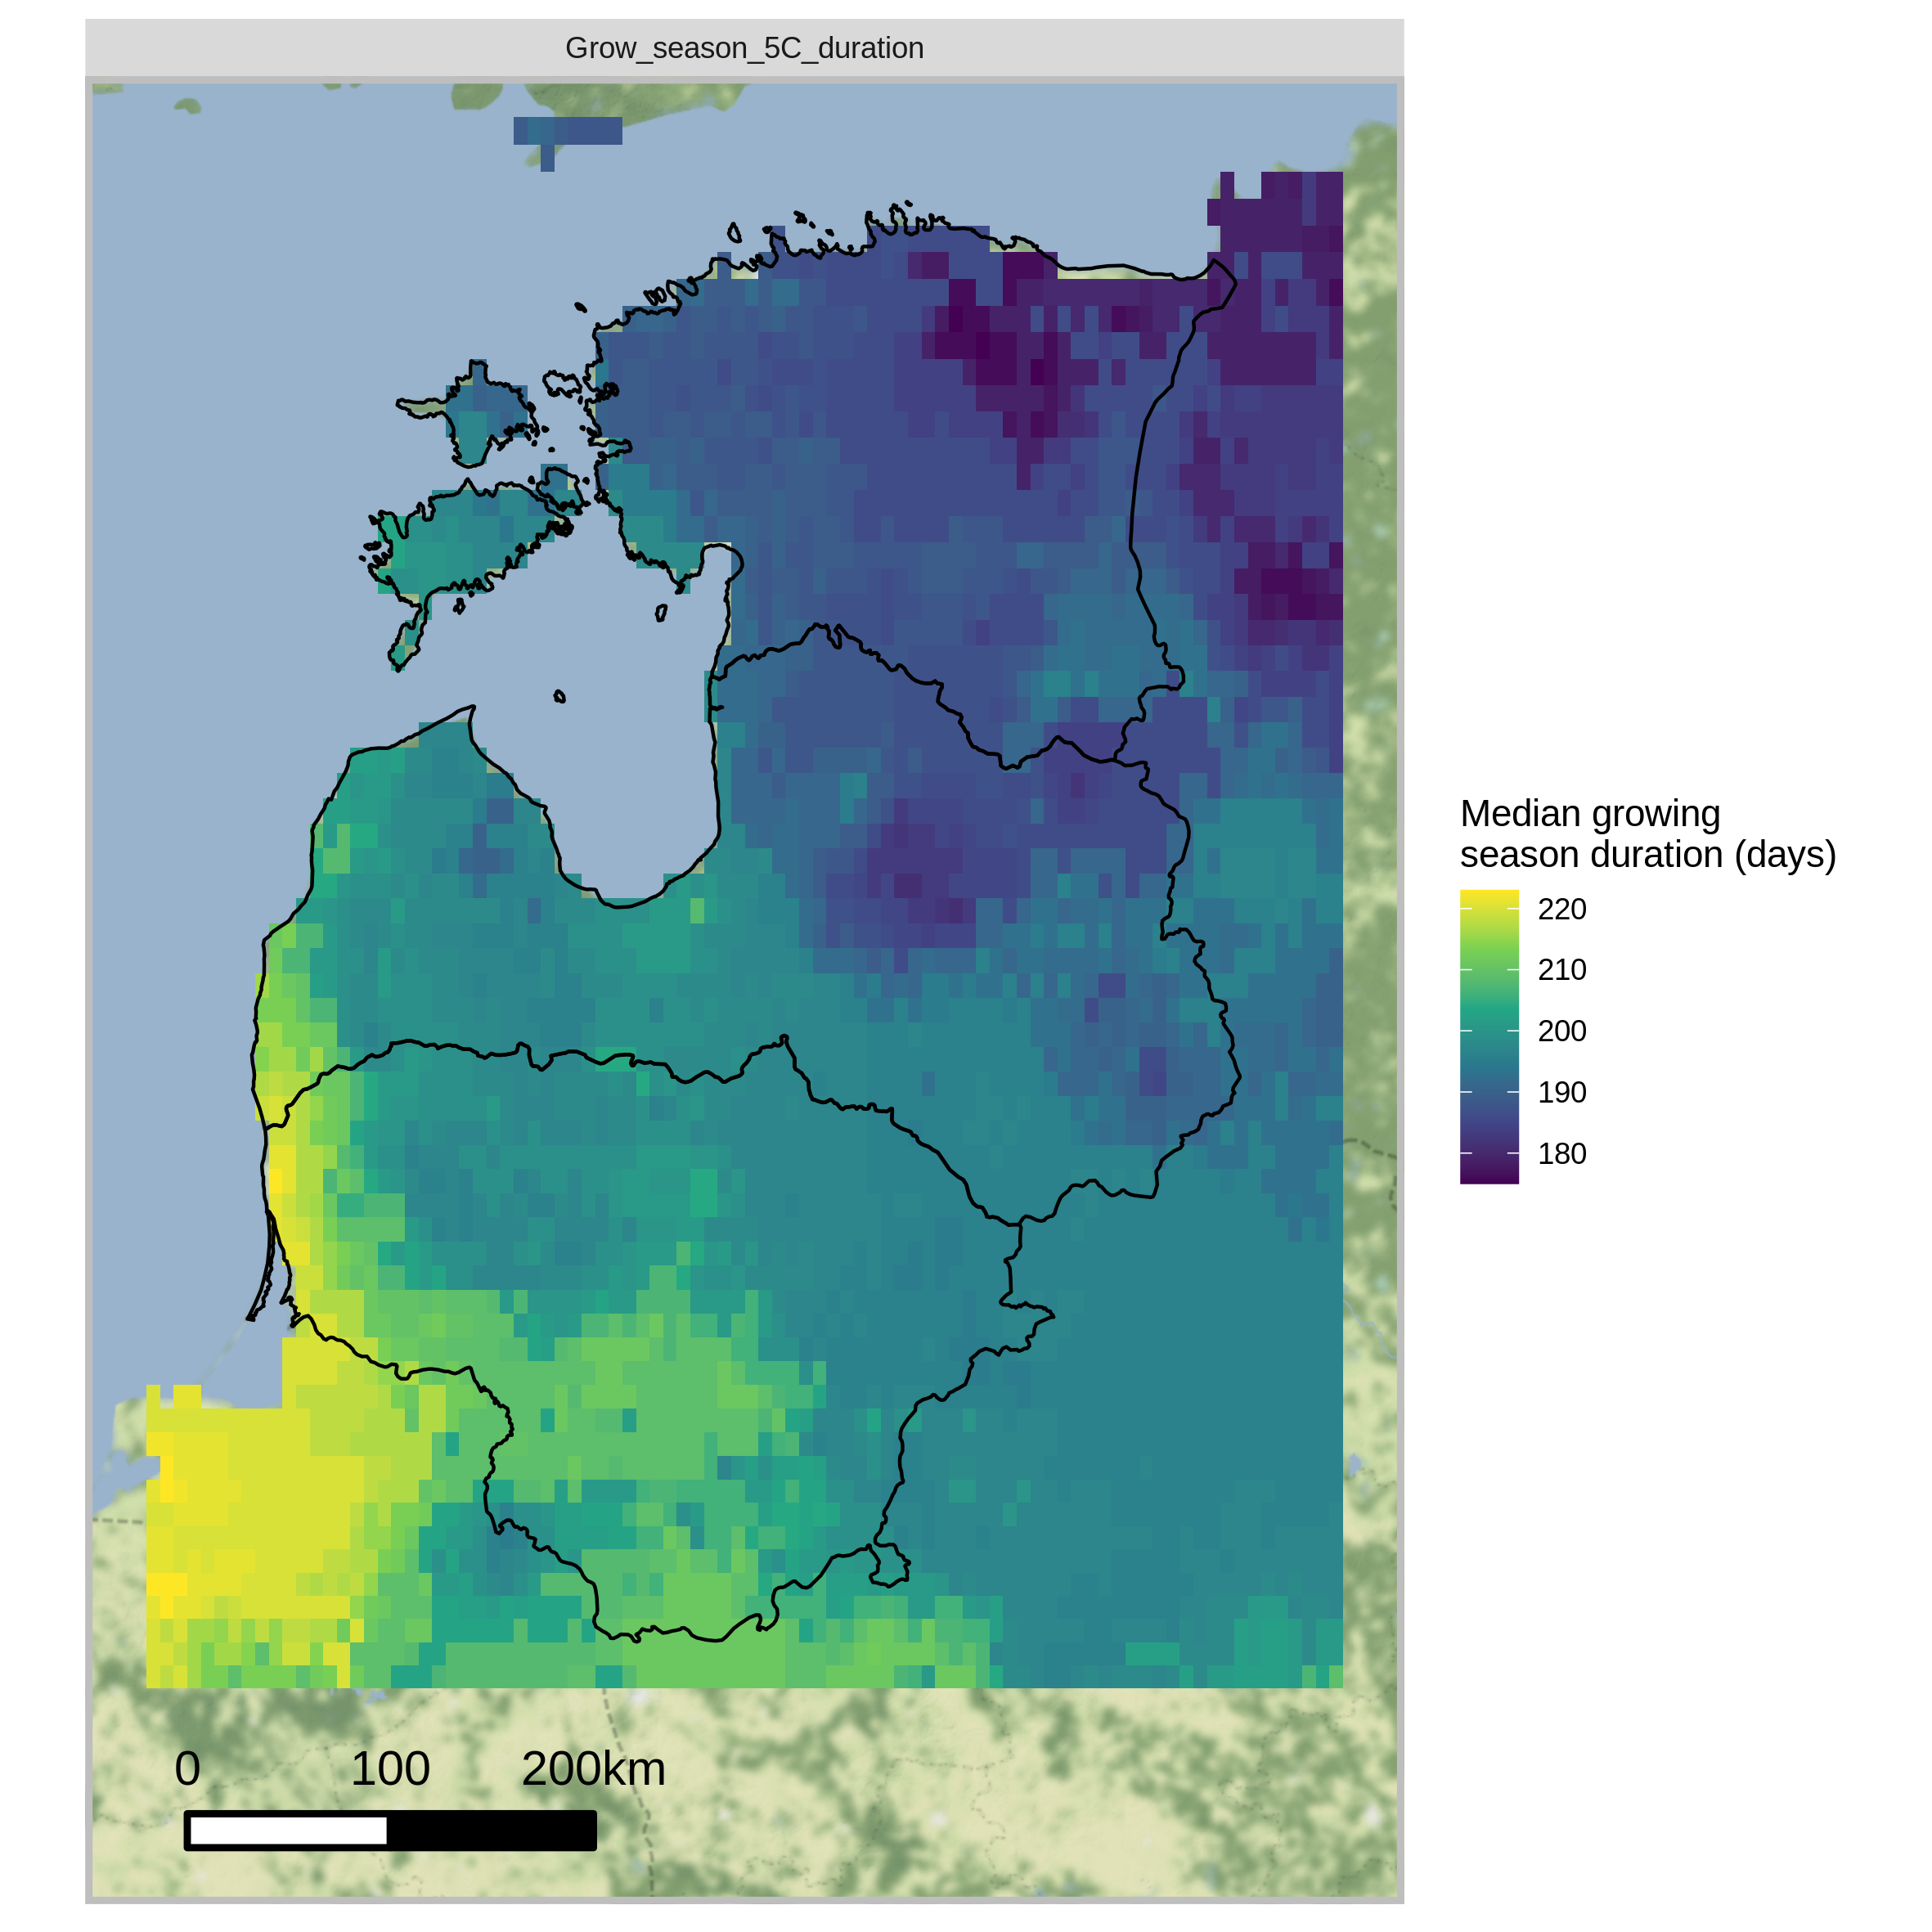
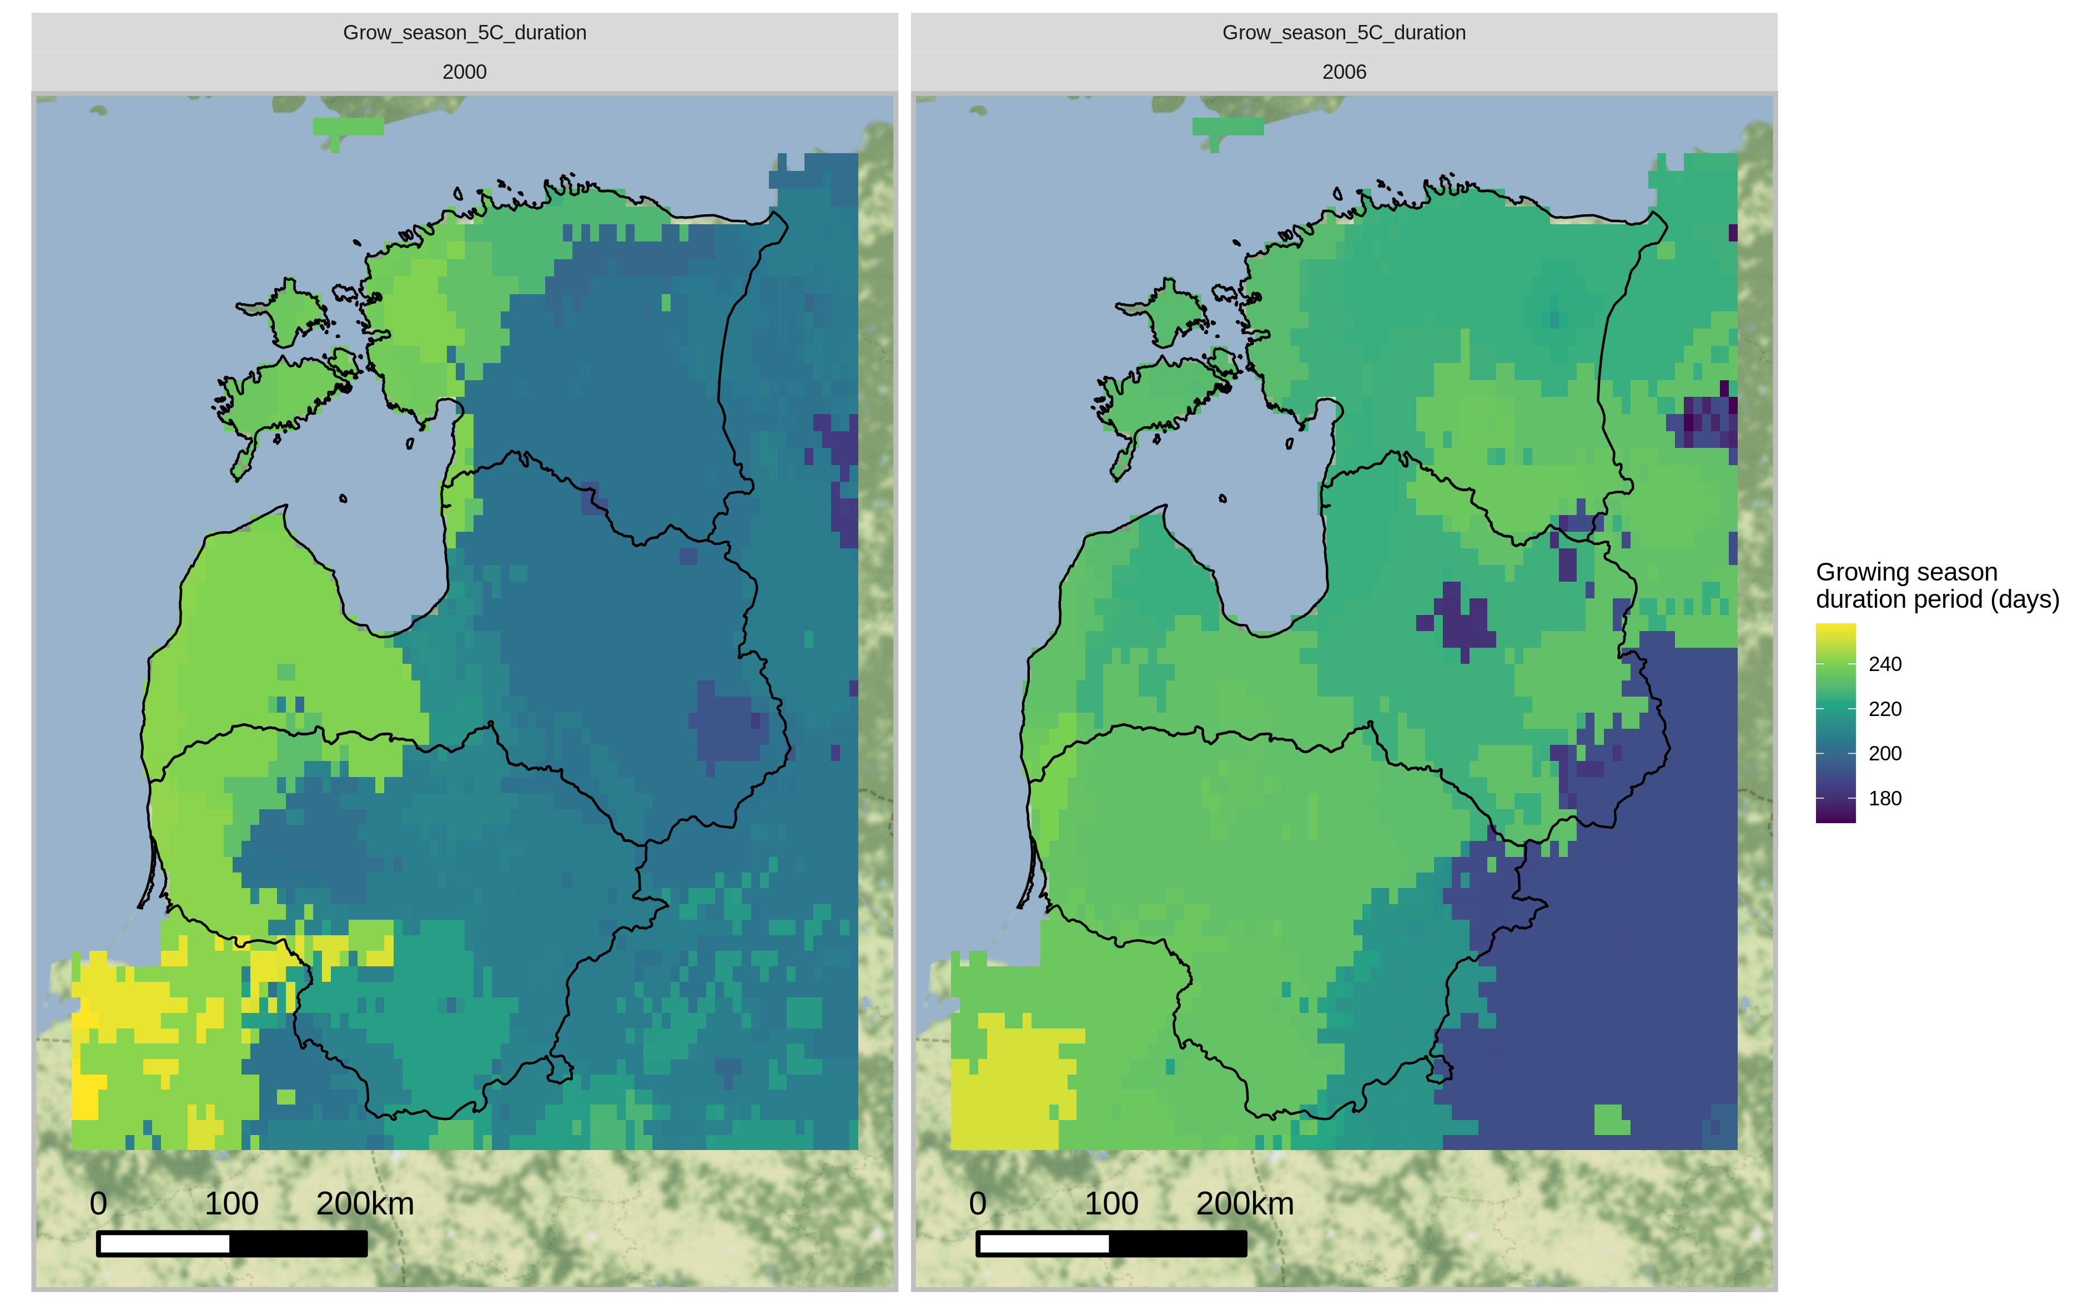
Thermal growing season (Td>5°C)
<180 days
2000
2006
>220 days

Slide 6
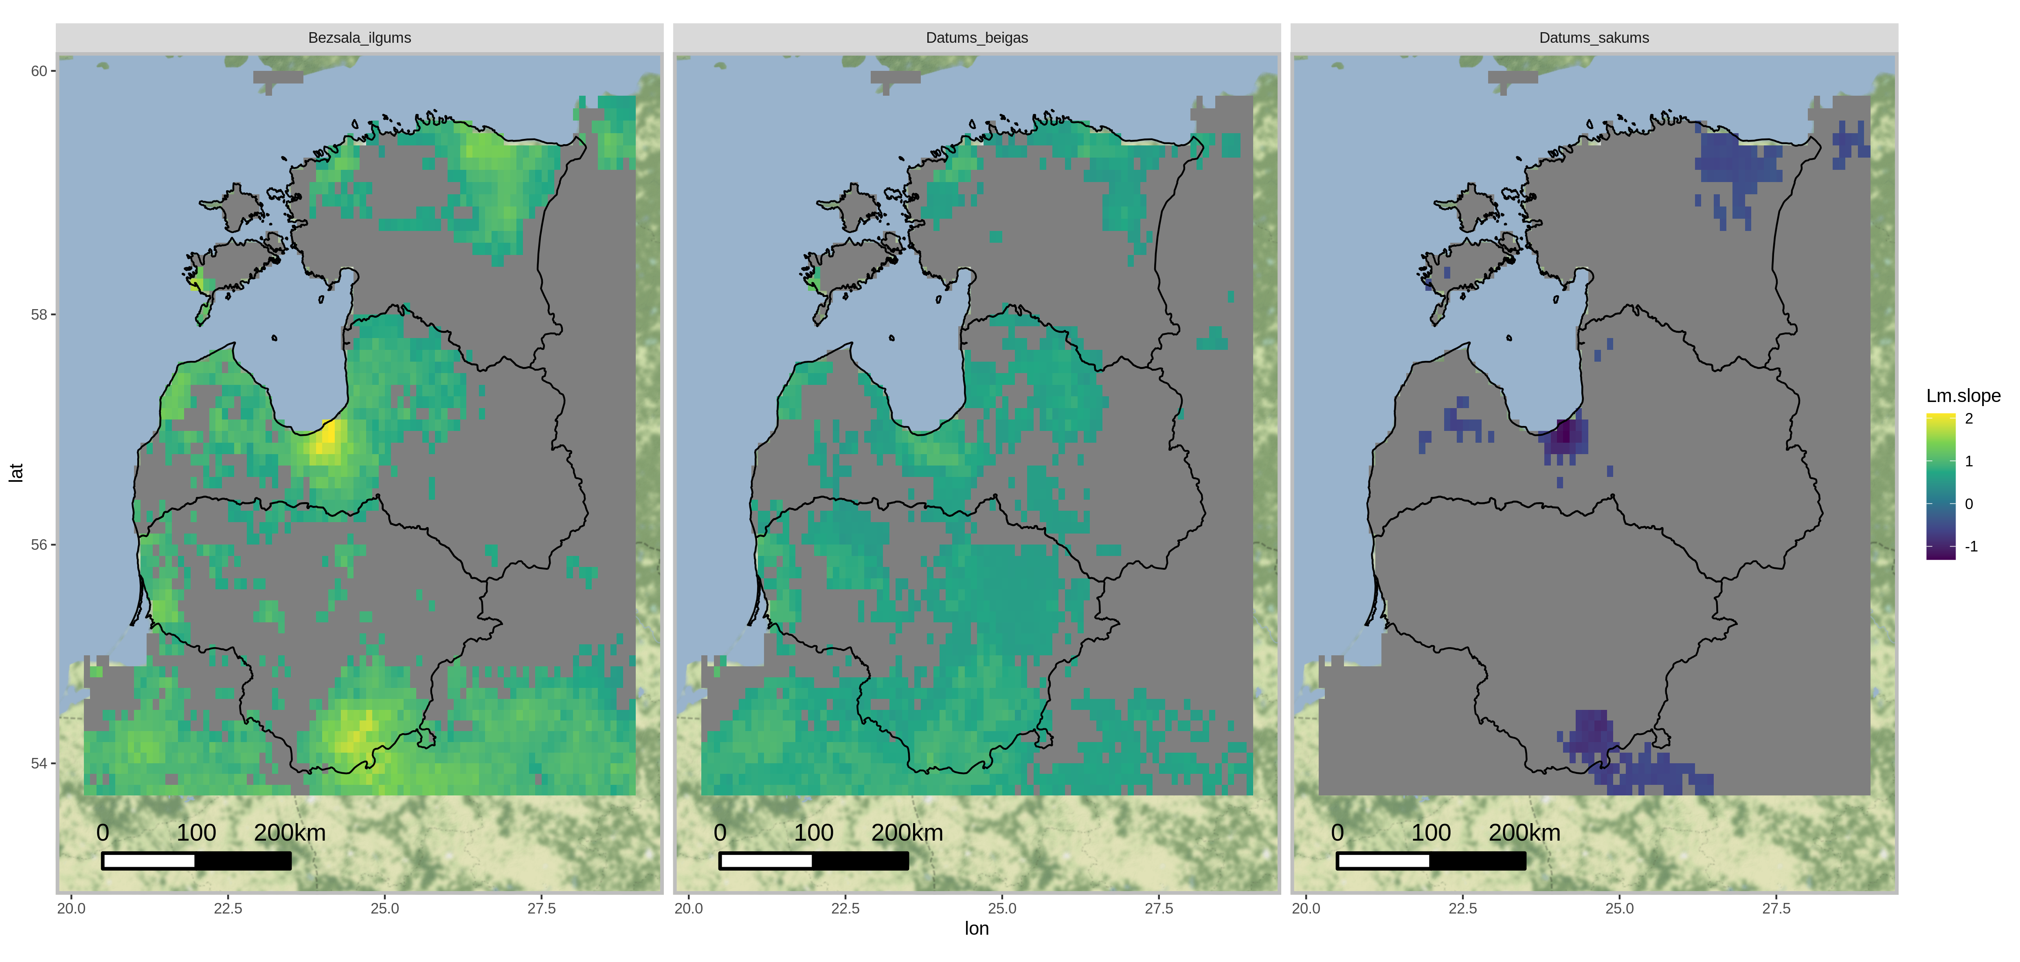
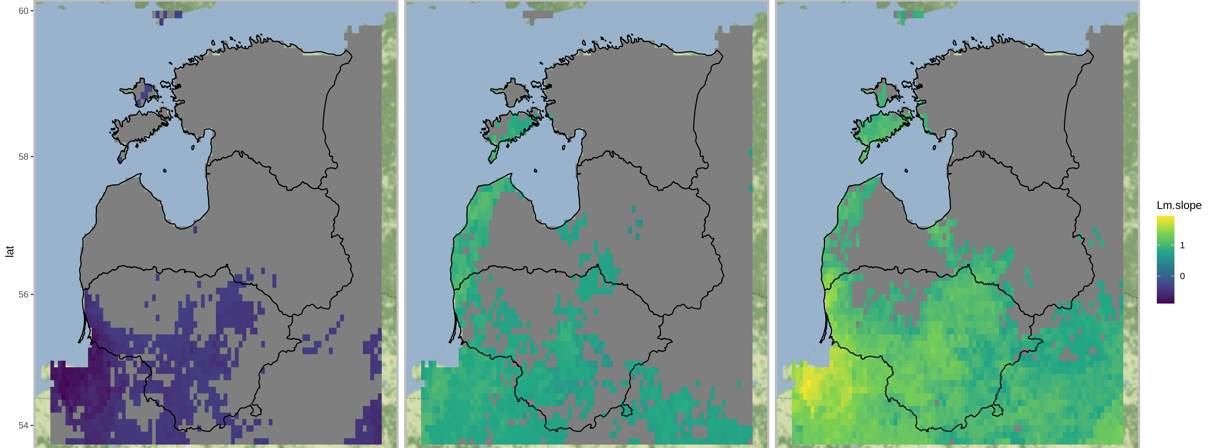
GSB
GSE
AVG -0.13 day/y
AVG 0.54 day/y
GSL
AVG 0.68 day/y
Frost free season,
slope (day/year)
AVG -0.19 day/y
AVG 0.60 day/y
AVG 0.79 day/y
Thermal growing
season,
slope (day/year)
GSB_start
GSE_end
GSL_lenght
p.value <= 0.05

Slide 7
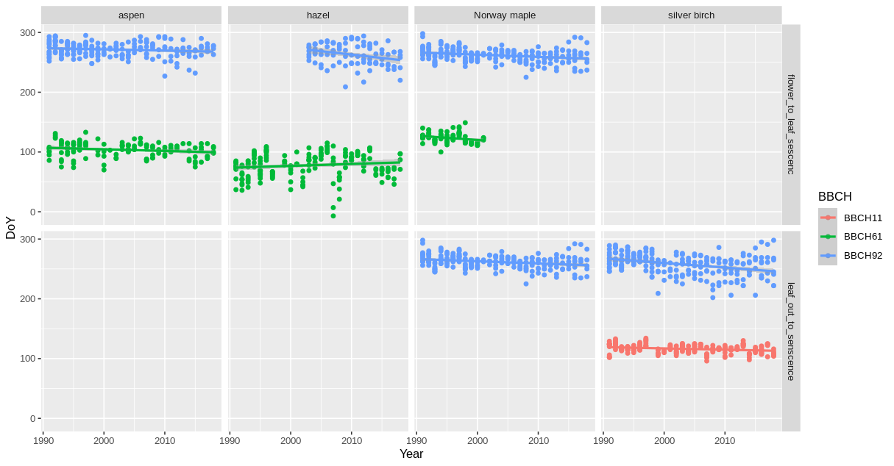
Phenological growing season
Populus tremula
Corylus avelana
Acer platanoides
Betula pendula
Phenological growing season. Leaf unfolding (BBCH11), flowering (BBCH61) and senescence (coloring (BBCH92)/ leaf fall (BBCH93)) trends in Latvia (1991-2020).

Slide 8
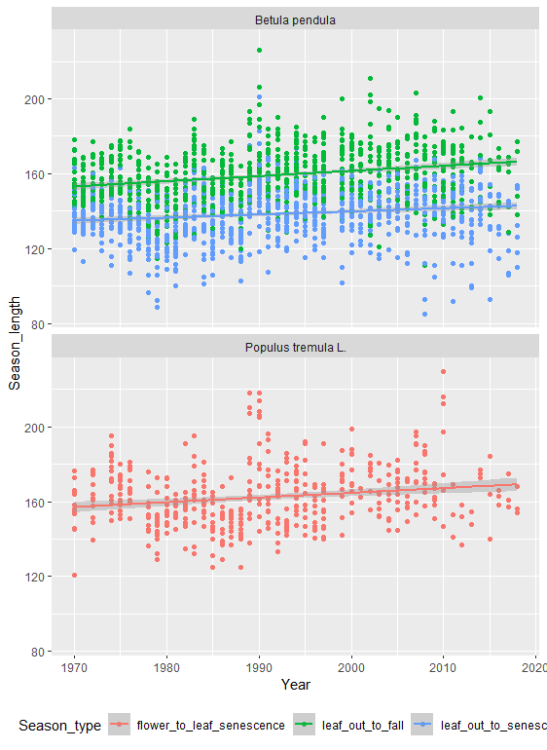
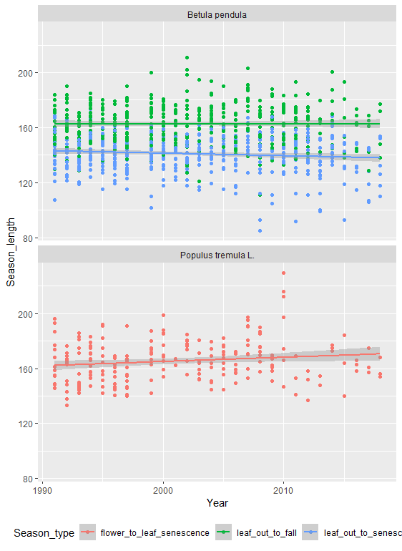
Lenght_Phenological growing season
GSL - (1971-2020), days
GSL - (1991-2020), days

Slide 9
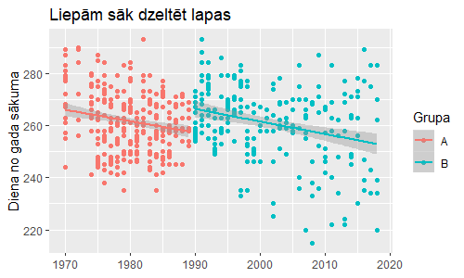
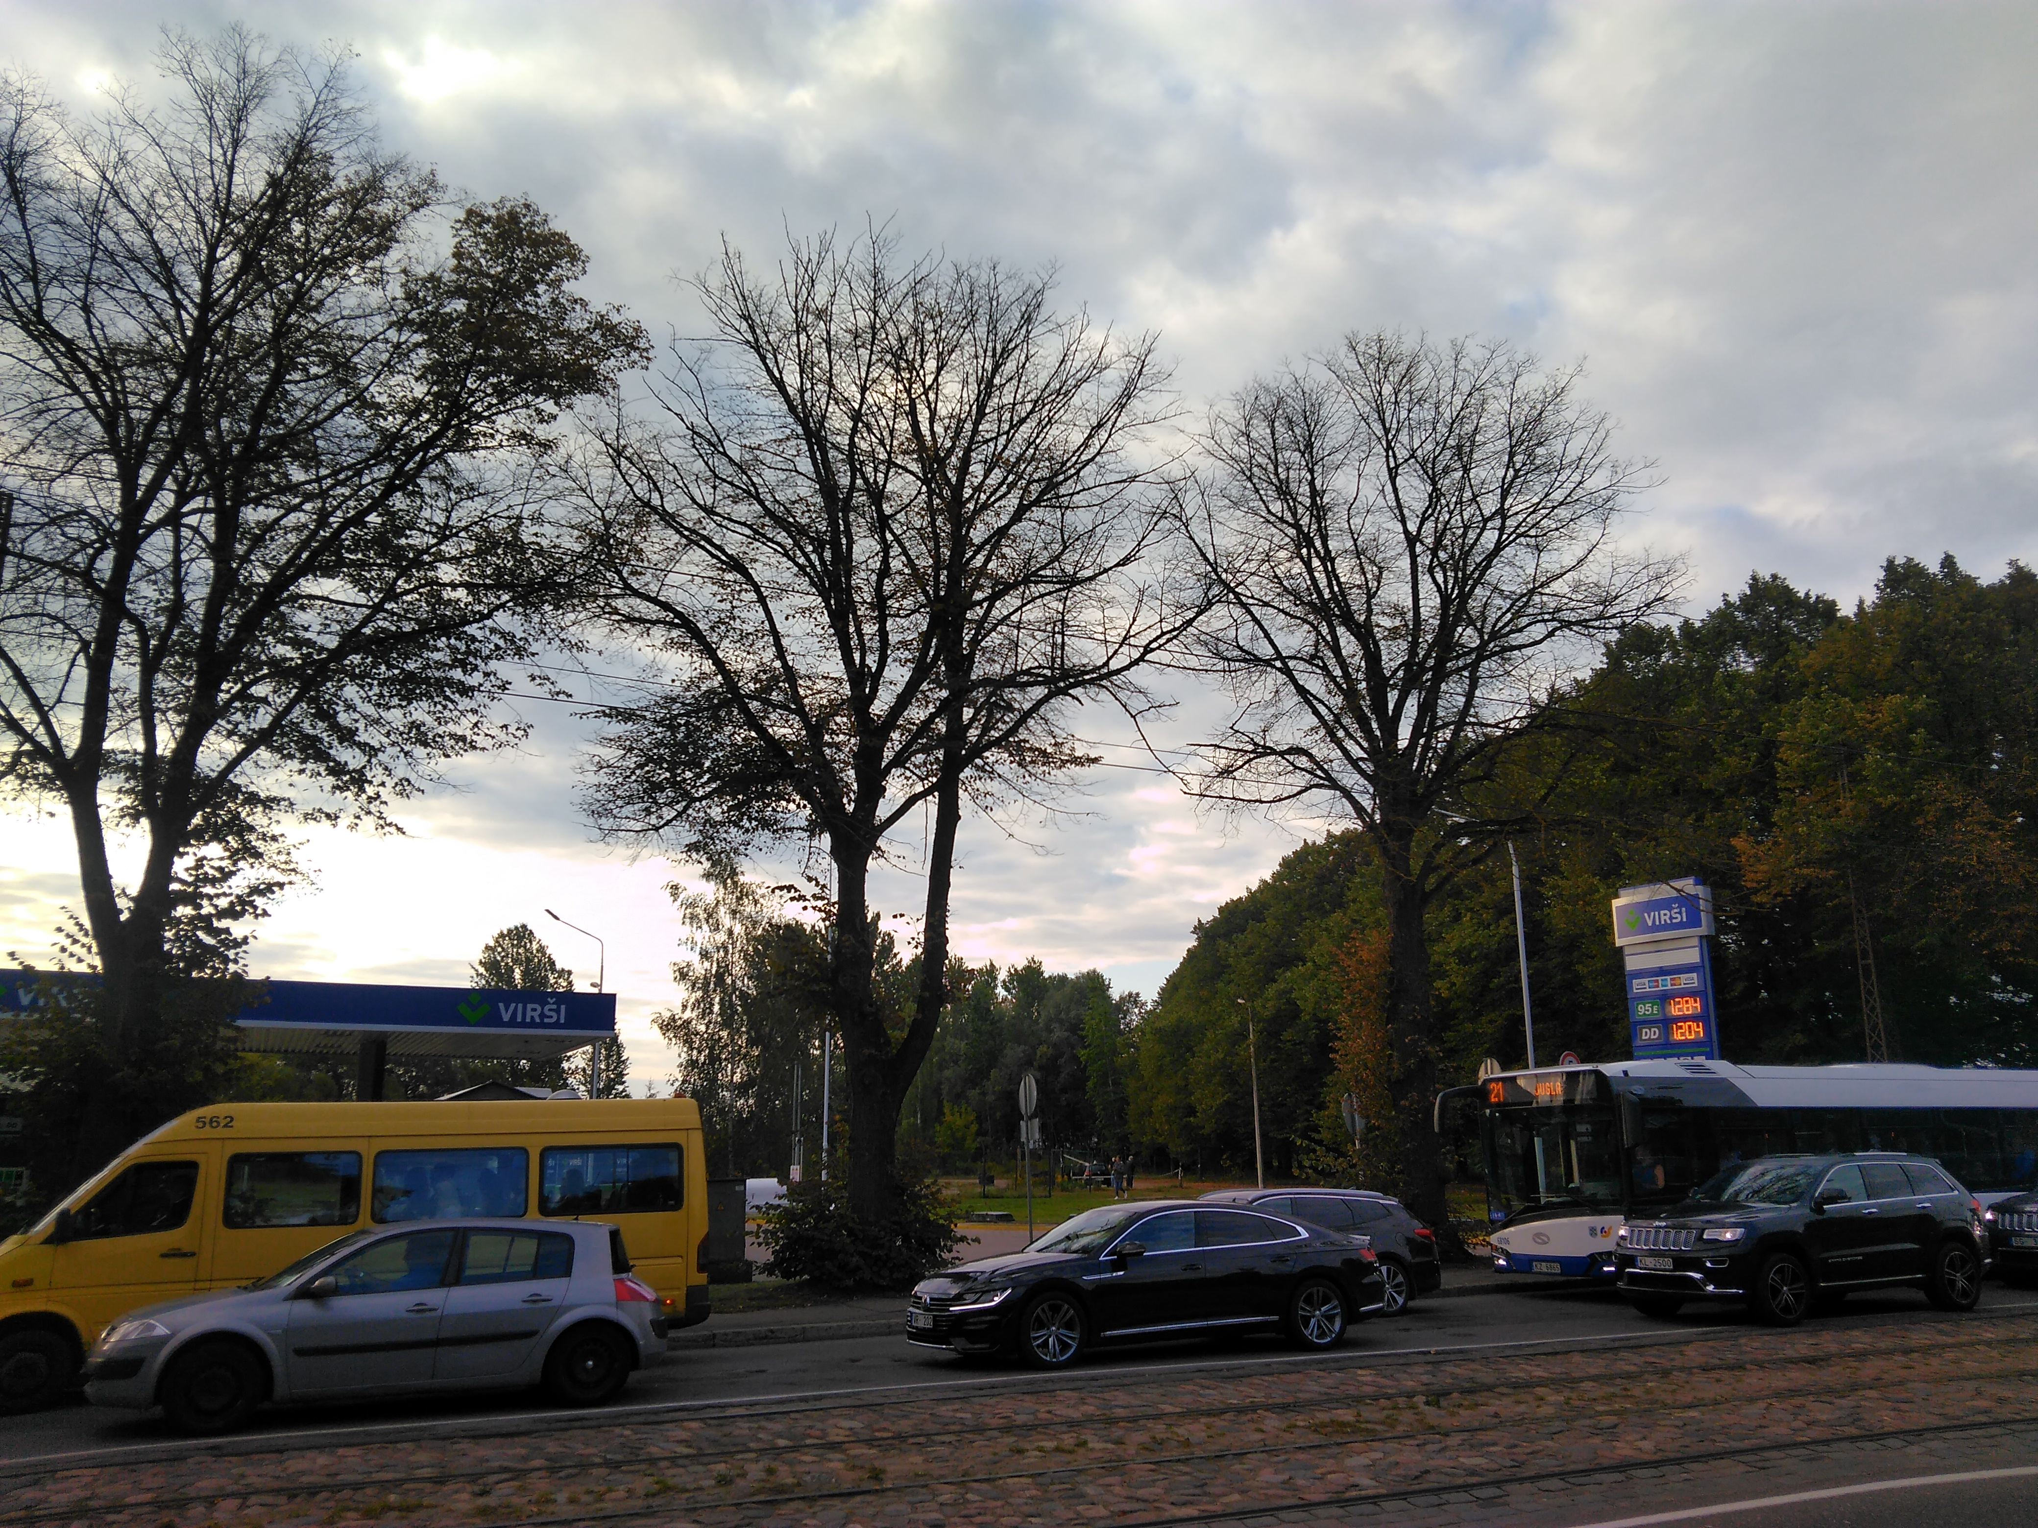
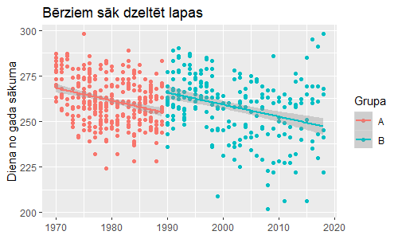
Drought?
Tilia cordata BBCH92
Betula pendula BBCH92
02/09/2019, Riga

Slide 10
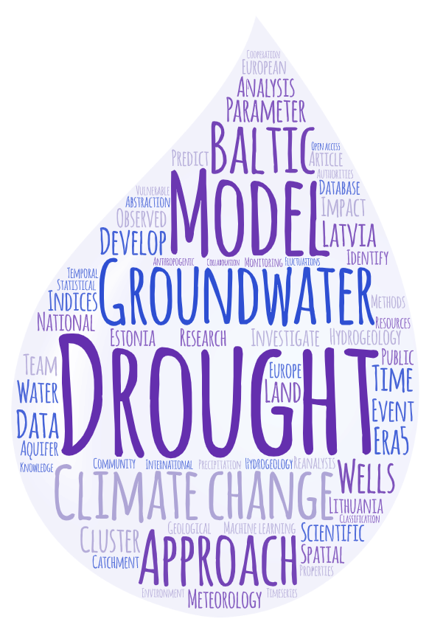
Thank you!
Dr.geogr. Gunta Kalvāne| gunta.kalvane@lu.lv
Dr.geol. Andis Kalvāns | andis.kalvans@lu.lv
Dr.geogr. Agrita Briede| agrita.briede@lu.lv
This study was carried out within the framework of the Climate change and sustainable
use of natural resources institutional research grant of the University of Latvia
(No. AAP2016/B041//ZD2016/AZ03) and the Latvian Council of Science,
project “Spatial and temporal prediction of groundwater drought with mixed
models for multilayer sedimentary basin under climate change” (No. lzp-2019/1-0165).
"Spatial and temporal prediction of groundwater drought with mixed models for multilayer sedimentary basin under climate change" (LZP-2019/1-0165)

